Slide 1
Virtualization
CS422/522 Lecture 15
10 November 2014
Last updated: 10 November 2014

Slide 2
Outline
Recap
Introduction
x86 Virtualization
Overview
Wrap-Up

Slide 3
Recap
OSI Model
Independent in theory, not in practice
How do we access www.google.com

Slide 4
Outline
Recap
Introduction
x86 Virtualization
Overview
Wrap-Up

Slide 5
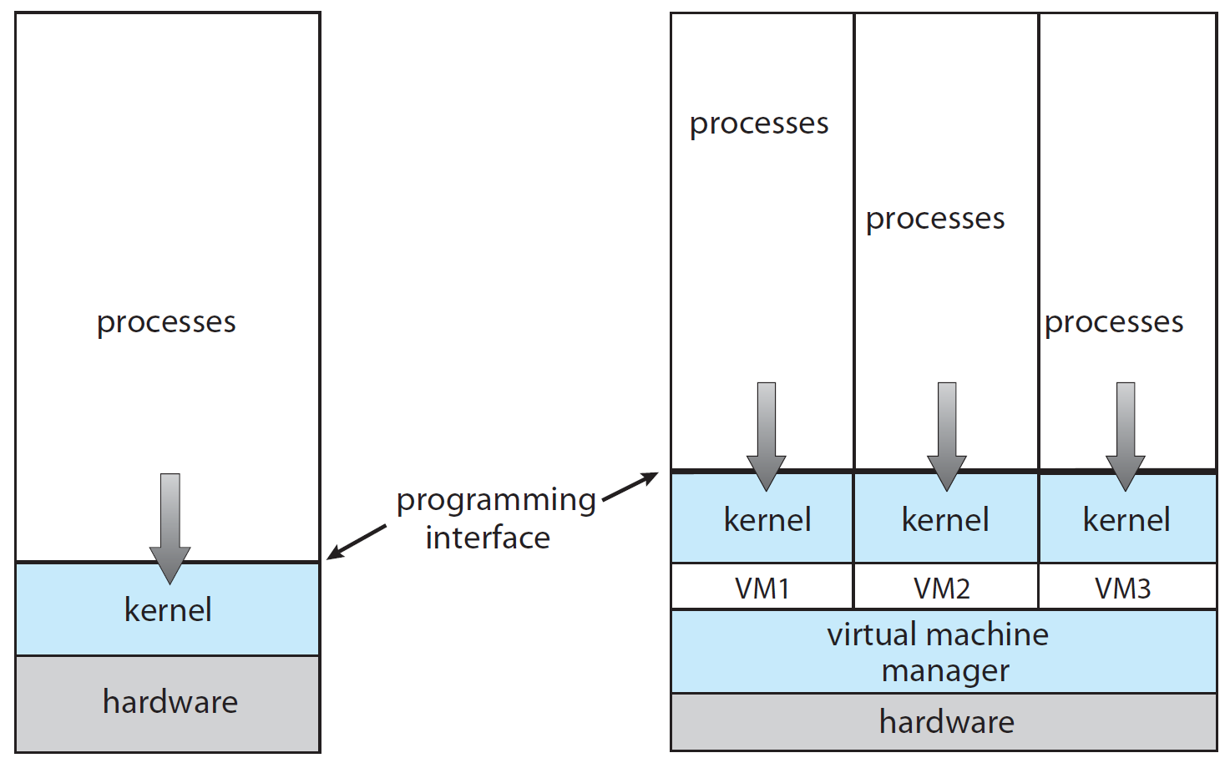
Virtualization

Slide 6
Introduction
Looks, feels, behaves, acts like the real thing but is not
Where have we seen this?
Virtual memory, Qemu in labs
Some other examples:
  Qemu in our labs
  Windows games on Linux and Mac (virtualize DirectX and WinAPI)
  Android / iOS simulators (emulators) for app development
  The Cloud

Slide 7
Motivation
Complete (machine-level) isolation (security)
Consolidation
Multiple operating systems
Kernel development
Allocate resources at machine level
Application / configuration distribution

Slide 8
Terminology
Application containment -
Simulation –
Emulation -
Virtualization -
Paravirtualization -
Separated environment
Mimic a machine
Mimic a machine's interface
Transparent multiplexing of a machine
Opaque multiplexing of a machine

Slide 9
Requirements for Virtualization
Fidelty
Performance
Safety

Slide 10
Challenges
Not all hardware can be transparently multiplexed
Overheads
Resource fairness
Isolation

Slide 11
Outline
Recap
Introduction
x86 Virtualization
Overview
Wrap-Up

Slide 12
x86 Overview
Instructions that violate requirements
Memory
I/O devices

Slide 13
Instructions
Privileged -- user mode trap into kernel
Control sensitive -- change configuration of resources -- pushf, popf, sgdt, sidt, sldt, smsw
Behavior sensitive -- behavior depend on configuration of resources -- pop, push, call, jmp, int n, ret, lar, lsl, verr, verw, mov
Normal instructions
Example: push %cs; pop %eax -- reveals CPL

Slide 14
Trap and Emulate
Execute code as normal
Execute privileged instruction
Triggers trap to hypervisor
Hypervisor handles and returns to user
Example -- system call -- getpid

Slide 15
T-E System Call
Description CPU VCPU
int 0x80 U U
Enter VMM S U
VMM sets VM to enter OS S S
VMM returns to VM U S
VM processes call, returns to process U S
Enters VMM S S
VMM set VM to return to process S U
VMM returns to VM U U
What type of system call? What would an I/O call look like?

Slide 16
Trap and Emulate
Execute code as normal
Execute privileged instruction
Triggers trap to hypervisor
Hypervisor handles and returns to user
Example -- system call -- getpid
How to handle sensitive instructions?

Slide 17
T-E Sensitive
Preprocess all code before executing
Place breakpoints before sensitive instructions
Use address breakpoint registers
Issues?

Slide 18
Trap and Emulate
Execute code as normal
Execute privileged instruction
Triggers trap to hypervisor
Hypervisor handles and returns to user
Example -- system call -- getpid
How to handle sensitive instructions?
Issues?

Slide 19
Binary Translation
OS reads binary code to be executed
Identifies sensitive instructions
Replaces with safe calls
Example -- system call -- getpid
Issues?
Also known as dynamic recompilation

Slide 20
x86 Hardware Virtualization
Instantiates different machine states: vmcs (virtual machine control structures): recall task state segment
vmxon / vmxoff -- turn on / off support
vm entry / vm exit -- run / stop a VM

Slide 21
Memory Virtualization
Guest thinks it owns physical memory
Guest cannot use paging mechanisms directly
VMMs utilize shadow (nested) page tables

Slide 22
Shadow Page Tables
VM creates a mapping 0x800000 in guest page
VM accesses 0x800000
Causes a page fault calls into VMM
VMM notices guest page has mapping
Installs new mapping and physicall backs it in shadow
Returns to VM

Slide 23
State of Page Table
PDE and PTE may not even be set
We still get a page fault
When might an application make a valid page fault even if PTE is unset?

Slide 24
Device Virtualization
Default: emulate devices, translate to system calls
Better: paravirtual devices, translate to system calls
Best: Hardware support for virtualization, direct access to hardware

Slide 25
Outline
Recap
Introduction
x86 Virtualization
Overview
Wrap-Up

Slide 26
Summary
Anything can be emulated, but performance...
Virtualize core components
For the rest:
  Emulate, at a minimum
  Translate, if possible
  Use hardware multiplexing, when possible

Slide 27
Overview
Virtualization gives us machine-level separation
Overheads for CPU activities not too horrible
Privileged instructions (I/O) occur more overhead
Virtualization is not a perfect method for isolation

Slide 28
Outline
Recap
Introduction
x86 Virtualization
Overview
Wrap-Up

Slide 29
Lab 7
Start planning Lab 7
"Optional" -- discuss with me a project
Due Dec 4, NO LATE DAYS
5 min one-on-one demo day -- Dec 5

Slide 30
Next Time
Multiprocessor Scheduling
Wednesday 1:00PM

