Slide 1
Scheduling
CS422/522 Lecture 8
29 September 2014
Last updated: 29 September 2014

Slide 2
Outline
Recap
Scheduling Overview
Scheduling Algorithms
Real-time Scheduling
Scheduling in Xv6
Wrap-Up

Slide 3
Recap
Race conditions
Synchronization
Atomic operations
Priority Inversion

Slide 4
Debugging
Before you begin:
Read documentation
Understand hardware interface
Understand software interfaces
Find the exact line / instruction causing bug
Understand error message
Think about all data related to that point
Examine memory / variables
Make sure you setup the data correctly
Use error message to narrow in on issue
Check your code

Slide 5
Example
int 0x30 -- triple fault
Triple fault: unable to access memory
Possible sources:
IDT not set or lidt not called
Invalid IDT
0x30 IDT entry improperly set
GPF not correctly set

Slide 6
Outline
Recap
Scheduling Overview
Scheduling Algorithms
Real-time Scheduling
Scheduling in Xv6
Wrap-Up

Slide 7
Scheduling
N processes >> M processors
Each process:
Has illusion of ownership of the machine
Has own virtual processor
Allocated timeslice of CPU
System support:
Cooperative
Preemptive

Slide 8
Cooperative Multiprocessing
What causes process switches?
Explicit yields
Wait on I/O
Termination
"Transitions to kernel"
Disadvantage: bad application may never release CPU.
Advantage: (critical / sensitive) operations are not interrupted.

Slide 9
Preemptive Multiprocessing
What causes process switches?
Timer interrupt
Resource available (hardware interrupt)
Advantage: system enforced fair share of CPU
Disadvantage: preemption may occur during sensitive operations

Slide 10
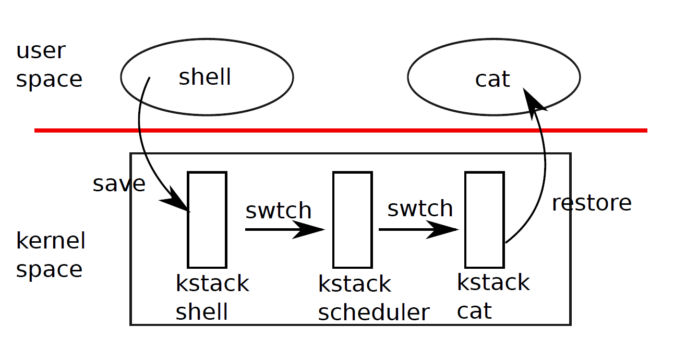
Scheduling Process
Current process yields
Enters kernel
Save current process state
Kernel selects new process
Kernel loads new process state (context switch)

Slide 11
Scheduling Criteria
CPU utilization
Throughput
Turnaround time
Waiting time
Response time

Slide 12
Scheduling Algorithm Families
Cooperative
Preemptive
Real-time

Slide 13
Multiprocessor/Multicore Concerns
Synchronized access to list of processes
Processor affinity
Resource contention:
NUMA Architecture / migration
Single (limited) resource, many consumers

Slide 14
Outline
Recap
Scheduling Overview
Scheduling Algorithms
Real-time Scheduling
Scheduling in Xv6
Wrap-Up

Slide 15

First-Come, First-Serve
Processes become runnable, enter queue
First in queue runs
Employs cooperative multiprocessing:
Release CPU on I/O or termination
Returns to tail of queue on I/O completion
Example:
Issue: Long waiting time

Slide 16

Shortest-Job-First
Processes become runnable, enter queue
Queue sorted by job run-time
Employs cooperative multiprocessing
Example:
Issues:
High consumption processes may never run, starvation
Requires knowledge of application run time

Slide 17
Priority Scheduling
Each process has a priority
High priority runs
New high priority proceess joins the queue:
Cooperative: wait for current process to end
Preemptive: interrupt current process and replace
Priority ~ Shortest-Job-First
Priority can address starvation: increase priority of old processes (aging)

Slide 18
Round-Robin
First-come, first-serve with preemption
Processes run until done using CPU or preempted
Preempted aftera quantum / time slice
Challenge: balance between execution time / context switch time

Slide 19
Outline
Recap
Scheduling Overview
Scheduling Algorithms
Real-time Scheduling
Scheduling in Xv6
Wrap-Up

Slide 20
Real-Time Scheduling
Critical operations must occur at a certain time:
Soft: executed as soon as possible
Hard: if not executed don't execute
Processes typically run periodically and for a fixed period of time
Delays:
Interrupt -- time to begin processing the interrupt
Dispatch -- context switch

Slide 21

Priority Scheduling
Processes run at assigned priority
PID CPU Time Period Priority
0 100 ms 35 ms 0
1 50 ms 20 ms 1

Slide 22

Rate-Monotonic
        Priority set to inverse of period
        Optimal for static scheduling
PID CPU Time Period Priority
0 100 ms 35 ms 1/100
1 50 ms 20 ms 1/50

Slide 23

Another RM Example
PID CPU Time Period Priority
0 50 ms 25 ms 1/50
1 80 ms 35 ms 1/80

Slide 24
Earliest-Deadline-First
Prioritize earliest deadline first
PID CPU Time Period Priority
0 50 ms 25 ms dynamic
1 80 ms 35 ms dynamic

Slide 25
Outline
Recap
Scheduling Overview
Scheduling Algorithms
Real-time Scheduling
Scheduling in Xv6
Wrap-Up

Slide 26
Xv6 Scheduler
struct proc *p;
for(;;){
sti();
acquire(&ptable.lock);
for(p = ptable.proc; p < &ptable.proc[NPROC]; p++){
if(p−>state != RUNNABLE)
continue;
proc = p;
switchuvm(p);
p−>state = RUNNING;
swtch(&cpu−>scheduler, proc−>context);
switchkvm();
proc = 0;
}
release(&ptable.lock);
}

Slide 27
Interrupt-Based Context Switch
switch(tf−>trapno){
case T_IRQ0 + IRQ_TIMER:
if(cpu−>id == 0){
acquire(&tickslock);
ticks++;
wakeup(&ticks);
release(&tickslock);
}
lapiceoi();
...
if(proc && proc−>state == RUNNING &&
tf−>trapno == T_IRQ0+IRQ_TIMER)
yield();

Slide 28
Outline
Recap
Scheduling Overview
Scheduling Algorithms
Real-time Scheduling
Scheduling in Xv6
Wrap-U

Slide 29
Lab 4a
Assigned last week, should wrap up by Thursday.

Slide 30
Next Time
Wednesday 1:00PM
Interprocess Communication

