Slide 1

Note: The data and information in this document is reflective of a hypothetical situation and client. This document is to be used for KPMG Virtual Internship purposes only.
Sprocket Central Pty Ltd
Data analytics approach
[Division Name] - [Engagement Manager], [Senior Consultant], [Junior Consultant]

Slide 2
Note: The data and information in this document is reflective of a hypothetical situation and client. This document is to be used for KPMG Virtual Internship purposes only.
Agenda
Introduction
Data Exploration
Model Development
Interpretation

Slide 3
Note: The data and information in this document is reflective of a hypothetical situation and client. This document is to be used for KPMG Virtual Internship purposes only.
Introduction
We will help boost business by analysing your existing customer dataset to determine customer trends and behaviour
When analysed, the data would reveal useful customer insights which could help optimise resource allocation for targeted marketing. Hence, improve performance by focusing on high value customers.
This will help decide which of these 1000 new customers should be targeted to drive the most value for the organisation.
Thus, we are starting with a PowerPoint presentation which will outline the approach which we will be taking.
This presentation includes a detailed approach for our strategy behind each of the 3 phases, that is, Data Exploration, Model Development, Interpretation.

Slide 4
Note: The data and information in this document is reflective of a hypothetical situation and client. This document is to be used for KPMG Virtual Internship purposes only.
Data Exploration
Customers to be targeted according to Gender, Wealth segment, Car ownership and State
Gender: There are 517 female, 470 male and 17 ‘U’ customers. There are more female customers.
Wealth Segment: 50.8% of the customers are Mass customers, 25.1% of the customers are High net worth and 24.1% of the customers are Affluent customers.
Car ownership: 50.7% of the customers do not own a car while 49.3% own a car. Without a car, bicycles are more on demand.
State: 50.6% of the customers belong to New South Wales, 26.6% belong to Victoria and 22.8% belong to Queensland.

Slide 5
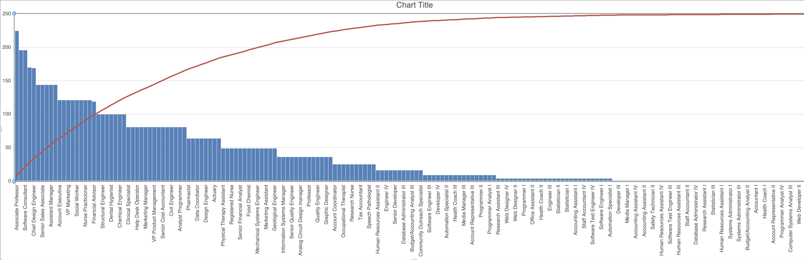
Note: The data and information in this document is reflective of a hypothetical situation and client. This document is to be used for KPMG Virtual Internship purposes only.
Data Exploration
Customers to be targeted according to Job Titles

Slide 6
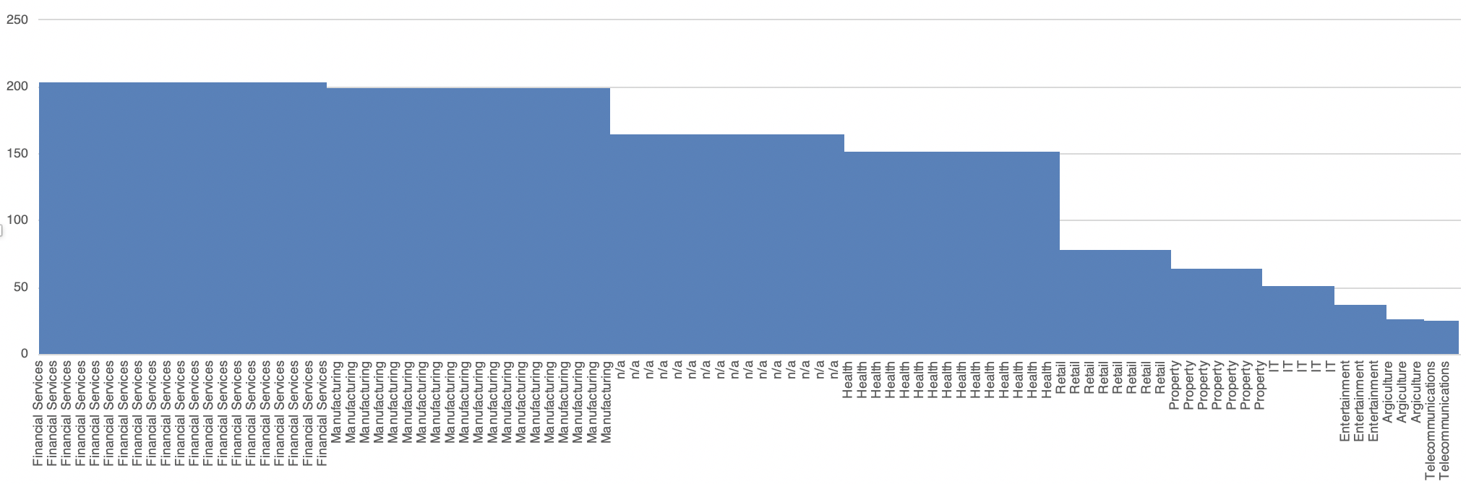
Note: The data and information in this document is reflective of a hypothetical situation and client. This document is to be used for KPMG Virtual Internship purposes only.
Data Exploration
Customers to be targeted according to Job Industry Categories

Slide 7
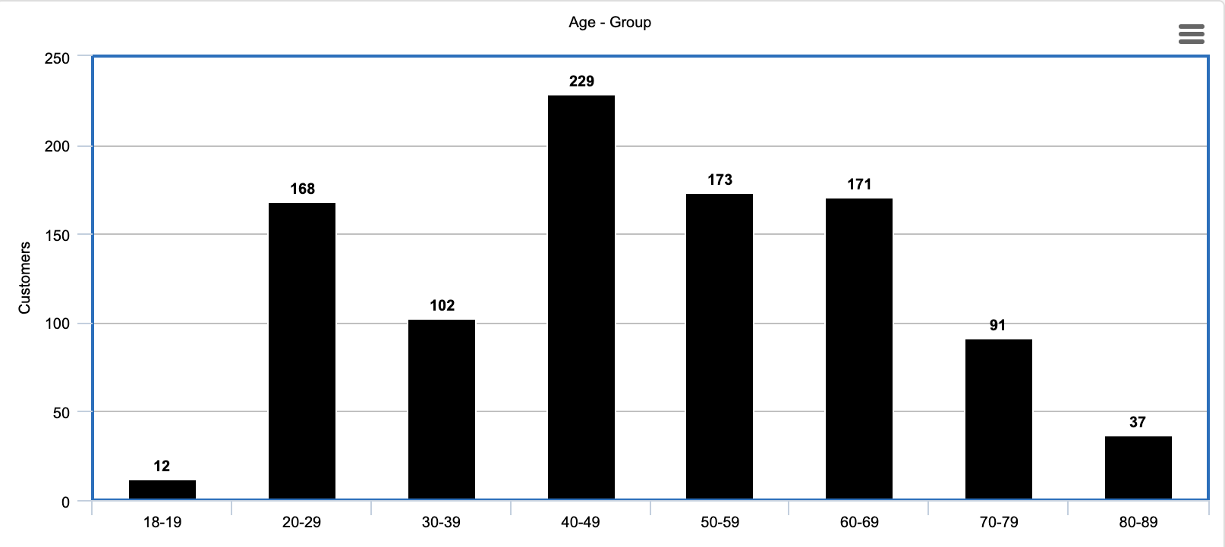
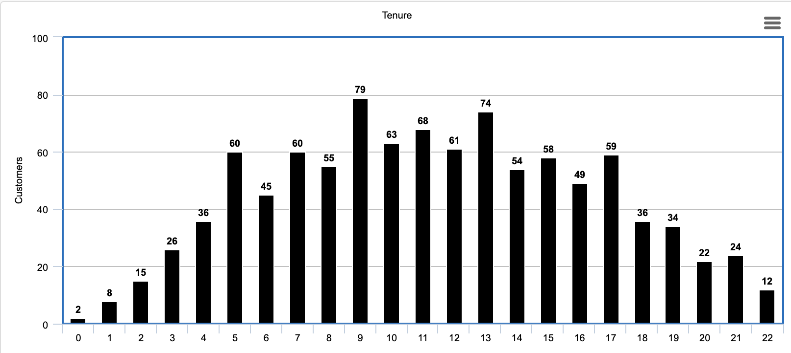
Note: The data and information in this document is reflective of a hypothetical situation and client. This document is to be used for KPMG Virtual Internship purposes only.
Data Exploration
Customers to be targeted according to Age – group and Tenure
AGE-GROUP
TENURE

Slide 8
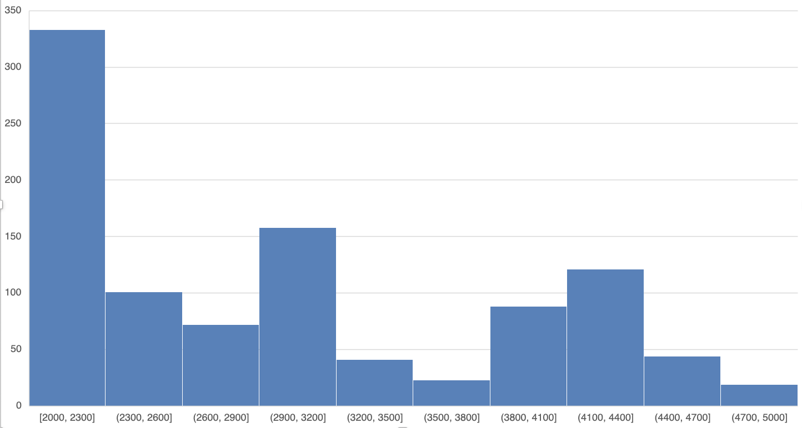
Note: The data and information in this document is reflective of a hypothetical situation and client. This document is to be used for KPMG Virtual Internship purposes only.
Data Exploration
Customers to be targeted according to their Post-codes
From the graph on the right, we can observe which set of post codes have the most customers, and, hence, in which areas is it best to set up the business.

Slide 9
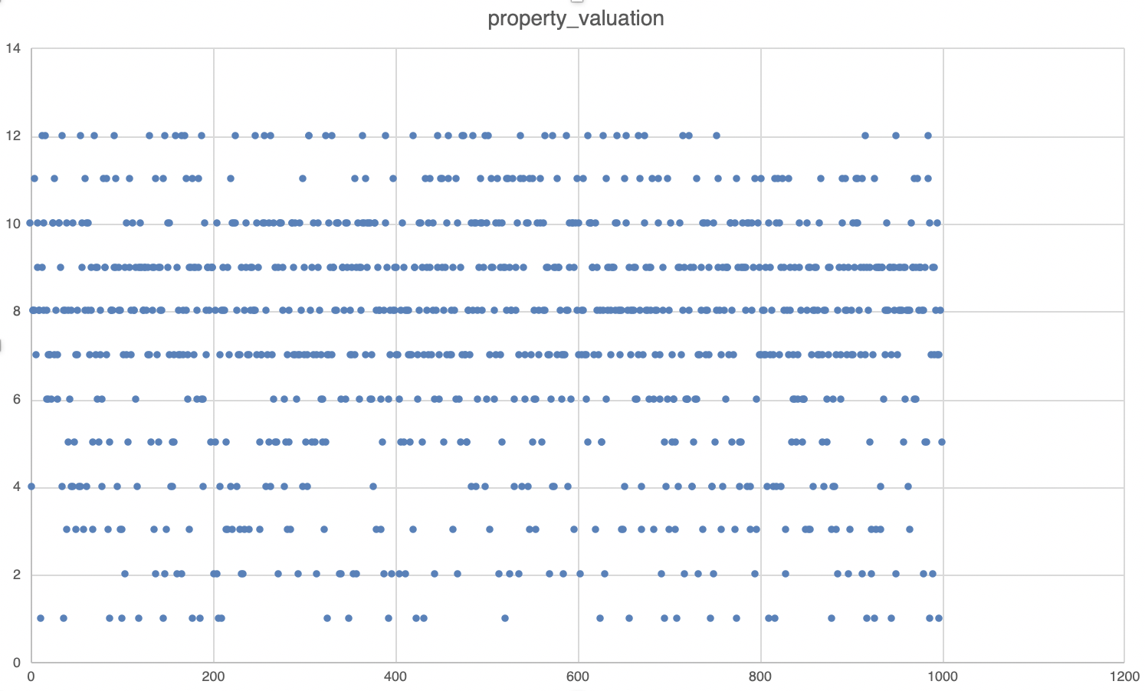
Note: The data and information in this document is reflective of a hypothetical situation and client. This document is to be used for KPMG Virtual Internship purposes only.
Data Exploration
Customers to be targeted according to their Property Valuations
The scatter plot on the right gives us the most popular property valuations of all the customers.

Slide 10
Note: The data and information in this document is reflective of a hypothetical situation and client. This document is to be used for KPMG Virtual Internship purposes only.
Model Development
Fields to include or determine for Model Development
Adding a field ‘High Margin Product’.
High Margin Product are products that give a high level of profit compared to the money spent on producing them. This could indicate whether the product purchased by the customer is in a high margin category in the past three months based on the fields ‘list_price’ and ‘standard cost’.
Other additions to the data already previously made include calculating age brackets of customers using their Date of Birth.
Calculating distance from office to home address.
Determine whether customer ma purchase a bicycle for transportation.
This would exclude the people who do not own a car as they would anyway require a cycle for their transportation or travel.

Slide 11
Note: The data and information in this document is reflective of a hypothetical situation and client. This document is to be used for KPMG Virtual Internship purposes only.
Interpretation
Observations and Conclusions
Target more towards female customers, especially in the age range of 40-70 years.
Pay attention more to the Mass Customers focusing on the ones who does not own a car.
The area having postcodes 2000-2300 in the NSW state have more potential customers and good region to escalate and improve business.
Associate Professor, Software Consultant, Chief design engineer, Senior sales associate, Assistant Manager, Account Executive, VP Marketing, Social Worker, Nurse Practitioner, Financial Advisor are the top 10 Job titles and Financial Services and Manufacturing are the top 2 Job Industry categories where most of our customers belong

Slide 12
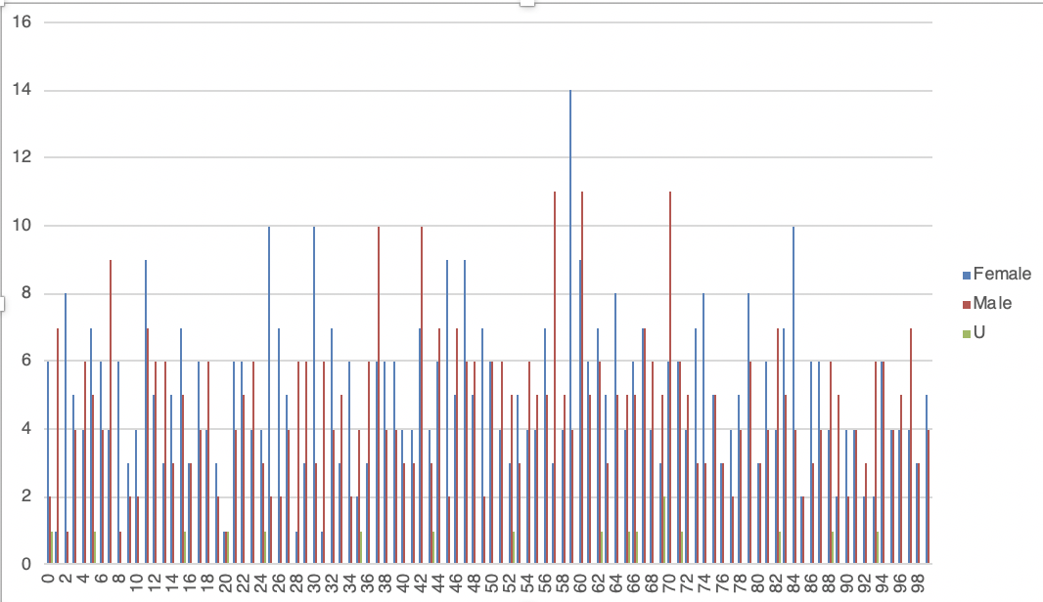
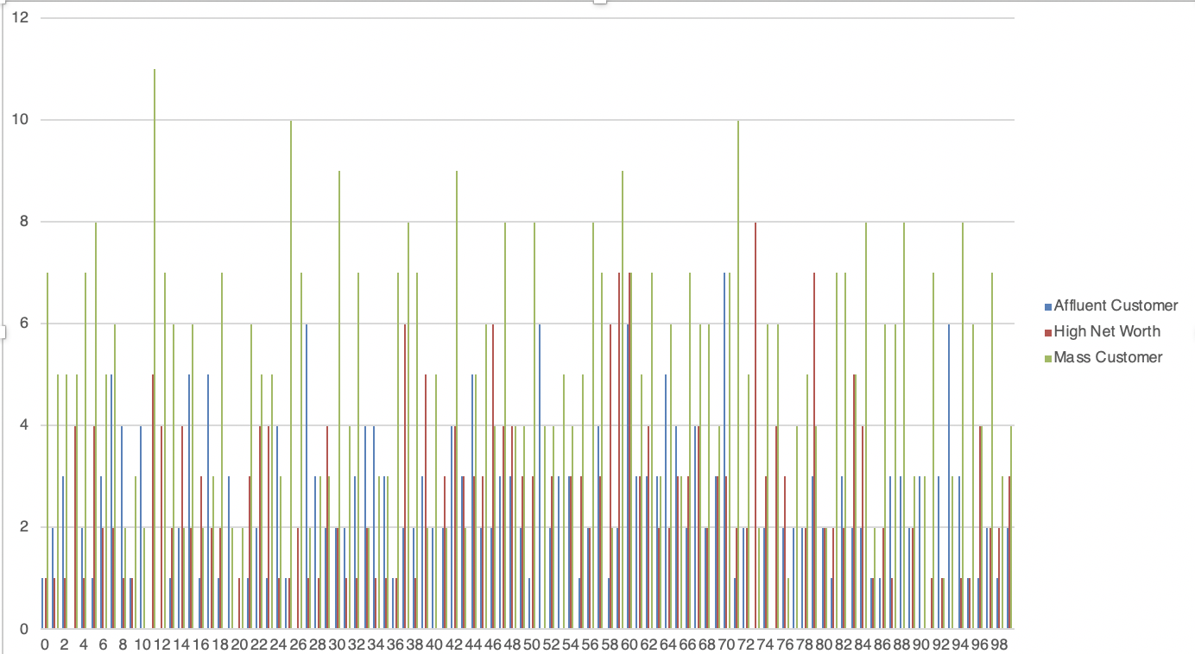
Note: The data and information in this document is reflective of a hypothetical situation and client. This document is to be used for KPMG Virtual Internship purposes only.
Interpretation
Extra Interpretations based on past 3 years of bike related purchases
GENDER
WEALTH SEGMENT

Slide 13
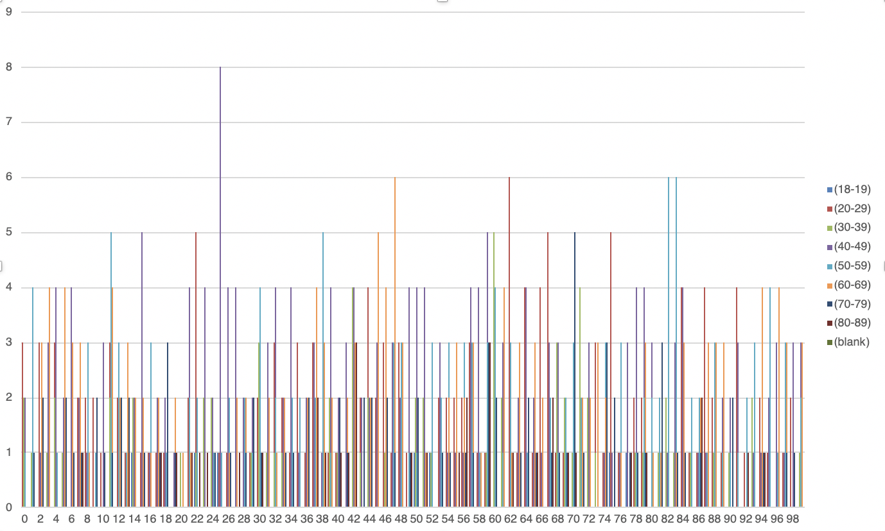
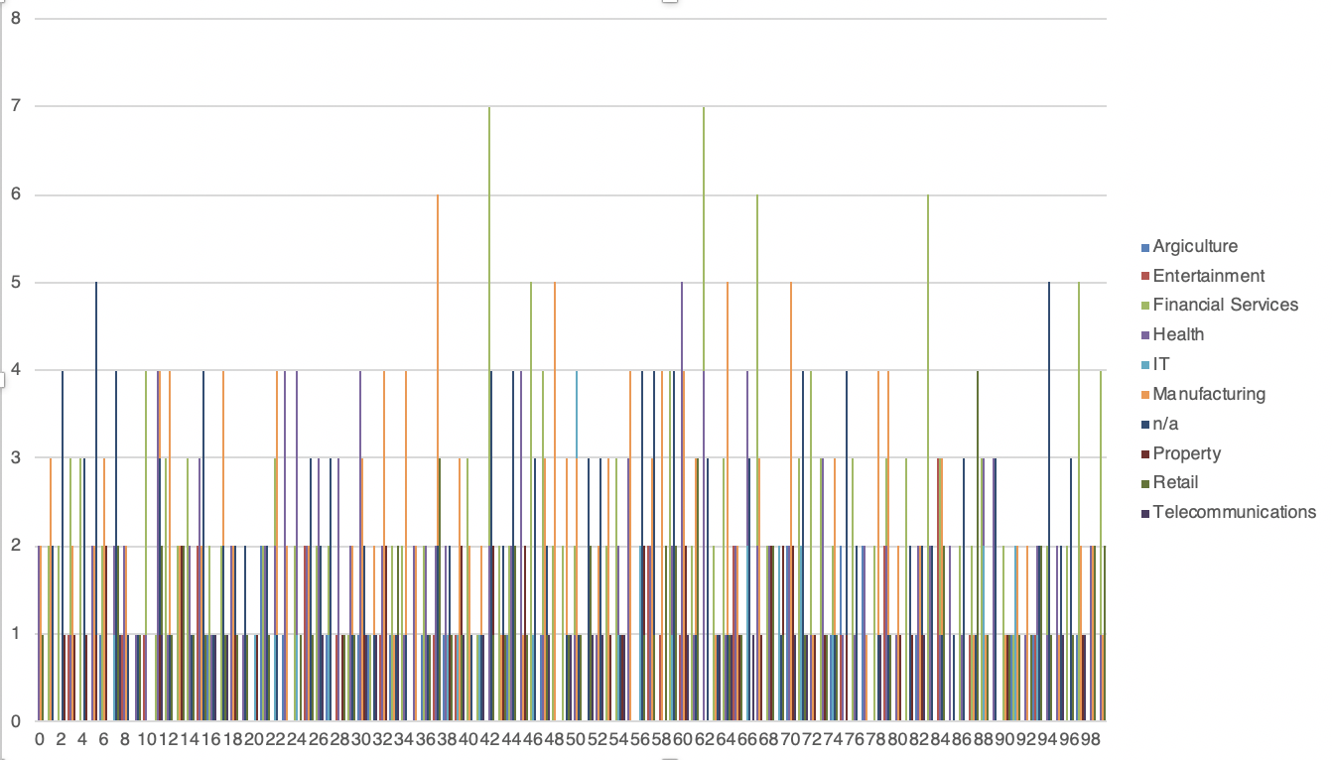
Note: The data and information in this document is reflective of a hypothetical situation and client. This document is to be used for KPMG Virtual Internship purposes only.
Interpretation
Extra Interpretations based on past 3 years of bike related purchases
AGE-GROUP
JOB INDUSTRY CATEGORY

Slide 14
Note: The data and information in this document is reflective of a hypothetical situation and client. This document is to be used for KPMG Virtual Internship purposes only.
Appendix

Slide 15
Note: The data and information in this document is reflective of a hypothetical situation and client. This document is to be used for KPMG Virtual Internship purposes only.
Appendix
Data given by organization purely used along with ABS (Australian Bureau of Statistics) Databases used for more Interpretations, Calculations and Analysis

