Slide 1
IS452: Week 1

Slide 2
Who am I?
Dr. Nick LaLone, Adjunct, iSchool
Former PhD Student at Penn State, Sociologist, Journalist, Admin, Assistant Professor and Data Scientist

Slide 3
What is 452?
grad level introduction to programming
We’ll cover:
basics of programming in Python
core processing and
Not all intro to programming courses are the same

Slide 4
What is 452?
Focus on data processing
Other explicit omissions
This course is for beginners
Notes:
Data Processing Versus: games, large software engineering, data analytics
Omissions : object oriented design, scientific programming, pandas, graphical interfaces, games, etc.

Slide 5
Why does this class exist?
So you can:
Recognize a programming problem when you have one
Assess how to tackle it
And be able to do it yourself
and know when it’s time to say no
Notes:
Maybe I’m the only one who keeps getting asked why the class I teach exists?
Because being able to directly interact with data and digital files is powerful and sometimes the only way to get the job done
As current/future information professionals, you know that data and digital formats are constantly changing. So you need to be prepared for anything.
Which means you need to be prepared to learn anything. This class isn’t to make you a Python dev, it’s to give you programming fundamentals so you can:

Slide 6
The 2-Hour Rule
If you’ve been working for 2 hours without much success:
walk away for a while

Slide 7
I’m not going to read the syllabus to you
Quizes
Weekly homework
Research essays (2 of 3)
Midterm project
Final project

Slide 8
More info on the assignments
Weekly quizzes
These are multiple choice questions based on the readings, and are designed for you to identify areas you need to review. You can take them up to three times (as needed).
Weekly homeworks
These will consist of problems found in the textbook and then later custom problems I’ve written and are described in moodle.
Midterm project:
A larger programming project (Dracula) you should be working on through the course of the first section of class and two short essays on programming topics.
Two (pick two of three) research essays
Three essay topics will be offered, so you can pick two to do or do all three for extra credit. These can be completed at any time before the due date, so something easy to work ahead on.
Final project
Proposals will be submitted just after midterms, which gives you 8 weeks to spread the work out.

Slide 9
That’s a lot of homework
Your grade is distributed.
Plenty of extra credit
weighting and extra credit allow a buffer
If 100% on the other areas
at least a ~76% average on the weekly homework to keep your A.
Notes:
I respect that you have lives and other classes and a personal life
Your grade doesn’t depend on a single weekly homework assignment and there will be plenty of extra credit so you can keep your grade up even when things have gone poorly
I don’t expect that you’ll get 100% on every homework, so the weighting and extra credit allow a buffer for you to maintain an A even if you stumble on a few homework assignments.
Presuming that you can maintain 100% on the other areas, you just need to maintain at least a ~76% average on the weekly homework to keep your A. There’s plenty of extra credit to keep that score up.
But this does require a steady amount of time.

Slide 10
Late and extension polices
Weekly homework Caveats
Homework is due at 11:55pm,
but anything before 8am is fine
Homework assignments may be turned in up to 2 days late (a ‘day’ is the 24 hour period after an assignment is due), with a 10% penalty for each day late.
3 extensions for an extra 5 days without penalty.
you don’t need to explain why you need to use them.
Just email me that you need one.

Slide 11
This class requires time
452 requires consistent work
Everything is doable!
You will survive
You will do well
You will learn a lot

Slide 12
Suggestions for success
Start early!
steady amount of time each day
The readings will help you.
Read the homework before the reading.
Do not fear the math.
I forbid you to use the word stupid about any human in this room
But you’re free to let Python have it
Notes:
Start early!
steady amount of time each day
The readings will help you.
Read the homework before the reading. This helps you know where to focus your reading and flag relevant examples.
Do not fear the math. Several of the chapters are very math heavy in examples, but I’ve selected homework problems that should not require advanced math ability to complete. I’ll also provide some clarifications in the assignment moodle page.
I forbid you to use the word stupid about any human in this room
But you’re free to let Python have it

Slide 13
Expected Computer Skills
install programs
unzip and zip files
take screenshots
send emails with attachments
navigate your file system
how to use Blackboard Ultra
Notes:
Please find out how to:
Install programs
Unzip and zip files
Take screenshots
Send emails with attachments
Know how to navigate your file system, opening folders and moving around you directory, etc.
Be comfortable interacting in Blackboard Collaborate
Be able to share your screen in Blackboard

Slide 14
Participation and attendance
participate during class and online in discussion boards.
There will be discussion prompts each week to help start a conversation.
If you will be missing class, please let me know before class.

Slide 15
Communication and asking questions
Administrative questions (E-Mail)
Just about you
About the entire class (Discussion Board)
Will open with admin updates and reminders
Content questions (Discussion Board)
Don’t post your solutions!

Slide 16
How class normally works
lectures pre-written notes available via github repo.
You can, but aren’t required to, read the lecture notes before class.
I sometimes tweak notes just before class
I live code everything
demonstrating things live based on those lecture notes.
don’t use your time trying to desperately copy everything I type.
Listen, observe, make the connections.

Slide 17
Installation
The link is in the moodle.
Carefully and completely follow the directions.
Nothing in there is optional, nothing in there is because I think that writing directions is fun
We’ll be using:
Anaconda
which will install python for you
PyCharm Education Edition
which will be the environment where you will write and run python

Slide 18
Moodle
You’re going to be a moodle pro after this class
Let’s do a tour and talk about where to find stuff

Slide 19
Backboard ground rules
Keep the side chatter in the chat to a minimum, but feel free to interrupt with questions.
Question tips:
go for specific questions about the topic at hand.
keep a running list of questions about things you hope I'll get to. Ask those when I open the floor.
This seems a little cruel, but it keeps things on pace. Constantly reading questions and replying "We'll be talking about that soon" eats away at the little class time we have.
Feel free to email me things you'll hope we cover in class or other types of questions.
When we start digging in more I'll have polls for class questions.

Slide 20
Buddies!
Introduce yourself to the person sitting next to you, so pair off into duos or trios. Start an email thread with each other to say hi.
You can opt out of this if you like, but here’s a group of people to compare notes or share horror stories.

Slide 21
Learning Strategies for Technical Skills,
Or: learning how to learn programming

Slide 22
Less why; more how
We spend a lot of time talking about:
Reading
Grants
Publications
So much support for the essential scholarly work, but little prep for learning tech things.

Slide 23
Effort versus hardship
We don’t mean impossible
When we say that programming is hard
We mean that it requires effort
will have to think hard
but you should experience hardship
Crying can be normal but should never be expected as a hazing ritual
It shouldn’t make an instructor feel good
It’s a signal that you need a break

Slide 24
But this seems harder than it should be
And you’re right
Most of us (including me) aren't from a computer science or STEM background
But most materials and instructors expect this, thus there's a lot of disconnect
“You mean you don’t like physics puzzles?”
Their expectations for a baseline are not our actual baseline

Slide 25
Specialization
Each of us has specialized learning skills
Going through graduate programs solidifies those skills and perspectives even more
Discomfort in not knowing
In Sociology there is no real right answer.
We come to a conclusion and justify it.
Disagreement appears!
Discussion over Correctness

Slide 26
We forget we had to learn how to learn
Going Native.
We forget as we move further from learning stuff
Do you remember learning how to read? to write?

Slide 27
Until we move into foreign domains
The Black Box Appears!
A Stranger Appears!
We lacking experience to learn efficiently
We are used to being efficient.
Source of frustration

Slide 28
How do humanities skills fit into writing code?

Slide 29
Programs as research papers
What are you writing?
Short, to the point
Single task
Make this into that
Long, lots of dependencies
Making a nuanced point
handles lots of options, problems, threads, etc.

Slide 30
Iteration
Writing a paper requires:
a thesis statement
doing some research
finding supportive evidence
making your point

Slide 31
Iteration
Writing a program requires
defining a problem to solve
doing some research
finding supportive frameworks and tools
making your deliverable

Slide 32
Neither is written from start to finish
Even though the final product doesn't look like that
We outline, develop, reevaluate, and trash
Sometimes we need to kill it with fire and start again in the morning
Think of errors as writing group partners
Sure, sometimes you’ll end up with a jerk
But remember that the critical feedback is a major part of why you’re there in the first place

Slide 33
Critical feedback is your friend
Success comes through failures
Take time to reflect on them so you learn and improve
Failure doesn’t have to be a four letter word
Embrace revisions
It's still hard to take criticism, but we accept that it is necessary, grit our teeth, and slog through
Error messages are no different
They are not the universe casting judgement on your soul and finding you wanting
They're a slightly impersonal method of the computer being confused

Slide 34
Debugging as spell checking
Proofreading
Error is reported--go find it
Look at your spelling
Check your punctuation balance
Check your containers and whitespace
Make sure you said what you meant to say

Slide 35
Debugging as spell checking
Debugging
Error is reported--go find it
Look at your spelling
Check your punctuation balance
Check your containers and whitespace
Make sure you said what you meant to say

Slide 36
Be okay not knowing the road you’ll travel
You will find the road
You will make it to the other side
Impossible to know exactly how to get there without stepping a foot out the door
So you want to write a poem…
Do you know how it’ll end when you start it?
Should you?
This idea of prescriptive solutions is both dishonest and not correct

Slide 37
Necessary uncertainty
Simple battle plan:
Receive input
Do magic
Profit
Data battle plan
Read in the data somehow
Investigate what it needs
Somehow do what it needs
Produce glorious outputs somehow

Slide 38
Archival research
Who here has done research in the archives?
Sometimes you need one specific shiny thing
Most of the time you know that what you need is in there somewhere
So you visit to sort out where it is and collect it into a useful format
This ‘browsing’ activity also happens in writing code

Slide 39
Enough of this
A Tour of PyCharm?

Slide 40
OK, that was the hard sell on approaches toward getting stuff done, let's shift to more tangible details

Slide 41
Taking notes
What you're learning about isn't linear, so think outside the linear piece of paper
There are certainly linear aspects, but there's nothing linear about "first we learn about hair colors, then vegetable names, then about cars, then geography." in languages
When you take notes, focus on capturing the concepts and patterns
It's easier to fill in or look up a missing piece of syntax than it is a missing concept.

Slide 42
Taking notes
Be comfortable not knowing the full score as you’re moving forward
I know it can be hard, but really just turn that page and move forward
You’ll want to revisit things and add clarification as we build up our knowledge
Consider using a mind mapping program or drawing your notes in clusters

Slide 43
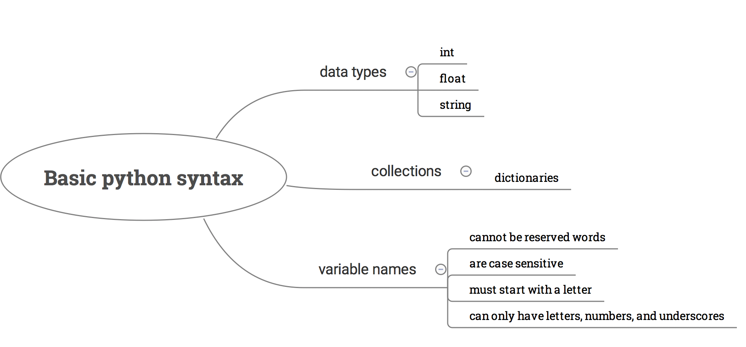
Taking notes

Slide 44
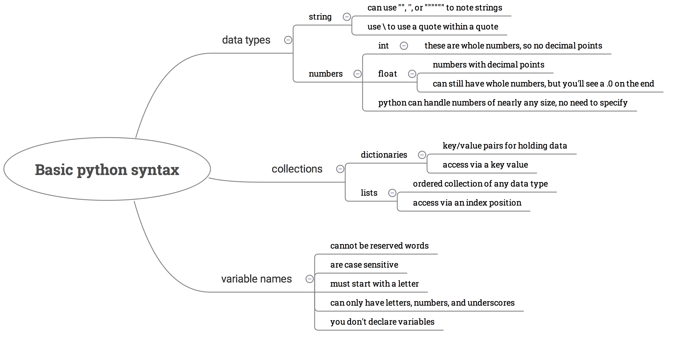
Taking notes

