Slide 1
IS452: Week 1

Slide 2
Welcome!
Meet us:
Elizabeth Wickes, Lecturer, iSchool
Formerly Data Curation Specialist at UIUC Library, iSchool grad, and Curation Manager Wolfram|Alpha
Garrick Sherman, PhD student, iSchool
Formerly UX at Wolfram Research, iSchool grad
(he’s in California!)

Slide 3
What is 452?
This is a grad level introduction to programming course
We’ll cover:
The basics of programming in Python in the first half
Other core data processing tools and applications in the second half
Not all intro to programming courses are the same
We’re going to focus on programming for data processing
Versus: games, large software engineering, data analytics
There will be some explicit omissions: object oriented design, scientific programming, pandas, graphical interfaces, games, etc.
If you’ve taken an intro to programming class in the last few years you likely don’t need this class and should email me. This isn’t always the case, which is why you should contact me directly.

Slide 4
Why does this class exist?
Maybe I’m the only one who keeps getting asked why the class I teach exists?
Because being able to directly interact with data and digital files is powerful and sometimes the only way to get the job done
As current/future information professionals, you know that data and digital formats are constantly changing. So you need to be prepared for anything.
Which means you need to be prepared to learn anything. This class isn’t to make you a Python dev, it’s to give you programming fundamentals so you can:
Recognize a programming problem when you have one
Assess how to tackle it
And be able to do it yourself (and know when it’s time to say no)

Slide 5
I’m not going to read the syllabus to you
You’re adults and can read it on your own
(and need to for the syllabus quiz!)
Class time is: 9am-11:50am
This includes a mandatory (as part of class time) 45-60min lab time
Assignments:
Short weekly quizzes on that week’s content (10 questions, 3 attempts)
Weekly homework assignments
2 of 3 research essays due periodically (weeks 4, 12, and 15)
Midterm programming project that includes 2 long narrative problems
Final project

Slide 6
More info on the assignments
Weekly quizzes
These are multiple choice questions based on the readings, and are designed for you to identify areas you need to review. You can take them up to three times (as needed).
Weekly homeworks
These will consist of problems found in the textbook and then later custom problems I’ve written and are described in moodle.
Midterm project:
A larger programming project (Dracula) you should be working on through the course of the first section of class and two short essays on programming topics.
Two (pick two of three) research essays
Three essay topics will be offered, so you can pick two to do or do all three for extra credit. These can be completed at any time before the due date, so something easy to work ahead on.
Final project
Proposals will be submitted just after midterms, which gives you 8 weeks to spread the work out.

Slide 7
That’s a lot of homework
I respect that you have lives and other classes and a personal life
Your grade doesn’t depend on a single weekly homework assignment and there will be plenty of extra credit so you can keep your grade up even when things have gone poorly
I don’t expect that you’ll get 100% on every homework, so the weighting and extra credit allow a buffer for you to maintain an A even if you stumble on a few homework assignments.
Presuming that you can maintain 100% on the other areas, you just need to maintain at least a ~76% average on the weekly homework to keep your A. There’s plenty of extra credit to keep that score up.
But this does require a steady amount of time.

Slide 8
Late and extension polices
The following things only apply to the weekly homework
Homework is due at 11:55pm, but anything before 8am is fine
Homework assignments may be turned in up to 2 days late (a ‘day’ is the 24 hour period after an assignment is due), with a 10% penalty for each day late.
You also can use up to 3 extensions which give you an extra 5 days to turn it in without penalty. These are tracked in an ungraded assignment, and you don’t need to explain why you need to use them. Just email me that you need one.

Slide 9
This class requires time
452 requires consistent time throughout each week to be successful
Everything is doable!
You will survive
You will do well
You will learn a lot
Let’s go over some strategies for success

Slide 10
Suggestions for success
Start early!
Give yourself a steady amount of time each day for this
These readings aren’t the kind of thing you can skim before class and be done with. I assign the readings to help you complete the homework and be successful with the assignments.
Read the homework problems before you do the reading. This helps you know where to focus your reading and flag relevant examples.
Do not fear the math. Several of the chapters are very math heavy in examples, but I’ve selected homework problems that should not require advanced math ability to complete. I’ll also provide some clarifications in the assignment moodle page.
I forbid you to use the word stupid about any human in this room
But you’re free to let Python have it

Slide 11
Computing expectations
I expect all students to be capable of the following computing activities:
Install programs
Unzip and zip files
Take screenshots
Send emails with attachments
Know how to navigate your file system, opening folders and moving around you directory, etc.
Be comfortable interacting in Blackboard Collaborate
Be able to share your screen in Blackboard

Slide 12
Participation and attendance
I expect you to talk and participate during class and online in discussion boards. This is a bit more important for the online section. There will be discussion prompts each week to help start a conversation.
Two classes are excused:
One “life happens” time. You don’t need to tell me what’s going on, just email me that you need(ed) to use it
One scheduled event, like a job interview or conference. You must email me about this to make arrangements
Contact me if you need to miss more than 2 classes.

Slide 13
Communication and asking questions
Administrative questions
Just about you (like a question about your grade)
Me and/or Garrick if he was the one who graded it
About the entire class (like when grades will be posted)
To the discussion board for that week, office hours, or email
I’ll usually open with admin updates and reminders
I can address some of these questions in class, but that can eat up time
Content questions
Don’t post your solutions in the forums, but you can ask questions about the homework in the forums.

Slide 14
How class normally works
All the lectures will be pre-written and available before class in the class github repo. You can, but aren’t required to, read the lecture notes before class. I sometimes am tweaking the notes just before class, so don’t depend on it being accurate until just before class.
I live code everything, so I will be demonstrating things live based on those lecture notes.
Focus on taking notes of the concepts and patterns that I use, but keep in mind that (nearly) all the examples will be in the notes. So don’t use your time trying to desperately copy everything I type. Listen, observe, make the connections.
You can always look up the names and examples of what was demonstrated later.

Slide 15
Installation
The link is in the moodle.
Carefully and completely follow the directions.
Nothing in there is optional, nothing in there is because I think that writing directions is fun
We’ll be using:
Anaconda
which will install python for you
PyCharm Education Edition
which will be the environment where you will write and run python

Slide 16
Moodle
You’re going to be a moodle pro after this class
Let’s do a tour and talk about where to find stuff

Slide 17
Backboard ground rules
Keep the side chatter in the chat to a minimum, but feel free to interrupt with questions.
Question tips:
go for specific questions about the topic at hand.
keep a running list of questions about things you hope I'll get to. Ask those when I open the floor.
This seems a little cruel, but it keeps things on pace. Constantly reading questions and replying "We'll be talking about that soon" eats away at the little class time we have.
Feel free to email me things you'll hope we cover in class or other types of questions.
When we start digging in more I'll have polls for class questions.

Slide 18
Buddies!
Introduce yourself to the person sitting next to you, so pair off into duos or trios. Start an email thread with each other to say hi.
You can opt out of this if you like, but here’s a group of people to compare notes or share horror stories.

Slide 19
Learning Strategies for Technical Skills,
Or: learning how to learn programming

Slide 20
Less why; more how
We spend a lot of time talking about how to:
Read for grad school
Find funding
Write publications
Etc.
So much support for the essential scholarly work, but little prep for learning tech things.

Slide 21
Effort versus hardship
We don’t mean impossible
When we say that programming is hard
We mean that it requires effort
will have to think hard
but you should experience hardship
Crying can be normal but should never be expected as a hazing ritual
It shouldn’t make an instructor feel good
It’s a signal that you need a break

Slide 22
But this seems harder than it should be
And you’re right
Most of us (including me) aren't from a computer science or STEM background
But most materials and instructors expect this, thus there's a lot of disconnect
“You mean you don’t like physics puzzles?”
Their expectations for a baseline are not our actual baseline

Slide 23
Specialization
Each of us has specialized learning skills
Going through graduate programs solidifies those skills and perspectives even more
An awkward date:
Me: In Sociology there is no real right answer. You come to a conclusion and justify it.
Him: Don't you feel freaked out by not knowing what the right answer should be?
Me: Don't you find that painfully restricting?

Slide 24
We forget we had to learn how to learn
The higher we get in our home domains, the more that methodology seems to be a part of us and how we see the world.
We also forget learning some things as we move further from that experience and begin building our knowledge webs ever deeper.
Do you remember learning how to read and that it sucked?

Slide 25
Until we move into foreign domains
Our knowledge web breaks apart and we have a set of incomplete and unconnected nodes
A lack of learning schemas creates undue difficulty
We aren't lacking the skills to succeed; we're lacking the experience to make us efficient learners
And we’re used to being efficient. I argue that this is the inspiration for the crying
If all materials start at square 5, but you're at square 1

Slide 26
How do humanities skills fit into writing code?

Slide 27
Programs as research papers
What are you writing?
Short, to the point
Single task
Make this into that
Long, lots of dependencies
Making a nuanced point
handles lots of options, problems, threads, etc.

Slide 28
Iteration
Writing a paper requires:
a thesis statement
doing some research
finding supportive evidence
making your point
Writing a program requires
defining a problem to solve
doing some research
finding supportive frameworks and tools
making your deliverable

Slide 29
Iteration
Writing a paper requires:
a thesis statement
doing some research
finding supportive evidence
making your point
Writing a program requires
defining a problem to solve
doing some research
finding supportive frameworks and tools
making your deliverable
Hmmmmmm…

Slide 30
Neither is written from start to finish
Even though the final product doesn't look like that
We outline, develop, reevaluate, and trash
Sometimes we need to kill it with fire and start again in the morning
Think of errors as writing group partners
Sure, sometimes you’ll end up with a jerk
But remember that the critical feedback is a major part of why you’re there in the first place

Slide 31
Critical feedback is your friend
Success comes through failures
Take time to reflect on them so you learn and improve
Failure doesn’t have to be a four letter word
Embrace revisions
It's still hard to take criticism, but we accept that it is necessary, grit our teeth, and slog through
Error messages are no different
They are not the universe casting judgement on your soul and finding you wanting
They're a slightly impersonal method of the computer being confused

Slide 32
Debugging as spell checking
Debugging
Error is reported--go find it
Look at your spelling
Check your punctuation balance
Check your containers and whitespace
Make sure you said what you meant to say
Proofreading
Error is reported--go find it
Look at your spelling
Check your punctuation balance
Check your containers and whitespace
Make sure you said what you meant to say

Slide 33
Debugging as spell checking
Debugging
Error is reported--go find it
Look at your spelling
Check your punctuation balance
Check your containers and whitespace
Make sure you said what you meant to say
Proofreading
Error is reported--go find it
Look at your spelling
Check your punctuation balance
Check your containers and whitespace
Make sure you said what you meant to say
Hmmmmmm…

Slide 34
Be okay not knowing the road you’ll travel
You will find the road
You will make it to the other side
Impossible to know exactly how to get there without stepping a foot out the door
So you want to write a poem…
Do you know how it’ll end when you start it?
Should you?
This idea of prescriptive solutions is both dishonest and not correct

Slide 35
Necessary uncertainty
Simple battle plan:
Receive input
Do magic
Profit
Data battle plan
Read in the data somehow
Investigate what it needs
Somehow do what it needs
Produce glorious outputs somehow
https://en.wikipedia.org/wiki/Gnomes_(South_Park)#/media/File:Gnomes_plan.png

Slide 36
Archival research
Who here has done research in the archives?
Sometimes you need one specific shiny thing
Most of the time you know that what you need is in there somewhere
So you visit to sort out where it is and collect it into a useful format
This ‘browsing’ activity also happens in writing code

Slide 37
OK, that was the hard sell on approaches toward getting stuff done, let's shift to more tangible details

Slide 38
Taking notes
What you're learning about isn't linear, so think outside the linear piece of paper
There are certainly linear aspects, but there's nothing linear about "first we learn about hair colors, then vegetable names, then about cars, then geography." in languages
When you take notes, focus on capturing the concepts and patterns
It's easier to fill in or look up a missing piece of syntax than it is a missing concept.

Slide 39
Taking notes
Be comfortable not knowing the full score as you’re moving forward
I know it can be hard, but really just turn that page and move forward
You’ll want to revisit things and add clarification as we build up our knowledge
Consider using a mind mapping program or drawing your notes in clusters

Slide 40
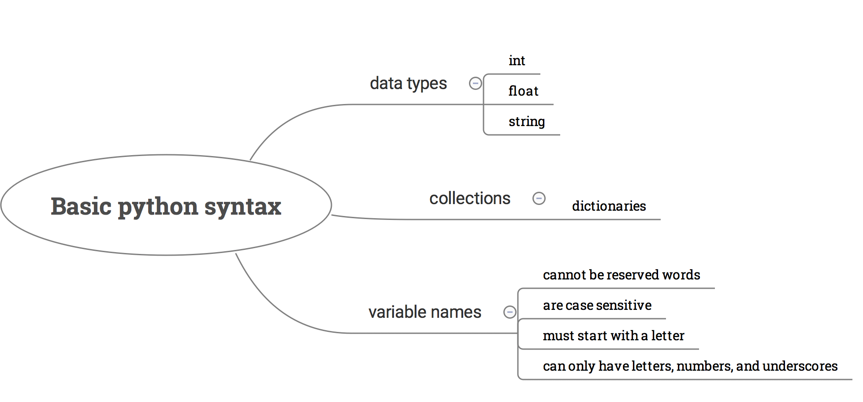
Taking notes

Slide 41
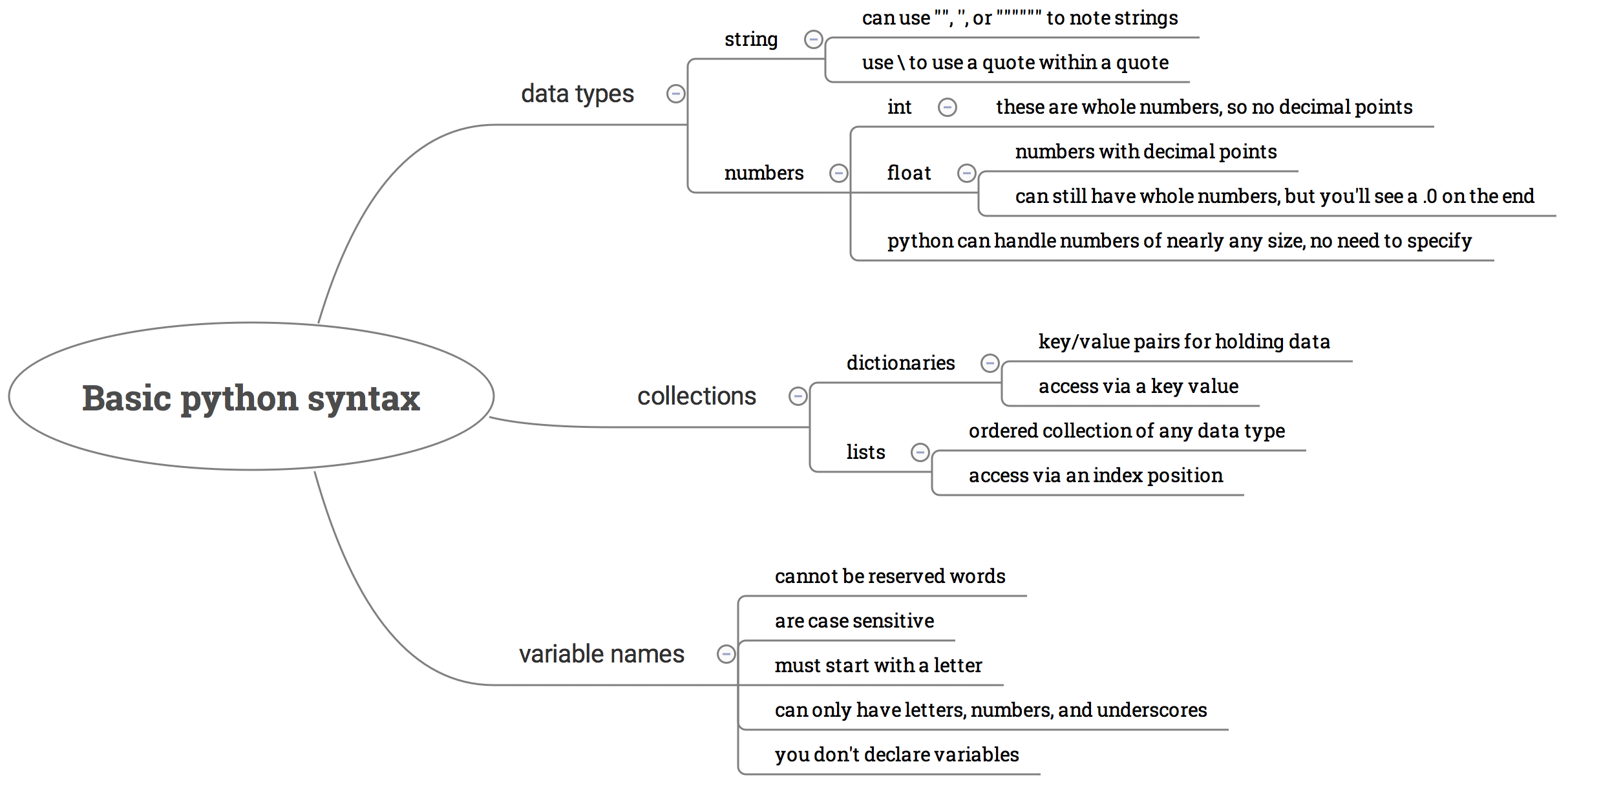
Taking notes

Slide 42
Enough of this
Let’s do some python

