Slide 1
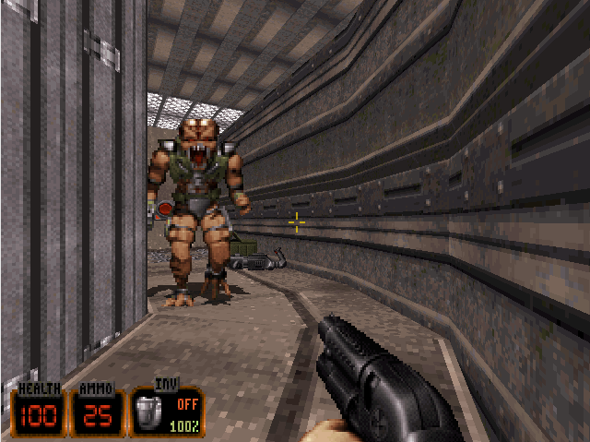
Mid 1990s: 3D models, beginnings of hardware acceleration

Slide 2
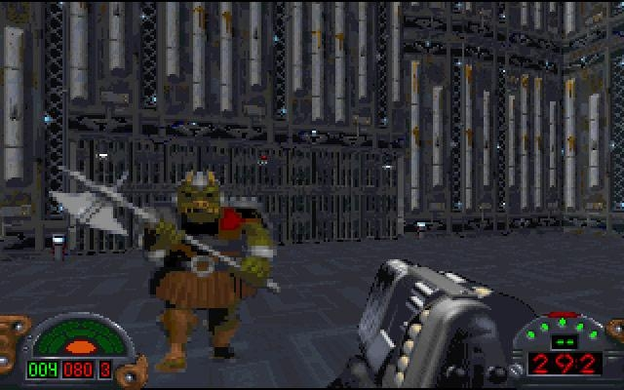
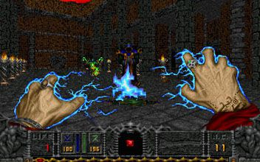
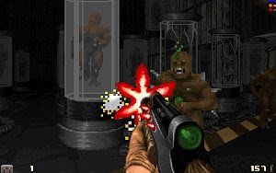
In the mid-1990s, game engines recreated true 3D worlds with arbitrary level geometry. Instead of sprites the engines used simply textured (single-pass texturing, no lighting details) polygonal objects.
FromSoftware released King's Field, a full polygon free roaming first-person real-time action title for the Sony PlayStation in December 1994. Sega's 32X release Metal Head was a first-person shooter mecha simulation game that used fully texture-mapped, 3D polygonal graphics.[5] A year prior, Exact released the Sharp X68000 computer game Geograph Seal, a fully 3D polygonal first-person shooter that employed platform game mechanics and had most of the action take place in free-roaming outdoor environments rather than the corridor labyrinths of Wolfenstein 3D. The following year, Exact released its successor for the PlayStation console, Jumping Flash!, which used the same game engine but adapted it to place more emphasis on the platforming rather than the shooting. The Jumping Flash! series continued to use the same engine.
Dark Forces, released in 1995 by LucasArts, has been regarded as one of the first "true 3-D" first-person shooter games[citation needed]. Its engine, the Jedi Engine, was one of the first engines to support an environment in three dimensions: areas can exist next to each other in all three planes, including on top of each other (such as stories in a building). Though most of the objects in Dark Forces are sprites, the game does include support for textured 3D-rendered objects. Another game regarded as one of the first true 3D first-person shooter is Parallax Software's 1994 shooter Descent.

Slide 3
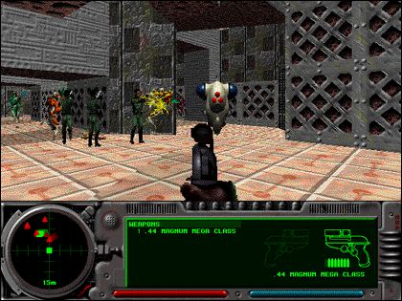
The Quake engine (Quake, 1996) used fewer animated sprites and used true 3D geometry and lighting, using elaborate techniques such as z-buffering to speed up the rendering. Quake was also the first true-3D game to use a special map design system to preprocess and pre-render the 3D environment: the 3D environment in which the game took place (referred for the first time as a Map) was simplified during the creation of the map to reduce the processing required when playing the game.
Static lightmaps and 3D light sources were also added in the BSP files storing the levels, allowing for more realistic lighting.
The first Graphics processing units[8] appeared in the late 1990s, but many games still supported software rendering at that time. id Tech 2 (Quake II, 1997) was one of the first games to take advantage of hardware accelerated graphics (id Software later reworked Quake to add OpenGL support to the game).
GoldSrc, the engine derived from the Quake engine by Valve Corporation for Half-Life (1998), added Direct3D support, and a skeletal framework to better render the NPCs, and also greatly improved the NPCs artificial intelligence (AI) compared to the Quake engine.

