Slide 1







$$\text{Noise} \text{suppression} \text{factor}\text{ (}\text{dB}\text{)}: 𝒩_{n}=20×\ln{\frac{n\left(t\right)−n\left(t−t_{d}\right)}{n\left(t\right)}}$$
$$\text{S}\text{ignal} \text{to} \text{noise} \text{ratio} \text{(}\text{dB}\text{)}: 𝒮𝒩ℛ=20×\ln{\frac{S}{n\left(t\right)−n\left(t−t_{d}\right)}}$$
U1
U2
S-n(t- $t_{d}$)
MX1
TD1
Medium
S
S-n(t- $t_{4}$)
S-n(t- $t_{5}$)
S-n(t-td)+n(t)
Source
+
Driver
n(t)
-
S+n(t)
n(t- $t_{3}$)
NGC
U3
TD2
S
-
+
S+n(t- $t_{2}$)
Amplifier
S+n(t- $t_{1}$)
MX2
U4

Slide 2
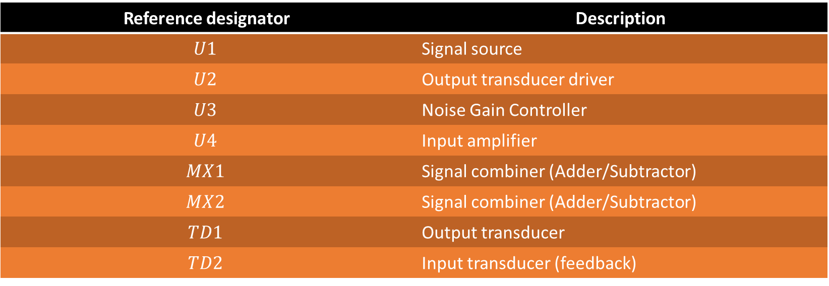
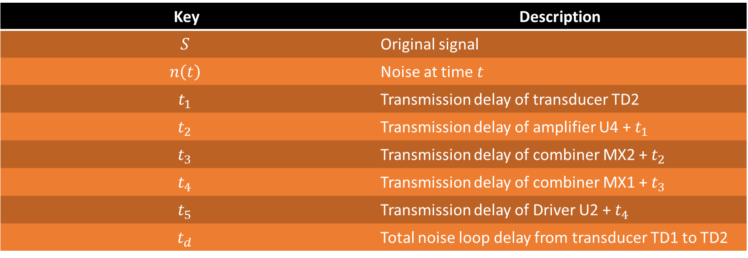
Key | Description
$$S$$ | Original signal
$$n\left(t\right)$$ | Noise at time $t$
$$t_{1}$$ | Transmission delay of transducer TD2
$$t_{2}$$ | Transmission delay of amplifier U4 + $t_{1}$
$$t_{3}$$ | Transmission delay of combiner MX2 + $t_{2}$
$$t_{4}$$ | Transmission delay of combiner MX1 + $t_{3}$
$$t_{5}$$ | Transmission delay of Driver U2 + $t_{4}$
$$t_{d}$$ | Total noise loop delay from transducer TD1 to TD2
Reference designator | Description
$$U1$$ | Signal source
$$U2$$ | Output transducer driver
$$U3$$ | Noise Gain Controller
$$U4$$ | Input amplifier
$$MX1$$ | Signal combiner (Adder/Subtractor)
$$MX2$$ | Signal combiner (Adder/Subtractor)
$$TD1$$ | Output transducer
$$TD2$$ | Input transducer (feedback)

