Slide 1
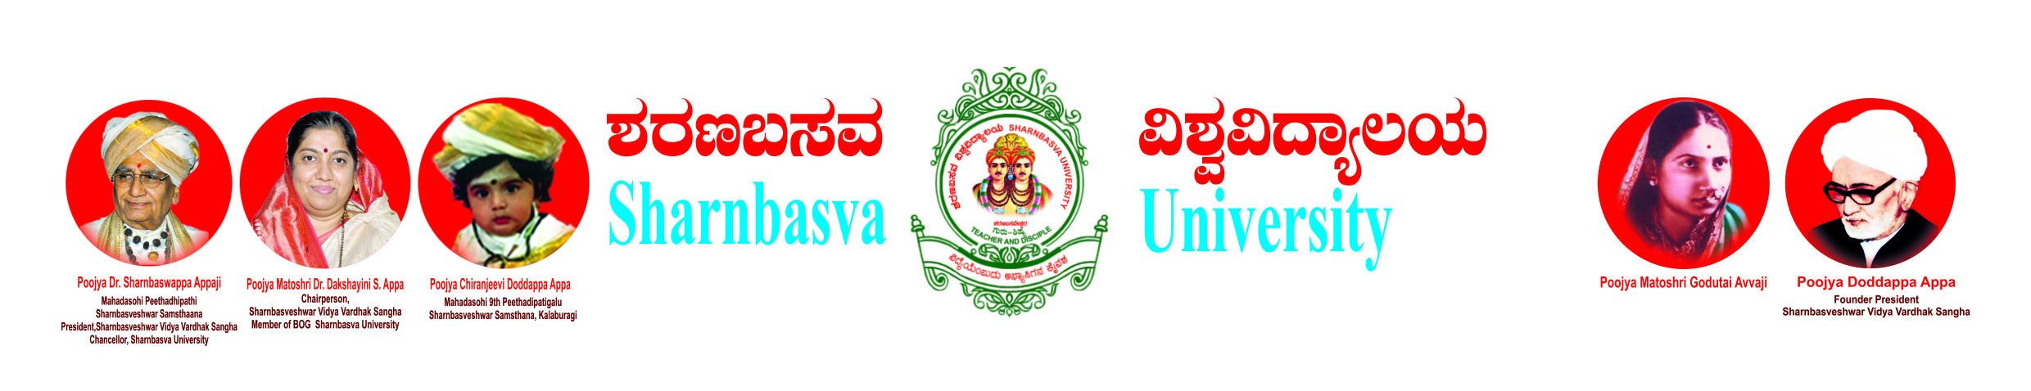
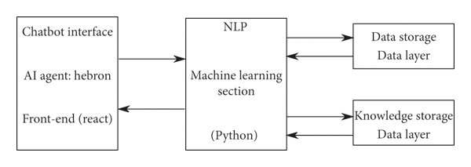
CHATBOT IN PYTHON
Simran Tabassum, Rehana Banu, Meghana, Harsha, AIML, FETW,SUK
1. Abstract
2. Introduction
3. Objectives
A Chabot is artificial intelligence (AI) computer software that can simulate a conversation using textual or audio techniques. The basis of chat bots is artificial intelligence, which analyses a customer's data and blends the response with them. AI-powered bots can take over a variety of duties since they are considerably more powerful-and can execute numerous tasks at once. Natural language processing enables a bot to converse in the most natural manner possible. A balanced blend of innovative technology and human intervention is the optimal user-Chabot connection.
Artificial Intelligence (ΑΙ) increasingly integrates our daily lives with the creation and analysis of intelligent software and hardware, called intelligent agents. Intelligent agents can do a variety of tasks ranging from labor work to sophisticated operations.
A chatbot is a typical example of an AI system and one of the most elementary and widespread examples of intelligent Human-Computer Interaction (HCI).
It is a computer program, which responds like a smart entity when conversed with through text or voice and understands one or more human languages by Natural Language Processing (NLP).
Chatbots are also known as smart bots, interactive agents, digital assistants, or artificial conversation entities.
Chatbots allow businesses to connect with customers in a personal way without the expense of human representatives. For example, many of the questions or issues customers have are common and easily answered. That’s why companies create FAQs and troubleshooting guides. Chatbots provide a personal alternative to a written FAQ or guide and can even triage questions, including handing off a customer issue to a live person if the issue becomes too complex for the chatbot to resolve. Chatbots have become popular as a time and money saver for businesses and an added convenience for customers.
4. Design/Block diagram
5. Future Scope
6. Conclusion
As an AI language model, I cannot predict the future, but I can provide information about the current possibilities and potentials of chatbots. Chatbots have gained popularity in recent years due to their ability to provide quick and efficient customer service. However, their potential goes far beyond that. Here are some possible future scopes of chatbots:1. Personalization: Chatbots can use machine learning algorithms to analyze customer data and provide personalized experiences to each customer.2. Expansion to new domains: With advancements in AI, chatbots can be trained to handle increasingly complex tasks and industries, such as healthcare, finance, and education.3. Integration with IoT: Chatbots can be integrated with IoT devices, enabling them to control home appliances, cars, and other electronic devices.4. Voice-based chatbots: Chatbots that can interact through voice assistants like Amazon Alexa and Google Assistant are becoming increasingly popular, paving the way for more voice-based applications.5. Conversational AI: With advancements in natural language processing and machine learning, chatbots are becoming more intelligent and capable of holding more natural conversations with users.Overall, the future scope of chatbots is vast, and they are likely to become a crucial part of many industries, providing innovative solutions to various challenges.
chatbots are becoming increasingly popular in various industries as they provide efficient and personalized customer support services. They are an excellent way of enhancing customer engagement and loyalty, and they help businesses save costs. However, to be effective, chatbots must be designed to offer seamless user experience and to accurately identify and respond to user queries. Additionally, chatbots should work alongside human customer service representatives to ensure that complex or sensitive issues are handled appropriately. Overall, while chatbots have their limitations, the benefits they offer in terms of efficiency, cost-effectiveness, and improved customer experience make them a worthwhile investment for businesses.
Prof. Swati S, AIML, FETW,SUK

