Slide 1
Airbnb NYC 2019 – Data Analysis Overview
Exploratory Data Analysis of Airbnb Listings
Prepared for Management Review

Slide 2
Agenda
• Dataset Overview
• Pricing Distribution
• Room Type Analysis
• Borough-Level Insights
• Availability & Demand
• Key Business Takeaways

Slide 3
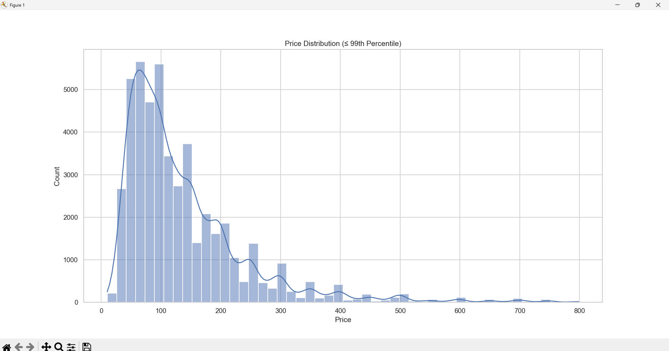
Price Distribution of Listings
Notes:
Most listings fall in the budget to mid-range segment, with a long tail of luxury listings.

Slide 4
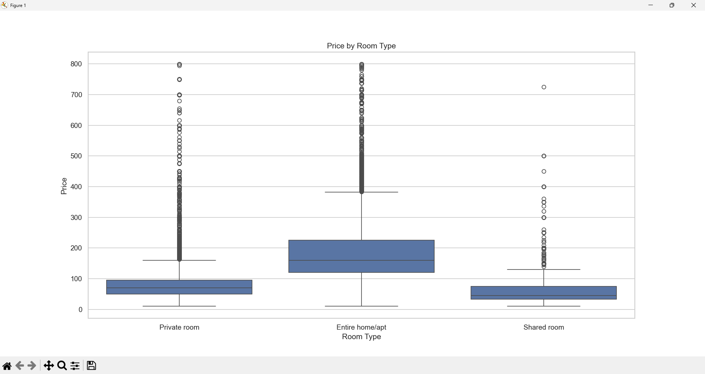
Price by Room Type
Notes:
Entire homes command significantly higher prices than private or shared rooms.

Slide 5
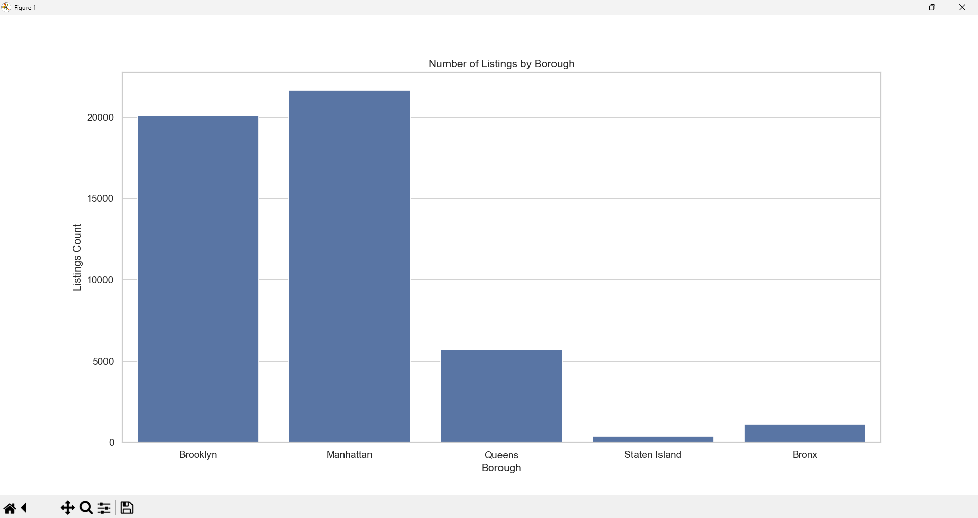
Number of Listings by Borough
Notes:
Manhattan and Brooklyn dominate Airbnb supply in NYC.

Slide 6
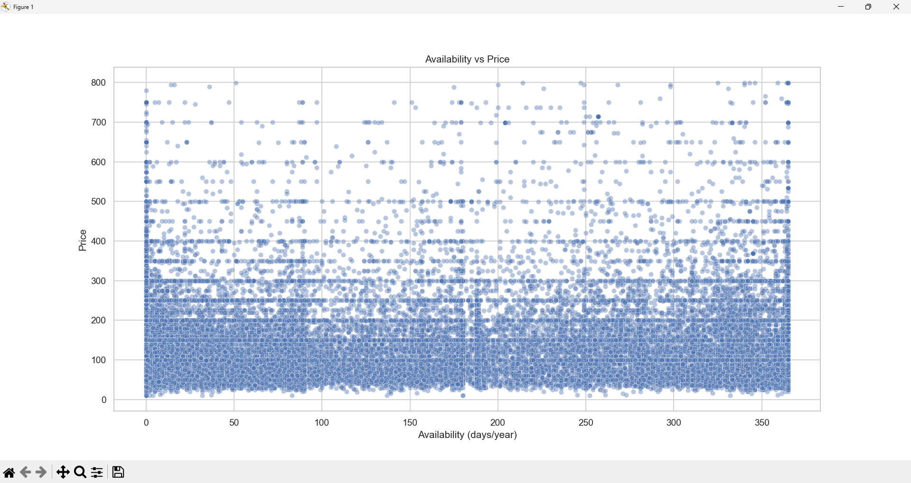
Availability vs Price
Notes:
Price shows weak relationship with availability, indicating demand-driven pricing.

Slide 7
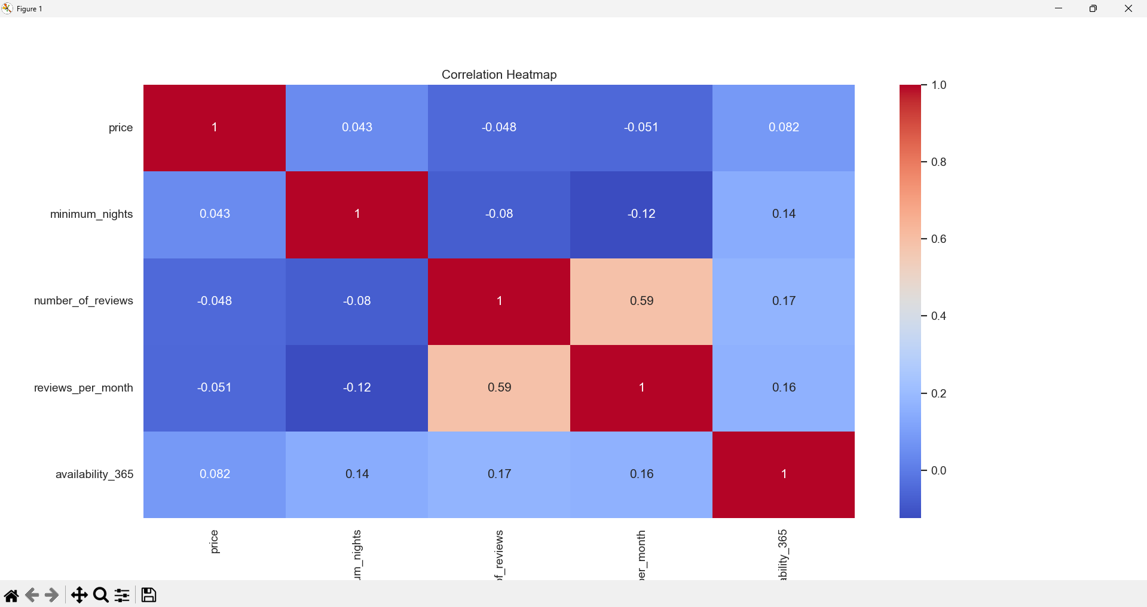
Correlation Analysis
Notes:
Review frequency strongly correlates with total reviews, not with price.

Slide 8
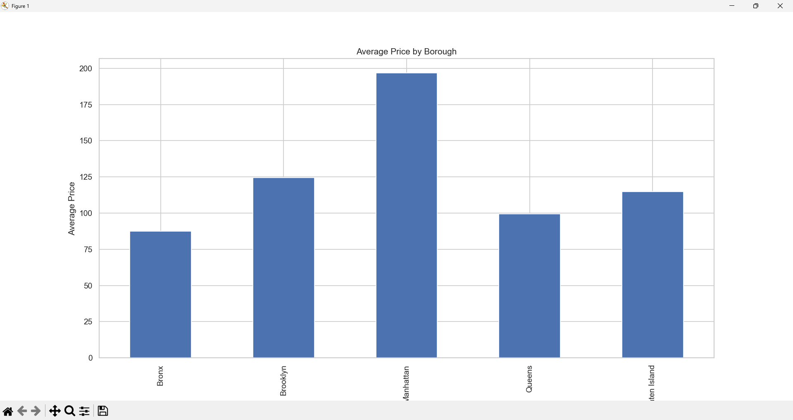
Average Price by Borough
Notes:
Manhattan has the highest average prices, followed by Brooklyn.

Slide 9
Key Business Takeaways
• Location and room type are the strongest price drivers
• Entire home listings dominate premium pricing
• Demand indicators outperform price in explaining engagement
• Brooklyn offers strong value relative to Manhattan

