Slide 1
Business Growth & Cohort Analysis
Revenue, Retention & Actionable Insights

Slide 2
Executive Summary
Total Revenue: ₹64.9M | Total Orders: 55,704 | Customers: 22,840
Revenue growth driven by campaigns, not organic retention
Retention after Month 2 drops below 8% (critical risk)
Revenue heavily dependent on Mobiles & Tablets
High cancellations causing revenue leakage

Slide 3
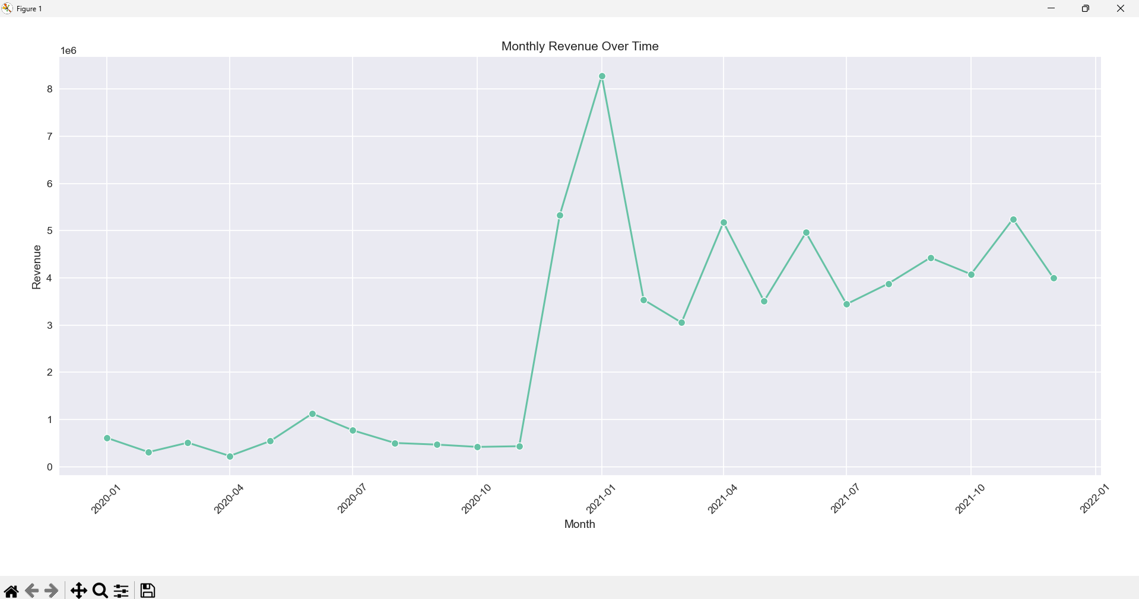
Revenue & Order Growth Over Time

Slide 4
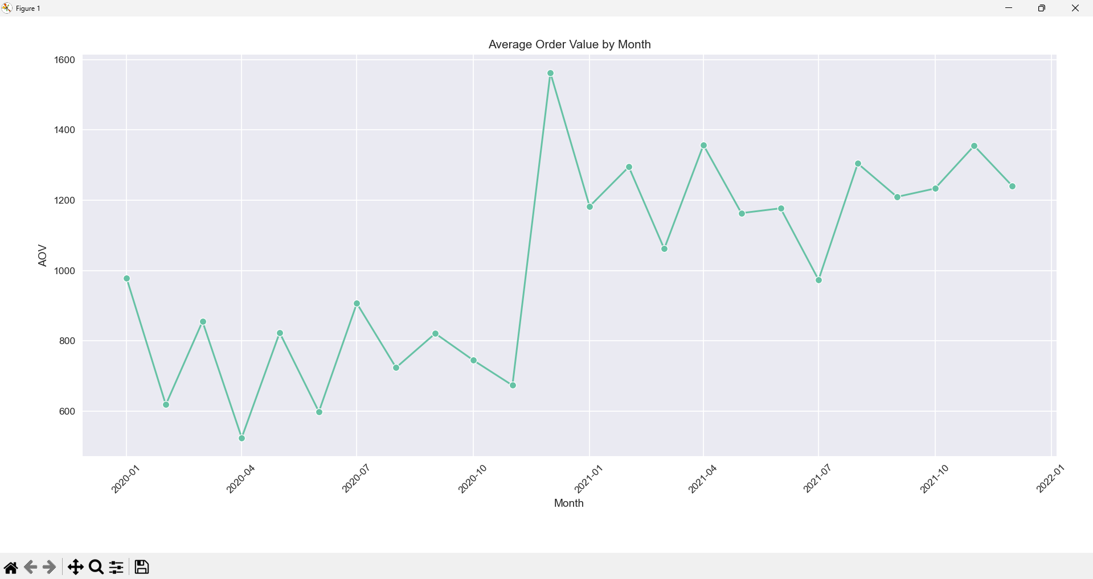
Average Order Value Trend

Slide 5
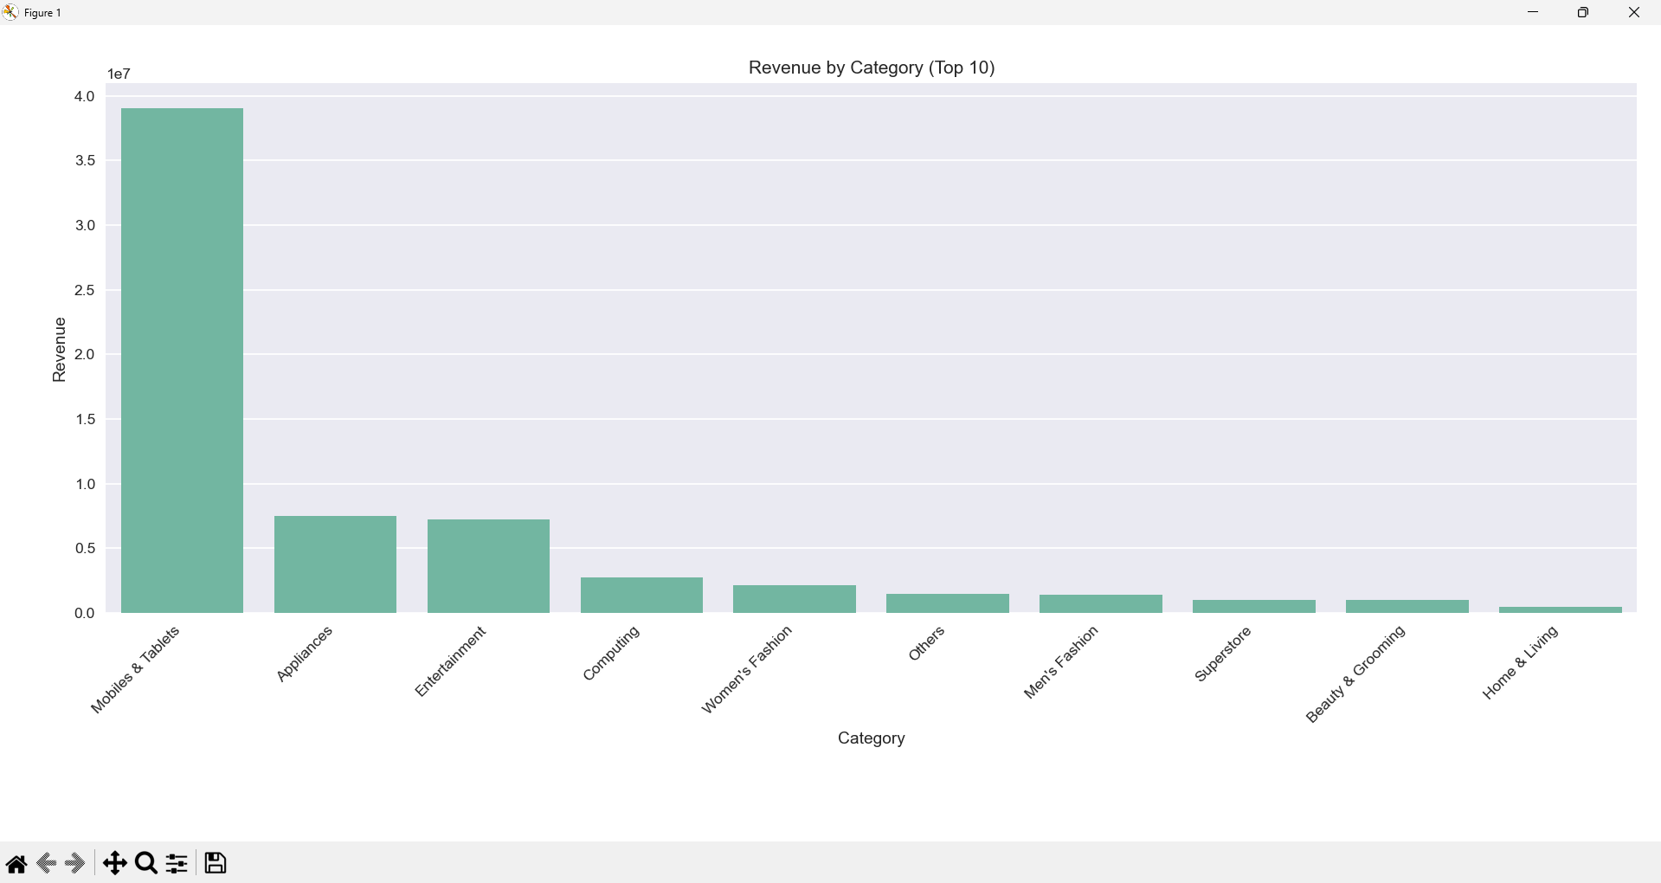
Revenue by Category

Slide 6
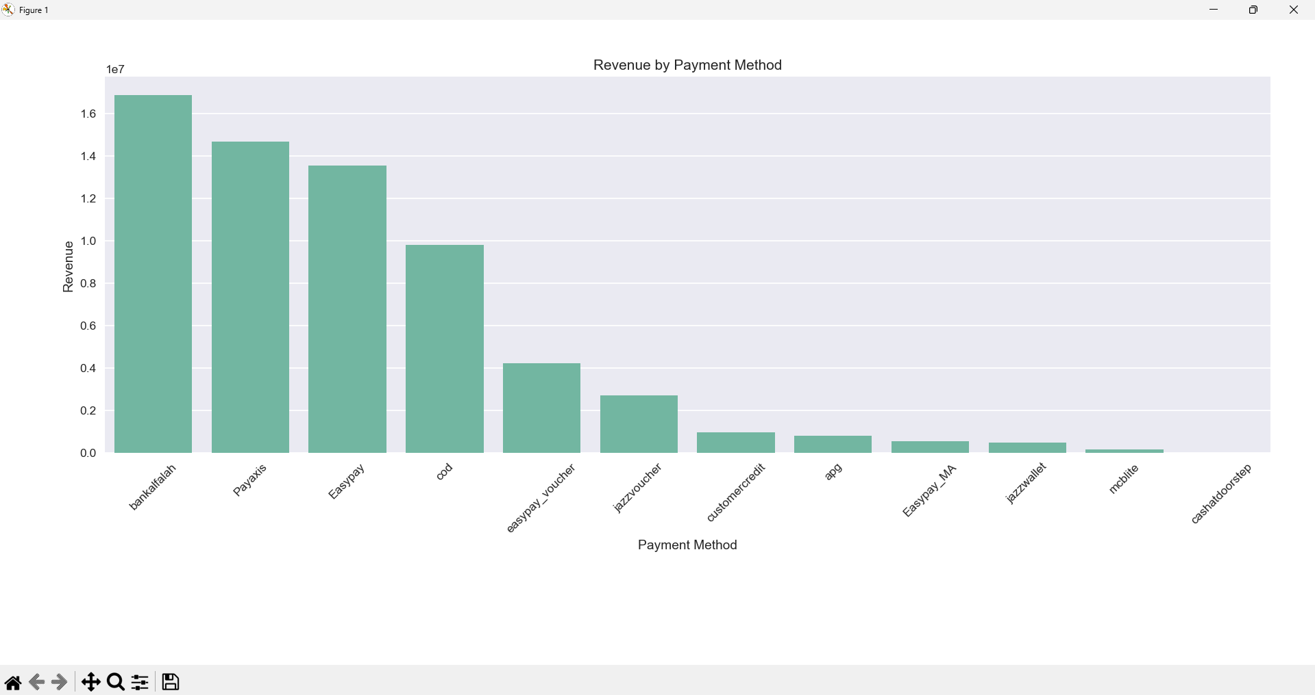
Revenue by Payment Method

Slide 7
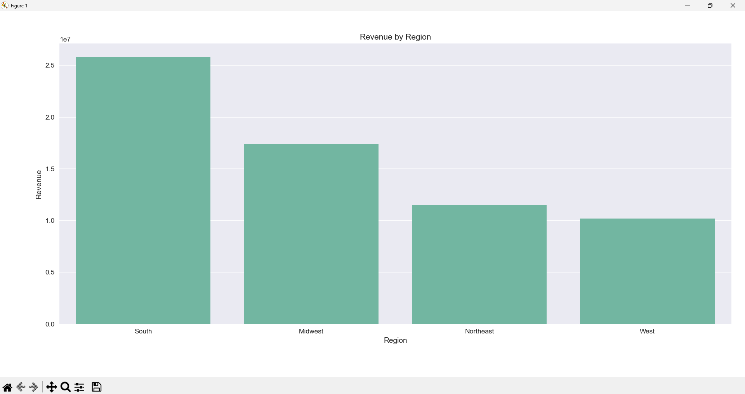
Revenue by Region

Slide 8
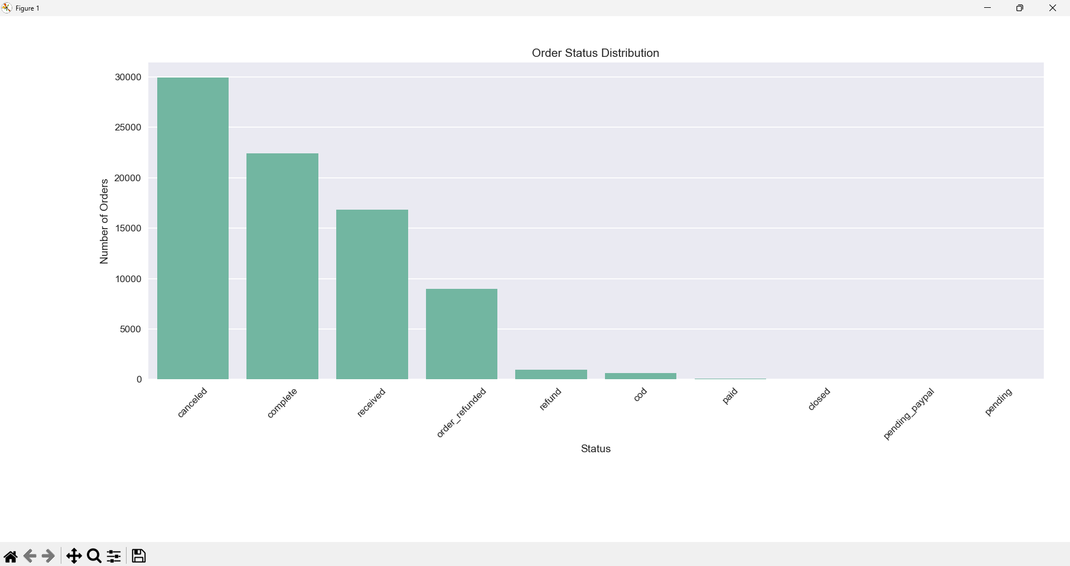
Order Status Distribution

Slide 9
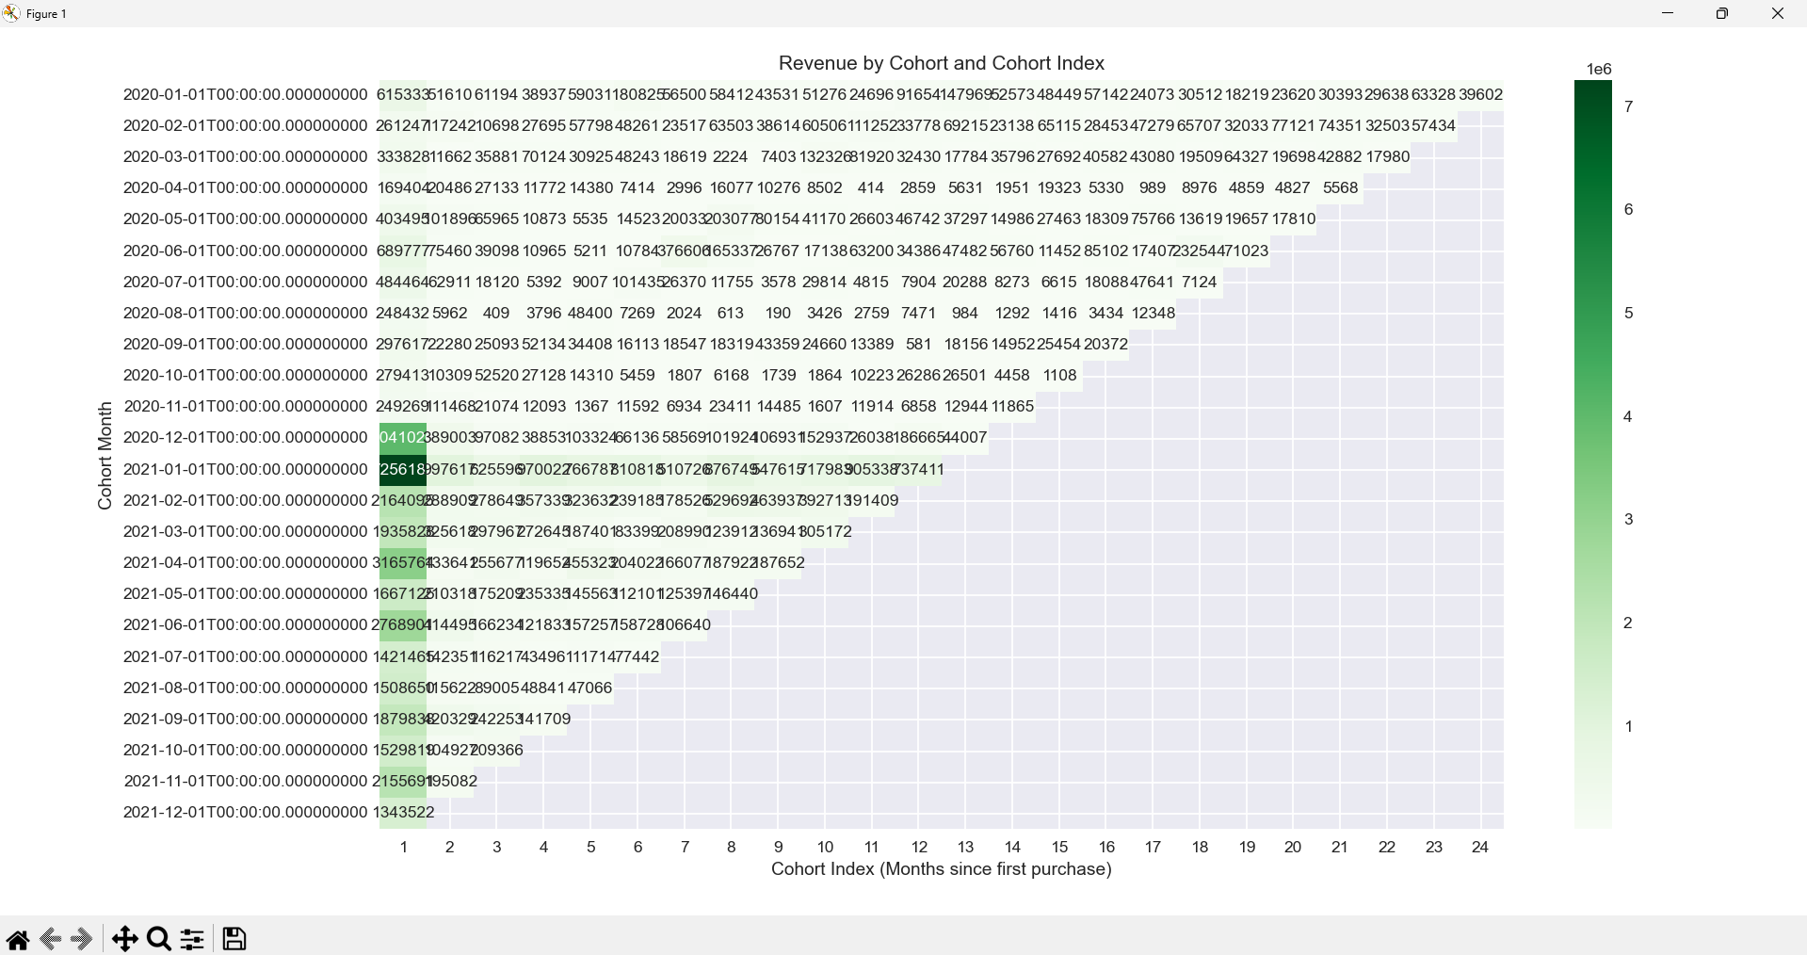
Customer Retention Cohort Analysis

Slide 10
Revenue Contribution by Cohort

Slide 11
Key Strategic Insights
Retention is the biggest bottleneck to sustainable growth
Majority of revenue comes from first purchase only
High-value repeat customers exist but are unmanaged
Cancellations exceed completed orders – major operational issue

Slide 12
Actionable Recommendations
Improve 2nd purchase conversion via post-purchase nudges
Launch VIP / power-buyer program for repeat customers
Reduce cancellations by incentivizing prepaid payments
De-risk revenue by pushing accessories & bundles
Optimize regional marketing, especially West region

