Slide 1
Customer Churn Analysis – Business Insights
Retention Risk, Revenue Impact & Actionable Strategy

Slide 2
Executive Summary
Global churn rate is critically high at 56.7%
  Contract length is the strongest driver of churn
  Monthly plans show nearly 100% churn across all tiers
  Behavioral signals enable early churn intervention
  3,219 high-risk customers identified for targeted retention

Slide 3
Dataset Overview
Training dataset: 440,833 customers
  Test dataset: 64,374 customers
  12 behavioral, contractual, and financial features analyzed
  Dataset size ensures statistically reliable insights

Slide 4
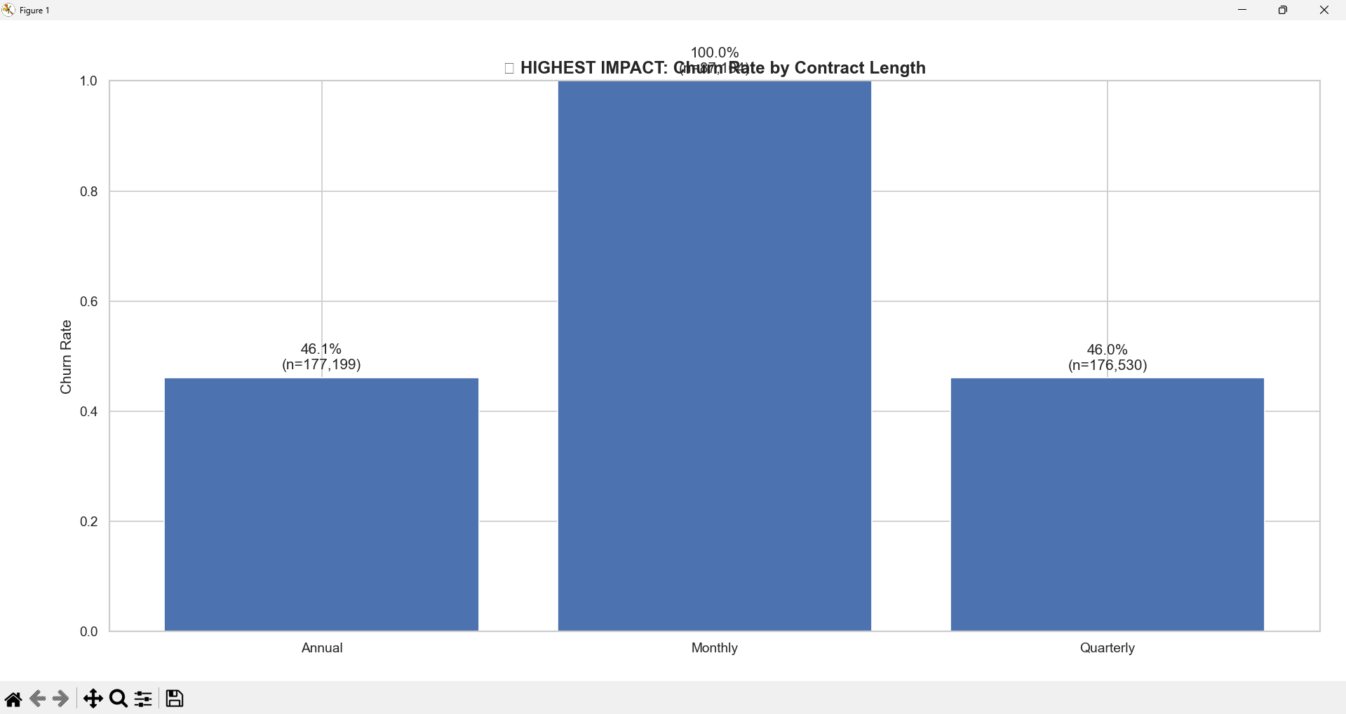
Churn Rate by Contract Length

Slide 5
Key Insight: Contract Length Drives Churn
Monthly customers churn at nearly 100%
  Quarterly and Annual contracts reduce churn by ~50%
  Commitment structure matters more than pricing discounts
  Monthly plans function as paid trials, not loyal customers

Slide 6
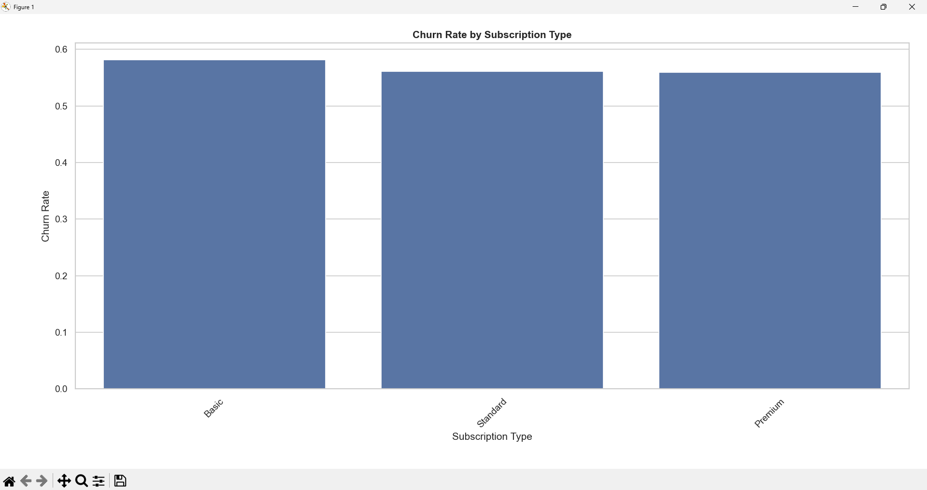
Churn Rate by Subscription Type

Slide 7
Subscription Tier Impact
Basic, Standard, and Premium show similar churn rates
  Features and pricing tiers are not reducing churn
  Customer churn driven by experience, not feature depth
  Retention efforts should focus on activation & trust

Slide 8
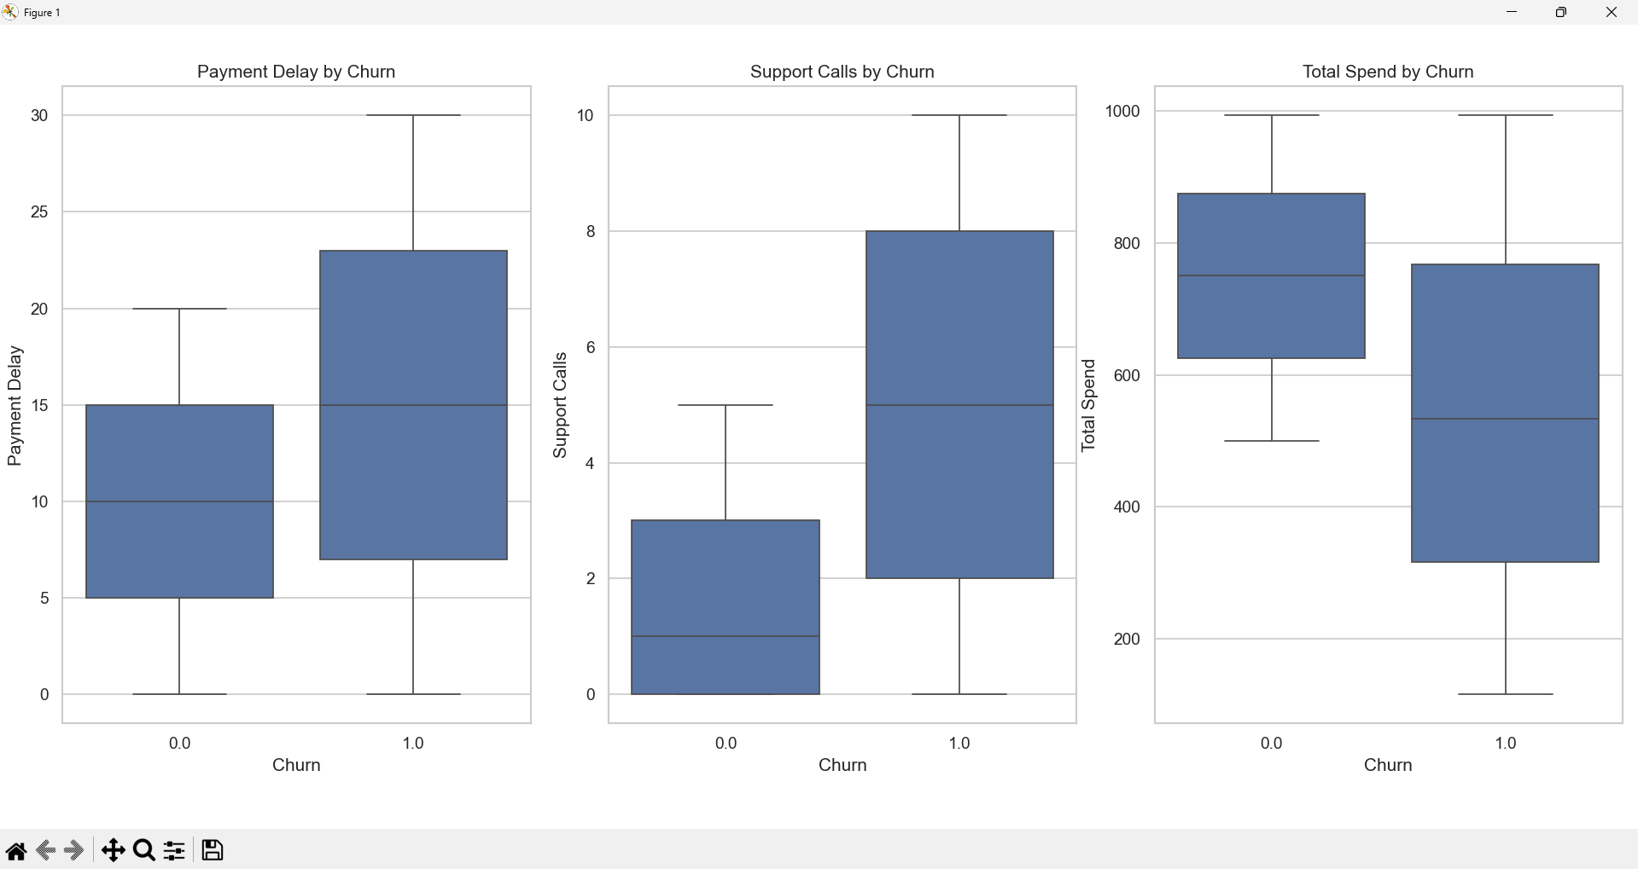
Behavioral Indicators of Churn

Slide 9
Behavioral Churn Signals
Churned customers show higher payment delays
  Support call frequency spikes before churn
  Lower total spend correlates with higher churn risk
  These signals act as early warning indicators

Slide 10
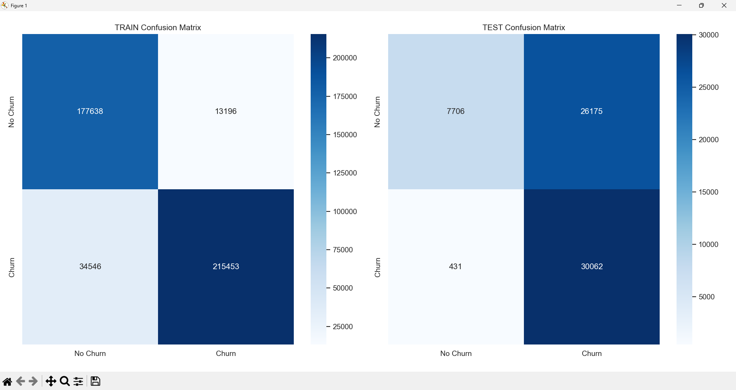
Churn Risk Model Performance

Slide 11
Model Interpretation
Recall of 98.6% ensures almost all churners are flagged
  Precision of 53.5% acceptable for retention use-cases
  Model functions best as a churn risk radar
  Designed for operational intervention, not forecasting

Slide 12
High-Risk Customer Segments
Monthly + Any subscription tier = highest churn risk
  Top 5% high-risk customers: 3,219 identified
  Targeted retention reduces cost and increases ROI
  Avoid blanket discounts; focus on risk-based actions

Slide 13
Business Impact
Reduced revenue leakage through early intervention
  More efficient allocation of retention budgets
  Improved lifetime value of retained customers
  Clear roadmap for pricing and contract redesign

Slide 14
Strategic Recommendations
Reposition or eliminate Monthly contracts
  Proactively intervene using behavioral risk signals
  Shift focus from features to onboarding and engagement
  Operationalize churn risk insights across teams

