Slide 1
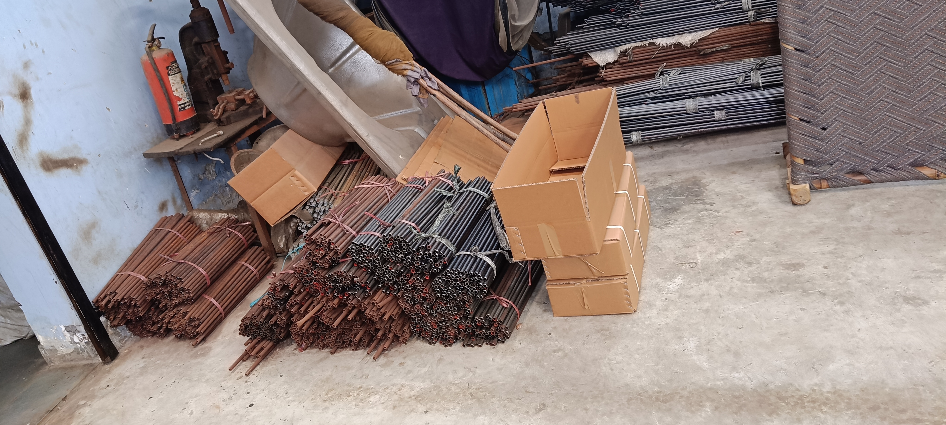
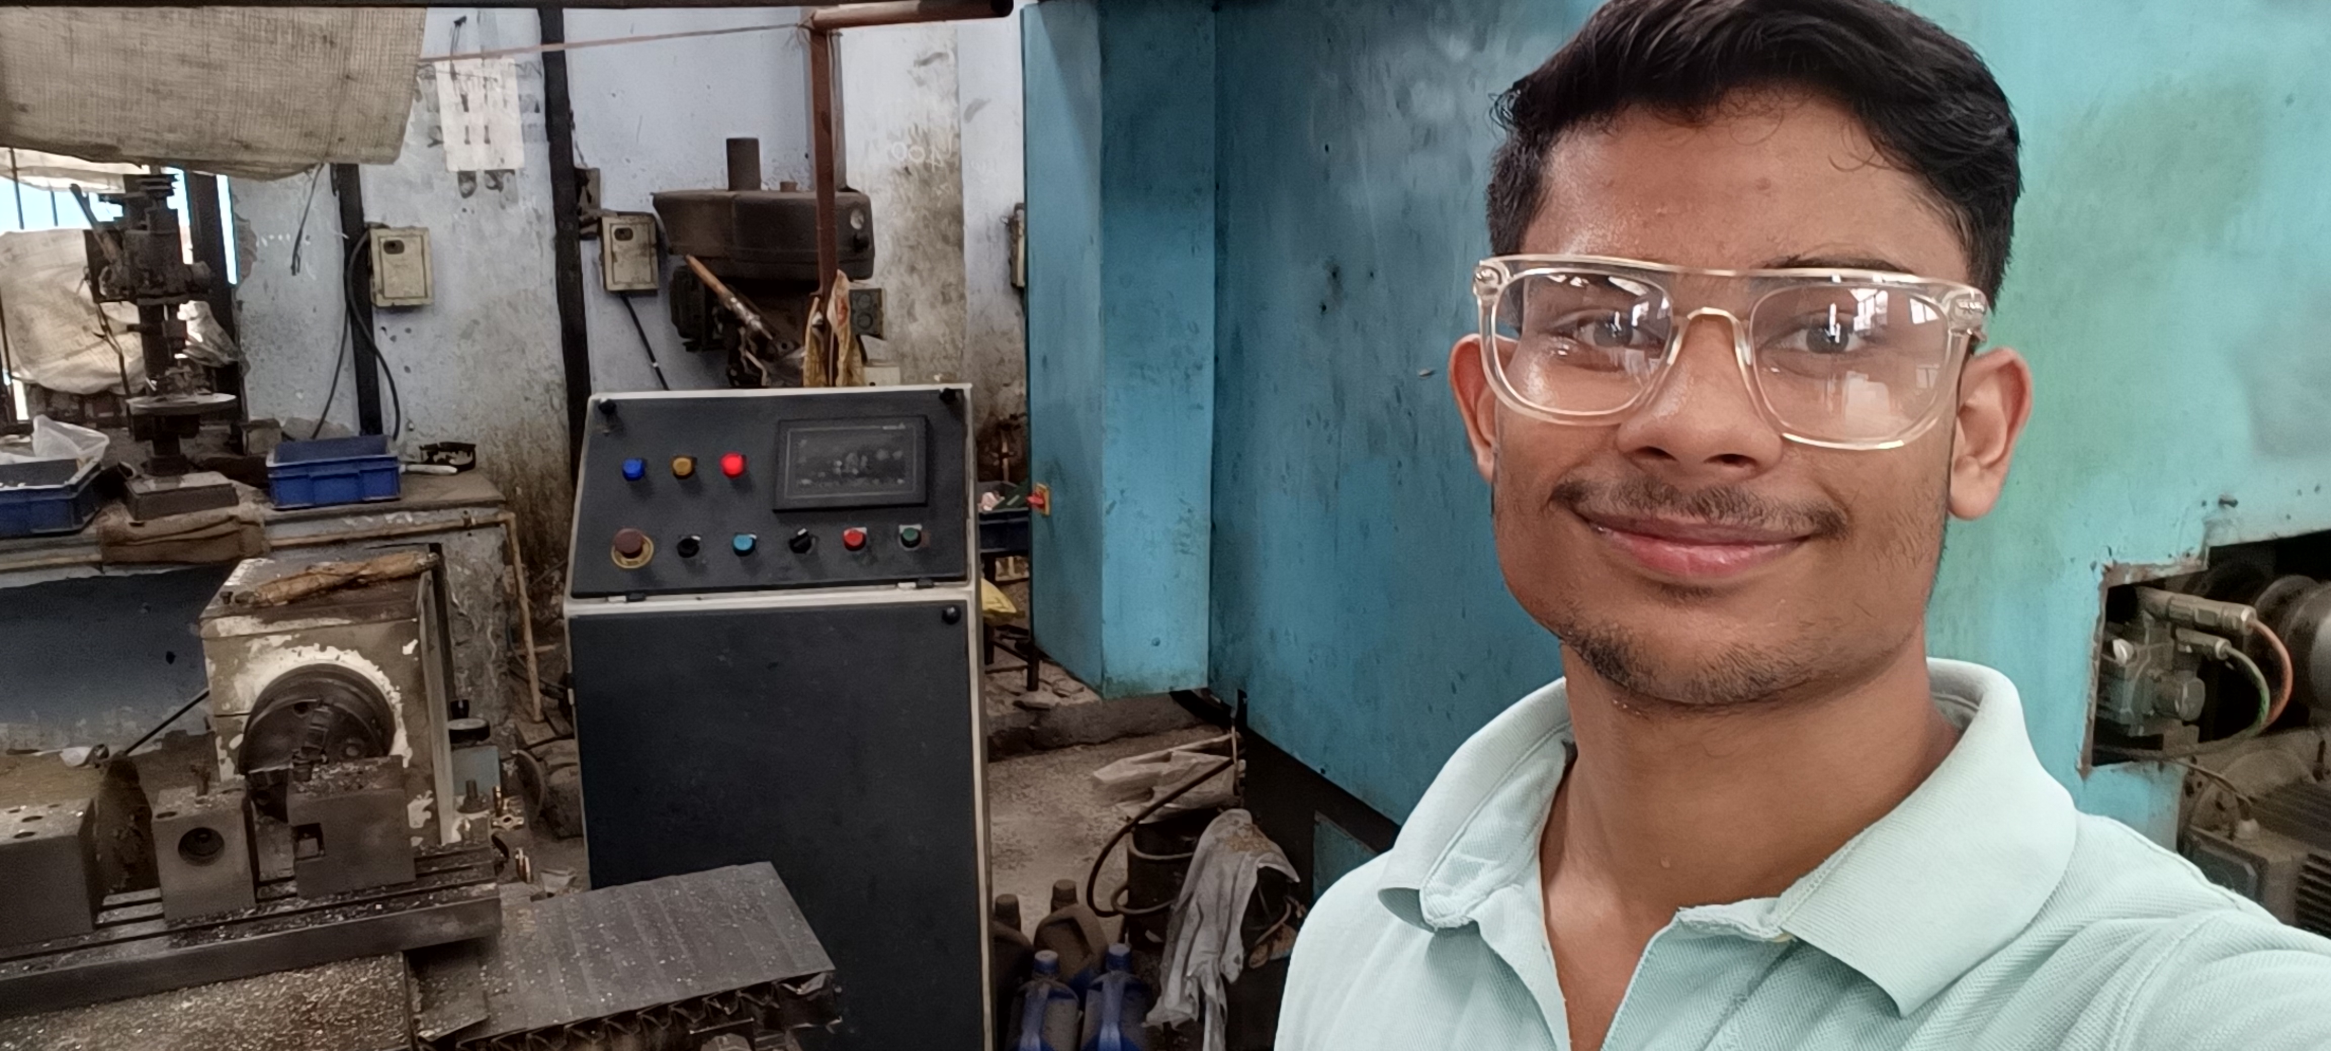

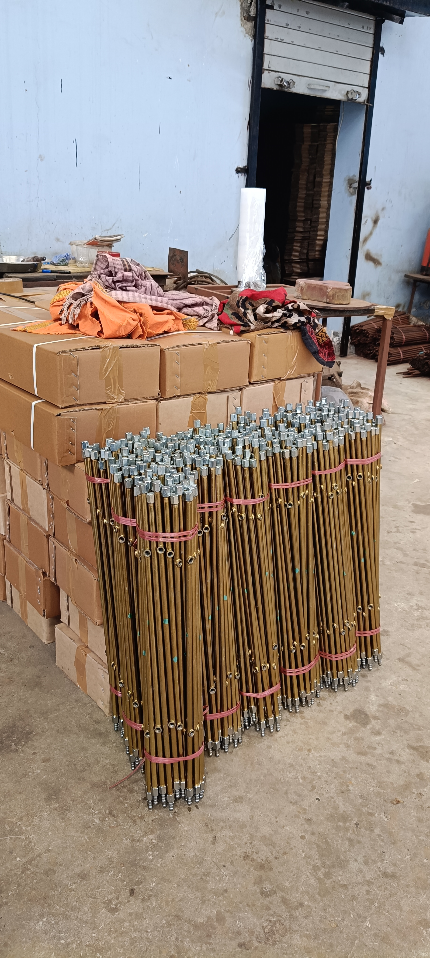
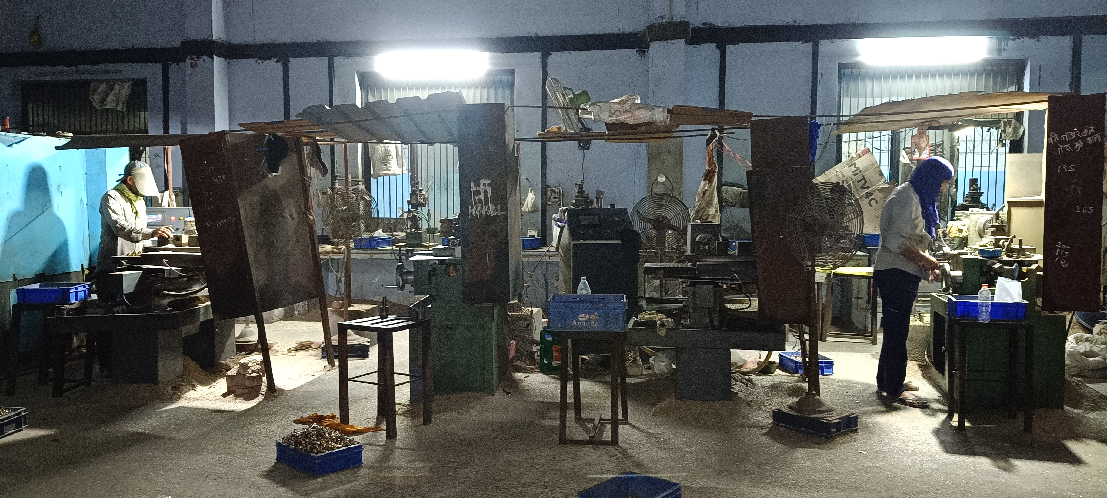

Improving Production Planning through Material Flow Analysis: Gas Stove Parts Manufacturer
Submitted By-Name- Rishit Jain
Roll Number- 24F2004595
Email- 24F2004595@ds.study.iitm.ac.in

Slide 2



MetaFab India: Business & Manufacturing Context
MetaFab India is a B2B MSME manufacturing company based in Greater Noida, Uttar Pradesh.
Major Products
Manufacturing Flow
Brass Burner Ring
Cast Iron Pan Support
Gas Valve Assembly
Raw Material Procurement → Production → Quality Inspection → Finished Goods → Customer Delivery
Business Context
Operational records were largely maintained manually. Production is commonly initiated after customer orders are received. Customer fulfilment windows are short, while manufacturing capacity is finite.
Business Objective: Improve production planning using operational data.

Slide 3

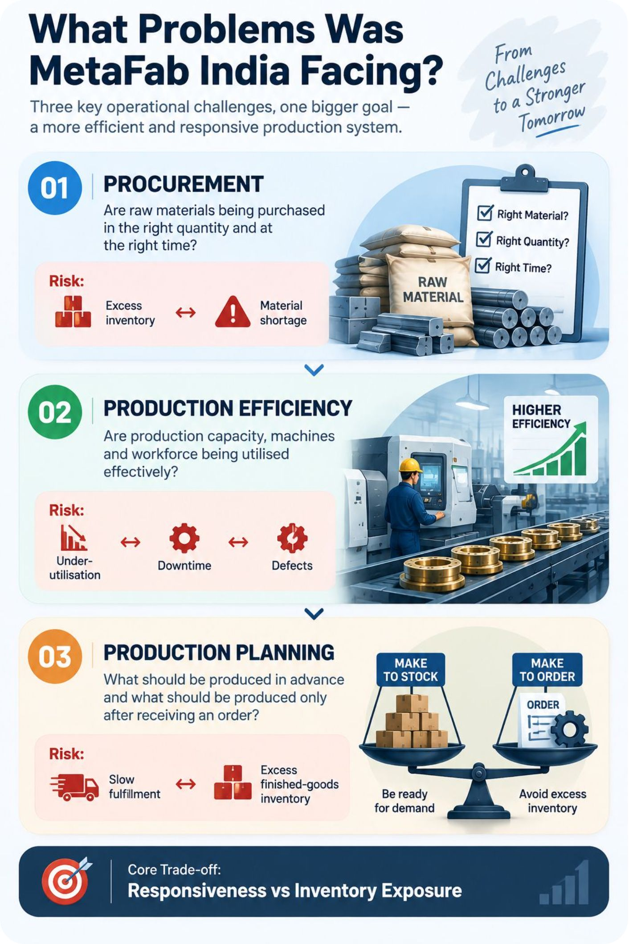
What Problems Was MetaFab India Facing?
01 — PROCUREMENT
Are raw materials being purchased in the right quantity and at the right time?
Risk: Excess inventory ↔ Material shortage
02 — PRODUCTION EFFICIENCY
Are production capacity, machines and workforce being utilised effectively?
Risk: Under-utilisation ↔ Downtime ↔ Defects
03 — PRODUCTION PLANNING
What should be produced in advance and what should be produced only after receiving an order?
Risk: Slow fulfilment ↔ Excess finished-goods inventory

Slide 4
Operational Data Collected from MetaFab India
8 DATASETS
2,529 RECORDS
41 COLUMNS
JAN–JUN 2026
1. Purchase Data
2. Production Data
Quantity purchased, price and procurement cost
Production output, material consumed and defects
3. Sales Invoice Data
4. Raw Material Inventory
Customer demand, quantity sold and revenue
Opening stock, purchases, consumption and closing stock
5. Finished Goods Inventory
6. Production Capacity
Production, sales and closing stock
Practical capacity and machine mapping
7. Workers Attendance
8. Machine Breakdown
Workers present and overtime
Breakdowns, reasons and downtime
The datasets together cover procurement, inventory, demand, production and operational constraints.

Slide 5

EDA: What Did the Initial Analysis Show?
73.15%
77.57%
185,173
Procurement
Procurement
Production
Purchase Quantity CV
Purchase Cost CV
Good Units Produced
4.63%
57.95%
73.1 hrs
Production
Capacity
Operations
Overall Defect Rate
Recorded-Day Capacity Utilisation
Machine Downtime
88.2%
Operations
Worker Attendance
Procurement and demand are highly variable, while production operates below practical capacity and machine downtime is concentrated.

Slide 6
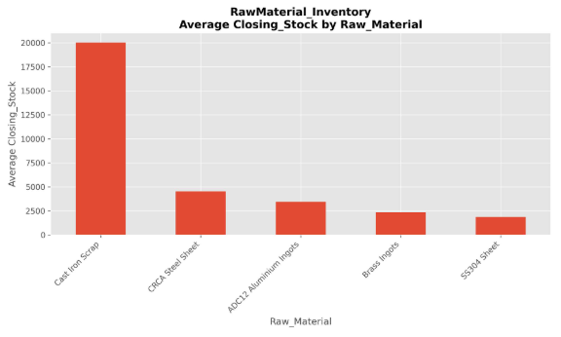
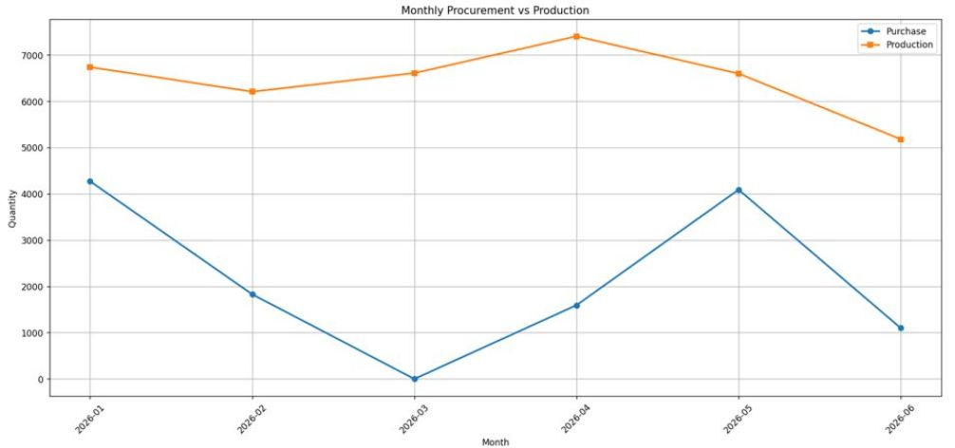
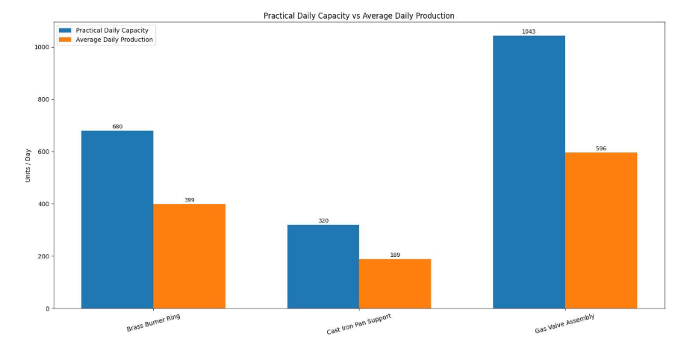
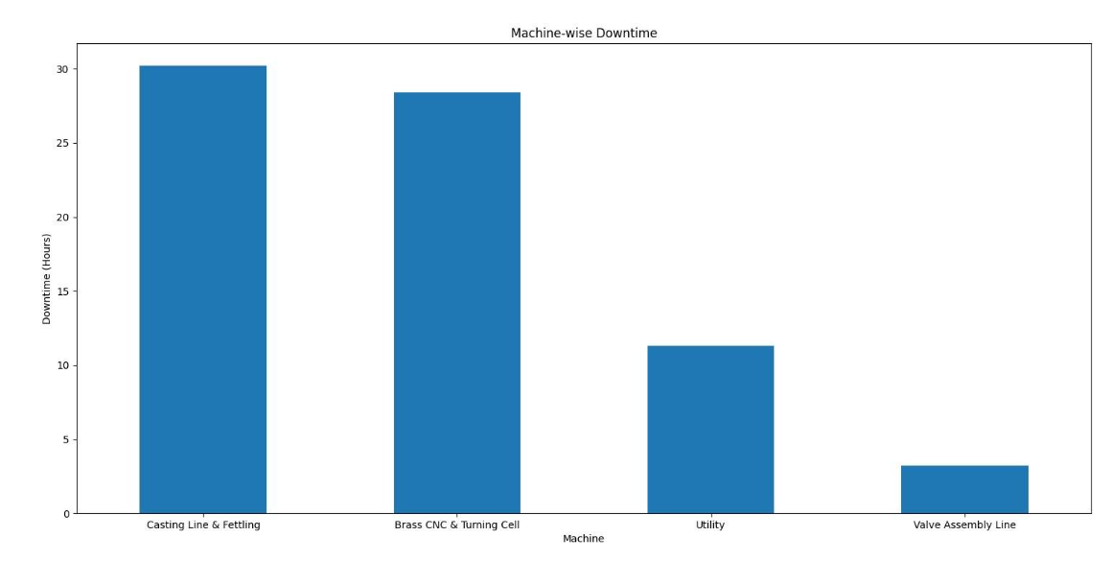
2. Closing Stock Coverage by Raw Material
Cast Iron Scrap — 114.7 days
Brass Ingots — 13.3 days
Key Message: Significant imbalance exists between materials.
EDA Visualizations: What the Numbers Look Like
1. Monthly Procurement vs Production
Key Message: Procurement fluctuates considerably, while production remains comparatively stable.
3. Actual Production vs Practical Capacity
4. Machine Downtime by Production Area
Brass Burner Ring — 58.68%
Cast Iron Pan Support — 59.12%
Gas Valve Assembly — 57.12%
Overall — 57.95%
Key Message: Approximately 80% of recorded downtime comes from two areas.
Casting Line & Fettling
Brass CNC & Turning Cell

Slide 7

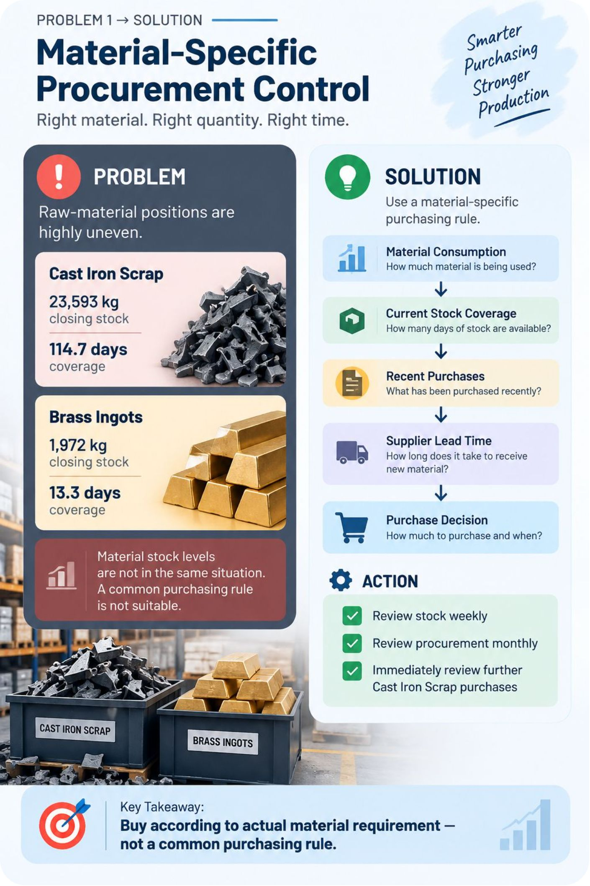

Problem 1 → Solution: Material-Specific Procurement Control
PROBLEM
SOLUTION
Raw-material positions are highly uneven.
Cast Iron Scrap
23,593 kg closing stock
114.7 days coverage
Brass Ingots
1,972 kg closing stock
13.3 days coverage
Use a material-specific purchasing rule
Material Consumption ↓ Current Stock Coverage ↓ Recent Purchases ↓ Supplier Lead Time ↓ Purchase Decision
ACTION
Review stock weekly
Review procurement monthly
Immediately review further Cast Iron Scrap purchases
Buy according to actual material requirement, not by a common purchasing rule.

Slide 8

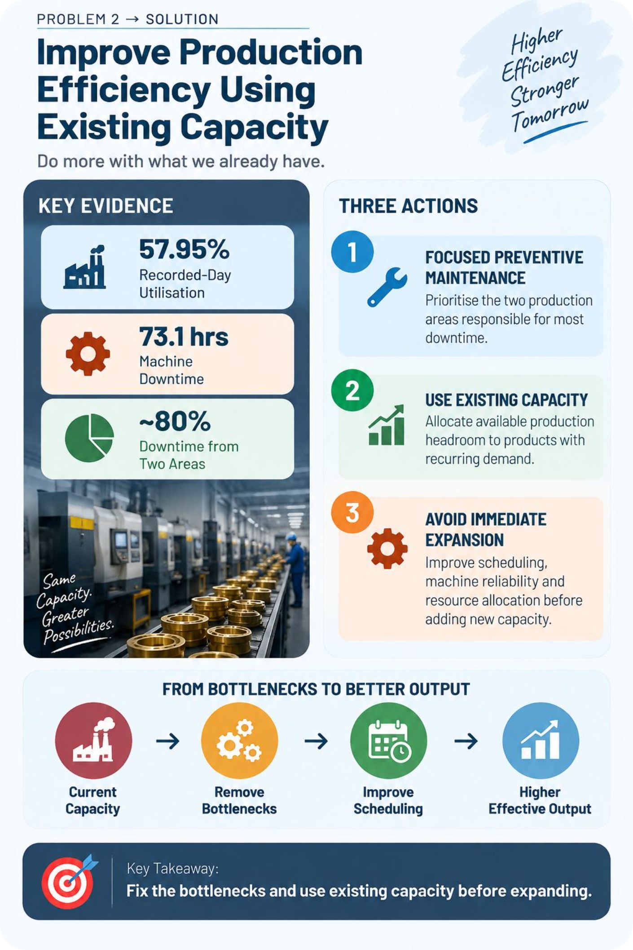

Problem 2 → Solution: Improve Production Efficiency Using Existing Capacity
KEY EVIDENCE
THREE ACTIONS
57.95% Recorded-Day Utilisation
73.1 hrs Machine Downtime
~80% Downtime from Two Areas
FOCUSED PREVENTIVE MAINTENANCE
Prioritise the two production areas responsible for most downtime.
USE EXISTING CAPACITY
Allocate available production headroom to products with recurring demand.
AVOID IMMEDIATE EXPANSION
Improve scheduling, machine reliability and resource allocation before adding new capacity.
Fix the bottlenecks and use existing capacity before expanding.

Slide 9

Problem 3 → Solution: Selective Make-to-Stock Planning
PRODUCT-WISE DEMAND VARIABILITY
DECISION RULE
Brass Burner Ring — 46.6% Weekly CV
Pre-production candidate
Cast Iron Pan Support — 46.2% Weekly CV
Pre-production candidate
Gas Valve Assembly — 56.5% Weekly CV
More cautious / stronger order evidence
Demand in ≥ 4 of the last 6 months
AND
Weekly CV ≤ 50%
↓
Eligible for Controlled Pre-Production
↓
Check Finished Goods Stock + Raw Materials + Capacity
↓
Make-to-Stock / Make-to-Order Decision
DEMAND SIGNAL
WMA — Brass Burner Ring, Cast Iron Pan Support
SMA — Gas Valve Assembly
Do not pre-produce everything. Pre-produce selectively where demand is sufficiently stable.

Slide 10
MetaFab Production Planning Decision Framework
01
02
STEP 1 — DEMAND
STEP 2 — VARIABILITY
Recent orders + demand history
Weekly demand CV
03
04
STEP 3 — INVENTORY
STEP 4 — MATERIAL
Finished-goods position
Raw-material availability
05
06
STEP 5 — CAPACITY
STEP 6 — CONSTRAINTS
Practical capacity vs planned production
Machine downtime + workforce availability
FINAL DECISION
MONITOR
MAKE-TO-STOCK
OR
MAKE-TO-ORDER
OR
MATERIAL READINESS
Production + Defects + Inventory + Dispatch
FEEDBACK
Recalculate monthly
The final solution converts individual analyses into one repeatable production-planning routine.

