Slide 1
SOLANA × IDOS GAMES
IMPERIVM
Read the mempool.
Build your legion.
An imperial card battler
where crypto culture becomes tactics.
99 cards · 9 rulers · Browser play
IMPERIVM / CRYPTO WORLD’S FAIR
Hackathon draft · 9 Oct 2026 / 1
Notes:
Product title and founder: repository README. Demo: https://imperivm.onrender.com. Build status checked 9 Oct 2026. This is a preparation draft, not evidence of submission or a published iDos game.

Slide 2
THE IDEA
Crypto culture becomes tactics
01
Read the public queue
Delayed edicts reveal what is coming.
Choose when to commit or respond.
02
Trade pressure for resources
Garrison a fighter to earn orders.
That fighter gives up its attack.
03
Build conditional combinations
DeFi, NFT, DePIN and meme cards
reward different sequences and formations.
IMPERIVM / CRYPTO WORLD’S FAIR
Hackathon draft · 9 Oct 2026 / 2
Notes:
Mechanics: lib/engine and lib/cards.ts. Mempool is a public queue inside the game; block numbers are local game turns, not Solana transactions. Card illustrations: existing project assets. No claims about real staking yields or financial returns.

Slide 3
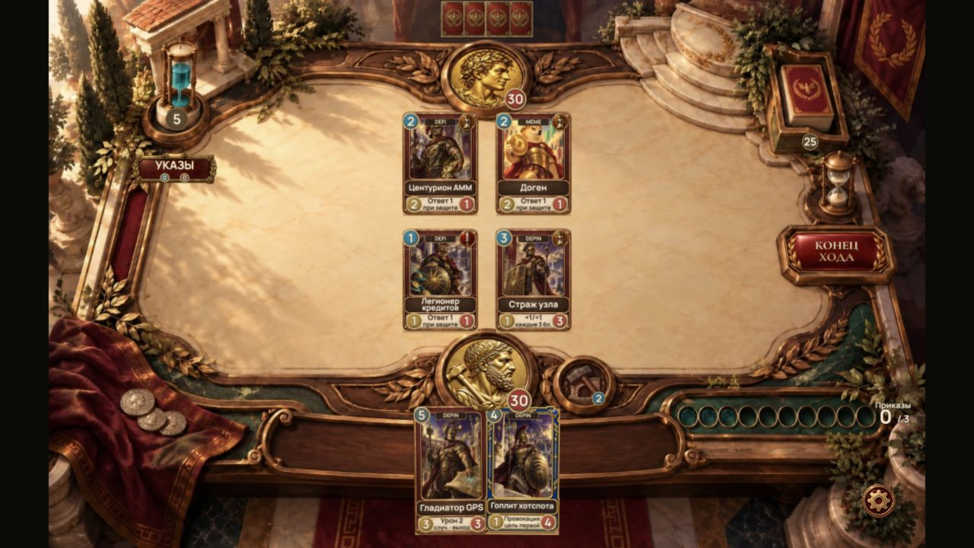
THE DUEL
A working imperial arena
IMPERIVM / CRYPTO WORLD’S FAIR
Hackathon draft · 9 Oct 2026 / 3
Notes:
Actual public training match, screenshot captured 9 Oct 2026 at 1280×720: readme/current/battle.jpg and its README media ledger. Arena supports AI and free online 1v1. Public WS readiness and code tests are distinct from a completed two-device live PvP test.

Slide 4
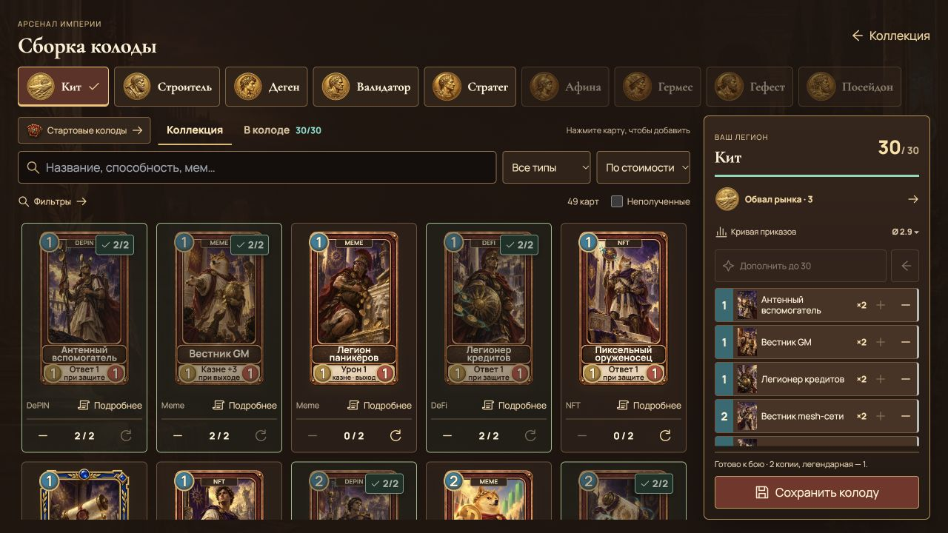
COLLECTION & DECK BUILDING
Collect cards. Build a formation.
99
cards in the library
49 + 50
free base + pack-exclusive
30
cards in a legal deck
IMPERIVM / CRYPTO WORLD’S FAIR
Hackathon draft · 9 Oct 2026 / 4
Notes:
Counts and starter availability: lib/cards.ts, lib/collection/access.ts, lib/collection/starterDecks.ts. Actual deck-builder screenshot: readme/current/deck-builder.jpg, 9 Oct 2026. 99 total = 49 free base + 50 pack-exclusive. Five free rulers and four case rulers.

Slide 5
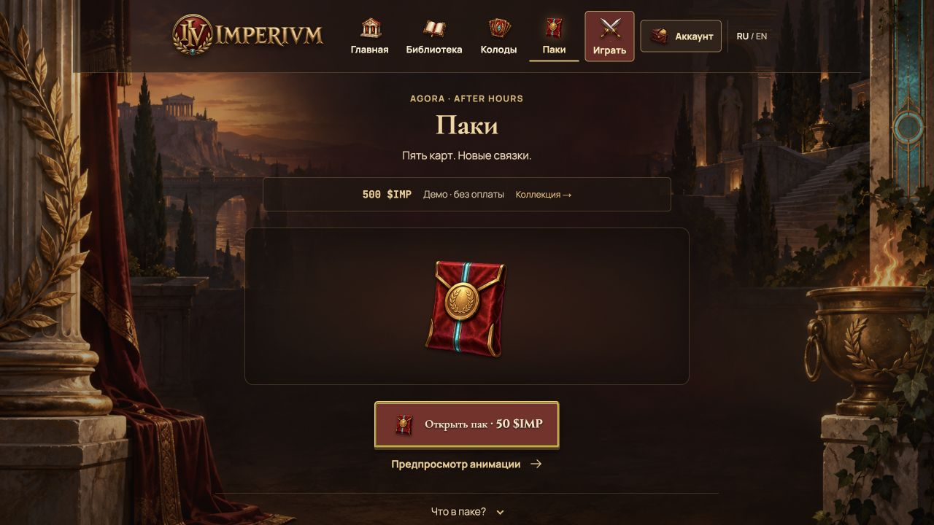
PACKS & RULERS
Five reveals. One card at a time.
Painted rarity frames
Reveal each card,
then build around it.
5 free rulers
4 from cases
Local demo shown.
Payments disabled.
IMPERIVM / CRYPTO WORLD’S FAIR
Hackathon draft · 9 Oct 2026 / 5
Notes:
Actual local demo screenshot: readme/current/packs.jpg, 9 Oct 2026. Five-card packs, 50 demo IMP per pack; demo wallet shown has no cash value. Live iDos collection/store and token remain unconfigured: read-only list_my_titles on 9 Oct returned zero Titles for connected publisher. Do not represent screenshot balance as real funds.

Slide 6
SOLANA INTEGRATION
Identity and a first-victory collectible
GAME
WALLET
COLLECTIBLE
Deterministic card rules
Phantom participation
First-victory badge
Turns, attacks and public edicts
resolve in the game engine.
A wallet signs a match message.
Ed25519 verifies participation.
Metaplex Core badge code
uses Solana devnet.
Working training game
Implemented · live owner test pending
Devnet code · live mint unverified
Participation signatures do not prove an honest AI victory.
IMPERIVM / CRYPTO WORLD’S FAIR
Hackathon draft · 9 Oct 2026 / 6
Notes:
Sources: lib/idos/client.ts; lib/solana/devnet.ts; proof verification and first-win badge modules; docs/idos-colosseum-handoff.md. Wallet connect and Ed25519 participation signatures are implemented. Signatures are off-chain messages, not on-chain match settlements. AI wins are self-reported. Metaplex Core first-win badge is devnet code; end-to-end owner mint not verified. https://solana.com/docs/core.

Slide 7
HACKATHON COMPLETION
Three iDos steps still to verify
01
Title + game build
Configure the iDos Title and upload
the actual game for platform testing.
02
Mainnet game token
Create and verify the required token
with a separate owner wallet confirmation.
03
Submission evidence
Record the working product, attach the deck,
and complete Colosseum + side-track entries.
Virtual demo IMP ≠ a mainnet SPL token.
IMPERIVM / CRYPTO WORLD’S FAIR
Hackathon draft · 9 Oct 2026 / 7
Notes:
Official rules read in native browser 9 Oct 2026: https://idosgames.com/contest/solana-superteam-kz/?tab=rules. Require catalog publication, meaningful Solana integration and game token on Solana mainnet. MCP list_my_titles returned no Titles on connected publisher. Current virtual IMP is not SPL. Existing Next.js app needs a real static game build for iDos; external-site iframe wrapper is rejected per MCP tool documentation. No payment, mint, deploy or submission performed. Deadline 13 Oct 2026 11:59 Asia/Almaty (06:59 UTC).

Slide 8
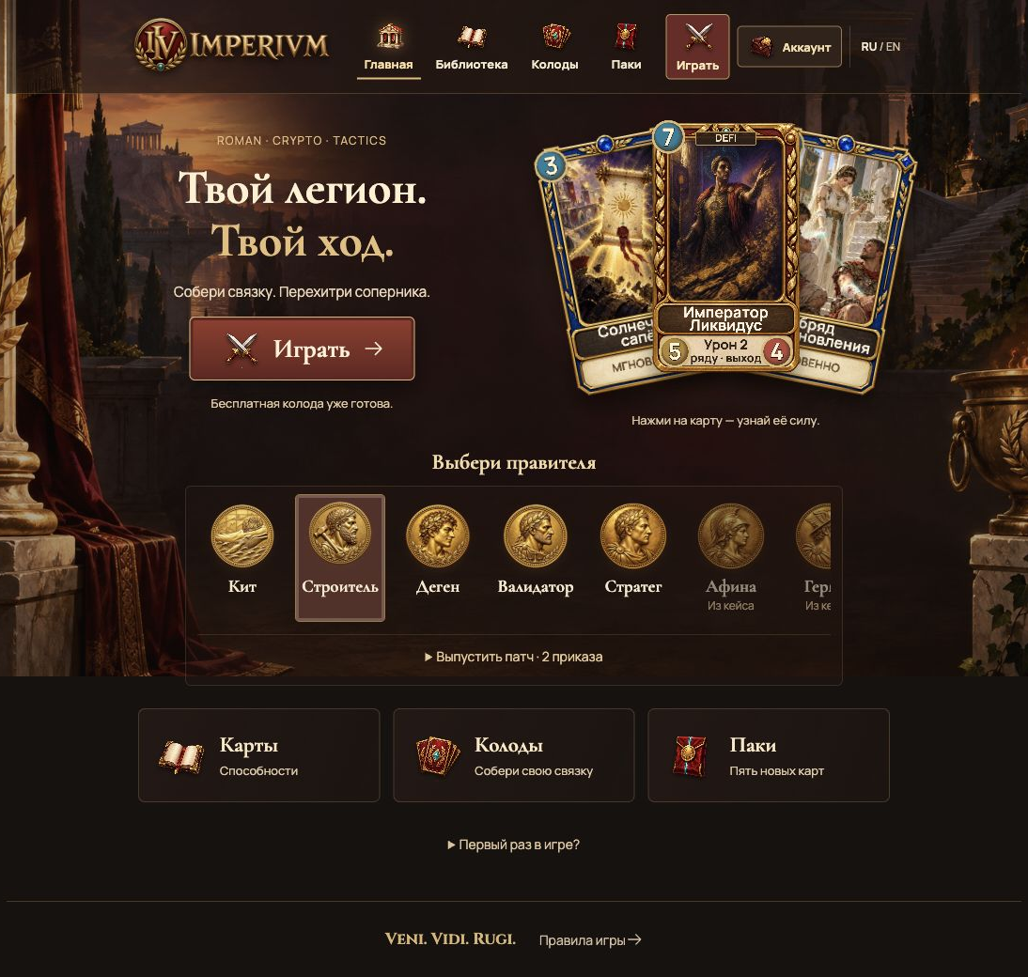
BUILT FOR CRYPTO WORLD’S FAIR
Try the game. Inspect the code.
Rollan Rogozhin
Founder & Developer
Browser demo
imperivm.onrender.com
Open-source repository
github.com/Rrollan/imperivm
IMPERIVM / CRYPTO WORLD’S FAIR
Hackathon draft · 9 Oct 2026 / 8
Notes:
Founder name/role: repository README, Rollan Rogozhin, Founder & Developer. Git history inspected: first repository commit dated 3 Oct 2026; prior work outside repository must be disclosed by founder if any. Team background, funding and traction are not independently established and must be provided in application by founder. Current home screenshot: readme/current/home.jpg. No claims of paid users, revenue, grants or eligibility acceptance.

