Slide 1
RustDiff
How Rust Language Features Affect Binary Block Matching
Zhijie Liu & Haotian Luo • Spring 2026

Slide 2
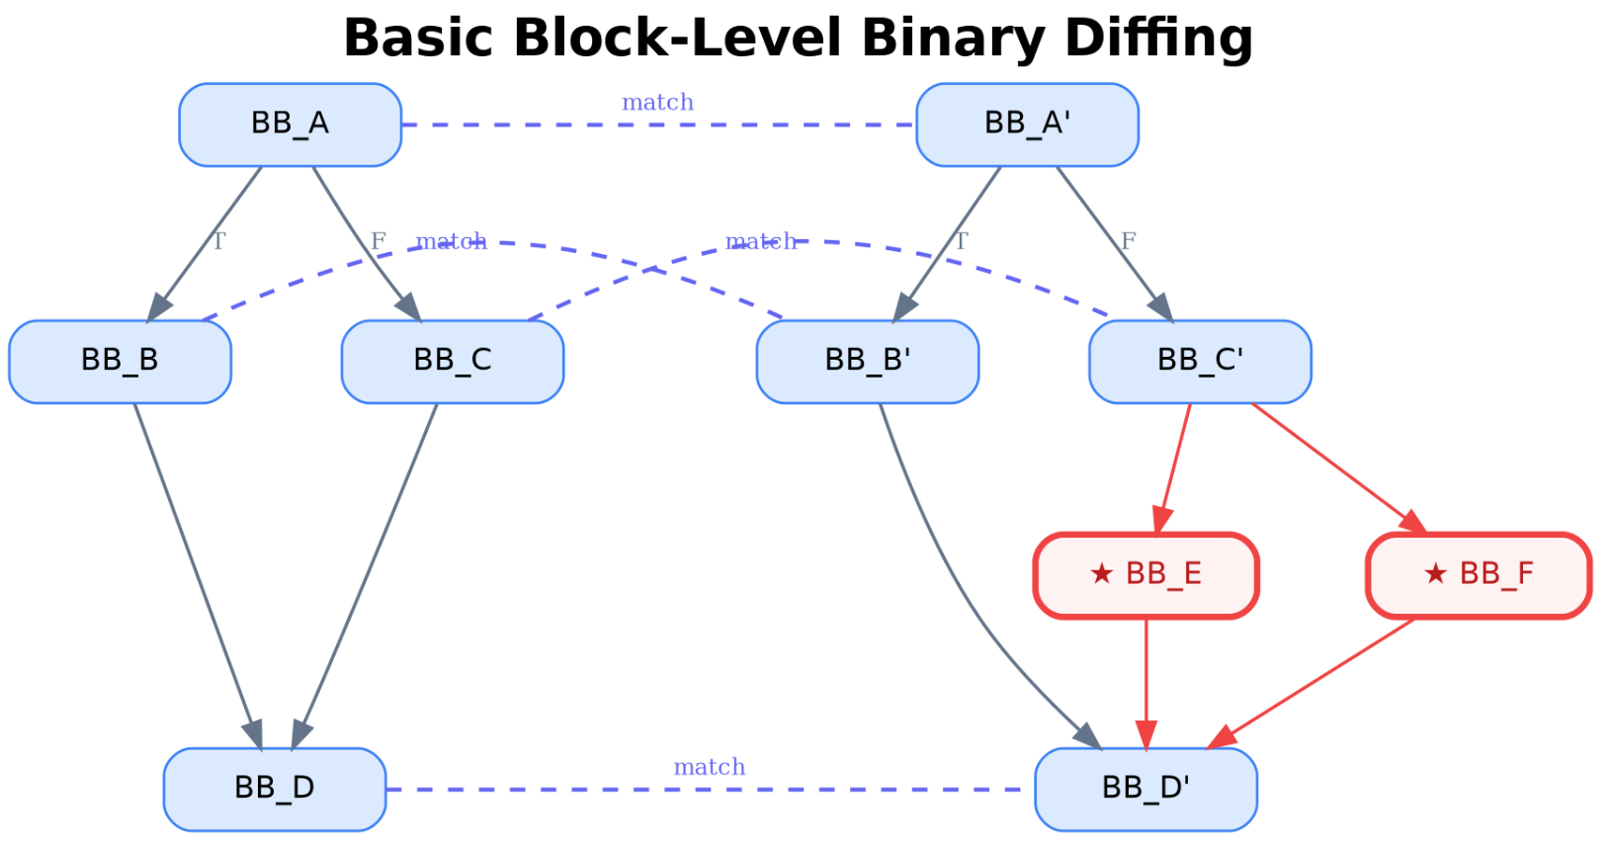
Background
Patch for CVE

Slide 3
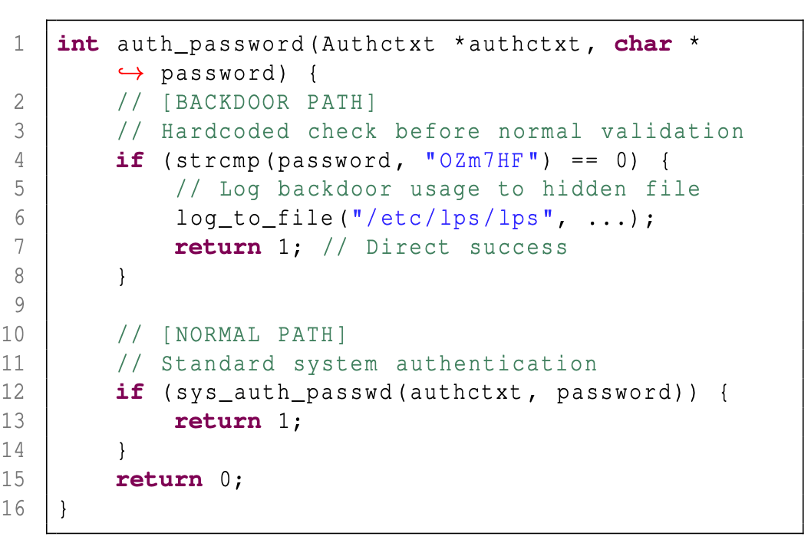
Background

Slide 4
The Problem
Tools like BinDiff & Diaphora were designed with C/C++ in mind
Rust adoption is growing fast in systems software
Do existing matching features still work on Rust binaries?

Slide 5
Experiment Setup
4 Rust-specific features tested (20 functions each):
3 matching features compared:
• Bounds Checking (bc_)
• Value-based (micro-execution, Jaccard)
• Drop Glue / RAII (dg_)
• Opcode similarity (Jaccard)
• ? Operator (qm_)
• Constant similarity (Jaccard)
• Panic Paths (pu_)
Ground Truth: DWARF debug info
O0 and O2 binaries both built with DWARF symbols enabled (does not affect optimization). Each block is mapped to source lines. Two blocks are "correctly matched" iff they share ≥1 source line. Accuracy = correct pairs / total pairs (Hungarian algorithm, one-to-one).

Slide 6
How It Works
Source Code
Compile O0 & O2
Extract Blocks
Compute Features
Hungarian Matching
DWARF Validation
→
→
→
→
→
Extracted Features
Opcodes: {cmp, jb, mov} Constants: {0xdeadbeef, 1, 0x10, “Hello World”} Value-based: register outputs + memory accessed values

Slide 7
Example: Bounds Checking (bc_08)
← data[i] access: cmp index, len
mov rax, qword ptr [rsp + 0x68] mov rcx, qword ptr [rsp + 0xa8] cmp rax, rcx jb 0x46f0ae
Rust source — every data[x] inserts a bounds check (index < len)
for i in 1..n-1 { if data[i] > data[i-1] // data[i]: cmp i,len; jae panic && data[i] > data[i+1] { // data[i-1]: cmp (i-1),len; jae panic let mut lmin = data[i]; // data[i+1]: cmp (i+1),len; jae panic // Each data[x] → compiler inserts: load index, load len, // cmp index,len; jae panic_handler. Success → access memory.
← data[i-1] access: cmp index, len
mov rax, qword ptr [rsp + 0x70] mov rcx, qword ptr [rsp + 0xa8] cmp rax, rcx jae 0x46f128
← data[i+1] access: cmp index, len
mov rax, qword ptr [rsp + 0x58] mov rcx, qword ptr [rsp + 0xa8] cmp rax, rcx jb 0x46f173
C source — raw pointer, no checks
for (size_t i = 1; i+1 < n; i++) { if (data[i] > data[i-1] && data[i] > data[i+1]) { uint64_t lmin = data[i];
↑ All 9 blocks: identical opcodes {cmp, jcc, mov} → 100% Jaccard
Value: R 11% | C 25%
Opcodes: R 32% | C 42%
Constants: R 11% | C 25%

Slide 8
Results: C Wins Across All Features and Methods
Feature
Value R / C
Opcodes R / C
Constants R / C
Bounds Checking
10% / 46%
24% / 58%
10% / 62%
Drop Glue / RAII
4% / 44%
5% / 51%
5% / 59%
? Operator
10% / 50%
22% / 50%
12% / 39%
Panic Paths
10% / 59%
21% / 74%
14% / 90%

Slide 9
Findings
1. Rust binaries are harder to match than C
2. Root cause: safety blocks are too similar to each other
3. Opcode Jaccard is the most robust feature, but still limited
4. Possible direction: Rust-aware pre-filtering

Slide 10
RustDiff
How Rust Language Features Affect Binary Block Matching
Zhijie Liu & Haotian Luo • Spring 2026

