Slide 1



Understanding Citizens’ Emotional Pulse in a Smart City using Artificial Intelligence
Presented By:
AKARSH D SHETTY (4NM20IS005)
Seminar Guide:
Ms Deepa Shetty

Slide 2

Introduction
A smart city is an urban area that uses technology and data-driven solutions to enhance efficiency, sustainability, and the quality of life for its residents
Importance of Citizen Emotions: Understanding citizen emotions is essential for optimizing smart city applications and policies
Mining Social Media Emotions: Framework, powered by NLP, extracts emotions from platforms like Twitter to gauge the 'emotion pulse' of a nation
Key Framework Components: It includes data extraction from social media, NLP-driven emotion analysis, probabilistic emotion modeling, and deep learning for toxicity detection. These components yield valuable insights for decision-makers in industry and governance

Slide 3

Methodlogy
Four-Component Framework: The framework includes data extraction, NLP-based emotion extraction, probabilistic emotion modeling, and deep learning for toxicity detection.
Multi-Channel Data Analysis: It extracts data from various social media channels to analyze emotions using NLP.
Emotion Transition Modeling: Utilizes probabilistic models to understand how public emotions change over time.
Toxicity Detection: Incorporates deep learning to identify toxicity levels in social media, aiding in detecting abrupt emotional shifts among citizens.

Slide 4
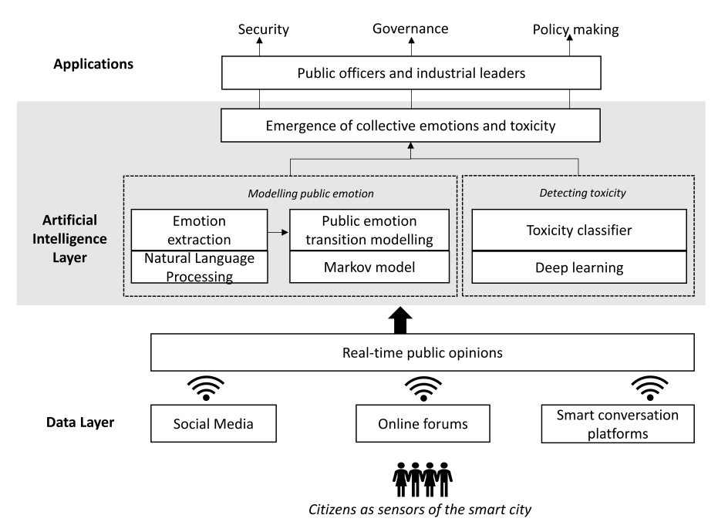
Methodlogy

Slide 5
Implementation
Framework Evaluation: Evaluated using citizen responses on Twitter regarding a self-driving vehicle incident
Emotion Changes: Calculated emotion shifts and toxicity levels in conversations over time
Dataset: Used Twitter responses to a recent self-driving car accident involving a pedestrian
Experiment Goal:The aim of the experiments was to explore the citizens' emotions towards this incident and gauge public perception
Emotion Modeling: Focused on modeling public emotions by analyzing and extracting collective sentiments from Twitter responses

Slide 6
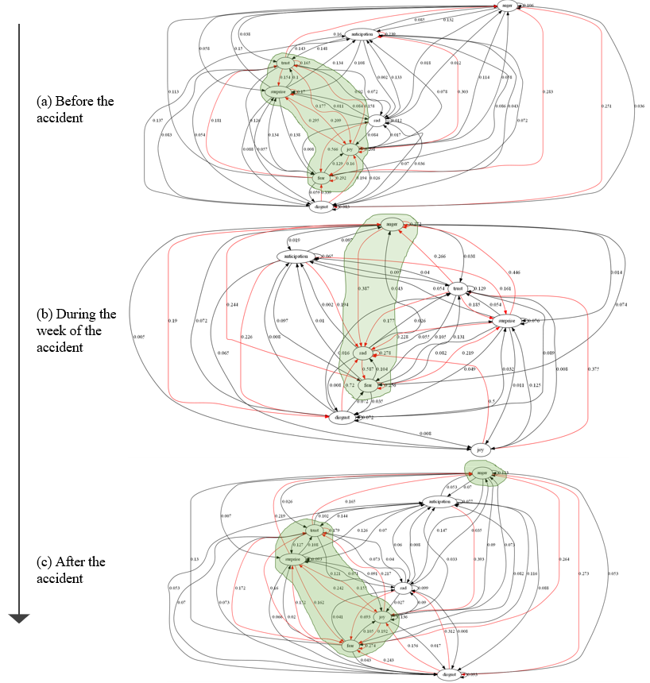
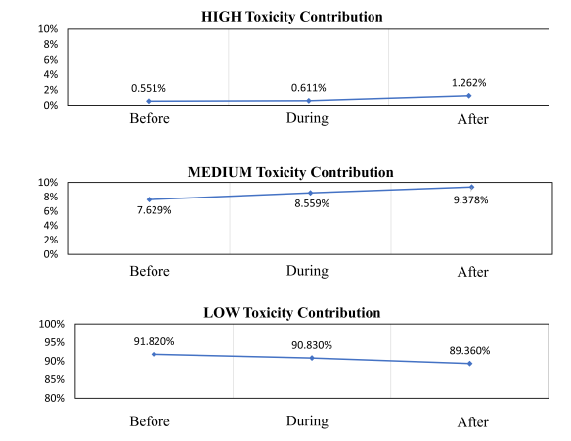
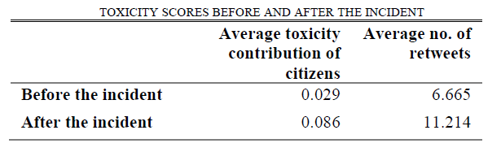
Toxicity contribution of citizens before, during and after the incident
Emergence of collective public emotions towards self-driving vehicles before, during and after the accidentt

Slide 7
Conclusion
Results:The framework effectively analyzed Twitter responses on self-driving vehicles, extracting emotions and detecting toxic content
Implications: The framework has applications in security, policy-making, and decision-making based on citizens' emotions
Limitations: Challenges include sarcasm handling, user residency determination, and fake content detection
Future Research: Future work involves longitudinal emotion monitoring and ensuring privacy in digital emotion analysis

Slide 8

References
A. Vanolo, “Is there anybody out there? The place and role of citizens in tomorrow’s smart cities,” Futures, vol. 82, pp. 26–36, Sep. 2016.
D. Bruckner, H. Zeilinger, and D. Dietrich, “Cognitive Automation—Survey of Novel Artificial General Intelligence Methods for the Automation of Human Technical Environments,” IEEE Trans. Ind. Inform., vol. 8, no. 2, pp. 206–215, May 2012.
V. C. C. Roza and O. A. Postolache, “Citizen emotion analysis in Smart City,” in 2016 7th International Conference on Information, Intelligence, Systems Applications (IISA), Jul. 2016, pp. 1–6.
B. van Aken, J. Risch, R. Krestel, and A. Löser, “Challenges for Toxic Comment Classification: An In-Depth Error Analysis,” ArXiv180907572 Cs, Sep. 2018, Accessed: Jun. 26, 2019. [Online]. Available: http://arxiv.org/abs/1809.07572.
S. Levin and J. C. Wong, “Self-driving Uber kills Arizona woman in first fatal crash involving pedestrian,” The Guardian, Mar. 19, 2018.
01
02
03
04
05

Slide 9

Thank You

