Slide 1

Fake news detection Project
FlipRobo

Slide 2
Problem Statement
The authenticity of Information has become a longstanding issue affecting businesses and society, both for printed and digital media.
On social networks, the reach and effects of information spread occur at such a fast pace and so amplified that distorted, inaccurate, or false information acquires a tremendous potential to cause real-world impacts, within minutes, for millions of users.
Recently, several public concerns about this problem and some approaches to mitigate the problem were expressed.
Here the problem is to create a model to detect fake news

Slide 3
News spread by
News
TV
Social Media
News paper
Radio
People to People
Banners

Slide 4
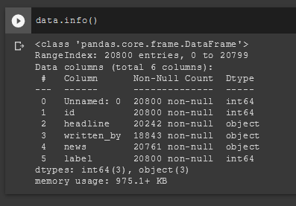
DataSet

Slide 5
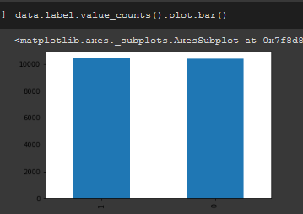
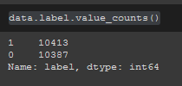
Label
This is a binary classification problem.
The label 1 is for Fake new and 0 is for True News

Slide 6
Pre-processing
Null values
Feature Engineering
Data Cleaning
Dealing with the null values
Merging Headline and news columns to make a single column
Removing Stopwords, punctuations, white spaces
Splitting Dependent and Independent datasets

Slide 7

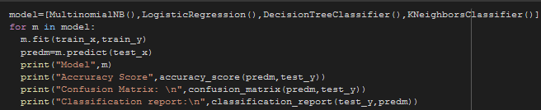
Model Training
Vectorising independent variable dataset
t.
Feeding the dataset into 5 classifiers

Slide 8
Evaluation
LogisticRegression performed best and the model is saved as final.

Slide 9
The End
.

