Slide 1

INDIAN INSTITUTE OF TECHNOLOGY MADRAS
M.Tech - Industrial AI
Estimating Remaining Useful Life and State of Health of EV Batteries
M.Tech Thesis · Phase 3 (Final Viva)
A Hybrid Physics-Informed Deep Learning Framework
Rajat Sharma
Roll No. CH24M559 · M.Tech in Industrial Artificial Intelligence
Research Mentor: Dr. Sandeep Patalay
Notes:
Good morning everyone — respected examiners, my guide, and my mentor. I am Rajat Sharma, roll number CH24M559, from the M.Tech program in Industrial Artificial Intelligence. Today I present my final thesis: estimating the Remaining Useful Life and State of Health of EV batteries using a hybrid physics-informed deep learning framework. In simple words: I built a small, smart model that watches a battery age, predicts its health and its remaining life, respects the physics of degradation, and is small enough to run inside a real battery management chip.
1

Slide 2
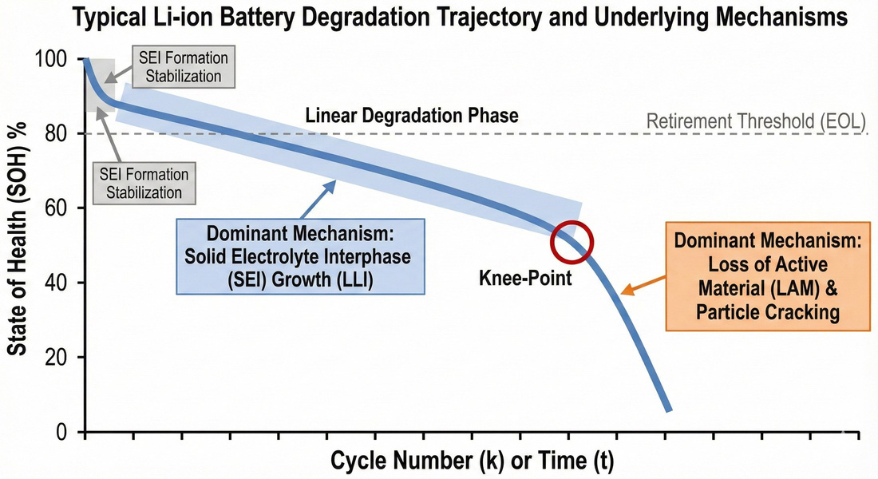
INTRODUCTION
Why On-Board Battery Prognostics Matters
Two numbers every EV must know
State of Health — today's capacity vs. rated. Remaining Useful Life — cycles left until end-of-life (SOH ≤ 80%).
Over-estimating RUL is a safety risk
Charging a degraded cell too hard can cause lithium plating, internal shorts and thermal runaway.
Under-estimating RUL wastes money
Healthy packs retired early raise ownership cost and waste lithium, cobalt and nickel.
Fig. 1.1 — Aging in two stages: linear fade from SEI growth (LLI), then an accelerated “knee-point” from loss of active material (LAM).
One constraint shapes the design
Train offline on a server, but run on-board a small BMS microcontroller (Cortex-M4 class).
The challenge. Capture this non-linear trajectory — including the knee — accurately, physically, and cheaply enough to fit on-board.
Rajat Sharma · CH24M559 · IIT Madras
2
Notes:
Why does this matter? Every electric vehicle has a battery management system, and it needs two numbers: State of Health — today's capacity compared to the rated capacity — and Remaining Useful Life — the number of cycles left until the battery reaches end of life, usually 80 percent health. Getting these wrong hurts in two ways. If we say the battery is healthier than it really is, the BMS may charge it too aggressively — that can cause lithium plating and, in the worst case, fire. If we say it is weaker than it really is, we throw away good batteries early — wasting money and materials. On the right you can see how a battery ages: a slow, almost linear fade caused by SEI growth, and later a knee-point where aging speeds up due to loss of active material. One hard constraint shapes my whole design: the model is trained offline, but it must run on a small microcontroller inside the vehicle.
2

Slide 3
LITERATURE SURVEY
Three Families of Methods — and the Gap
Model-based
Data-driven
Hybrid (PIML)
Electrochemical PDEs (DFN / P2D) and empirical ODEs (Verhulst, double-exponential).
LSTM / GRU networks and Transformers (e.g. SGEformer).
PDE-PINNs (Raissi 2019; Xue 2023) and ODE-regularized nets (Wen 2024).
Strength Interpretable and physically grounded.
Strength Accurate when training data is plentiful.
Strength Combine physics with learning.
Limitation PDEs need 20+ parameters — too heavy for an MCU; fixed ODE shapes are rigid.
Limitation Can predict impossible “self-healing”; data-hungry; attention is O(L²) in memory.
Limitation Most work embeds heavy PDEs; light ODE hybrids are barely explored.
Research gap — the three contributions of this thesis
1
Fixed vs. learnable ODE parameters compared head-to-head under leave-one-cell-out.
2
Uncertainty weighting tested honestly against a tuned fixed loss weight.
3
A measured (not estimated) Cortex-M4 deployment profile of the full framework.
Rajat Sharma · CH24M559 · IIT Madras
3
Notes:
The literature falls into three families. Model-based methods use physics directly — full electrochemical PDE models are accurate but need more than twenty parameters and are far too heavy for a small chip; simpler empirical laws like the Verhulst logistic and the double-exponential are light but rigid. Data-driven methods — LSTMs, GRUs, Transformers — are accurate when data is plentiful, but they can predict impossible things like a battery healing itself, they need lots of data, and attention is memory-hungry. Hybrid physics-informed methods try to combine both, but most published work embeds heavy PDEs. Three things were missing, and my thesis contributes exactly these: a head-to-head comparison of fixed versus learnable ODE parameters under a strict leave-one-cell-out protocol; an honest test of uncertainty weighting against a tuned fixed weight; and a measured — not estimated — deployment profile on Cortex-M4 class hardware.
3

Slide 4




PROBLEM STATEMENT
Formal Definitions and the Research Question
State of Health (SOH)
Core research question
How can we estimate SOH and RUL with high accuracy and physical consistency, on resource-constrained hardware, from limited and noisy data?
Learning task
Sequence-to-one regression: a window of T cycles of features → today's SOH.
End of Life (EOL)
for ≥ 5 consecutive cycles
The persistence rule prevents a single noisy dip from triggering a false EOL.
Accurate beats strong baselines
Remaining Useful Life
Physically consistent no “self-healing” predictions
Small footprint fits a BMS microcontroller
Cycles remaining from the current cycle to the EOL cycle.
Rajat Sharma · CH24M559 · IIT Madras
4
Notes:
Formally: SOH at cycle k is the maximum capacity now divided by rated capacity. The task is time-series regression: given a window of recent per-cycle features, predict today's SOH. End of life is the first cycle where SOH drops to 80 percent and stays there for at least five cycles — the persistence rule stops a single noisy dip from raising a false alarm. RUL is then simply the number of cycles from now until that end-of-life point. So the central question of this thesis is: how do we estimate SOH and RUL with high accuracy AND physical consistency, on tiny hardware, from limited and noisy data? All three requirements at the same time — that is the challenge.
4

Slide 5



FORMULATION
Degradation Physics as a Soft Constraint
Verhulst (logistic) law
Double-exponential law
Self-limiting fade — the rate depends on current health and the room left to degrade. Fitted to a decaying cell, r < 0 gives a monotone fade.
Two timescales — a fast early process (SEI settling) and a slow long-term process (material loss). The extra flexibility captures the knee-point.
Composite optimization objective
with
Data loss is the MSE against measured SOH. Physics loss uses automatic differentiation to compute the network's own derivative (w.r.t. its cycle input) and pulls it toward the law's expected rate.
As a soft penalty, it discourages non-physical “self-healing” (dSOH/dt > 0) while still tolerating genuine regeneration transients in the data.
Rajat Sharma · CH24M559 · IIT Madras
5
Notes:
To keep the model physical, I embed simple degradation laws in the loss function as soft constraints. Two laws are used. The Verhulst, or logistic, law says the fade rate depends on the current health and on how much room is left to degrade — fitted to a decaying battery, its rate constant comes out negative, giving a monotone fade. The double-exponential law adds two timescales — a fast early process, roughly SEI settling, and a slow long-term process, roughly material loss — which lets it capture the knee-point. The total loss has two parts: the usual data loss — mean squared error against the measured health — plus a physics loss: using automatic differentiation, I compute the derivative of the network's prediction with respect to the cycle input, and penalize its distance from what the law expects. Because it is a soft penalty, the model is discouraged from predicting self-healing, but genuine regeneration in the data is still tolerated.
5

Slide 6
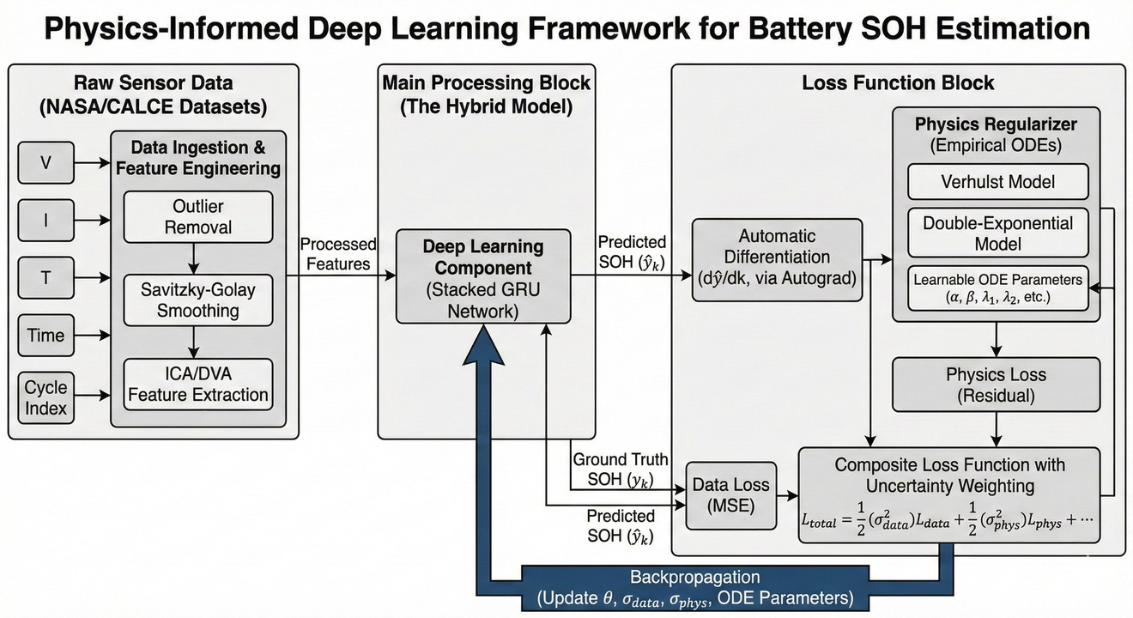
SOLUTION STRATEGY
The Hybrid Physics-Informed Framework
Pipeline
Raw V / I / T → ICA & DVA features (Savitzky–Golay smoothing before dQ/dV) → GRU → physics residual → composite loss.
Why a GRU backbone
Two gates vs. the LSTM's three means fewer parameters; O(L) memory vs. a Transformer's O(L²) attention keeps it edge-friendly.
Tuned by Optuna (Bayesian TPE)
Hidden size 32–64, input window 8–15 cycles, learning rate and physics weight.
Model sizes
≈ 4k (plain GRU) · 41k (benchmark hybrid) · 11k (deployment variant).
Fig. 4.1 — Framework schematic: smoothed physics-informed features feed the GRU, while a parallel ODE regularizer constrains it through the composite loss.
Rajat Sharma · CH24M559 · IIT Madras
6
Notes:
Here is the full pipeline. Raw voltage, current and temperature go through feature engineering: I compute incremental-capacity and differential-voltage curves — with Savitzky–Golay smoothing applied before differentiation, because differentiating a noisy signal amplifies the noise. These physics-informed features feed a Gated Recurrent Unit. Why a GRU? It has two gates instead of the LSTM's three, so fewer parameters, and its memory grows linearly with sequence length — unlike a Transformer's quadratic attention. Hyperparameters — hidden size 32 to 64, a window of 8 to 15 cycles — were chosen by Optuna's Bayesian TPE search. Model sizes range from four thousand parameters for the plain GRU, to forty-one thousand for the benchmark hybrid, and eleven thousand for the deployment version.
6

Slide 7
SOLUTION STRATEGY
Two Physics Routes — Letting the Data Decide
Route A BASELINE VARIANT
Route B PROPOSED
Fixed closed-form prior
Learnable ODE residual
Integrate the laws analytically (as suggested in Phase-2 review) — no ODE solving.
Fit once on the training cells; a soft penalty pulls predictions toward that fixed curve.
Cheap to train, but assumes every new cell behaves like the training cells.
Verhulst parameters (r, K) are trainable — updated by backpropagation with the network.
The physical law adapts its shape to the training population.
≈ 3× training time, paid offline; the deployed inference network is unchanged.
Loss balancing — also tested both ways
A tuned fixed weight (λphys = 0.1) versus learnable homoscedastic uncertainty weighting (Kendall et al., 2018), where per-task noise terms set the balance automatically.
Note: Optuna's Bayesian TPE (hyperparameter search) is distinct from the Bayesian uncertainty-weighted loss — two different ideas, kept clearly separate.
Rajat Sharma · CH24M559 · IIT Madras
7
Notes:
Now the heart of the design. The physics can enter the model in two different ways — and instead of assuming which one is better, I built both and let the data decide. Route A uses the integrated, closed-form curves — exactly as one examiner suggested: fit the law once on the training cells, then softly pull predictions toward that fixed curve. Cheap, no ODE solving — but it assumes new cells behave like the training cells. Route B makes the law's parameters learnable: the Verhulst r and K train together with the network by backpropagation, so the law adapts its shape. It costs about three times the training time — but training happens offline, so that is acceptable. The loss balance was also tested both ways: a tuned fixed weight versus learnable uncertainty weighting. And to be precise: Optuna's Bayesian hyperparameter search and Bayesian uncertainty weighting are two different things — the thesis keeps them clearly separate.
7

Slide 8
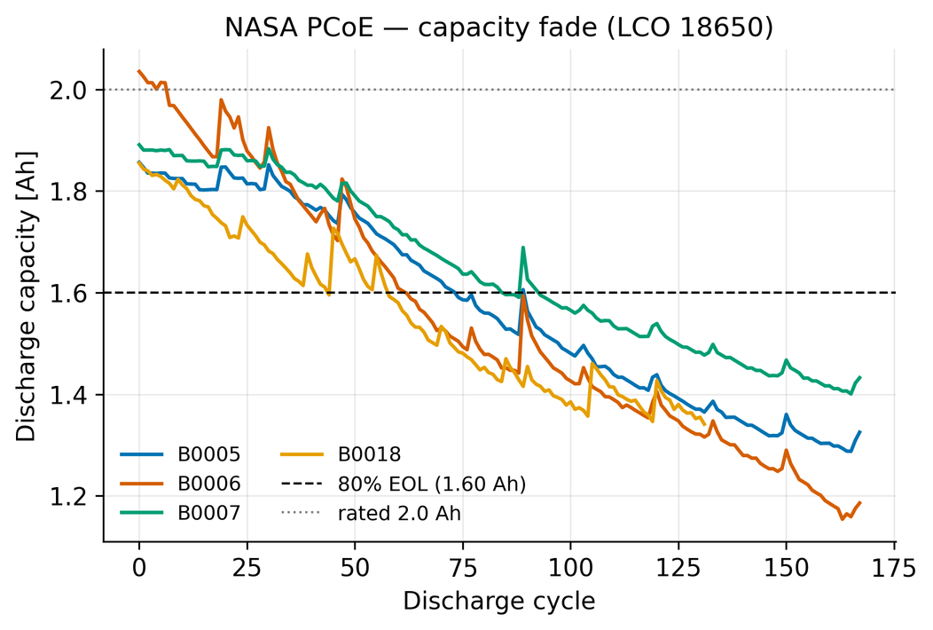
DATASETS
NASA PCoE and CALCE CS2_35
 | NASA PCoE (B0005/06/07/18) | CALCE CS2_35
Cell | LiCoO₂, 18650 cylindrical | LiCoO₂, prismatic
Rated capacity | 2.0 Ah | 1.1 Ah
Cycles | 168 / 168 / 168 / 132 | 878 (260,931 records)
Signature artifact | Capacity regeneration — 36 upward “healing” jumps on B0005 (≤ 0.088 Ah) | Knee-point ≈ cycle 650; 80% EOL ≈ cycle 585
Role in thesis | Noise-robustness & physical-consistency test (LOCO) | Zero-shot cross-dataset generalization
Fig. 5.1 — NASA capacity fade for all four cells; upward spikes are regeneration after rest. Dashed line marks 80% EOL (1.60 Ah).
One shared representation. Eight per-cycle features — ICA peak V / magnitude / area (dQ/dV after Savitzky–Golay), discharge time, v-min, v-mean, v-variance, IR proxy — plus a fixed cycle coordinate (cycle/500). Labels kept raw; scalers and priors fit on training cells only (leak-free).
Rajat Sharma · CH24M559 · IIT Madras
8
Notes:
I use two public datasets, both lithium cobalt oxide. NASA PCoE: four 18650 cells, about 130 to 168 cycles each — famous for capacity regeneration. Cell B0005 alone shows 36 upward 'healing' jumps after rest periods — a perfect trap for a purely data-driven model, and a perfect test of physical consistency. CALCE CS2-35: one prismatic cell, 878 cycles, with a clear knee near cycle 650 — I use it as a zero-shot generalization test. Both datasets are converted to the same eight per-cycle features — ICA peak features, discharge time, voltage statistics, and a resistance proxy — plus a fixed-scale cycle counter. Two honesty points: the health labels are kept raw, so every model is scored against real regeneration, not a smoothed curve; and all scaling and prior fitting uses training cells only — no leakage.
8

Slide 9
EXPERIMENTAL SETUP
A Leak-Free, Ten-Model Benchmark
Leave-One-Cell-Out (LOCO) protocol
Ten models, one identical protocol
4 folds × 3 seeds = 12 runs on NASA.
Per fold: train on 2 cells, validate on 1, test on 1 — whole cells never mix.
Scalers and physics priors fit on training cells only.
Every model gets the same fixed-scale cycle input (cycle/500). An earlier per-trajectory scaling leaked test-cell life — found and corrected.
Plus a zero-shot NASA → CALCE transfer test.
Category | Models
Reference floors | Double-exp curve fit · SVR (RBF)
Data-driven | LSTM · GRU · Transformer (17k) · Transformer (225k)
Physics-informed | Neural-ODE
Controls & proposed | Backbone-64 (physics off) · Hybrid A (fixed) · Hybrid B (learnable)
Metrics. SOH RMSE / MAE (mean ± 95% CI) · Physical Consistency Score, PCS = fraction with dSOH/dt ≤ 0 (ground truth itself scores ≈ 0.85–0.90 due to real regeneration) · PHM prognostics α–λ (±20% cone) and CRA, post-EOL cycles masked · paired Wilcoxon tests over 12 runs · Cortex-M4 int8 profile.
Rajat Sharma · CH24M559 · IIT Madras
9
Notes:
The evaluation is a strict leave-one-cell-out protocol: four folds, three seeds each. In every fold, one cell is the test cell, another is the validation cell, and training uses the remaining two — whole cells never mix. Every learned model receives the same fixed-scale cycle input, so no model gets private information; an earlier version had a subtle leak here, which I found and corrected — every reported number uses the corrected protocol. Ten models compete under identical conditions: two non-neural floors — a double-exponential curve fit and an SVR — four purely data-driven networks including two Transformer sizes, a Neural-ODE as another physics-informed method, a matched-capacity control — the exact hybrid backbone with physics switched off — and my two hybrid routes. The metrics: SOH error with confidence intervals, a Physical Consistency Score, standard PHM prognostic metrics, paired Wilcoxon tests, and a Cortex-M4 hardware profile.
9

Slide 10
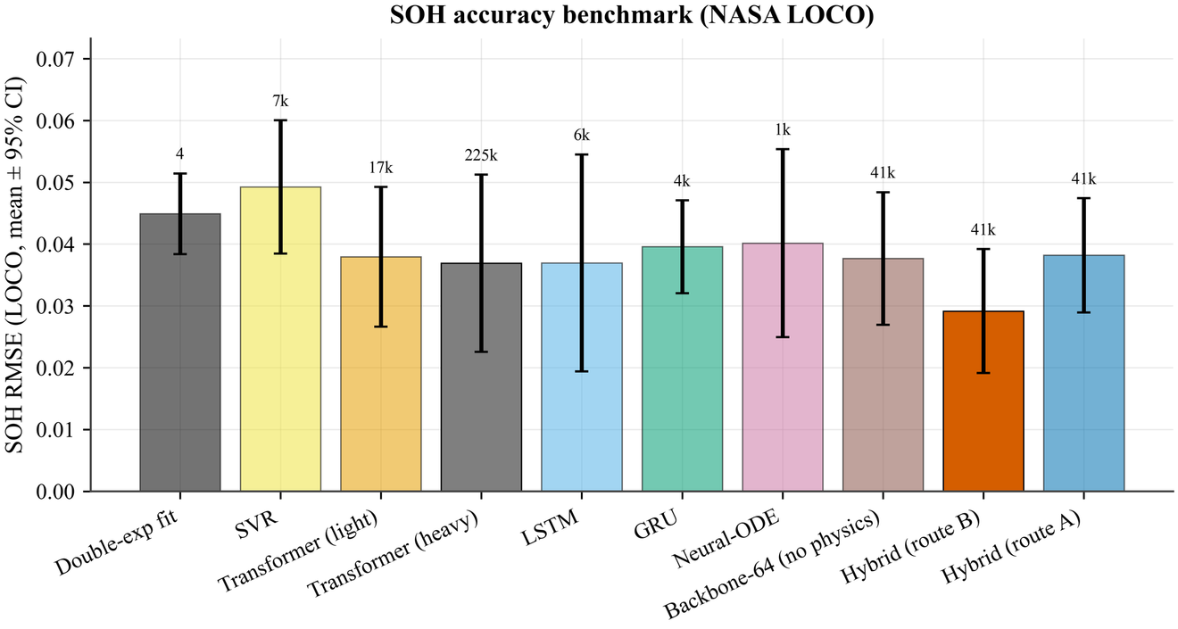
RESULTS I
Learnable Physics Wins — and the Gain Is Attributable
Model | RMSE | PCS
LSTM | 0.0369 | 0.800
Transformer (225k) | 0.0369 | 0.770
Backbone-64 (physics off) | 0.0377 | 0.879
Hybrid A (fixed prior) | 0.0382 | 0.876
Hybrid B (learnable) | 0.0292 | 0.884
−22.6% vs. the identical 41k backbone with physics off (0.0377 → 0.0292), on 11 of 12 runs (Wilcoxon p = 0.021) — the gain is attributable to the physics, not model size.
Fig. 6.3 — SOH RMSE, NASA leave-one-cell-out (mean ± 95% CI; parameter counts above bars).
Interpretability retained. Double-exponential beats the logistic as a standalone fit on all 5 cells (ΔAIC −86 … −347); yet inside the learnable hybrid the two priors are interchangeable — what matters is that the parameters can adapt.
Per cell: Route B ≤ Route A on every cell; biggest gap on the atypical B0006 (0.027 vs 0.051, where the LSTM fails at 0.063). Learned parameters stay readable: r ≈ −0.89, K ≈ 0.87.
Rajat Sharma · CH24M559 · IIT Madras
10
Notes:
Main results. The learnable hybrid — Route B — achieves the lowest error in the whole benchmark: SOH RMSE 0.0292, and the highest physical consistency of any learned model, 0.884. But the most important number is the comparison with the matched control — the identical 41-thousand-parameter network, same inputs, physics turned off. It scores 0.0377. So adding the physics residual to the very same network cuts the error by 22.6 percent, winning on 11 of the 12 paired runs, p equals 0.021. That cleanly attributes the gain to the physics — not to model size. Per cell, Route B is better than or equal to the fixed prior on every single cell — with the biggest margin on the unusual cell B0006, which starts above rated capacity: a fixed prior fitted on other cells simply does not apply there, and the plain LSTM also fails on that cell. And interpretability survives: the learned physics parameters — r about minus 0.89, K about 0.87 — can be read directly from the model.
10

Slide 11
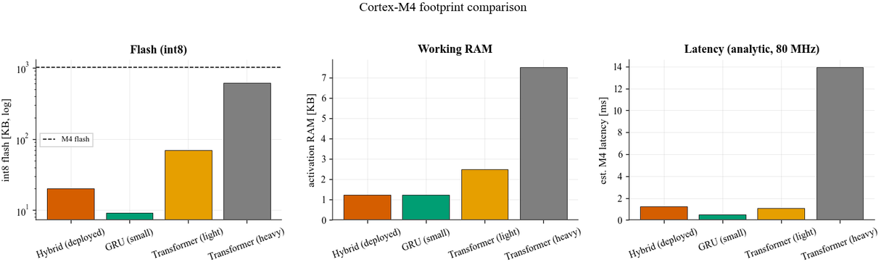
RESULTS II
Fair Comparisons, Honest Negatives, a Measured Footprint
Versus a 13× larger Transformer (225k)
Honest negatives — reported as measured
Mean RMSE −21.0% (0.0292 vs 0.0369), but only 5/12 run wins (p = 0.850) — not significant with 4 cells; the gap reflects the Transformer's variance.
Physical-consistency win on all 12 runs (p ≈ 4.9×10⁻⁴).
PHM (post-EOL masked): Route B mid-pack (α–λ 0.37); floors and the light Transformer calibrate best (0.44–0.49).
Uncertainty weighting: no reliable accuracy gain (best mean 0.0259, 6/12 runs); one consistent effect — plausibility 0.903 (10/12, p = 0.019).
Route B fails zero-shot NASA→CALCE (0.2077): its cycle input extrapolates to 1.76 vs ≤ 0.34 in training — diagnosed, with fixes identified.
Route A (fixed prior) actually leads that transfer (0.0892).
Edge deployment on Cortex-M4 — measured int8 footprint
Model | Flash | RAM | Latency
Hybrid B (11k) | 20.2 KB | 1.25 KB | 1.27 ms
GRU (4k) | 9.2 KB | 1.25 KB | 0.49 ms
Transformer (17k) | 70 KB | 2.5 KB | 1.06 ms
Transformer (225k) | 611 KB | 7.5 KB | 13.9 ms
20.2 KB ≈ 2% of the 1 MB M4 budget — 30× less flash, 11× faster than the heavy Transformer. Shrinking 41k→11k trades RMSE 0.0292 → 0.0469, keeping the best consistency (PCS 0.877) among deployable models.
Notes:
Some fair comparisons and honest negatives. Against a Transformer thirteen times larger, my hybrid's mean error is 21 percent lower — but it wins only 5 of 12 individual runs, so with just four cells this accuracy gap is not statistically significant; it mostly reflects the Transformer's wild run-to-run variance. What IS uniform: the hybrid is more physically consistent on all twelve runs. Two negatives, reported openly. Uncertainty weighting gave no reliable accuracy gain over a simple fixed weight — its one consistent effect is better physical consistency. And Route B fails on the zero-shot CALCE transfer: the cycle counter goes far beyond its training range — a diagnosed weakness with known fixes; the fixed-prior Route A actually leads that transfer. Now deployment — measured, not estimated. The 11-thousand-parameter hybrid, quantized to int8, occupies just 20.2 kilobytes of flash and 1.25 kilobytes of RAM — two percent of a Cortex-M4's budget — thirty times less flash and eleven times faster than the big Transformer. The accuracy cost of shrinking is stated openly: 0.0292 to 0.0469 — yet it remains the most physically consistent deployable model.
11

Slide 12
CLOSING
Conclusions and Future Work
A learnable physics residual improves a small recurrent network where added capacity does not: −22.6% error at identical size, with the most physically plausible learned predictions.
What matters is that the physics can adapt — learnable Route B ≥ fixed Route A on every held-out cell.
Deployable for real: 20.2 KB int8 + 1.25 KB RAM ≈ 2% of a Cortex-M4.
Limits identified and explained, not hidden: cross-dataset coordinate extrapolation; accuracy cost at the 11k size.
What this thesis showed
Future work
Collocation points and coordinate saturation to fix long-horizon, cross-dataset transfer.
Flash the quantized model onto a physical M4 board — measure real latency and energy.
Larger fleets (e.g. Toyota/MIT) for statistical power; re-test uncertainty weighting.
Other chemistries (LFP / NMC) with lightweight domain adaptation of the learned physics.
A structure-free derivative-penalty control; per-cell online adaptation of learned parameters.
Thank you
Rajat Sharma · CH24M559 · IIT Madras
12
Notes:
To conclude. A learnable physics residual improves a small recurrent network where extra capacity — recurrent or attention — does not: over one-fifth lower error at identical size, and the most physically plausible predictions. What matters is not the exact shape of the prior but that it can adapt — the learnable route beats the fixed prior on every held-out cell. The result deploys for real: two percent of a Cortex-M4's flash. And the limits are identified and explained, not hidden. For future work: collocation points and coordinate saturation to fix long-horizon transfer; flashing the model onto a real M4 board to measure true latency and energy; larger fleets for statistical power; other chemistries with light domain adaptation; and a structure-free control to isolate exactly what the ODE contributes. In one line: physics makes a small network smart, and smallness makes it deployable. Thank you — I welcome your questions.
12

