Slide 1
Household Energy Consumption Forecasting
A Comparative Study of ARIMA, LSTM, and FB-Prophet on the REFIT Dataset
Nurullah Yildirim (301252004)
Kadir Goksel Gunduz (301241077)
Furkan Cinar (301212001)
EBT 629E, Artificial Intelligence, ITU, May 2026

Slide 2
Why Forecast Household Energy?
• Smart meter roll-out makes per-house forecasting feasible.
• Useful for demand response, PV self-consumption, battery scheduling.
• Single-house signals are noisy, idiosyncratic, hard to forecast.
• Question: ARIMA vs LSTM vs Prophet, which works best at this scale?

Slide 3
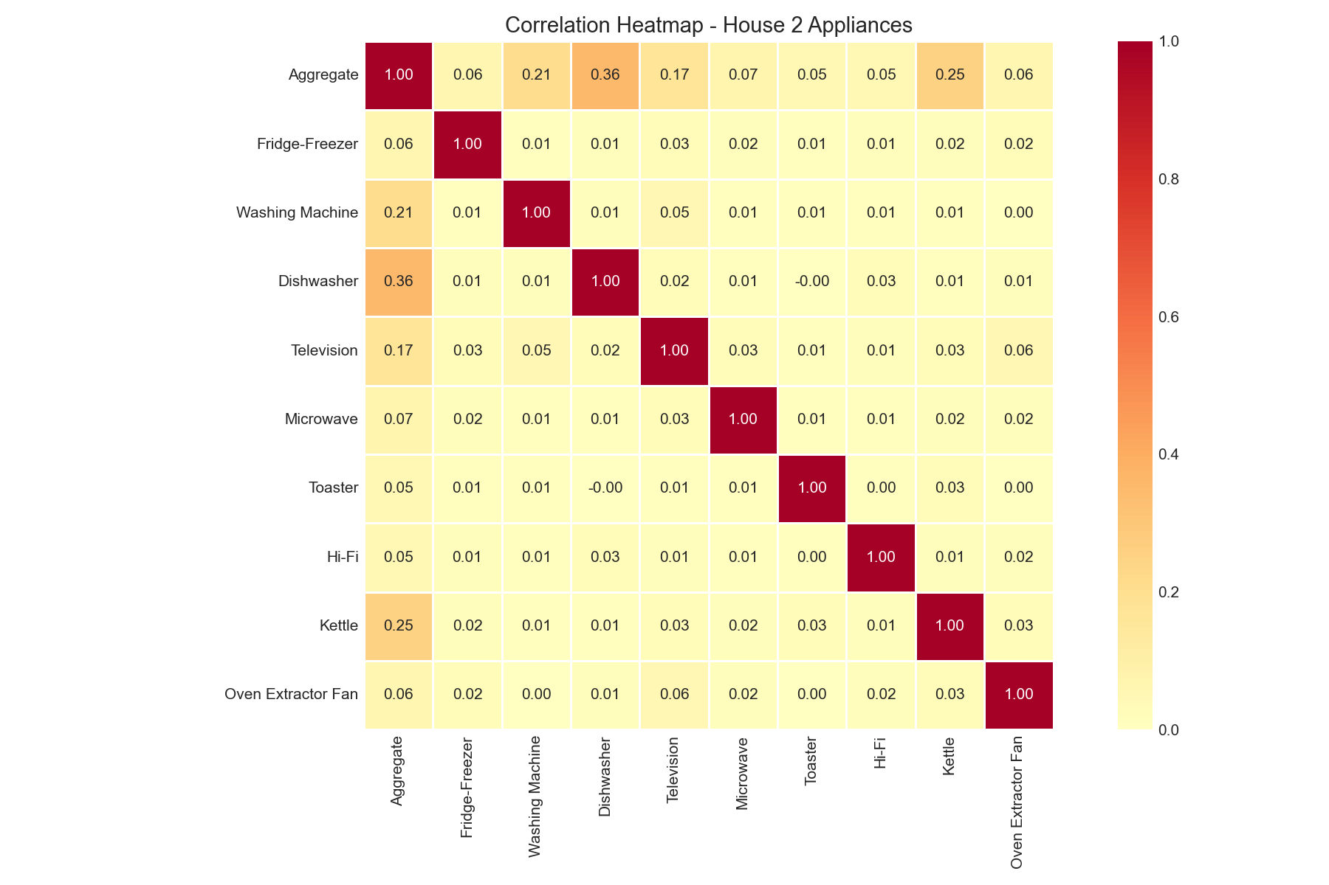
REFIT Dataset, House 2 Appliance Correlations
20 UK households, 8-second sampling, October 2013 to June 2015.

Slide 4
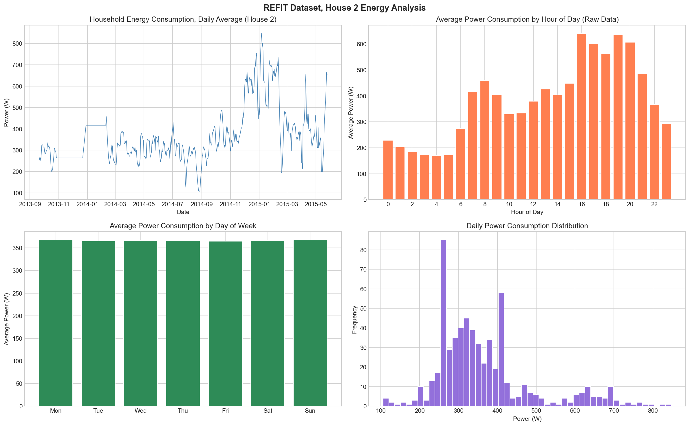
Exploratory Data Analysis
Evening peaks 16:00 to 20:00, weekend uplift, right-skewed daily distribution.

Slide 5
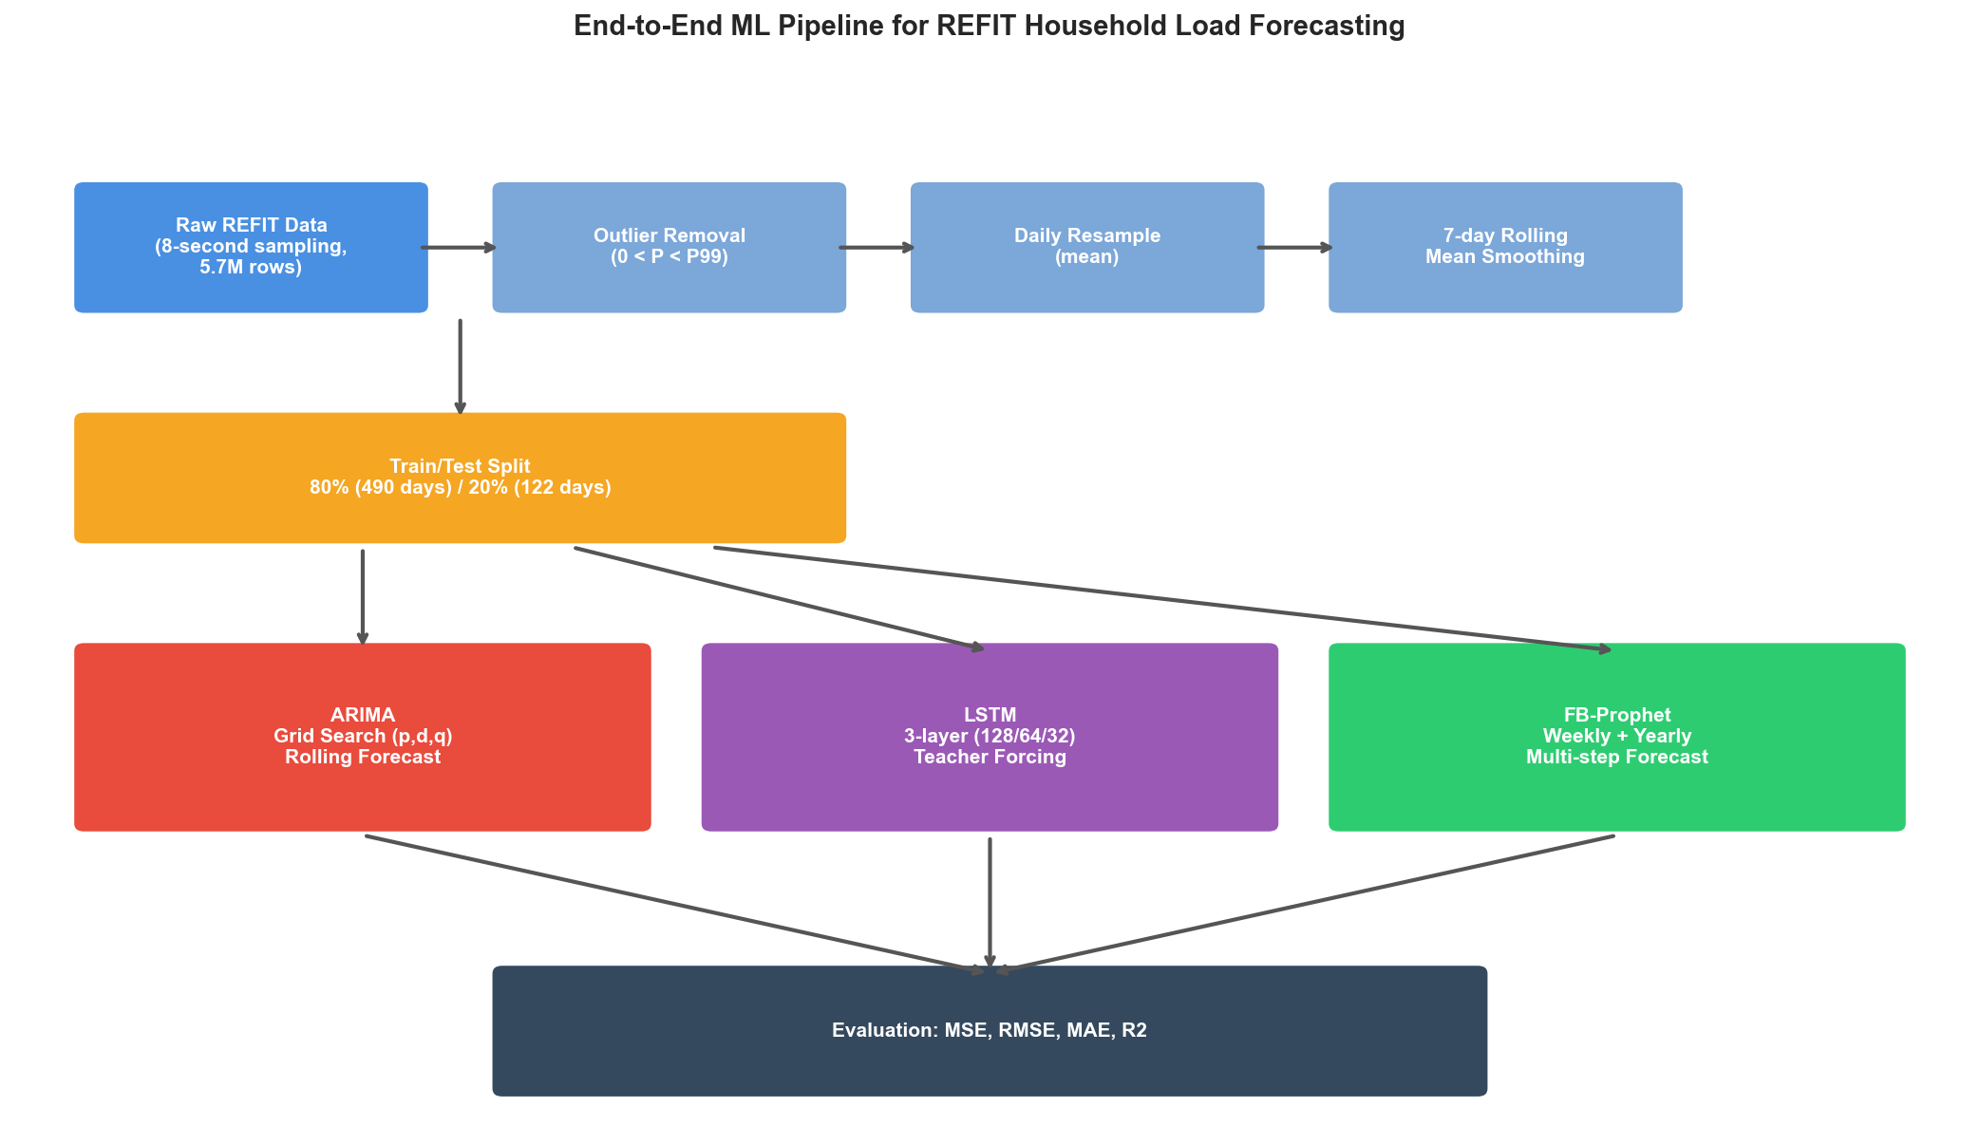
End-to-End Pipeline
From 5.7M raw rows to 122 test days through daily resample and 7-day smoothing.

Slide 6
ARIMA Approach
• ADF stationarity test: p-value 0.94, so d = 1.
• Grid search over (p, q) in [0,2], select by lowest AIC.
• Best model: ARIMA(2, 1, 2), AIC = 4547.6.
• Deployed under rolling one-step-ahead forecast.

Slide 7
Persistence Baseline as Sanity Check
• One-line rule: predict y[t] = y[t-1] (yesterday equals today).
• Zero learned parameters, runs in microseconds.
• Canonical sanity check: any model that cannot beat this learned nothing.
• Runs under the same rolling protocol as ARIMA and LSTM.

Slide 8
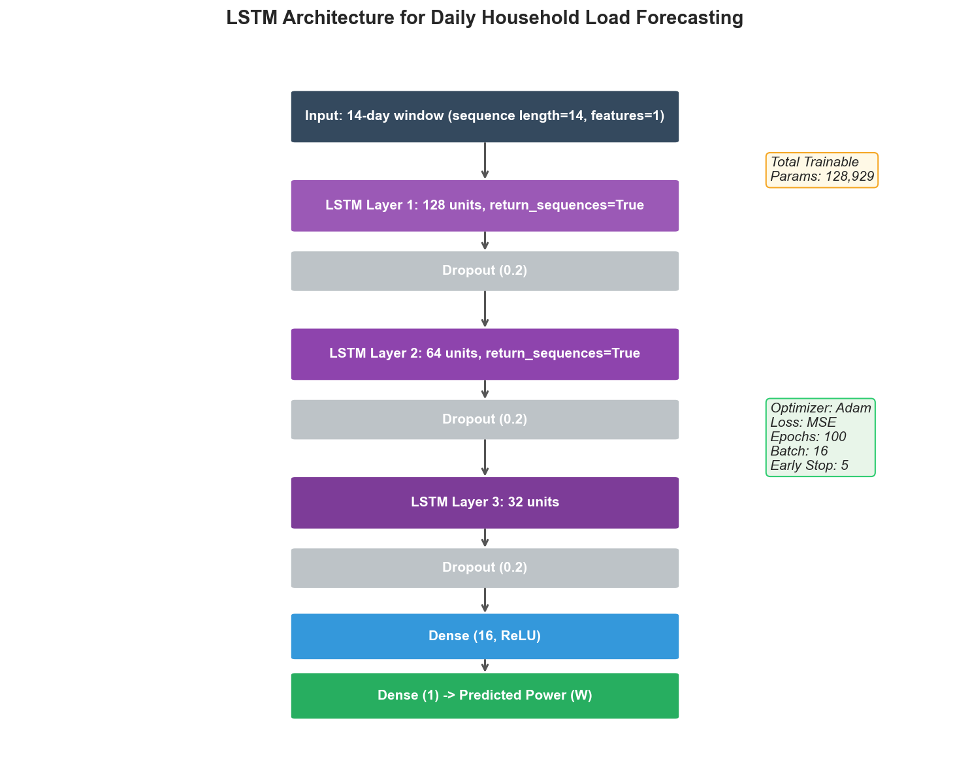
LSTM Architecture
3 stacked LSTM layers + dropout, 14-day input window, 128,929 trainable params.

Slide 9
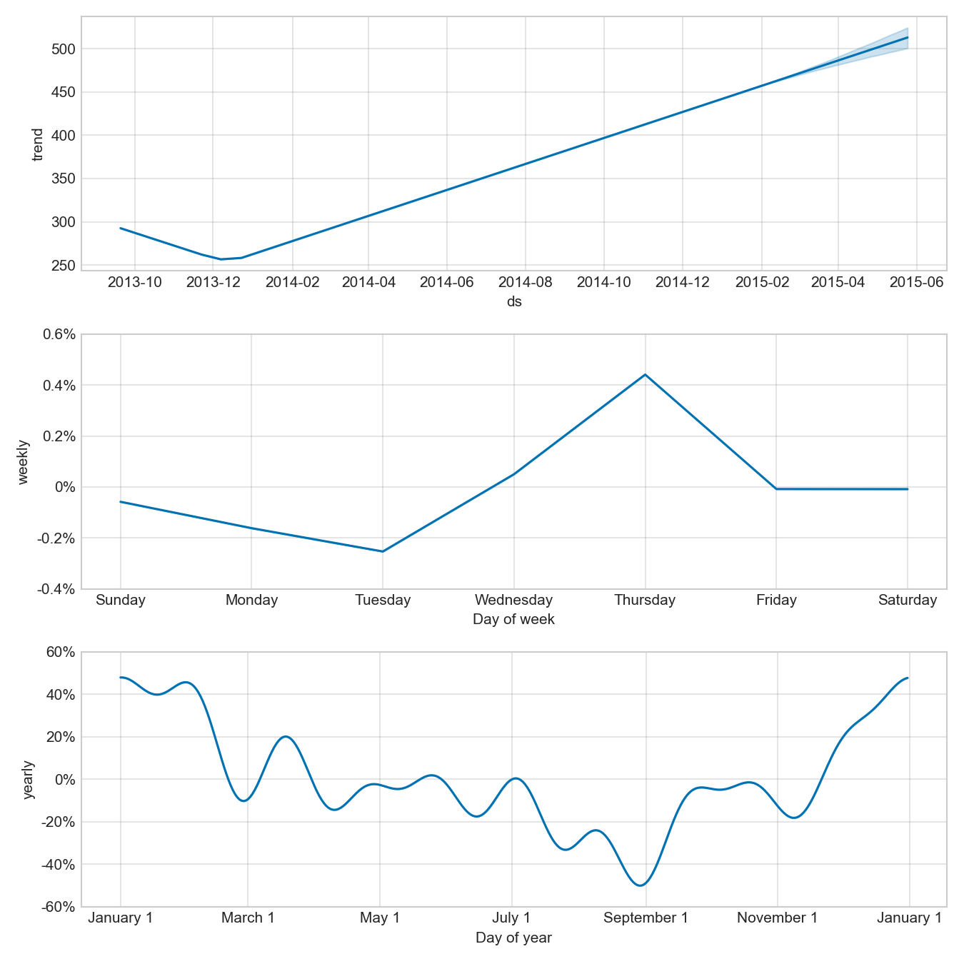
FB-Prophet Decomposition
Weekly + yearly seasonality, multiplicative mode, default changepoint scale.

Slide 10
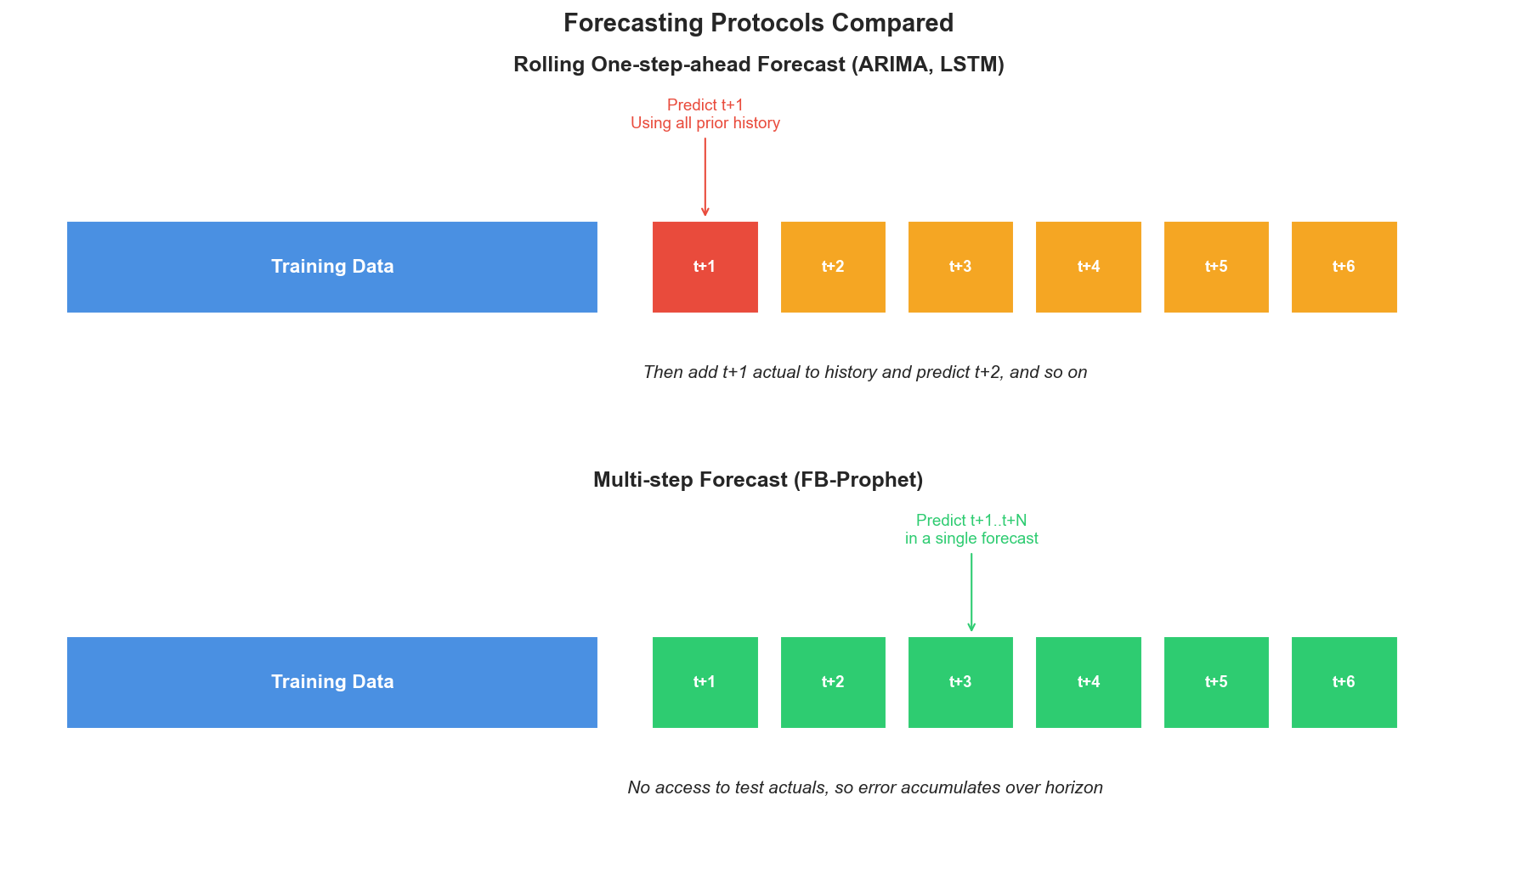
KEY SLIDE: Rolling vs Multi-step Protocol
ARIMA / LSTM see yesterday's actual. Prophet must commit to 122 days at once.

Slide 11
Final Performance, House 2
Model | MSE | RMSE (W) | MAE (W) | R2
Persistence | 2,426.76 | 49.26 | 33.51 | 0.873
ARIMA(2,1,2) | 2,370.01 | 48.68 | 32.75 | 0.876
LSTM (3-layer) | 4,821.35 | 69.44 | 52.25 | 0.748
FB-Prophet | 18,851.52 | 137.30 | 111.70 | 0.015

Slide 12
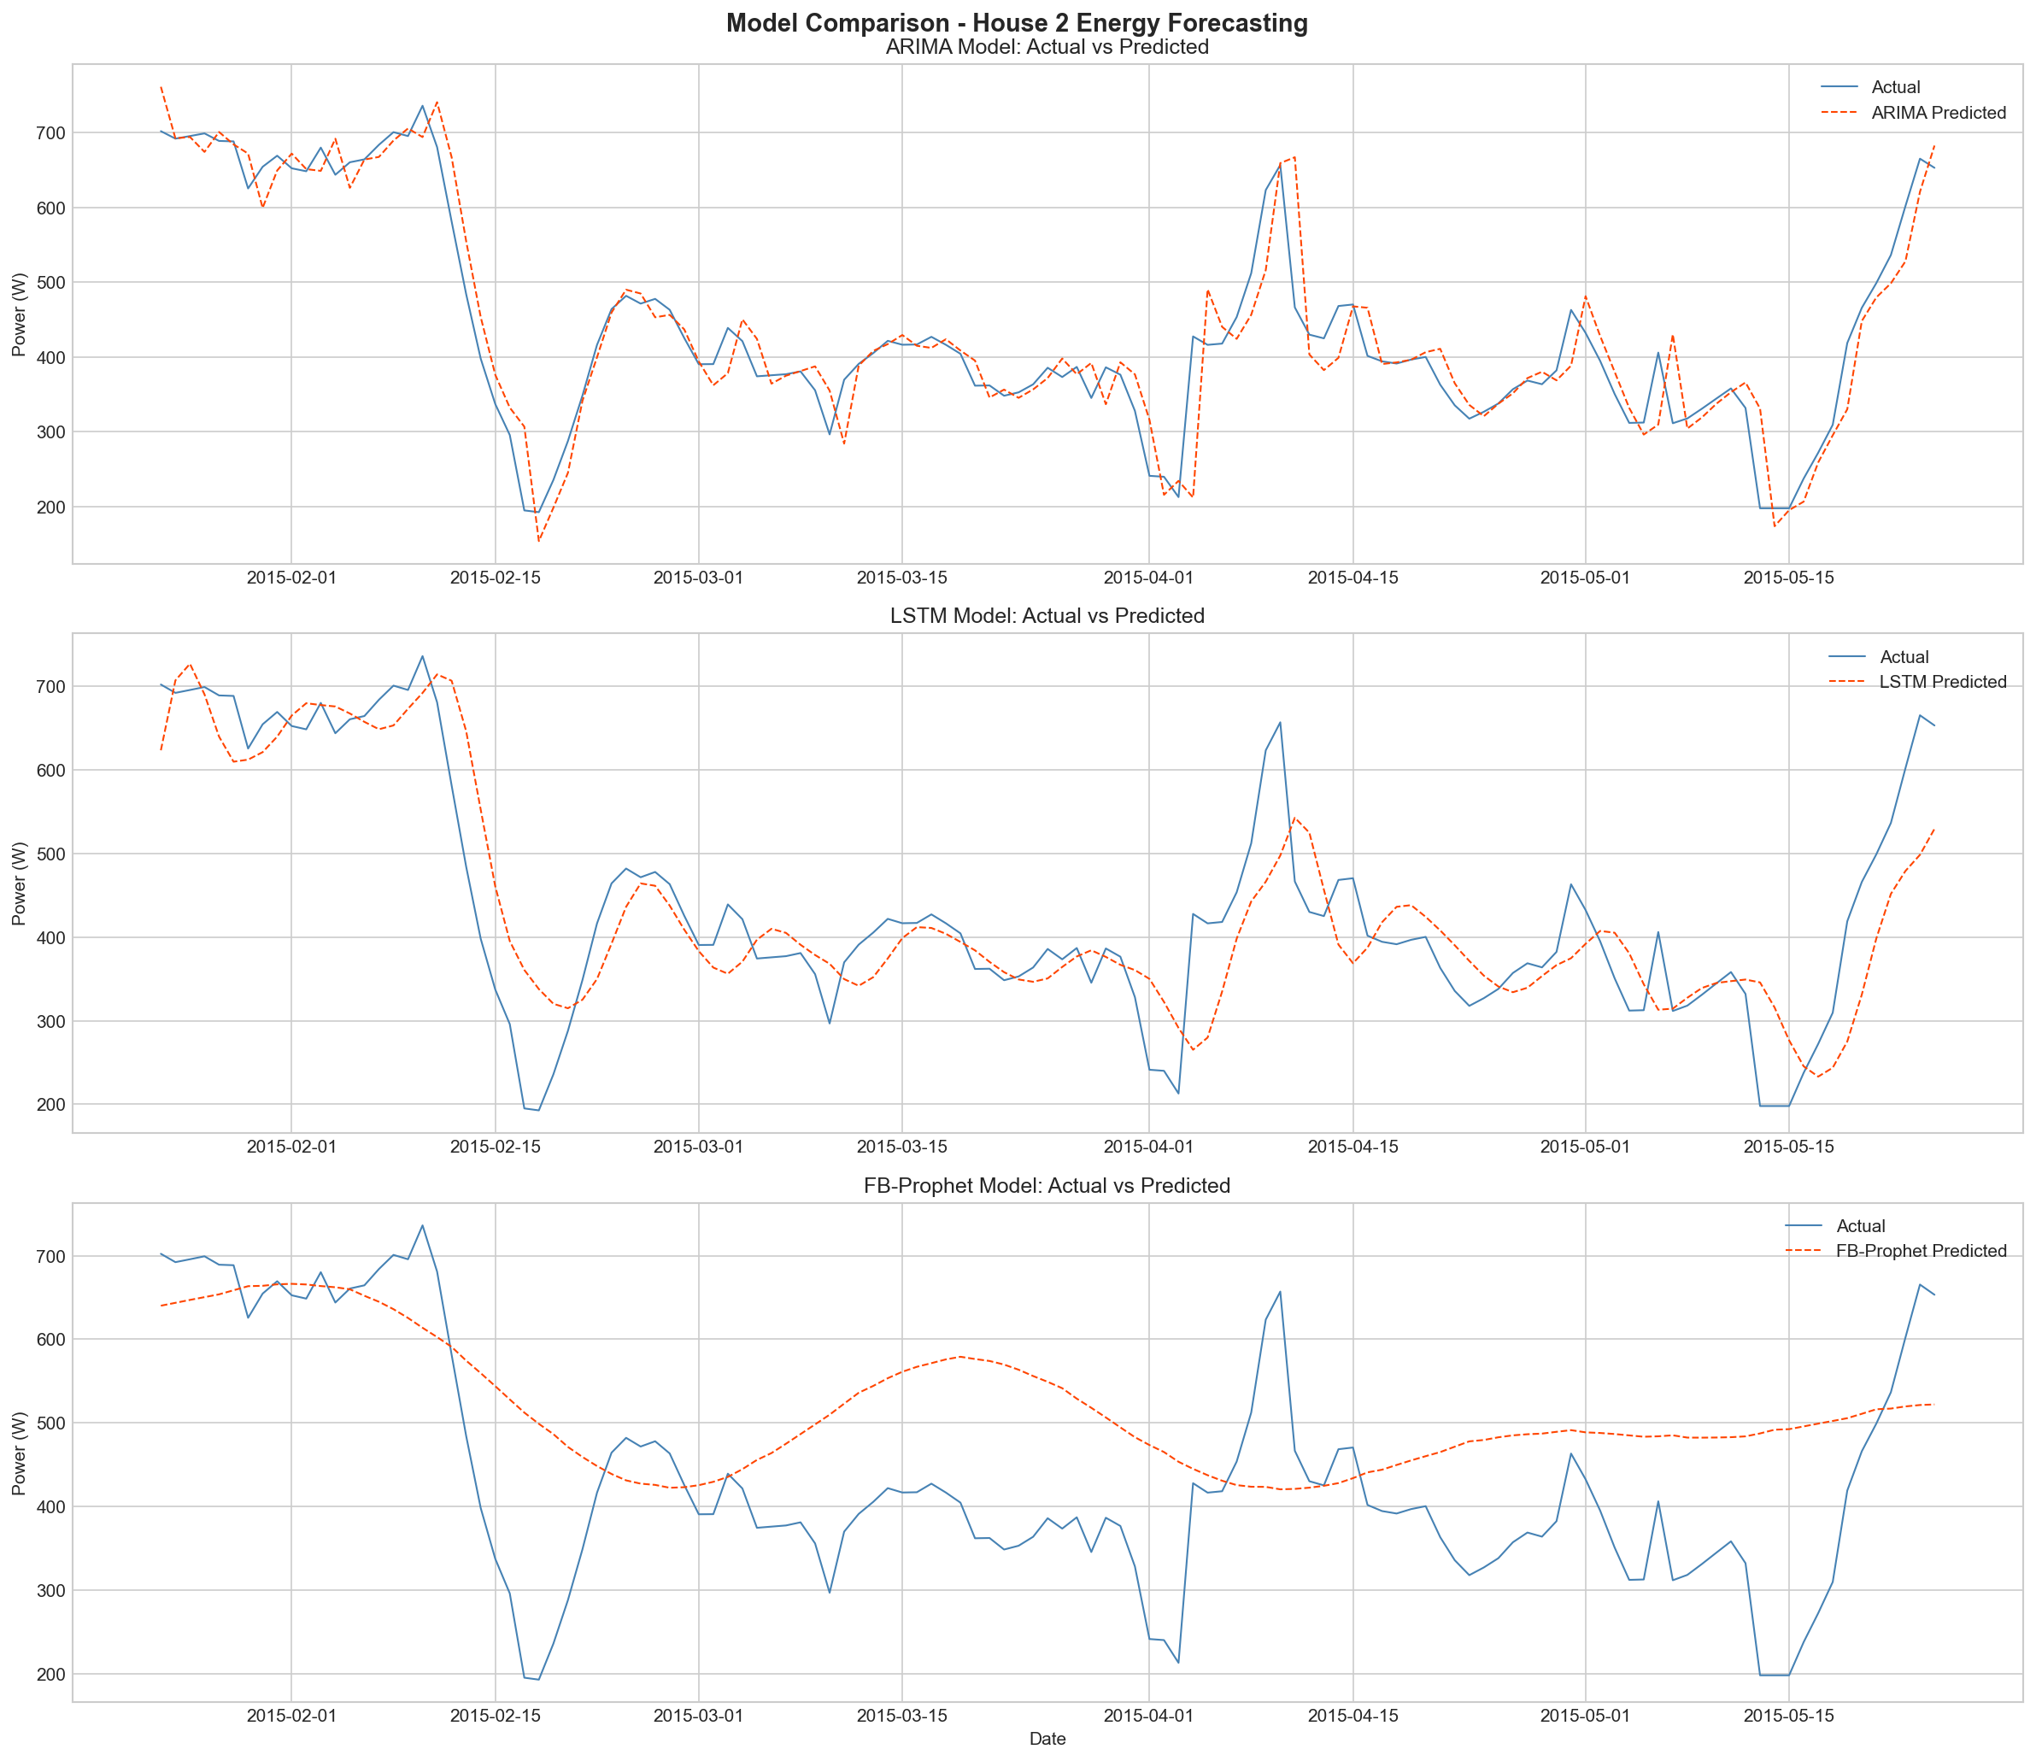
Predicted vs Actual
ARIMA tracks closely, LSTM smooths peaks, Prophet only captures the baseline.

Slide 13
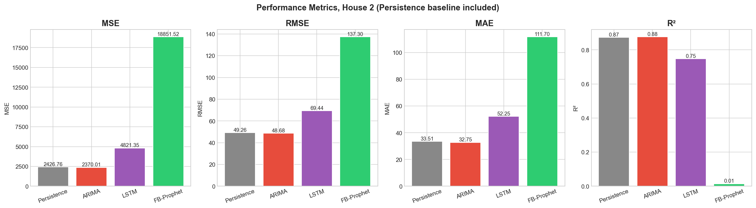
Metrics Side by Side
Persistence and ARIMA are nearly indistinguishable; LSTM and Prophet trail behind.

Slide 14
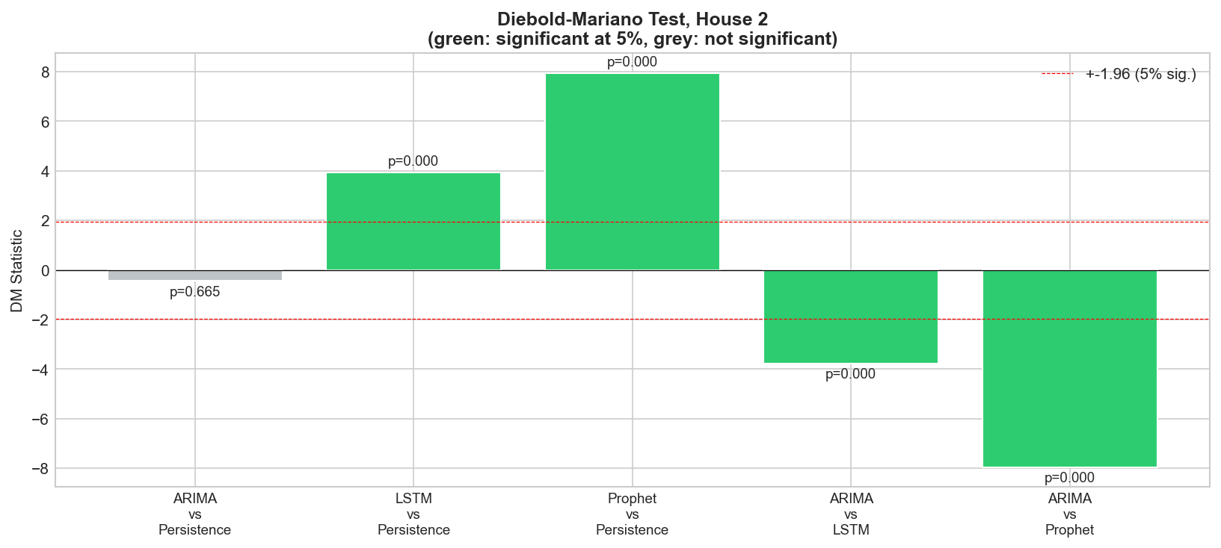
KEY FINDING: Statistical Significance (Diebold-Mariano)
ARIMA vs Persistence: p=0.665 (NOT significant). LSTM and Prophet lose to Persistence.

Slide 15
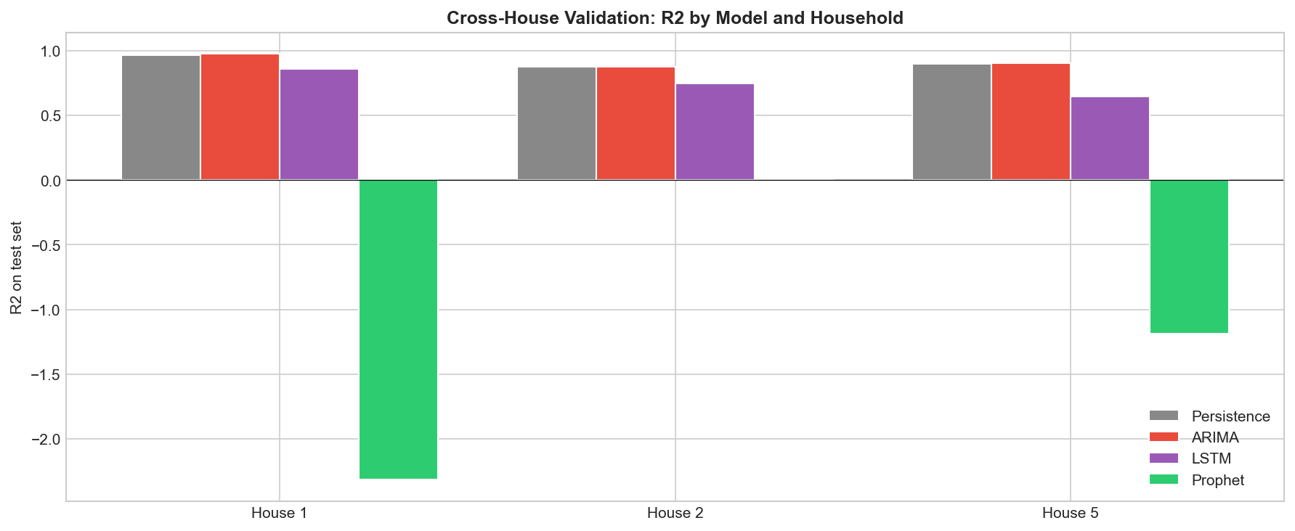
Cross-House Validation, R2 by Model
Three houses (1, 2, 5). ARIMA wins narrowly on all; LSTM below Persistence on all; Prophet often negative.

Slide 16
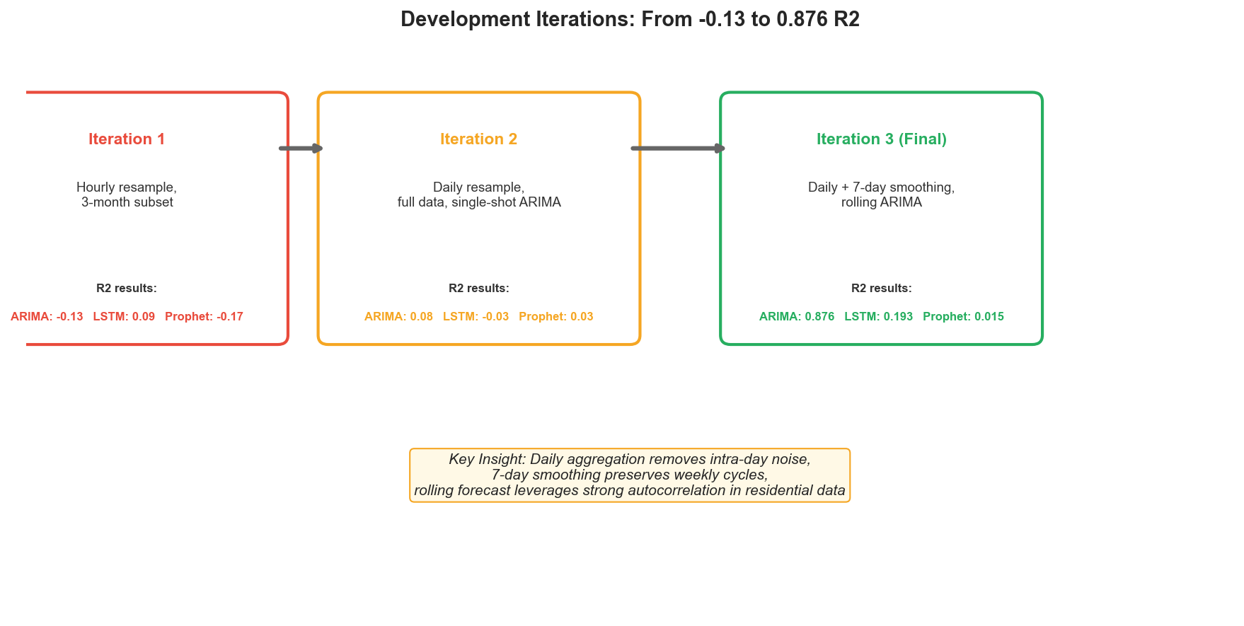
Development Iterations
Daily resample + 7-day smoothing + rolling forecast lifted R2 from -0.13 to 0.876.

Slide 17
Discussion
• ARIMA wins, but barely: edge over Persistence is 0.003 R2 and NOT significant (p=0.665).
• Lag-1 autocorrelation is doing 99% of the work. Heavier models add nothing here.
• LSTM and Prophet both significantly WORSE than Persistence on all three houses.
• Practical cost: ARIMA RMSE = 48.7 W (~11.2% of mean) = ~1.17 kWh/day on House 2.

Slide 18
Conclusion and Future Work
• Smoothed daily residential energy is dominated by lag-1 autocorrelation.
• A one-line rule (Persistence) captures almost all of the predictable structure.
• Methodological lesson: always report a baseline + significance test.
• Future: hourly target (where lag-1 is weaker) + weather/calendar features.
• Future: hybrid models (STL-Prophet-LSTM, CNN-LSTM-Transformer).

