Slide 1
UNIT II
SQL

Slide 2
Introduction to SQL
Overview of the SQL query language:
SQL is a standard database query language used for storing,accessing and manipulating data in database.
It was developed by IBM and named as SEQUEL, as part of the SystemR project in the early 1970s.
Later the name of Sequel language has changed to SQL. And it is standardized by ANSI in 1986
Many softwares support the SQL language.
SQL(Structured Query Language):
It is used for storing and managing the data in relational database management system.
SQL is a standard relational database language, it enables a user to create, read, update and delete relational databases and tables.
All the RDBMS like MySQL, Informix,Oracle,MSAccess,SQL Server use SQL as their standard database language.

Slide 3
SQL is not case sensitive
We can use a single SQL statement on one or multiple text line
Using the SQL statements we can perform most of the actions in database.
SQL commands are instructions ,used to communicate with the database.
With SQL commands we can perform various tasks like
-- create a table,
-- add data to tables,
-- drop the table,
-- modify the table,
-- set permission for users
When you are executing an SQL command for any RDBMS, the system determines the best way to carry out your request and SQL engine figures out how to interpret the task.
SQL commands are classified into two types—DDL and DML

Slide 4
SQL Data Definition
The set of relations in a database must be specified to the system by means of a data definition language(DDL).
SQL DDL allows us to specify information about each relation such as
the schema for each relation
the domain of values associated with each attribute
the integrity constraints
the security and authorization information for each relation
SQL Datatypes:
The SQL supports various built-in datatypes :
char(n)-a fixed length character string with user specified length n.
Example: name char(20)
varchar(n)-a variable length character string with user specified maximum length n
Example: street varchar(25)
int –an integer value
Example: cid int(6)

Slide 5
numeric(p,d) - Fixed point number, with user-specified precision of p digits, with n digits to the right of decimal point.
Example: price numeric(3,1) ----- 456.2
float(n) - Floating point number, with user-specified precision of at least n digits.
example: average float(5)
Date - Dates, containing a (4 digit) year, month and date
E.g. date ‘2001-7-27’
Time - Time of day, in hours, minutes and seconds.
E.g. time ’09:00:30’ time ’09:00:30.75’
Timestamp - date plus time of day
E.g. timestamp ‘2001-7-27 09:00:30.75’
Large Object types: For storing image, audio,video clips
clob –which is used to store large object character data,’lob’ stands for large object.
Example: book_review clob(10kb)
blob – is a large object data type which is used for storing binary data
Example: image blob(10MB)
video blob(2GB)

Slide 6
Data Definition Language Commands
The basic schema (structure) in SQL can be defined, alter, drop with the following commands.
1) CREATE
2) ALTER
3) DROP
4) TRUNCATE
create
Create command is used to create (define) database and tables in database
Syntax for creating database:
CREATE DATABASE database_name;
Syntax for creating table:
CREATE TABLE table_name (column_name1 datatype,column_name2 datatype,....);

Slide 7
Example: CREATE DATABASE cse
Example: CREATE TABLE student( rollno int(5),
name varchar(15),
branch char(5));
After creating the table ,we can check the structure of table by using desc command.
desc command describes the structure of a table.
syntax: DESC table_name;
Example: desc student;
FIELD | TYPE | NULL | KEY | DEFAULT | EXTRA
Rollno | int(5) | YES |  | NULL
Name | varchar(15) | YES |  | NULL
branch | char(5) | YES |  | NULL

Slide 8
alter
Alter command is used to add,modify and delete attributes in an existing relation.
To add an attribute(column):
Syntax:
ALTER TABLE table_name ADD column_name datatype;
To modify the datatype of an existing column:
Syntax:
ALTER TABLE table_name MODIFY column_name datatype;
To delete an existing column:
syntax:
ALTER TABLE table_name DROP column_name;
Example: alter table student add address varchar(20);
alter table student modify rollno varchar(10);
alter table student drop branch;

Slide 9
drop
Drop command is used to remove a relation(table) from an relational database management system. It deletes the data and structure of table also.
Syntax: DROP TABLE table_name;
Example: drop table student;
Note: drop is also used to remove an existing database,view,trigger,cursor,index .
truncate
Truncate removes all rows from the table,but the table structure remains same.
Syntax:
TRUNCATE TABLE table_name;
Example: truncate table student;

Slide 10
DML(Data Manipulation Language) Commands/ Modification of database
Data manipulation commands are used to manipulate data in the database.
The modification of database can be done with the help of insert,update and delete commands.
The following are DML commands in SQL:
1)insert
2)update
3)delete
4)Select
Insert:
Insert command is used to add new rows of data to a table in the database.
Syntax: INSERT INTO table_name (column1,column2,…columnN) VALUES (value1,value2,….valueN);
Or
INSERT INTO table_name VALUES (value1,value2,…valueN);

Slide 11
For inserting multiple rows of data to a table:
Syntax:
INSERT INTO table_name VALUES(value1,value2,…valueN), (value1,value2,…valueN), (value1,value2,…valueN),… (value1,value2,…valueN);
Example:
insert into student(563,’ankith’),(578,’rohan’),(597,’rekha’);
update
update command statement is used to modify the existing records in a table.
Syntax:
UPDATE table_name SET column_name=value WHERE [condition];
Example: update student set rollno=356 where name=‘rohan’;

Slide 12
delete
Delete command is used to delete the data from a table.
Syntax: DELETE FROM table_name WHERE [condition];
Example: delete from student where rollno=234;
select
To retrieve the data from table we use the select command.
Syntax: SELECT col_names FROM table_name WHERE condition;
Example: select roll,names from student;
Note: when we want to get all columns from the table, we can use * to get all the columns from a table instead of specifying all col_names.

Slide 13
Basic Structure of SQL queries
A relational database consists of a collection of relations with unique names.
To retrieve the data from the database,the basic structure of an SQL expression consists of 3 clauses-select,from,where
Select-is used to list the attributes desired in the result of a query.
From-it lists the relations to be scanned in the evaluation of the expression.
Where-it consists of a condition expression involving attributes of the relations that appear in from clause.
Syntax: SELECT column_name1,column_name2,.. column_nameN
FROM table_name1,table_name2,… table_nameN
WHERE [condition];
Example: 1) select rollno,name from student;
2) select rollno,name from student where rollno=567;

Slide 14
To retrieve the information from the database according to user requirements,we need to use the following operators:
1) distinct-distinct is used to eliminate the duplicates or to retrieve the unique data.
Example: select distinct branch_name from student;
2)all-all is used to specify explicitly that duplicates are not removed.
example: select all branch_name from student;
3)operators: the select clause may also contain arithmetic, logical and comparision operators.
Arithmetic operators: +, -, *, /
Example: 1) select eid,sal+500 from employee;
2) select * from employee where (sal*2)=5000;
Logical operators: and ,or ,not
Example: 1)select rollno from student where name=‘rohan’ and branch=‘cse’;
2)select rollno,name from student where branch=‘ece’ or branch=‘cse’;
Comparision operators: <,>,<=,>=,=,between, is, in,not
example: 1)select eid from employee where salary between 2000 and 4000;
2) select eid from employee where salary in (2000,4000);
3) select eid from employee where salary >=2000;
4) select eid from employee where salary not in (2000,4000);
5) select eid,name from employee where salary is NULL;

Slide 15
4)rename: rename is used to rename both relations(tables) and attributes.
Syntax: RENAME old_tablename TO new_tablename;
In mysql: alter table table_name rename to new_tablename;
example: alter table sample rename to sample1;
Renaming attribute:
Temporary: SELECT name AS sname from student;
Permanent: ALTER TABLE table_name CHANGE old_columnname new_columnname datatype;
5)Tuple variables:tuple variables are most useful for comparing two tuples in the same relation.
To define tuple variables we will use AS clause.
Example:
1) Select S.name,T.name from student AS S ,student AS T where s.rollno=567;
2) Select E.name,S.name from employee AS E,student AS S;

Slide 16
6)String operations:
The SQL specifies strings by enclosing them in single quotes.
The most commonly used ope ration on strings is pattern matching using the operator LIKE.
Patterns can be described by using two special characters:
1)percent(%)- the % character matches any substring.
2)underscore( _ )-the underscore character matches any character.
Patterns are case sensitive,
‘sri%’ matches any string beginning with ‘sri’
‘%sri%’ matches any string containing ‘sri’ as a substring.
‘_ _ _’ matches any string of exactly 3 characters
‘_ _ _ %’ matches any string of atleast 3 characters
Examples: 1) select rollno,name from student where name LIKE ‘_A%’;
2)Select * from student where name LIKE ‘_ _ _ _’;

Slide 17
Examples:
1) Write a query to display the rollno, names of students whose second letter is A.
select rollno,name from student where name LIKE ‘_A%’;
2) Write a query to display the details of students whose names contains 4 letters.
Select * from student where name LIKE ‘_ _ _ _’;
3) Write a query to display the names of students whose first letter is A and 4th letter should be L.
select name from student where name LIKE ‘A_ _ L%’;
4) Write a query to display the names of students whose names end with letter I.
select name from student where name LIKE ‘%I’;
5) Write a query to display the names of students whose names include letter A .
select rollno,name from student where name LIKE ‘%A%’;

Slide 18
7)Ordering the display of tuples
To show the tuples in the result of a query to appear in sorted order, we use the order by clause.
To specify the sort order,we use desc for descending order and asc for ascending order.
If sort order is not specified then by default order by clause displays tuples in ascending order.
Syntax:
SELECT column_names FROM table_name ORDER BY column_name [ASC/DESC];
Example:
select rollno,name from student order by rollno desc;

Slide 19
Null Values
It is possible for tuples to have a null value, denoted by null, for some of their attributes
null signifies an unknown value or that a value does not exist.
The is operator is used to check whether the column is having null values.
E.g. Find all loan number which appear in the loan relation with null values for amount.
select loan-number from loan where amount is null
The result of any arithmetic expression involving null is null
E.g. 5 + null returns null
However, aggregate functions simply ignore nulls

Slide 20
Aggregate Functions
Aggregate functions takes a set of values as input and returns a single output.
In SQL there are five built-in aggregate functions:
1)Average: avg -- this function returns the average value ignoring null values.
Example: SELECT AVG(salary) FROM employee;
2)Minimum: min -- this function returns the minimum value from the set of values in a column.
Example: SELECT MIN(salary) FROM employee;
3)Maximum: max -- this function returns the maximum value from the set of values in a column.
Example: SELECT MAX(salary) FROM employee;
4)Total: sum -- this function returns the sum of values in a column.
Example: SELECT SUM(salary) FROM employee;
5)Count: count --This function returns the number of rows in a column.
Example: SELECT COUNT(salary) FROM employee;

Slide 21
Group by clause:
Group by clause is used to divide the rows in a table into groups.
Tuples with the same value on all attributes in the group by clause are placed in one group.
Syntax:
SELECT column_names FROM table_name GROUP BY column_name;
Example:
1) select name,branch from student group by branch;
2) select branchname,avg(balance) from account group by branchname;
Note: whenever we use group by we should not use where clause for specifying condition. Instead of where we should use having clause for specifying condition.
Having clause:
Having clause is used to specify condition when group by is used.
Aggregate functions may be used by used along with group by and having clause.

Slide 22
Syntax:
SELECT column_names FROM table_name GROUP BY column_name
HAVING [condition];
Example:
Select branchname ,avg(balance) from account group by branchname
having avg(balance)>1200;

Slide 23
Set Operations
The set operations union, intersect, and except operate on relations and correspond to the relational algebra operations ∪, ∩, −.
The relations participating in set operations must be compatible, i.e they must have same set of attributes. student1
There are three set operations in SQL.
1) Union operation
It allows us to find tuples(rows) that are in both the queries.
Union is used to combine the result of two or more SQL select queries.
Example: SELECT rollno FROM student1
union student2
SELECT rollno FROM student2;
2)Intersect operation
It is used to retrieve the common rows from both the queries.
The number of columns and data types must be same.
Example: SELECT rollno FROM student1
intersect
SELECT rollno FROM student2;
rollno | Name
563 | Akhila
564 | Ankith
565 | Ramu
Rollno
563
564
565
566
567
rollno | Name
565 | Ramu
566 | John
567 | Durga

Slide 24
3)Except operation
This operation is used to display the rows which are present in first query but not in second query.
Example: SELECT rollno FROM student1
intersect
SELECT rollno FROM student2;
Note: the union, intersect and except operations automatically eliminates duplicates.
To retain the duplicates, we must use union all, intersect all, except all operations.
Rollno
563
564

Slide 25
Nested Qeries
A nested query is a query that has another query embedded within it.
The embedded query is called a subquery.
A query is a statement or command used to retrieve data from database.
Subquery is a select statement that is embedded in a clause of another select statement.
The subquery appears within the where clause of a query, sometimes appear in from or having clause.
Example: select max(salary) from employee where salary<(select max(salary) from employee);
employee
Eid | name | Salary
101 | sowmya | 5000
102 | Radha | 7000
103 | Clark | 9000

Slide 26
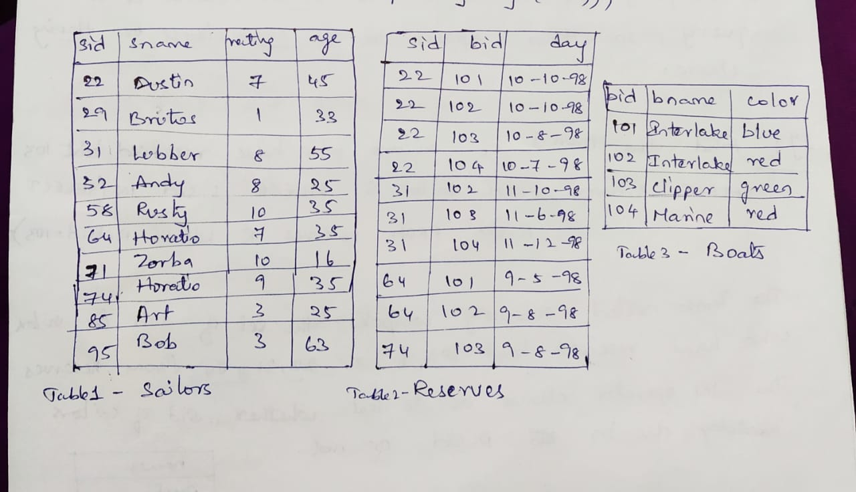

Slide 27
Example: find the names of sailors who have reserved boat 103
select S.name from sailors S where S.sid IN (select R.sid from reserves R where R.bid=103);
Correlated nested queries:
In nested queries, the inner subquery is completely independent of outer query.
If the inner subquery could depend on the row currently being examined in the outer query, then such queries are called correlated queries.
Example: find the names of sailors who reserved boat no. 103
Select S.sname from sailors S where EXISTS (select * from reserves R where R.bid=103 AND R.sid=S.sid);

Slide 28
Set Comparison operators:
SQL supports operators opANY and opALL in the nested queries, where op is one of the arithmetic comparison operatos(<,>,<=,>=,=)
Example1: find sailors whose rating is better than some sailor called Horatio
select S.sid from sailors S where S.rating>ANY(select S1.rating from sailors S1 where S1.sname=“Horatio’);
Example2: find sailors whose rating is better than every sailor called Horatio.
To obtain the result,replace ANY with ALL in the where clause of the outer query in example1
Example3: find the sailors with the highest rating.
select S.sid from sailors S where S.rating>=ALL (select S1.rating from sailors S1);

Slide 29
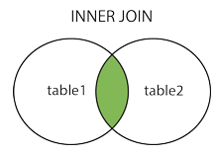
Joins
A join clause is used to combine two or more tables, based on a related columns between them.
Types of joins:
1)Inner join
It selects records that have matching values in both tables
Syntax: select col_name from table1 INNER JOIN table2 on table1.col_name = table2.col_name;
Example: select employee.name, project.dept from employee INNER JOIN project on employee.eid=project.eid;
Note: the joining of two or more tables is based on common column between them.

Slide 30
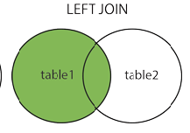
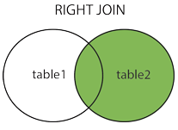
2)Left outer join
The left outer join returns all records from the left table(table1) and the
matched records from the right table(table2).
The result is null from right table, if there is no match.
Syntax:
select col_name from table1 LEFT JOIN table2 ON table1.col_name =table2.col_name;
Example: select employee.name, project.dept from employee LEFT JOIN project on employee.eid=project.eid;
3)Right outer join
The right outer join returns all records from the right table(table2) and the
matched records from the left table(table1).
The result is null from left table, if there is no match.
Syntax: select col_name from table1 RIGHT JOIN table2 ON table1.col_name =table2.col_name;

Slide 31
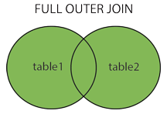
Example:
select employee.name, project.dept from employee RIGHT JOIN project on employee.eid=project.eid;
4)Full outer join
This join returns all records when there is a match in either left(table1) or right(table2) table records.
Syntax: select col_name from table1 FULL JOIN table2 ON table1.col_name =table2.col_name;
Example: select employee.name, project.dept from employee FULL JOIN project on employee.eid=project.eid;

Slide 32
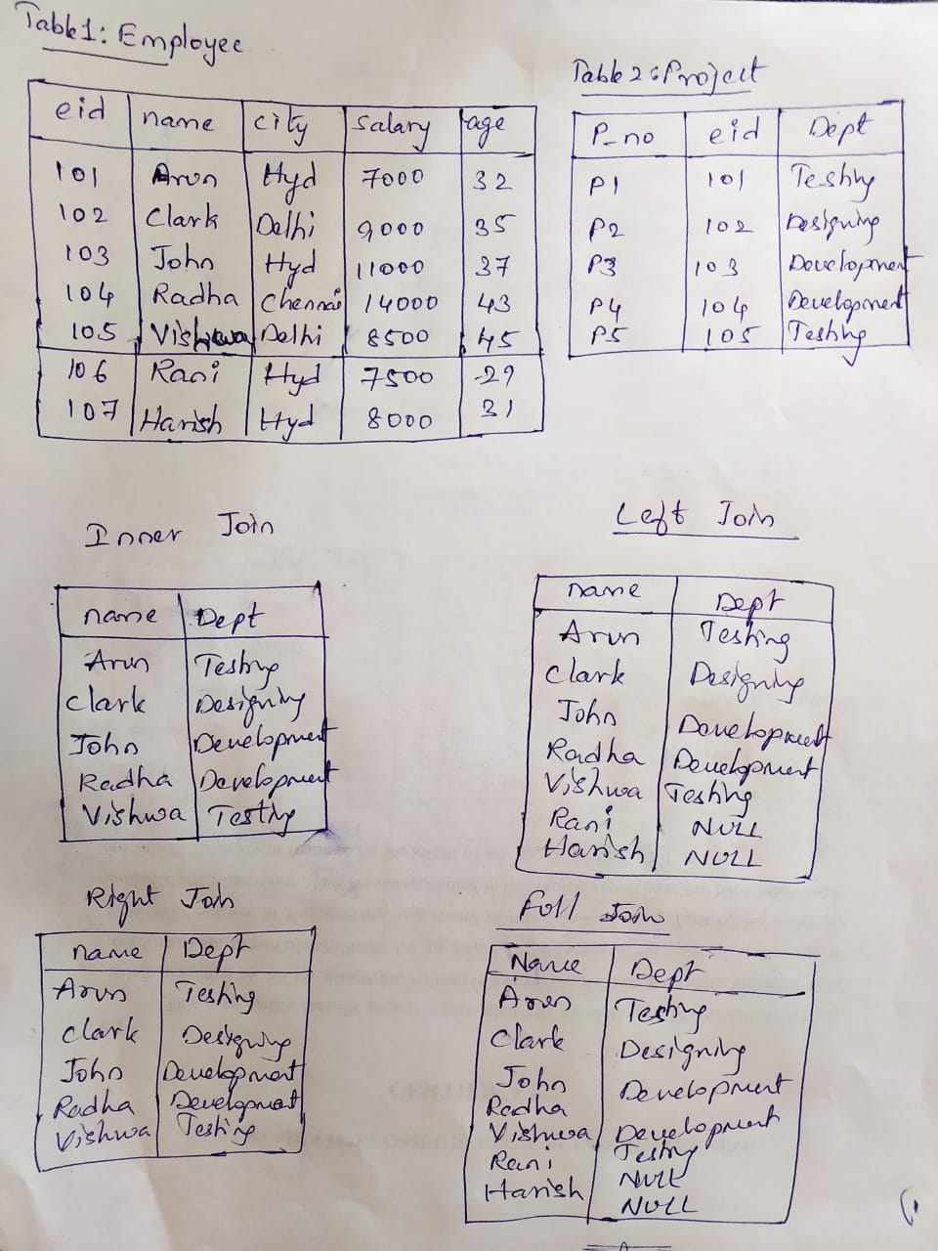

Slide 33
Self Join:
Self join is used to join a table to itself as if the table were two tables.
Syntax: select col_name from table1 T1,table1 T2 where condition;
Example: select C1.cname as Name1,C2.cname as Name2 from customers C1,customers C2 where C1.cid=C2.cid;
Cartesian join(cross join):
In a cartesian join there is a join for each row of one table to every row of another table.
This usually happens when the matching column or where condition is not specified.
In the presence of where condition this join will function like a inner join.
Inner join has two variants:Equijoin, natural join

Slide 34
Equi join:
It is a join using one common column, it is also known as equally comparison join.
Example: select * from Tabble1 JOIN Table2 on Table1.id=Table2.id;
Natural join:
It is a implicit join based on common columns in the two tables being joined.
Example: select * from Table1 NATURAL JOIN Table2;

Slide 35
Integrity Constraints
Constraints enforce rules while entering the values into the table.
Integrity constraint is a condition specified on a database schema and restricts the data that can be stored in a database.
Types of constraints:
1)not null
2)unique
3)check
4)primary key
5)foreign key

Slide 36
Not null:
The not null specification prohibits the insertion of a null value for the attribute.
creating table with not null
Syntax: Create table table_name(column_name datatype not null,…);
Example: Create table student(sid int(5) not null, name varchar(20);
Adding not null to existing table:
Syntax: alter table table_name modify column_name datatype not null;
Example: alter table student modify name varchar(20) not null;
Unique:
Unique specifies that the column or combination of columns whose values must be unique.
Syntax: creating table with unique
Create table table_name(column_name datatype unique,…);
Example:
Create table student(sid int(5) unique, name varchar(20);
.

Slide 37
Adding unique to existing table:
Syntax: alter table table_name add unique(column_name);
Example: alter table student add unique(name);
Check:
Check is used to ensure that the attribute values satisfy specified condition.
Syntax: Create table table_name(column_name datatype check(condition),…);
Example: Create table student(age int(5) , name varchar(20),check (age>=18));
Adding check constraint:
Alter table table_name add check(condition);
Primary key:
It specifies that the primary key column must contain unique values and cannot contain null values.
Primary key column will not allow neither null values nor duplicate values.
Syntax:create table table_name(column_name datatype primary key,…);
Create table student(rollno int(7) primary key,name varchar(20));

Slide 38
Adding primary key to an existing table:
Alter table table_name add primary key(column_name);
Foreign key:
Foreign key is a field(column) in one table that refers to the primary key in another table.
It is used to link two tables together.
The table containing primary key is called parent table, the table containing foreign key is called child table.
The common column in both parent and child table must have same datatype and size, but names of the columns may or may not be same.
Syntax: create table table_name(col_name datatype, ….. col_name datatype,
, foreign key(col_name) references table_name(col_name));
example: create table marks(rollno int(6),name varchar(20),
foreign key(rollno) references student(rollno);

Slide 39
Default:
Provides a default value for a column when none is specified.
Syntax: create table table_name (column _name datatype default [default value]);
Example: create table student (name varchar(15),
phoneno int(14) default ‘no number’,
branch char(5) );

Slide 40
Views
In SQL, a view is a virtual table based on the result set of an SQL statement.
A view is a table whose data are not explicitly stored in the database but are computed as needed from a view definition.
A view contains rows and columns, just like a real table.
The columns in a view are columns from one or more tables in the database.
A view can be created from a single table or multiple tables or another view.
View stores only query, it will not store any data, hence view does not occupy memory.
Creating views:
Syntax: create view view_name as <query_expression>;
Example: create view student_view as select rollno,name from student;
Retrieving data from views:
Syntax:select col_names from view_name;
Example: select * from student_view;

Slide 41
Replacing views:
Replace clause is used to recreate the views if already exists.
Syntax: create or replace view view_name as <query expression>;
Example: create or replace view customer_view as select * from customer;
Updating views:
A view can be updated under certain conditions.
A simple views can be updated since these are derived from only one table.
A view cannot be updated when select clause contains---
--distinct keyword
--set operations
--aggregate functions
--group by or having clause
--order by clause
--multiple tables
--subqueries
--calculated columns

Slide 42
Syntax: update view_name set col_name=value where condition;
Example: update student_view set rollno=367 where name=‘clark’;
Inserting values into a view:
Insert command is used to insert values into a view.
Syntax: insert into view_name values(values);
Example: insert into student_view values(167,’vishnu’, ‘civil’);
Deleting rows from a view:
We can delete the data from a view using delete command.
Syntax: delete from view_name where condition;
Example: delete from student_view where rollno=167;
Dropping view: Drop command is used to drop a view.
Syntax: drop view view_name;
Example: drop view student_view;

Slide 43
Transactions
A transaction consists of a sequence of query and/or update statements.
A transaction begins implicitly when an SQL statement is executed.
In SQL there are two commands to save and rollback the transactions.
Commit: commits (saves) the current transaction.
After transaction is committed, a new transaction is automatically started.
Syntax: commit;
Rollback: makes the current transaction to be rollback.i.e it undoes all the updates performed by the SQL statements in transaction.
Syntax: rollback;

Slide 44
Authorization
We may assign a user several forms of authorization on the parts of database such as relation or a view.
Example:
-- authorization to read data
--authorization to insert new data
--authorization to update data
--authorization to delete data
Each of these types of authorization is called a privilege.
when the user is given privileges then user will be able to perform the operations like select , insert, update and delete.
A user who creates a new relation is given all privileges on that relation automatically.
The SQL includes two commands related to privileges: grant, revoke.

Slide 45
Grant: grant command statement is used to grant the authorization.
Syntax:
grant <privilege list> on <relation_name or view_name> to <user/role list>;
Example:
1) grant select on Account to John,Clark;
2) grant update(amount) on Loan to John;
Revoke: To revoke an authorization,we use the revoke command statement.
Syntax:
revoke <privilege list> on <relation_name or view_name> from <user/role list>;
Example:
revoke select on Account from John,Clark;

Slide 46
PL/SQL Subprograms
A subprogram is a program module that performs a particular task.
These subprograms are combined to form larger programs.
PL/SQL subprograms are named PL/SQL blocks that can be invoked with a set of parameters.
PL/SQL provides two kinds of subprograms:
1)Procedures
2)Functions

Slide 47
PL/SQL Procedures:
The PL/SQL procedures or PL/SQL stored procedures is a PL/SQL block which performs one or more specific tasks.
Procedures contains two parts:--header, body
Header:
The header contains the name of the procedure and the parameters or variables passed to procedure.
Body:
The body contains a declaration section, execution section and exception section.
Passing parameters to procedure:
1)IN- it indicates that the parameter accepts the value from the user .
2)OUT- it indicates that it returns the value to the user.
3)INOUT- it indicates that it returns as well as accepts values.

Slide 48
Syntax:
create [or replace] procedure procedure_name
({IN,OUT,INOUT} <arguments><datatype>)
//declaration section
begin
//execution section
//exception section
end;
Example 1: create procedure P1(IN a int(2))
select a+2 as result;
execution: call P1(4);
output:
result
6

Slide 49
Example 2:
create procedure P2(out a int)
begin
select count(*) into a from Employee where salary>2000;
end;
Execution: call P2(@a);
Output:
Example 3:
create procedure P3( IN a int , IN b int , OUT c int)
begin
set c: a+b;
select c;
end;
execution: call P3( 5,4, @ c); output:
@a
5
c
9

Slide 50
PL/SQL Functions
A function is a named PL/SQL block which performs one or more specific tasks.
The PL/SQL function is similar to PL/SQL procedure.
The main difference between function and procedure is , a function must always return a value and a procedure may or may not return a value.
Syntax:
create function function_name (parameters)
returns datatype
begin
//execution section function body
return return_variable;
end;
The return statement specifies that datatype you are going to return from the function.

Slide 51
Example 2:
create function Sample( )
returns char(50)
return ‘ Hello World’;
Execution: select Sample( );
Output :
Example 3:
create function Total( )
returns int
begin
declare total_salary;
select sum(salary) into total_salary from Employee;
return total_salary;
end;
Execution: select Total( );
output:
Example 1:
create function Add(a int, b int)
returns int
begin
declare c int;
set c:=a+b;
return c;
end;
Execution: select Add(3,5);
output:
Sample( )
Hello World
c
8
total_salary
9000

Slide 52
Triggers
A trigger is a procedure that is automatically invoked by the DBMS in response to specified changes to the database.
A database that has a set of associated triggers is called an active database.
A trigger description consists of 3 parts:
1)Event- a change to the database that activates the trigger.
2)Condition- a query that is run when the trigger is activated.
3)Action- a procedure that is executed when the trigger is activated and its condition is true.
An event (insert,update,delete) could activate a trigger, regardless of which user or application invoked the activating statement.
A condition in a trigger can be a true or false statement or a query. A query is interpreted as true if the answer set is nonempty and false if the query has no answers.
A trigger action examines the answers of the query in the condition part of the trigger, then activates the trigger , executes the new queries and make changes to the database.

Slide 53
Syntax:
create trigger trigger_name before/after insert/update/delete on table_name
for each row/for each statement
trigger level
begin
//local declaration
//statements trigger body
end;
Trigger body gets executed when the trigger event occurs either before or after on the specified table.
trigger event
before/after insert/update/delete on table_name
trigger specification

Slide 54
Types of trigger levels:
1)row level trigger ( for each row)- It is fired each time a row in the table is effected by the triggering statement.
2) statement level trigger ( for each statement)- it is fired once on behalf of the triggering statement independent of the number of rows the triggering statement is effected.
Example1:
create trigger T_sum before insert on Account
for each row
declare sum int;
set sum=sum + new. Account;
Execution: mysql>set @sum=0;
mysql> select @sum;
Output:
@sum
1864

Slide 55
Example2:
create trigger T_update before update on Account
for each row
begin
if new. amount< 0 then
set new. amount=0;
else if new. amount>100 then
set new.amount=100;
end if;
end;

Slide 56
Example 3:
create trigger T_salary before insert on Employee
for each row
begin
set new.salary=new.salary+100;
end;
Checking by inserting values:
Mysql>insert into Employee values (102,’xyz’,100);

Slide 57
Example 4:
Create trigger T_delete before delete on Employee
for each row
begin
insert into emp_log values (old.name, old.salary);
end;
Mysql> delete from Employee where id=675;
Mysql> select * from Employee;
Mysql> select * from emp_log;

Slide 58
Syllabus
Introduction to SQL: Overview of the SQL Query Language, SQL Data Definition, Basic Structure of SQL Queries, Additional Basic Operations, Set Operations, Null Values, Aggregate Functions Nested Sub queries, Modification of theDatabase.
Intermediate and Advanced SQL: Join Expressions, Views, Integrity Constraints, SQL Data Types, Authorization. Functions and Procedures, Triggers.

