Slide 1
COMPUTER ORGANIZATION
Mr. Abdul Majeed
Assistant Professor, CSE
Text Books:
1. Computer System Architecture – M.Morris Mano, Third Edition, Pearson/PHI, 2011.
2. Microprocessor and Interfacing – Douglas V Hall, Second Edition, TATA McGraw Hill, 2006.

Slide 2


Slide 3
Computer Definition: Computer is an electronic device which takes input(data and instructions) and process that Input according to instructions given, typically in binary form, and produced the output.
Organization : Working of internal parts of the computer, like Mother board, RAM, Cache memory, ROM is called as Computer organization.
The components from which computers are built, i.e., computer organization.

Slide 4
INTRODUCTION
Computer organization is done on the basis of Computer architecture.
While designing a computer system, architecture is considered first.
Computer Organization is how operational attribute are linked together and contribute to realize the architectural specification.
Organization describes how it does it.

Slide 5
The significant components of Computer organization are ALU, CPU, memory and memory organization.
Examples are things that are transparent to the programmer:
1. Control signals
2. Interfaces between computer and peripherals
3. The memory technology being used

Slide 6
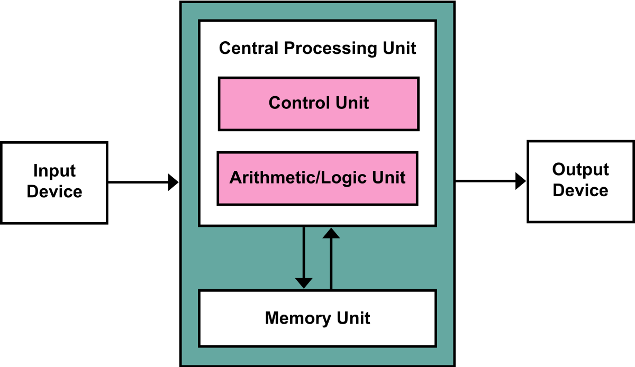

Slide 7
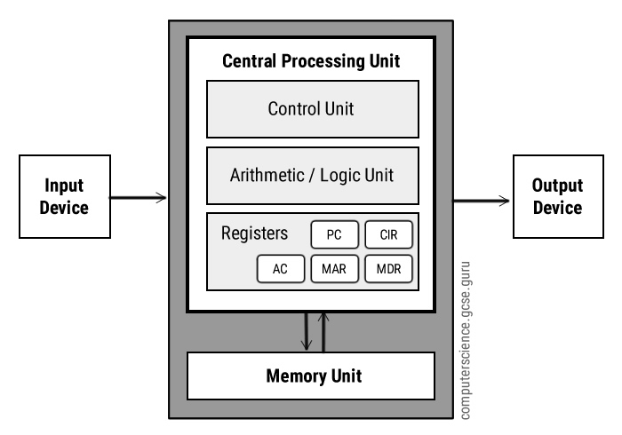

Slide 8
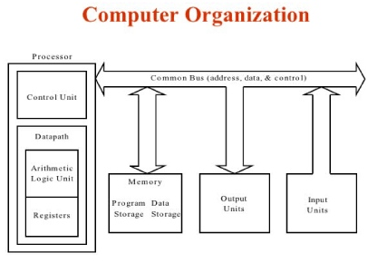

Slide 9
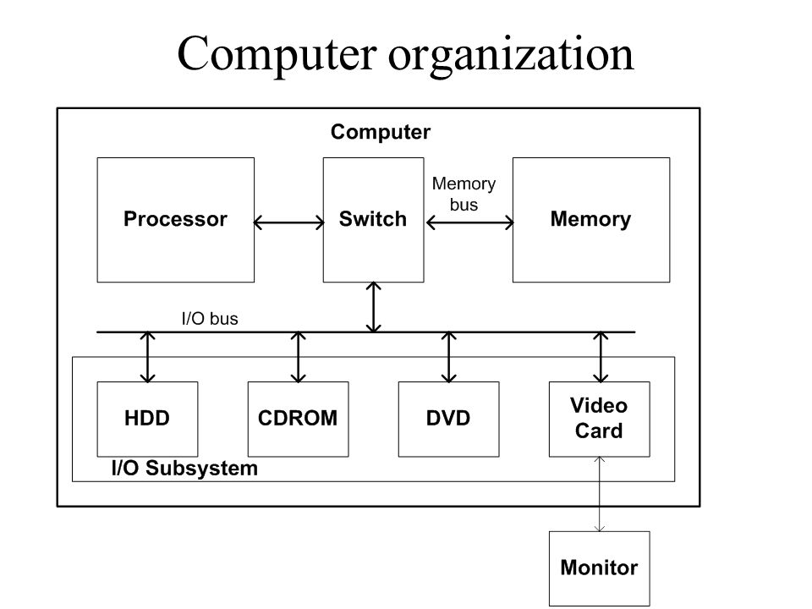

Slide 10
UNIT - I
Introduction to computer organization-
Digital Computers, Instruction codes, stored program organization, computer registers, computer instructions , instruction cycle, types of instruction formats (Zero, one, two and three address), RISC instructions.
Addressing modes: mode field, implied, immediate register, register direct, register indirect, auto increment, decrement, indexed, relative, base address mode, Numerical examples and problems.

Slide 11
1. Digital Computers
1940s, used primarily for numerical computations.
The digital computer is a digital system that performs various computational tasks.
The word digital implies that the information in the computer is represented by variables that take a limited number of discrete values.
These values are processed internally by components that can maintain a limited number of discrete states.
Digital computers use the binary number system, which has two digits: 0 and 1.
A binary digit is called a bit.(bit, byte, nibble)

Slide 12
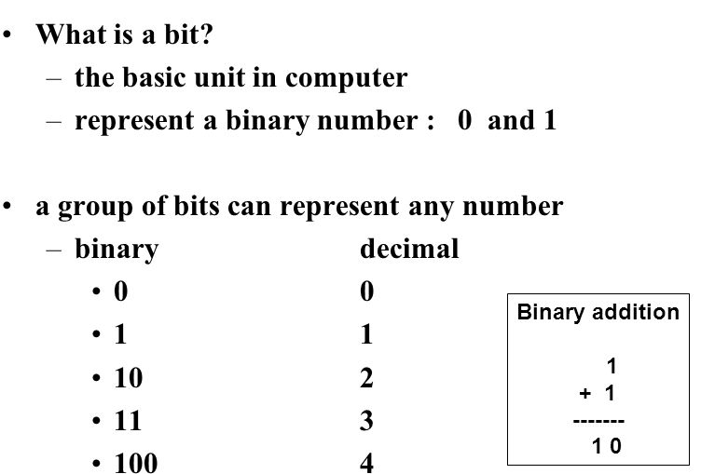
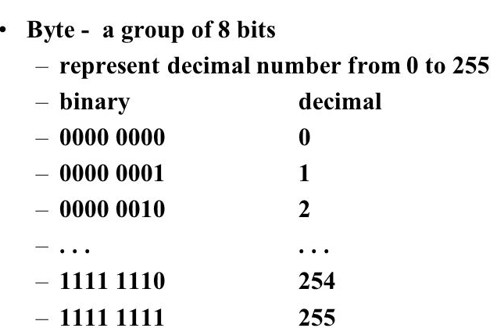

Slide 13
Information is represented in digital computers in groups of bits.
In general: add 1 bit, double the number of patterns
1 bit - 2 patterns
2 bits - 4
3 bits - 8
4 bits - 16
5 bits - 32
6 bits - 64
7 bits - 128
8 bits - 256 - one byte
Mathematically: n bits yields 2^{n} patterns (2 to the nth power)
All storage is measured in bytes, despite being very different hardware
Kilobyte, KB, about 1 thousand bytes
Megabyte, MB, about 1 million bytes
Gigabyte, GB, about 1 billion bytes
Terabyte, TB, about 1 trillion bytes (rare)

Slide 14
By using various coding techniques, groups of bits can be made to represent not only binary numbers but also other discrete symbols, such as decimal digits or letters of the alphabet.(compilers, interpreter)
The groups of bits are used to develop complete sets of instructions for performing various types of computations.
The seven bits 1001011 represent a binary number whose decimal equivalent is 75. However, this same group of seven bits represents the letter K when used in conjunction with a binary code for the letters of the alphabet.

Slide 15
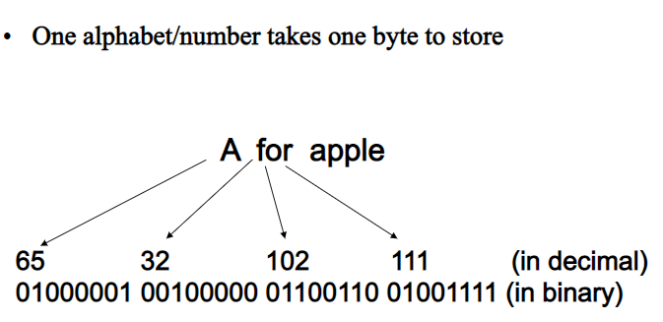
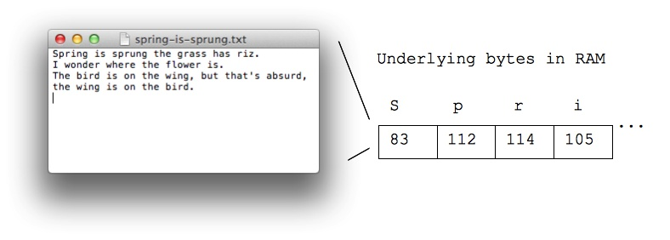
ASCII is an encoding representing each typed character by a number
Each number is stored in one byte (so the number is in 0..255)
A is 65
B is 66
a is 97
space is 32

Slide 16
Computer organization is concerned with the way the hardware components operate and the way they are connected together to form the computer system.
The various components are assumed to be in place and the task is to investigate the organizational structure to verify that the computer parts operate as intended.

Slide 17
Instruction Code
An instruction code is a group of bits(0101) that tells the computer to perform a specific operation.
Program→set of instruction→operand + operation + sequence of instruction to be executed.
Every computer has its own instruction format.
Generally the size of the instruction format will be the multiple of 8.
8bit, 16bit, 24bit, 32bit,48bit,64bit….

Slide 18
Instruction code format
The instruction format is divided into three parts
Address- Specifies operands, registers, memory word
Opcode-Specifies the operation
Indirect bit(I)

Slide 19
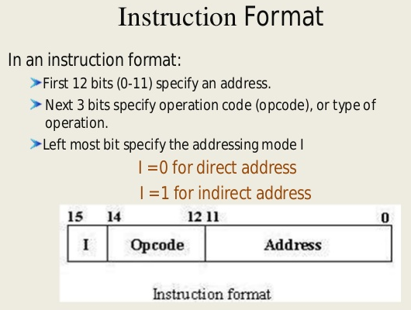

Slide 20
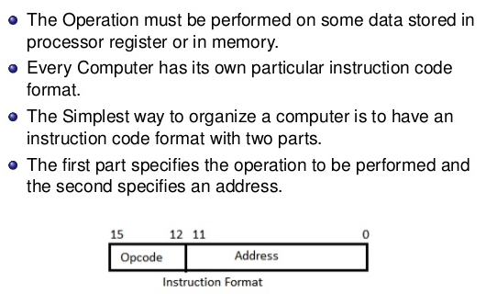
The simple way to organize a instruction code is by two parts

Slide 21
At the lowest level, each instruction is a sequence of 0s and 1s(0011, 0101…) that describes a physical operation the computer is to perform (such as Add, Sub, Div….) and, depending on the particular instruction type,
the specification of special storage areas called registers that may contain data to be used in carrying out the instruction, or the location in computer memory of data.
If we perform any operation on registers then it is called as micro operation.

Slide 22
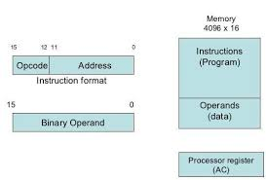
From where we are getting this instruction code
In the memory, the instructions will be present. So from the memory we are getting the instruction code and we are going to convert into group of bits, and this group of bits read by the processor.

Slide 23
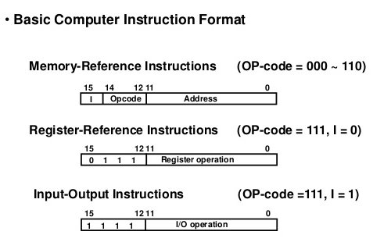
This instruction is of three types

Slide 24
The instruction code can be of three types
Immediate addressing-specifies actual operands
Direct addressing-specifies address of operands
Indirect addressing- specifies the address of memory word in which address of operand is present.

Slide 25
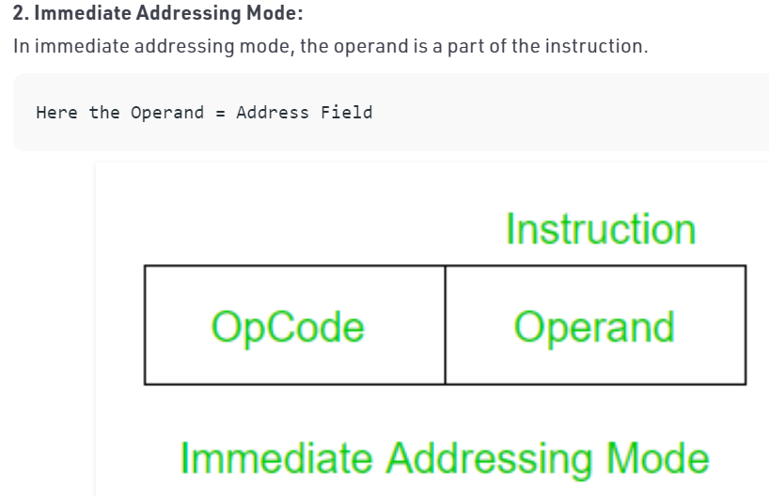

Slide 26
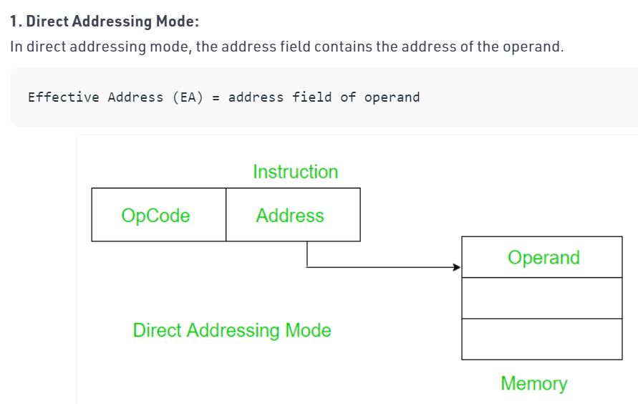

Slide 27
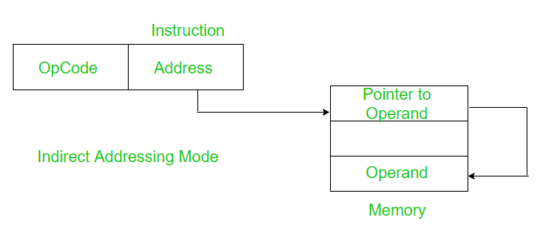

Slide 28
Stored Program Organization
The simplest way to organize a computer is to have one processor register and instruction code format with two parts.
The 1st part specifies the operation to be performed and the 2nd specifies an address.
The memory address tells the control where to find an operand in memory. This operand is read from memory and used as the data to be operated on together with the data stored in the processor register.
Below Figure depicts this type of organization.

Slide 29
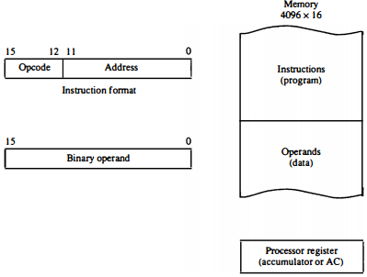
Instructions are stored in one section of memory and data in another.

Slide 30
For a memory unit with 4096 words we need 12 bits to specify an address since 2^12 = 4096.
If we store each instruction code in one 16-bit memory word, we have available four bits for the operation code (abbreviated op code) to specify one out of 16 possible operations, and 12 bits to specify the address of an operand. The control reads a 16-bit instruction from the program portion of memory. It uses the 12-bit address part of the instruction to read a 16-bit operand from the data portion of memory. It then executes the operation specified by the operation code.

Slide 31
Computers that have a single- processor register usually assign to it the name accumulator and label it AC.
The operation is performed with the memory operand and the content of AC.
If an operation in an instruction code does not need an operand from memory, the rest of the bits in the instruction can be used for other purposes.
For example, operations such as clear AC, complement AC, and increment AC operate on data stored in the AC register. They do not need an operand from memory.
For these types of operations, the second part of the instruction code (bits 0 through 11) is not needed for specifying a memory address and can be used to specify other operations for the computer.

Slide 32
Computer Registers
A type of very fast computer memory.
used to execute programs and operations efficiently.
The only purpose of having register is fast retrieval of data(from RAM) for processing by CPU.
It quickly accept, store, and transfer data and instructions that are being used immediately by the CPU.
The registers used by the CPU are termed as Processor registers.

Slide 33
A processor register may hold an instruction, a storage address, or any data (such as bit sequence or individual characters).
The computer needs processor registers for manipulating data and a register for holding a memory address.
The register holding the memory location is used to calculate the address of the next instruction after the execution of the current instruction is completed.

Slide 34
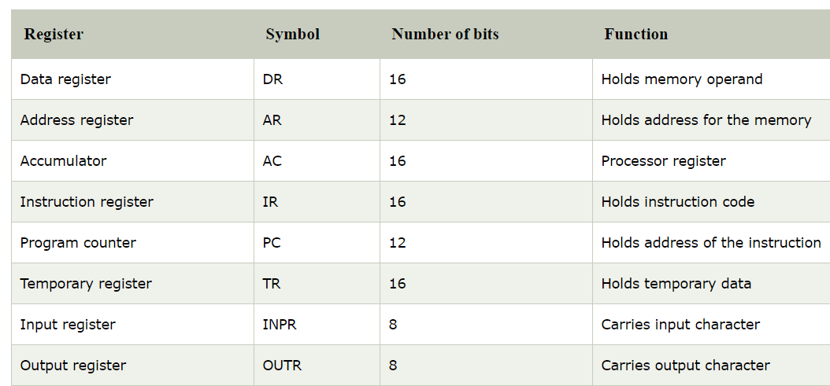
Below is the list of some common registers used in a computer:

Slide 35
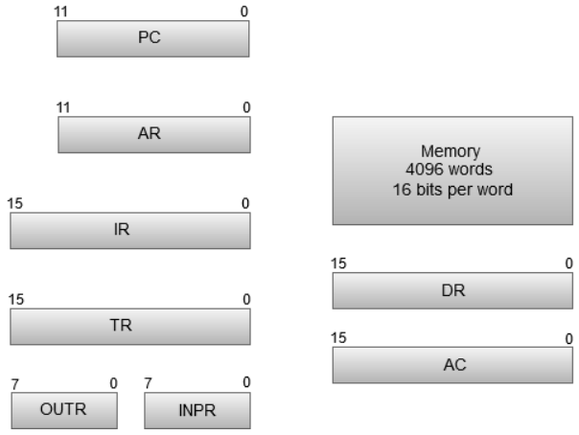
The below figures shows the registers and memory configuration for a computer.

Slide 36
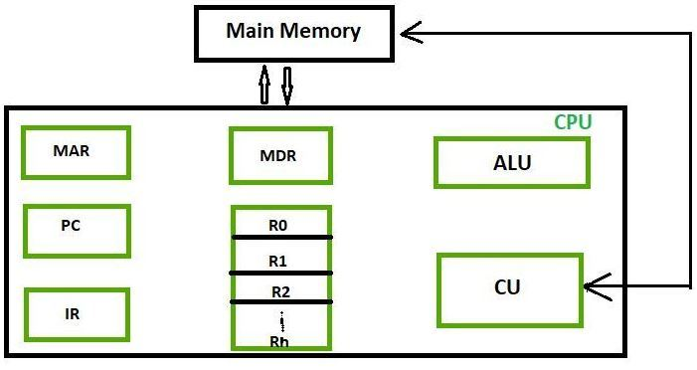

Slide 37
Instruction Cycle
Program->set of instructions + order of execution
A program residing in the memory unit of a computer consists of a specific sequence of instructions. These instructions are executed by the processor by going through a cycle for each instruction.
Instruction cycle basically related with execution of instructions.
Each instruction will pass through some cycle and some phases.

Slide 38
In a basic computer, each instruction cycle consists of the following 4-phases:
Fetch the instruction
Fetch the instruction from Memory, at T1.
Decode the instruction.
Which operation the corresponding instruction performs(CU) at T2.
Read effective address(EA)
if indirect bit(I)=1
Read the effective address from memory (if the instruction has an indirect address).
Execute the instruction.(ALU)

Slide 39
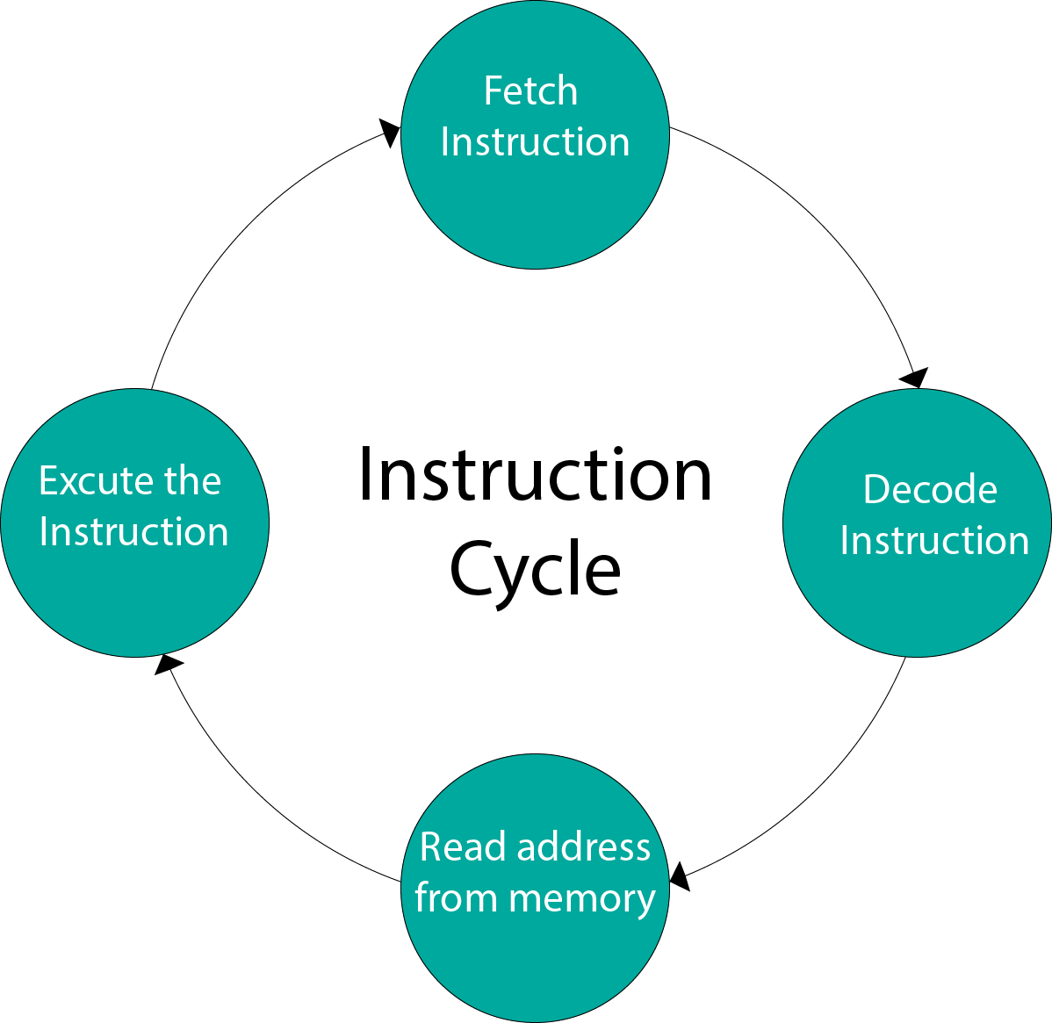

Slide 40
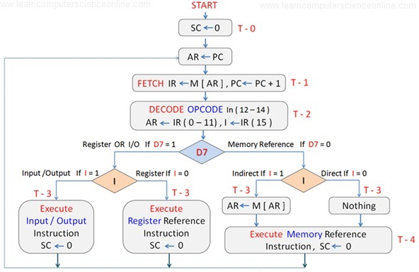
Flowchart for Instruction Cycle

Slide 41
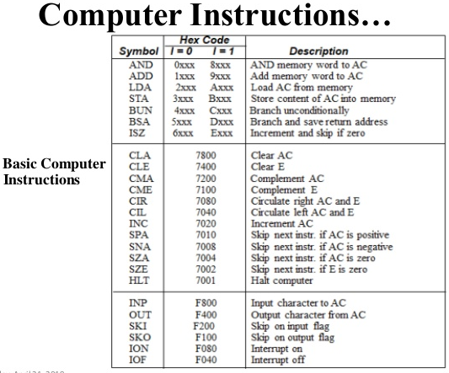

Slide 42
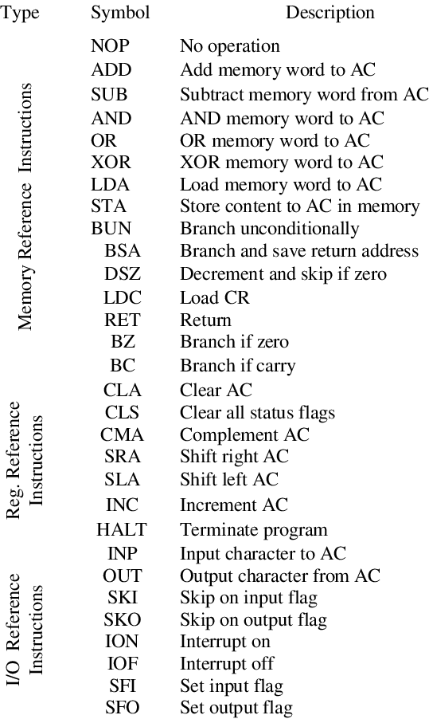
Computer Instructions

Slide 43
Types of instruction formats
Instructions are categorized into different formats with respect to the operand fields (no. of operands we provided to the instruction) in the instructions.
Operands can be processor register or can be a memory.
Zero address instruction
One address instruction
Two address instruction
Three address instruction
three operands into the instructions

Slide 44
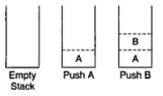
Example: Zero address instruction
An instruction that contains no address fields.
operand sources and destination are both implicit.
Zero address instructions format is used for stack-organized architecture.
Lets write an assembly code for evaluating the expression
X=(A+B)*(C+D)
PUSH A
PUSH B
ADD //A+B
PUSH C
PUSH D
ADD //C+D
MUL //(A+B)*(C+D)
POP X

Slide 45
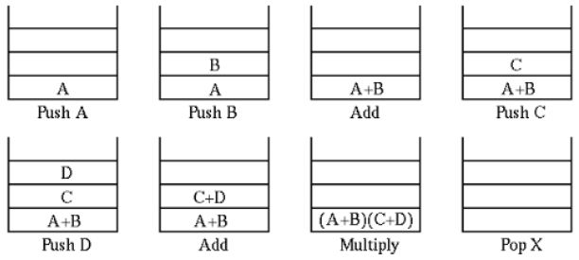

Slide 46
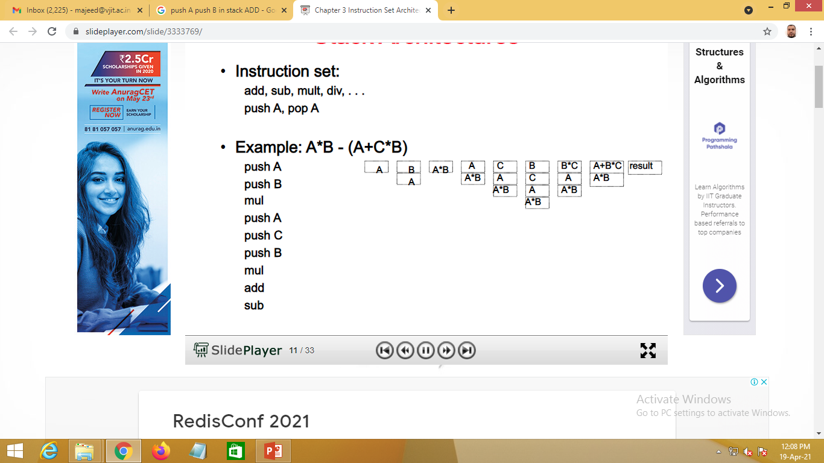
Example-2: Zero address instruction

Slide 47
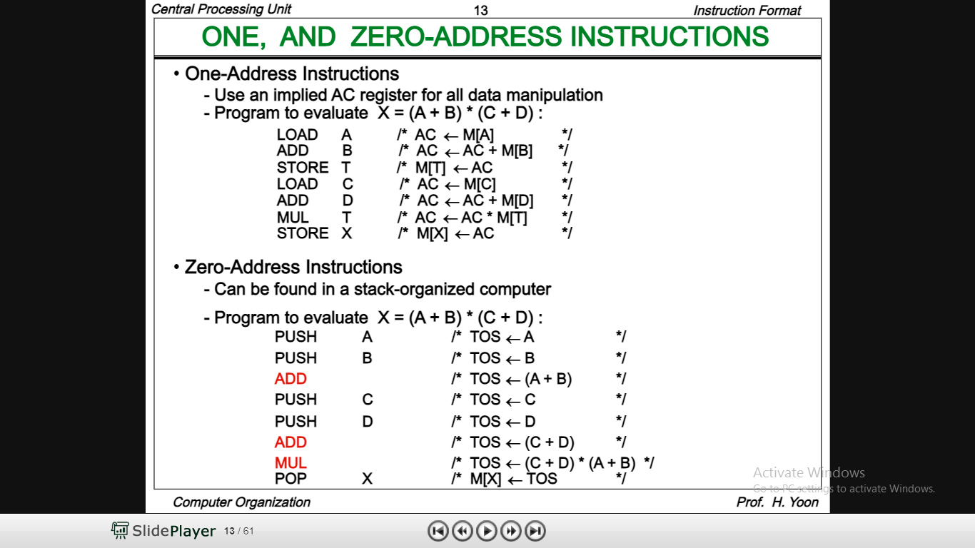
Example: One address instruction
In one address instruction accumulator (AC) is used.
Example : ADD B //AC←M[B]+AC One address
Lets write an assembly code for evaluating the expression X=(A+B)*(C+D)
LOAD A
ADD B
STORE T
LOAD C
ADD D
MUL T
STORE X

Slide 48
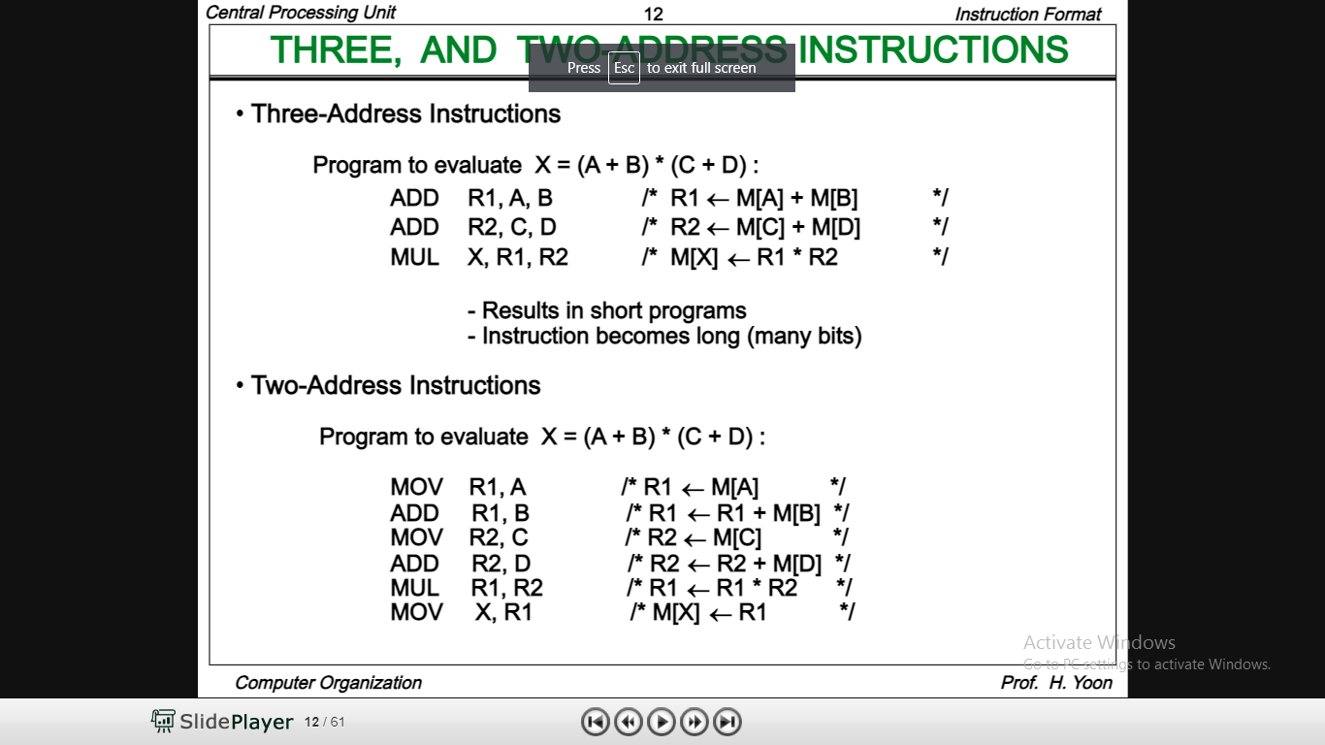
Example: Two address instruction
One of the address acts as source as well as destination.
Overwriting of data occurs here.
Example: ADD R1,R2 //R1←R1+R2 (two address)
Here R1is acting as source and destination & will be overwritten.
Lets write an assembly code for evaluating the expression X=(A+B)*(C+D)
MOV R1, A
ADD R1,B
MOV R2,C
ADD R2,D
MUL R1,R2
MOV X,R1

Slide 49
Example: Three address instruction
Lets write an assembly code for evaluating the expression X=(A+B)*(C+D)
ADD R1,R2,R3 //R1←R2+R3
ADD R1,A,B //R1← M[A]+M[B]
ADD R2,C,D //R2← M[C]+M[D]
MUL X,R1,R2 //M[X]←R1*R2
Advantage:
it results in short progams when evaluating arithmetic expression-less SLOC
Reduces the size of instruction
ADD B
SUB B

Slide 50
RISC Instructions
RISC: Reduced Instruction Set Computer
RISC is a microprocessor(logic chip) design to perform AL functions.
The main idea behind the RISC is to make hardware simpler by using instruction set composed of a few basic steps for loading , evaluating and storing operation.
An instruction execute in single clock cycle(cpi) cycle per instruction

Slide 51
Characteristics of RISC
Simpler instruction, hence simple instruction decoding.
Simple addressing mode
More number of general purpose register
RISC utilizes a small, highly optimized set of instructions
Pipelining can be achieved

