Slide 1
Dynamic Programming
Unit-3

Slide 2
Dynamic Programming
Dynamic Programming is used in optimization problems
Dynamic Programming algorithm solves each sub-problem just once and then saves its answer in a table, thereby avoiding the work of re-computing the answer every time
Two main properties of a problem suggest that the given problem can be solved using Dynamic Programming.
These properties are overlapping sub-problems and optimal substructure

Slide 3
Dynamic Programming
Overlapping Sub-Problems:
Dynamic Programming also combines solutions to sub-problems.
It is mainly used where the solution of one sub-problem is needed repeatedly.
The computed solutions are stored in a table, so that these don’t have to be re-computed.
Hence, this technique is needed where overlapping sub-problem exists.

Slide 4
Dynamic Programming
Optimal Sub-Structure:
A given problem has Optimal Substructure Property, if the optimal solution of the given problem can be obtained using optimal solutions of its sub-problems
This property is called “Principle of Optimality”
In an optimal sequence of decisions or choices each sub sequence must also be optimal
If it is not possible to apply principle of optimality then it is almost impossible to solve the problem

Slide 5
Dynamic Programming
Dynamic Programming algorithm is designed using the following four steps −
Characterize the structure of an optimal solution.
Recursively define the value of an optimal solution.
Compute the value of an optimal solution, typically in a bottom-up fashion.
Construct an optimal solution from the computed information

Slide 6
Applications of Dynamic Programming Approach
Matrix Chain Multiplication
Optimal Binary Search Tree
Travelling Salesman Problem
0/1 Knapsack Problem
All Pairs Shortest Path Problem
Reliability Design

Slide 7
Matrix Chain Multiplication
If a chain of matrices is given, we have to find the minimum number of the correct sequence of matrices to multiply.
We know that the matrix multiplication is associative, so four matrices ABCD, we can multiply A(BCD), (AB)(CD), (ABC)D, A(BC)D, in these sequences
Matrix chain multiplication is to find which ordering is efficient to multiply
Eg if A=5x4 B=4x6 C=6x2
(AB)C=(5*4*6)+(5*6*2)=180
A(BC)=(5*4*2)+(4*6*2)=88

Slide 8
Matrix Chain Multiplication
Step1: Structure of an optimal parenthesization:
Let A_{i....j} where i≤ j denotes the matrix that results from evaluating the product A_{i} A_{i+1}....A_{j}
for some value of k, we first compute the matrices A_{i.....k} & A_{k+1....j} and then multiply them together to produce the final product A_{i....j}.
The cost of computing A_{i....k} plus the cost of computing A_{k+1....j} plus the cost of multiplying them together is the cost of parenthesization.

Slide 9

Matrix Chain Multiplication
Step 2: A Recursive Solution
Let m [i, j] be the minimum number of scalar multiplication needed to compute the matrixA_{i....j}.
So the minimum cost of parenthesizing the product A_{i} A_{i+1}......A_{j} becomes
To construct an optimal solution, let us define s [i,j] to be the value of 'k' at which we can split the product A_{i} A_{i+1} .....A_{j}

Slide 10
Matrix Chain Multiplication Example
The matrices have size 4 x 10, 10 x 3, 3 x 12, 12 x 20. We need to compute M [i,j], 0 ≤ i, j≤ 5. We know M [i, i] = 0 for all i.
1
2
3
4
M₁₁=0 | M₂₂=0 | M₃₃=0 | M₄₄=0
1
M₁₂= K= | M₂₃= K= | M₃₄= K=
2
M₁₃= K= | M₂₄= K=
3
M₁₄= K=
4

Slide 11
Matrix Chain Multiplication Example
M11=M22=M33=M44=0
M14=?
A1=4x10 A2=10x3 A3=3x12 A4=12x20
P0=4 P1=10 P2=3 P3=12 P4=20

Slide 12
Matrix Chain Multiplication Example
Here P₀ to P₄ are Position and M₁ to M₄ are matrix of size (p_{i} to p_{i-1})
On the basis of sequence, we make a formula
In Dynamic Programming, initialization of every method done by '0'.
So we initialize it by '0'.
It will sort out diagonally.

Slide 13
1
2
3
4
M₁₁=0 | M₂₂=0 | M₃₃=0 | M₄₄=0
1
M₁₂= K= | M₂₃= K= | M₃₄= K=
i=1,j=2, 1<=k<2(k=1)
M12=min{m[1,1]+m[2,2]+P0P1P2
=min{0+0+4.10.3}
=120
i=2,j=3,2<=k<3(k=2)
M23=min{m[2,2]+m[3,3]+P1P2P3}
=min{0+0+10.3.12}
=360
i=3,j=4,3<=k<4(k=3)
M34=min{m[3,3]+m[4,4]+P2P3P4}
=min{0+0+3.12.20}
=720
2
M₁₃= K= | M₂₄= K=
3
M₁₄= K=
4

Slide 14
1
2
3
4
M₁₁=0 | M₂₂=0 | M₃₃=0 | M₄₄=0
1
i=1,j=3,1<=k<3(K=1,2)
M13=min{(m[1,1]+m[2,3]+P0P1P3), (m[1,2]+m[3,3]+P0P2P3)}
=min{(0+360+4.10.12) , (120+0+4.3.12)}
=min{840,264}
=264
i=2,j=4,2<=k<4(K=2,3)
M24=min{(m[2,2]+m[3,4]+P1P2P4), (m[2,3]+m[4,4]+P1P3P4)}
=min{(0+720+10.3.20), (360+0+10.12.20)}
=min{1320,2760}
=1320
M₁₂=120 K=1 | M₂₃=360 K=2 | M₃₄=720 K=3
2
M₁₃= K= | M₂₄= K=
3
M₁₄= K=
4

Slide 15
1
2
3
4
M₁₁=0 | M₂₂=0 | M₃₃=0 | M₄₄=0
1
i=1,j=4,1<=k<4(k=1,2,3)
M14=min{(m[1,1]+m[2,4]+P0P1P4), (m[1,2]+m[3,4]+P0P2P4), (m[1,3]+m[4,4]+P0P3P4)}
=min{(0+1320+4.10.20), (120+720+4.3.20), (264+0+4.12.20)}
=min{2120,1080,1224}
=1080
M₁₂=120 K=1 | M₂₃=360 K=2 | M₃₄=720 K=3
2
M₁₃=264 K=2 | M₂₄=1320 K=2
3
M₁₄= K=
4

Slide 16
1
2
3
4
A14
M₁₁=0 | M₂₂=0 | M₃₃=0 | M₄₄=0
1
K=2
M₁₂=120 K=1 | M₂₃=360 K=2 | M₃₄=720 K=3
2
A12
A34
M₁₃=264 K=2 | M₂₄=1320 K=2
K=1
K=3
3
M₁₄=1080 K=2
A33
A44
4
A11
A22
A14=((A1A2)(A3A4))

Slide 17
Examples:
A1=5x4 A2=4x6 A3=6x2 . Find the optimal solution to perform the multiplication
A1=4x5 A2=5x3 A3=3x2 A4=2x7 A5=7x2. Find the optimal solution to perform the multiplication

Slide 18
Input: Array p[0…n] containing matrix dimensions and n
Result: Minimum-cost table m and split table s
1.Algorithm Matrix_Chain_Mul(p[], n)
2.{
3.for i:= 1 to n do
4. m[i, i]:= 0 ;
5.for len:= 2 to n do // for lengths 2,3 and so on
6.{
7. for i:= 1 to ( n-len+1 ) do
8. {
9. j:= i+len-1;
10. m[i, j]:= ∞ ;
for k:=i to j-1 do
12. {
13. q:= m[i, k] + m[k+1, j] + p[i-1] p[k] p[j];
14. if q < m[i, j]
15. {
16. m[i, j]:= q;
17. s[i, j]:= k;
18. }
19. }
20. }
21.}
22.return m and s
23.}
Time complexity of above algorithm is O(n³)

Slide 19
0/1 Knapsack Problem
In 0/1 Knapsack, items cannot be broken which means that the item should consider as a whole or should leave it. This is called it as 0/1 Knapsack
In 0/1 Knapsack, the value of x_{i} can be either 0 or 1
Dynamic-Programming Approach
There are n items and weight of i^{th} item is w_{i} and the profit of selecting this item is p_{i}
Place items in the knapsack such that it should not cross the limit of the capacity and it has to give more profit.

Slide 20
0/1 Knapsack Problem
Let x_{i} = 1 when item i is selected and let x_{i} = 0 when item i is not selected.
n
p_{i} x_{i}
maximize
i = 1
n
w_{i} x_{i} <= c
subject to
i = 1
and x_{i} = 0 or 1 for all i
All profits and weights are positive.

Slide 21
We use set s^{i} is a pair ( P, W )
where P= f_{i}(y), W=y
Note That s⁰ =( 0, 0 )
We can compute s^{i+1} from s^{i} by first computing
s^{i} ={ ( P, W ) ( P- p_{i+1}, W- w_{i+1})€ s ^{i} }
1

Slide 22
OR
S^{i} = S^{i-1} + (p_{i}, w_{i})
Merging :- s^{i+1} can be computed by merging the
pairs in s ^{i} and s ^{i}
Purging :- if s^{i+1} contains two pairs ( p _{j}, w _{j} ) and ( p _{k}, w _{k} )
with the property that p _{j} ≤ p _{k} and w _{j} ≥ w _{k}
When generating s ^{i}’s, we can also purge all pairs ( p, w ) with w > m as these pairs determine the value of f _{n} (x) only for x > m.
The optimal solution f _{n} (m) is given by the highest profit pair.
1
1

Slide 23
Set of 0/1 values for the x _{i} ’ s
Set of 0/1 values for x _{i} ’ s can be determined by a search through the s^{i} s
Let ( p, w ) be the highest profit tuple in s ^{n}
Step1: if ( p, w ) € s ^{n} and ( p, w ) € s ^{n -1}
x _{n} = 1
otherwise x _{n} = 0
This leaves us to determine how either ( p, w ) or
( p – p_{n}, w- w_{n} ) was obtained in S^{n-1} .
This can be done recursively ( Repeat Step1 ).

Slide 24
0/1 Knapsack Problem
Find the optimal solution such that W(1,2,3)=(2,3,4) and P(1,2,3)=(1,2,5) and the capacity of knapsack is 6
Initially S⁰={(0,0)}
Find S¹
S⁰₁ ={(0+1,0+2)}={(1,2)} (S={(p,w)}
S¹={Merge S⁰ & S⁰₁ }
S¹ ={(0,0)(1,2)}
Find S²
S¹₁ ={(0+2,0+3)(1+2,2+3)}
={(2,3)(3,5)}

Slide 25
0/1 Knapsack Problem
S²={Merge S¹ & S¹₁ }
={(0,0)(1,2)(2,3)(3,5)}
Find S³
S² ₁= {(0+5,0+4)(1+5,2+4)(2+5,3+4)(3+5,5+4)}
={(5,4)(6,6)(7,7)(8,9)}
As (7,7)and(8,9) are crossed the limit of knapsack capacity remove these two pairs
S² ₁={(5,4)(6,6)}
S³={Merge S² & S² ₁}
S³ ={(0,0)(1,2)(2,3)(3,5)(5,4)(6,6)}

Slide 26
0/1 Knapsack Problem
S³ ={(0,0)(1,2)(2,3)(3,5)(5,4)(6,6)}
Observe the pairs (3,5)(5,4) for the wt 5 the profit is 3 and for the wt 4 the profit is 5.
According to purging rule more wt with less profit is removed.
So remove(3,5)
So S³ ={(0,0)(1,2)(2,3)(5,4)(6,6)}
Process is stopped here as we have 3 objects.
Optimal Profit is 6

Slide 27
0/1 Knapsack Problem
(6,6) belongs to set S³, so object 3 is included in the knapsack
To search for next item remove 3rd object wt and profit
(6-5,6-4)=(1,2)
(1,2) belongs to S¹ , so object 1 is included
To search for next item remove 1st object wt and profit
(1-1,2-2)=(0,0)
The objects and optimal solution is
(x1,x2,x3)=(1,0,1) with max profit=6

Slide 28
0/1 Knapsack Problem
Find the optimal solution such that W(1,2,3)=(2,3,3) and P(1,2,3)=(1,2,4) and the capacity of knapsack is 6
Find the optimal solution such that W(1,2,3,4)=(24,10,10,7) and P(1,2,3,4)=(24,18,18,10) and the capacity of knapsack is 25

Slide 29
Find the optimal solution such that W(1,2,3,4)=(24,10,10,7) and P(1,2,3,4)=(24,18,18,10) and the capacity of knapsack is 25

Slide 30
Travelling Salesman Problem
A traveler needs to visit all the cities from a list, where distances between all the cities are known and each city should be visited just once.
Find the shortest possible route that he visits each city exactly once and returns to the origin city
Let us consider a graph G = (V, E), where V is a set of cities and E is a set of weighted edges.
An edge e(u, v) represents that vertices u and v are connected.
Distance between vertex u and v is d(u, v), which should be non-negative

Slide 31
Travelling Salesman Problem
Suppose we have started at city 1 and after visiting some cities now we are in city j.Hence, this is a partial tour.
We certainly need to know j, since this will determine which cities are most convenient to visit next.
We also need to know all the cities visited so far, so that we don't repeat any of them.
Hence, this is an appropriate sub-problem.
For a subset of cities S Є {1, 2, 3, ... , n} that includes 1, and j Є S, let C(S, j) be the length of the shortest path visiting each node in S exactly once, starting at 1 and ending at j.

Slide 32
Travelling Salesman Problem
When |S| > 1, we define C(S, 1) = ∝ since the path cannot start and end at 1.
Now, let express C(S, j) in terms of smaller sub-problems. We need to start at 1 and end at j.
We should select the next city in such a way that
C(S,j)=min C(S−{j},i)+d(i,j) where i∈S and i≠j c(S,j)
=min C(s−{j},i)+d(i,j) where i∈S and i≠j

Slide 33
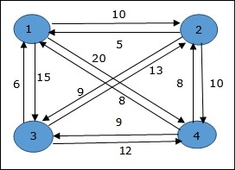
Travelling Salesman Problem
In the following example, we will illustrate the steps to solve the travelling salesman problem
Step 1: S = Φ
Cost(2,Φ,1)=d(2,1)=5
Cost(3,Φ,1)=d(3,1)=6
Cost(4,Φ,1)=d(4,1)=8

Slide 34
TSP
Step 2: S = 1
Cost(i,s)=min{Cost(j,s–(j))+d[i,j]}
Cost(2,{3},1)=d[2,3]+Cost(3,Φ,1)
=9+6=15
Cost(2,{4},1)=d[2,4]+Cost(4,Φ,1)
=10+8=18
Cost(3,{2},1)=d[3,2]+Cost(2,Φ,1)
=13+5=18
Cost(3,{4},1)=d[3,4]+Cost(4,Φ,1)
=12+8=20

Slide 35
TSP
Cost(4,{2},1)=d[4,2]+Cost(2,Φ,1)
=8+5=13
Cost(4,{3},1)=d[4,3]+Cost(3,Φ,1)
=9+6=15
Step 3: S = 2
Cost(2,{3,4},1)={d[2,3]+Cost(3,{4},1),
d[2,4]+Cost(4,{3},1)}
=min{9+20, 0+15}
=min{29,25}=25

Slide 36
TSP
Cost(3,{2,4},1)=min{d[3,2]+Cost(2,{4},1),
d[3,4]+Cost(4,{2},1)}
=min{13+18, 12+13}
=min{31,25}=25
Cost(4,{2,3},1)=min{d[4,2]+Cost(2,{3},1),
d[4,3]+Cost(3,{2},1)}
=min{8+15, 9+18}
=min{23,27}=23

Slide 37
TSP
Step 4: S=3
Cost(1,{2,3,4},1)=min{d[1,2]+Cost(2,{3,4},1),
d[1,3]+Cost(3,{2,4},1),
d[1,4]+Cost(4,{2,3},1)}
=min{10+25, 15+25, 20+23}
=min{35,40,43}
=35
The minimum cost path is 35

Slide 38
TSP
To find the path:
Start from cost {1, {2, 3, 4}, 1} we get the minimum value for d [1, 2]
When s = 3, select the path from 1 to 2 (cost is 10) then go backwards to search Cost(2,{3,4},1)
When s = 2, we get the minimum value for d [4, 2]. Select the path from 2 to 4 (cost is 10) then go backwards to search Cost(4,{3},1)
When s = 1, we get the minimum value for d [4, 3]. Selecting path 4 to 3 (cost is 9), then we shall go to
s = Φ step. We get the minimum value for d [3, 1] (cost is 6).

Slide 39
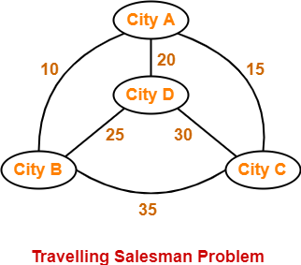
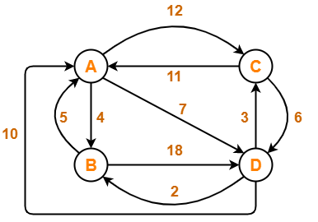
Examples for TSP

Slide 40
All-Pairs Shortest Paths
The all pair shortest path algorithm is also known as Floyd-Warshall algorithm is used to find all pair shortest path problem from a given weighted graph.
As a result of this algorithm, it will generate a matrix, which will represent the minimum distance from any node to all other nodes in the graph.
It means any sub path of shortest path is a shortest path between the end nodes.

Slide 41
All-Pairs Shortest Paths
Steps:
1) Let A^{k}_{i,j} be the length of shortest path from node i to node j such that the label for every intermediate node will be ≤ k
2) Now, divide the path from i node to j node for every intermediate node, say ‘k’ then there arises two case.
a. Path going from i to j via k. b. Path which is not going via k.
3) Select only shortest path from two cases.
4) Using recursive method we compute shortest path.
5)Initially: A⁰=W[i,j]
6) Next computations:
A^{k}_{i,j}=min{A^{k−1}_{i,j},A^{k−1}_{i,k}+A^{k−1}_{k,j}}

Slide 42
All-Pairs Shortest Paths
0 4 11
A⁰= 6 0 2
3 ∞ 0
K=1 , compute A¹
A^{k}_{i,j}=min{A^{k−1}_{i,j},A^{k−1}_{i,k}+A^{k−1}_{k,j}}
A¹_{1,1}=min{A⁰₁₁,A⁰₁₁+A⁰₁₁}
=min{0,0+0}=0
A¹_{1,2}=min{A⁰₁₂,A⁰₁₁+A⁰₁₂}
=min{4,0+4}=4
A¹_{1,3}=min{A⁰₁₃,A⁰₁₁+A⁰₁₃}
=min{11,0+11}=11
6
4
1
2
11
3
2
3
0 4 11
A¹=

Slide 43
All-Pairs Shortest Paths
0 4 11
A⁰= 6 0 2
3 ∞ 0
A^{k}_{i,j}=min{A^{k−1}_{i,j},A^{k−1}_{i,k}+A^{k−1}_{k,j}}
A¹_{2,1}=min{A⁰₂₁,A⁰₂₁+A⁰₁₁}
=min{6,6+0}=6
A¹_{2,2}=min{A⁰₂₂,A⁰₂₁+A⁰₁₂}
=min{0,6+4}=min{0,10}=0
A¹_{2,3}=min{A⁰₂₃,A⁰₂₁+A⁰₁₃}
=min{2,6+11}=min{2,17}=2
A¹_{3,1}=min{A⁰₃₁,A⁰₃₁+A⁰₁₁}
=min{3,3+0}=3
A¹_{3,2}=min{A⁰₃₂,A⁰₃₁+A⁰₁₂}
=min{∞,3+4}=min{∞,7}=7
A¹_{3,3}=min{A⁰₃₃,A⁰₃₁+A⁰₁₃}
=min{0,3+11}=min{0,14}=0
6
4
1
2
11
3
2
3
0 4 11
A¹= 6 0 2
3 7 0

Slide 44
All-Pairs Shortest Paths
0 4 11
A¹= 6 0 2
3 7 0
K=2 , compute A²
A^{k}_{i,j}=min{A^{k−1}_{i,j},A^{k−1}_{i,k}+A^{k−1}_{k,j}}
A²_{1,1}=min{A¹₁₁,A¹₁₂+A¹₂₁}
=min{0,2+6}=min{0,10}=0
A²_{1,2}=min{A¹₁₂,A¹₁₂+A¹₂₂}
=min{4,4+0}=4
A²_{1,3}=min{A¹₁₃,A¹₁₂+A¹₂₃}
=min{11,4+2}=min{11,6}=6
6
4
1
2
11
3
2
3
0 4 6
A²=

Slide 45
All-Pairs Shortest Paths
0 4 11
A¹= 6 0 2
3 7 0
A^{k}_{i,j}=min{A^{k−1}_{i,j},A^{k−1}_{i,k}+A^{k−1}_{k,j}}
A²_{2,1}=min{A¹₂₁,A¹₂₁+A¹₁₁}
=min{6,6+0}=6
A²_{2,2}=min{A¹₂₂,A¹₂₂+A¹₂₂}
=min{0,0+0}=0
A²_{2,3}=min{A¹₂₃,A¹₂₂+A¹₂₃}
=min{2,0+2}=2
A²_{3,1}=min{A¹₃₁,A¹₃₂+A¹₂₁}
=min{3,7+6}=min{3,13}=3
A²_{3,2}=min{A¹₃₂,A¹₃₂+A¹₂₂}
=min{7,7+0}=7
A²_{3,3}=min{A¹₃₃,A¹₃₂+A¹₂₃}
=min{0,7+2}=min{0,9}=0
6
4
1
2
11
3
2
3
0 4 6
A²= 6 0 2
3 7 0

Slide 46
All-Pairs Shortest Paths
0 4 6
A²= 6 0 2
3 7 0
K=3 , compute A³
A^{k}_{i,j}=min{A^{k−1}_{i,j},A^{k−1}_{i,k}+A^{k−1}_{k,j}}
A³_{1,1}=min{A²₁₁,A²₁₃+A²₃₁}
=min{0,6+3}=min{0,9}=0
A³_{1,2}=min{A²₁₂,A²₁₃+A²₃₂}
=min{4,6+7}=min{4,13}=4
A³_{1,3}=min{A²₁₃,A²₁₃+A²₃₃}
=min{6,6+0}=6
6
4
1
2
11
3
2
3
0 4 6
A³=

Slide 47
All-Pairs Shortest Paths
0 4 6 A²= 6 0 2
3 7 0
A^{k}_{i,j}=min{A^{k−1}_{i,j},A^{k−1}_{i,k}+A^{k−1}_{k,j}}
A³_{2,1}=min{A²₂₁,A²₂₃+A²₃₁}
=min{6,2+3}=5
A³_{2,2}=min{A²₂₂,A²₂₃+A²₃₂}
=min{0,2+7}=min{0,9}=0
A³_{2,3}=min{A²₂₃,A²₂₃+A²₃₃}
=min{2,2+0}=2
A³_{3,1}=min{A²₃₁,A²₃₃+A²₃₁}
=min{3,0+3}=min{3,3}=3
A³_{3,2}=min{A²₃₂,A²₃₃+A²₃₂}
=min{7,0+7}=7
A³_{3,3}=min{A²₃₃,A²₃₃+A²₃₃}
=min{0,0}=min{0,0}=0
6
4
1
2
11
3
2
3
0 4 6
A³= 5 0 2
3 7 0

Slide 48
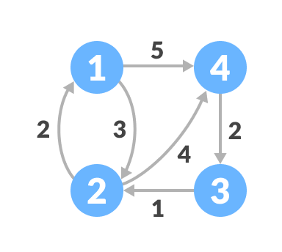
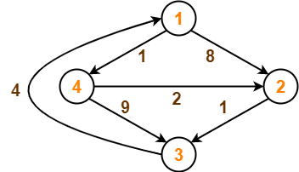
All-Pairs Shortest Paths
Examples

Slide 49
Optimal Binary Search Tree
To search an identifier from dictionary it will build binary tree.
A binary search tree T is a binary tree, either it is empty or each node in the tree contains an identifier and,
All identifiers in the left subtree of T are less than the identifier in the root node T.
All identifiers in the right subtree are greater than the identifier in the root node T.
The left and right subtree of T are also binary search trees.
Different Binary search trees can be formed for the same set of identifier set

Slide 50
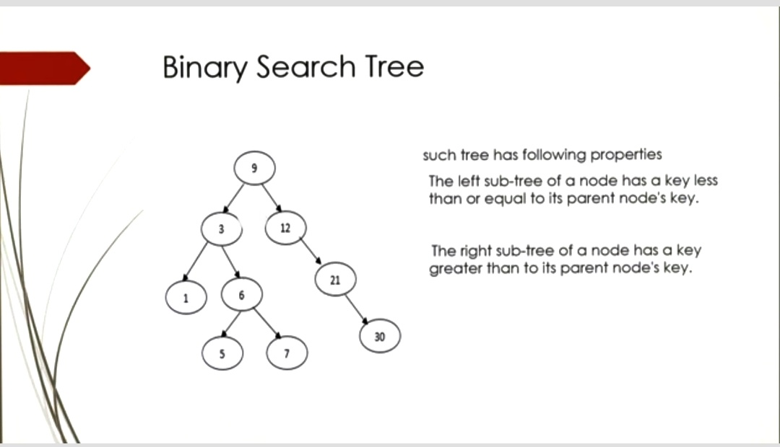

Slide 51
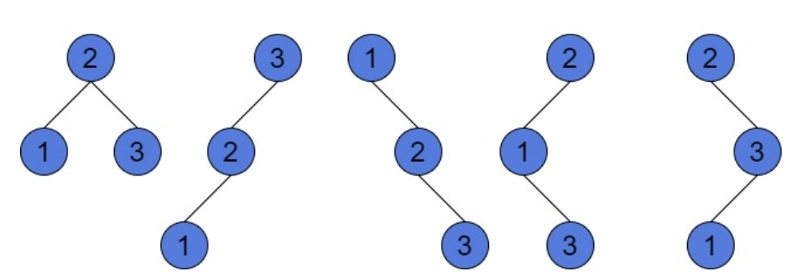

Slide 52
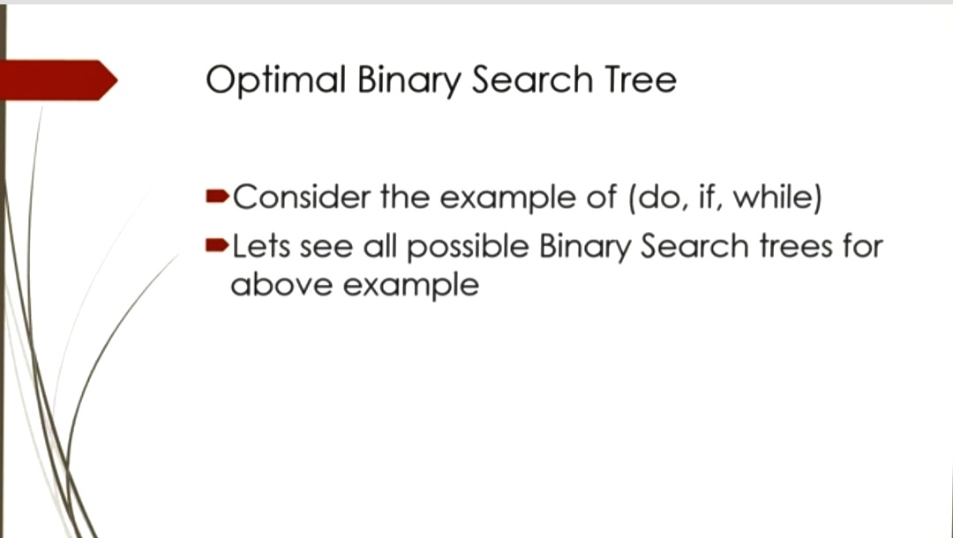

Slide 53
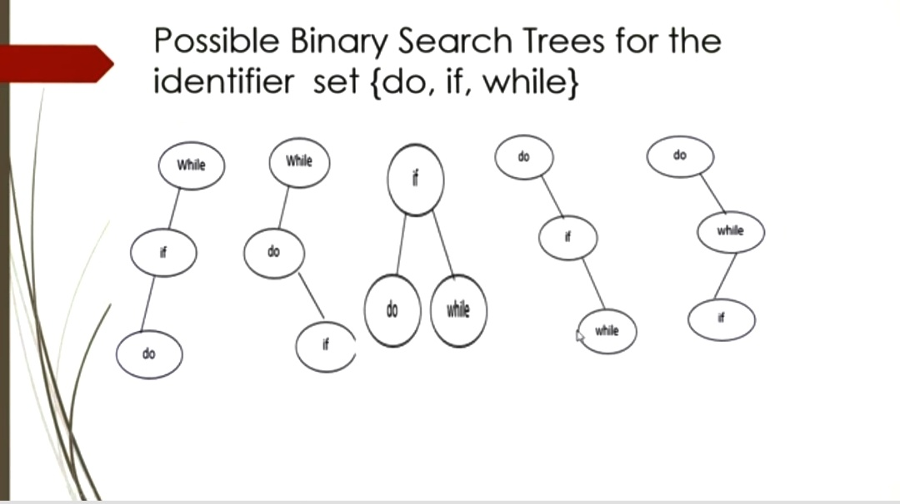

Slide 54
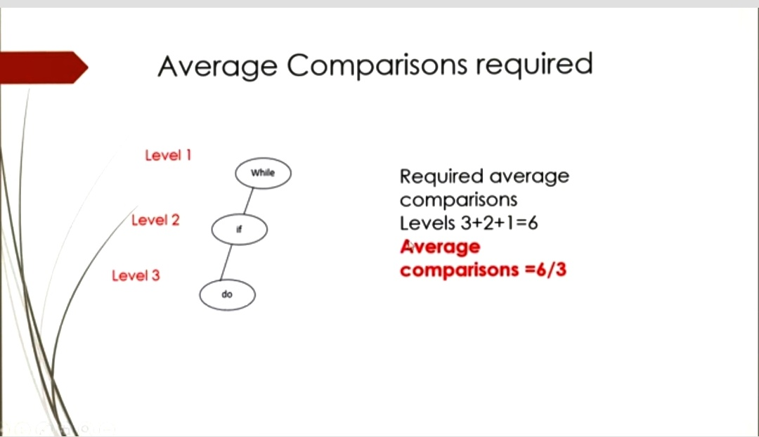

Slide 55
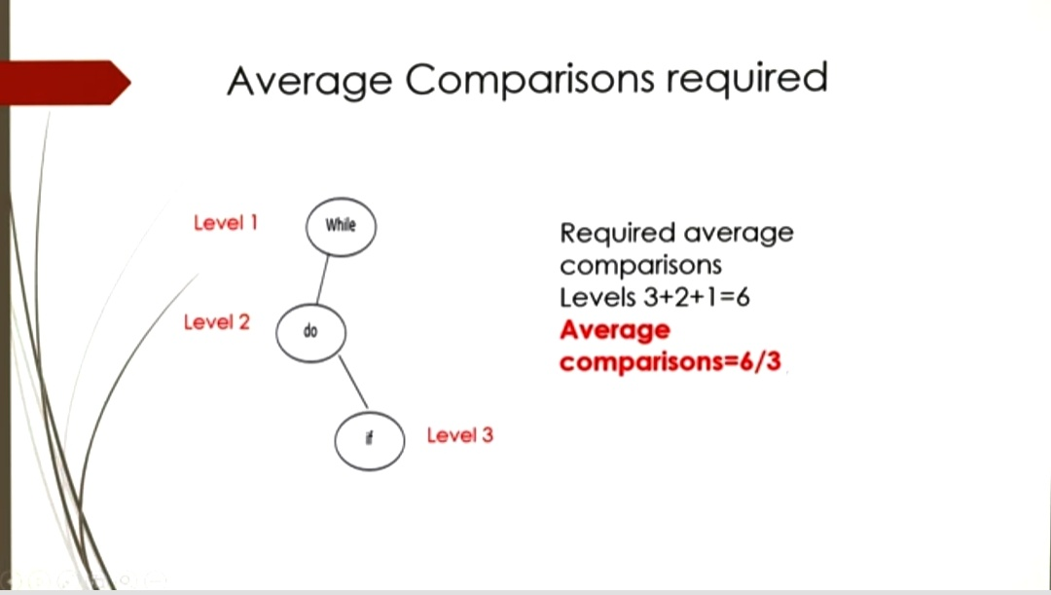

Slide 56
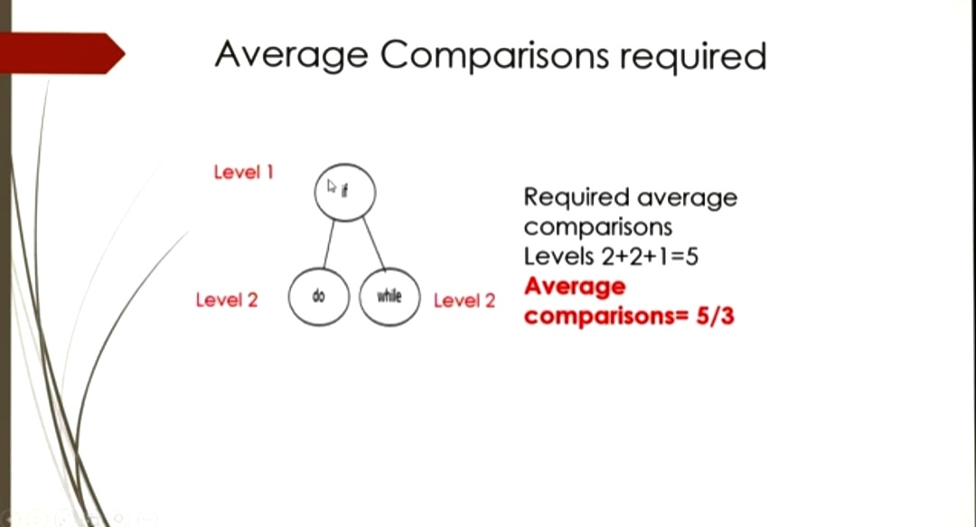

Slide 57
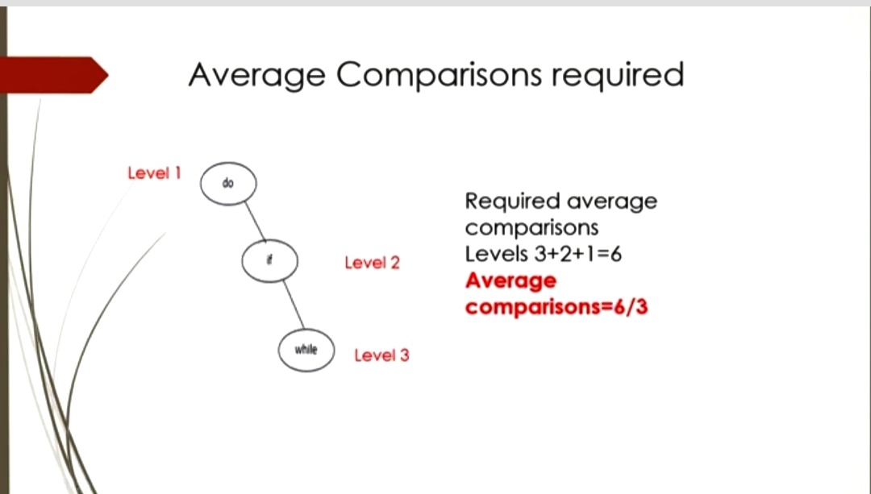

Slide 58
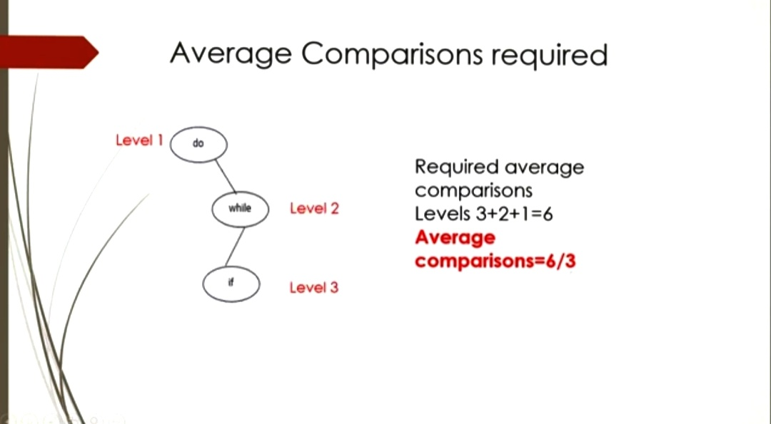

Slide 59
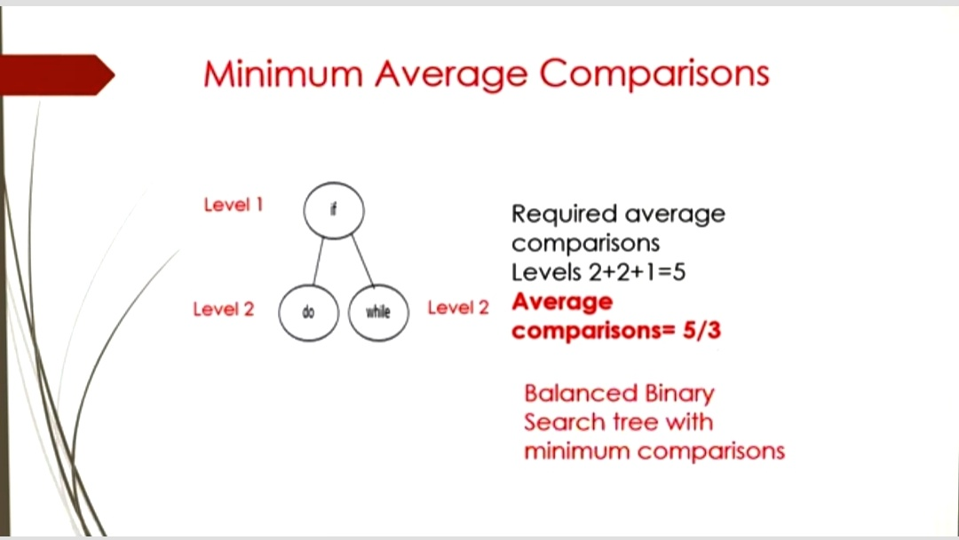

Slide 60
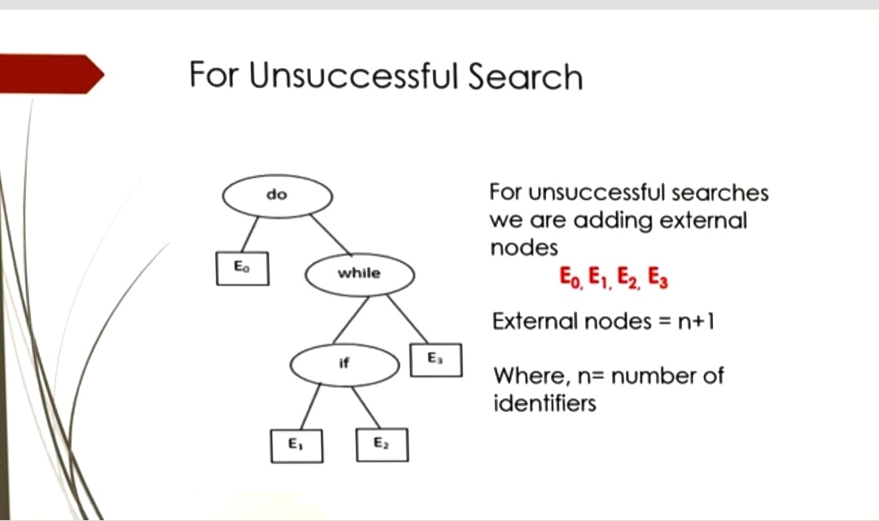
10
30
20

Slide 61
Optimal Binary Search Tree
stop
if
E₃
do
E₂
Problem
Given sequence of identifiers (a₁,a₂ …., a_{n)} with a₁<a₂ <··· < a_{n.}
Let p(i) be the probability with which we search for a_{i}
Let q(i) be the probability with which we search for an identifier x such that a_{i}< x <a_{i+1} .
Want to build a binary search tree (BST) with minimum expected search cost.
E₀
E₁

Slide 62
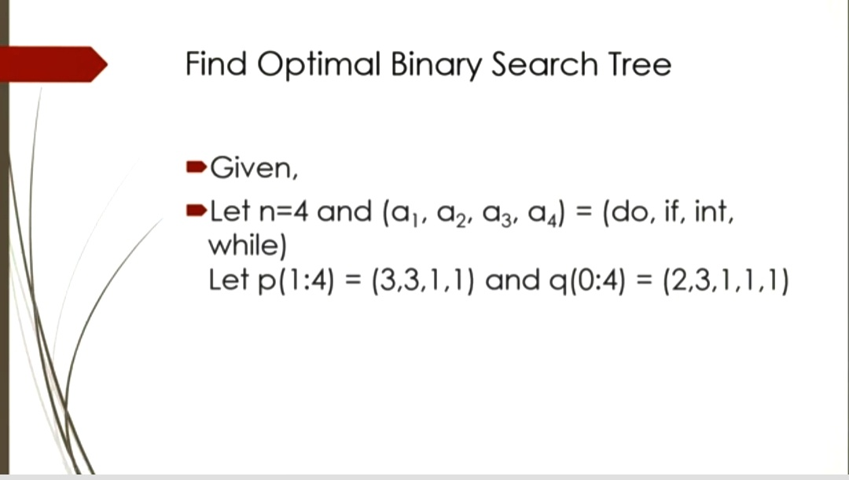

Slide 63
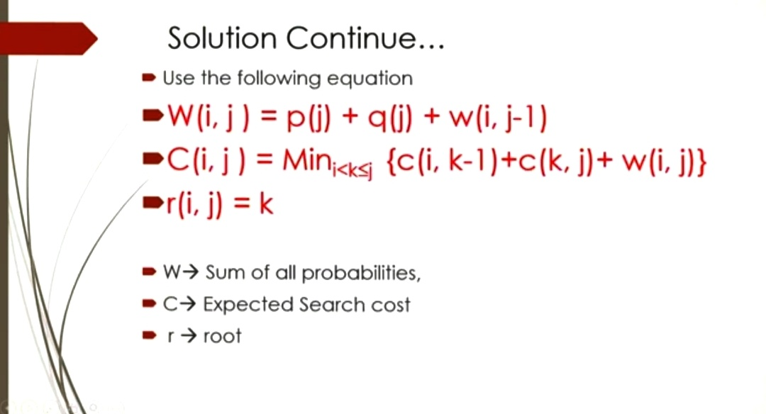

Slide 64
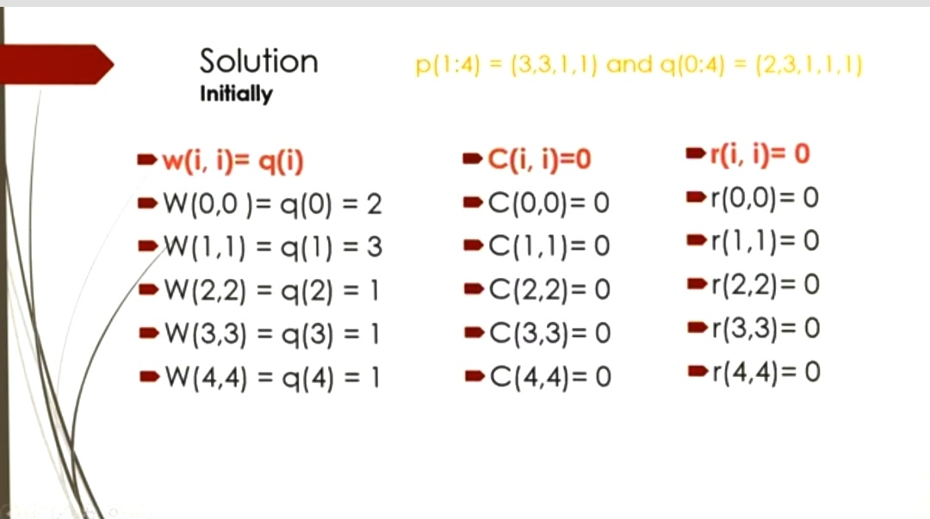

Slide 65
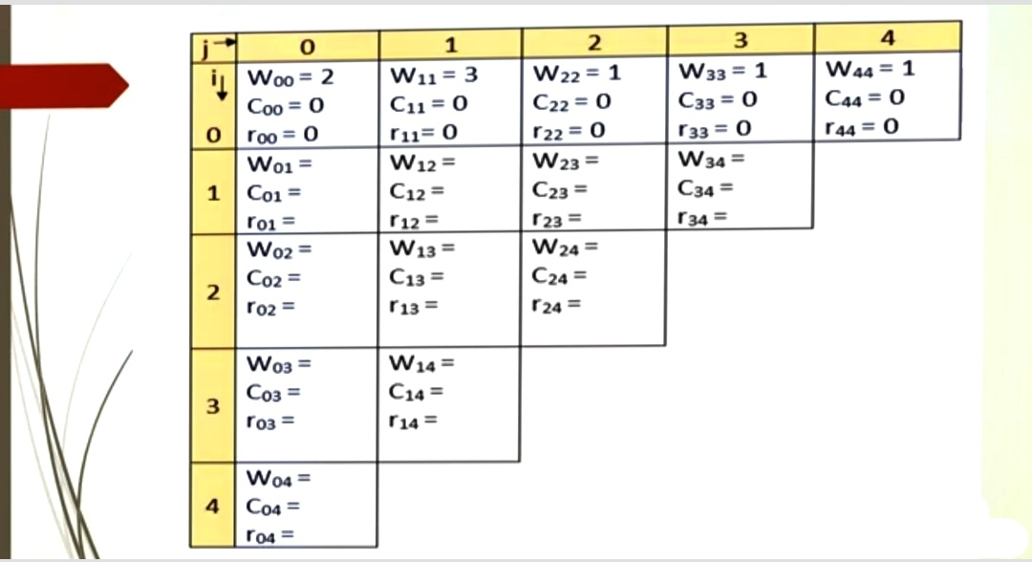

Slide 66
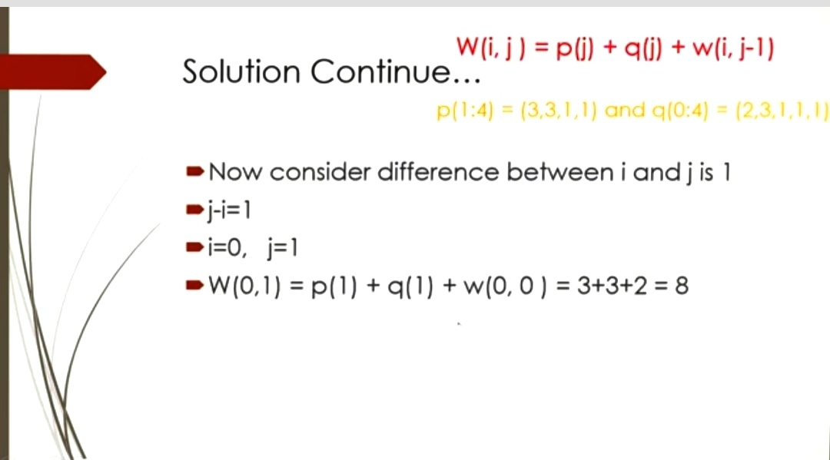

Slide 67
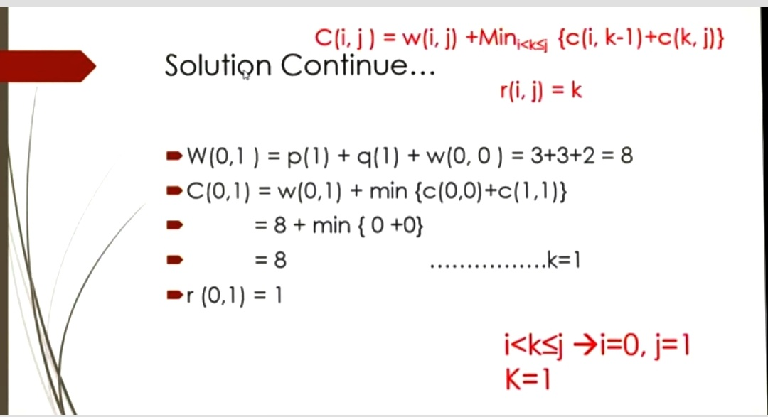

Slide 68
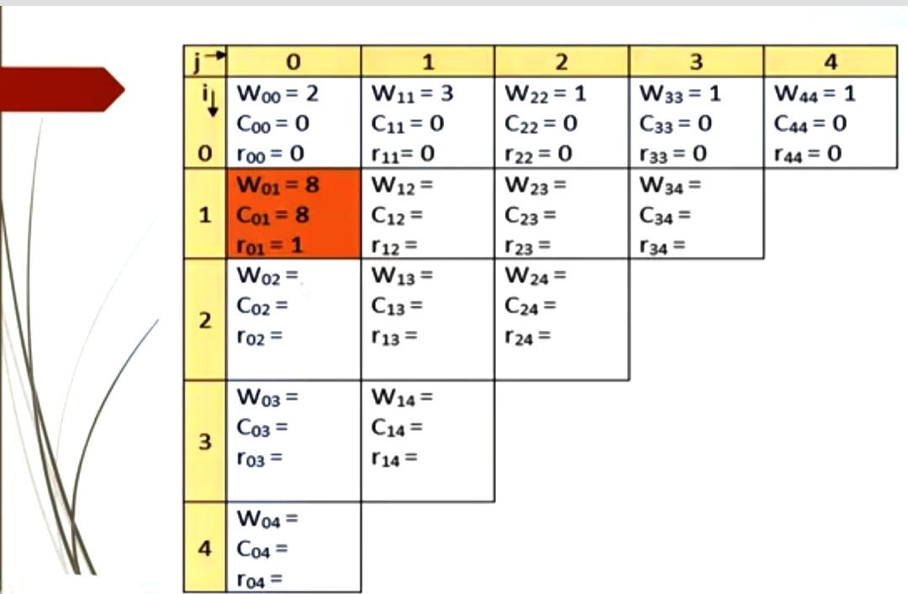

Slide 69
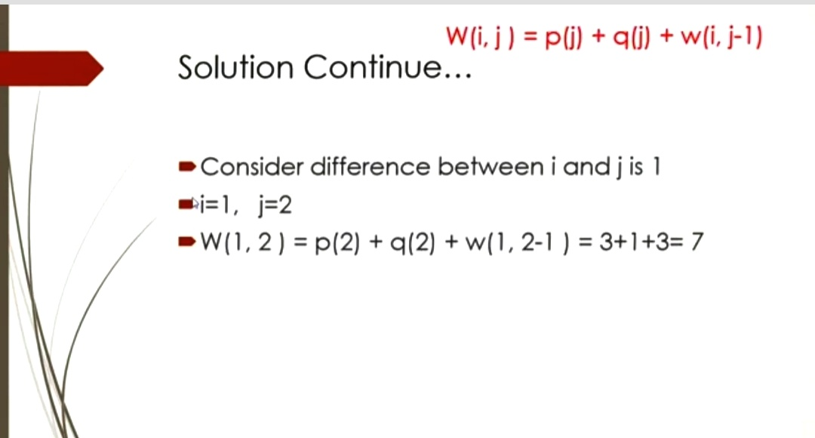

Slide 70
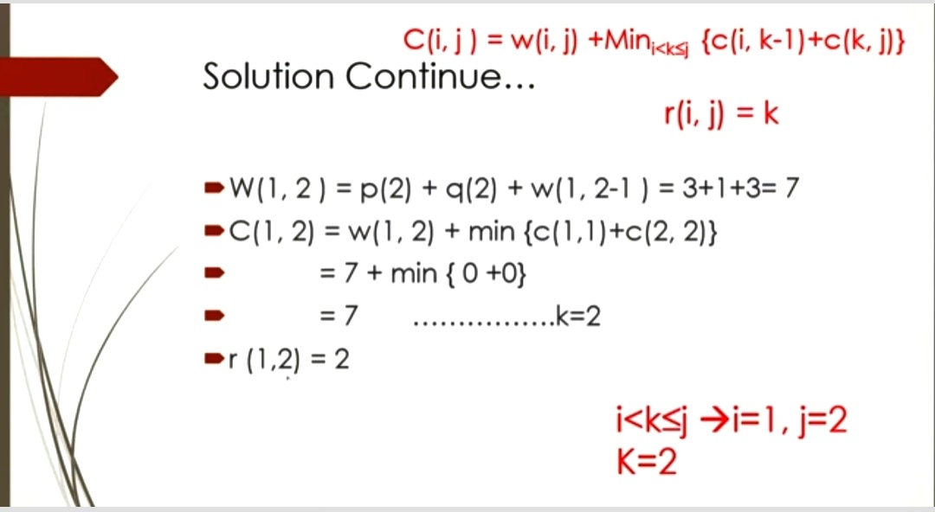

Slide 71
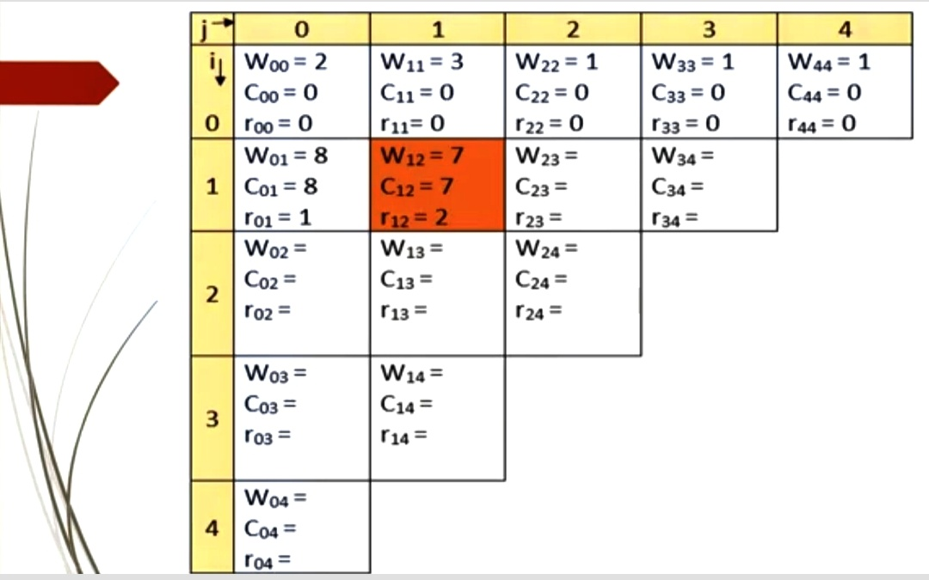

Slide 72
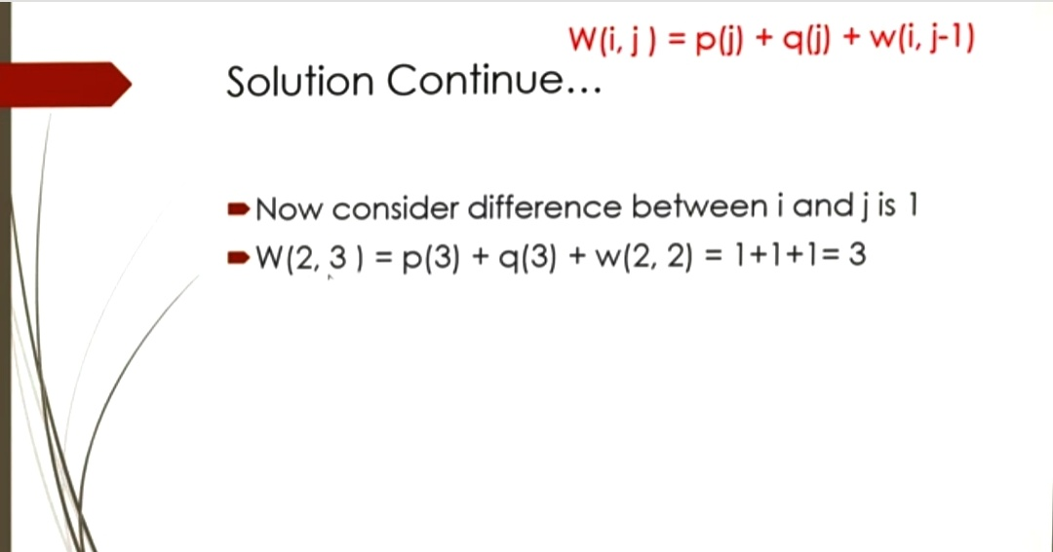

Slide 73
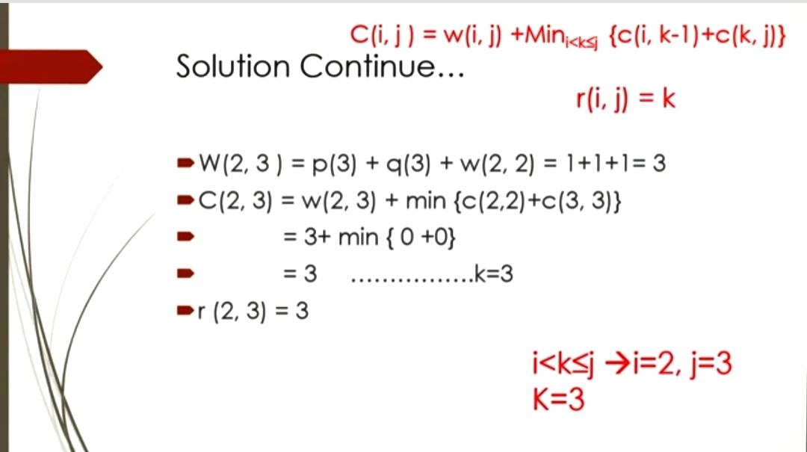

Slide 74
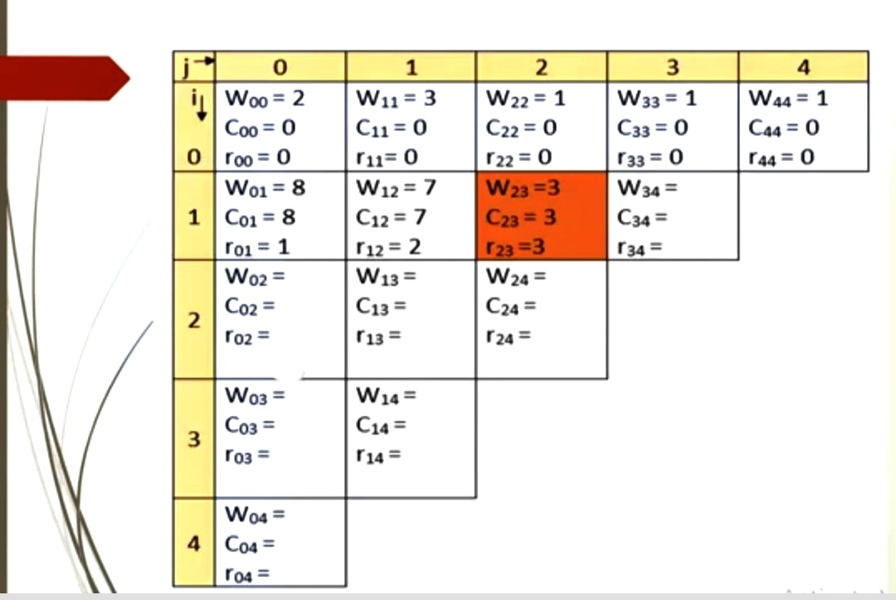

Slide 75
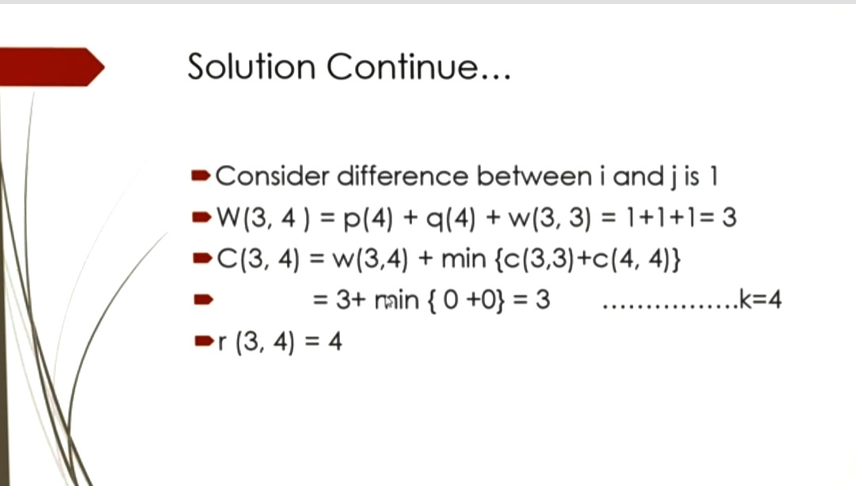

Slide 76
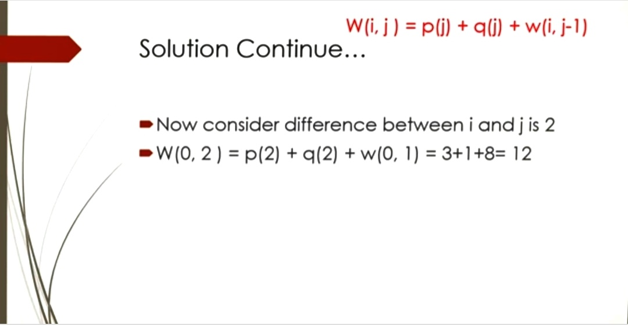

Slide 77
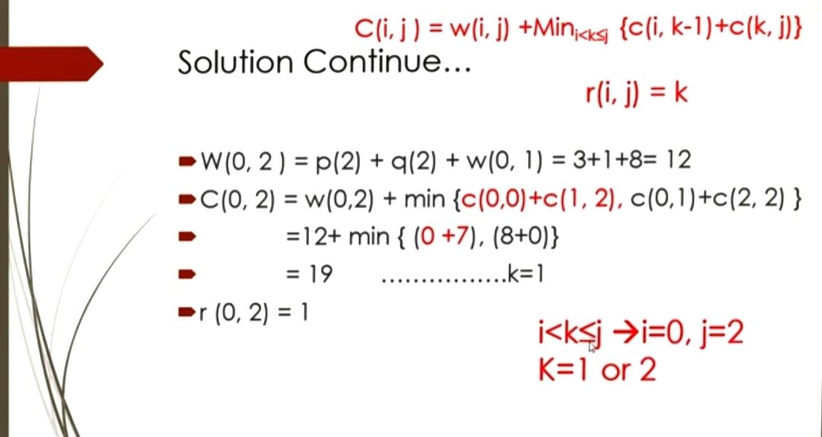

Slide 78
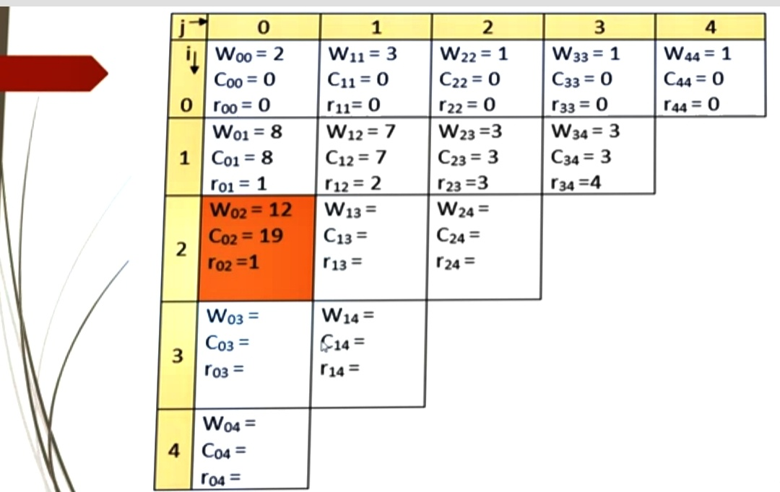

Slide 79
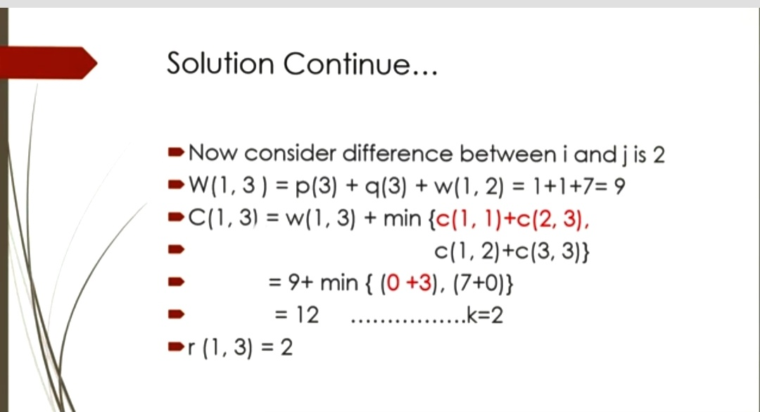

Slide 80
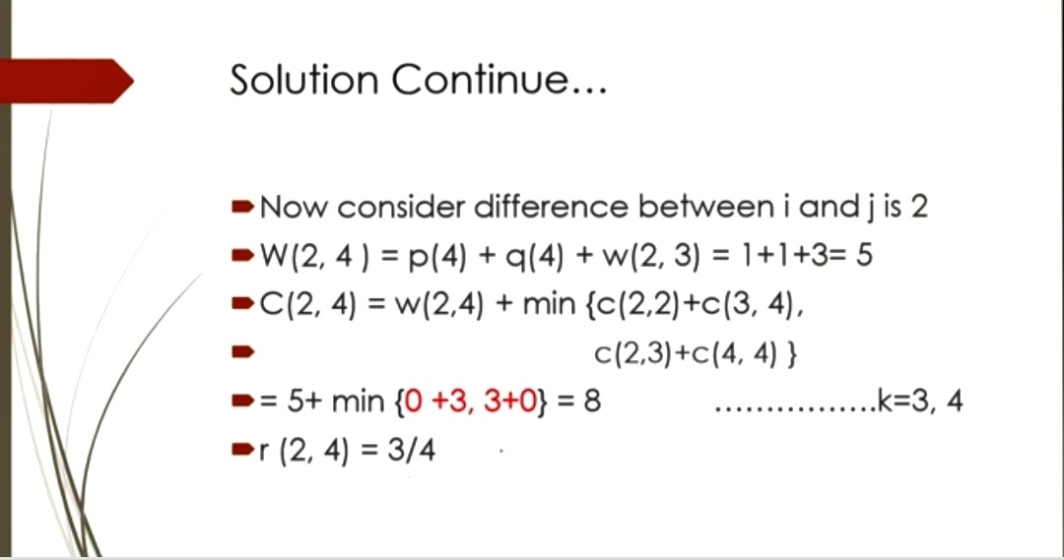

Slide 81
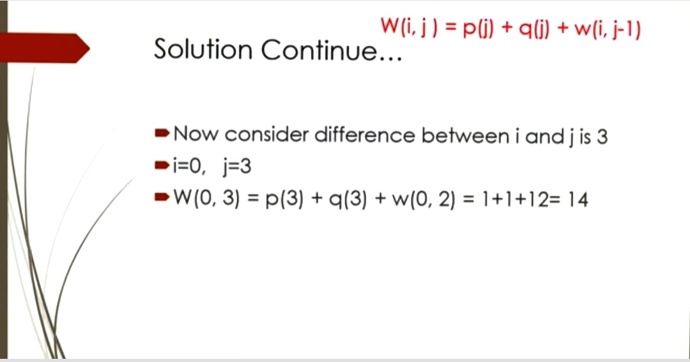

Slide 82
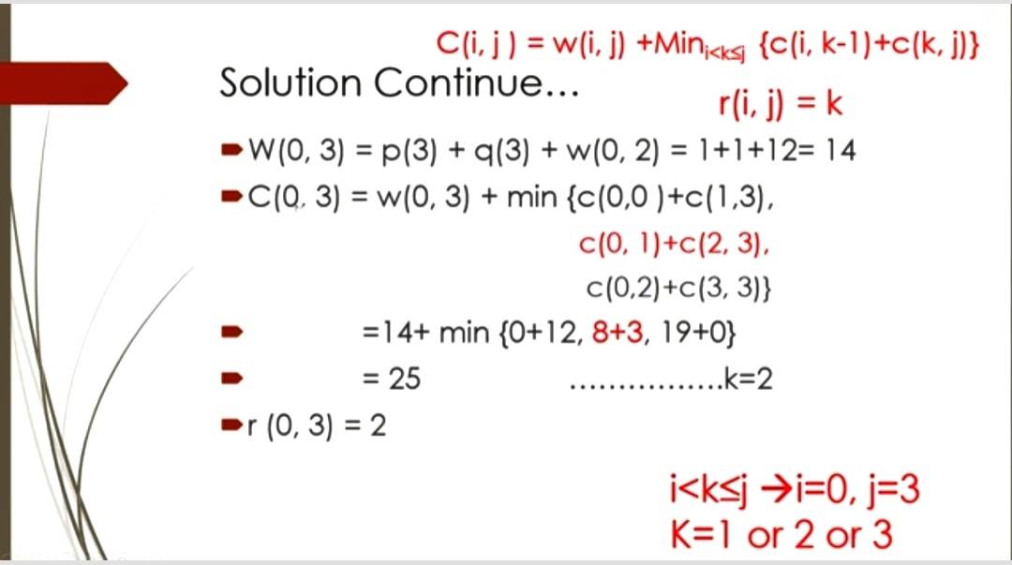

Slide 83
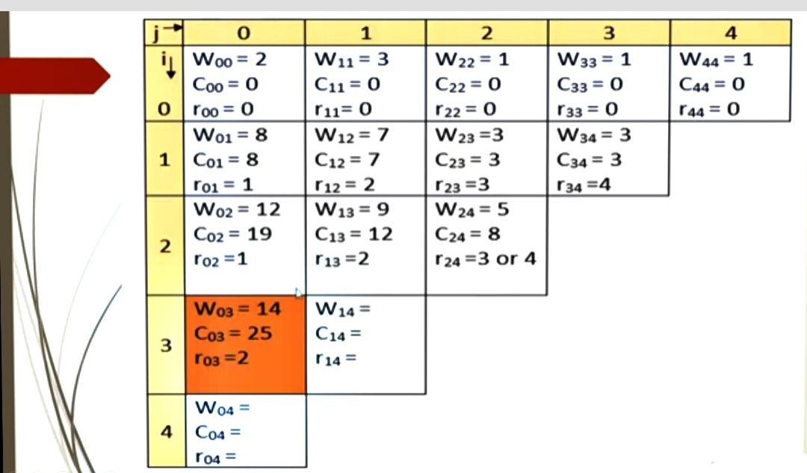

Slide 84
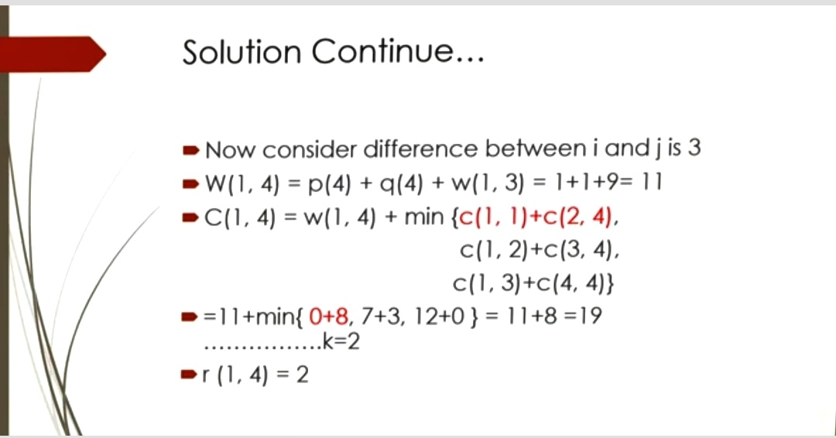

Slide 85
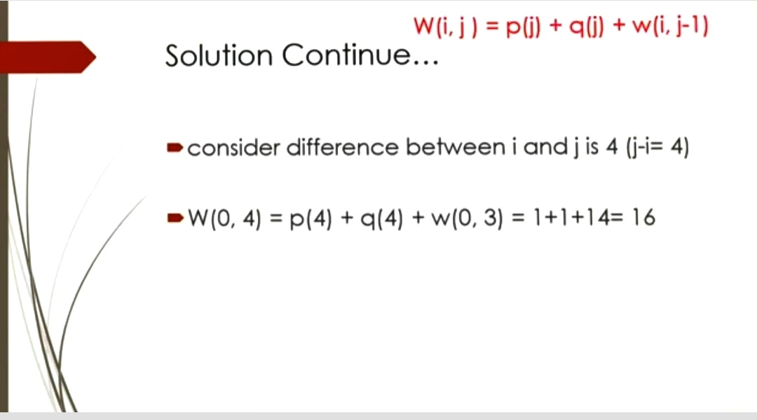

Slide 86
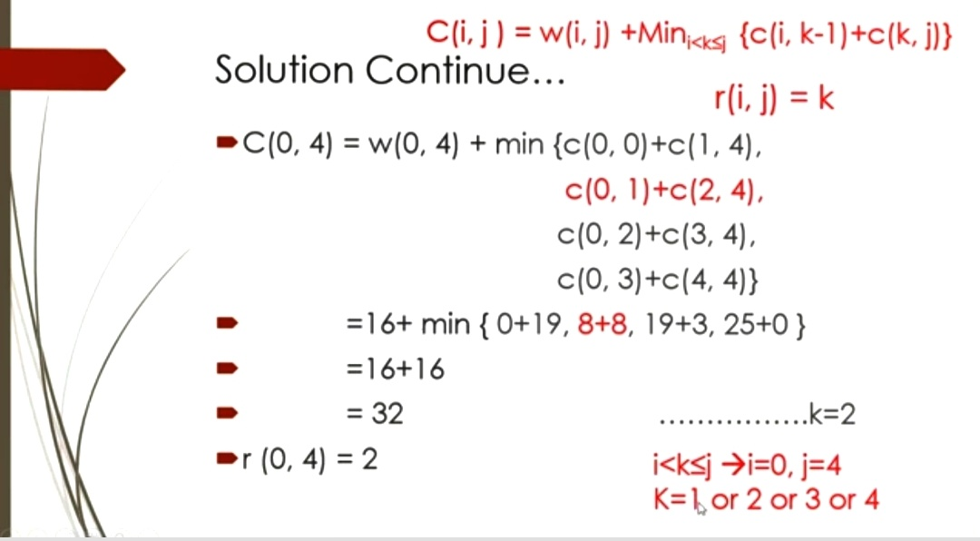

Slide 87
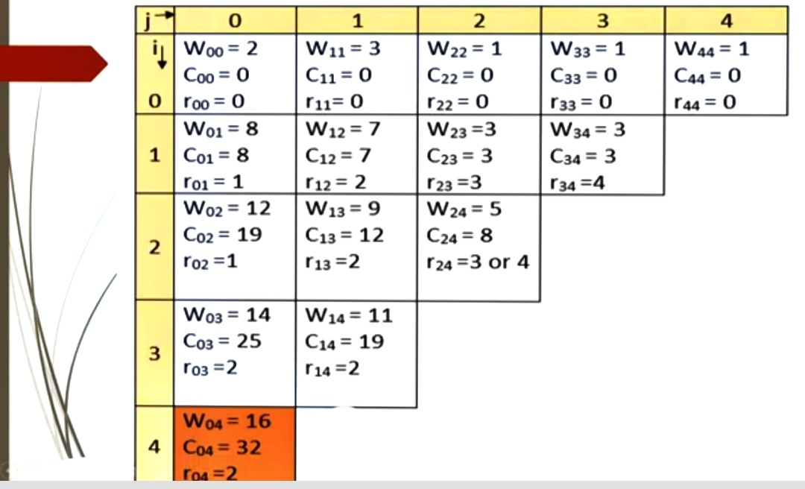

Slide 88
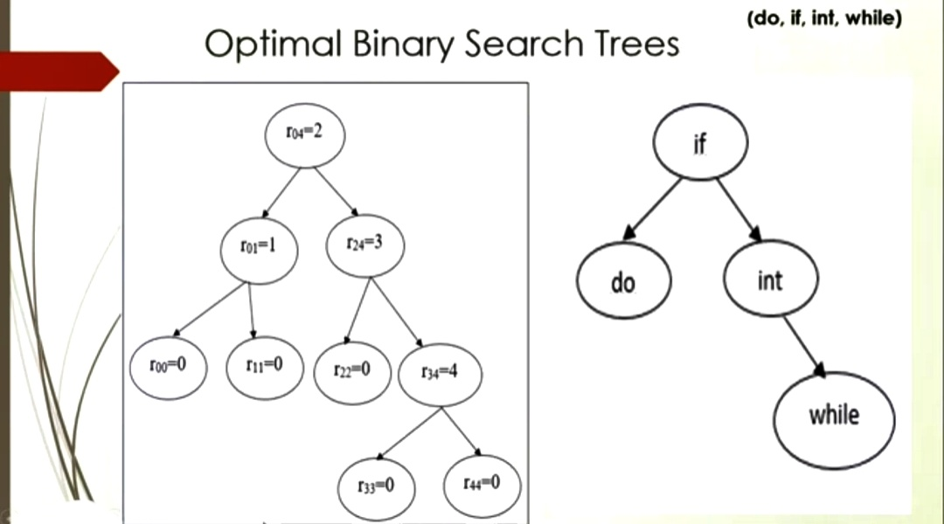

Slide 89
OBST
Construct the OBST (a1,a2,a3,a4)=(end,goto,print,stop)
P1=1/20,P2=1/5,P3=1/10,P4=1/20
q0=1/5,q1=1/10,q2=1/5,q3=1/20,q4=1/20

Slide 90
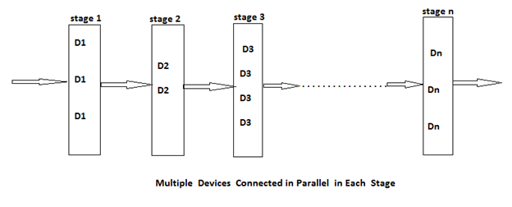
Reliability design
So, if we duplicate the devices at each stage then the reliability of the system can be increased.
It can be said that multiple copies of the same device type are connected in parallel through the use of switching circuits.
Here, switching circuit determines which devices in any given group are functioning properly.

Slide 91

Reliability design
In reliability design, the problem is to design a system that is composed of several devices connected in series.
If r1 is the reliability of the device.
Then the reliability of the function can be given by πr1.
If r1 = 0.99 and n = 10 that n devices are set in a series, 1 <= i <= 10, then reliability of the whole system πri can be given as: Πri = 0.904

Slide 92
Reliability design
Then they make use of such devices at each stage, that result is increase in reliability at each stage.
If at each stage, there are mi similar types of devices Di, then the probability that all mi have a malfunction is (1 - ri)^{mi}, which is very less.
And the reliability of the stage I becomes (1 – (1 - ri) ^{mi}). Thus, if ri = 0.99 and mi = 2, then the stage reliability becomes 0.9999 which is almost equal to 1.
Which is much better than that of the previous case or we can say the reliability is little less than 1 - (1 - ri) ^{mi} because of less reliability of switching circuits.

Slide 93

Reliability design
In reliability design, we try to use device duplication to maximize reliability. But this maximization should be considered along with the cost.
Let c is the maximum allowable cost and ci be the cost of each unit of device i. Then the maximization problem can be given as follows:
Maximize π Øi (mi) for 1 <= I <= n
Subject to:
mi>= 1 and integer 1 <= i <= n

Slide 94
Reliability design
Here, Øi (mi) denotes the reliability of the stage i.
The reliability of the system can be given as follows:
Π Øi (mi) for 1 <= i <= n
If we increase the number of devices at any stage beyond the certain limit, then also only the cost will increase but the reliability could not increase.
We can assume that each ci>0 and so each mi must be in the range i i 1 ≤ m ≤ u , where

