Slide 1
Unit III
RELATIONAL ALGEBRA

Slide 2
Formal Relational Query Languages
Relational Query Languages:
Language in which user requests information from the database.
Query languages can be categorized as:
Procedural
Non-procedural, or declarative
The formal relational query languages in relational database are
Relational algebra- it is procedural
Relational calculus- it is non-procedural
--Tuple relational calculus,
-- Domain relational calculus

Slide 3
Relational algebra operations/Relational operations
Relational algebra consists of a set of operations that take one or two relations as input and produce a new relation as a result.
The fundamental operations in relational algebra are
select: σ
project: ∏
union: ∪
set difference: –
Cartesian product: x
rename: ρ

Slide 4
Select operation:
The select operation selects tuples that satisfy a given predicate.
We use sigma (σ )to denote selection.
The predicate appears as a subscript to σ .
Notation: σ _{p}(r) Account
Example: σ _{branch_name=“Abids”} (Account)
This query selects the tuples of the Account relation where the branch is Abids
Example: query to find all tuples in which the amount is more than 5000.
σ _{amount>5000} (Account)
Acc_id | Branch_name | amount
1212 | Abids | 4500
1234 | Hyderabad | 15000
1245 | BanjaraHills | 8000

Slide 5
Project operation:
The project operation allows us to retrieve the attributes from the relation.
Projection is denoted by greek letter pi ( ∏ ).
We list the attributes that we wish to appear in the result as a subscript to ∏.
Notation:
Here, r denotes relation name,A1,A2,.. are attributes .
Example: write a query to list all the account ids and amount of the Account.
∏_{acc_id, amount} (Account)
Composition of relational operations:
Example: Find those customers who live in hyderabad.
∏_{ename} (σ _{city=‘”hyderabad”} (Customers))

Slide 6
Union operation:
union returns a relation instance containing all tuples that occur either in first relation or second relation or both.
It is denoted by ‘ U’.
The union operation of R U S is valid when both R and S have same number of attributes.
Notation: R U S
Example: to find all customers with either an account or a loan
∏_{customer_name} (depositor) ∪ ∏_{customer_name} (borrower)
Set-difference operation:
The set difference operation allows us to find tuples that are in one relation but not in another.
It is denoted by ‘ –’.
notation : R – S
The expression R – S returns a relation containing the tuples that are in R but not in S.

Slide 7
Example: find all customers of the bank who have an account but not the loan
∏_{customer_name} (depositor) - ∏_{customer_name} (borrower)
Cartesian product operation:
This operation allows us to combine information from any two relations.
It is denoted by cross( X ).
Notation: The cartesian product of relation r1 and r2 can be written as
r1 X r2
Example: the relation schema for R =borrower X loan is
(borrower.customer_name, borrower.loan_number, loan. Loan_number, loan.branch_name, loan.amount)

Slide 8
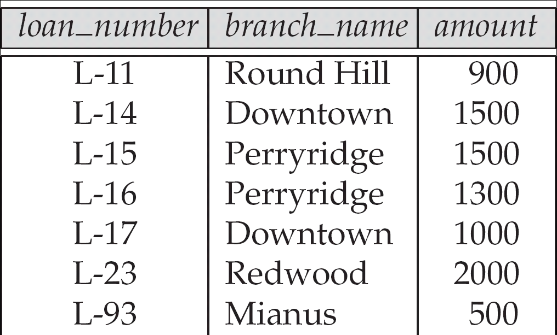
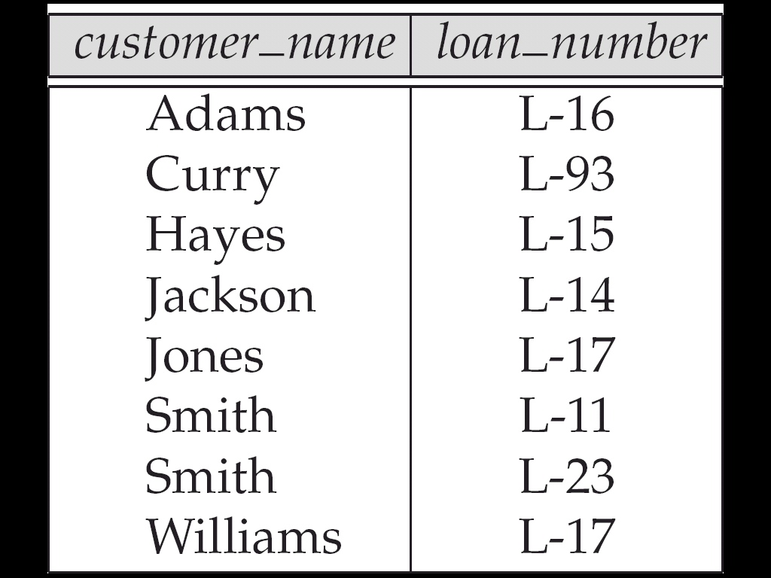
Loan relation
Borrower relation

Slide 9
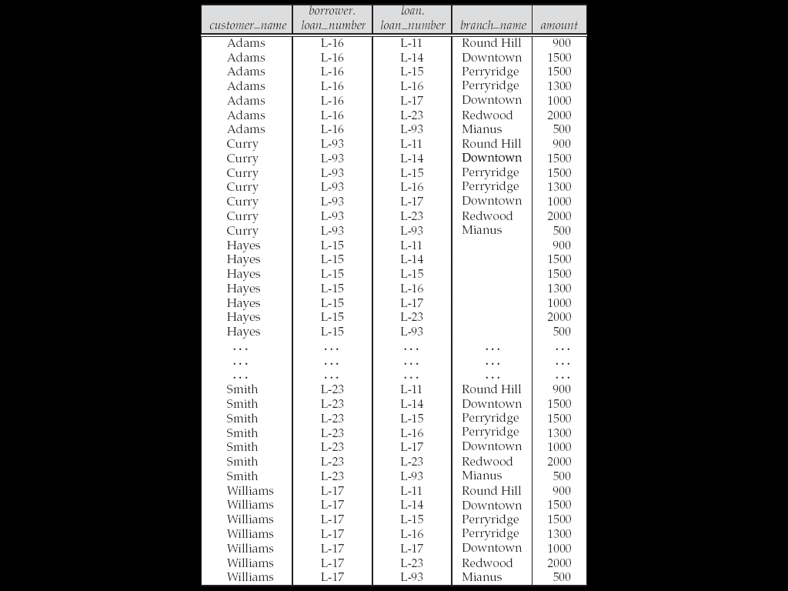
Result of borrower X Loan:

Slide 10
Rename operation:
Allows us to name, and therefore to refer to, the results of relational-algebra expressions.
Allows us to refer to a relation by more than one name.
It is denoted by greek letter rho (ρ )
Notation:
ρ _{x} (E)
returns the expression E under the name X

Slide 11
Relational Calculus
Relational calculus is a non-procedural query language.
In the non-procedural query language, the user is concerned with the details of how to obtain the end results.
The relational calculus tells what to do but never explains how to do.
Types of Relational calculus:
1)Tuple relational calculus
2)Domain relational calculus
Tuple Relational calculus:
The tuple relational calculus is specified to select the tuples in a relation.
In TRC, filtering variable uses the tuples of a relation.
The result of the relation can have one or more tuples.

Slide 12
A TRC query has the form or Notation:
{T | P (T)}
Where T is a tuple variable and P(T) is the condition or formula used to fetch T.
Tuple relational calculus uses some operators, it uses logical connectives ∧ (and), ∨ (or) and ┓ (not).
It uses Existential (∃) and Universal Quantifiers (∀) to bind the variable.
Example:
1)find all sailors with a rating above 7.
{ S|S ∈ Sailors ∧ S.rating>7}

Slide 13
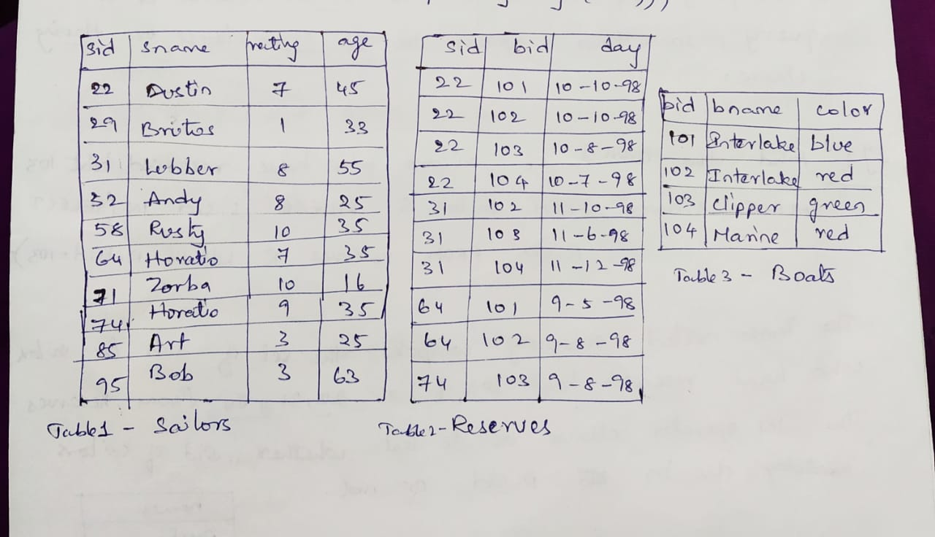
Example tables(relations)

Slide 14
2)Find the names and ages of sailors with a rating above 7.
{ P| ∃ S ∈ Sailors (S.rating >7 ∧ P.name=S.sname ∧ P.age=S.age)}
3)Find the names of sailors who have reserved boat 103
{P|∃ S ∈ Sailors ∃ R ∈ Reserves (R.sid=S.sid ∧ R.bid=103 ∧ P.sname=S.sname)}
4) Find the names of sailors who have reserved a red boat.
{P|∃ S ∈ Sailors ∃ R ∈ Reserves ∃ B ∈ Boats (R.sid=S.sid ∧ B.bid=R.bid ∧ B.color=‘red’ ∧ P.sname=S.sname)}

Slide 15
Domain Relational Calculus
In domain relational calculus the records are filtered based on the domain of attributes.
A DRC query has the form or notation:
{(x1,x2,…,xn) |P(x1,x2,…,xn)}
where (x1,x2,….xn) is either a domain variable or a constant and P(x1,x2,…,xn) denotes a DRC formula or condition.
A DRC formula is same as TRC formula, the main difference is that variables are now domain variables.
Domain relational calculus uses the same operators as tuple calculus. It uses logical connectives ∧ (and), ∨ (or) and ┓ (not).
It uses Existential (∃) and Universal Quantifiers (∀) to bind the variable.

Slide 16
Example tables(relations)

Slide 17
Examples:
1) Find all sailors with rating above 7.
{(I,N,T,A)|(I,N,T,A) ∈ Sailors ∧ T>7}
2) Find the names of sailors who have reserved boat 103
{ (N)| ∃ I,T,A((I,N,T,A) ∈ Sailors ∧ ∃(Ir,Br,D) ∈ Reserves(Ir=I ∧ Br=103))}

Slide 18
UNIT-III:
Formal Relational Query Languages: The Relational operations, The Tuple Relational Calculus, The Domain Relational Calculus.
Relational Database Design: Features of Good Relational Designs, Atomic Domains and First Normal Form, Decomposition Using Functional Dependencies, Decomposition Using Multi valued Dependencies, BCNF.

