Slide 1
UNIT -- V:
Multi Processors:
Characteristics of Multi Processor.
Interconnection structures:
Time shared common bus,
Multiport memory,
Crossbar switch,
Multi-stage switching network.
Introduction to Flynn’s classification:
SISD, SIMD, MISD, MIMD (Introduction).

Slide 2
Multiprocessors
A multiprocessor is a computer system with two or more central processing units (CPUs), with each one sharing the common main memory(RAM) as well as the peripherals.
This helps in simultaneous processing of programs.
The key objective of using a multiprocessor is to boost the system’s execution speed, with other objectives being fault tolerance and application matching.

Slide 3
Characteristics of Multiprocessors
A multiprocessor system is an interconnection of two or more CPUs with memory and input-output equipment.
The term "processor" In multiprocessor can mean either a central processing unit (CPU) or an input-output processor (IOP).
However, a system with a single CPU and one or more IOPs is usually not included in the definition of a multiprocessor system unless the IOP has computational facilities comparable to a CPU.

Slide 4
As it is most commonly defined, a multiprocessor system implies the existence of multiple CPUs, although usually there will be one or more IOPs as well.
As mentioned in Sec. 9-1, multiprocessors are classified as multiple instruction stream, multiple data stream (MIMO) systems.

Slide 5
There are some similarities between multiprocessor and multicomputer systems since both support concurrent operations.
However, there exists an important distinction between a system with multiple computers and a system with multiple processors.
Computers are interconnected with each other by means of communication lines to form a computer network.
The network consists of several autonomous computers that may or may not communicate with each other.
A multiprocessor system is controlled by one operating system that provides interaction between processors and all the components of the system cooperate in the solution of a problem.

Slide 6
Computations can proceed in parallel in one of two ways.
Multiple independent jobs can be made to operate in parallel.
2. A single job can be partitioned into multiple parallel tasks.

Slide 7
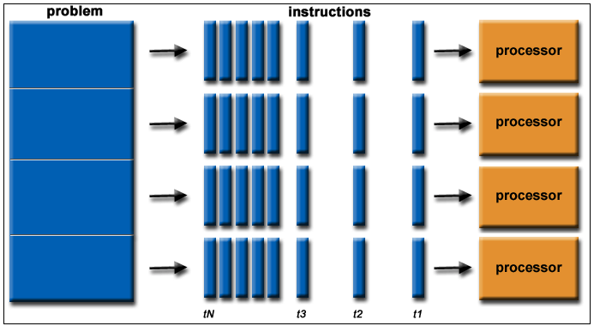
Multiple independent jobs can be made to operate in parallel.

Slide 8
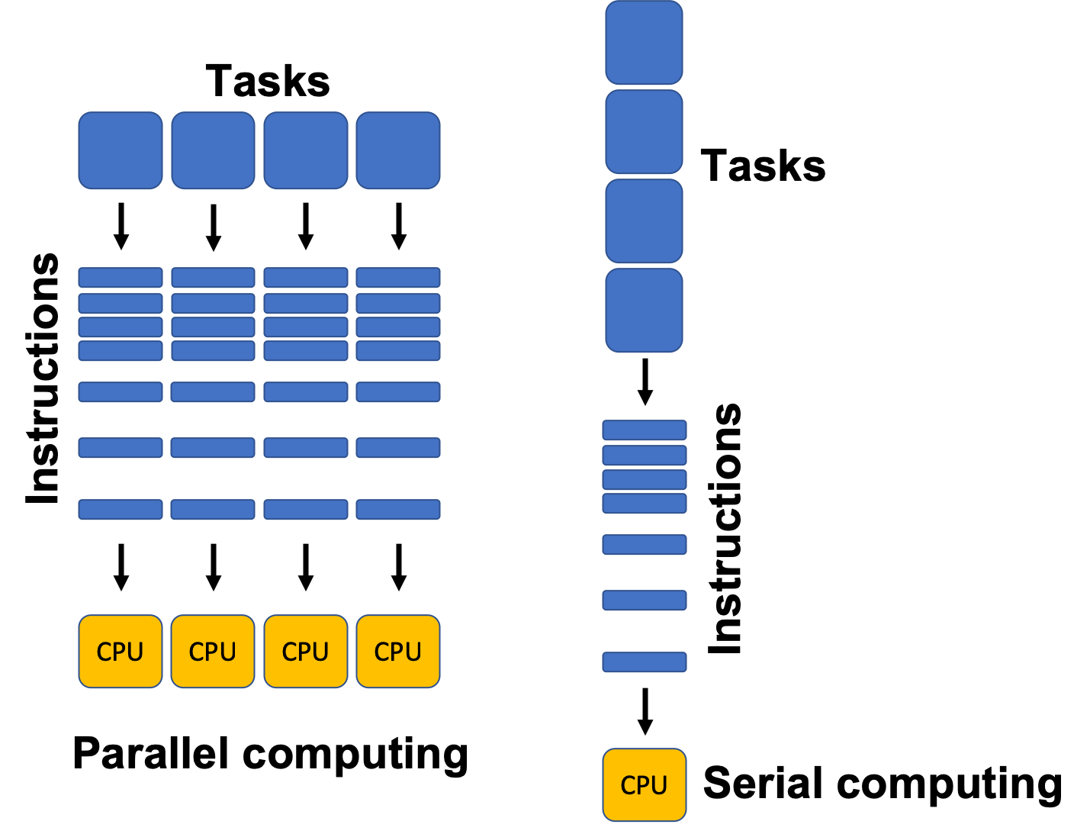

Slide 9
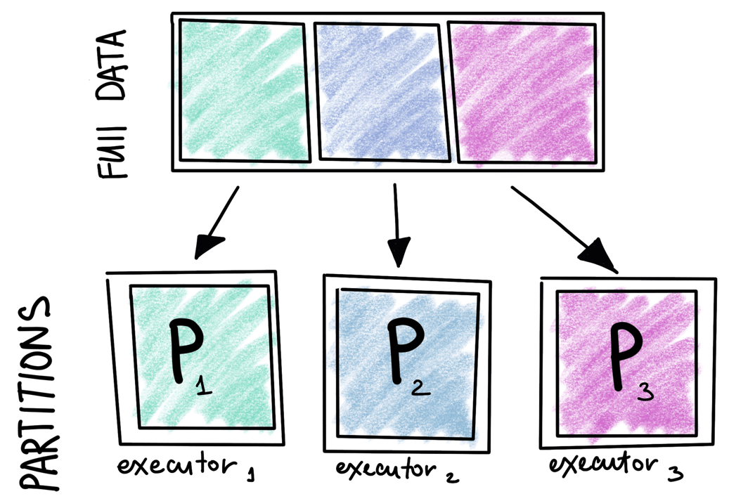
A single job can be partitioned into multiple parallel tasks.

Slide 10
Multiprocessing improves the reliability of the system
A failure or error in one part has a limited effect on the rest of the system.
If a fault causes one processor to fail, a second processor can be assigned to perform the functions of the disabled processor.
The system as a whole can continue to function correctly with perhaps some loss in efficiency.
The benefit of a multiprocessor organization
improved system performance, by decomposing a program into parallel executable tasks.

Slide 11
Multiprocessors are classified by the way their memory is organized.
A multiprocessor system with common shared memory is classified as a shared memory or tightly coupled multiprocessor.
This does not preclude each processor from having its own local memory. In fact, most commercial tightly coupled multiprocessors provide a cache memory with each CPU.
In addition, there is a global common memory that all CPUs can access. Information can therefore be shared among the CPUs by placing it in the common global memory.

Slide 12
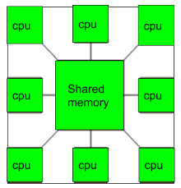
Common Shared Memory

Slide 13
An alternative model of microprocessor is the distributed-memory or loosely coupled system.
Each processor element in a loosely coupled system has its own private local memory.
The processors are tied together by a switching scheme designed to route information from one processor to another through a message- passing scheme. The processors relay program and data to other processors in packets.
A packet consists of an address, the data content, and some error detection code. The packets are addressed to a specific processor or taken by the first available processor, depending on the communication system used.
Loosely coupled systems are most efficient when the interaction between tasks is minimal, whereas tightly coupled systems can tolerate a higher degree of interaction between tasks.

Slide 14
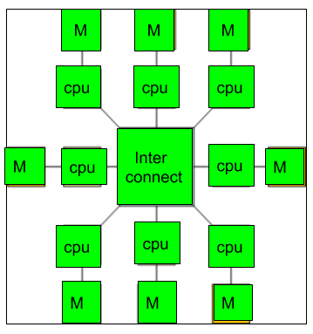
DISTRIBUTED-MEMORY

Slide 15
Benefits of using a multiprocessor include:
Improves reliability of the system
Enhanced performance
Multiple applications
Multiple users
Multi-tasking inside an application
High/increased throughput and/or responsiveness
Hardware sharing among CPUs

Slide 16
Interconnection Structures
The components that form a multiprocessor system are CPUs, IOPs connected to input-output devices, and a memory unit that may be partitioned into a number of separate modules.
The interconnection between the components can have different physical configurations, depending on the number of transfer paths that are available between the processors and memory in a shared memory system or among the processing elements in a loosely coupled system.

Slide 17
CPU(CPU1,CPU2,CPU3…..), MEMORY, IO DEVICES(IOP,IOP,IOP,)

Slide 18
There are several physical forms available for establishing an interconnection network. Some of these schemes are presented in this section:
1. Time-shared common bus
2. Multiport Memory
3. Crossbar Switch
4. Multistage switching Network
5. Hypercube System

Slide 19
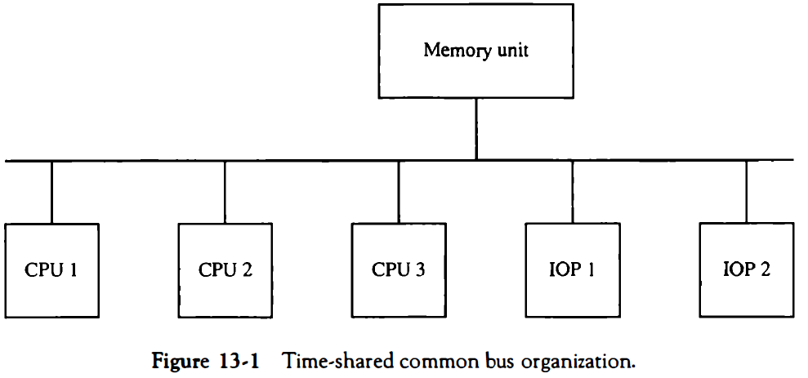
Time-shared common bus
A common-bus multiprocessor system consists of a number of processors connected through a common path to a memory unit.
A time-shared common bus for five processors is shown in Fig. 13-1 . Only one processor can communicate with the memory or another processor at any given time.

Slide 20
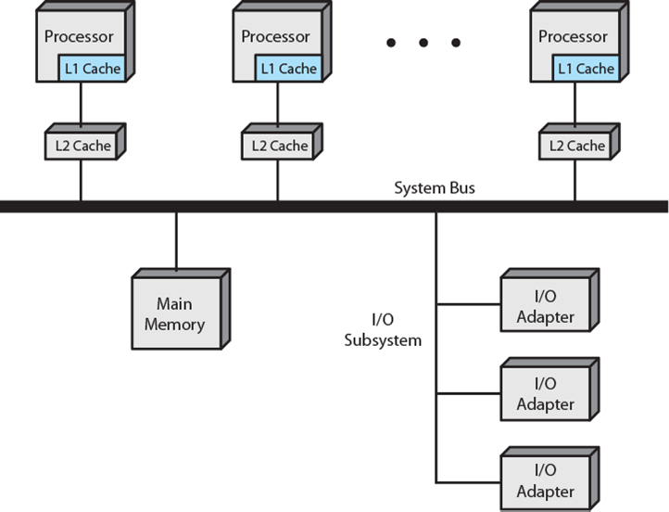

Slide 21
Any other processor wishing to initiate a transfer must first determine the availability status of the bus, and only after the bus becomes available can the processor address the destination unit to initiate the transfer.
A command is issued to inform the destination unit what operation is to be performed .

Slide 22
The receiving unit recognizes its address in the bus and responds to the control signals from the sender, after which the transfer is initiated.
The system may exhibit transfer conflicts since one common bus is shared by all processors.
These conflicts must be resolved by incorporating a bus controller that establishes priorities among the requesting units.
A single common-bus system is restricted to one transfer at a time.

Slide 23
This means that when one processor is communicating with the memory, all other processors are either busy with internal operations or must be idle waiting for the bus.
As a consequence, the total overall transfer rate within the system is limited by the speed of the single path.
The processors in the system can be kept busy more often through the implementation of two or more independent buses to permit multiple simultaneous bus transfers.
However, this increases the system cost and complexity.

Slide 24
A more economical implementation of a dual bus structure is depicted in Fig. 13-2. Here we have a number of local buses each connected to its own local memory and to one or more processors.
Each local bus may be connected to a CPU, an IOP, or any combination of processors.
A system bus controller links each local bus to a common system bus .

Slide 25

Only one processor can communicate with the shared memory and other common resources through the system bus at any given time. The other processors are kept busy communicating with their local memory and I/O devices.

Slide 26
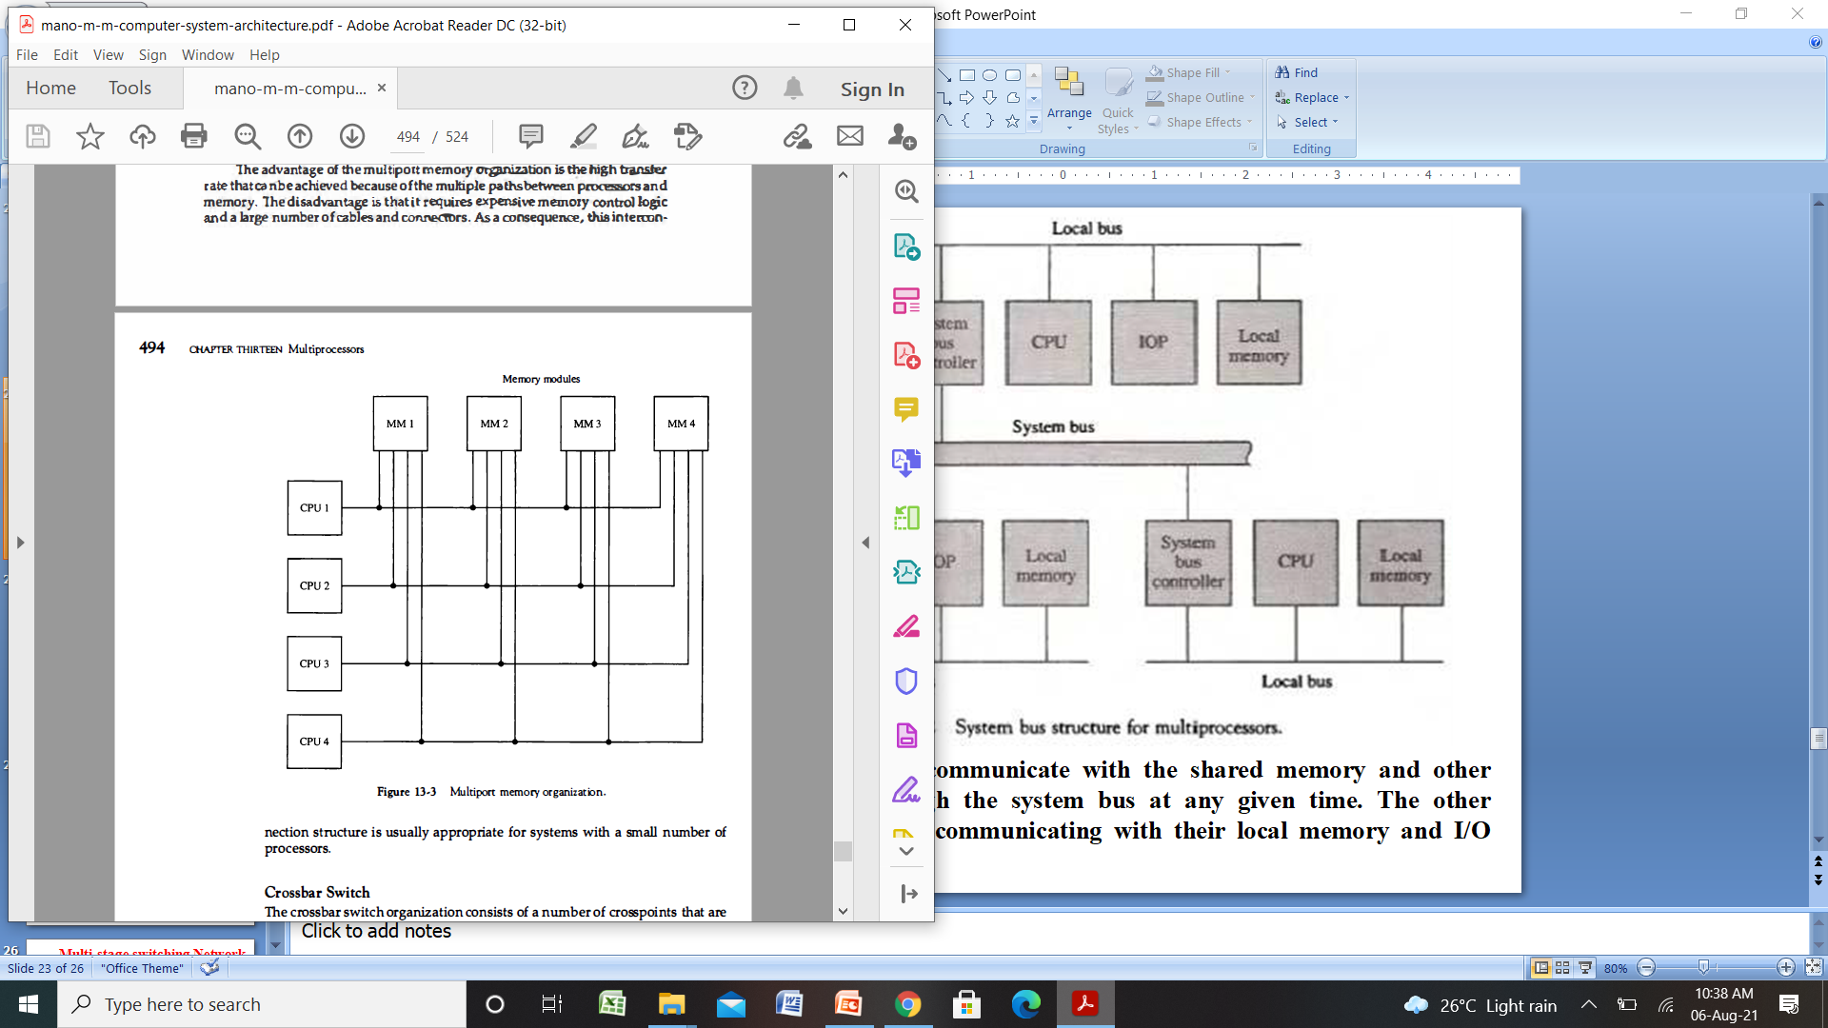
Multiport Memory

Slide 27
A multiport memory system employs separate buses between each memory module and each CPU.
This is shown in Fig.. 13-3 for four CPUs and four memory modules (MMs).
Each processor bus is Connected to each memory module.
A processor bus consists of the address, data, and control lines required to communicate with memory.
The memory module is said to have four ports and each port accommodates one of the buses

Slide 28
The advantage of the multi port memory organization is the high transfer rate that can be achieved because of the multiple paths between processors and memory.
The disadvantage is that it requires expensive memory control logic and a large number of cables and connectors.
As a consequences this interconnection structure is usually appropriate for systems with a small number of processors.

Slide 29
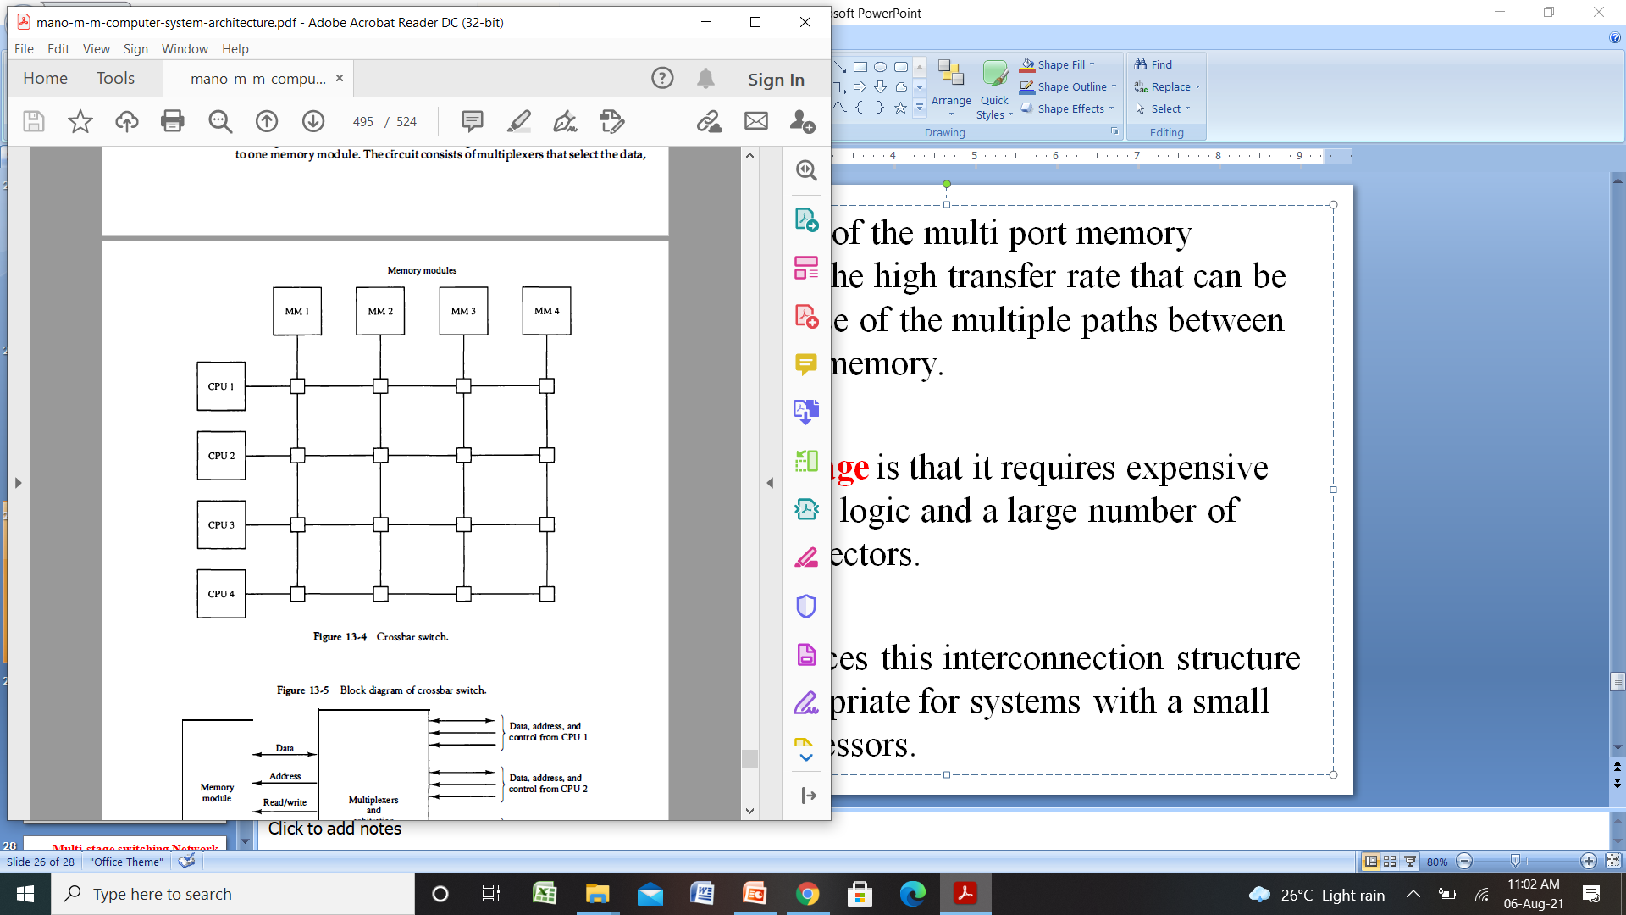
Crossbar Switch

Slide 30
The crossbar switch organization consists of a number of cross points that are placed at intersections between processor buses and memory module paths.
The small square in each cross point is a switch that determines the path from a processor to a memory module.
Each switch point has control logic to set up the transfer path between a processor and memory.
It examines the address that is placed in the bus to determine whether its particular module is being addressed.

Slide 31
It also resolves multiple requests for access to the same memory module on a predetermined priority basis.
A crossbar switch organization supports simultaneous transfers from memory modules because there is a separate path associated with each module.
The circuit consists of multiplexers that select the data, address, and control from one CPU for communication with the memory module.
Priority levels are established by the arbitration logic to select one CPU when two or more CPUs attempt to access the same memory.

Slide 32
Multi-stage switching Network
The basic component of a multistage network is a two-input, two-output, interchange switch.
The 2 X 2 switch has two input labeled A and B, and two outputs, labeled 0 and 1.
The switch has the capability connecting input A to either of the outputs. Terminal B of the switch behaves in a similar fashion.
There are control signal(not shown) associated with the switch that establish the interconnection between the input and output terminals

Slide 33
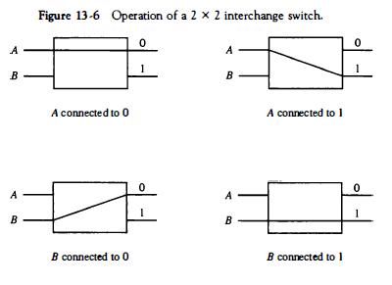

Slide 34
How it works….
Using the 2 x 2 switch as a building block, it is possible to build multistage network to control the communication between a number of source and destinations.
To see how this is done, consider the binary tree shown Fig. 13-7.
The two processors P1 and P2 are connected through switches to eight memory modules marked in binary from 000 through 1 1 1 . The path from source to a destination is determined from the binary bits of the destination

Slide 35
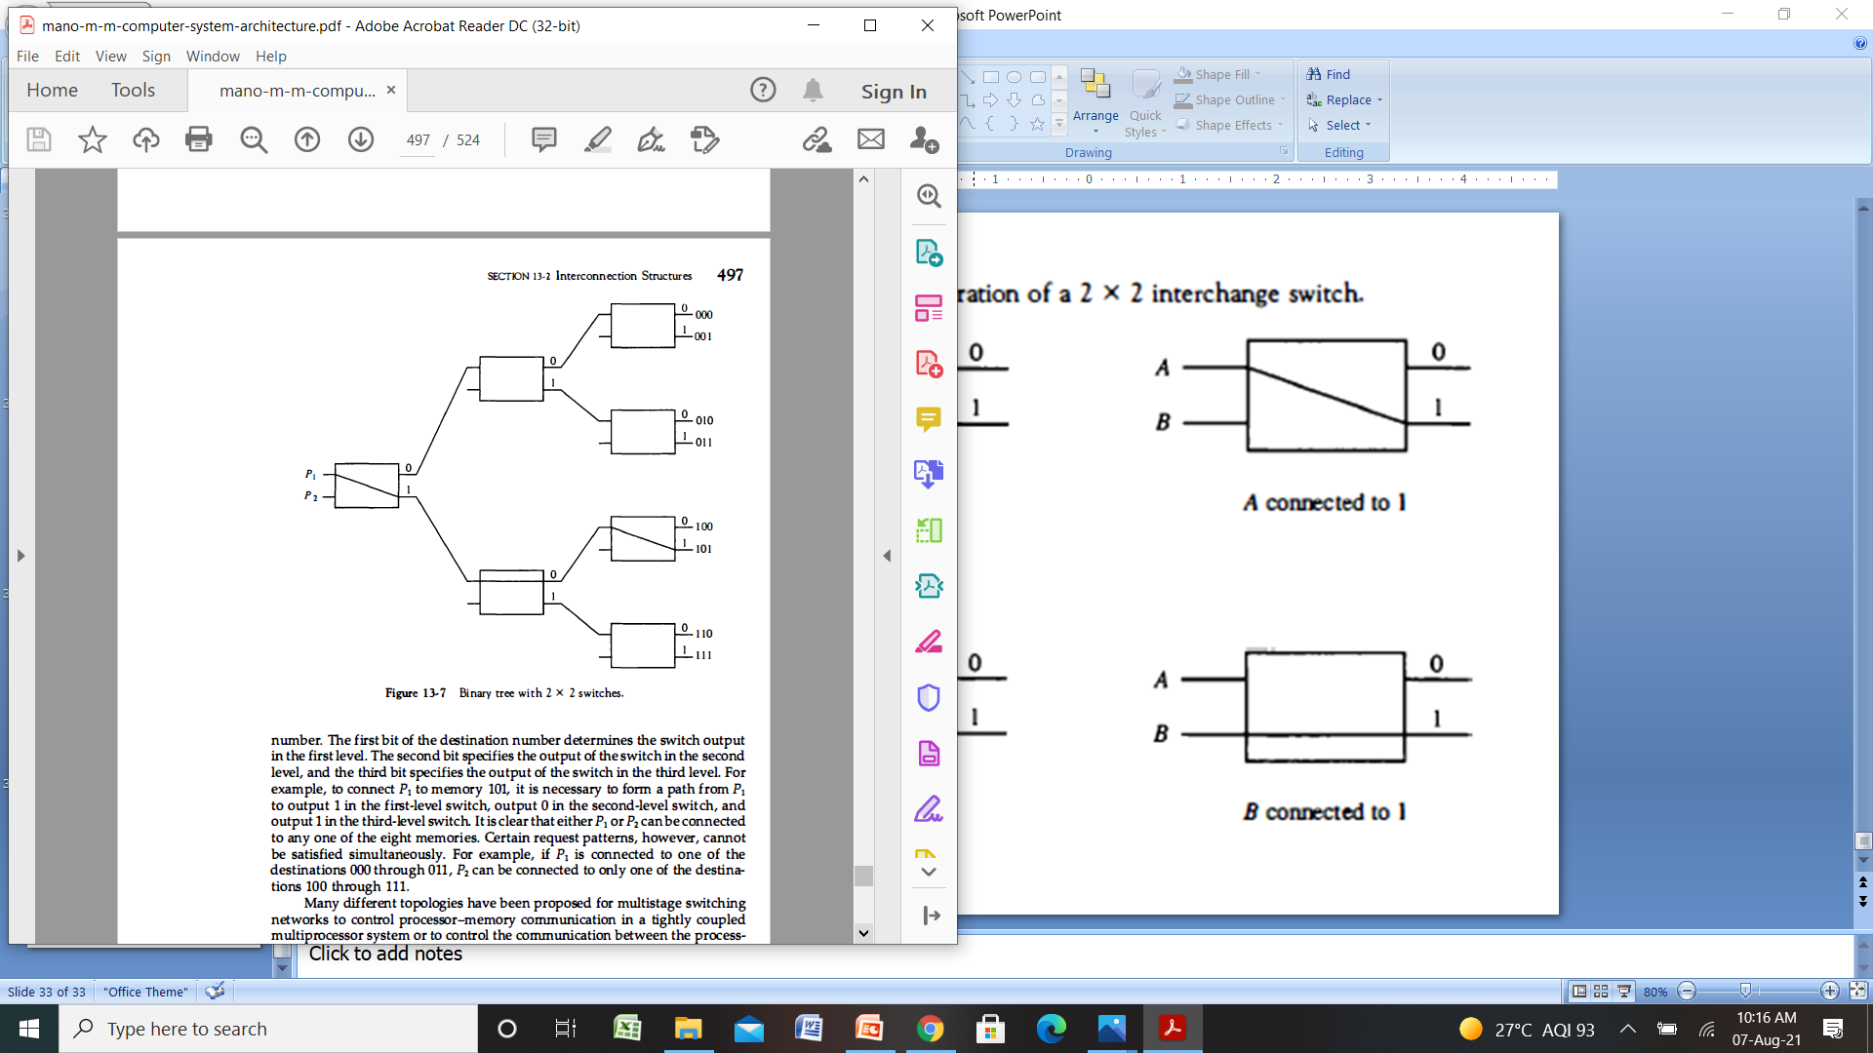

Slide 36
Only binary Tree?
Many different topologies have been proposed for multistage switching networks to control processor-memory communication in a tightly coupled multiprocessor system or to control the communication between the processing elements in a loosely coupled system.
One such topology is the omega switching network shown in Fig. 13-8.

Slide 37
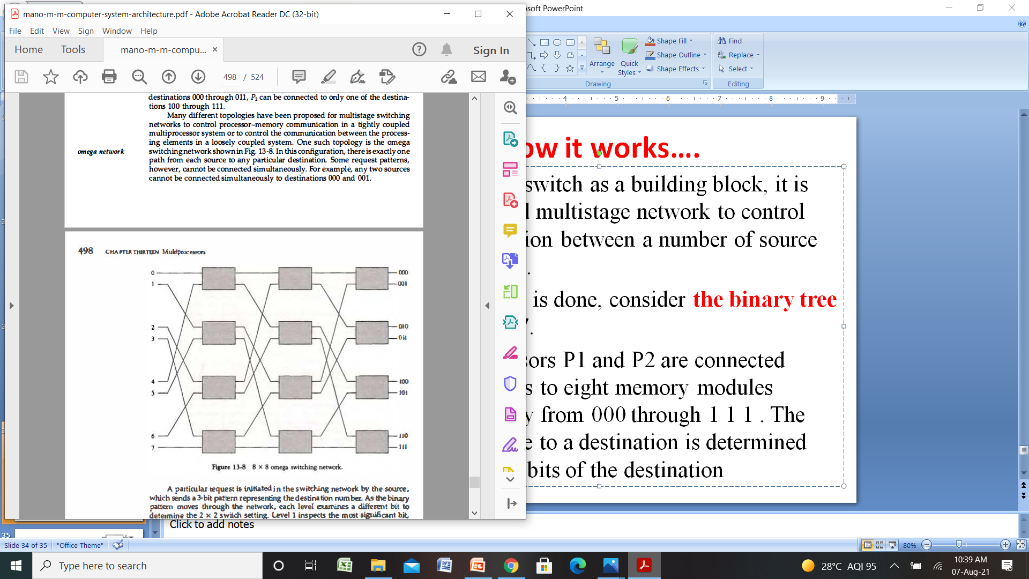

Slide 38
Introduction to Flynn’s classification:
There are a variety of ways that parallel processing can be classified. It can be considered from the internal organization of the processors, from the interconnection structure between processors, or from the flow of information through the system.
One classification introduced by M. J. Flynn considers the organization of a computer system by the number of instructions and data items that are manipulated simultaneously.
SISD (Single Instruction Single Data Stream)
SIMD (Single Instruction Multiple Data Stream)
MISD (Multiple Instruction Single Data stream)
MIMD (Multiple Instruction Multiple Data Stream)

Slide 39
Parallel processing
The purpose of parallel processing is to speed up the computer processing capability and increase its throughput.
The amount of hardware increases with parallel processing. and with it, the cost of the system increases.
However, technological developments have reduced hardware costs to the point where parallel processing techniques are economically feasible.

Slide 40
SISD:
SISD (Single Instruction Single Data Stream) represents the organization of a single computer containing a control unit, a processor unit, and a memory unit.
Single instruction: Only one instruction stream is being acted or executed by CPU during one clock cycle.
Single data stream: Only one data stream is used as input during one clock cycle.
Instructions are executed sequentially and the system may or may not have internal parallel processing capabilities.

Slide 41
A SISD computing system is a uniprocessor machine that is capable of executing a single instruction operating on a single data stream.
Most conventional computers(Von Neumann) have SISD architecture.
Parallel processing in this case may be achieved by means of multiple functional units or by pipeline processing.

Slide 42
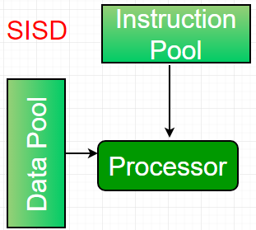

Slide 43
SIMD:
SIMD (Single Instruction Multiple Data Stream) represents an organization that includes many processing units under the supervision of a common control unit.
All processors receive the same instruction from the control unit but operate on different items of data.
The shared memory unit must contain multiple modules so that it can communicate with all the processors simultaneously

Slide 44
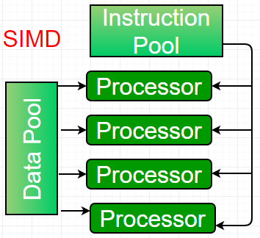

Slide 45
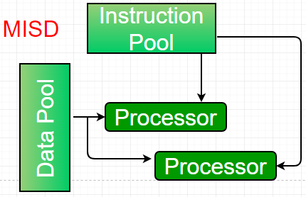
MISD:
MISD (Multiple Instruction Single Data stream) structure is only of theoretical interest since no practical system has been constructed using this organization.

Slide 46
MIMD:
MIMD (Multiple Instruction Multiple Data Stream) organization refers to a computer system capable of processing several programs at the same time.
Most multiprocessor and multicomputer systems can be classified in this category.

Slide 47
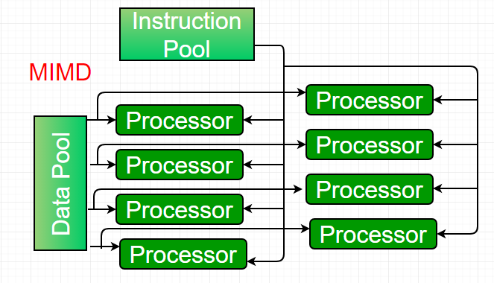

Slide 48
