Slide 1
Lower Bound Theory&Np-Hard
Unit-5

Slide 2
Lower Bound Theory
Lower Bound Theory Concept is based upon the calculation of minimum time that is required to execute an algorithm is known as a lower bound theory or Base Bound Theory.
Lower Bound Theory uses a number of methods/techniques to find out the lower bound.
The techniques which are used by lower Bound Theory are:
Comparisons Trees
Oracle and adversary argument
State Space Method

Slide 3
Comparison trees
In a comparison sort, we use only comparisons between elements to gain order information about an input sequence (a1; a2......an).
Given a_{i},a_{j} from (a₁, a₂.....a_{n})We Perform One of the Comparisons
a_{i} < a_{j} less than
a_{i} ≤ a_{j} less than or equal to
a_{i} > a_{j} greater than
a_{i} ≥ a_{j} greater than or equal to
a_{i} = a_{j} equal to

Slide 4
Comparison trees
Consider sorting three numbers a1, a2, and a3. There are 3! = 6 possible combinations:
(a1, a2, a3), (a1, a3, a2),
(a2, a1, a3), (a2, a3, a1)
(a3, a1, a2), (a3, a2, a1)
The Comparison based algorithm defines a decision tree.
Decision Tree: A decision tree is a full binary tree that shows the comparisons between elements that are executed by an appropriate sorting algorithm operating on an input of a given size.

Slide 5
Comparison trees
In a decision tree, there will be an array of length n.
So, total leaves will be n! (I.e. total number of comparisons)
Taking an Example of comparing a1, a2, and a3.
Left subtree will be true condition i.e. a_{i} ≤ a_{j}
Right subtree will be false condition i.e. a_{i} >a_{j}

Slide 6
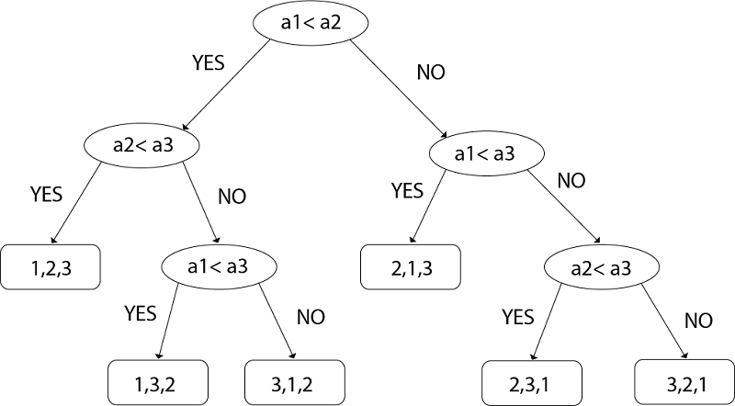

Slide 7
NP-Hard and NP Complete Problems
A problem can be classified into two groups
A problem can be solved in polynomial time is P-Class
Eg: Searching an element from a list is O(logn)
A problem can be solved in non polynomial time is NP-Class
Eg: Knapsack Problem O(2^{n/2}),TSP O(n²2^{n})
NP Class further divided into NP-Complete and NP-Hard
A Problem D is called NP-Complete if
1) It belongs to NP-Class
2)Every problem in NP can also be solved in polynomial time

Slide 8
Computational Complexity Problem
P-Class
NP-Class
NP-Hard
NP-Complete

Slide 9
Non-Deterministic Algorithm
The algorithm in which every operation is uniquely defined is called Deterministic algorithm
The algorithm in which every operation may not have a unique result, rather there can be specified set of possibilities for every operation, such an algorithm is called non-deterministic algorithm
The non-deterministic algorithm is a two stage algorithm
1.Non-deterministic (Guessing stage): Generate an arbitrary string that can be thought of as a candidate solution
2.Deterministic(Verification stage): It takes input as candidate solution and returns yes if the solution is the actual distance

Slide 10
1.Algortihm Non-Deterministic()
2.// A[1:n] is a set of elements
3.//Determine the index i in A at which x is located
4.//The for loop is the guessing stage
5.for i:= 1 to n do
6.A[i]:=choose(i);
7.//Verification Stage
8.if(a[i]==x) then
9.{
10.write(i);
11.sucess();
12.}
13.write(0);
14.fail();
15.}

Slide 11
0/1 Knapsack Problem
1.Algorithm D-Knapsack()
2.//P[1:n],W[1:n] represents profit and weight of each object I
3.//Profit and wt is the current profit and weight
4.//m is the capacity of the knapsack
5.{ // initially no item is selected
6.wt:=0; Profit:=0;
7.//Guessing stage
8.For i:=1 to n do
9.{
10.x[i]:=choose(0,1);

Slide 12
11. wt:=wt+x[i]*wt[i];
12.Profit:=Profit+x[i]*p[i];
13.}
14.//Verification stage
15.if((wt>m) or(Profit<pt)) then
16.fail();
17.Else
18.sucess();
19.}

Slide 13
Optimization Problem: Optimization problems are those for which the objective is to maximize or minimize some values.
Eg: Finding the minimum number of colors needed to color a given graph.
Finding the shortest path between two vertices in a graph.
Decision Problem: There are many problems for which the answer is a Yes or a No. These types of problems are known as decision problems.
Eg:Whether a given graph can be colored by only 4-colors.

Slide 14

The classes NP-Hard and NP-Complete
1.P is the set of all decision problems solvable by deterministic algorithms in polynomial time. NP is the set of all decision problems solvable by nondeterministic algorithms in polynomial time.
$P⊆NP$
P
NP

Slide 15
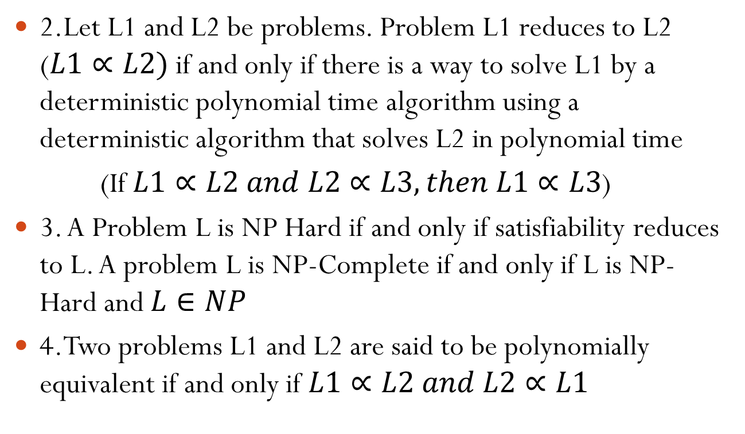
The classes NP-Hard and NP-Complete
2.Let L1 and L2 be problems. Problem L1 reduces to L2 ($L1∝L2)$if and only if there is a way to solve L1 by a deterministic polynomial time algorithm using a deterministic algorithm that solves L2 in polynomial time
(If $L1∝L2 and L2∝L3,then L1∝L3$)
3. A Problem L is NP Hard if and only if satisfiability reduces to L. A problem L is NP-Complete if and only if L is NP-Hard and $L∈NP$
4.Two problems L1 and L2 are said to be polynomially equivalent if and only if $L1∝L2 and L2∝L1$

Slide 16
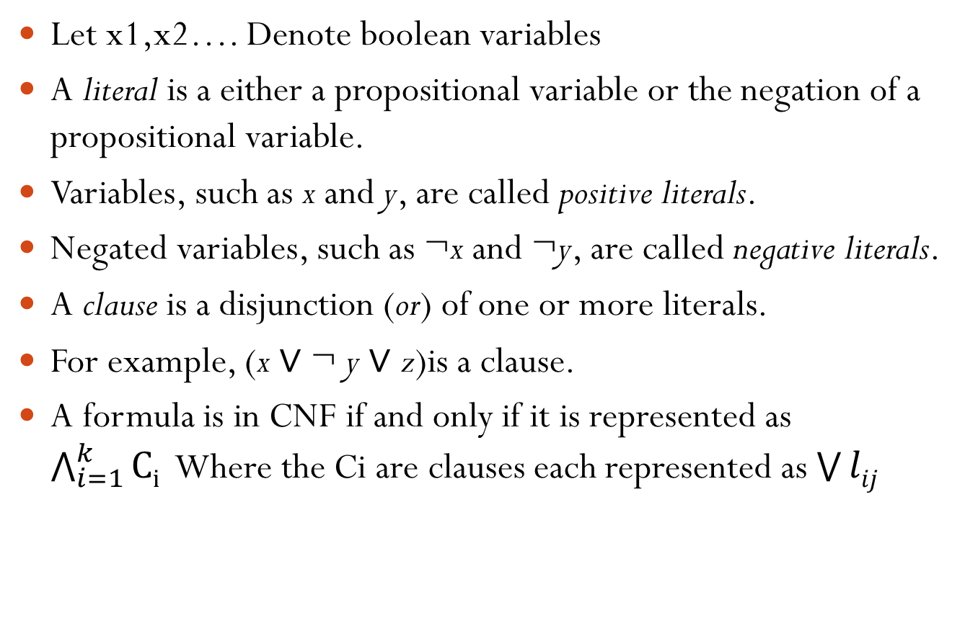
Satisfiability Problem
Let x1,x2…. Denote boolean variables
A literal is a either a propositional variable or the negation of a propositional variable.
Variables, such as x and y, are called positive literals.
Negated variables, such as ¬x and ¬y, are called negative literals.
A clause is a disjunction (or) of one or more literals.
For example, (x ∨ ¬ y ∨ z)is a clause.
A formula is in CNF if and only if it is represented as $\bigwedge_{i=1}^{k}{Ci }$Where the Ci are clauses each represented as $\bigvee{lij}$

Slide 17
Satisfiability Problem
The satisfiability problem is to determine whether a formula is true for some assignment of truth values to the variables.
CNF-Satisfiability is the satisfiability problem for CNF formulas
For example, formula
is satisfiable. Choose x=false, y=true,z=true
(¬x ∨ y) ∧
(¬y ∨ z) ∧
(x ∨ ¬z ∨ y)

Slide 18
Clique Decision Problem(CDP)
A clique is a subgraph of a graph such that all the vertices in this subgraph are connected with each other that is the subgraph is a complete graph.
The Maximal Clique Problem is to find the maximum sized clique of a given graph G, that is a complete graph which is a subgraph of G and contains the maximum number of vertices.
This is an optimization problem.
Correspondingly, the Clique Decision Problem is to find if a clique of size k exists in the given graph or not.

Slide 19
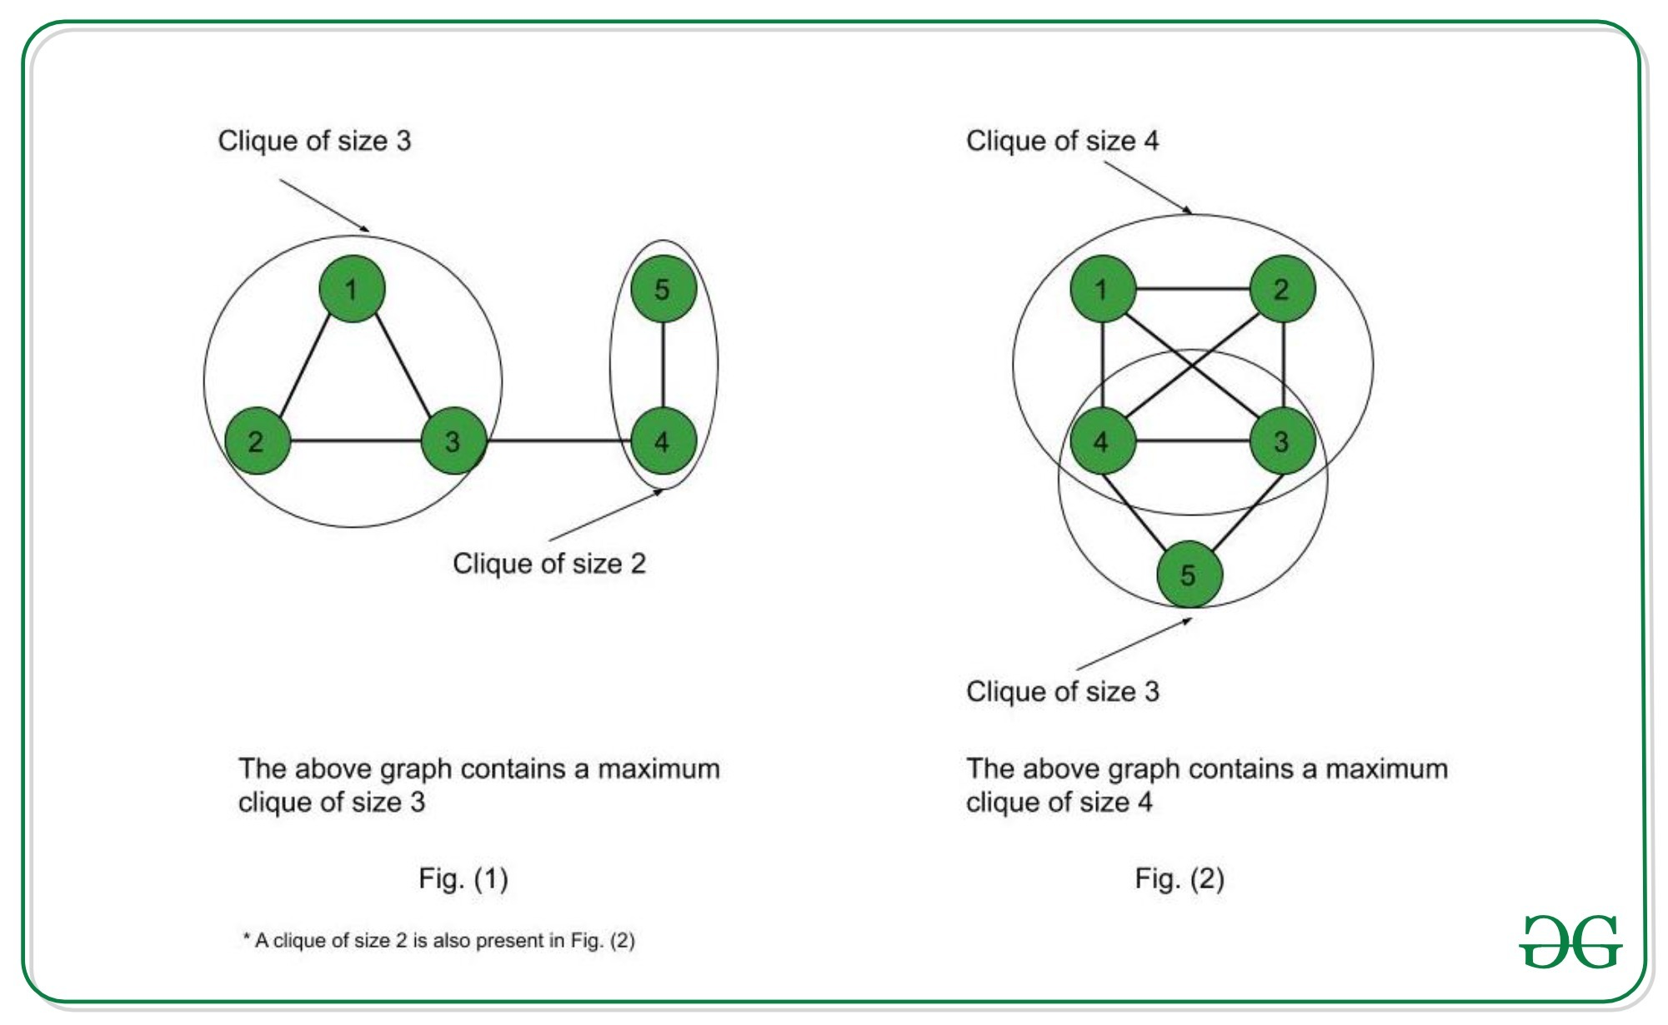
Clique Decision Problem(CDP)

Slide 20
Clique Decision Problem(CDP)
To prove that a problem is NP-Complete, we have to show that it belongs to both NP and NP-Hard Classes.
Let the boolean expression be – F = (x₁ v x₂) ^ (x₁‘ v x₂‘) ^ (x₁ v x₃) where x₁, x₂, x₃ are the variables, ‘^’ denotes logical ‘and’, ‘v’ denotes logical ‘or’ and x’ denotes the complement of x.
Let the expression within each parentheses be a clause.
Hence we have three clauses – C₁, C₂ and C₃.
Consider the vertices as – <x₁, 1>; <x₂, 1>; <x₁’, 2>; <x₂’, 2>; <x₁, 3>; <x₃, 3> where the second term in each vertex denotes the clause number they belong to.

Slide 21
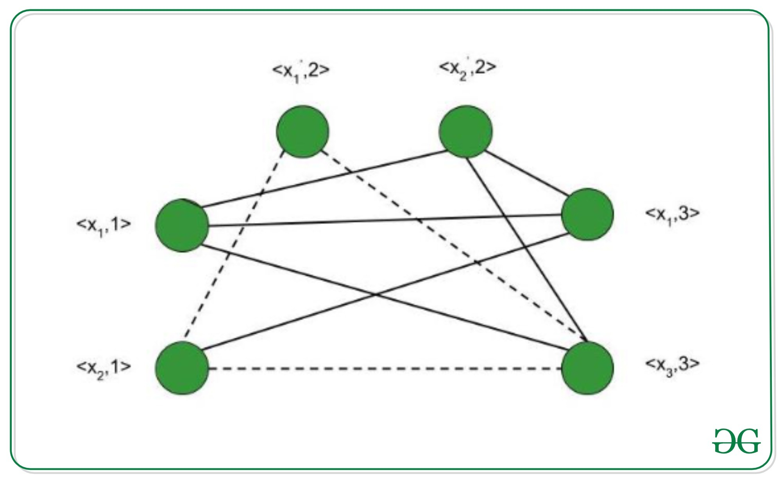
We connect these vertices such that –
No two vertices belonging to the same clause are connected.
No variable is connected to its complement.
<x₁, 1>; <x₂, 1>; <x₁’, 2>; <x₂’, 2>; <x₁, 3>; <x₃, 3>

Slide 22
Thus, the graph G (V, E) is constructed such that –
V = { <a, i> | a belongs to C_{i} } and
E = { ( <a, i>, <b, j> ) | i is not equal to j ; b is not equal to a’ }
Consider the subgraph of G with the vertices <x₂, 1>; <x₁’, 2>; <x₃, 3>. It forms a clique of size 3 (Depicted by dotted line in above figure) .
Corresponding to this, for the assignment – <x₁, x₂, x₃> = <0, 1, 1> F evaluates to true.
Therefore, if we have k clauses in our satisfiability expression, we get a max clique of size k and for the corresponding assignment of values, the satisfiability expression evaluates to true.
Hence, for a particular instance, the satisfiability problem is reduced to the clique decision problem.
The Clique Decision Problem is NP and NP-Hard. Therefore, the Clique decision problem is NP-Complete.

Slide 23
Node Cover Decision Problem
A vertex cover of an undirected graph is a subset of its vertices such that for every edge (u, v) of the graph, either ‘u’ or ‘v’ is in the node cover.
Although the name is Node Cover, the set covers all edges of the given graph.
Given an undirected graph, the node cover problem is to find minimum size node cover. The following are some examples.

