Slide 1
DBMS
Database management systems

Slide 2
DATABASE MANGEMENT SYSTEMS
Course Outcomes:
At the end of the course student would be able to
Understand the concepts of Entity-Relationship Model for enterprise level databases.
Analyze the database and provide restricted access to different users of database.
Understand various Normal forms to carry out schema refinement.
Analyze various Concurrency control protocols.
Examine working principles of Recovery algorithms.

Slide 3
SYLLABUS
UNIT-I:
Introduction to Database System Concepts: Database-System Applications, Purpose of Database Systems, View, Database Language, Database Architecture, Database Users and Administrators.
Introduction to the Relation Models and Database Design using ER Model: Overview of the Design Process, The Entity-Relationship Model, Constraints, Entity-Relationship Diagrams, Reduction to Relational Schemas, Entity-Relationship Design Issues, Extended E-R Feature, Structure of relational databases , database schema , keys, schema diagrams.
UNIT-II:
Introduction to SQL: Overview of the SQL Query Language, SQL Data Definition, Basic Structure of SQL Queries, Additional Basic Operations, Set Operations, Null Values, Aggregate Functions Nested Sub queries, Modification of theDatabase.

Slide 4
Intermediate and Advanced SQL: Join Expressions, Views, Integrity Constraints, SQL Data Types, Authorization. Functions and Procedures, Triggers.
UNIT-III:
Formal Relational Query Languages: The Relational operations, The Tuple Relational Calculus, The Domain Relational Calculus.
Relational Database Design: Features of Good Relational Designs, Atomic Domains and First Normal Form, Decomposition Using Functional Dependencies, Decomposition Using Multi valued Dependencies, BCNF.
UNIT-IV:
Transactions: Transaction Concept, a Simple Transaction Model, Storage Structure, Transaction Atomicity and Durability, Transaction Isolation, Serializability, Transaction Isolation and Atomicity.
Concurrency Control:Lock-Based Protocols, Deadlock Handling, Timestamp- Based Protocols.

Slide 5
UNIT-V:
Recovery System: Failure Classification, Recovery and Atomicity, Recovery Algorithm, Buffer Management, Failure with Loss of Nonvolatile Storage, ARIES, Remote Backup Systems.
Text Books:
Abraham Silberschatz, Henry F. Korth,S.Sudarshan, Database System Concepts‖,6thEdition, Tata McGraw-Hill.
RaghuRamaKirshna,JohannesGehrk,DatabaseManagementSystem‖TataMcGrawHill 3rd Edition.

Slide 6
Introduction to Database System Concepts

Slide 7
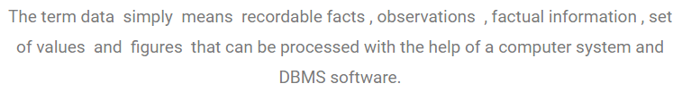
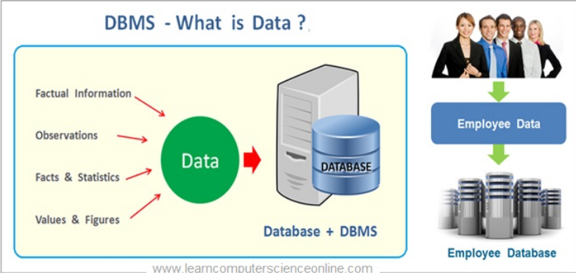
What is Data?

Slide 8
Data: data are individual units of information
Examples-text,images,video,numbers,audio
Database-Collection of inter related data
Management system-is a set of programs to store and retrieve the data.
DBMS-It is a collection of inter related data and set of programs to store and access those data in an easy and effective manner.
DBMS contains information about a particular enterprise
DBMS provides an environment that is both convenient and efficient to use.

Slide 9
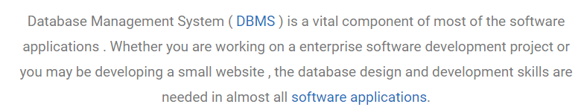
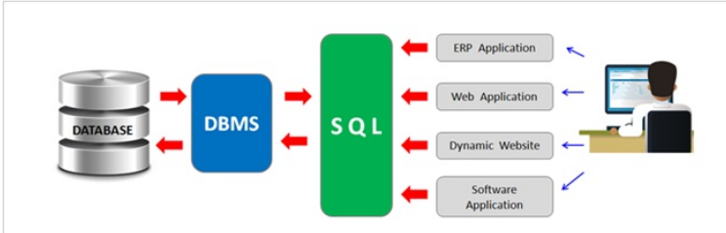
DBMS

Slide 10
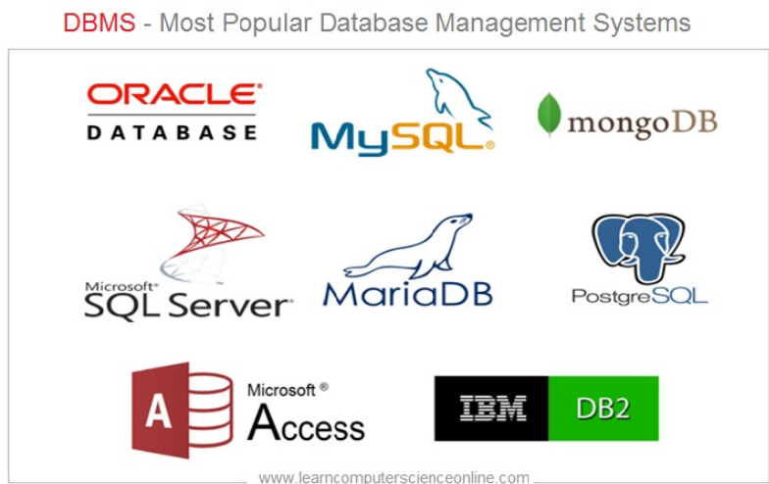

Slide 11
Given below is the list of most popular database management systems-softwares/tools
SolarWinds Database Performance Analyzer
DbVisualizer
Oracle RDBMS
IBM DB2
Altibase
Microsoft SQL Server
SAP Sybase ASE
Teradata
ADABAS
MySQL
FileMaker
Microsoft Access
Informix
SQLite
PostgresSQL
AmazonRDS
MongoDB
Redis
CouchDB
Neo4j
OrientDB
Couchbase
Toad
phpMyAdmin
SQL Developer
Seqel PRO
Robomongo
Hadoop HDFS
Cloudera
MariaDB
Informix Dynamic Server
4D (4th Dimension)

Slide 12
Database Management System (DBMS)
Database Applications:
Banking: all transactions
Airlines: reservations, schedules
Universities: registration, grades
Sales: customers, products, purchases
Manufacturing: production, inventory, orders, supply chain
Human resources: employee records, salaries, tax deductions
Databases touch all aspects of our lives

Slide 13
Purpose of Database System
In the early days, database applications were built on top of file systems
Drawbacks of using file systems to store data:
1)Data redundancy and inconsistency
Multiple file formats, duplication of information in different files
2)Difficulty in accessing data
Need to write a new program to carry out each new task
3)Data isolation — multiple files and formats
4)Integrity problems
Integrity constraints (e.g. account balance > 0) become part of program code
Hard to add new constraints or change existing ones

Slide 14
Purpose of Database Systems (Cont.)
Drawbacks of using file systems (cont.)
5)Atomicity of updates
Failures may leave database in an inconsistent state with partial updates carried out
E.g. transfer of funds from one account to another should either complete or not happen at all
6)Concurrent access by multiple users
Concurrent accessed needed for performance
Uncontrolled concurrent accesses can lead to inconsistencies
E.g. two people reading a balance and updating it at the same time
7)Security problems
Database systems offer solutions to all the above problems

Slide 15
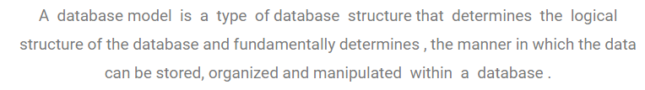
Types of DBMS models
1)NDBMS-network DBMS
2)HDBMS-hierarchical DBMS
3)RDBMS-relational DBMS
4)ODBMS- Object Oriented DBMS

Slide 16
View of data
A major purpose of a database system is to provide users with an abstract view of the data. i.e Data abstraction
Data Abstraction
It provides only essential information and hides the background details.
Developers hide the complexity from users through several levels of abstraction, to simplify users interactions with the system.
Data abstraction or view of data can be represented in database in three different levels:
1)Physical level
2)Logical level
3)View level

Slide 17
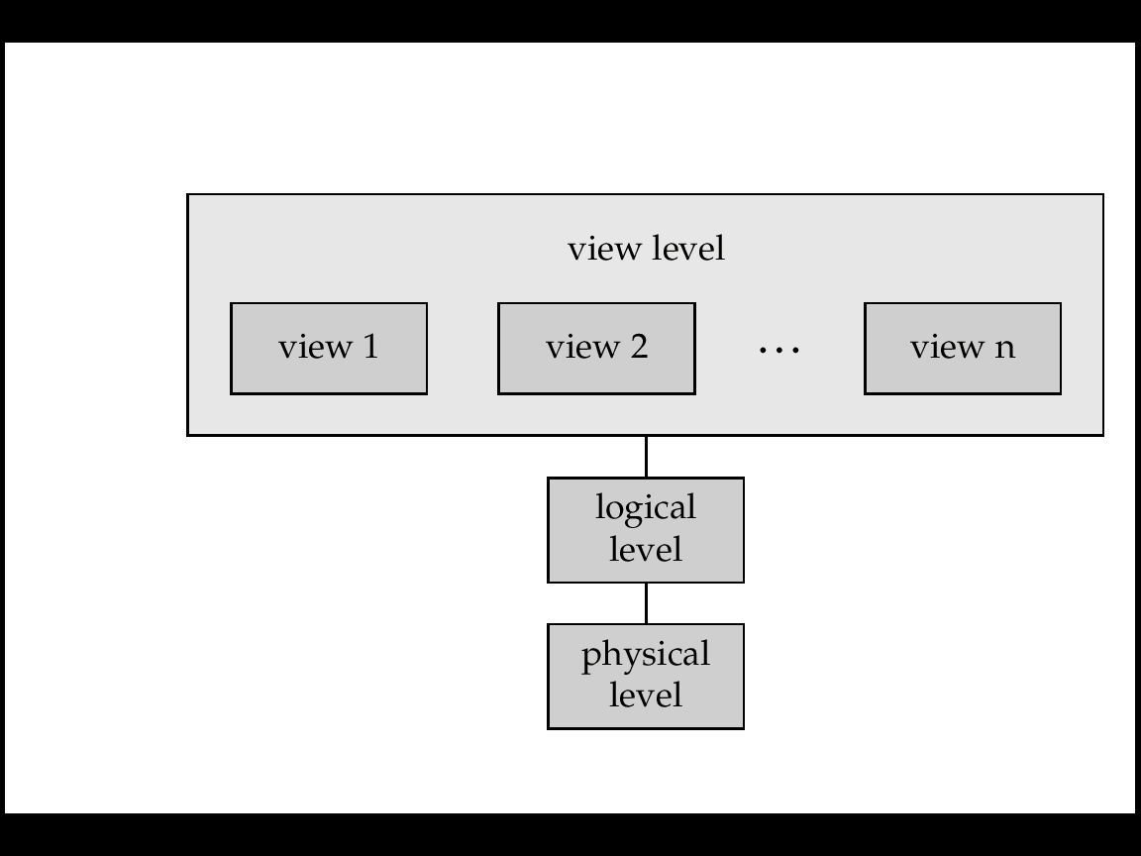
View of data

Slide 18
Physical level:
The lowest level of abstraction describes how the data is actually stored.
Logical level:
The next higher level of abstraction describes what data is stored in the database and what relationships exist among those data.
View level:
Highest level of abstraction describes only part of the entire database.
View level of abstraction exists to simplify their interaction with the system.
The system may provides many views for the same database.

Slide 19
Example:
Consider a database consists of 2 tables-Account,Employee table
Account-Acc_no,Bal
Employee-e_name,salary
Physical level: Account,Employee can be described as storage locations.
Logical level: Account is table
Acc_no: String
Balance: integer
View level: several views of database are defined.
example: cashier in a bank can see only the part of a database that has information of employees accounts.

Slide 20
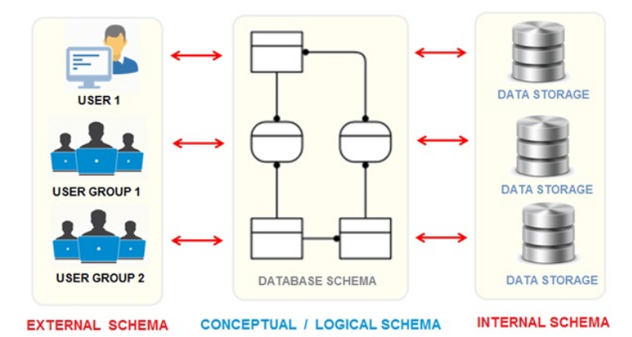
View level
Logical level
Physical level

Slide 21
Instances and Schemas
The collection of information stored in the database at a particular moment is called an instance of the database.
The overall design of the database is called the database schema.
Database systems have several schemas ,
Physical schema: database design at the physical level.
Logical schema: database design at the logical level

Slide 22
Data models
A data model provides a way to describe the design of a database at the physical, logical and view level.
Data model is a conceptual tool for describing data, data relationships, data semantics and consistency constraints.
A data model organizes data elements and standardizes how the data elements relate to one another.
Data models can be classified as 4 categories:
1)Relational model
2)Entity-Relationship model
3) Object-oriented data model
4) Semi structured data model

Slide 23
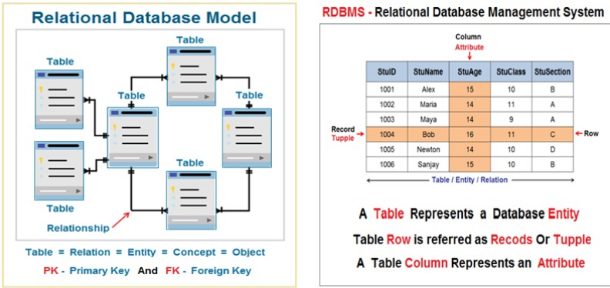
Relational model:
It uses a collection of tables to represent both data and the relationships among those data.
Each table has number of columns and rows.

Slide 24
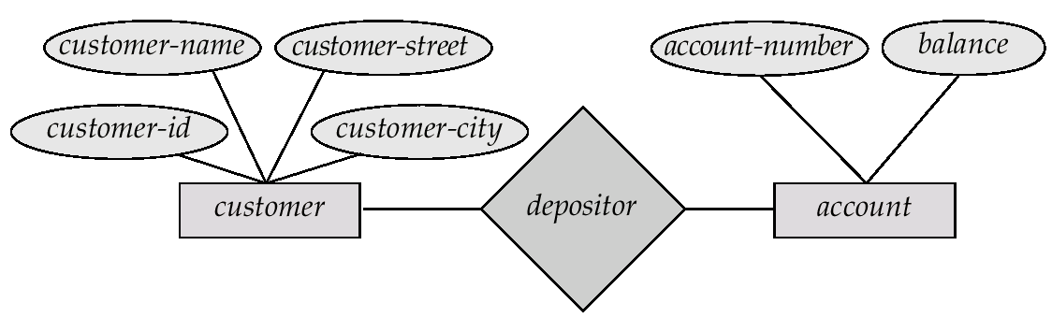
Entity-Relationship model:
The ER data model is collection of basic objects called entities and their relationships among these objects.
An entity is a “thing or object” in the real world.
ER model is widely used in database design.

Slide 25
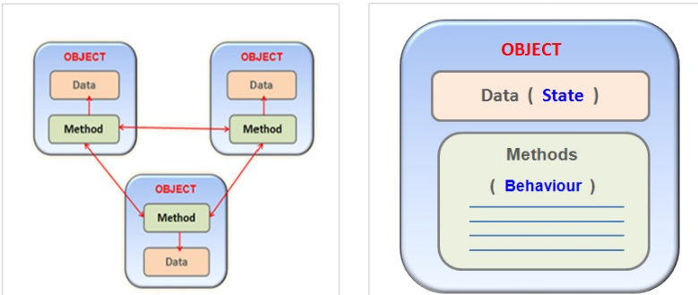
Object-oriented data model:
This model can be seen as extending the ER model with notations of encapsulation, methods, and object identity.
The object-relational data model combines the features of object-oriented and relational data model.

Slide 26
Semi structured data model:
Semi structured data contains tags and elements which is used to group data and describe how the data is stored.
Data cannot be stored in the form of rows and columns as in database.
XML is widely used to represent semi structured data.

Slide 27
Database Languages
The database system languages are broadly categorized into two types.
1)Data Definition Language
2) Data Manipulation language
Data Definition Language(DDL):
DDL is used to specify the database schema.
DDL is also used to specify additional properties of data.
The following constraints can be given during database schema definition :
1)Domain constraints
2)Referential Integrity
3)Assertions
4)Authorization
--read,insert,update,delete authorization

Slide 28
Data manipulation language(DML):
A DML is a language that enables users to access or manipulate the data .
The types of access are
Retrieval of information stored in database
Insertion of information stored in database
Deletion of information stored in database
Modification of information stored in database
There are 2 types of DML:
1)Procedural DML-require a user to specify what data are needed and how to get those data.
Example: PL/SQL
2)Declarative DML(non-procedural)-require a user to specify what data are needed without specifying how to get those data.
Example: SQL

Slide 29
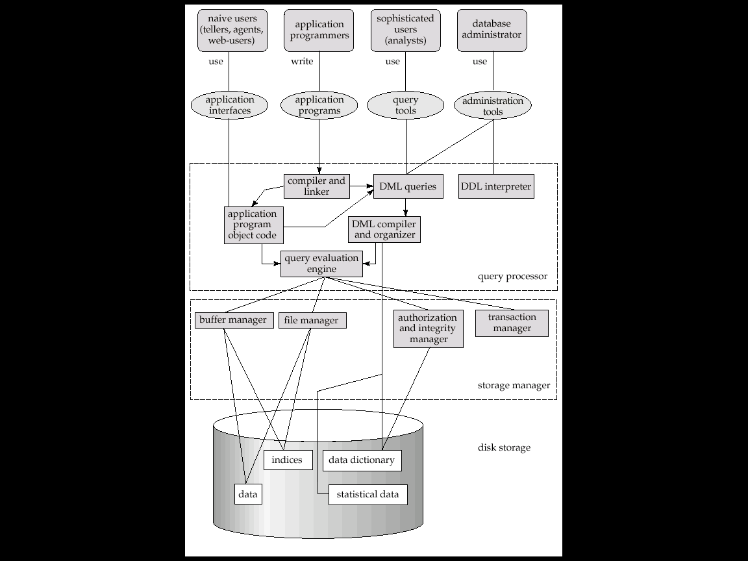
Database Architecture

Slide 30
In the system structure, mainly the users of database are 4 types:
-native users, application programmers, sophisticated users, database administrators
In the Query processor section, the compiler and linker will make the application program object code and
The Query evaluation engine will evaluate and it makes the thing happen.
DML queries will be compiled and organized through DML compiler and organizer
The DML queries are evaluated by query evaluation engine.
In the storage manager section, the buffer manager contains the temporary data.
The tables are distributed and kept in file manager.
Authorization and integrity manager will look after authorization permissions and integrity constraints.
All the transactions related data is managed by Transaction manager.
Disk storage consists of different types of data ,indices(index structures), data dictionary(metadata) and statistical data.

Slide 31
Database Users and Administrators
Database Users
People who work with a database can be categorized as database users or database administrators.
There are 4 different types of database system users.
1)Native users
Users who interact with the system by involving one of the application programs that have been written previously.
2)Application programmers
These are computer professionals who write application programs.
3)Sophisticated users
Users interact with the system without writing programs, instead they form their requests in a database query language.
4)Specialized users
Users who write specialized database applications that do not fit into the traditional data processing framework.

Slide 32
Database Administrators:
Coordinates all the activities of the database system.
A person who has central control over the system are called database administrator(DBA).
Database administrator's duties include:
Schema definition
Storage structure and access method definition
Schema and physical organization modification
Granting of authorization for data access
Routine maintenance
- periodically backing up the data
-ensuring enough free disk space is available
-monitoring jobs running on the database

