Slide 1

AI-Powered
Handwritten Text
Recognition System
Final Project Review | Department of [Department] | [Institution Name]
TEAM MEMBERS
2420030166– M. Satya Charan Reddy
2420030140– R. Sai Charan
2420030121– S. Sai Rishik
Guide: Dr. Sunanda | Academic Year: [20XX–XX]
Notes:
Title slide. Replace all bracketed text. Use the full project title, list every team member with registration number, and name your guide. Insert the institution logo in the dashed box.

Slide 2




Introduction & Problem Statement
Background
[Handwritten text is widely used in educational notes, application forms, historical documents, examination papers, and business records. Converting this information into digital text makes it easier to store, edit, search, and process. However, differences in handwriting styles, character shapes, spacing, orientation, and image quality make automatic recognition challenging.
Problem Statement
Manual conversion of handwritten content into digital text is time-consuming and prone to errors. Traditional OCR systems that perform well on printed text may struggle with irregular handwriting, making it necessary to develop an AI-based system that can recognize handwritten digits and characters accurately and efficiently.
Motivation / Need
[Reduce manual transcription effort.
Automate handwritten digit and character recognition.
Improve the accessibility of handwritten information.
Enable digital storage and retrieval of recognized text.
Provide prediction confidence to help users identify uncertain results.
Notes:
State the domain, the exact problem and why it matters. Keep it to about 2 minutes. Add one real-world statistic if you can, with a citation.

Slide 3


Objectives & Scope
Objectives
Project Scope
Recognition of handwritten digits and characters.
Image-based input and preprocessing.
CNN-based classification.
Prediction confidence analysis.
Interactive result visualization.
Potential extension to word-level and sentence-level recognition
1
[Handwritten Image Preprocessing
Prepare handwritten images by applying grayscale conversion, noise reduction, resizing, normalization, and segmentation where required.
2
AI-Based Character Recognition
Develop a Convolutional Neural Network (CNN)-based model to identify handwritten digits and characters from input images.
3
Performance Evaluation
Evaluate the recognition system using appropriate metrics such as accuracy, precision, recall, F1-score, and prediction confidence.
4
Digital Text Generation
Develop an interactive interface that displays the uploaded image, predicted character or digit, confidence score, and correction suggestions when predictions are uncertain.
Notes:
Objectives should be measurable and start with action verbs. The scope slide tells the panel what you did and did not attempt.

Slide 4
Literature Survey
S.No | Author(s) & Year | Method / Technique | Key Findings | Limitation / Gap
1 | Cohen et al. (2017) | EMNIST dataset for handwritten letter and digit recognition | Extended the MNIST dataset to include handwritten letters, supporting character recognition research. | Recognition performance depends on dataset quality and how well the data represents different handwriting styles
2 | Li et al. (2023) | TrOCR using pretrained image and text Transformers | Demonstrated an end-to-end approach for printed and handwritten text recognition using pretrained Transformer models. | Requires suitable pretrained models and computational resources; may be more complex than a basic CNN classifier.
3 | AlKendi et al. (2024) | Comprehensive survey of handwritten text recognition techniques | Reviewed handwritten text recognition methods, datasets, and challenges associated with handwriting variation. | Recognition remains challenging for historical documents, overlapping characters, and irregular handwriting.
4 | de Sousa Neto et al. (2024) | Systematic literature review of data augmentation for handwritten text recognition | Examined data augmentation techniques for improving training data availability and handwritten text recognition | Generating sufficient representative training samples remains challenging, and augmentation alone cannot address every handwriting variation.
Notes:
Summarise four to six relevant papers or existing systems. End with the research gap, because that gap justifies your project.

Slide 5

Research Gap
Existing handwritten recognition systems face challenges related to handwriting variation, image quality, and computational requirements. This project proposes a CNN-based recognition system with image preprocessing, prediction confidence, and an interactive interface to recognize handwritten digits and characters efficiently.

Slide 6





Proposed System & Methodology
STEP 1
STEP 2
STEP 3
STEP 4
STEP 5
Define Problem
Collect Data
Design
Implement
Test & Evaluate
Identify the challenges involved in handwritten digit and character recognition, including handwriting variation, image quality, and manual transcription.
Use a suitable labeled handwriting dataset, such as EMNIST, and incorporate additional handwriting samples if available.
Design an end-to-end pipeline consisting of image input, preprocessing, feature extraction, CNN-based classification, confidence analysis, and digital output.
Develop the recognition model using Python and TensorFlow/Keras. Use OpenCV and NumPy for image preprocessing and Streamlit for the interactive interface.
Evaluate the system on unseen test samples. Measure recognition accuracy, analyze incorrect predictions, and examine performance on different handwriting styles.
Key Novelty / Contribution
The proposed system combines image preprocessing, CNN-based character classification, prediction confidence, and interactive result visualization in a single workflow. Its main contribution is to provide a practical and user-friendly approach to handwritten digit and character recognition, with potential extensions toward word- and sentence-level text recognition.
Notes:
Walk through the five steps left to right. Rename the steps to match your project (for example, Requirement Analysis, Design, Coding, Testing, Deployment). End with your novelty.

Slide 7
System Architecture
Architecture Flow
Handwritten Image Input
↓
Image Preprocessing
↓
Feature Extraction
↓
CNN-Based Classification
↓
Prediction Confidence Analysis
↓
Result Display and Digital Text Output
Components
1
Image Input Module
Accepts a handwritten digit or character image uploaded by the user.
2
Image Preprocessing Module
Converts the image to grayscale, reduces noise, resizes the image, normalizes pixel values, and segments characters when required.
3
Recognition Module
Uses a trained CNN model to extract relevant visual features and classify the input as a digit or character from the supported classes.
4
Result and Visualization
Displays the uploaded image, predicted digit or character, confidence score, and correction guidance when the prediction is uncertain.
Notes:
Insert a clear block diagram: input, processing, storage, output. Number each block and explain them on the right. Redraw the figure yourself rather than copying it.

Slide 8


Hardware & Software Requirements
Hardware
Software & Tools
Libraries / Frameworks
Computer or laptop.
Processor: Intel Core i5 or equivalent.
RAM: 8 GB minimum recommended; 16 GB is preferable.
Storage: Sufficient space for datasets, model files, and application files.
GPU: Optional; useful for faster model training.
Internet connection for downloading datasets and installing packages.
Operating System: Windows or Linux.
Programming Language: Python.
Development Environment: Visual Studio Code, Jupyter Notebook, or Google Colab.
Version Control: Git and GitHub.
Interactive Interface: Streamlit.
TensorFlow/Keras — CNN model development and training.
OpenCV — Image preprocessing.
NumPy — Numerical operations.
Pandas — Dataset organization and analysis.
Scikit-learn — Evaluation metrics and supporting utilities.
Matplotlib — Data visualization.
Deployment / Platform: The system is designed to run locally or in a suitable notebook environment. Streamlit can provide the interactive interface for uploading handwritten images and viewing recognition results.
Notes:
List only what you actually used, with versions. For a pure software project, shorten the hardware list and add cloud or deployment resources.

Slide 9
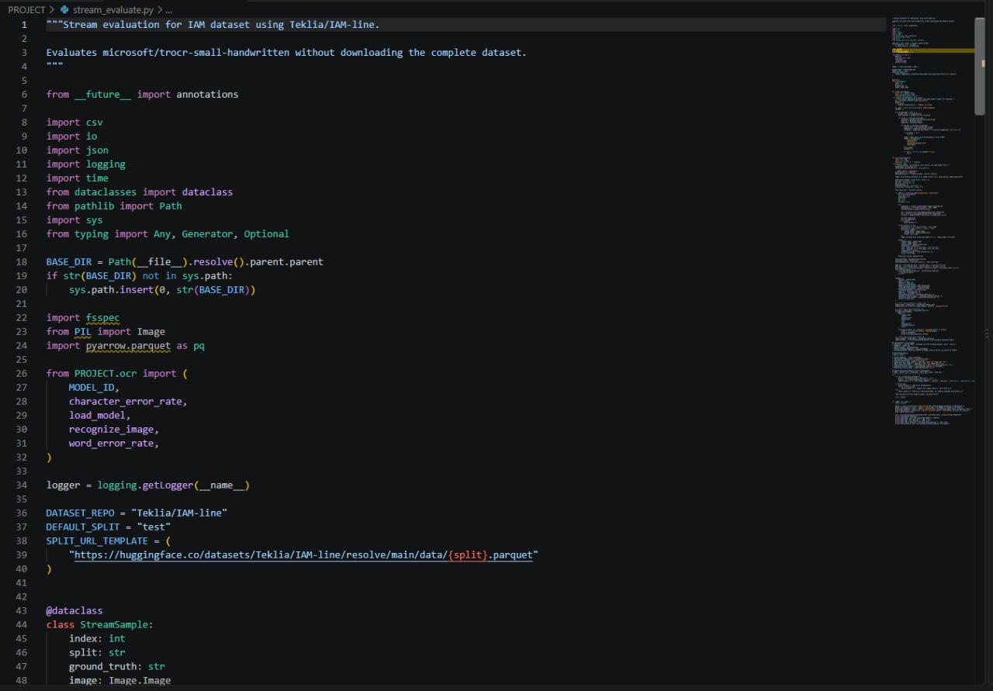
Dataset / Data Understanding
[10,000]
[14]
Records (rows)
Features (columns)
[0]
[2]
Missing values
Target classes
Source: [Kaggle / UCI / self-collected / sensor]
Features: [key inputs and the target variable]
Quality: [missing values, duplicates, imbalance]
Notes:
Explain where the data came from and what it contains. Show a screenshot of the first rows or the info summary. For non-data projects, replace this slide with “Requirement Analysis” or “Input Specification”.

Slide 10
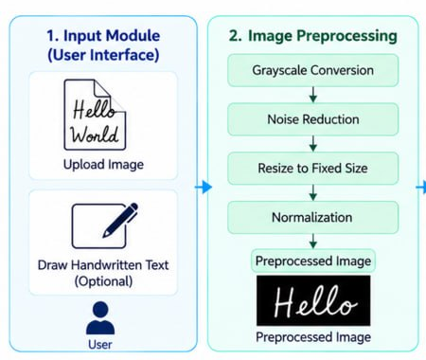
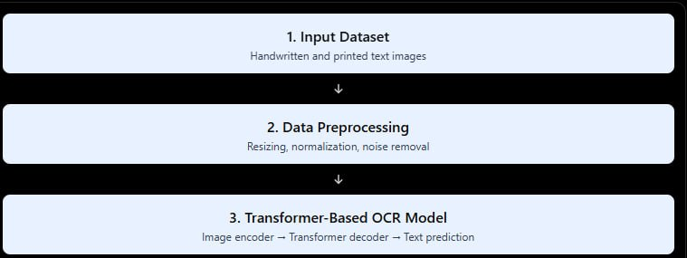



Data Preprocessing & Exploratory Analysis
Cleaning
Transformation
Feature Selection
Load the handwritten image.
Convert it to grayscale when appropriate.
Apply noise reduction if required.
Check image orientation and background quality.
Handle invalid or unreadable input images.
Resize images to the dimensions expected by the model.
Normalize pixel values to a consistent range.
Convert image arrays into the required tensor format.
Apply segmentation when the input contains multiple characters and the selected recognition pipeline requires it.
Edges and boundaries.
Curves and strokes.
Character shapes.
Spatial patterns.
Distinguishing features between similar characters.
Notes:
Show two or three plots that tell a story: distributions, correlations, outliers. Explain what each plot told you and what you did about it.

Slide 11
Module-wise Description
1
Image Upload and Input Validation
2
Image Preprocessing
Purpose: Accept handwritten image files and verify that they can be processed.
Input → Output: Uploaded image → Validated image.
Purpose: Prepare images for the recognition model through resizing, grayscale conversion where appropriate, noise reduction, and normalization.
Input → Output: Raw image → Preprocessed image.
3
CNN Model Training and Recognition
4
Result Visualization and Evaluation
Purpose: Train or load the CNN model and predict the digit or character represented by an input image.
Input → Output: Preprocessed image → Predicted class and confidence score.
Purpose: Display predictions, show confidence levels, and evaluate recognition performance using suitable metrics.
Input → Output: Predictions and test results → Visualized output and evaluation report.
Notes:
Divide the project into three to five modules. For each, state its purpose, inputs, outputs and who built it. Duplicate a card if you have more modules.

Slide 12

Algorithms & Technologies Used
Image Preprocessing
Convolutional Neural Network (CNN)
Interactive Application and Evaluation
Why Chosen:
Learns visual features directly from images.
Supports image classification.
Can identify distinguishing patterns in handwritten characters.
Provides a suitable foundation for digit and character recognition.
Key Parameters:
Number of convolutional layers.
Number and size of filters.
Kernel dimensions.
Activation functions.
Batch size.
Learning rate.
Why Chosen:
Streamlit supports a simple interactive interface.
Scikit-learn provides evaluation metrics.
Matplotlib supports charts and visual analysis.
The combination helps present model outputs clearly.
Key Parameters:
Confidence threshold.
Test-set configuration.
Evaluation metrics.
Input validation rules.
Why chosen
Provides image manipulation operations.
Helps standardize image dimensions.
Supports grayscale conversion, filtering, and normalization.
Prepares input images for model inference.
Key parameters
Image dimensions.
Noise-reduction settings.
Pixel normalization range.
Image orientation and channel format.
Selection criteria: The approach is selected based on recognition performance, robustness to handwriting variation, computational requirements, ease of implementation, and usability.
Notes:
Name each model, algorithm or technology, say why you chose it, and list the key settings. Then explain how you picked the final one.

Slide 13
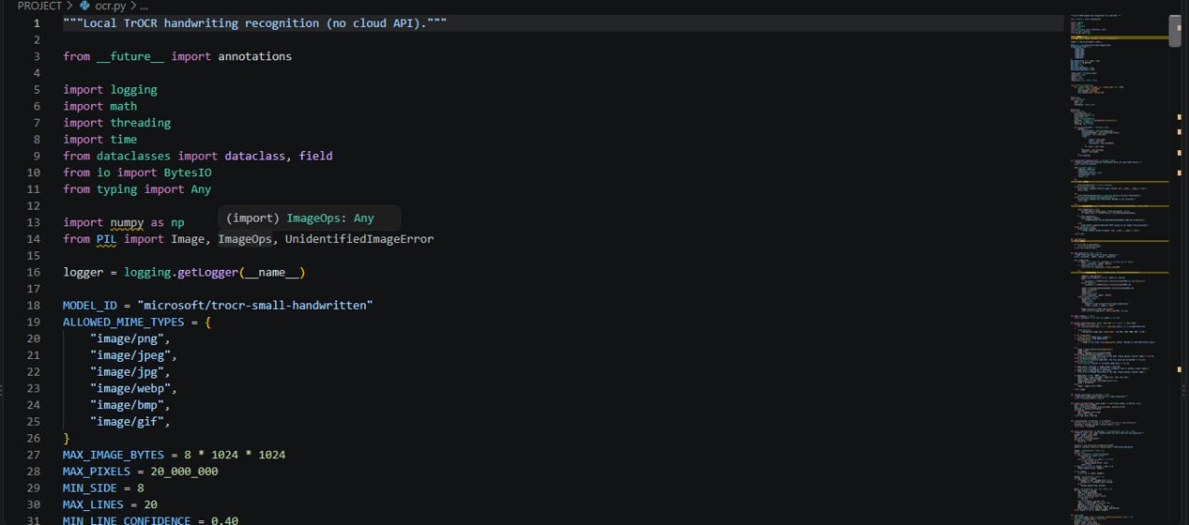
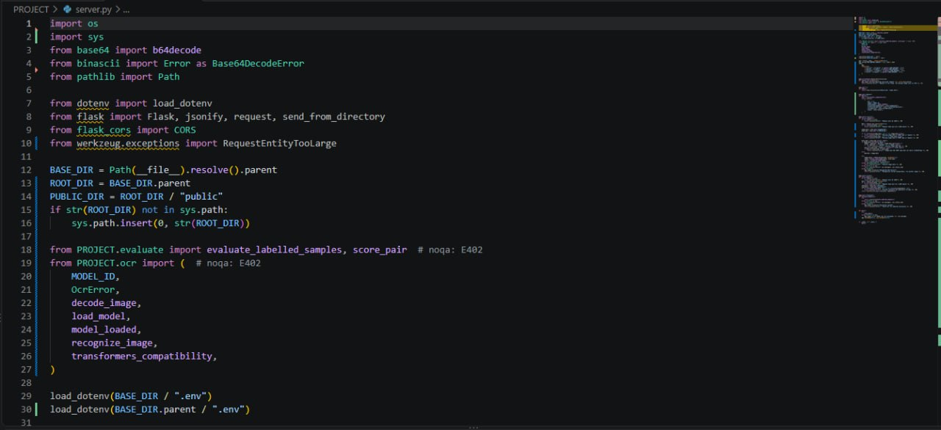
Implementation / Model Building
Feature Selection
The primary input features are image pixel values and spatial patterns extracted automatically by the CNN.
The model learns visual representations of character strokes, curves, boundaries, and shapes during training.
Core implementation (ocr.py · server.py)
Preprocessing Pipeline
Load the labeled handwriting dataset.
Inspect image dimensions and class labels.
Preprocess and normalize images.
Divide the dataset into training, validation, and test sets.
Select suitable model parameters using validation results.
Data Splitting
Use separate training, validation, and test datasets.
Example split, if appropriate for your dataset:
Training: 70%
Validation: 15%
Testing: 15%
Configuration
Model: Convolutional Neural Network.
Framework: TensorFlow/Keras.
Input: Preprocessed handwriting image.
Output: Probability distribution over supported classes.
Notes:
Describe the build in the order you did it. Paste only the most important code or pseudocode, not entire files. For hardware projects, show the circuit or wiring summary instead.

Slide 14
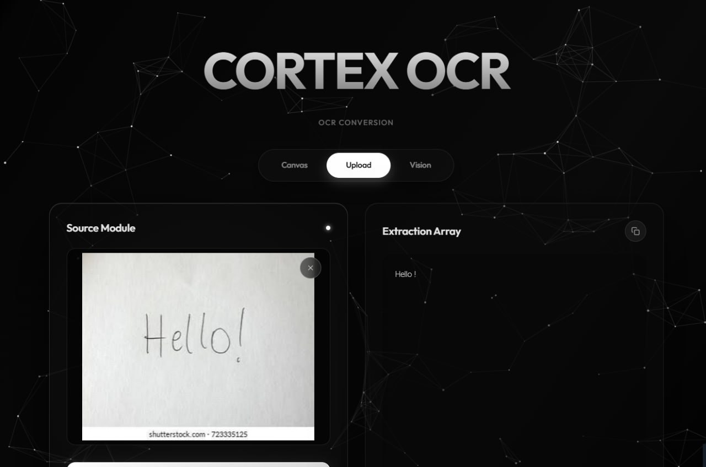
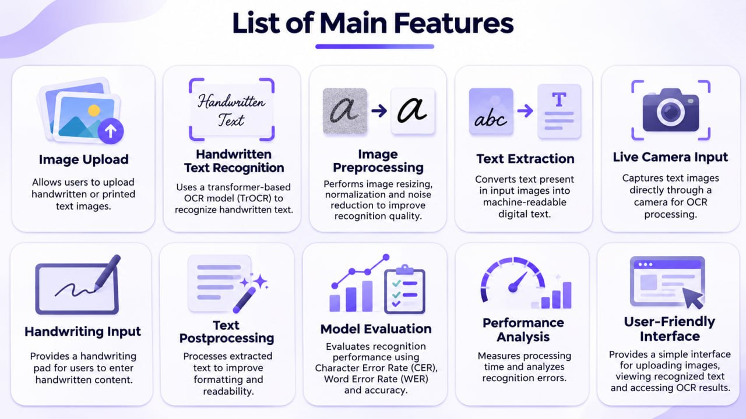
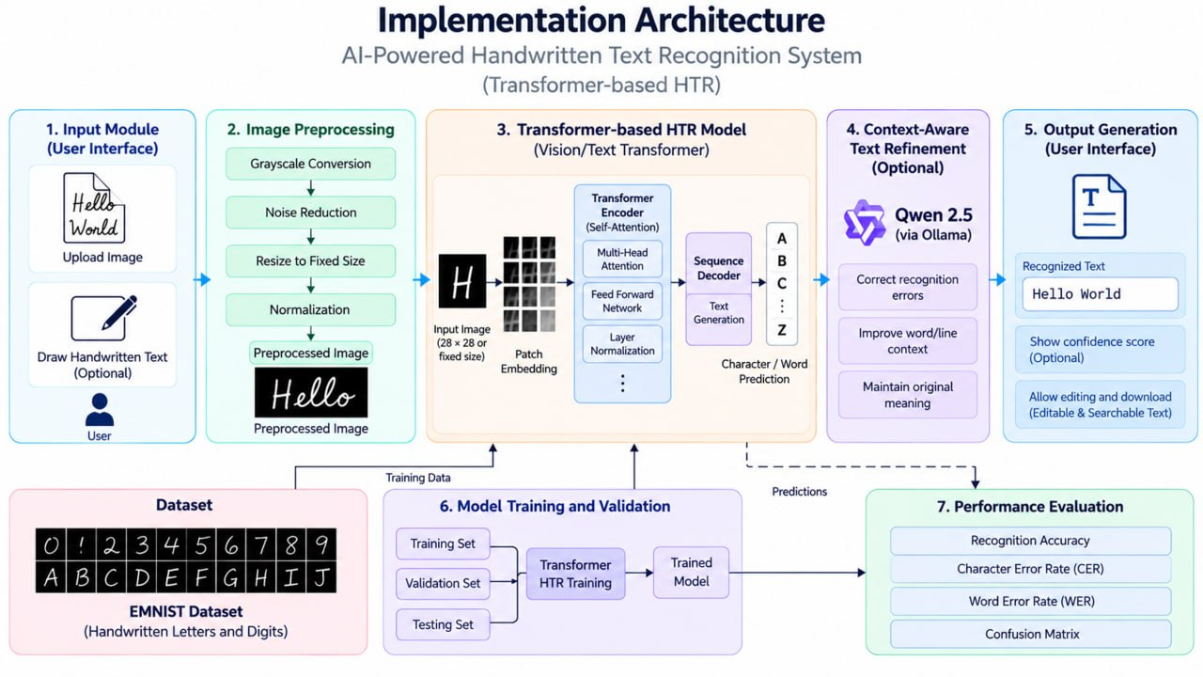
Working Prototype / Output Screens
Cortex OCR interface
Upload, canvas and vision input with extracted text output
Main features
Upload, handwriting pad, camera input, post-processing, evaluation
Implementation architecture
Input → preprocessing → Transformer HTR → output → evaluation
Notes:
Show real screenshots, photos of the hardware or a short demo video link. Caption each one with what the viewer should notice.

Slide 15
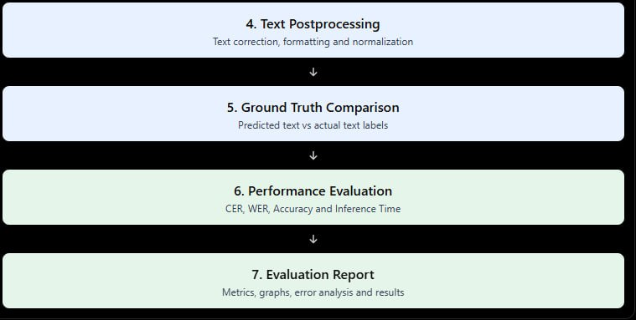
Results & Performance Comparison
Metric | Model A | Model B | Model C
Accuracy | 0.00 | 0.00 | 0.00
Precision | 0.00 | 0.00 | 0.00
Recall | 0.00 | 0.00 | 0.00
F1-score | 0.00 | 0.00 | 0.00
ROC-AUC | 0.00 | 0.00 | 0.00
Best: [Model] – [metric = value]
Chart and table hold illustrative values only. Replace them with your own results.
Notes:
Right-click the chart and choose Edit Data to enter your real numbers. Replace the metrics with the ones that fit your project (accuracy, latency, power, throughput, user rating). State clearly which option performed best.

Slide 16
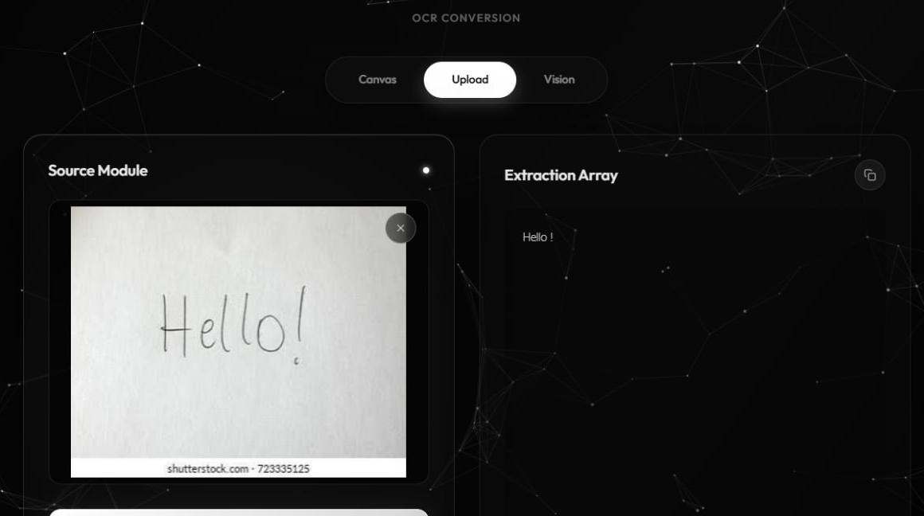
Analysis & Key Findings
[XX.X%]
Best [metric] achieved by [model / system]
Interpretation: [What the result means]
Error analysis: [Where and why it fails]
Key drivers: [Most important features or factors]
Notes:
Explain what the numbers mean. Use a confusion matrix, ROC curve, feature-importance chart or output comparison. Be honest about weak results; panels value that.

Slide 17

Testing & Validation
Test ID | Test Description | Expected Result | Actual Result | Status
TC-01 | [What is tested] | [Expected output] | [Observed output] | [Pass / Fail]
TC-02 | [What is tested] | [Expected output] | [Observed output] | [Pass / Fail]
TC-03 | [What is tested] | [Expected output] | [Observed output] | [Pass / Fail]
TC-04 | [What is tested] | [Expected output] | [Observed output] | [Pass / Fail]
Functional Testing
Validation Method
Performance Testing
[Unit and integration tests performed]
[Cross-validation, hold-out or field trials]
[Speed, load, accuracy or reliability checks]
Notes:
List representative test cases with expected and actual outcomes. Name the validation methods you used. Delete rows you do not need.

Slide 18


Challenges & Limitations
Challenges Faced
Limitations
1. Variation in Handwriting
Different people write the same character differently.
Response: Use representative handwriting data and evaluate performance across different writing styles.
2. Image Quality Problems
Blur, noise, uneven backgrounds, and incorrect orientation can affect recognition.
Response: Apply suitable preprocessing and validate input images.
3. Similar-Looking Characters
Some digits and letters have similar visual structures.
Response: Analyze misclassified examples and improve the training data or model configuration.
4. Model Training and Evaluation
Selecting suitable model parameters and avoiding overfitting require careful experimentation.
Response: Use validation data, monitor training performance, and evaluate on unseen test samples.
Recognition performance depends on the quality and diversity of the dataset.
A CNN character classifier does not automatically provide full sentence-level recognition.
Unfamiliar handwriting styles may reduce prediction reliability.
Confidence scores do not guarantee that a prediction is correct.
Training time and inference performance depend on the model and available hardware.
Notes:
Be candid. Pair every challenge with how you solved it, and list limitations that the panel would otherwise spot themselves.

Slide 19

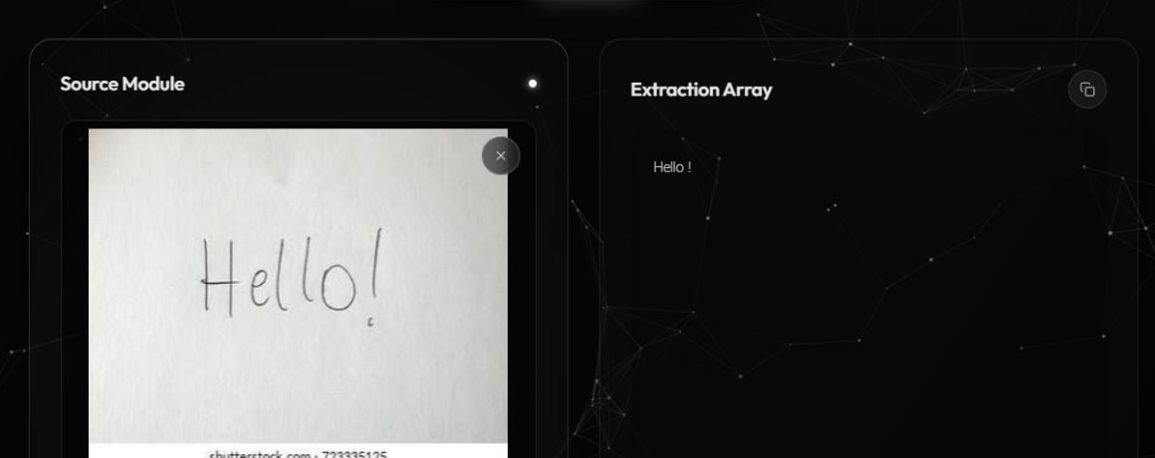
Conclusion
1
. Project Summary
The project focuses on developing an AI-based Handwritten Digit/Character Recognition System that processes handwritten images and classifies supported digits and characters using a Convolutional Neural Network.
The proposed workflow includes image preprocessing, CNN-based recognition, confidence analysis, and an interactive interface for displaying results
Final Outcome
[XX%]
Key Results
The final system will be evaluated using a separate test dataset and suitable performance metrics.
2
[Headline metric or achievement]
Objectives achieved: [x of y]
Overall Conclusion
The proposed system provides a practical foundation for converting handwritten digits and characters into digital text. By combining image preprocessing, deep learning, and interactive visualization, the project aims to reduce manual transcription effort and improve the accessibility of handwritten information.
The final effectiveness of the system will be established through experimental evaluation and testing.
3
Notes:
Revisit each objective and say whether you met it. Quote your headline result with numbers. Do not introduce new material here.

Slide 20



Future Scope & Applications
Improve Performance
Experiment with different CNN architectures.
Tune model parameters.
Improve training data quality and diversity.
Applications
Digitization of educational notes.
Conversion of handwritten forms into digital records.
Processing of handwritten documents.
Digital archiving and document management.
Educational applications for handwritten digit and character recognition.
Expand Data / Features
Incorporate additional handwriting datasets.
Include more supported character classes.
Evaluate the model on handwritten samples from different users.
Deploy & Build an Interface
Improve the Streamlit user interface.
Support batch image processing.
Add options to copy or download recognized text.
Scale & Secure
Evaluate performance on different devices.
Improve input validation and error handling.
Add suitable privacy protections for uploaded documents.
Notes:
Give concrete next steps, ideally tied to the limitations. Then name two or three real-world uses.

Slide 21
Team Contribution
Reg. No. | Name | Contribution / Modules Handled
2420030140 | Sai Charan | dataset preparation, image preprocessing, testing
2420030121 | Sai Rishik | CNN development, integration, documentation
2420030166 | M. Satya Charan Reddy | interface development, visualization, testing
Notes:
Show that work was planned and shared. Every member should be able to explain their own module.

Slide 22

References
Research Papers
Li et al., “TrOCR: Transformer-based Optical Character Recognition with Pre-trained Models,” Proceedings of the AAAI Conference on Artificial Intelligence, 2023.
AlKendi et al., 2024.
[Insert the complete verified title, publication, and DOI or URL of the paper cited in the previous review.]
de Sousa Neto et al., 2024.
[Insert the complete verified title, publication, and DOI or URL of the paper cited in the previous review.]
Dataset
Cohen, G., Afshar, S., Tapson, J., and van Schaik, A., “EMNIST: an extension of MNIST to handwritten letters,” 2017 International Joint Conference on Neural Networks.
Project Links
GitHub: [URL]
Dataset: [URL]
Demo video: [URL]
Notes:
Use IEEE style, numbered in order of first citation in the deck. Include datasets, documentation and code repositories.

Slide 23
THANK YOU
Questions & Discussion
[Team email / contact details]
[Guide name and department]
Notes:
Leave this slide up during questions. Make sure every team member can answer questions about their own module.

