Slide 1


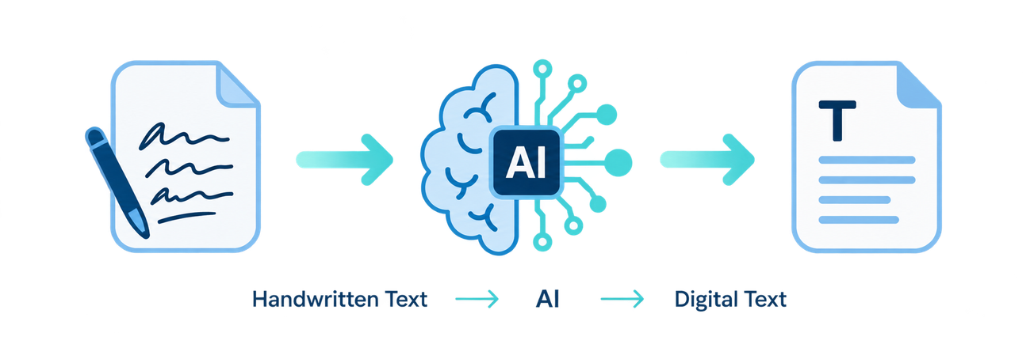
SECOND PROJECT REVIEW
AI-Powered
Handwritten Text
Recognition System
Engineering Project Presentation
TEAM MEMBERS
M. Satya Charan Reddy | 2420030166
R. Sai Charan | 2420030140
S. Sai Rishik | 2420030121
M. Satya Charan Reddy
R. Sai Charan
S. Sai Rishik
M. Satya Charan Reddy
R. Sai Charan
S. Sai Rishik
2420030166
2420030140
2420030121
N. Sunandha Ma’am
2420030166
2420030140
2420030121
N. Sunandha Ma’am
PROJECT GUIDE
N. Sunandha Ma’am
CSE • K L DEEMED TO BE UNIVERSITY
Notes:
1

Slide 2
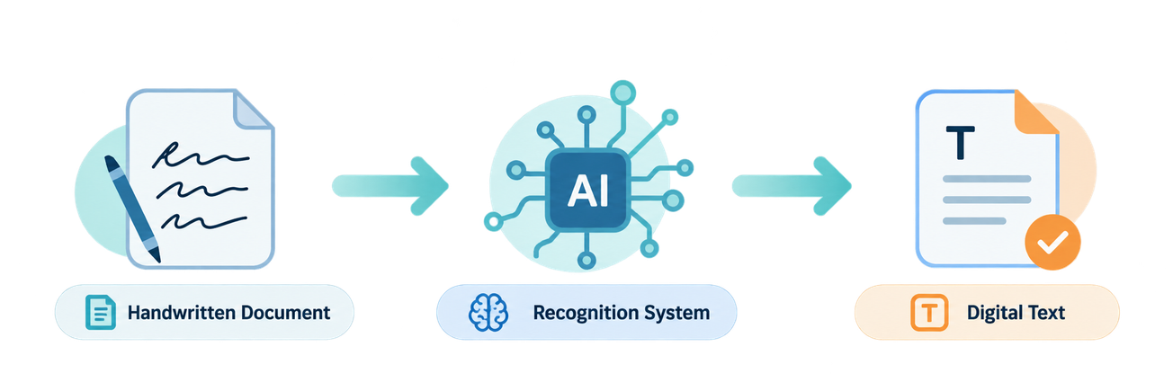
01 PROBLEM STATEMENT
Handwriting remains difficult to digitize
The challenge is reliable recognition across varied handwriting styles and image quality.
Clearly Defined Problem
Handwriting varies significantly across character shape, size, spacing, writing style and alignment. Manual transcription is time-consuming, repetitive and prone to errors.
Existing OCR systems are generally stronger for printed text and may struggle with cursive, irregular or low-quality handwriting.
Digitization
Editable notes
Convert paper records
Reduce retyping
Motivation
Make handwritten information easier to digitize, edit, store, search and process.
Searchable data
Automated entry
Store and retrieve
Lower manual effort
02
Notes:
2

Slide 3
02 OBJECTIVES
Four measurable objectives define the build
The project moves from image preparation to recognition, evaluation and usable digital output.
01
02
03
04
Image Processing
Text Recognition
Performance Evaluation
Digital Text Generation
Prepare handwritten images using resizing, normalization and noise reduction.
Develop or integrate an AI model for handwritten character, word or line recognition.
Evaluate CER, WER and recognition accuracy on a representative test set.
Generate clear, editable and searchable digital text.
EXPECTED OUTCOMES
✓
Functional prototype
✓
Automatic conversion
✓
Measurable accuracy
✓
Reduced transcription effort
✓
User-friendly output
03
Notes:
3

Slide 4
03 LITERATURE SURVEY / EXISTING SYSTEM
Existing HTR approaches evolve from OCR to Transformer-based recognition
Transformer-based HTR is established; our proposed extension adds Qwen 2.5 via Ollama for context-aware refinement.
APPROACH
TECHNIQUE
ADVANTAGES
LIMITATIONS
RESEARCH PAPER / LINK
Traditional OCR
Image processing +
handcrafted features
Simple; lightweight
Weak to handwriting
variation
HTR survey • AlKendi et al.
2024 • PDF ↗
CNN-Based Recognition
CNN visual feature
extraction
Effective for characters
and image patterns
Limited sequence context;
needs prepared input
HTR survey • AlKendi et al.
2024 • PDF ↗
CNN + LSTM + CTC
CNN + LSTM sequence
model + CTC alignment
Variable-length sequences;
words / lines
Higher compute;
complex training
HTR review • de Sousa Neto et al.
2024 • PDF ↗
Transformer-Based HTR
Vision/text Transformer
architecture
Long-range and
contextual dependencies
Higher data/compute;
established approach
TrOCR • Li et al.
2023 • PDF ↗
Transformer HTR + Qwen
HTR Transformer → Qwen 2.5
via Ollama
Context-aware refinement;
local LLM deployment
Needs validation to avoid
over-correction / hallucination
TrOCR + LLM • Al Ali et al.
2026 • PDF/IEEE ↗
RESEARCH GAP / PROPOSED DIRECTION: Existing work demonstrates Transformer HTR and LLM post-processing separately/in combination. Our proposed pipeline specifically evaluates HTR → Qwen 2.5 (Ollama) → context-aware refinement.
Paper links are provided for direct reference; reported performance should be compared on the same dataset before drawing conclusions.
04
Notes:
4

Slide 5
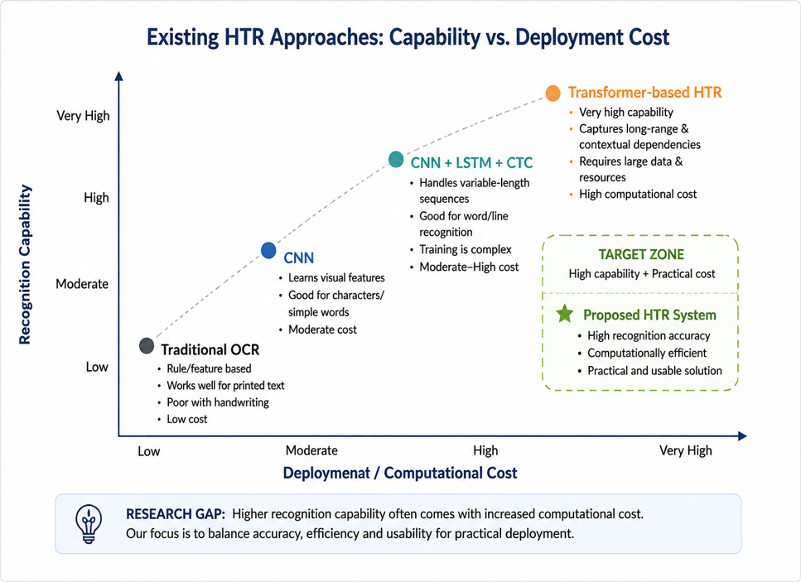
03 LITERATURE SURVEY / EXISTING SYSTEM
The Research Gap is practical: Robustness, Cost and Usability
A practical HTR system should remain robust on imperfect handwriting while keeping deployment requirements manageable.
LIMITATIONS / RESEARCH GAP
01
High variation in handwriting styles
02
Cursive and irregular text is difficult
03
Noisy or low-quality images reduce reliability
04
Advanced models can be computationally heavy
05
Practical deployment needs user-friendly workflows
Target balance: accuracy • robustness • efficiency
05
Notes:
5

Slide 6

04 PROPOSED SYSTEM RESPONSE
Proposed system: an end-to-end HTR pipeline
The workflow combines preprocessing, AI recognition and evaluation to produce editable digital text.
Input Image
Preprocessing
AI Recognition
Digital Output
Handwritten document or note
Resize, normalize, reduce noise
Characters, words or sequences
Editable and searchable text
COMMON CHALLENGES :
PROPOSED RESPONSE :
Limited handwriting robustness
AI-based handwriting recognition
Manual or inconsistent preprocessing
Image preprocessing pipeline
May require high computational resources
CER / WER / accuracy evaluation
Deployment can be resource-intensive
Editable digital output
Project focus: robust recognition • measurable evaluation • practical usability
06
Notes:
6

Slide 7
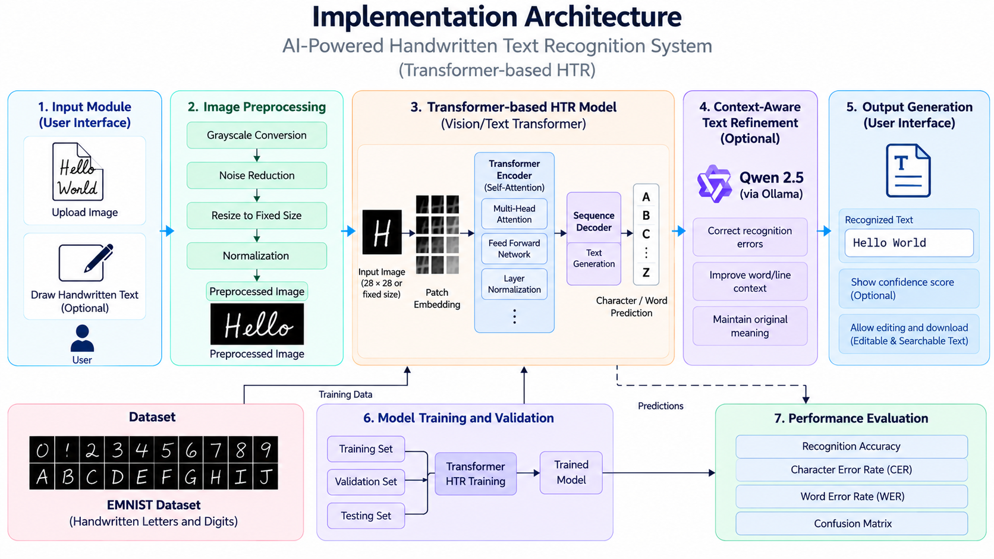

Slide 8
05 METHODOLOGY
Methodology: from handwritten image to reliable text
Dataset Collection: Select the EMNIST dataset containing handwritten letters and digits for model training and testing.
Data Preprocessing: Resize images, normalize pixel values, convert to grayscale where required, and reduce noise.
Dataset Splitting: Divide the dataset into training, validation, and testing sets.
Model Development: Build a Convolutional Neural Network (CNN) to learn handwriting patterns and recognize characters.
Model Training: Train the CNN using labled handwritten images and validate its performance.
Text Recognition: Process the input image and predict the corresponding handwritten characters.
Context-Aware Refinement: Explore Qwen 2.5 through Ollama to refine recognized text where appropriate.
Performance Evaluation: Evaluate recognition using accuracy, Character Error Rate (CER), and Word Error Rate (WER), as applicable.
Output Generation: Display the recognized text through a user-friendly interface, with optional confidence scores.
Testing and Validation: Test the system with different handwriting styles and image qualities to assess reliability.

