Slide 1

RFID STUdent Attendance system
Aware Innovations

Slide 2

My team
1.Rishabh Singh (Group leader)
2.Shivam Katiyar (Member)
3.Rishabh Pal (Member)
4.Abhisekh pal (Member)
5.Harshit Gupta (Member)
Guided by:
Durgesh Pandey(Assistant Professor)

Slide 3
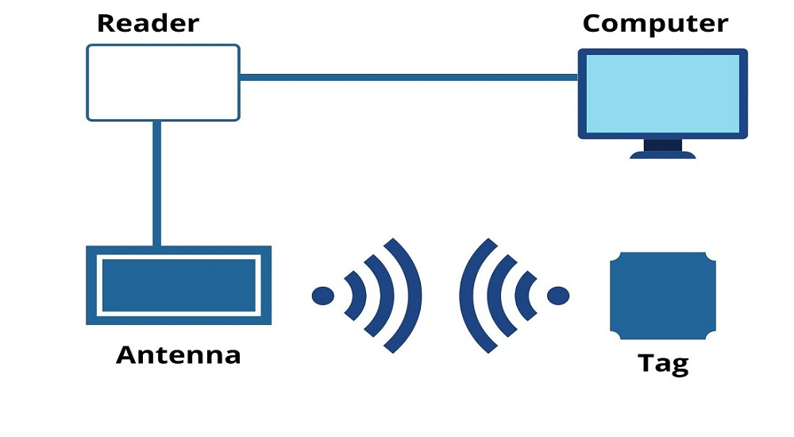
AGENDA
Introduction​
Objective
​Tools and Technology
Timeline
​Summary​

Slide 4
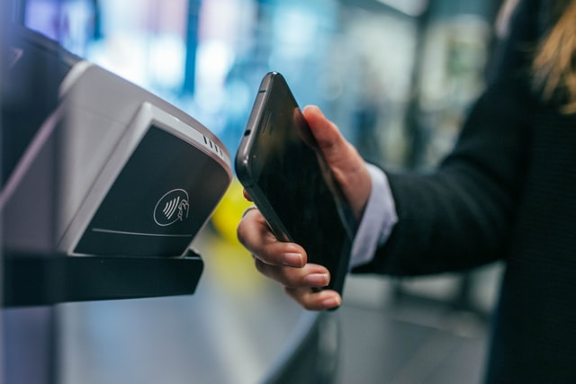
introduction
RFID attendance system is used to take attendance for student in school, college, and university. By placing their ID cards on the reader, students or workers can immediately verify their attendance.

Slide 5
objective
The main objective of the system is to uniquely identify and to mark attendance for a students. This is possible by the new emerging technology of RFID.

Slide 6
Tools and technology
1.RFID tags or cards
2.RFID readers
3.LCD display
4.Breadboard
5.Excel integration
6.Power supply
7.Attendance software

Slide 7
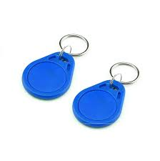
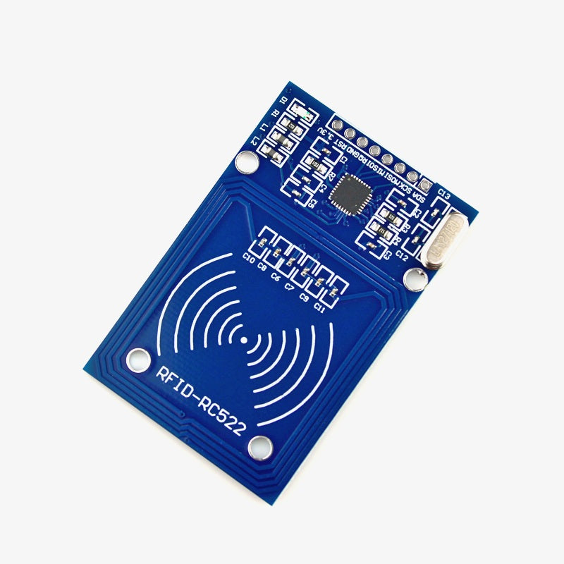
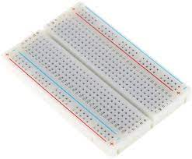
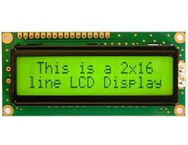
Tool used Rfid tag- An RFID tag is a small electronic device that contains a microchip and an antenna. These tags come in various forms, including cards, labels, stickers, or even embedded in items RFID reader- it is a network-connected device that can be portable or PERMANENTLY ATTACHED. IT USES RADIO WAVES TO TRANSMIT breadboard- A breadboard (sometimes called a plugblock) is used for because BUILDING TEMPORARY CIRCUITS. it allows components to be removed and replace easily. lcd display-LCD (Liquid Crystal Display) is a type of flat panel displayWHICH USES LIQUID CRYSTALS IN ITS PRIMARY FORM OF OPERATION.

Slide 8
TIMELINE
SEP
10-28
oct
1-17
OCT
17-30
NOV
1-15
NOV
17-30
Planning
Research
DESIGN
Implementation
Follow Up

Slide 9
summary
Students, faculty, and staff members are provided with RFID tags, which they present to the reader to mark their attendance. The reader then emits radio frequency signals that are received by the tags, which respond by transmitting their unique identification numbers.

Slide 10


THANK YOU

