Slide 1
Carbon Program
Service Blueprint
Grower
Dealer
Mapping a multi-year enterprise service across growers, dealers, field teams, operations, finance, and digital platforms.
Field team
Operations
Finance
Digital systems
Senior UX Designer | Service Design | UX Research | Systems Thinking

Slide 2
The program had many owners, but no shared view
Each function understood its own work. No one could see the full customer journey across a process lasting more than a year.
Duplicated work across teams
Core problem
Disconnected systems and handoffs
The experience looked like enrollment to customers, but operated like a long-running service ecosystem behind the scenes.
Inconsistent grower communication
Unclear ownership at key moments
Poor visibility into customer progress
Carbon Program Service Blueprint
02

Slide 3
The goal was a single source of truth for the service
The blueprint needed to document the visible journey and the hidden operational work that made it possible.
Customer
Operations
Systems
Alignment
Understand every touchpoint and expectation.
Reveal hidden work, ownership gaps, and handoffs.
Map dependencies across CRM, DMP, automation, and payment tools.
Create a shared foundation for process improvements.
Carbon Program Service Blueprint
03

Slide 4
My role covered research, facilitation, synthesis, and leadership alignment
I worked with two additional UX designers across three design sprints.
Planned research activities
Identified system dependencies
Interviewed stakeholders across business units
Synthesized operational pain points
Facilitated service blueprint workshops
Validated findings with teams
Mapped frontstage and backstage processes
Presented recommendations to leadership
Carbon Program Service Blueprint
04

Slide 5
Discovery moved from individual views to a validated service map
The work combined interviews, synthesis, blueprinting, and review cycles with the teams responsible for the service.
Research
Stakeholder
interviews
Journey
mapping
Affinity
mapping
Blueprint
creation
Validation
workshops
Leadership
reviews
Participants included growers, dealers, field representatives, operations, finance, product, customer support, and leadership.
Carbon Program Service Blueprint
05

Slide 6
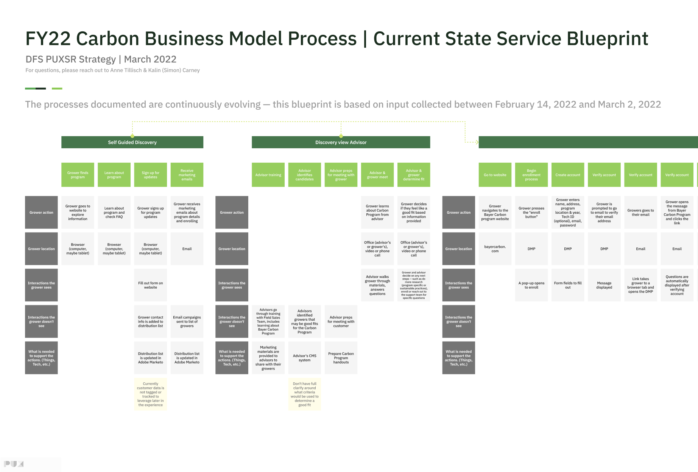
The blueprint made the whole service visible at once
It captured customer-facing moments, internal work, systems, handoffs, waits, and decision points across the full program lifecycle.
Carbon Program Service Blueprint
06

Slide 7
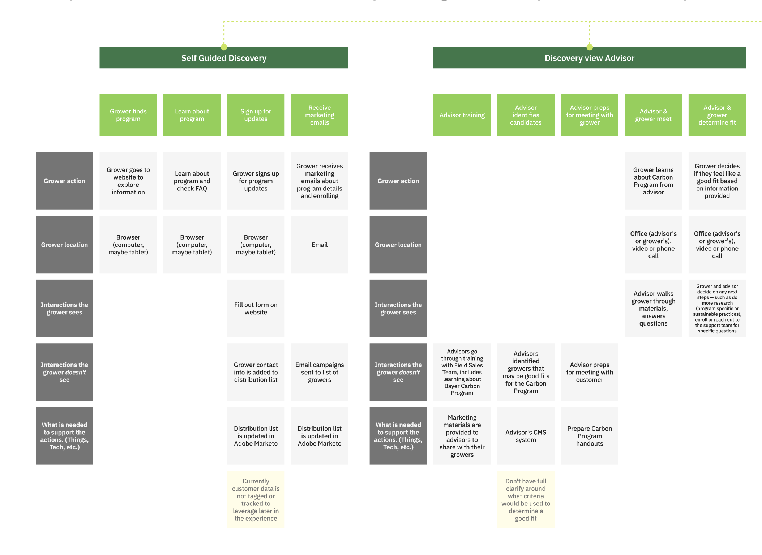
Two entry paths created different expectations before converging
Self-guided discovery and advisor-led discovery introduced different expectations before the journey moved into the same enrollment workflow.
Carbon Program Service Blueprint
07

Slide 8
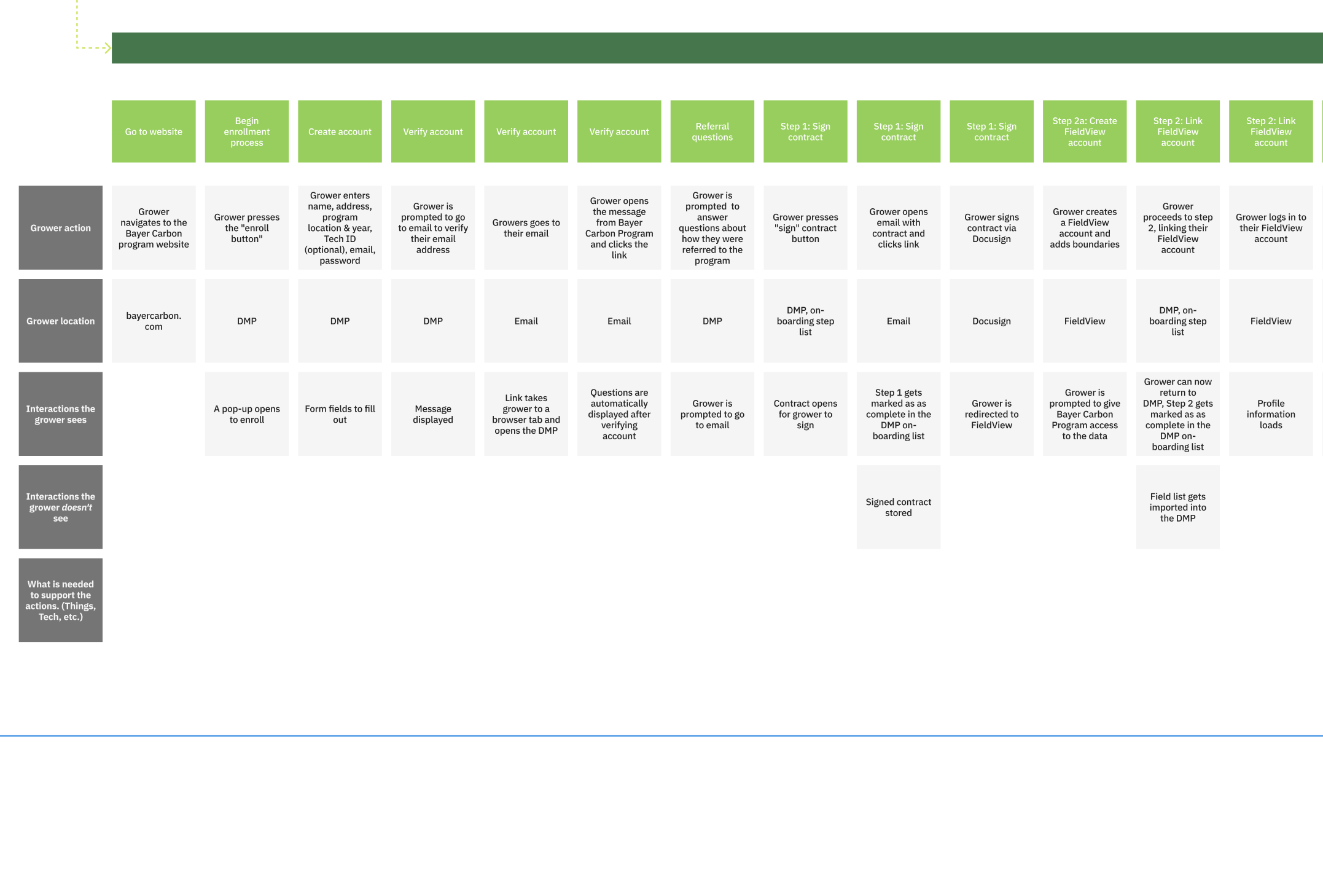
Enrollment revealed how quickly digital steps became operational work
Account creation, contract signing, FieldView setup, and DMP updates created a chain of visible and invisible work.
Carbon Program Service Blueprint
08

Slide 9
Most of the service happened where customers could not see it
The blueprint separated the simple external experience from the dense internal ecosystem required to deliver it.
Customer sees
Customer never sees
Website
Marketing automation
CRM and DMP
Emails
Verification
Operations approvals
Enrollment
Finance and legal
Field scheduling
Payments
Carbon Program Service Blueprint
09

Slide 10
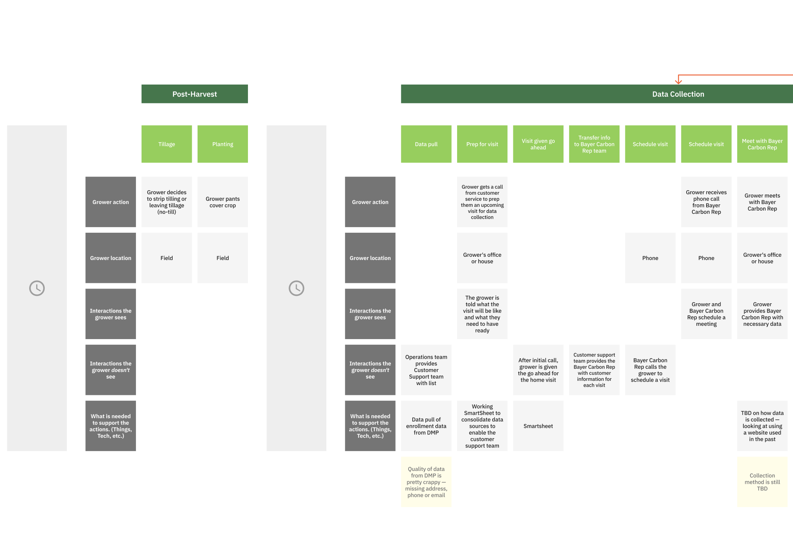
Waiting was often a seasonal dependency, not a broken experience
Post-harvest and data collection steps showed why customer quiet periods could represent expected agricultural timing.
Carbon Program Service Blueprint
10

Slide 11
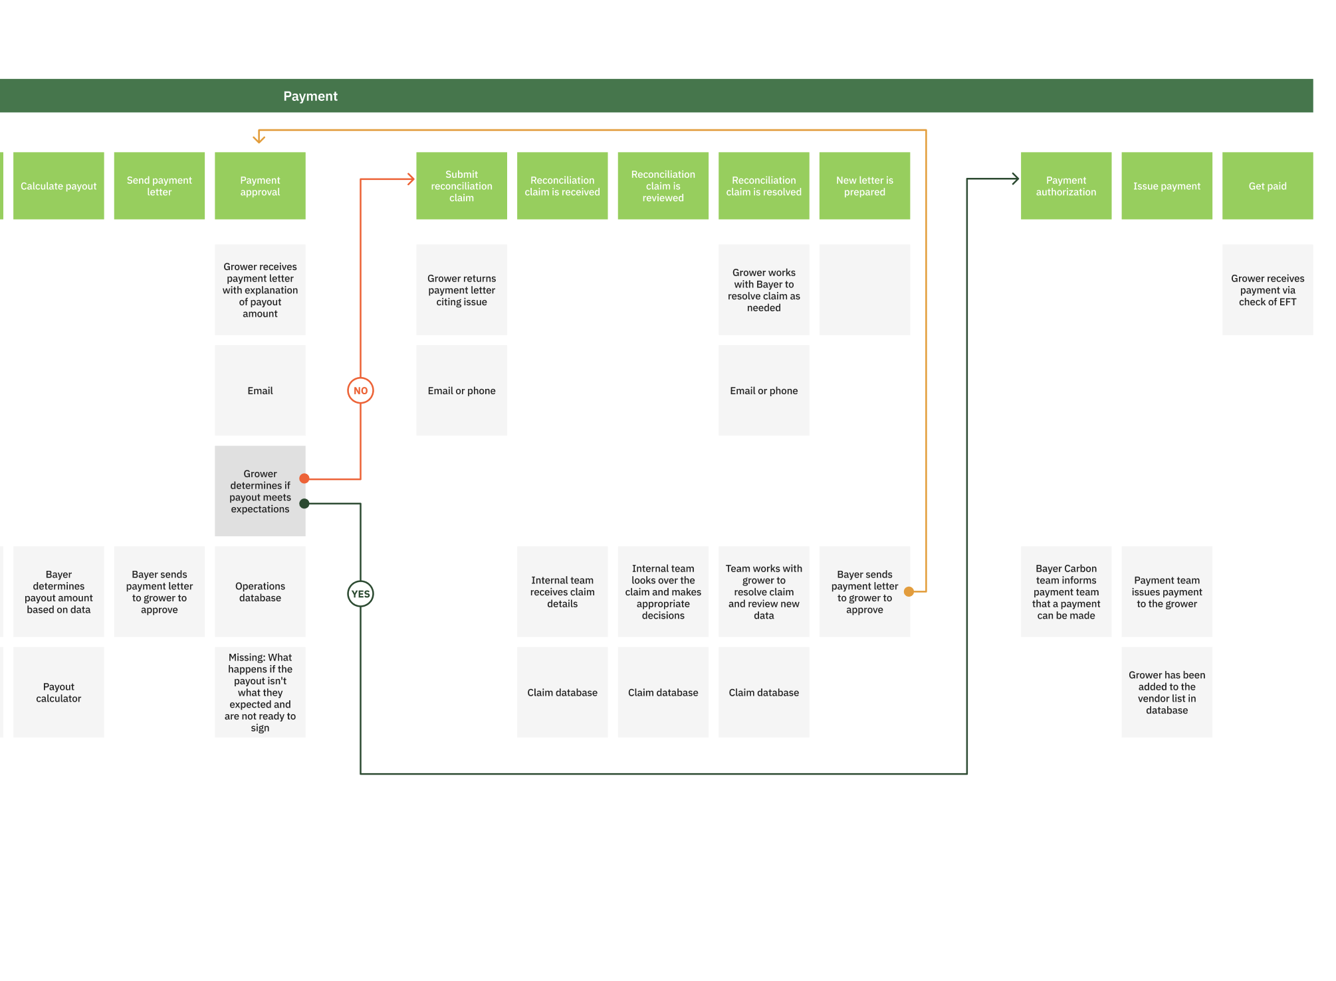
Decision points exposed the real workflow complexity
Payment eligibility depended on approvals, verification outcomes, reconciliation loops, and re-review across teams.
Carbon Program Service Blueprint
11

Slide 12
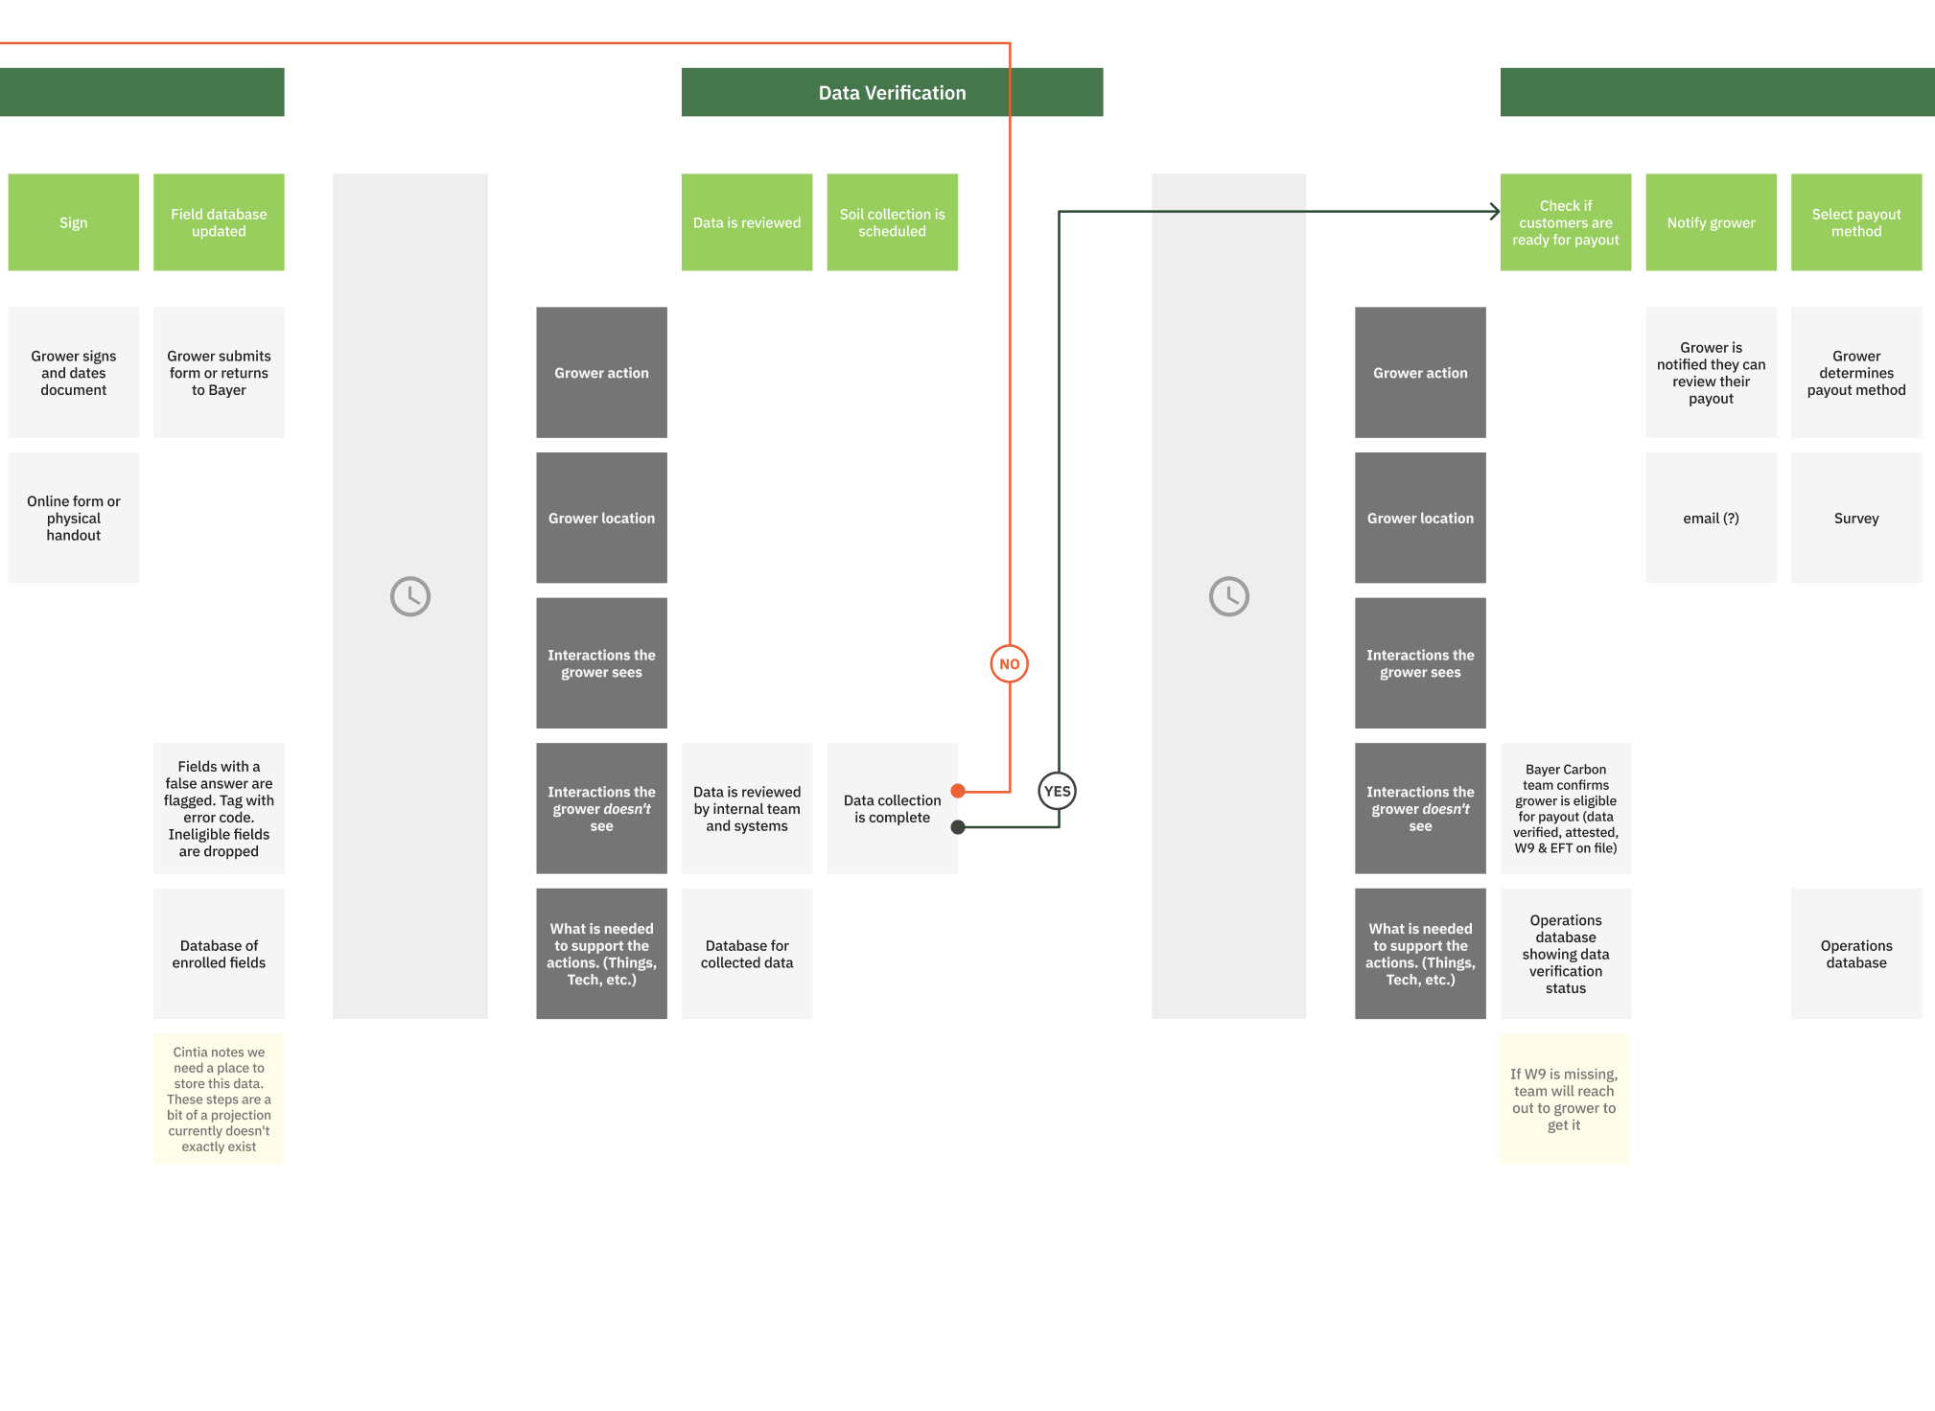
Verification connected back-office data to customer readiness
Data review, soil collection, payout readiness, and missing documentation created multiple points where ownership had to be explicit.
Carbon Program Service Blueprint
12

Slide 13
The findings grouped into process, technology, and experience themes
This framing helped teams see which issues were operational, which were system-driven, and which were felt by the customer.
Process
Technology
Customer experience
Duplicated activities
Manual handoffs
Undefined ownership
Systems lacked integration
Data was not shared
Customer status was hard to determine
Long periods without communication
Multiple entry points
Inconsistent expectations
Carbon Program Service Blueprint
13

Slide 14
The work gave the organization a foundation for service improvement
Even without a single product release metric, the service blueprint created practical alignment and exposed where improvements should start.
Created the organization's first end-to-end service blueprint
Aligned business units around one shared customer journey
Revealed duplicated operational work
Identified automation opportunities
Improved visibility into cross-functional dependencies
Established a foundation for future service improvements
Carbon Program Service Blueprint
14

Slide 15
Portfolio takeaway
15
This was not only a map of a service. It was a shared operating model for teams that had been optimizing separate pieces of one customer journey.
slides
The case study demonstrates service design, systems thinking, research synthesis, facilitation, and the ability to make enterprise complexity usable.
Carbon Program Service Blueprint
15

