Slide 1
SVM and Maximum Entropy Model for Sentiment Analysis of Tweets
Group- 5
Group Members
UMAR IBN ALI - 1328435
MD. SHAIKOT HOSSEN - 1233903
MD ABDUL QUADIR - 1311903
S M RAJU - 1416463

Slide 2
Contents
1.0 Abstract
2.0 Introduction
Project Objectives
Project Scope
What is Sentiment Analysis ?
Chosen Algorithms
3.0 Literature Review
4.0 Data Collection & Processing
Dataset
Raw data
Parsed data
Processing and Cleaning Data

Slide 3
Contents(Continue..)
5.0 Experimental and Experiment Results
Methodology
Evaluation Metric
Output of Experiment
Visualization and Analysis of Results
6.0 Conclusion and Future Work

Slide 4
1.0 Abstract
There are a lot of tweets regarding Apple products world-wide, as it is one of the leading technology companies in the world today. We used the twitter to mine sentiments of people about Apple.
We will compare SVM and Maximum Entropy to analyze sentiments. Thus, we can reach a conclusion about which algorithm is better for sentiment analysis.

Slide 5
Introduction
Project Objectives
To classify the twitter texts into positive, negative and neutral sentiments.
To evaluate which algorithm does this classification with more accuracy.

Slide 6
Introduction(Continue..)
Project Scope
Using twitter, we will mine the sentiments of people about Apple company around the world and analyze the sentiments to compare the two algorithms.

Slide 7
Introduction(Continue..)
What is Sentiment Analysis ?
Sentiment Analysis is the process of finding the opinion of user about some topic or the text in consideration.
In other words, it determines whether a piece of writing is positive, negative or neutral.

Slide 8
Introduction(Continue..)
Chosen Algorithms
Our chosen algorithms are Maximum Entropy Model and SVM, we would like to find out which algorithm is better at classification of sentiment.
SVM: Support Vector Machine (SVM) is a supervised machine learning algorithm which can be used for both classification or regression challenges.
Maximum Entropy Model: The Maximum Entropy classifier is a probabilistic classifier which belongs to the class of exponential models.

Slide 9
3.0 Literature Review
Go and L.Huang (2009) [1] proposed a solution for sentiment analysis for twitter data by using distant supervision, in which their training data consisted of tweets with emoticons which served as noisy labels. They build models using Naive Bayes, MaxEnt and Support Vector Machines (SVM).
Xia et al. [2] used an ensemble framework for Sentiment Classification which is obtained by combining various feature sets and classification techniques. In their work, they used two types of feature sets (Part-of-speech information and Word-relations) and three base classifiers (Naive Bayes, Maximum Entropy and Support Vector Machines) .
Luo et. al. [3] highlighted the challenges and an efficient technique to mine opinions from Twitter tweets. Spam and wildly varying language makes opinion retrieval within Twitter challenging task.
Parikh and Movassate (2009) [4] implemented two models, a Naive Bayes bigram model and a Maximum Entropy model to classify tweets. They found that the Naive Bayes classifiers worked much better than the Maximum Entropy model.

Slide 10
4.0 Data Collection & Processing
Dataset
Data is extracted from twitter. A twitter developer account is created, and tweets are extracted with keys generated by twitter. Tweets with the following word, '@Apple' are extracted from twitter.

Slide 11
4.0 Data Collection & Processing(Continue..)
#Code to Extract Tweets

Slide 12
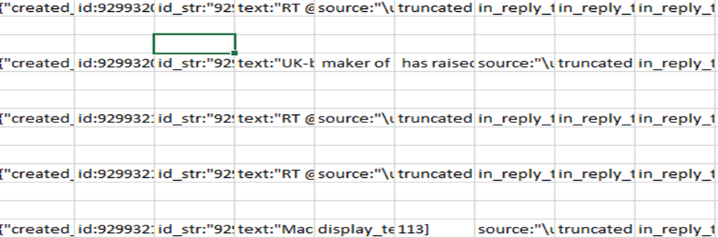
4.0 Data Collection & Processing(Continue..)
Raw data
The raw data contains many columns. The list of columns are: created_id, id_str, text, source, in_reply_to_status_id, in_reply_to_status_id_str, in_reply_to_user_id, name, screen name, location, language, retweet status etc.

Slide 13
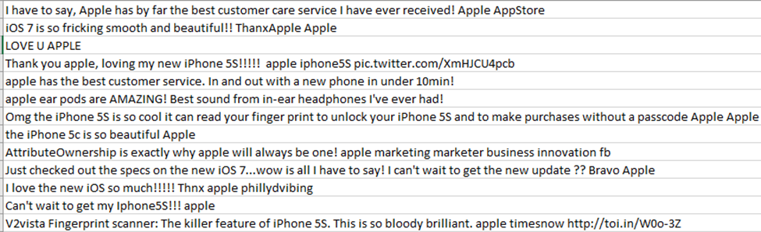
4.0 Data Collection & Processing(Continue..)
Parsed Data
The text column is useful for our project. So, we parse by text only.

Slide 14
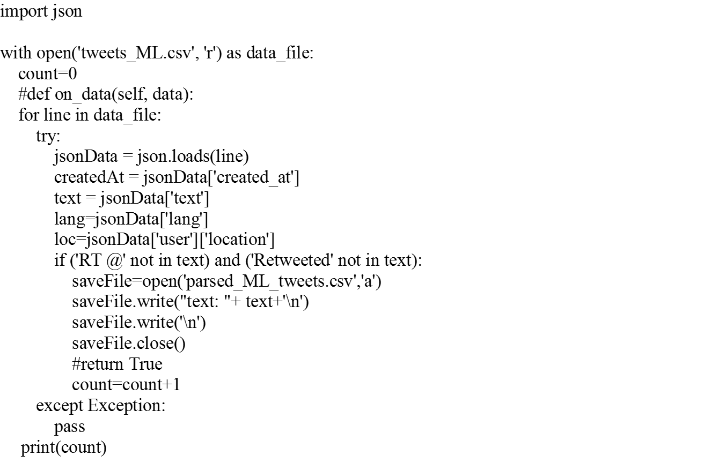
4.0 Data Collection & Processing(Continue..)
#Code to Parse Tweets

Slide 15
4.0 Data Collection & Processing(Continue..)
Processing and Cleaning Data
We remove all duplicate tweets.
Where necessary, spelling mistakes were corrected.
Tweets that are collected are manually assigned to be positive, neutral and negative.
The positive tweets, negative tweets and neutral tweets are then placed in separate csv files for our experimentation.

Slide 16
5.0 Experimental and Experiment Results
Methodology
In this sentiment analysis project, we used Vectorizer approach to classify our data from plain texts to matrices of datasets each containing keywords and their Boolean values “True” or “False”. First, we split all the sentences using splitter tools from the Positive, Negative and Neutral datasets. Then we create training feats and test feats for all 3 datasets. After that, we assigned 75% of each dataset to be train data and 25% of each datasets to be test data.

Slide 17
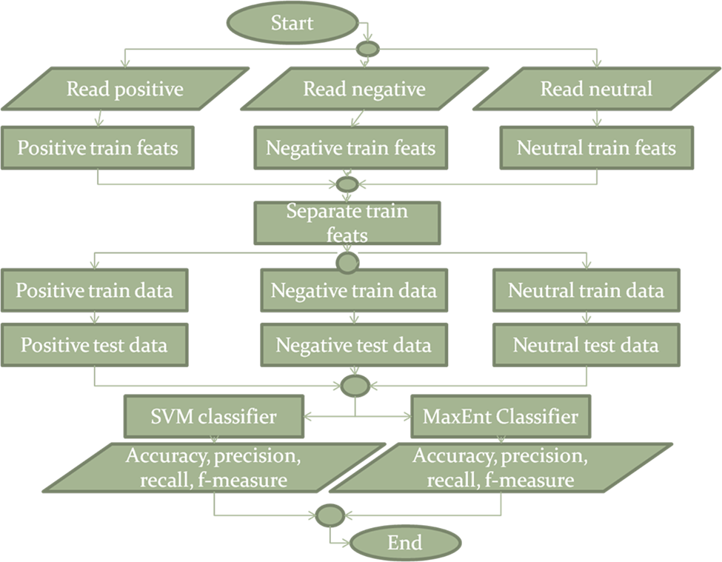
5.0 Experimental and Experiment Results(Continue..)

Slide 18
5.0 Experimental and Experiment Results(Continue..)
Evaluation Metric
Accuracy: (TP+TN)/ (TP+FP+TN+FN)
Precision: TP/(TP+FP)
Recall: TP/(TP+FN)
F-Measure: (2*TP)/(2*TP+FP+FN)

Slide 19
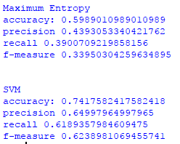
5.0 Experimental and Experiment Results(Continue..)
Output of Experiment

Slide 20
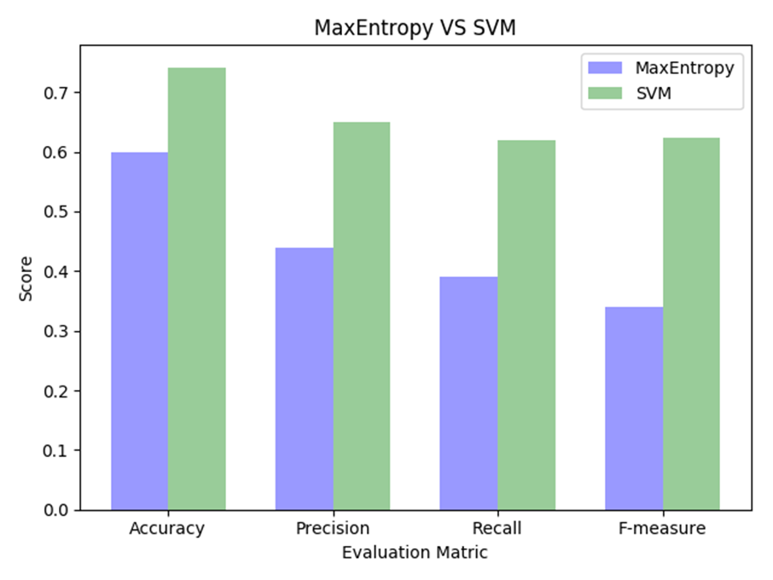
5.0 Experimental and Experiment Results(Continue..)
Visualization and Analysis of Results

Slide 21
Conclusion and Future Work
We conclude that sentiment analysis of tweets gives the best result using SVM classifier.
For future work, tweets in different languages can be used as dataset to improve our scope. 3 types of SVM kernel subclasses can be merged for better results of SVM classifier.

Slide 22
References
[1] Go, R. Bhayani, L.Huang. “Twitter Sentiment Classification Using Distant Supervision". Stanford University, Technical Paper,2009
[2] R. Xia, C. Zong, and S. Li, “Ensemble of feature sets and classification algorithms for sentiment classification,” Information Sciences: an International Journal, vol. 181, no. 6, pp. 1138–1152, 2011.
[3] ZhunchenLuo, Miles Osborne, TingWang, An effective approachto tweets opinion retrieval", Springer Journal onWorldWideWeb,Dec 2013, DOI: 10.1007/s11280-013-0268-7.
[4] R. Parikh and M. Movassate, “Sentiment Analysis of User- Generated Twitter Updates using Various Classi_cation Techniques", CS224N Final Report, 2009

