Slide 1

Obesity and Health Care Costs in the Medicare Population
STUDY GROUP: DANIEL LOVE, RYAN WIN, LUISA ZINI AND SHAUN RAMIREZ
Notes:
Presenter: Luisa to open, team to introduce themselves

Slide 2
Questions
Null Hypothesis
There is no relationship between obesity in adults aged 65 and over and medicare spending (costs)
AIM
To show general trends in healthcare expenditures for the Medicare population as compared to obesity trends for the years 2011-2016.
Notes:
Presenter: Luisa

Slide 3
Data Collection
Health expenditures data were primarily pulled and downloaded from the Center’s for Medicaid & Medicare. Source: The National Health Expenditure Accounts (NHEA)
Obesity data was collected from Kaggle.com. Source: Youth Risk Behavior Surveillance System (YRBBS 2016)
References:
  https://www.cms.gov/Research-Statistics-Data-and-Systems/Statistics-Trends-and-Reports/NationalHealthExpendData/NationalHealthAccountsHistorical
  https://www.kaggle.com/spittman1248/cdc-data-nutrition-physical-activity-obesity
Notes:
Presenter: Luisa
Our original focus was on trying to find comprehensive Healthcare expenditures data for 10-20 years. We hoped to find overall healthcare costs/expenditures at the National level and further stratified by state.
Data health expenditures: We explored numerous data sets from HealthData.gov, the National Institutes of Health (NIH), and the Center’s for Medicaid and Medicare Services (CMS). CMS has a data repository called Data.CMS.gov which offers downloads and API options. In the end, the best healthcare cost data came from CMS. The data set we found came from the National Health Expenditure Accounts data)
From the data set web page: “The National Health Expenditure Accounts (NHEA) are the official estimates of total health care spending in the United States. Dating back to 1960, the NHEA measures annual U.S. expenditures for health care goods and services, public health activities, government administration, the net cost of health insurance, and investment related to health care. The data are presented by type of service, sources of funding, and type of sponsor.
U.S. health care spending grew 4.6 percent in 2018, reaching $3.6 trillion or $11,172 per person. As a share of the nation's Gross Domestic Product, health spending accounted for 17.7 percent.”
Obesity data: Comprehensive obesity data was more difficult to find and after numerous searching we were able to pull a robust data set from Kaggle. This data is actually from the CDC’s Behavioral Risk Factor Surveillance System.
From the data set: “This dataset includes data on adult's diet, physical activity, and weight status from Behavioral Risk Factor Surveillance System. This data is used for DNPAO's Data, Trends, and Maps database, which provides national and state specific data on obesity, nutrition, physical activity, and breastfeeding.”
Website for BRFSS: https://www.cdc.gov/brfss/index.html

Slide 4
Data Exploration & Wrangling
Munging
Jupyter Notebooks
  Pandas
  Matplotlib.pyplot
  Folium
Excel
Insights and Issues
Locating the “right” data sets
Limitations on Data
Data reported/represented differently
Notes:
Presenter: Luisa
Most data wrangling was done in Jupyter notebooks using standard libraries. However, a small portion was done in Excel.
Issues and considerations:
1) Finding the right datasets was troublesome. We continued exploring even after beginning our data wrangling. Finding better data sets caused us to slightly pivot on what we were looking at. For instance, we were originally interested in whether median income (nationally and at the state level) was rising as fast as health care costs.
2) The obesity data is limited to years 2011-2016. So we were forced to constrain our Health expenditures data to 2011-2016 as well, even though it has data going back to the 1960s.
3) To manage scope we limited our expenditures data to Medicare populations. This was also one of our original focuses and seemed easier to stick with this. However, this pushed us toward also limiting the obesity data to 65 and over.
4) Additionally, data was presented in different ways. Obesity data was presented as percentages of samples from each state.
5) Finally, we had too much data to present in a legible manner. A line graph of all 50 states (and DC) is not a very aesthetically pleasing one.

Slide 5
Comparison Process
An overview of the issue of increasing healthcare costs
Additional Data for context
Comparison of US states obesity proportions with Medicare costs per capita
  Line Graphs - 10 specific states
  Heatmaps and Choropleth map - all states

Slide 6
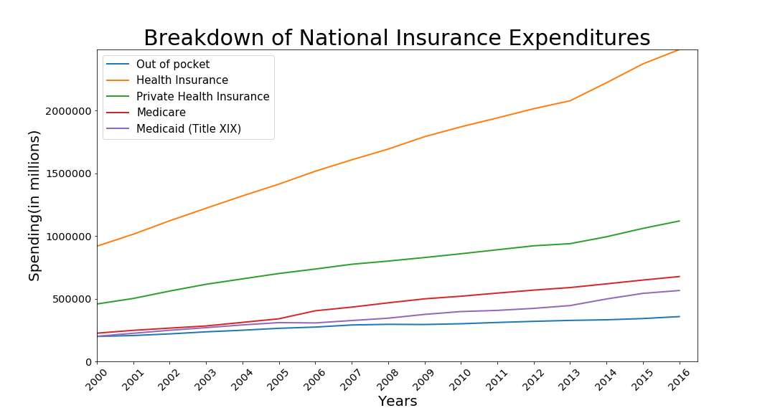

Slide 7
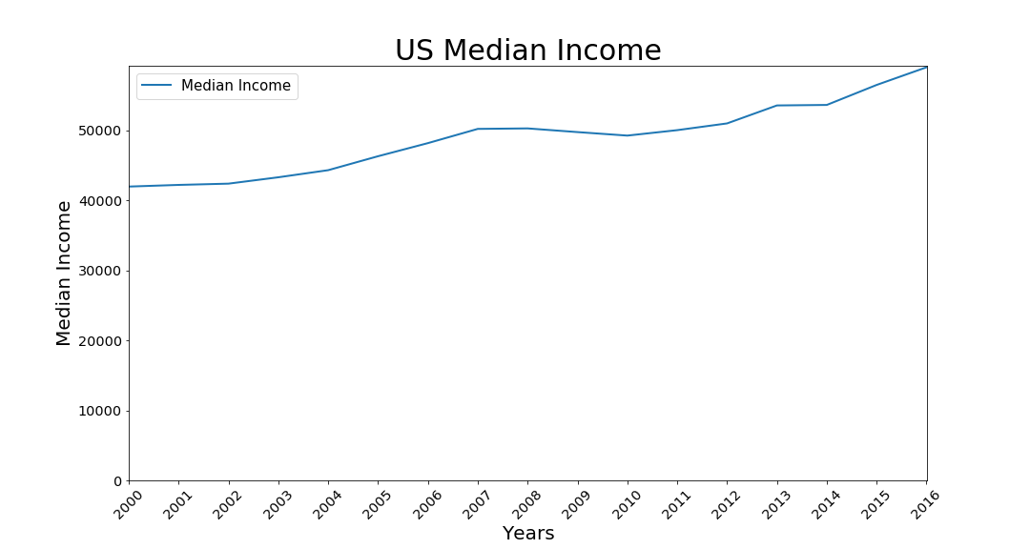
Median Income

Slide 8
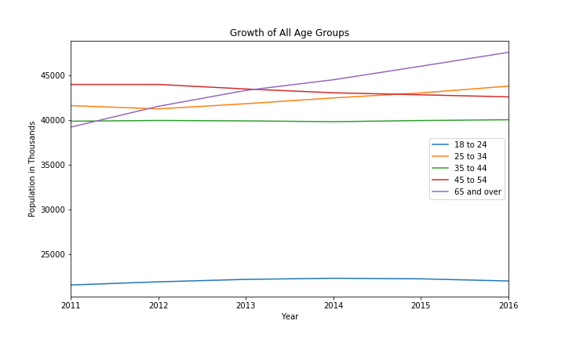

Slide 9
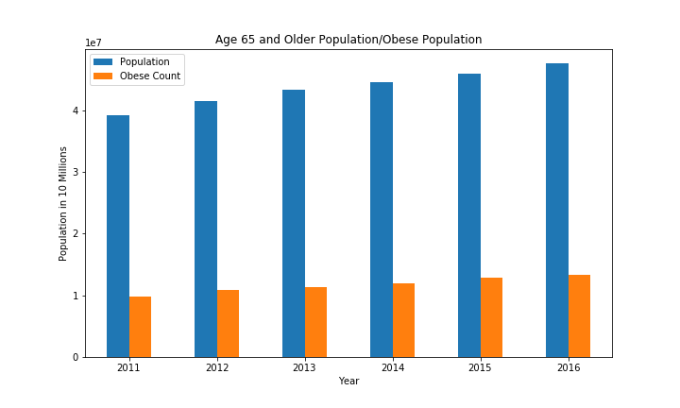

Slide 10
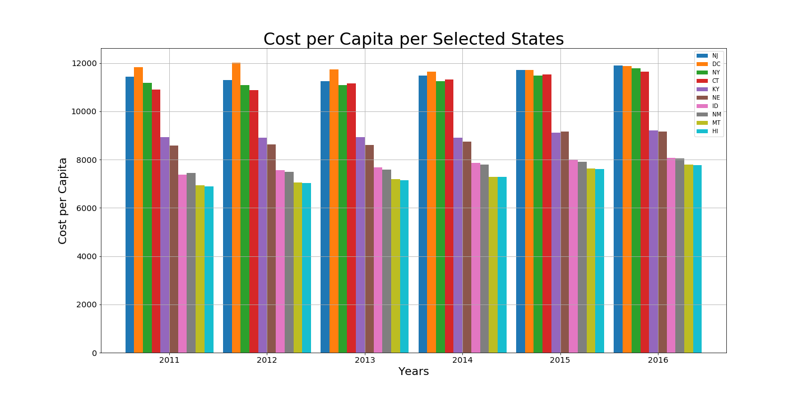
Notes:
In order to refine our comparison a little more we had to choose a sample of states. Otherwise our figures wouldn’t be legible. We wanted to choose as wide a distribution as possible and thus chose states from our Cost Per Capita data based on the Max, Min, and median. We limited to four-ish states (includes the federal district of Washington DC) from the top (NJ, DC, NY, CT), two from the middle (KY, NE) , and four from the bottom (ID, NM, MT, HI).

Slide 11
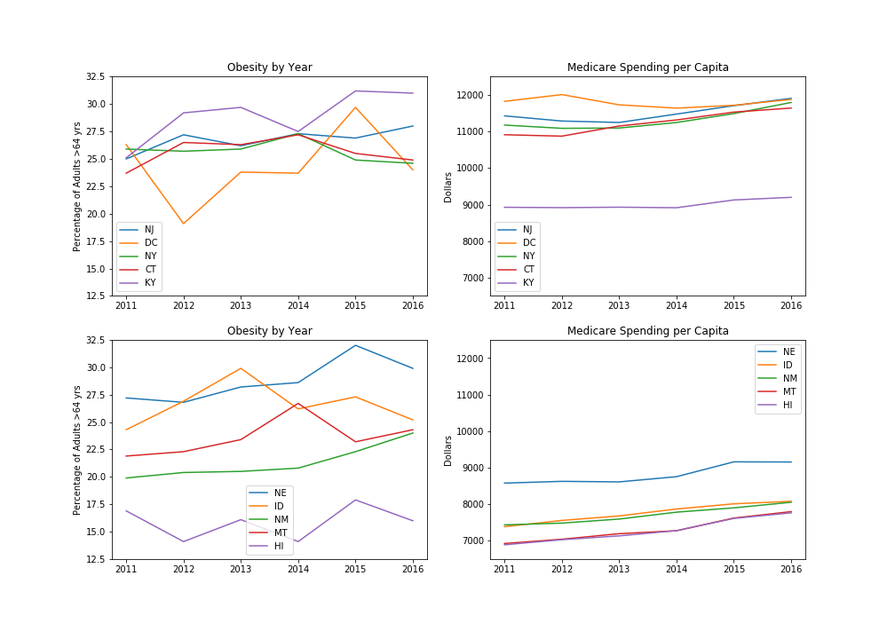
Notes:
Due to the differences in data types reported from our datasets (dichotomous data reported as a proportion vs continuous data in dollars) it was difficult to show any direct comparisons. Thus, we were limited to showing trend lines in our data for comparison. As you can see, over the five years represented here there is a general trend upward in Medicare costs per capita. However over the same five years, obesity within these states has been up & down with little consistency. So, this comparison didn’t really shed any light on our aim. So, we tried our hand at some different graphs.

Slide 12
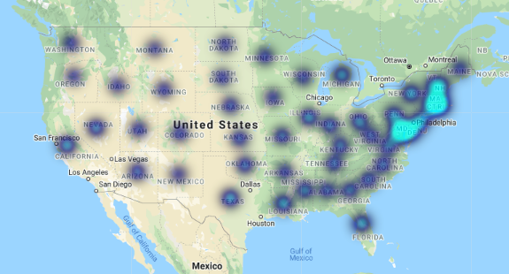
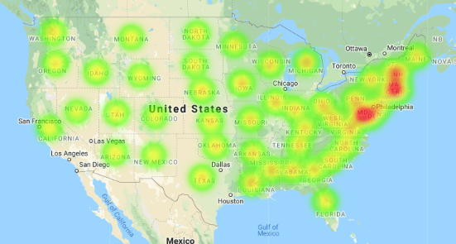
Heat Map Cost Per Capita 2011 ($)
Heat Obesity 2011 (%)
Why does it look like a trend is happening when other graphs didn’t appear to show one?
Is a heat graph of good representation of the data?

Slide 13
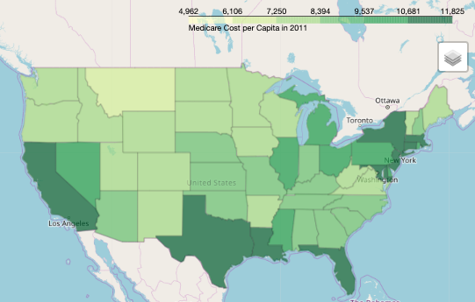
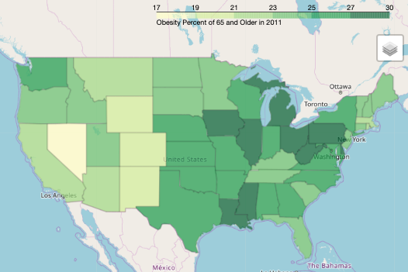
Choropleth Cost Per Capita 2011 ($)
Choropleth Obesity 2011 (%)
From these two graphs, we can see more clearly the contrast between obesity and the cost per capita of Medicare in 2011

Slide 14
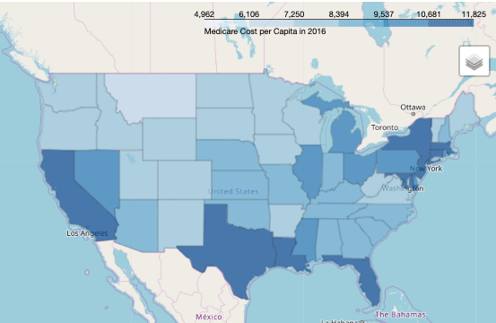
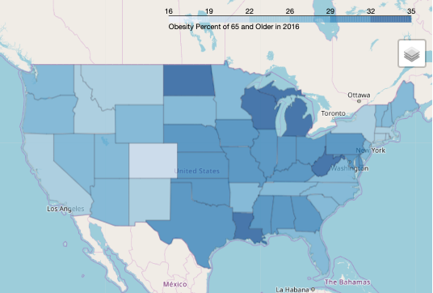
Choropleth Cost Per Capita 2016 ($)
Choropleth Obesity 2016 (%)
Again, no correlation can be seen between obesity and cost per capita of Medicare in 2016.

Slide 15

Conclusions
Healthcare costs are certainly on the rise, with out-of-pocket expenditures rising more slowly than others
Median income is ticking upward slightly
65 and older is the fastest growing age group (from 2011 – 2016)
Medicare spending is on the rise (from 2011-2016)
However, given our data:
  Unable to test our hypothesis
  Results are inconclusive for our aim

Slide 16
Discussion
Limitations
Time constraints
- cleaning data really does take up most of your time!
Data constraints
- by year
- by type
Medicare is much more expansive than we realized.
- 4 different plans plus Medigap that has 10 more plans

Slide 17
Post Project thoughts:
If we had two more weeks:
- Look for individual to find trends to flush out other things that may be influencing our results such as medicare complexity, other health factors, and location.
- Dive into healthcare to further investigate other causes of the growing cost/burden of healthcare.
- Widen our scope of obesity to see the effects on healthcare in the entire population and not just limit it to medicare.

