Slide 1

Brain tumor detection
Notes:
Good morning esteemed members of the IEEE conference. Today, I'm honored to present our groundbreaking work on brain tumor detection. Under the expert guidance of Mrs. Kavitha Nair, our dedicated team from the MIT Academy of Engineering , Pune has undertaken a profound endeavor to tackle one of the most pressing healthcare challenges of our time – the timely and accurate detection of brain tumors.
With the rising incidence of brain-related disorders, the need for effective diagnostic tools has never been more critical. Through our project, we aim to revolutionize the field of medical imaging by harnessing the power of advanced technologies, particularly Convolutional Neural Networks (CNNs), to provide clinicians with reliable and efficient tools for early tumor detection. By leveraging cutting-edge techniques in machine learning and image analysis, we aspire to not only enhance patient outcomes but also contribute to the broader understanding of neurological disorders and their treatment.

Slide 2
TABLE OF CONTENTS
OUR CENTER
KEY NUMBERS
01
02
PATIENT CARE
OUR SUCCESS
03
04
You can describe the topic of the section here
You can describe the topic of the section here
You can describe the topic of the section here
You can describe the topic of the section here

Slide 3
Our Team Infographics
AUTHORS
Yuvraj Patare
Sanket Yadav
School of Computer Engineering
MIT Academy of Engineering
Pune, India
School of Computer Engineering
MIT Academy of Engineering
Pune, India
Rupesh Pingale
Kavitha S.
School of Computer Engineering
MIT Academy of Engineering
Pune, India
School of Computer Engineering
MIT Academy of Engineering
Pune, India

Slide 4
INTRODUCTION
Brain tumors are abnormal growths of tissue in the brain.
They can impair neurological function and even be life-threatening if left untreated.
Early detection of brain tumors is crucial for timely treatment and improved patient outcomes.
Convolutional Neural Networks (CNNs) offer promise in automating the detection process from medical imaging data.
Notes:
The human brain is a marvel of complexity, a neurons that initiates our thoughts, emotions, and actions.
However, this intricate organ is not immune to maladies, and among the most formidable challenges it faces are tumors – abnormal growths of tissue that can arise within its confines.
These tumors, whether benign or malignant, have the potential to wreak havoc on neurological function, impairing cognition, mobility, and even vital functions such as breathing and heart rate.
Indeed, the stakes could not be higher when it comes to brain tumors, with delayed diagnosis often leading to devastating consequences.
Recognizing the urgency of this issue, our project endeavors to leverage cutting-edge technologies to facilitate early detection and intervention.
Through the application of advanced machine learning algorithms, particularly Convolutional Neural Networks (CNNs), we seek to empower clinicians with powerful tools that can swiftly and accurately identify brain tumors from medical imaging data.
By doing so, we aim to not only enhance patient outcomes but also alleviate the burden on healthcare systems worldwide.
Our journey begins with a deep dive into the world of brain tumor detection, where innovation and ingenuity converge to unlock new possibilities in healthcare.

Slide 5
PREVIOUS STUDY
Brain Tumor Detection Using Fuzzy C-Means and CNN
Image Processing and SVM for Brain Tumor Detection
CNN Model with Augmentation for Brain Tumor Detection
AI in Brain Tumor Detection Using CNN and VGG-16
Notes:
---
**1. Brain Tumor Detection Using Fuzzy C-Means and CNN -- Reference [3]**
This study proposes a hybrid approach combining fuzzy C-means clustering with convolutional neural networks (CNN) for brain tumor detection. Fuzzy C-means clustering is utilized for initial segmentation, followed by CNN-based classification for tumor detection. The method aims to leverage the strengths of both approaches to improve accuracy and robustness in tumor detection. The study reports an accuracy of 91% in tumor classification.
**Accuracy:** 91%
---
**2. Image Processing and SVM for Brain Tumor Detection -- Reference [4]**
This study explores the use of image processing techniques in conjunction with support vector machines (SVM) for brain tumor detection. Preprocessing steps such as image enhancement and feature extraction are performed to improve the quality of input data for SVM classification. The study achieves an accuracy of 88% in tumor detection.
**Accuracy:** 88%
---
**3. CNN Model with Augmentation for Brain Tumor Detection -- Reference [6]**
This study proposes a convolutional neural network (CNN) model augmented with data augmentation techniques for brain tumor detection. Data augmentation is employed to artificially increase the size of the training dataset, thereby improving the generalization capabilities of the CNN model. The study reports an accuracy of 95% in tumor classification.
**Accuracy:** 95%
---
**4. AI in Brain Tumor Detection Using CNN and VGG-16 -- Reference [8]**
This study investigates the use of artificial intelligence (AI) techniques, specifically convolutional neural networks (CNN) and the VGG-16 architecture, for brain tumor detection. The VGG-16 architecture is a deep CNN model known for its effectiveness in image classification tasks. The study achieves an accuracy of 94% in tumor detection.
**Accuracy:** 94%
---
These previous studies highlight various approaches and techniques utilized in brain tumor detection, ranging from traditional clustering methods to advanced deep learning architectures. Each study reports promising results in terms of accuracy, demonstrating the potential of these methodologies in improving diagnostic accuracy and patient outcomes in the field of neuroimaging.

Slide 6
RESEARCH GAP
Other solutions for
brain tumor detection
Limited robustness to diverse MRI image characteristics.
Poor generalization to different datasets and imaging conditions.
High computational complexity and resource requirements.
Our solution for
brain tumor detection
Enhanced robustness to variations in MRI images.
Improved generalization across diverse datasets and settings.
Better efficiency with simpler architecture and potentially lower computational requirements
Notes:
Building upon the foundation laid by previous research, our project seeks to address several key gaps and limitations that have impeded progress in the field of brain tumor detection.
Chief among these is the need for robust and generalizable algorithms that can effectively discern between tumor and non-tumor tissue across a diverse range of imaging conditions.
While existing methodologies have shown promise in controlled settings, their performance often falters when faced with the inherent variability of real-world medical imaging data.
Additionally, many current approaches suffer from prohibitively high computational complexity, making them impractical for widespread clinical use.
To bridge these gaps, our project aims to develop innovative solutions that enhance the robustness, generalization, and efficiency of brain tumor detection algorithms.
Through a combination of advanced machine learning techniques, tailored data preprocessing methods, and rigorous evaluation strategies, we seek to push the boundaries of what is possible in this critical area of healthcare research.

Slide 7
OBJECTIVES
Optimize MRI dataset pre-processing for improved feature extraction and noise reduction.
Enhance model architecture by exploring 2D CNN techniques for improved tumor detection.
Implement rigorous evaluation strategies for accurate performance assessment and generalization.
Notes:
With a clear understanding of the challenges and opportunities inherent in brain tumor detection, our project sets forth several key objectives that guide our research endeavors.
Firstly, we aim to leverage state-of-the-art medical imaging datasets to train and evaluate our algorithms, ensuring that they are robust and generalizable across diverse imaging conditions.
Secondly, we seek to develop novel data preprocessing techniques that enhance the quality and consistency of input data, thereby improving the performance of our detection algorithms.
we endeavor to explore a range of machine learning architectures, including convolutional neural networks (CNNs) and deep learning ensembles, to identify the most effective approach for brain tumor detection.
Finally, we aim to rigorously evaluate the performance of our algorithms using real-world clinical data, ensuring that they meet the stringent requirements for clinical deployment. Through these objectives, we aspire to advance the state-of-the-art in brain tumor detection, ultimately improving patient outcomes and enhancing the practice of neurology and neurosurgery.

Slide 8
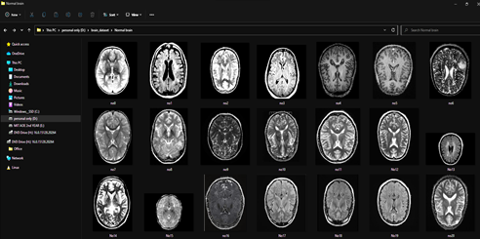
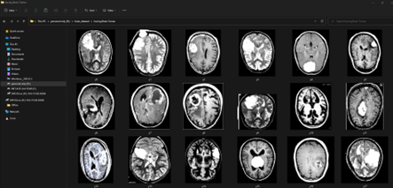
DATASET
Kaggle Brain Tumor MRI dataset: 7,023 unique MRI images.
Images categorized into glioma, meningioma, no tumor, and pituitary classes.
Dataset exhibits variation in image dimensions.

Slide 9
MATERIALS & METHODS
The proposed solution introduces a Deep Learning and CNN-based model for the detection of brain tumors, incorporating image processing and data pre-processing techniques.
Five distinct CNN models, coupled with the Adam Optimizer, are proposed for the classification of MRI images to accurately identify brain tumors.
The system encompasses several stages, beginning with image acquisition, followed by pre-processing, model training, and concluding with the determination of brain tumor presence or absence.
Notes:
To achieve our research objectives, we employed a multifaceted approach that combined cutting-edge machine learning techniques with rigorous experimental methodologies.
Central to our methodology was the utilization of state-of-the-art medical imaging datasets, including the Kaggle Brain Tumor MRI dataset, which comprises thousands of high-resolution MRI images annotated with ground truth labels.
These datasets served as the foundation for our algorithm development and evaluation efforts, providing us with a diverse array of imaging conditions and pathological presentations to explore. In parallel, we developed novel data preprocessing techniques to enhance the quality and consistency of input data, including image registration, normalization, and augmentation.
These preprocessing steps were crucial for ensuring that our algorithms could effectively extract relevant features from input images, regardless of variations in imaging conditions or patient demographics.
With our datasets prepared and preprocessed, we then embarked on the development of machine learning algorithms for brain tumor detection. Leveraging state-of-the-art neural network architectures, including convolutional neural networks (CNNswe trained and evaluated a range of models to identify the most effective approach for our application.
Through this comprehensive methodology, we sought to develop robust, generalizable, and clinically deployable algorithms for brain tumor detection, with the ultimate goal of improving patient outcomes and enhancing the practice of neurology and neurosurgery.

Slide 10
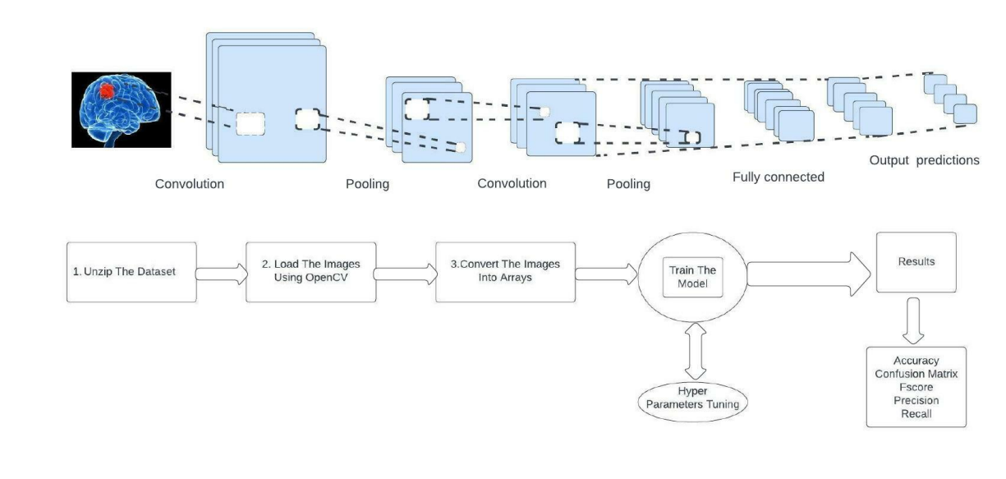
System Architecture
Notes:
Convolutional Layer:
"The convolutional layer extracts features from input images using filters, capturing spatial patterns such as edges and textures."
Pooling Layer:
"Pooling layers reduce spatial dimensions and downsample feature maps, preserving important information while reducing computational complexity."
Fully Connected Layer:
"Fully connected layers integrate extracted features and perform non-linear transformations, enabling the model to learn complex relationships in the data."
Output Prediction:
"The output layer generates predictions based on the learned features, providing the final classification or regression output of the model."

Slide 11
Model | Convolutional Layers | Fully Connected Layers | Hyperparameters | Performance
Model 1 | Two convolutional layers with (3, 3) kernel size, ReLU activation, and valid padding | Two fully connected layers with 252 units each, ReLU activation, and softmax output | LR: 0.001, Batch size: 32 | Effectiveness in brain tumor detection
Model 2 | Four convolutional layers with (7, 7) kernel size, ReLU activation, and same padding | Two fully connected layers with 512 units each, ReLU activation, and softmax output | LR: 0.001, Batch size: 32 | Advanced performance in brain tumor detection
Model 3 | Three convolutional layers with (7, 7) kernel size, ReLU activation, and same padding | Two fully connected layers with 512 units each, ReLU activation, and softmax output | LR: 0.001, Batch size: 32 | Robustness in brain tumor classification
Model 4 | Six convolutional layers with (7, 7) kernel size, ReLU activation, and same padding | Two fully connected layers with 1024 units each, ReLU activation, and softmax output | LR: 0.001, Batch size: 32 | High performance in brain tumor detection
Model 5 | Six convolutional layers with (7, 7) kernel size, ReLU activation, and same padding | Two fully connected layers with 512 units each, ReLU activation, and softmax output | LR: 0.001, Batch size: 32 | Well-suited for brain tumor detection

Slide 12
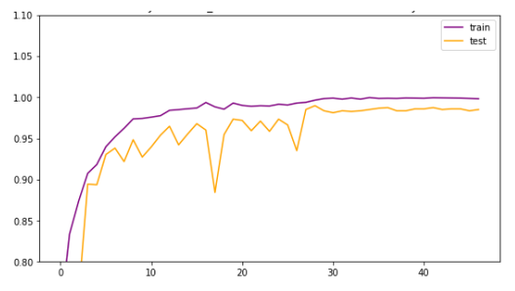
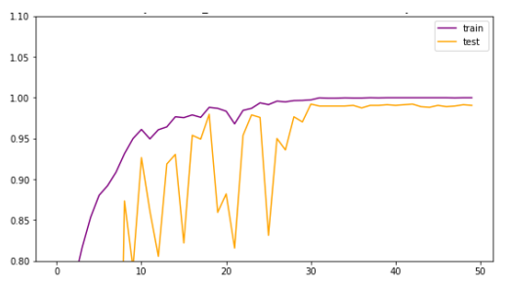
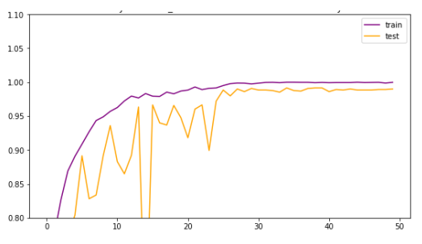
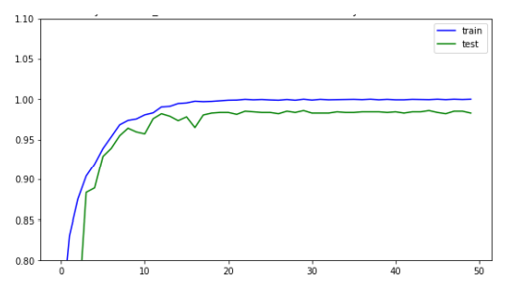
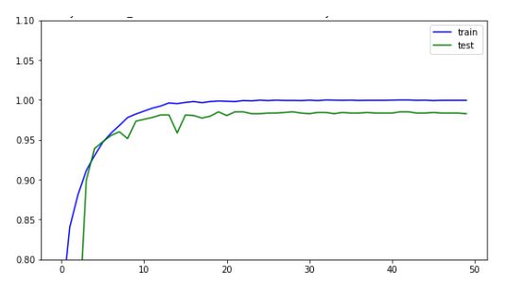
RESULT
Epoch vs Accuracy
Accuracy On Model 1
Accuracy On Model 2
Accuracy On Model 3
Accuracy On Model 4
Accuracy On Model 5
Accuracy On Model 5

Slide 13
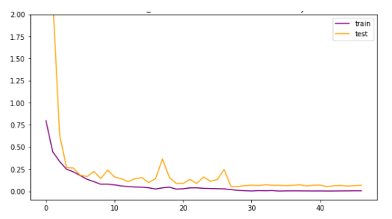
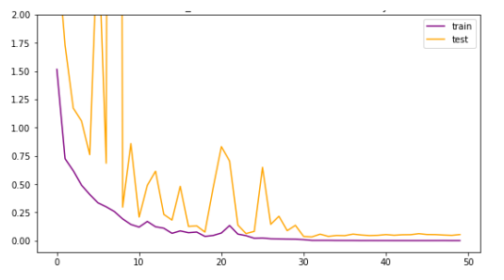
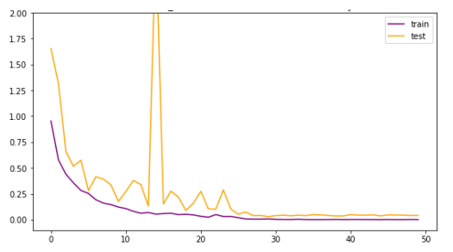
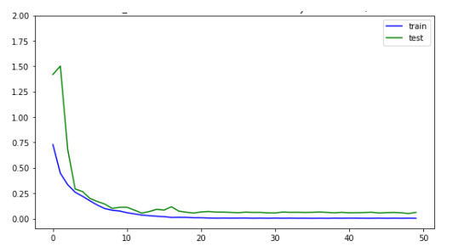
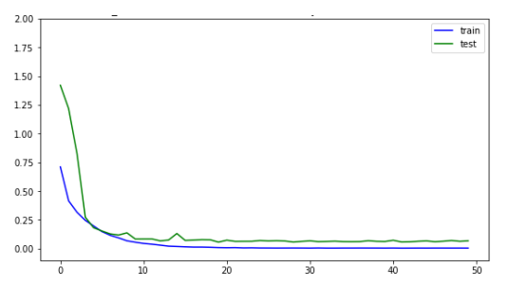
Epoch vs Loss
Loss On Model 1
Loss On Model 2
Loss On Model 3
Loss On Model 4
Loss On Model 5
Accuracy On Model 5

Slide 14
COMPARITIVE ANALYSIS
Model | Testing Accuracy | Testing Loss | Performance
Model 1 | 94.50% | 0.1258 | Balanced performance
Model 2 | 92.14% | 0.2443 | Trade-off: Quickest training, lowest testing accuracy, highest loss
Model 3 | 96.82% | 0.0915 | Moderate performance
Model 4 | 98.37% | 0.0595 | Competitive performance
Model 5 | 98.63% | 0.0534 | Top-performing candidate, well-suited for brain tumor detection

Slide 15
CONCLUSION
Deep learning, particularly CNNs, shows great promise for brain tumor detection in MRI images, offering high accuracy and precision.
Among the evaluated models, Model 5 stands out with the lowest validation loss (0.0534) and highest accuracy (98.63%).
Considerations such as computational resources and training time are important when selecting a model.
Model 5's exceptional validation metrics make it a promising tool for enhancing medical imaging and enabling early tumor detection and treatment.
Notes:
Deep learning, particularly Convolutional Neural Networks (CNNs), presents immense potential for brain tumor detection in MRI images, boasting remarkable accuracy and precision.
Among our evaluated models, Model 5 emerges as the standout performer, showcasing with a validation loss of 0.0534 and an accuracy of 98.63%.
However, it's crucial to consider factors such as computational resources and training time when selecting a model. With its exceptional validation metrics,
Model 5 holds great promise for revolutionizing medical imaging and facilitating early tumor detection and treatment

Slide 16
References
A.Pashaei, H.Sajedi. ”Brain tumor classification via convolutional neural network and extreme learning machines”. mashhad, Iran:8th International Conference on Computer and Knowledge Engineering (ICCKE).
G. Hemanth, L. S., M. Janardhan. ”Design and implementing brain tumor detection using machine learning approach”. Tirunelveli, India: 3rd International Conference on Trends in Electronics and Informatics(ICOEI).
Tonmoy Hossain1, Fairuz Shadmani Shishir , Mohsena Ashraf, MD Abdullah Al Nasim and Faisal Muhammad Shah “Brain Tumor Detection Using Convolutional Neural Network” 1st International Conference on Advances in Science, Engineering and Robotics Technology (ICASERT).
Suresha D, Jagadisha N, Shrisha H S, Kaushik K S “Detection of Brain Tumor Using Image Processing”,Fourth International Conference on Computing Methodology and Communication (ICCMC) Part Number:CFP20K25-ART; ISBN:978-1-7281-4889-2.

Slide 17
Aryan Sagar Methil “Brain Tumor Detection using Deep Learning and Image Processing” International Conference on Artificial Intelligence and Smart Systems (ICAIS) IEEE Xplore Part Number: CFP21OABART; ISBN: 978-1-7281-9537-7.
Gajendra Raut, Aditya Raut, Jeevan Bhagade, Jyoti Bhagade, Sachin Gavhane“Deep Learning Approach for Brain Tumor Detection and Segmentation” IEEE International Conference on Convergence to Digital World – Quo Vadis (ICCDW).
Shraddha S. More1 , Mansi Ashok Mange2 , Mitheel Sandip Sankhe3 , Shwethali Santosh Sahu4 “Convolutional Neural Network based Brain Tumor Detection” Fifth International Conference on Intelligent Computing and Control Systems (ICICCS) IEEE Xplore Part Number: CFP21K74-ART; ISBN: 978-0-7381-1327-2
Sneha Grampurohit, Venkamma Shalavadi, Vaishnavi R. Dhotargavi, Megha Kudari, Mrs Soumya Jolad “BRAIN TUMOR DETECTION USING DEEP LEARNING MODELS” IEEE India Council International Subsections Conference (INDISCON).

Slide 18

THANKS!
Do you have any questions?

