Slide 1

School of Computer Engineering & Technology
Presentation for FY Mini Project (Final Presentation)
STUDENTS NAME:
RUPESH PINGALE(0120200123)

Slide 2
INDEX
Introduction
Problem Statement and Objectives
Implementation
Result/Output

Slide 3
INTRODUCTION
Data science is the study of data to extract knowledge and insights from the data and apply knowledge and actionable insights.
In this Presentation, we will work on student performance and Visualization Project using Python such as Pandas, Numpy, Matplotlib.pyplot and tkinter Library.

Slide 4
PROBLEM STATEMENT WRITE A PYTHON CODE TO ANALYSE PERFORMANCE OF STUDENT FROM CSV.
Objectives to be achieved
1. To analyze Performance of student from their marks of exam.
2. Visualization of result dataset.
3. Determining percentage from overall marks obtained in 4 subject.
4. Analyzing Grade from the marks achieved.
5. Graphical representation of performance of student.

Slide 5
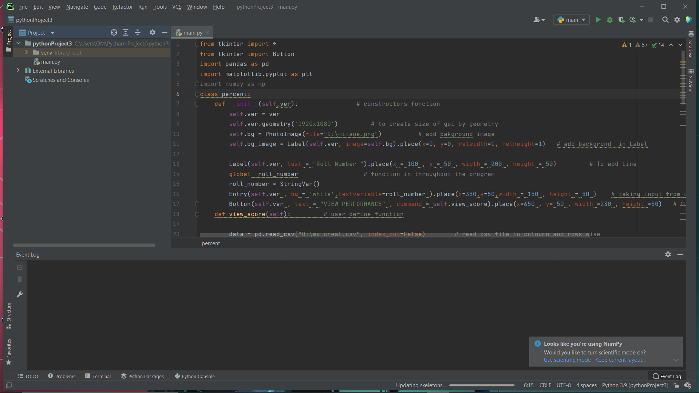
USE OF PLATFORM
Pycharm compiler

Slide 6
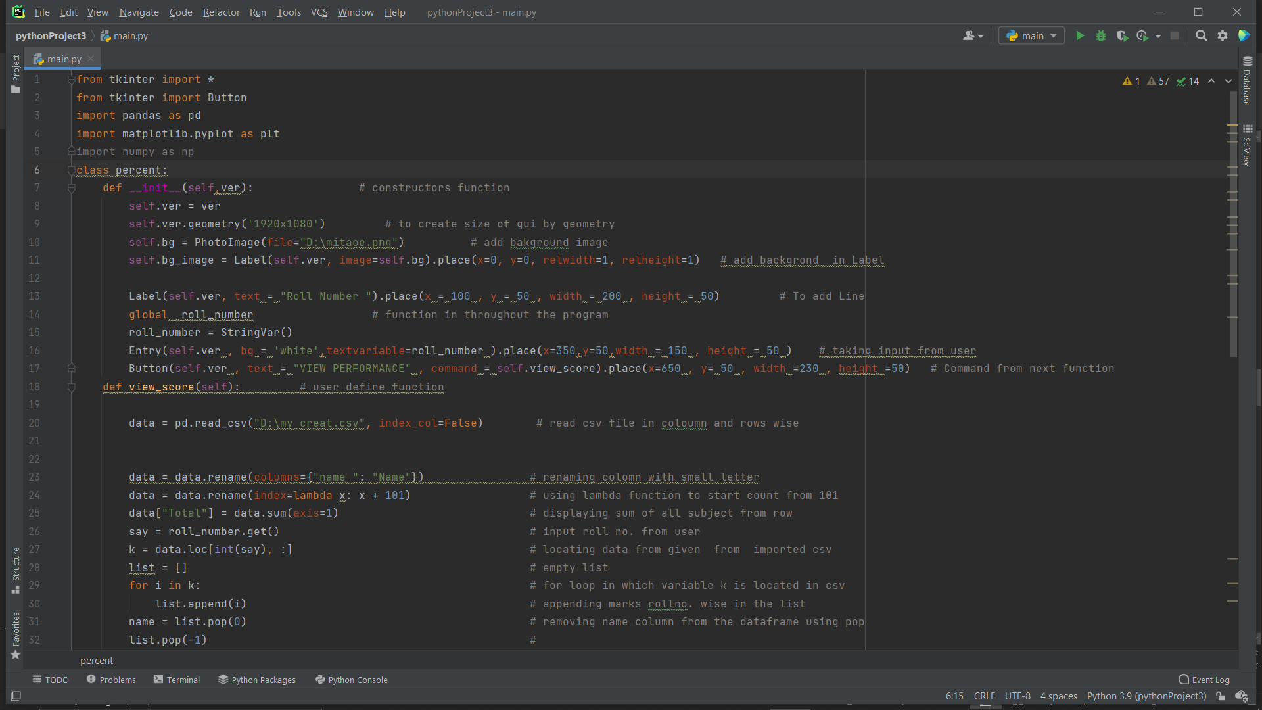
IMPLEMENTATION

Slide 7
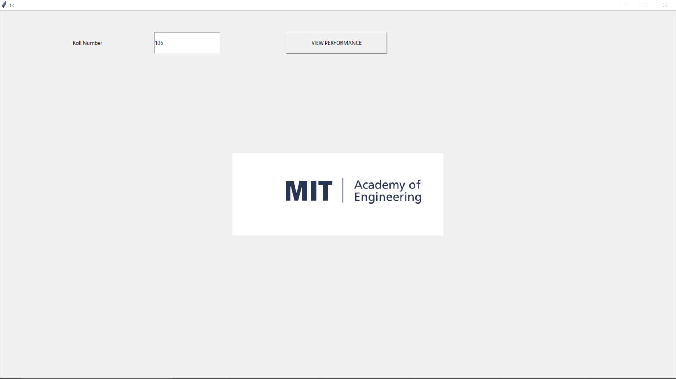
RESULT/OUTPUT

Slide 8
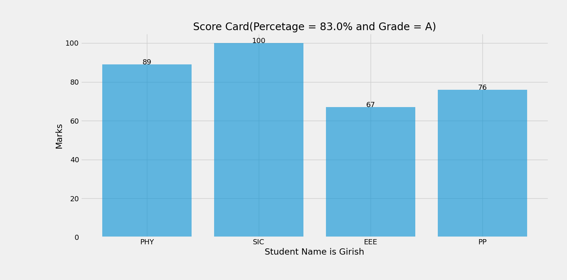
OUTPUT

Slide 9
Thank You !

