Slide 1

MS Big Data 2019-2020
SES721 – Ecosystème Big Data
Case Large company :
European Central Bank

Slide 2

1. Context and Organisation
Context :
established in 1998
capital of €11 Bn, from E.U. Member States only
3600 staff from over 27 nationalities
yearly budget of over €450 Mn
Organisation :
Executive Board : 6 ECB staff, including president Christine Lagarde
Governing Council : Executive Board + governors of the national central banks of the Eurozone's 19 member states (25 members)
29 « Directorate General » (divisions), divided between :
  core ECB : e.g. DG-Economics, DG-International, DG-Monetary Policy, DG-Research
  SSM (Single Supervisory Mechanism) : Microprudential Supervision I-IV

Slide 3
1.1 Main objectives and tools
Main objectives and tasks :
achieve and maintain price stability
support economic growth
define and implement monetary policy
forecast and analyse key macro-financial variables : GDP, inflation, interest rates...
support financial stability and supervise credit institutions
Tools (regarding data science):
macro side (monetary policy) :
  classic econometrics models (linear regressions, Vector Autoregressions)
  theoretical side : DSGE models (Dynamic and Stochastic General Equilibrium)
micro side (supervision of credit institutions) :
  no models : credit institutions self-evaluate ! (IMM : Internal Model Methods)
  loose verification of compliance with ECB guidelines

Slide 4
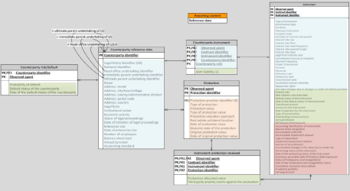

1.2 Where is Big Data ?
Big Data :
fledging concept at the ECB
first Data Lab in 2017
first parallel computing and machine learning models in 2018
first data science team established in 2019 !
Remote platforms and databases
remote storage and analytics platforms : DISC, ORBIS
EMIR database (2017)
  transaction-level data on derivatives contracts
  90K files, 25Bn observations, Hadoop storage and Spark treatment
Anacredit database (2012)
  detailed records on 60 million individual bank loans in the Euro Area
MMSR database (2016)
  loan information from 52 largest Euro Area banks
  daily record of 45000 transactions on unsecured/secured loans, total volume €600Bn

Slide 5
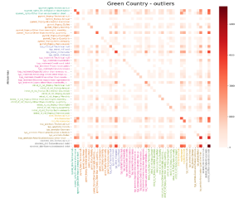
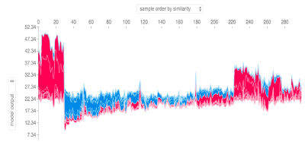
1.2 Where is Big Data ?
1.2 Where is Big Data ?
Machine learning
Anacredit
  outlier detection (isolation forest)
  data compression (auto-encoders)
  feature selection (XGboost)
SSM FAQ content: NLP for topic classification of legal opinions
DISC Cloud environment: web scraping of online stores for inflation nowcasting
Data visualisation
SUBA : querying and visualisation on Hive/Tableau
Anacredit : ELI5, DeepVis

Slide 6
1.3 Where is Big Data ? (again)
Big data mostly remarkable for its absence of core areas !
Macroeconomic forecasting and modelling
core activity of DG-Economics (including modelling division) and DG-research
no modern machine learning models used in this division, nor in any core ECB division
exclusive use of DSGE, Bayesian VARs and other semi-structural econometric models
yet all quantitative ML algorithms could and should be used for possible performance and accuracy improvement
Risk assessment of credit institutions
core activity of SSM (DG-Microprudential Supervision I-IV)
no machine learning algorithms used since no internal modelling at all !
risk assessement realised by institutions themselves, mostly on Excel models
yet very strong potential for ML algorithms on classification and outlier detection

Slide 7
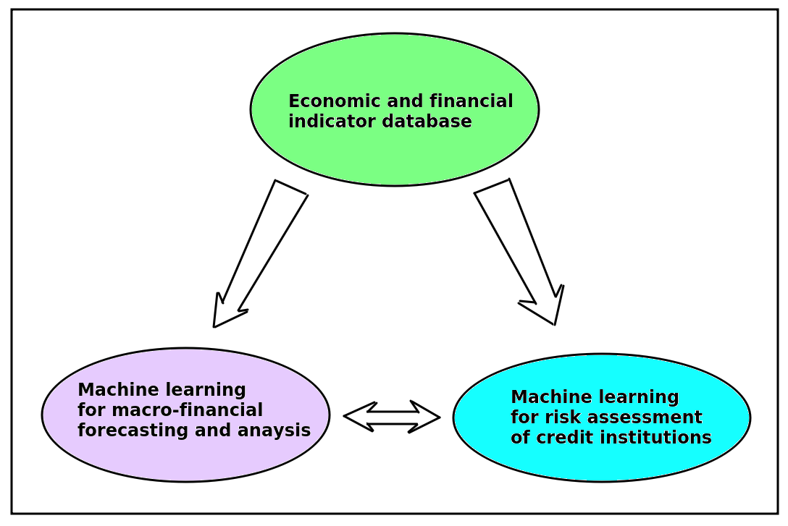
2. Big Data case
Value proposition : big data project based on 3 pillars
expanded microtransaction database for economic indicators
machine learning models for macro-financial forecasting and analysis
machine learning models for risk assessment of credit institutions

Slide 8
2.1 Pillar 1 : database for economic indicators
Massive databases already exist
EMIR, Anacredit, MMSR, DISC
focus only on financial transaction data
need for more economic-oriented indicators
proposition : create new massive database with micro-transaction economic data
Possibility 1 : web-based data
systematic use of web scraping
possible data : hotel booking, online prices on Amazon and retail stores, job offers, Google search, social medias for agent sentiment, real estate offers, ...
Possibility 2 : national administrative data
national administrations collect a lot of individual data (e.g. INSEE)
possible data : monthly VAT records, employer contributions, notarial acts, vehicle registration, income tax statements, oil tax, electricity consumption, ...

Slide 9
2.2 Pillar 2 : machine learning for economic forecasting
Economic forecasting :
key for decision-taking : interest rate primary decided by Board based on GDP/inflation forecasts
proposition : supplement classical DSGE and econometrics model with modern machine learning algorithms
Possibility 1 : standard economic datasets
use regular time series and economic indicators : real GDP, inflation, interest and exchange rates, consumption, investment, financial index (e.g. VIX), …
candidate algorithms : SVM, KNN-TSPI, random forest regression (and all bagging algorithms) ; boosting algorithms (XGBoost, AdaBoost, CatBoost, Light GBM) ; deep neural network, in particular RNN and LSTM.
Possibility 2 : micro-transactions datasets from pillar 1
offers strong potential for nowcasting (thanks to high-frequency data like daily datasets)
potential need for dimensionality reduction : PCA, UMAP, t-SNE
then run same ML algorithms as mentioned above

Slide 10
2.3 Pillar 3 : machine learning for risk assessment
Risk assessment of credit institutions :
main task of SSM, but no formal machine learning algorithms due to IMM
proposition : integrate machine learning to internalize the SSM assessment process, exploiting the massive financial transaction databases
Strategy :
exploit already existing massive financial databases : EMIR, Anacredit, MMSR
if needed : dimensionality reduction of datasets, using previously mentioned techniques
classification algorithms to assess the solvability of credit institutions and borrowers risk : KNN, SVM, bagging and boosting algorithms, deep neural networks, ...
outlier detection algorithms to detect non-normal and risky behaviours : SVMRank, RankBoost, plug-in techniques (KNN and kernel smoothing), isolation forests, one-class SVM, …
interpretable algorithms to analyse agent decision-making processes : decision trees, random forest with feature importance and Shapley value.

Slide 11
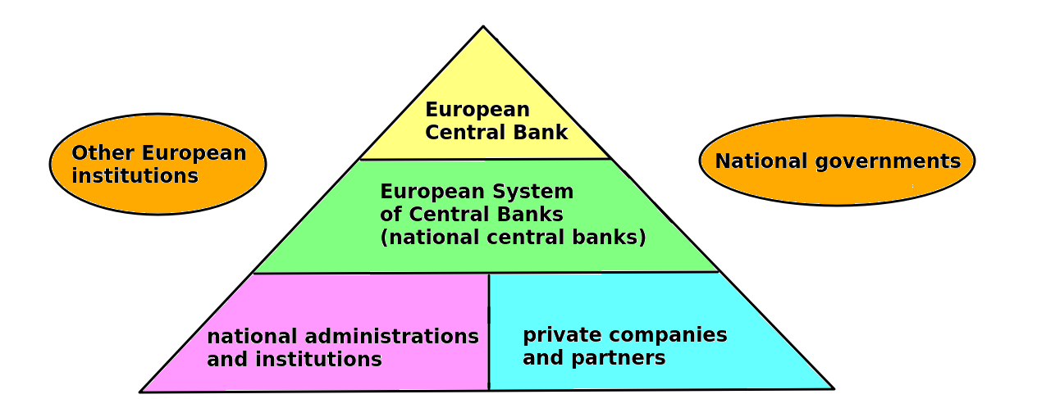
3. Further considerations
ECB : part of a complex hierarchical system
ECB is not autonomous : decisions are taken both at the international (European Union) level and at national level (national governements in Governing Council, national administrations and national central banks)
necessary to account for this specificity in business plan, cost estimation and deployment calendar

Slide 12
3.1 Pillar 1 : database for economic indicators
Key resources and partners : technical structure
embryo of infrastructure already exists : DISC database
already established a 5-year partnership with T-systems and Cloudera
Key resources and key partners : content
massive database of micro-transaction economic data cannot be collected by ECB alone
part can be done at ECB level (web scraping and web exploration)
but most of it : information collected by national central banks (e.g. Banque de France) and national administrations (e.g. INSEE) then channelled to ECB database
possible cooperation with corporate sector (e.g. Altares)

Slide 13
3.1 Pillar 1 : database for economic indicators
Cost structure :
limited infrastructure costs as cloud database already exists (DISC)
other costs : extra staff for part realised by ECB , extra data storage
precise storage cost impossible to evaluate (business confidentiality + unknown storage needs)
rough estimate : €200-300K/year for storage, €300K/year for 3 data scientists
extra costs : data collection at national level, including additional staff and computer equipments
also : data possibly collected already but need to centralise, clean and format datasets
bulk of the project cost : possibly millions of Euros, especially for poorest E.U. countries with limited infrastructures (very rough estimate : €10Mn/year for whole E.U.)
Application-specific challenges :
political : convince Executive Board and Governing Council of project utility, unlock budget
enforce data collection : adoption by Board → regulation by Commission → translation in national legislations → assessment and control by national administrations and ECB
minor : privacy and reputational risks with use of personal micro-data
minor : possible issues with data quality and selection bias compared to official data

Slide 14
3.1 Pillar 1 : database for economic indicators
Deployment calendar :
at least one year for negociation and transcription in law at E.U. and national levels
at least another year for technological deployment and data collection at national and ECB level
up to one year to collect sufficient data for machine learning/data analysis
minimum of 2 years before first assessment
Measuring impact and success :
control compliance of national authorities to integrate national data within planned timeline
evaluate volume / number of observations generated by the new database
estimate use of new database by ECB staff for machine learning applications
compare requests of new database with existing macro-financial databases (Bloomberg/Thomson)
recommandation : initial evaluation report after first 3 years, then renew report every 2 years

Slide 15
3.2 Pillar 2 : machine learning for economic forecasting
Key resources and partners :
databases : commercial databases (Thomson, Bloomberg) and massive database from pillar 1
standard libraries for machine learning : Scikit Learn, TensorFlow, SparkML
at least one cluster for Hadoop/Spark treatment
academic partnerships : to recruit data scientists and remain up-to-date for ML algorithms
Cost structure :
recruit 4 data scientists, 1 data engineer, 1 lawyer : 6 × €100K = €600K/year
Spark/Hadoop cluster : €100K/year for deployment and maintenance
total cost about €700K/year
Deployment calendar :
4-6 months to estimate the first models on regular data
one year to deploy Hadoop/Spark cluster and estimate models on massive micro-data

Slide 16
3.2 Pillar 2 : machine learning for economic forecasting
Application-specific challenges :
lack of understanding of big data and its potential for economists :
  Benoît Coeuré (2017) : Big Data reduces to « timelier and richer data »
  big data limited to DG-statistics and DG-IT : unknown in DG-Economics (« geek thing »)
  no ML culture due to long-time presence of DSGE/econometrics : more a curse than a blessing !
ideological reluctance to use machine learning :
  genuine « religion » of DSGE modelling at ECB and DG-Economics
  Christiano et al. (2017) : « People who don’t like dynamic stochastic general equilibrium (DSGE) models are dilettantes »
  need to first to convince executives that machine learning can improve on modelling
Measuring impact and success :
compare forecasting performance of machine learning models over traditional DSGE and VAR models (RMSE, MAE, Theil’s coefficient)
analyse performance of nowcasting algorithms and their contribution to decision making

Slide 17
3.3 Pillar 3 : machine learning for risk assessment
Key resources and partners :
resources already exist : databases (EMIR, Anacredit, MMSR) and remote platform (DISC)
everything can be done internally without further ado
Cost structure and deployment calendar:
recruit 3 data scientists : 3 × €100K : total cost of €300K/year
allow for one year to produce first machine learning algorithms and risks assessments
Application-specific challenges :
political challenge : switch from IMM (credit institutions evaluate their own risk level) to internal risk assessment by SSM
need to convince Governing Council and national States that delegating to the ECB generates added value and more reliable risk evaluation (thanks to ECB independance)

Slide 18
3.3 Pillar 3 : machine learning for risk assessment
Measuring impact and success :
compare risk assessment produced internally with that estimated by IMM : are they consistent ?
on historical data, compare default prediction of machine learning models over IMM models (ROC, AUC)
assess whether ECB machine learning models identify new outliers or institutions with underestimated risk
evaluate the contribution of machine learning algorithms to improve understanding of lender/borrower decisions.

Slide 19
Conclusion : key messages
big data remains significantly under-developed at ECB
mostly used for massive databases at DG-Statistics and DG-Information Systems
current databases focus on financial transactions : no massive database for economic indicators
machine learning is completely absent from DG-Economics
yet machine learning could and should be used to improve on macoreconomic forecasting and risk assessment of credit institutions
proposition : 3 pillars to develop big data at ECB : creation of a massive database for economic indicators ; creation of machine learning team for economic forecasting; creation of machine learning team for risk assessment of credit institutions
cost is not a major problem for pillars 2 and 3 : total yearly cost < €1Mn, i.e. 0.2 % of ECB yearly budget
cost may be an issue for pillar 1 : possibly up to €10Mn/year or more, to be shared among NCB’s
main challenges are political :
internally, convince Executive Board and division managers that big data and machine learning can generate added value ; create awareness and culture of big data
externally, convince national governments that additional expenses and delegation of control over the risk of credit institutions are justified and serve the common interest

