Slide 1
Economie de l’Internet et des données personnelles
Patrick Waelbroeck
patrick.waelbroeck@telecom-paristech.fr

Slide 2
Course organization
Two parts: economics (12 hours) and law (9 hours)
Pluri-disciplinary approach
  Personally, I would also add Philosophy > ethics
Why?
Data science = managing data over its life cycle
Example 1: business model based on ads (Youtube) vs. based on premium content (Netflix)
Example 2: Privacy by design < GDPR
Value of a data scientist < able to talk about all issues related to data

Slide 3
Course organization
Course credits: case study
Business case or
Economic analysis of a data issue (net neutrality, IP for algorithms, Moocs, digital labor, …)

Slide 4
Economie de l’Internet et des données personnelles
Introduction
Patrick Waelbroeck
patrick.waelbroeck@telecom-paristech.fr

Slide 5
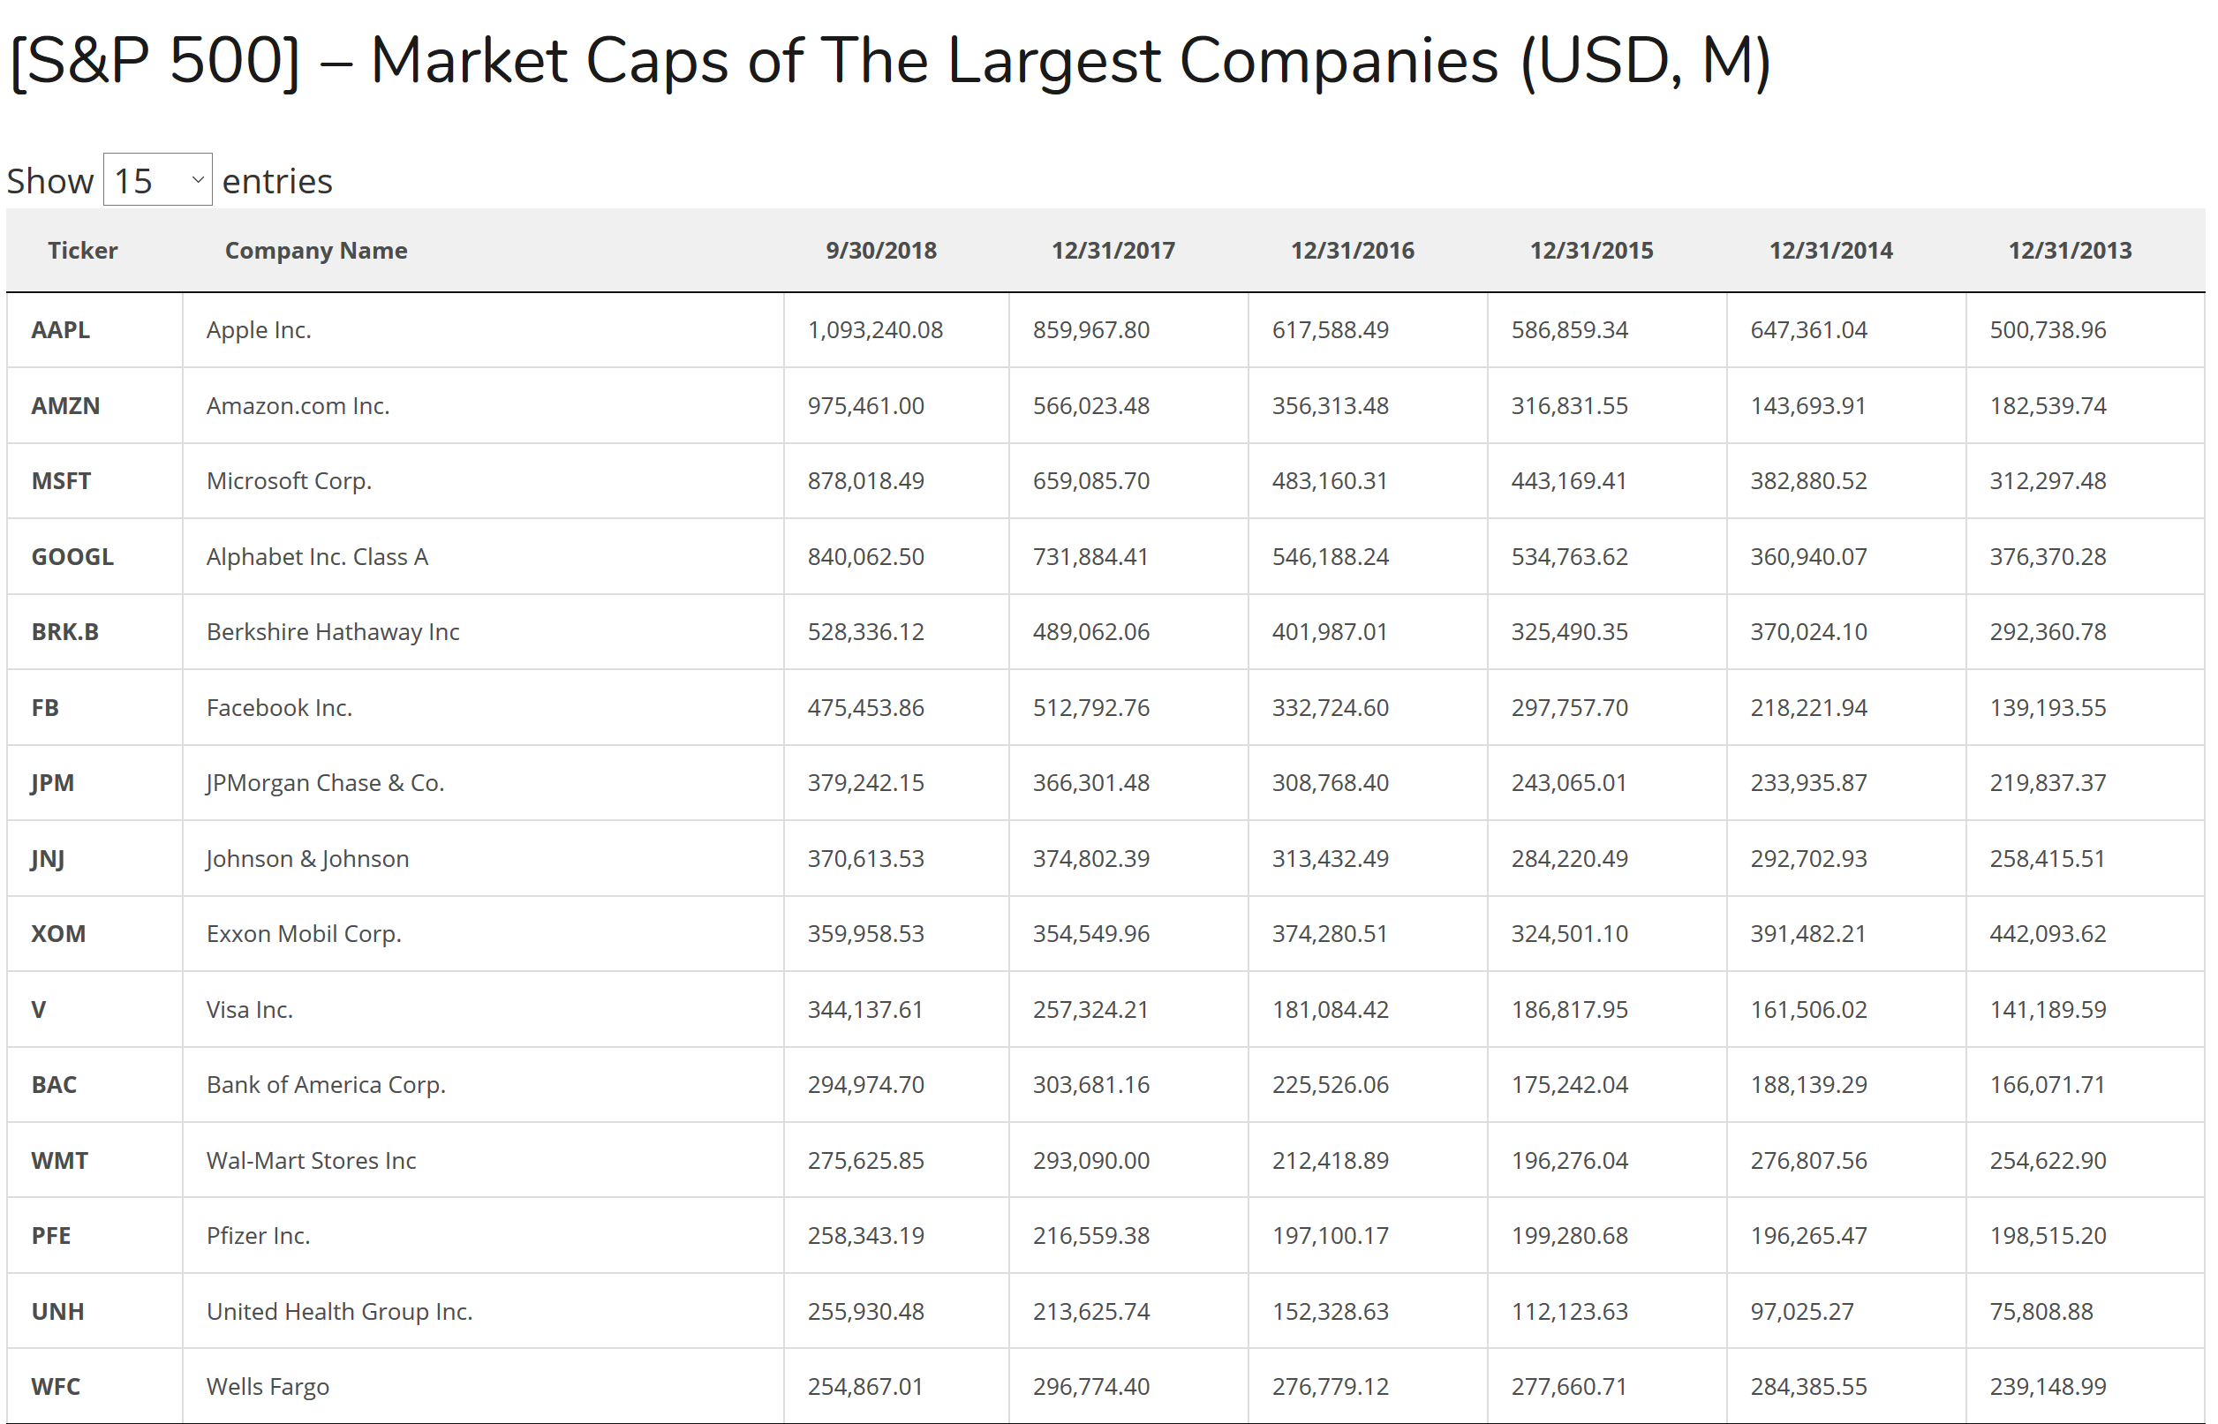
Introduction

Slide 6
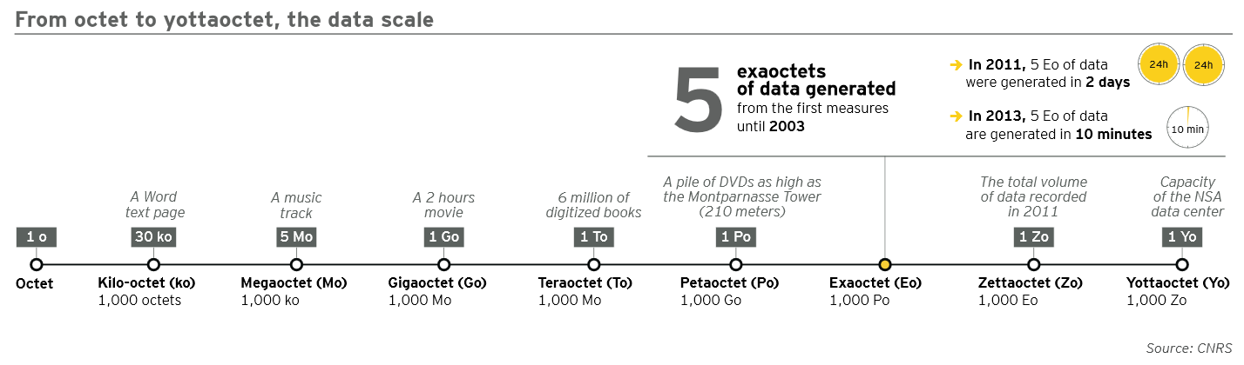
Introduction

Slide 7
Some new concepts
Uberization, on-demand
Two-sided markets
Collabortion : Wikipedia, crowdfunding, crowdsourcing
Long tail and attention economics
Makers/Influencers
Ad-blockers
Blockchain, crypto-currencies, Initial Coin Offering

Slide 8
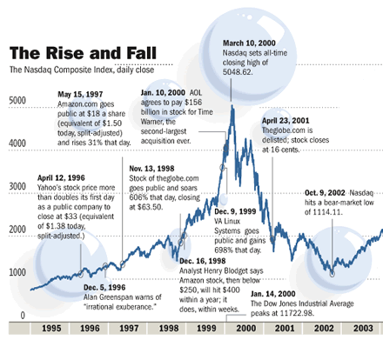
The new economy?

Slide 9
Five paradoxes
Paradox 1: Why is there price dispersion
Paradox 2: Everything is free; how do you make money ? how do you compete with free?
Paradox 3: Used goods can be ‘lemons’ but Ebay is alive and well
Paradox 4: Uber losses of 4,5$ billion in 2017, but valued at more than 62$ billion
Paradox 5 : Information is available to all bur people stay within information bubbles

Slide 10
Caractéristiques de l’économie numérique
Patrick Waelbroeck
patrick.waelbroeck@telecom-paristech.fr

Slide 11
Introduction
Informational externalities
Example: online reviews on Amazon.com
The review benefits all potential consumers but the reviewer is not paid

Slide 12
Externality
Individual action creates an economic effect on others that is not directly captured by a market mechanism
Two types:
  Informational externalities
  Network externalities

Slide 13
Network externality
Example: the value of a software increases with the number of users (Word, Windows, etc.)

Slide 14
Indirect network effects
or 2-sided network externality: is a demand economy of scale that crosses coupled heterogeneous markets.
Examples include:
  card-holders & merchants that accept the same credit card
  content consumers & creators (e.g. PDF, MP3 streaming, video)
  Online dating site
For coupled networks, expect to see an intermediary try to manage price pairs regardless of whether the intermediary is independent or managed by one side of the network.

Slide 15
Examples
Meetic: men/women
Crowfunding/P2P lending: prêteurs/emprunteurs
Moyen de paiement:
  consommateurs/commercçants
Google/Facebook :
  3 versants : consommateurs, intermédiaire publicitaires, producteurs
Jeux vidéos
  Console, développeurs, joueurs
  F2P

Slide 16
Le rôle des business modèles
Objectif : tarifier pour exploiter au mieux les externalités
Contrôle de l’accès aux ressources rares de la plateforme
Effet boîte de nuit
  Free for women
  Men pay two part tariffs
Double tarification : commission sur les deux côtés, Uber, AirBnb, etc.)

Slide 17
La stratégie du gatekeeper
Exemple : Kelkoo
Peut-être avantageux de limiter la concurrence si commission sur le prix final

Slide 18
Discussion
Donc, Certaines externalités sont internalisées, d’autres non (vol de données, fake news, polarisation des opinions, …)
= défaillance de marché
Solution : régulation, intervention de l’état sur les marchés (taxes, subventions, fourniture publique …)

Slide 19
Infrastructure
"The layers principle"
Content; IP rights enforcement
Logical = "machinery" of the internet; acrtions againts P2P networks, Digital Rights Management
Physical = computers, wireless devices, ...;
End-to-end principle = "dumb" network vs. packet discrimination; net neutrality

Slide 20
Net neutrality
Three debates:
Technical : DPI
Economics : Innovation?
  Note: Aol, Msn
Societal: censorship, freedom of expression
  Amysis?

Slide 21
Digital/information goods
Define a digital good as anything that can be distributed in purely digital form
Text: books, periodicals
Images: photos, movies, illustrations
Sound: music
Structured data: directories, GIS
Sometimes called information goods
Note : Iot, Activity trackers, GPS = physical web

Slide 22
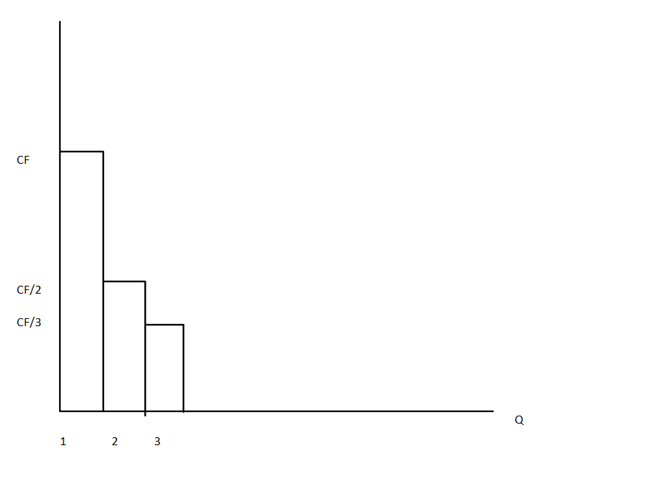
Couteux à produire, peu coûteux à reproduire
10 & 11 juin 2015

Slide 23
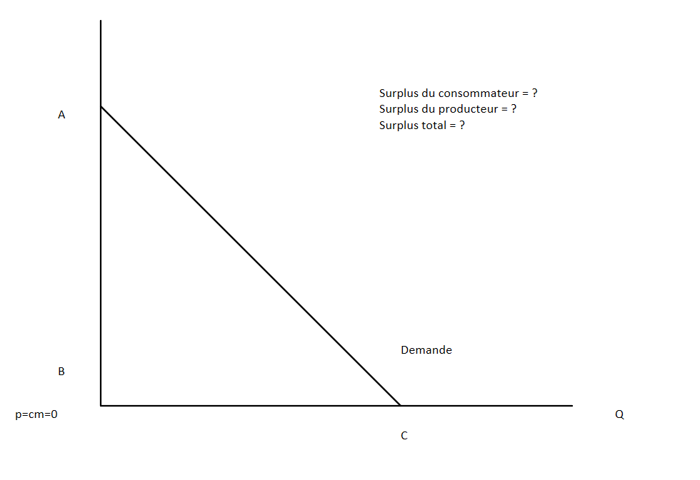
Coût marginal faible et concurrence
10 & 11 juin 2015

Slide 24
Consumer and producer surplus
Consumer surplus is the difference between the price paid and the higher price that consumers would have been willing to pay for the product.
Producer surplus is the difference between the payment received and the minimum payment that producers would have accepted.

Slide 25
Monopoly vs. competition
Monopoly versus competition
Smaller Quantity
Higher Price
Price discrimination.
The tradeoff associated with patents and copyright - deadweight loss in consumption versus possible new products.

Slide 26
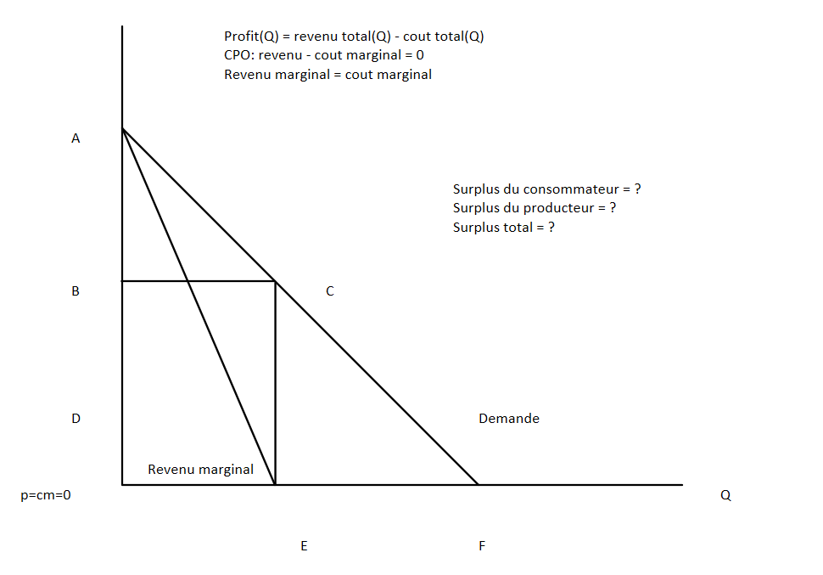
Monopole non discriminant
10 & 11 juin 2015

Slide 27
Monopole non discriminant
Π=RT(q)-CT(q)
dΠ/dq=0
r_{m}=c_{m}
10 & 11 juin 2015

Slide 28
Production of information goods
Producing first copy is generally sunk cost
Not recoverable if production halted
In contrast, for a building or equipment can recover some costs by selling
If additional copies are cheap for anyone to produce then hard to recover cost
Physical copies provide barrier (e.g., printing) Relatively expensive, especially mass copying
Degradation of copies provides barrier

Slide 29
Production of information goods
Information goods have little or no marginal cost
This is the cost of making additional copies.
Cost of media, or storage and transmission.
If marginal cost is low, it’s better to have many consumers.
Absorb high fixed costs.
This is called increasing returns to scale
The more you sell, the greater your profit per item.
Provides an advantage to large producers

Slide 30
Low marginal cost
Classical economic theory predicts that items in a
competitive market will be sold at marginal cost.
What if marginal cost is zero?
No incentive for sellers.
Obviously, this is not the way things work.
In real-world markets, copyright gives sellers a limited monopoly.
Cartel structures (e.g. music industry) also keep prices artificially high.

Slide 31
Public good
Definition: Goods that do not get used up when consumed. In other words, one person’s consumption of a good doesn’t reduce anyone else’s potential consumption of the same good.
Examples: Ideas, television broadcasts, national defense.
Obviously, these are not physical items that get used up. Instead they are usually ideas and artistic expressions.
They are at the core of the Information Age Economy, since information is a public good.

Slide 32
Non rivalry
Nonrivalry means that the amount one person consumes does not affect the amount available for others.
Rivalry allows for price competition among consumers.
If there are a limited number of luxury cars, Van Gogh paintings, stock shares, people will pay more for them.
This is called scarcity
If there is no limit to the number of goods available, no one will want to pay more than the lowest price.

Slide 33
Non excludability
Difficult to exclude people from using the good
This is a technical issue as it is always possible to exclude
Example: air

Slide 34
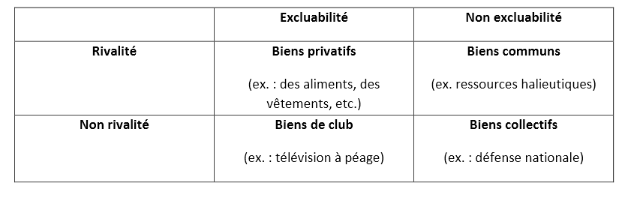
Typologie des biens

Slide 35
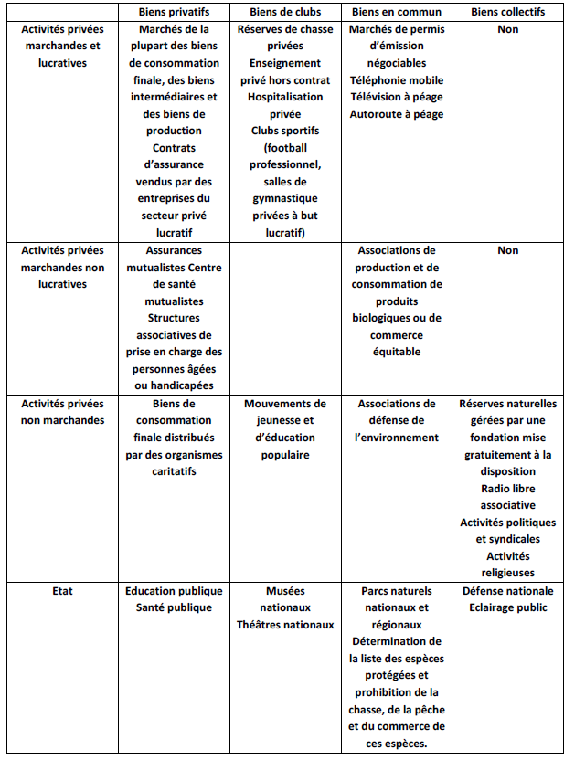
Gestion publique/privée

Slide 36
Bien public?
Problème du free-rider
En general produit par l’état
Question : Les produits numériques doivent-ils être produit par l’état ?
  Aucun pays ne suit cette approche
  Quel état ?

Slide 37
Les commons et leurs tragédies
Tragédie des communs
Tragédie des anti-communs
Autres solutions au problème du “free-rider” : Elinor Ostrom (prix nobel 2009)
  Monitoring and application des termes du contrat ce fonctionne que dans des petites communautés

Slide 38
Possible solution
Exclusive rights through (intellectua) property rights, leading to monopoly
Unfortunately, monopolies have undesirable side-effects
Corporations can exert undue influence over pricing and policy
Prices set above marginal cost.
This is nice for producers, but not economically
efficient.
There are people who would buy, if the good were available at a competitive price.
Problem with innovation: Arrow, Schumpeter

Slide 39
Production of public goods
A firm cannot capture all social surplus
Plus: competition drives down the price to marginal cost; zero profit
Under-production of the public good
Need for copyright and IP protection
But under-consumption because monopoly power

Slide 40
Experience goods
Part of the law of supply and demand requires that consumers can accurately assess their choices.
Information goods are experience goods.
I don’t know how much I’ll like a CD until I hear it.
Compare this to a traditional good, like a car or a chair.
This means that consumers have a hard time determining how much they’re willing to pay.
Recommendations, try-before-purchase, reputation become very important.

Slide 41
Durable goods
Information goods are durable
+ second-hand market, lease vs. rent (ownership)
Monopoly would like to price discriminate :
Different versions co-exist and compete
Planned obsolescence

