Slide 1
Price discrimination
Patrick Waelbroeck
patrick.waelbroeck@telecom-paristech.fr

Slide 2
Price discrimination
Charge different consumers different prices for same product
Examples
  Movies (adults, children, seniors)
  Movies: theatrical release, pay per view, dvd, cable, television
  Books: Hardcover and paperback
  Software: full versus ‘lite’ versions

Slide 3
Price variation vs. Price discrimination
Not all price differences are the result of price discrimination. Costs of dealing with different customers are not always the same.
Electricity generation has generally been less costly in the Northwest. Some customers are more prone to return purchases than others.

Slide 4
Example: Peak load pricing
At capacity, marginal costs include
  Costs of expanding capacity
  Value of unserved customers
For electricity, airlines, hotels, marginal costs fluctuate dramatically
Pricing should reflect likelihood of sellout or reaching capacity
Mobile telephone calls

Slide 5
Price discrimination: definition
Two varieties of a good are sold (by the same seller) to two buyers at different net prices
Net price = price after including cost related to product differentiation (delivery cost for instance)

Slide 6
Price discrimination
First degree (perfect): seller charges a different price for each good exactly equal to willingness to pay of buyer
Second degree (nonlinear, quantity discount): prices differ by amount of good purchased, not by consumer.
Third degree: different consumers charged different prices

Slide 7
Price discrimination law
Illegal if it gives some firm an advantage over other firms.
If individuals are consumers, is not illegal.
Price Discrimination is not likely to harm efficiency. Perfect Price discrimination is perfectly efficient.
Intention of this rule was to protect ‘mom-and-pop’ stores and grocers from department stores and supermarkets. It was intended to reduce competition.

Slide 8
Conditions for price discrimination
Market Power: If firm is price taker, cannot charge markup
  But: can have price discrimination in markets with free entry and competition
Firm must have some knowledge of consumer’s willingness to pay.
  Third degree: must know how the elasticity of demand differs across markets.
  Second degree: must have some knowledge about the different “types” of consumers that exist in the market place.
Prevent or limit resale

Slide 9
How to prevent resale?
Legal restrictions (computer software, educ. discount)
Services cannot be resold.
Warranties: the firm can void a warranty if the product is resold.
Adulteration: Make the product unfit for other potential uses (damaged goods)
  Ex: food
Transactions costs/switching costs/lock-in: If markets are spatially separated or barriers imposed by tarrifs, taxes, resale is more expensive (ex: email address, mobile phone #)
Contractual remedies (iTunes/Ebay case)

Slide 10
How to prevent resale? (cont.)
Transactions costs/switching costs/lock-in: If markets are spatially separated or barriers imposed by tarrifs, taxes, resale is more expensive (ex: email address, mobile phone #)
  DVD/BR region lock
  IP/geo-blocking
  Vs. copyright law?
Contractual remedies
  iTunes/Ebay case
  Vs. Copyright law: Oracle/Usedsoft
    Injunction against against UsedSoft in 2017
    Case withdrawn in 2015

Slide 11
Perfect Price discrimination
Find maximum price that every consumer is willing to pay and charge them that price.
Requires more information than any firm has, and the prevention of arbitrage.
Demand Curve becomes MR curve.
No Deadweight Loss but no consumers surplus
Theoretical ideal. Cannot be fully achieved.
But: Digital Rights Management (DRM), big data, machine learning, IA, etc.
Extracts all surplus on the market
=VALUE OF DATA
Discussion: fairness vs. Pareto optimality

Slide 12
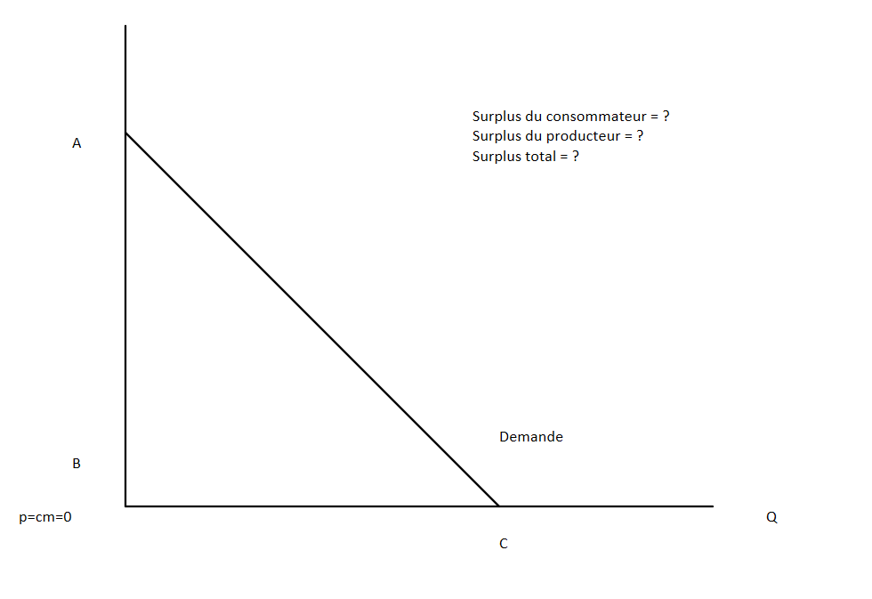
Discrimination du premier degré
10 & 11 juin 2015

Slide 13
Perfect Price discrimination: fairness
Discussion:
  fairness vs. Pareto optimality
Example of economic bias in algorithms
Other examples:
  Google shopping, EUR 2.4 billion fine
  Google Android
  Apple delisting
  Marketplace search results

Slide 14
Third-degree price discrimination
Different customers are charged different prices based on observed demographic characteristics (related to elasticity).
  Geographic markets
  Product use markets
  Customer types (senior citizen, students)

Slide 15
Price discrimination with two or more markets
If markets for a single product have different MRs, profits can be increased by shifting output from low MR markets to high MR markets.
Raise price in low MR market and lower price in high MR market.
High MR market is high elasticity market.
Elasticity (en %) = (∆Q/Q)/(∆P/P)
Need to Prevent Arbitrage.
Examples: Airlines with business travelers and vacationers. Coupons.

Slide 16
Elasticité de la demande : élevée
1%

Slide 17
Elasticité de la demande : faible
1%

Slide 18
Price discrimination with two or more markets
Raise price in market with lower elasticity (lower responsiveness)
Lower price in market with higher elasticity.
Do this until MRs are equalized. But prices will not be equalized.
Inverse elasticity rule : p ∝ 1/ε
Examples: Airlines with business travelers and vacationers

Slide 19
Second-degree price discrimination
Heterogeneous consumers.
  Ex: some consumers want 2 units and some consumer only want one unit.
  No observed characteristics that can be used to forecast willingness to pay for a given unit
  The consumer’s demand is private information
Heterogeneous tastes for different quantities
  Value first unit more than later units
  Each consumer has downward-sloping demand

Slide 20
Examples of second degree price discr.
Monopolist offers “menu of bundles” to choose from
Examples:
  Two part tariff: fixed fee plus fee for each additional unit
  Long-distance phone service
  Disneyland: admission fee and fee per ride
Alternative bundles
  Mobile phone service (100, 500, 1000 minutes)

Slide 21
Two-part tariff
The two-part tariff is another common example of non-linear pricing.
A two-part tariff consists of fixed fee and a per unit charge.
The fixed fee is the amount the consumer must pay for the right to purchase any amount of the good.
The per unit charge is the price the consumer pays for each unit of the good.

Slide 22
Two-part tariff strategy
If a monopolist is able to use a two-part tariff, she will set the per unit charge equal to the competitive equilibrium price and the fixed fee equal to the competitive consumer surplus.
  Remember that the competitive equilibrium was the solution that allowed the most total surplus.
By setting the per unit charge equal to the competitive price, the monopolist preserves the largest possible surplus and the capitalizes on it by setting the fixed fee equal to the surplus.

Slide 23
Bundling
Two or more products that are sold as a package.
CDs versus singles
Cable television bundles versus a la carte.
Subscription services versus pay per use –cable blanket versus long distance telephone or pay per view; Rhapsody versus iTunes.
Computers with software
Office suites versus individual components.

Slide 24
Bundling and tie-in
Bundling: firms sell two or more products combined
  Microsoft Office
  Internet Explorer and Windows
  Idea: charge more to consumers with a low value for one good but high value for the other
Tie-in sales: consumers that buy one product are required to make all future purchases of another product from the same firm.
  Xerox copiers and paper or service
  Printers and toner

Slide 25
When to bundle?
Mark: values "Baby one more time" at $3, "I will still love you" at $1
Sally: values "I will still love you" at $3, "Baby one more time" at $1
Individual pricing:
  Sell each song at $3 or $1
  At a price of $3 sell 1 to each, per person profits = $3
  At a price of $1 sell 2 to each, per person profits = $2
  Total profits: $3 + $3 = $6
Bundling
  Sell bundle at $4 to both: profits = $8

Slide 26
When to bundle?
Bundle products that are substitutes
  When consumers want one or the other
  When valuations are negatively correlated
Offer complements separately
Offer both if consumers are mixed

Slide 27
Issues with bundling
CDs versus singles- pricing versus cannibalism. iTunes versus prior models.
Cable television bundles versus a la carte; competition in content
Internet explorer vs. Netscape

Slide 28
Versioning
Sometimes (frequently) creating different grades of products might just better meet consumer demands.
Versioning is artificially creating different products (where the high end product would meet all needs) to achieve price discrimination.
+: market expansion
Problem: avoiding cannibalization of higher end product line.

Slide 29
Examples of versioning
Luxury versus regular automobile brands.
PC Junior.
‘lite’ versions of software with reduced functionality.
Putting identical chips in high and low powered calculators.
By delaying introduction
  Hardcover then later paperback books
  Film release, then video, then television

Slide 30
Examples of versioning: Quicken
Quicken Basic $34.95
Quicken 2001 Deluxe $59.95
Quicken Home & Business $79.95
  Payroll & invoicing
Quicken 2001 Suite $99.95
  Tax Software
Home & Business Suite $139.95
  Payroll & invoicing
  Tax software

Slide 31
How many versions?
Usually have at least three for software
  Low-priced: focus on price over functionality
    E.g., personal, essentials,
  Mid-priced: balance of two
  High-priced: for those who want all functions
    E.g., professional
Majority will avoid extremes
  With three choices nearly half generally buy mid-priced version

Slide 32
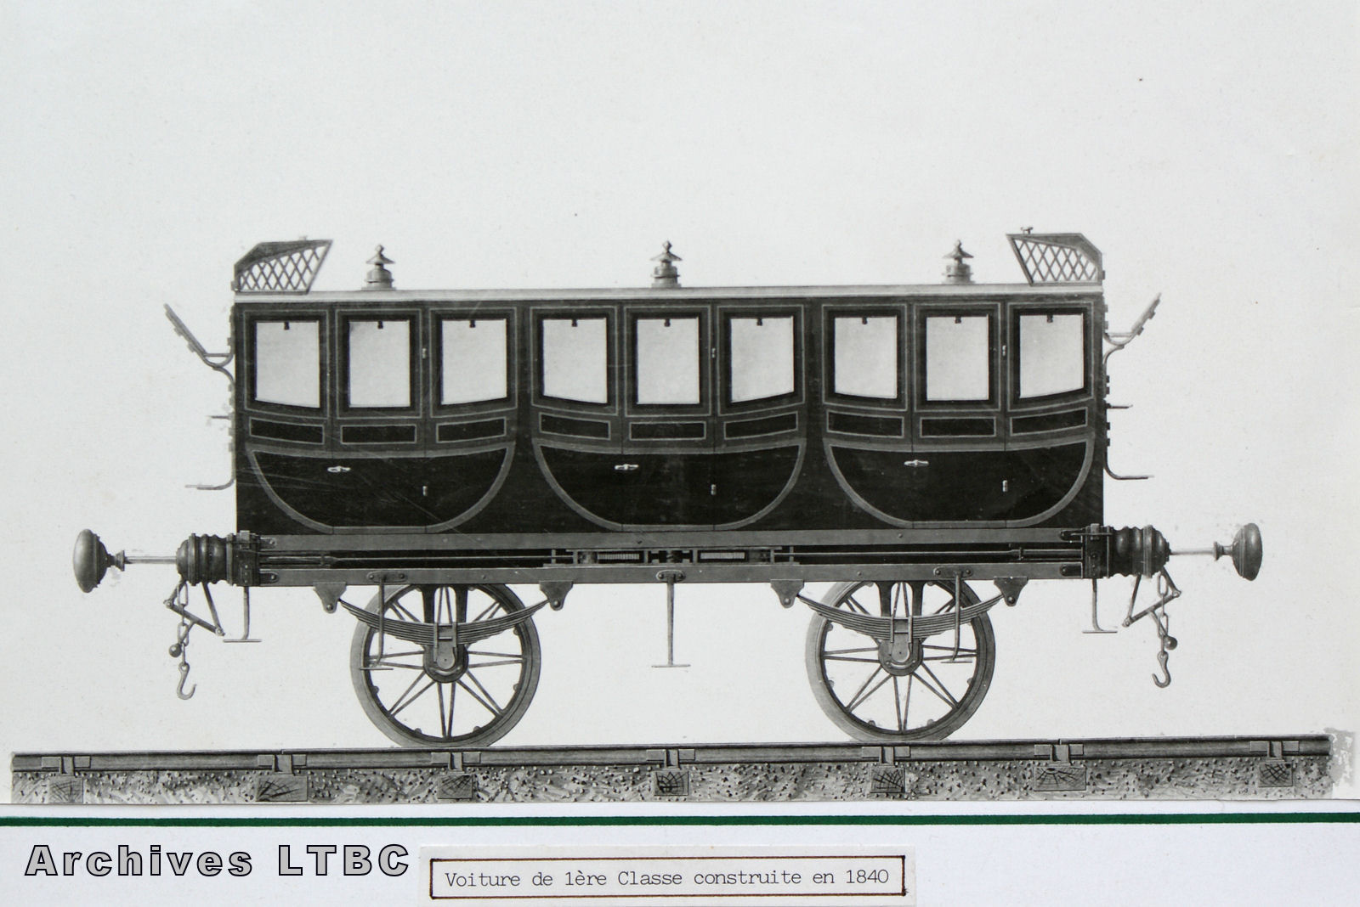
Versioning
Voiture de 1ère classe PO
3 compartiments
1840

Slide 33
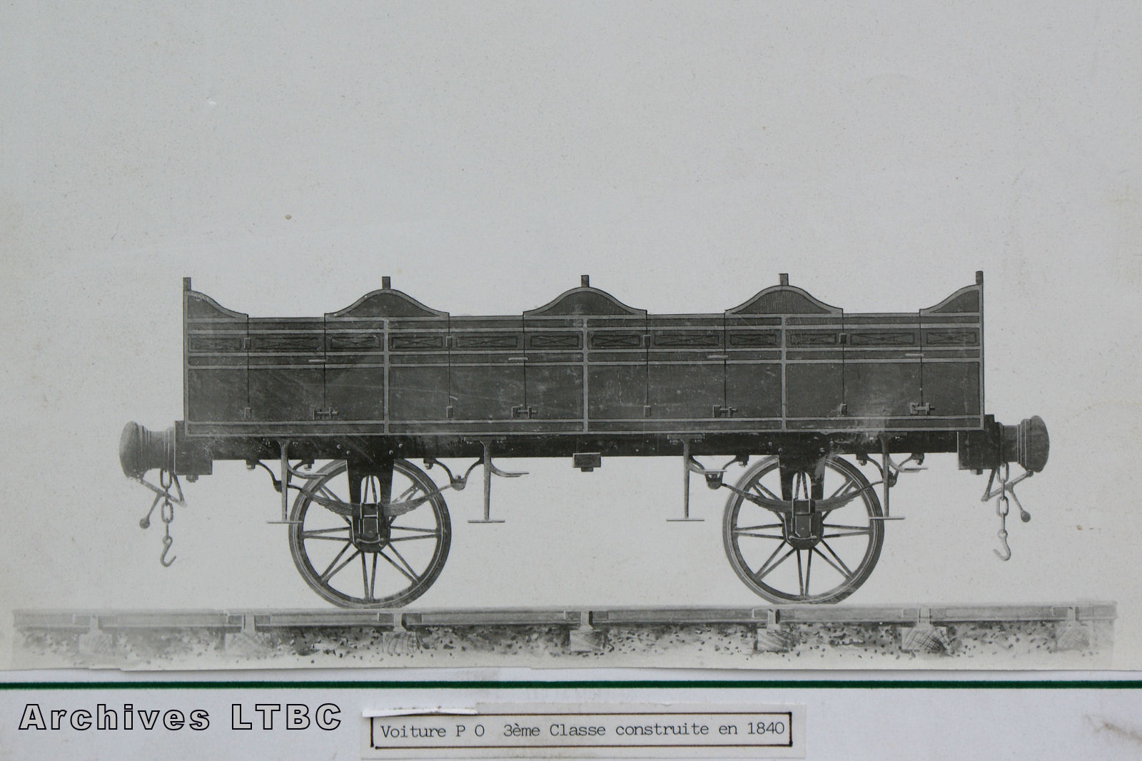
Versioning (suite)
Wagon de 3ème classe PO
4 compartiments
1840

Slide 34
Résultat
Versioning augmente les profits
Expansion de marché > cannibalisation
Preuve: exercice

Slide 35
Free version
For physical goods, generally too expensive to give away for free
  Marginal cost is not low
For digital goods, marginal cost near zero
Build interest and market by giving away
  But need people to pay eventually
Free versions (or cheaper ones)
  Limited functionality
  Limited time period
  No support
  Personal or educational use only

Slide 36
Les marchés à plusieurs versants
Externalités croisées ou indirectes, intergroupes
Souvent : externalités directes négatives, intra-groupes
« Diviser pour conquérir »
La plateforme peut avoir intérêt à limiter la concurrence
De manière plus générale : « waterbed effect »
Eléments inhabituels de politique de la concurrence : 1 réseau > 2 réseaux, élasticité prix positive de la demande, prix en dessous du coût marginal

Slide 37
Intertemporal price discrimination
Charge a high price today and attract high-value consumers; then setting a low price tomorrow to sell to low-value consumers
Example: sales
Problem: buyers anticipate that and if they are patient, firm is forced to set a low price today
Problem: Coase's conjecture
A durable good monopolist "competes with himself“
Example : “Loi du prix unique” (France) for physical book and e-books

Slide 38
Avoiding Coase’s trap
Flow of new customers willing to pay relatively high prices.
Rent rather than sell the product.
Improve the product, increase old consumers’ demand. OR: fuel future demand by engaging in planned obsolescence (intergenerational incompatibility). 2 typical patterns:
  a user upgrades one component of her system, which degrades the performance of another component;
  other users upgrade their software, so that it is no longer compatible with the single user’s software.
Commit not to lower price/Reputation (de Beers)
Make good non-durable
Fads, fashion
Make capacity constraints so expanding output costly
Most favored customer clause or Best price
Buy back guarantee

Slide 39
Coase conjecture: application algorithms
Ubik’s anti pre-cogs
= limits of predictive algorithms
In the economics literature: rational expectations
  Structural vs. reduced form econometrics
  Example: Fiscal gift, but anticipate further taxes: no effect

Slide 40
Welfare effects of price discrimination
Ambiguous
First degree
  Consumer surplus + producer surplus under first degree price discrimination is the same as under perfect competition.
  First degree price discrimination is efficient.
  Unfair

Slide 41
Welfare effects of price discrimination
Second degree
  Can raise/lower welfare for certain groups.
  On an airplane, if all customers were charged the same price, last minute travelers might be made better off while travelers who book far in advance might be made worse off.
  Students/low value typically better off if they wouldn’t be served under monopoly
  Typically need increase in quantity for increase in welfare

Slide 42
Summary
Firms price discriminate in order to increase profits.
Price discrimination is not always possible: firms must have market power and be able to limit resale.
In third degree price discrimination, a profit maximizing firm should follow the inverse elasticity rule in each market.
Second-degree price discrimination: self-selection leads to inefficiently low quality/quantity for “low types”
Limits of price discrimination : Coase conjecture
Price discrimination can have ambiguous overall welfare implications. Quantity increases typically necessary for welfare gain.

