Slide 1

Economics of Intellectual Property
Copyright and Piracy
Patrick Waelbroeck
patrick.waelbroeck@telecom-paristech.fr

Slide 2
Summary
Firms price discriminate in order to increase profits.
Price discrimination is not always possible: firms must have market power and be able to limit resale.
In third degree price discrimination, a profit maximizing firm should follow the inverse elasticity rule in each market.
Second-degree price discrimination: self-selection leads to inefficiently low quality/quantity for “low types”
Price discrimination can have ambiguous overall welfare implications. Quantity increases typically necessary for welfare gain.

Slide 3
Today
Last time: strategies assumed no piracy or perfect copyright protection
Today: with the internet, more difficult to prevent end-user copying of digital goods
Example: Peer-to-peer or file-sharing networks (Napster, Kazaa, Emule, BitTorrent, …)
End-user piracy ≠ for-profit or commercial piracy
Commercial piracy: should be limited; negative effect; no controversy
What are the economic implications of end-user piracy?

Slide 4
What is intellectual property?
Definition: Intellectual property is the tangible and intangible products of the human mind.
Physical property is either made or purchased.
Intellectual property is the results of one’s ideas.
Requires a creative effort <> Machine generated
Art, music, books, poetry, Software, blueprint
Value comes from both the physical medium (ink, paper, vinyl, aluminum, etc) and the work needed to produce the content.
Price reflects both the medium and the content.
Examples of IP: patent, copyright, trade secret

Slide 5
Patents
Technical inventions
Patentability ( software, business plans, algorithms, gene therapy , …)
  Ethical issues
3 criteria: novelty, non-obvious, commercial use
Limited protection in time vs. Knowledge disclosure
<> secret
Problems: patent thicket and wording, blocking patents, patent pools and essential patents, trolls, FRAND

Slide 6
Patent wars
IP strategy
$20 billion on patent litigation and patent purchases 2010+2011
  « Last year, for the first time, spending by Apple and Google on patent lawsuits and unusually big-dollar patent purchases exceeded spending on research and development of new products, according to public filings.”
Problem : patent on software and algorithms (US)
  General purpose technology
  Ethics?

Slide 7
La propriété intellectuelle – Evolution du droit du brevet
Protège les logiciels (aux Etats-Unis)
Protège les modèles d’affaires et protège certaines formules scientifiques
Théoriquement, plus de protection = plus d’incitations et plus d’innovations, mais moins d’utilisation (voir plus loin)
Explosion du nombre de brevet au cours des dernières années reflète cette évolution

Slide 8
La propriété intellectuelle – Evolution du droit du brevet
Mais :
  Brevets défensifs pour empêcher les concurrents d’innover “autour”
  Brevets bloquants
  Brevets comme armes de négociations
  Baisse de la “qualité” des brevets
  Holdup < investissement spécifique
Guerre de brevets
  L’approche de M. Lemley : rational ignorance
  Vs. European Patent Office

Slide 9
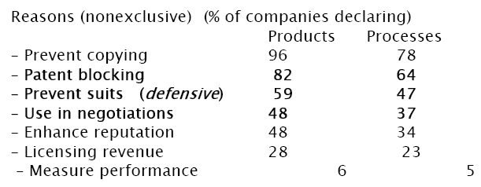
La propriété intellectuelle – les raisons pour breveter (Cohen et al 2000)

Slide 10
La propriété intellectuelle – Les brevets bloquants
Guelle et Zuniga (2008) :
Identification des brevets bloquants à partir des données de citations (faible nombres de citations forward entre autre)
Mise en évidence de stratégies de préemptions
Mise en évidence de stratégies bloquantes basée sur le retrait du dossier

Slide 11
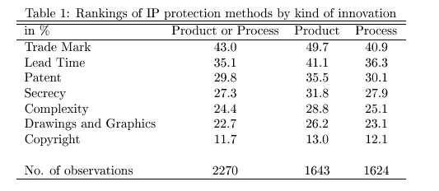
La propriété intellectuelle – les données d’enquêtes

Slide 12
La propriété intellectuelle – Big secret, little patent ?
Vers un droit probabiliste de la protection par brevet : invalidé
Choix stratégiques des instruments de protection
Le secret permet d’empêcher les concurrents d’accéder aux dernières technologies
Quels type d’innovations sont gardées secrètes / brevetées ?

Slide 13
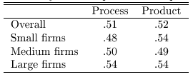
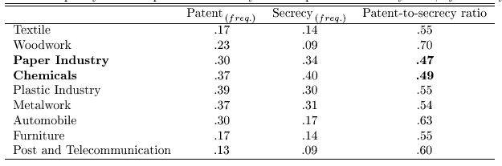
La propriété intellectuelle – ratio brevet-secret (Pajak, 2009)

Slide 14
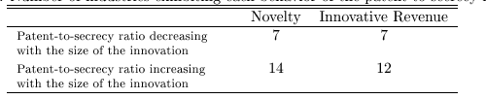
La propriété intellectuelle – Nombre d’industries

Slide 15
Copyright
Copyright exists to give creators of ‘artistic’ works the ability to generate revenues.
The theory is that without copyright, competition in selling reproductions of a title would drive the price down to the marginal cost of producing a reproduction.
They are given monopoly protection, which increases their revenues, but raises price to consumers.
The exclusivity created by copyright or patents is limited in length and in breadth.
This increases the number of inventions, but decreases the use of each invention

Slide 16
Copyright length
Life of the author plus 70 years
‘Work for hire’, movies, games?, 95 years.
Is this too long?
Creative commons members say ‘yes.’
17 economists say ‘yes.’
Mark Twain says `no’
Complicated issue

Slide 17
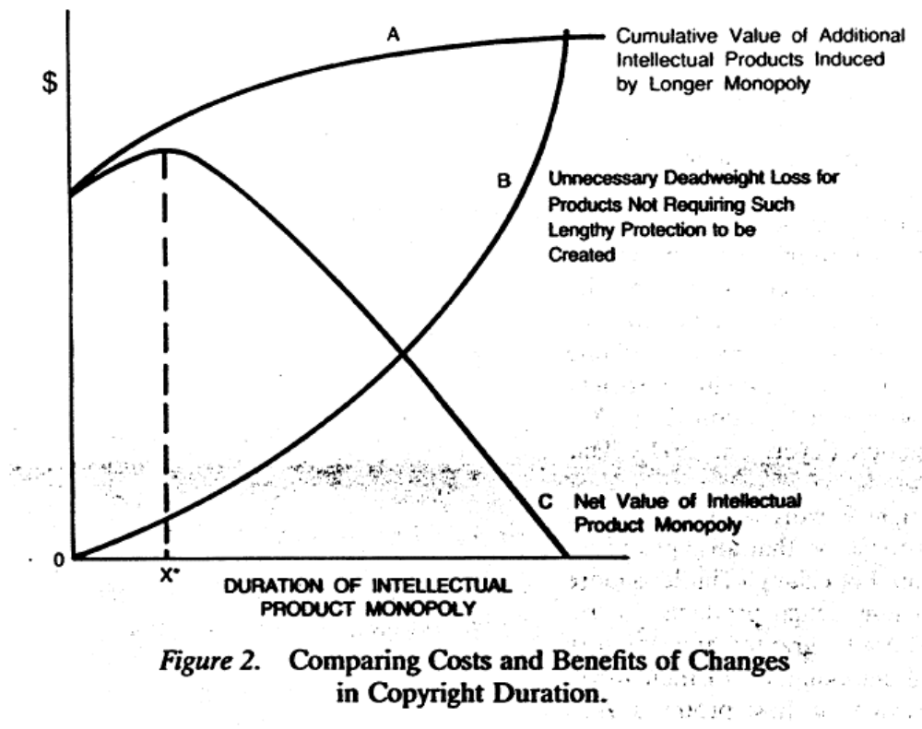
Copyright length

Slide 18
Extension of Copyright law
1790 -Books, maps and charts
1802 -Prints
1831 -Music
1865 -Photographs
1870 -Drama, paintings, drawings and sculpture
1912 -Movies
1964, 1976 -Computer Programs
1971 -Records and tapes
1976 -Dance
1990 -Architecture
1998 -Digital Millenium copyright act

Slide 19
Limitations
– Non-profit musical performances
– Radio musical performance in restaurants and small businesses (1976)
– Works of utility (a chair)
– Expressions of fact (phone book)
– Ideas vs. expression of ideas
– Fair use
– Parody and commentary

Slide 20
Fair use
There is in the law an attempt to balance the interests of copyright holders and those of users.
Fair use is a defense to a claim of copyright infringement. It allows copying in instances when the copying appears not to be hurting the copyright owners revenues.
Betamax Case said home videotaping was fair use, and thus home videotaping was allowed.

Slide 21
Fair use: 4 factors
Amount of the copyright product that is copied.
Nature of the Copyright product (commercial versus academic or scholarly.
Nature of the use of the copied product
Impact on the revenues of the copyright holder.
Last factor is the most important.
The economic rationale for ‘fair use’ is that it increases the welfare of the consumer without seriously reducing the welfare of the producer and it saves on transaction costs of negotiating with copyright holder.

Slide 22
Fair use and internet file-sharing
Is internet file-sharing fair use?
Judges say no: prevented the development of legal market for digital music
More generally, what is the impact of file-sharing on firm profits?
Is it always bad?

Slide 23
Basic problem of innovation
Incentive problem within the relationship between one principal (society) and one agent (potential innovator) in order to produce a public good (knowledge, music, writings, films, …).
Induce innovation if social expected value exceeds social expected cost. If so, create sufficient incentives for the innovator so that private expected compensation exceeds private expected costs.
IP must be particularly protected when
  creation process is costly (either financially or in terms of opportunity costs);
  research is risky (the probability of innovation is low).

Slide 24
Economic rationale of IP rights
Non-excludability means no sales, and no sales might mean no production → risk of underproduction
Law awards exclusive right to control the production and the sales of their goods.
Generates an underutilization problem:
  Monopoly: price > marginal cost (= zero) → consumers who are willing to pay more than zero but less than monopoly price don’t consume → inefficiency
IP laws strike a balance between the two conflicting problems: the exclusivity created by copyright or patents is limited in length and in breadth → second best solution

Slide 25
Basic trade-off
Incentives:
  Dynamic efficiency
  Infinitie protection
Use:
  Static efficiency
  No protection

Slide 26
Basic trade-off (cont.) of copyright
Modèle de différenciation verticale
copie // version qualité faible
U(s₂, p) = θs₂ - p
θ ∼ Uniforme [0,1] = goût pour la qualité
c = 0 = coût marginal de production
K(s) = coût de développement/qualité, croissante/convexe (ex: k s²/2)

Slide 27
Demand function
1
SC*
demand for original product
θ*
u(s,p) = 0
no purchase
0

Slide 28
Profits
Π₁(s,p) = d₁(s,p) p - K(s)
(p*,s*) = argmax{Π₁(s,p)} (p,s≥0)

Slide 29
Effect of piracy
Utilité de la copie
U(s₁, x) = θs₁ - x
s₁ < s₂
x = coût de la copie (=0)
// concurrence

Slide 30
Effect of piracy
1
Purchase original
u(s₁,p₁) = u(s₂,p₂)
SC**
θ*
Copies
u(s₁,p₁) = 0
θ**
outside option
0

Slide 31
Profits
Π₂(s,p) = d₂(s,p) p - K(s)
(p**,s**) = argmax{Π₂(s,p)} (p,s≥0)

Slide 32
Effect of piracy
Sous-utilisation
SC* < SC**
Sous-production/qualité
s** < s*
preuve: exercice!

Slide 33
Effect of end-user piracy on firms profits
Substitution: some customers do not purchase anymore (= competition)
Reduce profits
Reduce incentives to increase quality/variety
How to create value or appropriate revenues?
  Versioning
  Indirect appropriation
  Network externalities
  Informational externalities
  Technological protection (DRM)

Slide 34
How to create value?
Versioning
Indirect appropriation
Network externalities
Informational externalities
Technological protection (DRM)

Slide 35
Versioning
Free version = lower quality version
Some customers do not purchase anymore (= competition)
How to respond?
Introduce lower quality version at lower price
  Example: student version of software
Competes with free version (fighting free with free)

Slide 36
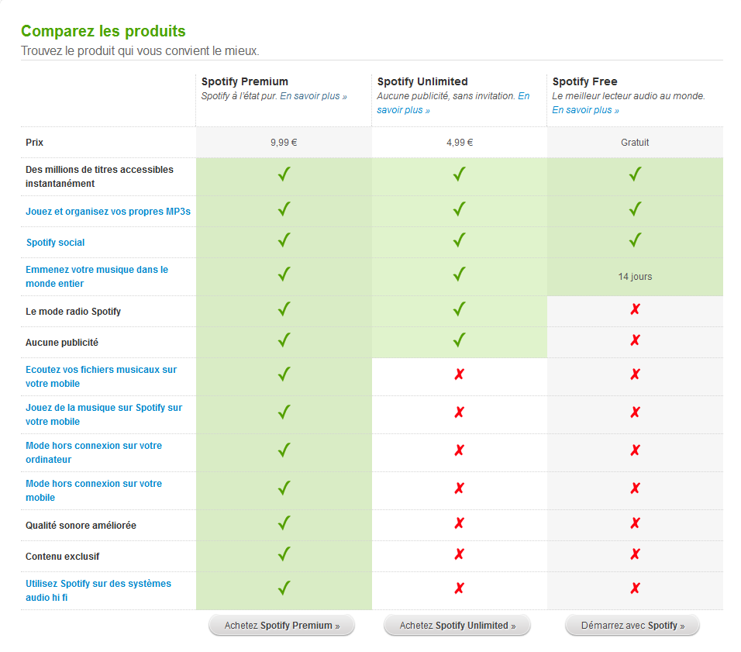
Freemium

Slide 37
Indirect appropriation
Possible to monitor number of copies
Example: photocopies
↑ Increase price of original product
Individual subscription <> libraries
Consequence: books → Academic journals
How to implement? Enforce monitoring of copies
Example: Business Software Alliance, site licences with internet activation

Slide 38
Indirect appropriation: examples
Increase price of complementary products
Examples:
  Concerts
  Ringtones
  Ipods
Taxed in many European countries:
  iPod
  Portable hard drives
  CD-R
  DVD+R/W

Slide 39
Network externalities
Strategy: use piracy to build a critical mass of users
Suppose two groups of consumers: low- and high-value
Without piracy: sell to high-value consumers
With piracy: more users → value increases → increase price and profit from high-value consumers

Slide 40
Network externalities (cont.)
Strategy: allow piracy to build a critical mass of users
Exemple: Microsoft in China
Early phase: Do not legally fight illegal copies
Later: lobby for reinforcement of intellectual property

Slide 41
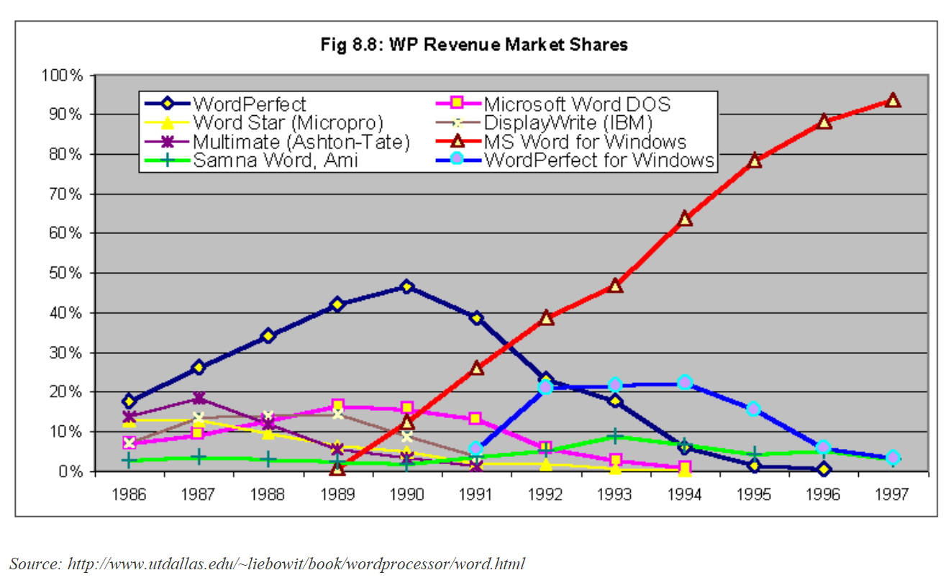
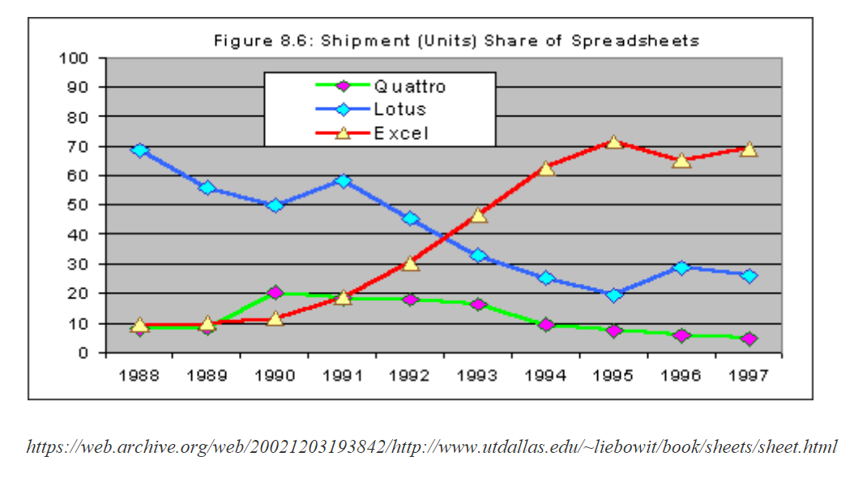
Network externalities (cont.)

Slide 42
Informational externalities
Music as an experience good
Consumers need information on new releases
Information-push : TV, radio, magasines
  Cost < record companies
Information-pull
Ex: free listening in record stores
Generalization: Internet, P2P networks
Cost < consumers

Slide 43
Digital copies and information
What if copies provide information? Competition effect vs. Matching effect of digital copies
Increase willingness to pay for music
Suppose large number of albums and no information: pick album at random; sometimes enjoy, sometimes do not enjoy; on average, low value if only one album matches your taste
Suppose you can download as much as you want for small cost: you find out which album you like best; higher willingness to pay for albums
Solution : freemium and F2P

Slide 44
Application: Music copyright
In the US:
Audio Home Recording Act 1992
< Sony DAT, Philips DC: taxes are redistributed, technological protectionDRM (first copy authorized)
Digital Millenium Copyright Act 1998
Tamper with technological protection = crime
Ex: CSS/DVD, WMA/AAC

Slide 45
Fair use in music P2P
Napster, Kazaa cases: upload = illegal distribution;
DRM and online distribution< DMCA
Digital sales explodes but still represent small proportion of sales

Slide 46
Conclusion
Internet and copyright: threats and opportunities
Threats:
  content owners
Opportunities:
  Possibility to extract value from complementary products (live concerts, ringtones, iPods, …)
  Explorers: Possibility to discover products that are not available offline; Long tail; online word-of-mouth
  New business models: freemium and streaming
In France : Hadopi, 3 strike law

Slide 47
Evaluating graduated response schemes
“Those who support the adoption of ‘graduated response’ regimes argue that they are successful and effective, but evidence to support these claims is inconsistent and confusing.“
  Communications Alliance (Australia - 29 August 2014 )

Slide 48
Evaluating graduated response schemes (cont.)
3 strike (Hadopi) law in France
« Effectiveness »?
  Natural rights view (property)
  Utilitarian approach (increased sales, distribution, creation, quality)
Two views can be contradictory: producer vs. consumer surplus
Hadopi law: both views
<> EU copyright enforcement directive: commercial scale

Slide 49
History
Sept. 2009, Hadopi-2: a judicial authority has the power to suspend or terminate Internet access
2010: Hadopi is operational, max. fine of EUR 1500
July 2013, Hadopi-3: removes Internet termination
End of July 2013: 2004847 first notices, 201288 second notices, 710 investigations
Discussion of transfer to CSA (French Audiovisual Board)

Slide 50
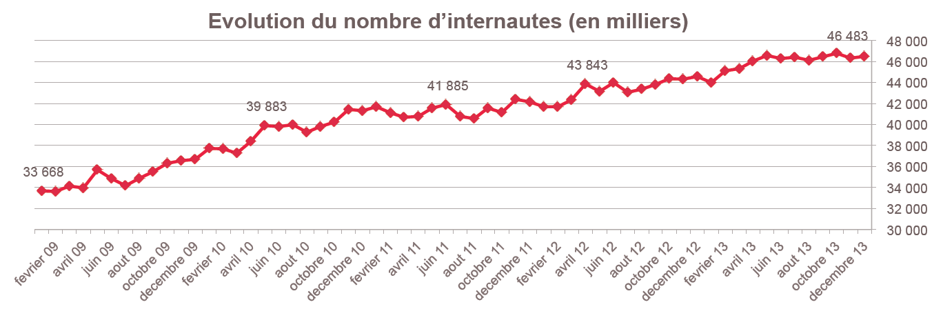
Internet penetration

Slide 51
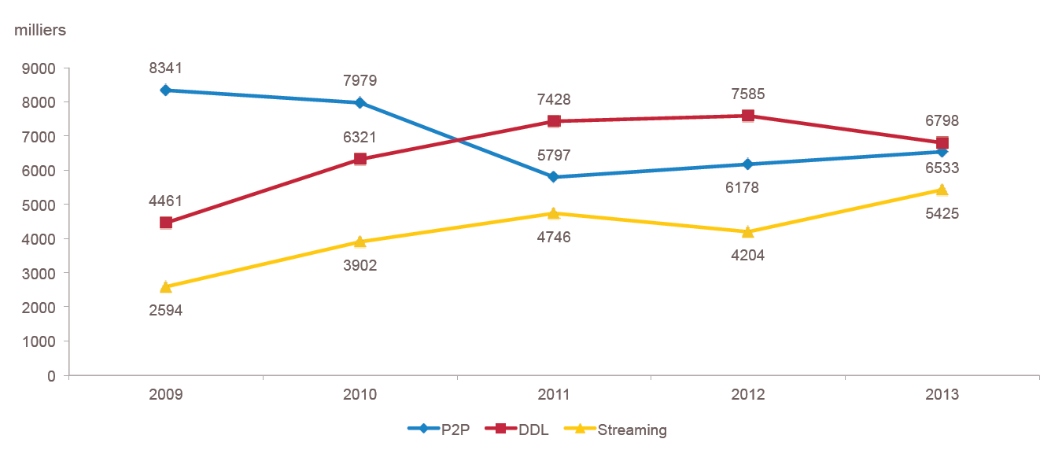
UVs by protocol

Slide 52
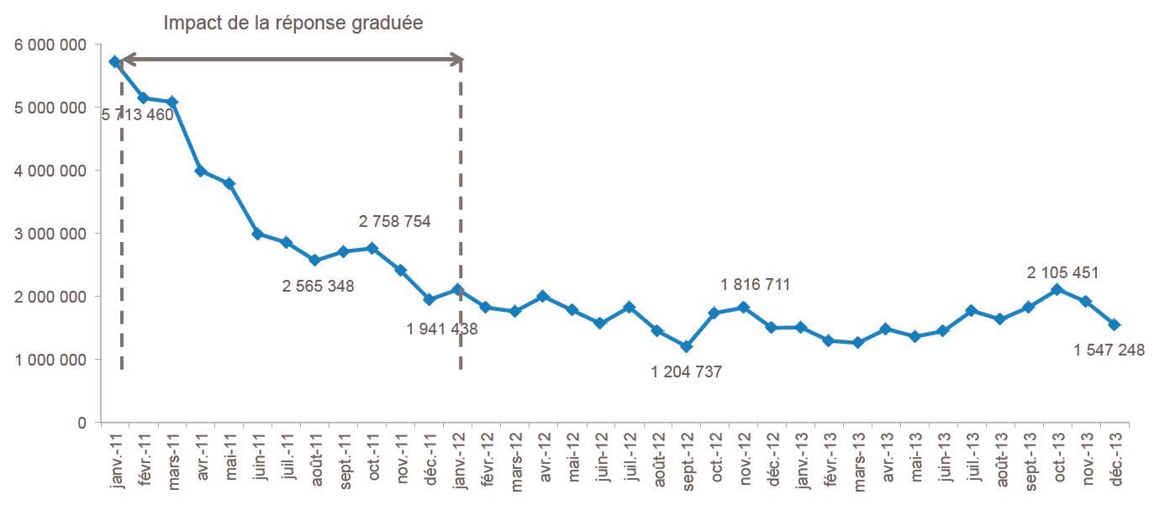
Number of publishers, Top 10 movies on P2P networks

Slide 53
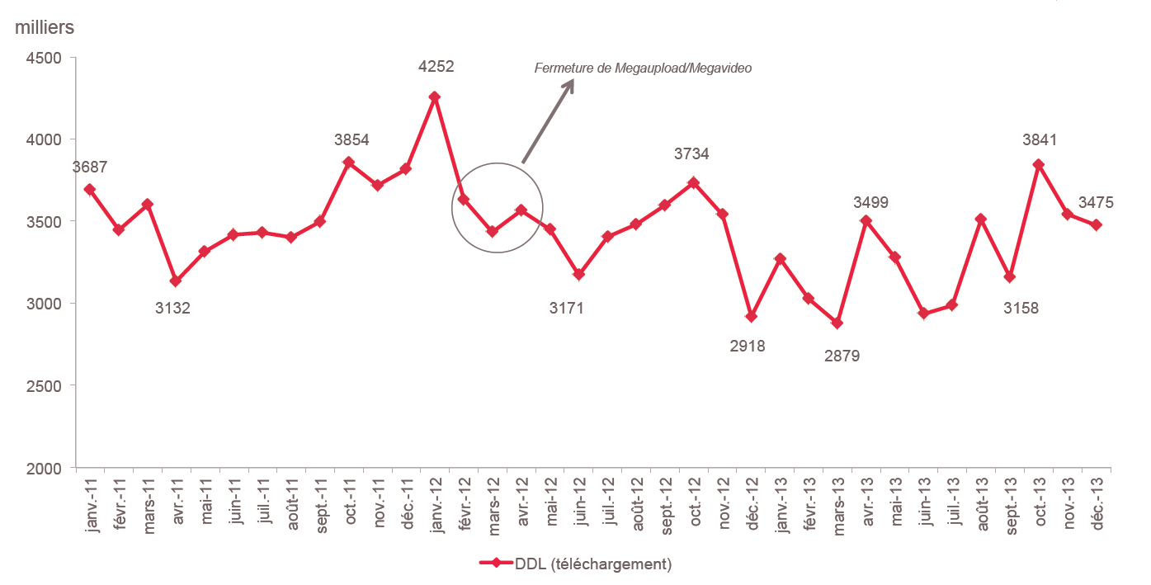
Number of individuals having accessed DDL sites at least once

Slide 54
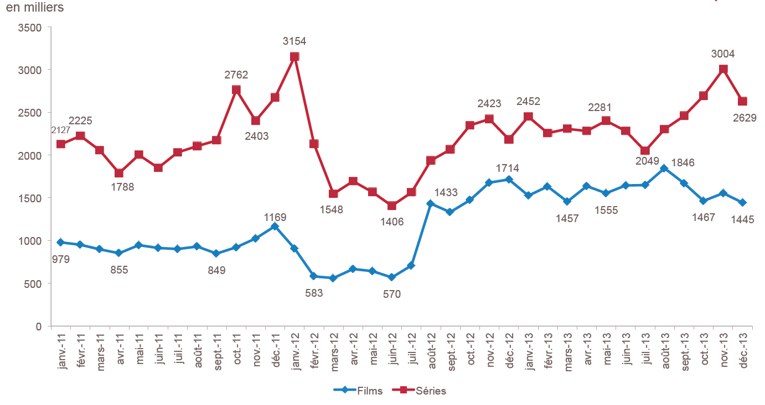
Number of individuals having streamed illegal content

Slide 55
Tendances du marché de la musique en ligne
D'un modèle d'offre (one size fits all) vers un modèle de demande orienté client
un marché numérique volatile où les technologies et les usages transforment continuellement le marché
  Ex : cloud
une mutation du marché qui s'opère avec des problèmes persistants de monétisation
  ARPU mensuel entre 0,15 et 0,20 EUR par mois net annonceur
  difficulté de l'instream audio et vidéo.

Slide 56
Tendances du marché de la musique en ligne
Une diversité de l'offre qui se traduit progressivement en diversité des consommations
  14 m de titres disponibles en 2010, 30m en 2013
  entre 2008 et 2010, le nombre de titres vendus séparément ou en albums est passé de 2 m à 4 m
  Amazon réalise 2/3 de ses ventes sur du back catalogue en utilisant une combinaison de prix et d'offres ciblées
  "long cauchemar" de la SACEM qui redistribue des centimes générés par quelques écoutes ou téléchargement
  Le problème de la prescription reste entier
  le numérique offre de nouvelles opportunités au répertoire local et à l'exportation

