Slide 1
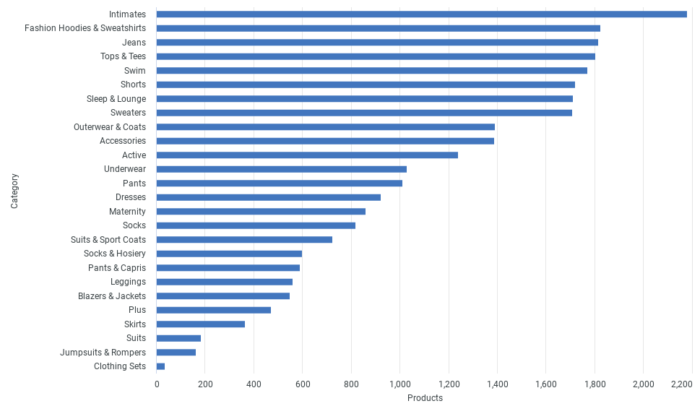
Category wise Products

Slide 2
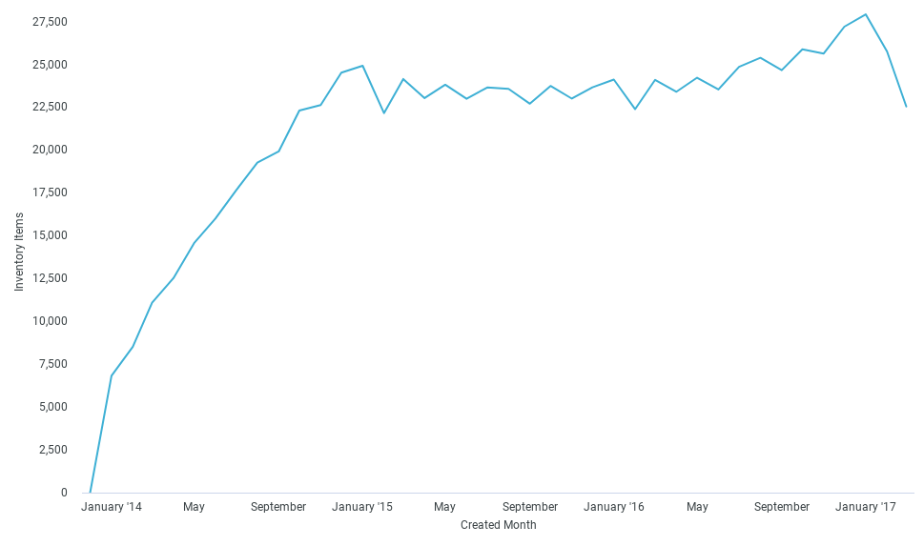
Inventory Items Created over Time

