Slide 1
From eBPF programs to IOVisor Modules Discussion 9/2/2015
Notes:
Light grey:
Dark grey:
Red:
Blue: #23d8b5

Slide 2
From eBPF programs to IOVisor Modules
From eBPF programs to IOVisor_Modules
What are eBPF programs
Why do we need IOV_Modules
Interacting with the Linux Kernel
What is an IOVisor_Module
IOV_Module, users perspective
IOV_Module, developers perspective
IOV_Module, graph composition
IOV_Module requirements
Discussion

Slide 3
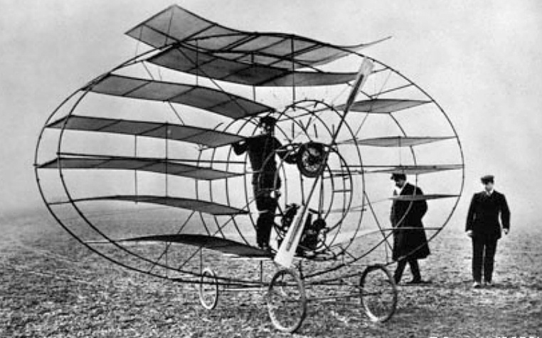

1 - From eBPF programs to IOVisor Modules

Slide 4
1a) What are eBPF programs?
In a very simplified way:
A safe, runtime way to extend Linux kernel capabilities
Functions, Maps, Attachment Points, Syscall
4) A way to interact with the kernel components from user space
User Space
Kernel
3) A way to hook it to Kernel events
1) Set of Tables
f1()
2) Set of Functions
Kernel internals
?
?
f_{next}()
f2()
f_{next}()
f3()
events
f_{next}()

Slide 5










1a) Simple Developer Workflow
Socket (TCP/UDP)
eBPF program written in Clang or P4
BPF
IP / routing
Translated into eBPF instructions (LLVM)
Bridge hook
Loaded in kernel
TC / traffic control
BPF
TAP/Raw
BPF
Hooked at different levels of Linux Networking Stack (as an example)
netif_receive_skb()
driver
https://github.com/iovisor/bcc
HW/veth/tap

Slide 6
1b) Why do we need IOVisor_Modules?
eBPF programs are too low level
Expose internals of Linux Kernel
Provide a ‘skeleton’ of an IO centric application
DP/CP framework
Skeleton of DP/Interfaces
Skeleton of CP/Model/API
No need for deep Linux Kernel expertise
Abstract hook points to Linux Kernel
Define interoperability between IOVisor_Modules
Integrate with existing Kernel capabilities (IOVisor_Module wrappers)
Many more reasons!

Slide 7
1c) Interacting with the Linux Kernel
If a function exists in Linux Kernel, use it
If it doesn’t exists, IOVisor_Module would be a way to
Prototype it before coding it into the kernel
Extend the capabilities of the Kernel

Slide 8
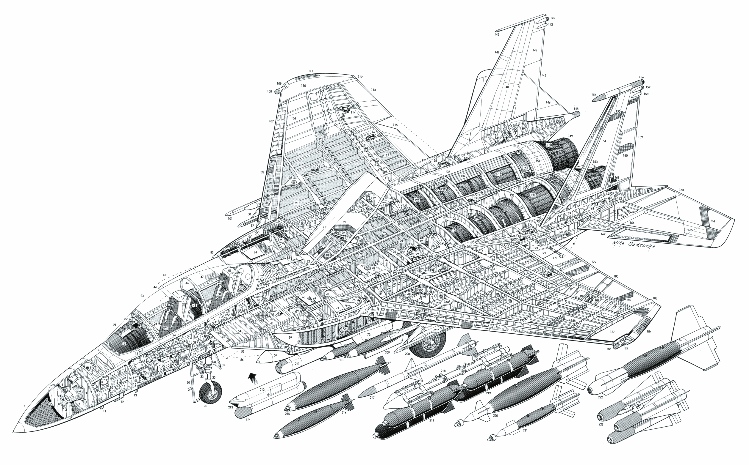
2 – What is an IOVisor_Module?

Slide 9

2a) IOV_Module, users perspective
Controllers live up here
IOVisor_Modules
Catalog
Search for IOV_Mod
Management interface
- REST API
- Cli / config file
Download IOV_Mod
Somewhere in the cloud (iovisor.org)
there is a catalog of public IOV_Modules
IOVisor_Module
Something runs in user space
Something runs in kernel
Interfaces
- Interface Type (Net, Tracing, Storage, …)

Slide 10
2b) IOV_Module, developers perspective
IOVisor_Module
Users interact with the Module with:
Management interface
- REST API
- Cli / config file
IOVisor_Modules
Catalog
IOVisor
SDK
User space helper
IOVisor_Module
Control Plane
(user space)
Publish new Modules
Python, C, C++, Go, JS …
Somewhere in the cloud (iovisor.org)
there is a catalog of public IOV_Modules
IOV_Module
developer
Data Plane
Clang / P4
IOVisor_Module
Data Plane
(kernel)
Interfaces
- Interface Type (Net, Tracing, Storage, …)

Slide 11
2c) IOV_Module, graph composition
extending Linux Kernel capabilities
Open repo of
“IOV_Modules”
APIs to Controllers
IOVisor
Manager
User space
Kernel code
Kernel space
Metadata
Kernel code
Kernel attachment points

Slide 12
3 – IOVisor_Module Requirements?

Slide 13
IOVisor_Module Requirements
Data Plane works even when Control Plane is killed (Platform requirement)
Non disruptive reattachment of CP to DP (IOV_Module feature dependent)
Shared Maps/Tables across IOVisor_Modules / eBPF programs (Platform requirement)
How to define coprocessors?
How do they interact with HW engines?
…
…

Slide 14
Plan
Start producing code and tools to experiment around the concept of IOVisor Module
Create a ‘reference’ IOVisor_Module
Pick a use case to test the limits of the concept
Volunteers? ☺

Slide 15
Discussion….

