Slide 1
Audio & Video Filter Web Application
Streaming Processed Multimedia Content
Rodion Makarov s270470
GitHub
Music and Multimedia streaming over the Internet
2025

Slide 2
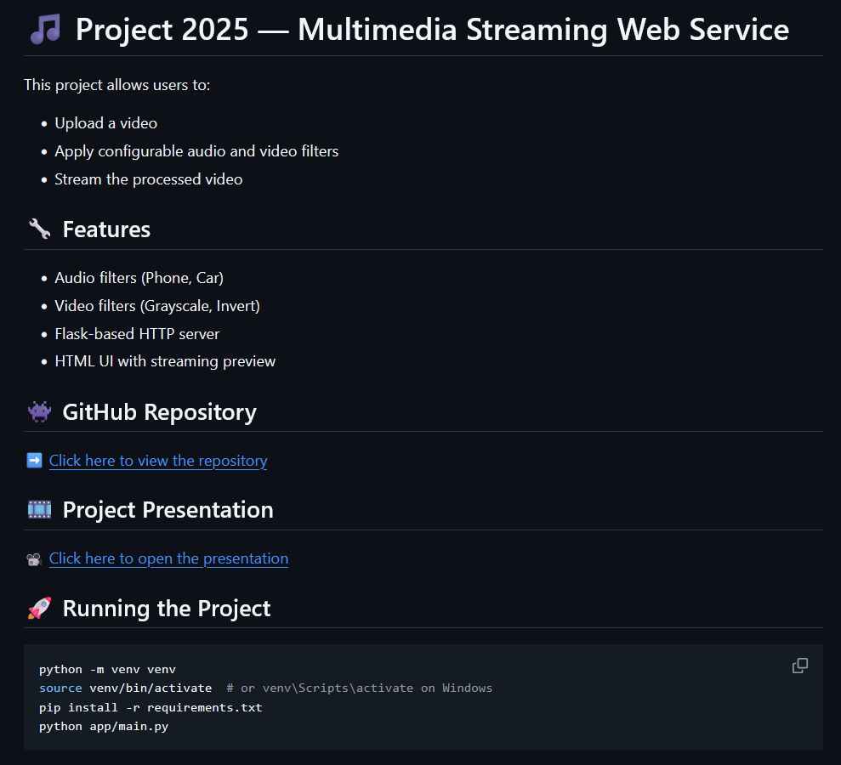
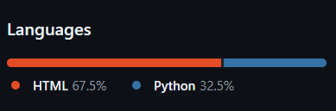
Project Overview
GitHub
Goal: To apply filters to MP4 files via a web interface, allowing users to watch the result via streaming
Key Functionality:
Upload MP4 files in the browser.
Choose and stack audio and video filters.
Configure filter parameters.
Stream processed video.
Technologies Used:
Frontend: HTML + JavaScript
Backend: Python
Processing: FFmpeg (for video), NumPy, SciPy (for audio)

Slide 3
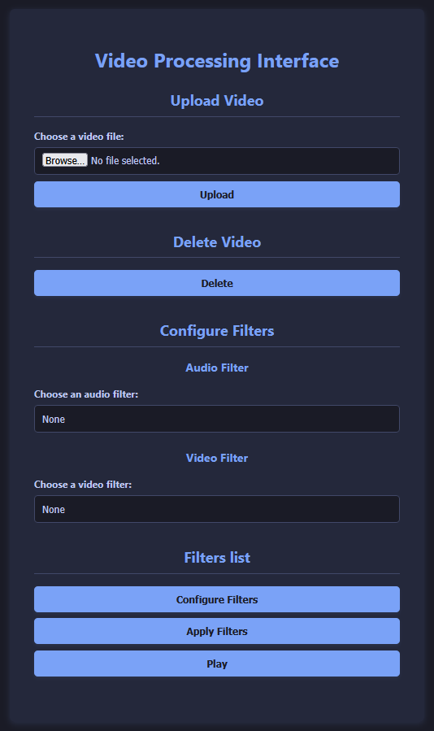
Key Features &
User Experience
Clean and simple UI
File Upload & Management:
Upload MP4 files.
Option to delete previously uploaded videos.
Only one video can be present on the server at a time.
Configurable Filters:
User can select one or more implemented filters for both audio and video.
Parameters for filters can be configured.
Seamless Streaming of Processed Content

Slide 4
Code Architecture
├── .git/ Git repository
├── .gitignore Files that Git should ignore
├── app/ Contains the main application logic
│ ├── main.py Main application file
│ ├── video_filters.py Contains video filters
│ └── audio_filters.py Contains audio filters
└── templates/ Contains HTML templates for the user interface
└── index.html Main HTML file for the web application

Slide 5
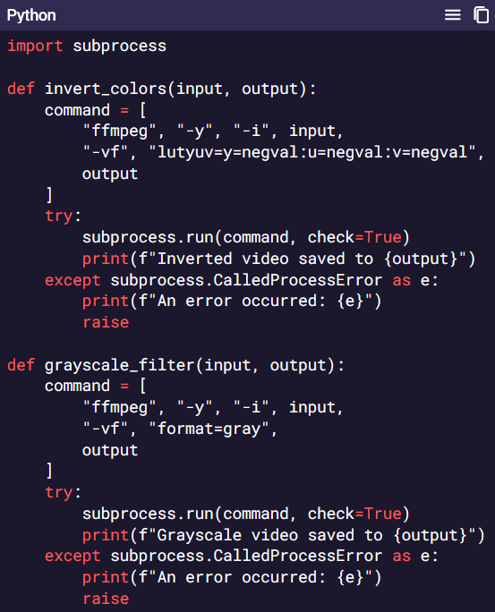
Implemented Video Filters
Grayscale:
Converts the video to black and white.
Strips chroma channels, preserving only brightness (luminance).
Show relevant code snippet (like the one in your PPT for grayscale_filter).
Invert Colors:
Inverts each YUV channel in the video.
Show relevant code snippet (like the one in your PPT for invert_colors).

Slide 6
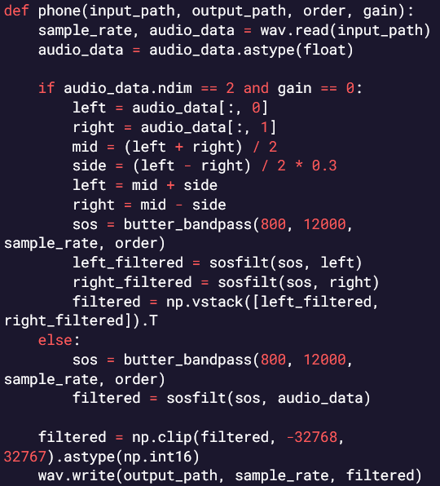
Implemented Audio Filters - part 1
Phone Filter:
Simulates phone-like audio quality.
Attenuates stereo side signal (mono effect).
Applies a bandpass filter in the range 800–12000 Hz using SciPy's butter_bandpass and sosfilt.
Show relevant code snippet (like the one in your PPT for phone filter).

Slide 7
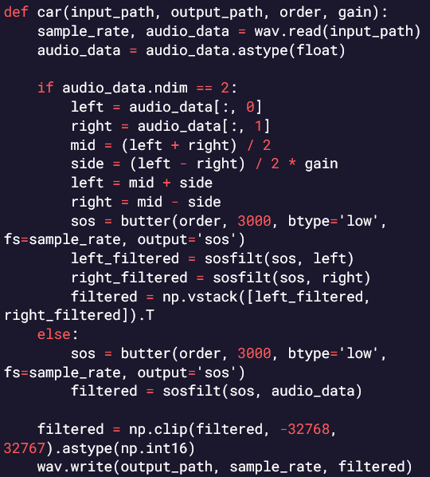
Implemented Audio Filters - part 2
Car Filter:
Simulates audio heard inside a car.
Amplifies stereo side signal for spatial feel.
Applies a low-pass filter at 3 kHz to muffle high tones.
Combines mid/side processing and filtering.
Show relevant code snippet (like the one in your PPT for car filter).

Slide 8
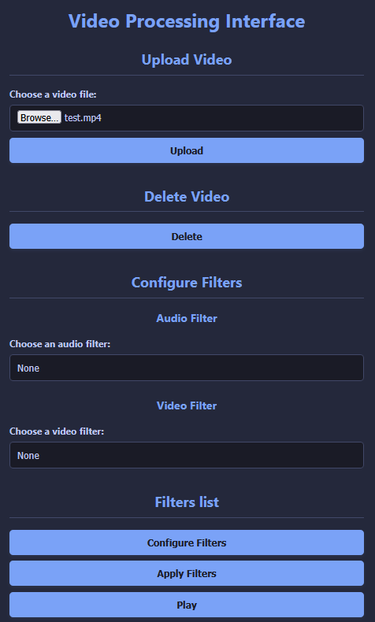
System Workflow
Modular and Stackable Filter Architecture.
Step-by-Step Process:
Upload Video: User uploads an MP4 file through the web interface.
Configure Filters: User selects desired audio and video filters and their parameters via dropdown menus.
Apply Filters: The server processes the uploaded video, applying the configured audio and video filters. This step involves generating a second video with applied filters.
Stream Result: Once processing is complete, the user can stream the filtered video.

Slide 9
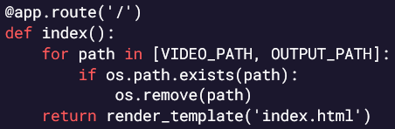
Endpoint from main.py - part 1
@app.route('/')
Purpose: Serves the main HTML page (index.html) and initializes the application state by ensuring no previous video files remain from past sessions.

Slide 10
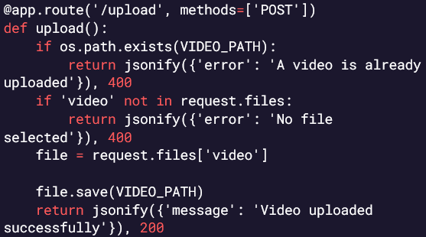
Endpoint from main.py - part 2
@app.route('/upload', methods=['POST'])
Purpose: This endpoint allows clients to upload a video file to the server.
How it works:
It accepts a POST request at /upload with a file field named 'video'.
If a video already exists at VIDEO_PATH, it returns an error.
If no file is provided, it returns an error.
Otherwise, it saves the uploaded video to VIDEO_PATH and returns a success message.

Slide 11
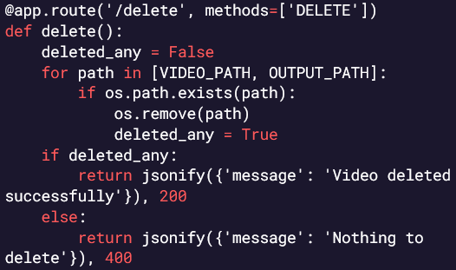
Endpoint from main.py - part 3
@app.route('/delete', methods=['DELETE'])
Purpose: This endpoint deletes the uploaded video and its processed output from the server.
How it works:
It accepts a DELETE request at /delete.
It checks if files exist at VIDEO_PATH and OUTPUT_PATH, and removes them if found.
If any file was deleted, it returns a success message.
If no files were found, it returns a "Nothing to delete" message with a 400 status.

Slide 12
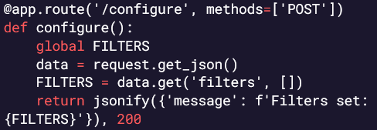
Endpoint from main.py - part 4
@app.route('/configure', methods=['POST'])
Purpose: This endpoint sets filter configurations for future video processing.
How it works:
It accepts a POST request at /configure with a JSON body containing a filters list.
It updates the global FILTERS variable with the provided filters.
Returns a success message confirming the filters were set.

Slide 13
Endpoint from main.py - part 5
@app.route('/apply', methods=['POST'])
Purpose: This endpoint applies a series of configured audio/video filters to an uploaded video.
How it works:
Accepts a POST request at /apply.
Checks that a video has been uploaded.
Creates a temporary copy of the video using ffmpeg.
Iterates over the global FILTERS list and applies each filter in sequence:
Video filters: like color invert, grayscale.
Audio filters: like phone, car, with custom parameters.
Uses external tools (ffmpeg) and custom functions (invert_colors, grayscale_filter, phone, car) to process the video/audio.
Replaces the original processed video with the final output.
Returns success or an error message if any filter fails.

Slide 14
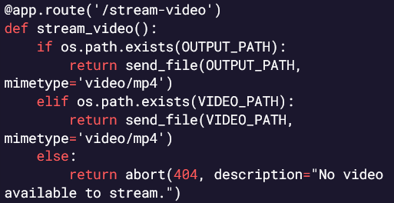
Endpoint from main.py - part 6
@app.route('/stream-video')
Purpose: This endpoint streams the available video to the client.
How it works:
Accepts a GET request at /stream-video.
If a processed video exists at OUTPUT_PATH, it streams that.
If only the original uploaded video exists at VIDEO_PATH, it streams that instead.
If no video is found, it returns a 404 error.

Slide 15

Rodion Makarov s270470 GitHub
18 pls…🥺

