Slide 1
Group A61 - MessagIST
Gonçalo Rua, 1102604
Rodrigo Arêde, 1102606
João Gouveia, 1102611

Slide 2
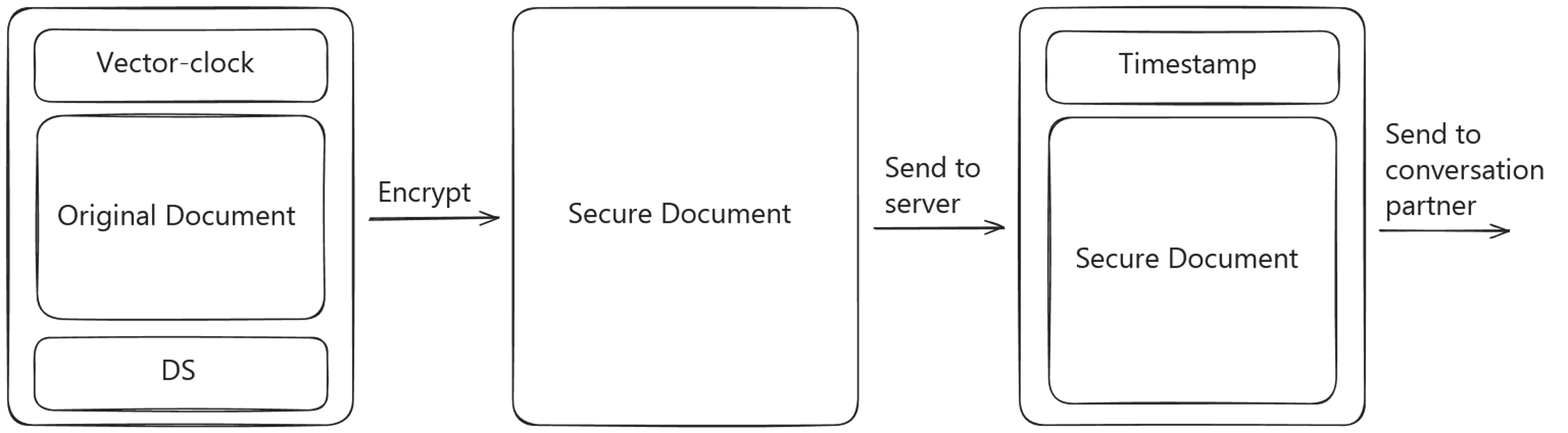
Secure Documents
Overview

Slide 3
Secure Documents – Vector Clocks
Overview
Both clients keep track of a vector clock for the conversation.
Appended to messages being sent.
Used to check incoming messages.

Slide 4
Secure Documents – Vector Clocks
Why?
Used to detect out of order or replayed messages.
The server appends timestamps to the messages according to the order it receives them.
What if the server is compromised, and suddenly decides to reorder / replay messages?
Vector clocks reduce the damage the server can make.
Replayed messages can be detected.
Out of order messages can be detected unless they were sent concurrently.

Slide 5
Secure Documents – Signing
Overview
Clients sign messages using elliptic-curve cryptography (Ed25519).
Allows clients to guarantee that the message hasn't been tampered with.
Allows clients to confirm the sender's indentity.

Slide 6
Secure Documents – Signing
Why Ed25519?
Provides the same security as RSA.
Faster signing.
Smaller signatures.
Faster key generation.
Smaller keys.
Our key recovery strategy is only possible because of the small keys Ed25519 uses.

Slide 7
Secure Documents – Encrypting
Overview
Clients encrypt messages with AES in CBC mode, using 256-bit keys.
Allows clients to guarantee that only the parties involved in the conversation can read messages.

Slide 8
Secure Documents – Encrypting
Why AES CBC?
AES:
  The "standard" for symmetric cryptography.
  Exists for more than 20 years - Time-tested.
CBC:
  Not possible to detect patterns in the plaintext by analyzing the ciphertext (unlike ECB).

Slide 9
Infrastructure
Overview
Public Server (DMZ): Acts as na intermediary between clients and the main server.
Main Server: Handles core business logic and interacts with the database.
PostgreSQL Database Server: Stores user data and chat history.
Client Application: User interface for communication.

Slide 10
Infrastructure - NAT Firewall Overview
Overview
Purpose:
  Secure network zones using firewalls.
  Route traffic between WAN, DMZ, and internal networks.
Firewalls:
  Firewall 1: Handles WAN to DMZ traffic.
  Firewall 2: Handles DMZ to internal traffic.

Slide 11
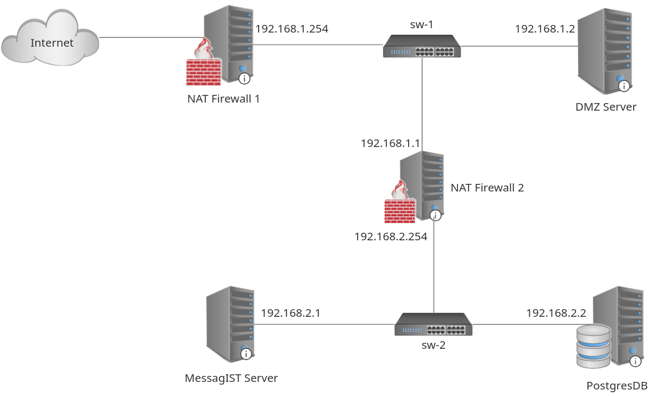
Infrastructure
Overview

Slide 12
Infrastructure
Why a DMZ?
Hosts services that need to be accessible from the internet (public-facing API).
Key Benefits: Enhanced Security, Isolation and Controlled Access.
  Limits direct access to the internal network.
  Even if a public-facing server in the DMZ is compromised, attackers cannot directly access internal resources.
  Allows specific traffic to the DMZ while restricting internal network access to authorized connections only.

Slide 13
Communication Channels
Overview
Server-Side TLS
Each server:
  Certificate
  Private Key​

Slide 14
Key Distribution
Overview
 | Current Implementation | Real-World Scenario
Server ↔ Server | Certificates manually copied to the required servers. | Certificates manually copied to the required servers.
Public Server ↔ Clients | Certificates distributed manually. | Certificate would be signed by a trusted CA.

Slide 15
Security Challenge
Overview
Requirement | In practice
[SR1]: End-to-end encryption | Sender and receiver exchange a session a key
[SR2]: Protocol that allows two users to exchange a key | Protocol that allows two users to agree on a secret.
[SR3]: If a phone is lost, user must be able to recover the message history | Users must be able to recover their asymmetric key pair and session keys.c

Slide 16
Key Exchange
Overview
Users agree on a chat passphrase -> Symetric Key.
Flexible for users.
Possible to create strong and memorizable passphrase.
Exchanged:
  Verbally.
  Secure messaging services.

Slide 17
Key Recovery
Overview
The private key of a user is encoded as a list of 17 words (1 number and 16 actual words).
This list is shown to the user upon sign up.
Users should memorize or store this list somewhere safe.
On login, users are requested to insert this list if their key is not found on local storage.

Slide 18
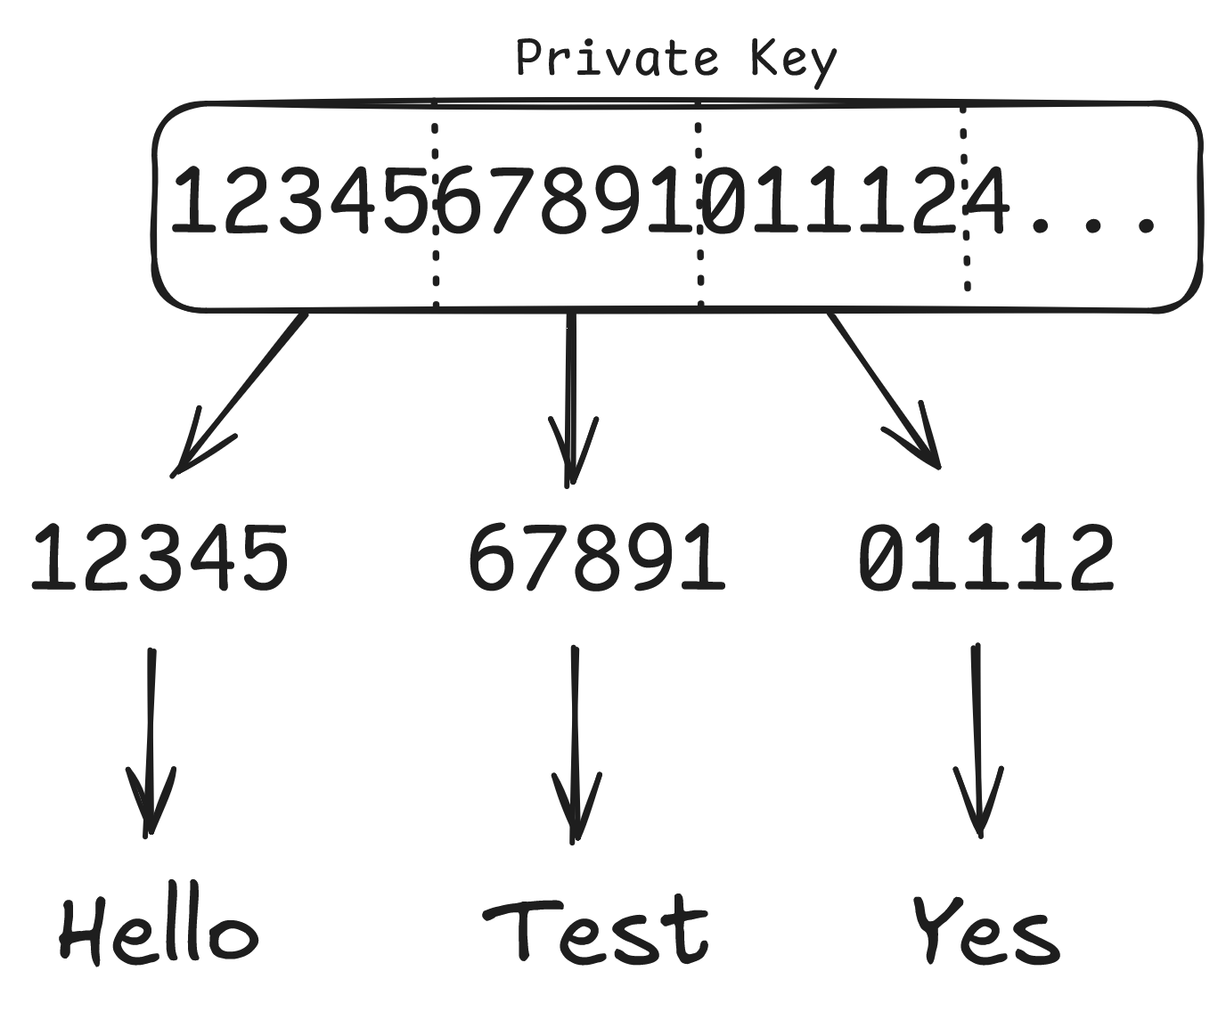
Key Recovery
Overview

Slide 19
Protocol
Overview
Sign up.
Login.
Establish session with the server.
Send and receive messages.

Slide 20
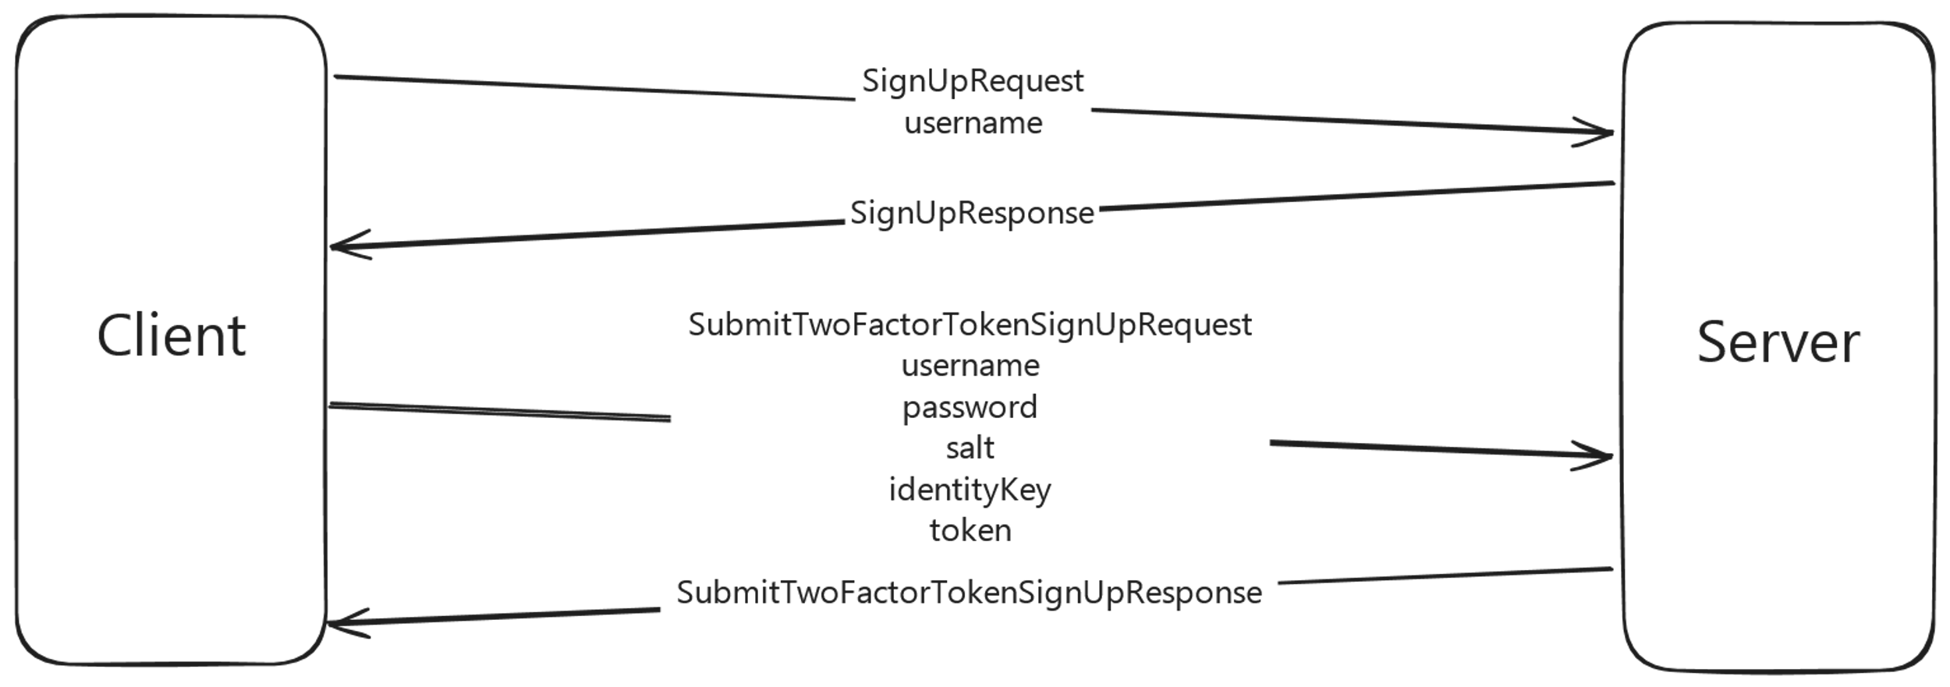
Protocol
Signing Up

Slide 21
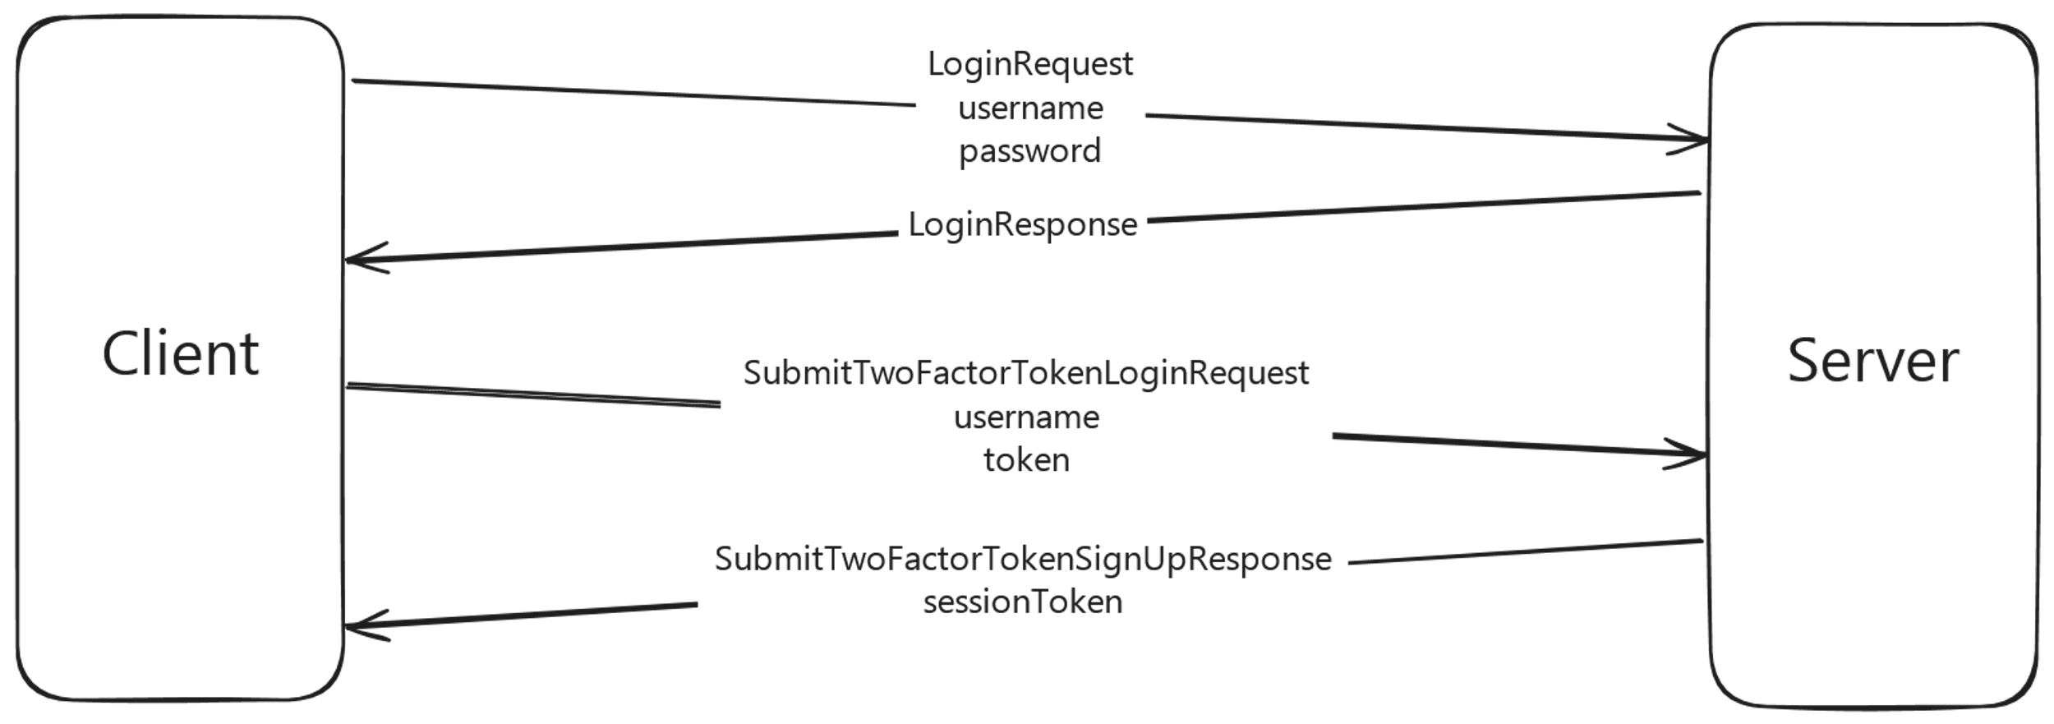
Protocol
Login

Slide 22
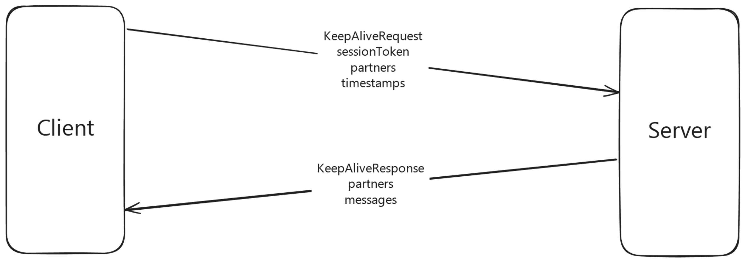
Protocol
Session (and receiving messages)

Slide 23
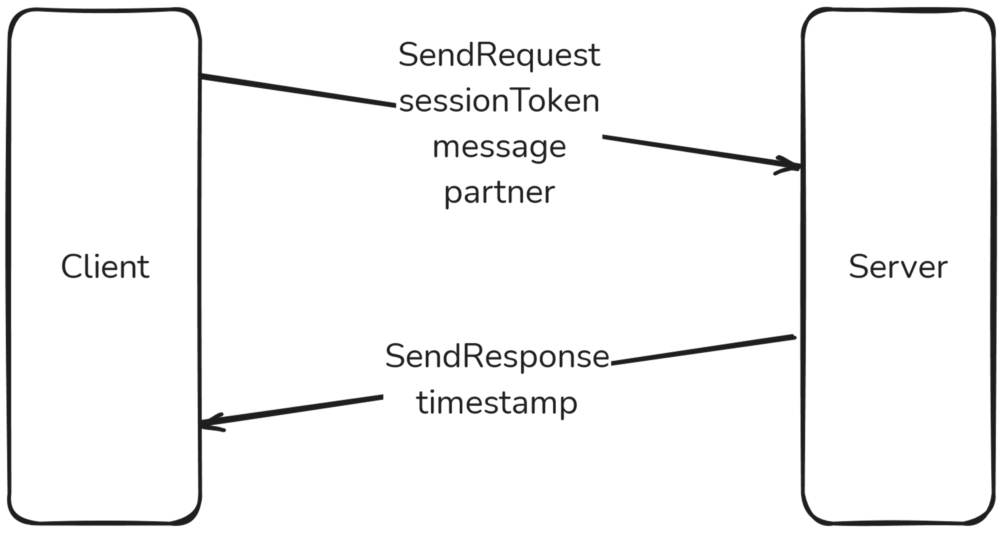
Protocol
Sending Messages

Slide 24
Conclusion
We developed a secure messaging service using modern and proven techniques.
All security requirements were successfully fulfilled.

