Slide 1



CSC207 Final Project Presentation
Presented by Group #24
Alice Baker
Yue chen
Yuewen zhang
Zhikang Tian

Slide 2
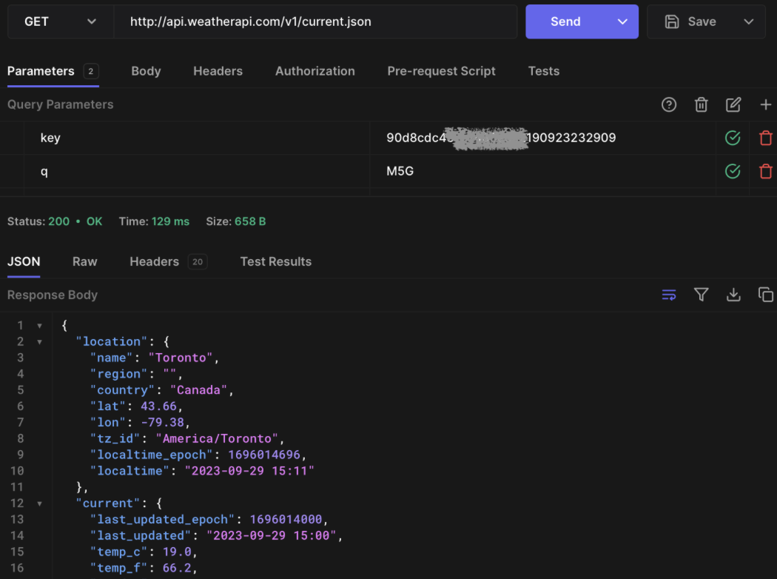

Weather api
Our Project has connected Weather API from weatherapi.com, which is an API can help us get detailed weather conditions based on the location we provide.
We have chosen this API as it is free for us to get information and easy to connect and parse.
An example screenshot from hoppscotch.io of GET from Weather API for location of Toronto.

Slide 3
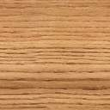


API Endpoint
Description: This endpoint retrieves the current weather data for a specific location.
URL Structure: https://api.weatherapi.com/v1/current.json?key=[API_KEY]&q=[LOCATION]
Class Involved in our Project: APIDataAccessObject
Method: getWeather(String location)
Functionality: When user requests the weather for a specific location, this endpoint is called. The response includes data such as temperature, conditions, and time.

Slide 4





Specification
New User Sign Up: username and location
User Login
Get Weather: Get weather conditions from the API
Portal to Group: GroupView, access to group features
(Not Ready) Portal to Trip
Group
Create Group
Edit Group
Trip
Create Trip
Edit Trip

Slide 5
demo

Slide 6


Software design

Slide 7

SOLID principles
While we design our program and codes, we followed the principles what we have learnt in this course, by adherence to SOLID principles, our codes are promoted to be more understandable, flexible, and maintainable software design.
Here are the three SOLID Principles we will evaluate further:
Single Responsibility Principle (SRP)
Interface Segregation Principle (ISP)
Dependency Inversion Principle (DIP)

Slide 8
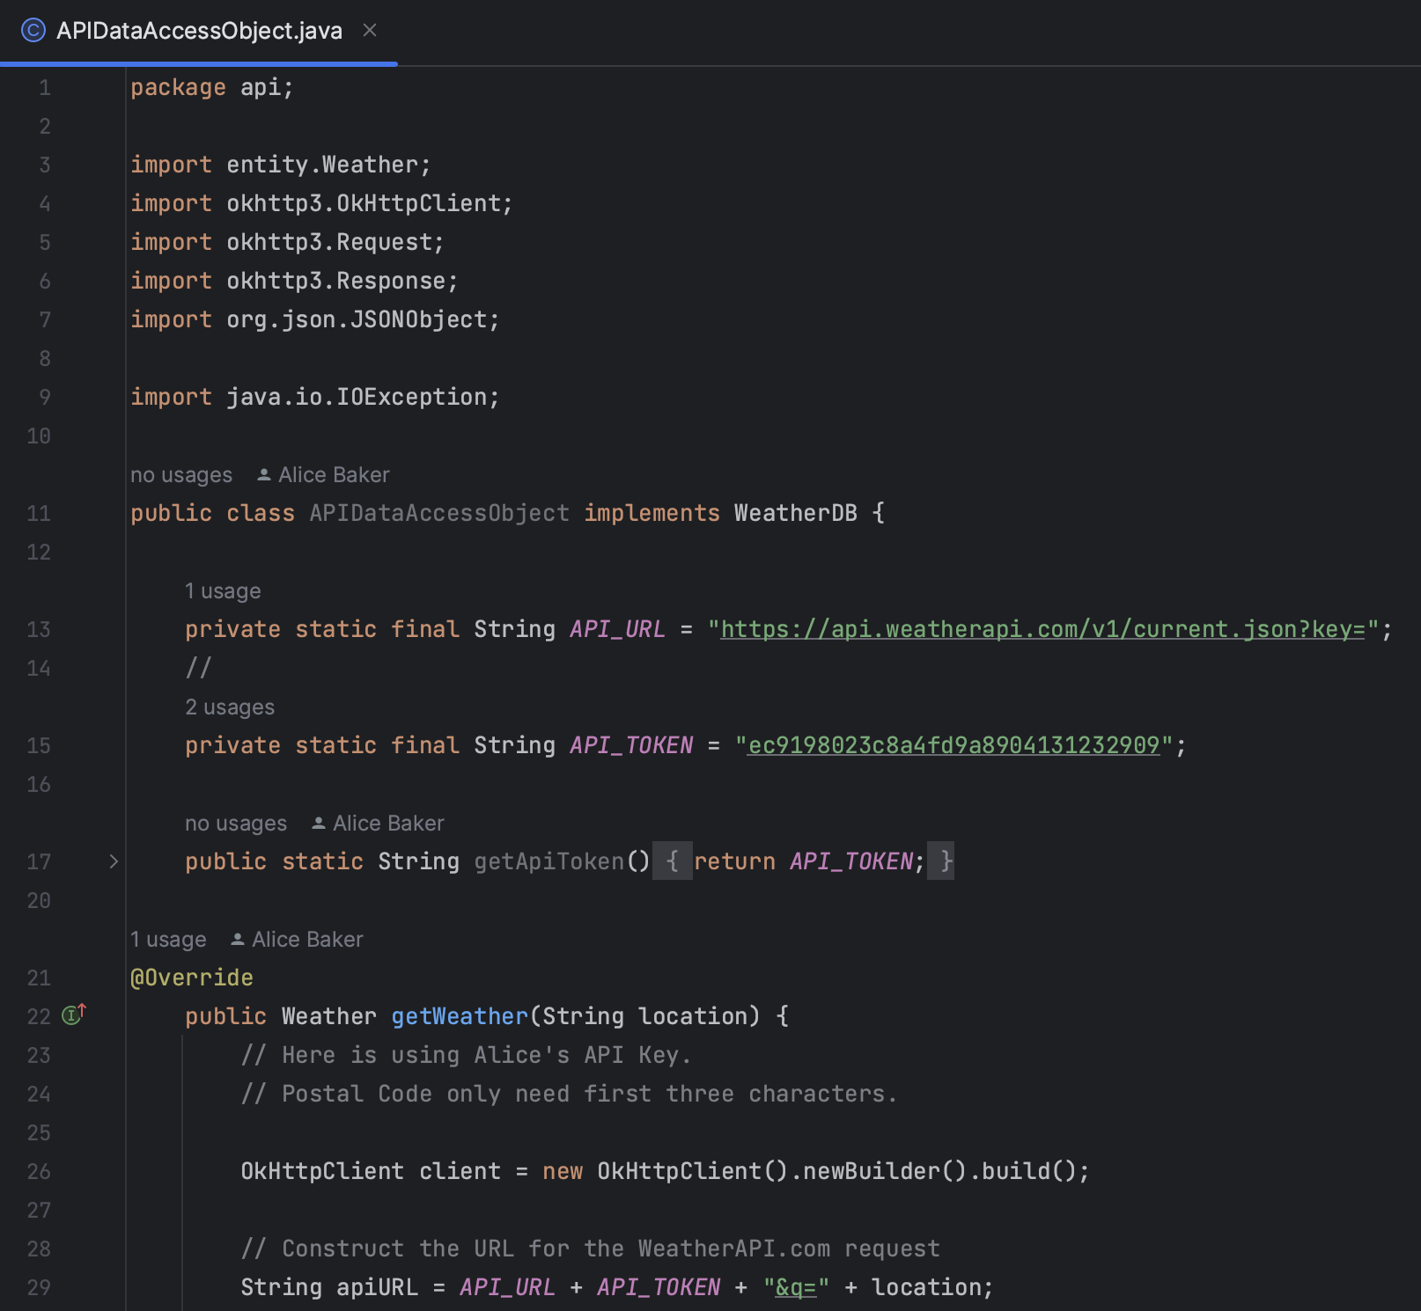
Single Responsibility Principle (SRP)
In our code, one class has only one responsibility, for example, the APIDataAccessObject class that only handles fetching weather data (GET) from the API, while View and other elements are from other classes.
Same as other use cases, each class in the code only process their own responsibility.

Slide 9
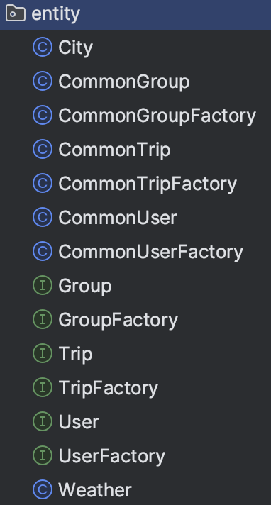
Interface Segregation Principle (ISP)
Specific Interfaces for Different Features: Our application uses different interfaces for distinct functionalities. For example, we have separate interfaces for user management (User), weather data handling (Weather), and group management (Group).
Segregating these interfaces makes the code more modular and easier to update, changes in the group management feature (add a feature called leave group) won't affect the user management part (no need to modify User interface), as they rely on different interfaces.

Slide 10
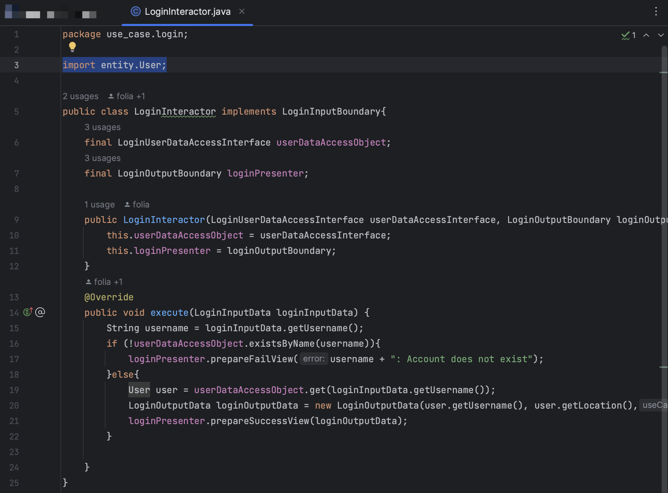
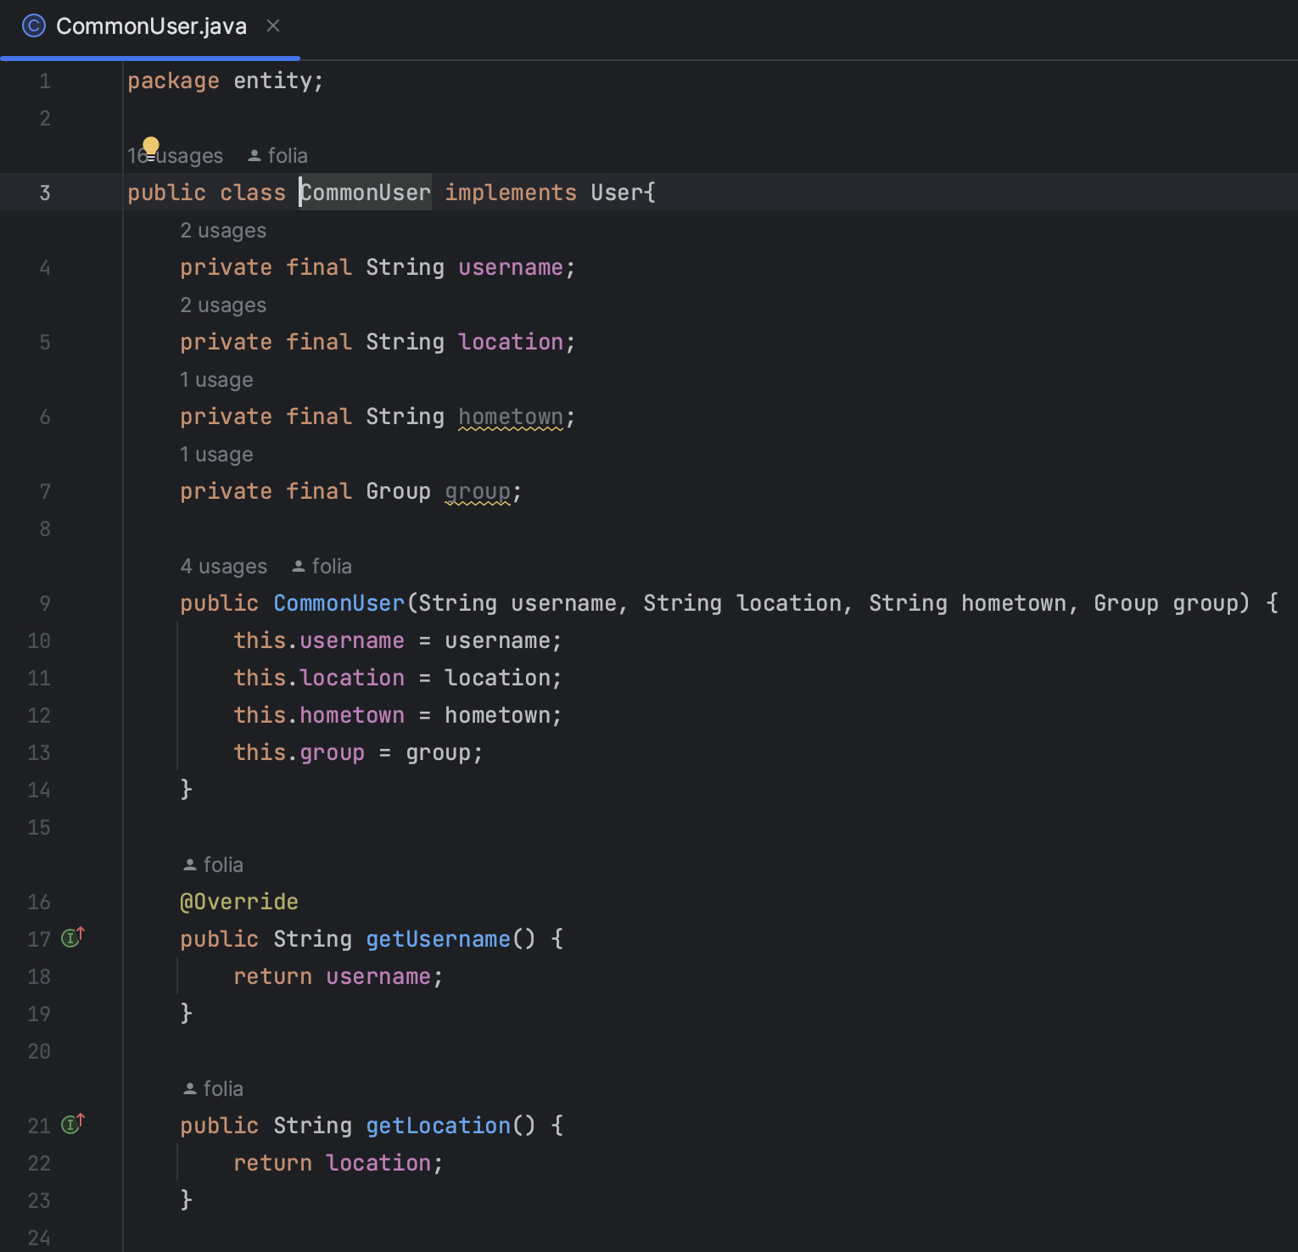
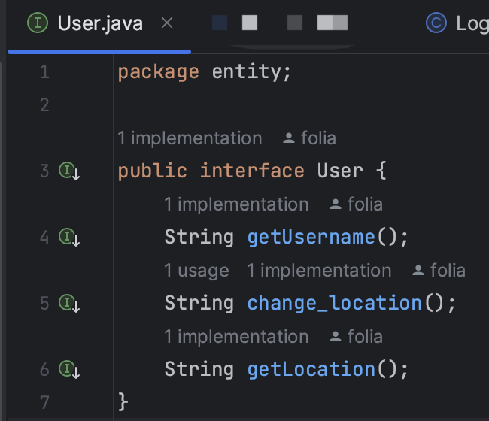
Dependency Inversion Principle (DIP)
Our code is just like the principle says, high-level modules like user interaction handlers depend on abstract interfaces rather than concrete implementations. For example, our LoginInteractor depends on User interface rather than the concrete CommonUser class.
This demonstrates a clear adherence to DIP and makes our application more flexible and testable.

Slide 11

Clean architecture
Clean Architecture is the base of our Project.
This is to say, all of our codes are built upon Clean Architecture – strictly following the rules and the Clean Architecture Engine, which ensured that our project codes are easy to maintain, extend, and test, largely due to its emphasis on separation of concerns and the Dependency Rule, where dependencies can only point inwards, meaning inner layers are independent of outer layers.

Slide 12
Clean architecture diagram

Slide 13
Project UML diagram

Slide 14
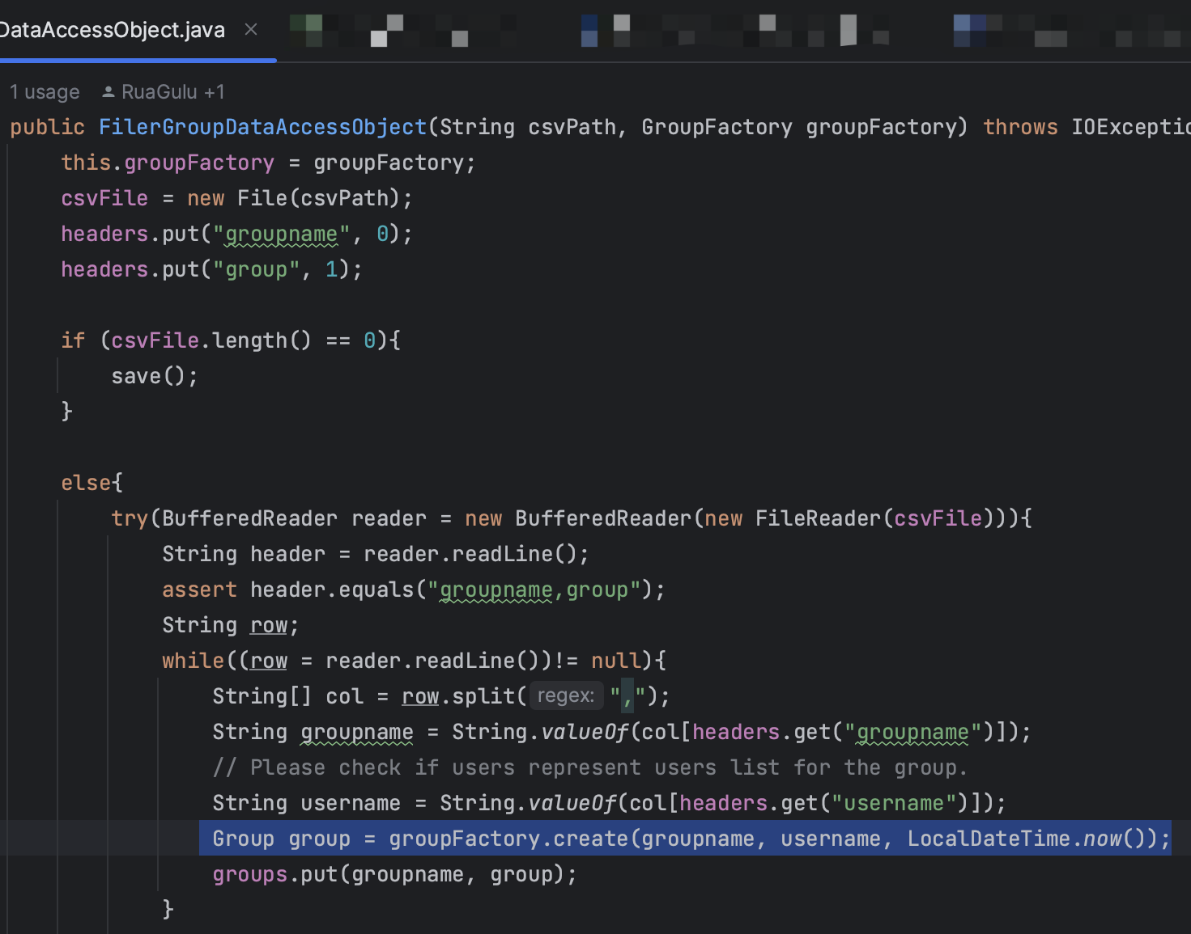
Evidence of adherence in Dependency Rule
A great example in our project for convincing the adherence of the Dependency Rule in Clean Architecture would be the implementation of `FilerGroupDataAccessObject`, that the original `groupFactory.create` method takes in a whole `user` class, which needs access to `Entities`.
Access to `Entities` violates the Clean Architecture Dependency Rule as `Data Access` is high level and should not access `Entities`.
Then we implemented the solution without violate Dependency Rule, we now search the `user` by `username` when creating `CommonGroup` and now `groupFactory.create` can just take in `username` as a string.

Slide 15

For Design Patterns, we implemented our codes with:
Observer Pattern
Builder Pattern
We chose these patterns as the Builder Pattern for creating complex objects with ease, while the Observer Pattern for managing updates between your Views and ViewModels efficiently, as we have many use cases for our project.
DESIGN patterns

Slide 16

Observer Pattern
The Observer Pattern involves two key types of objects – Subjects and Observers. The Subject maintains a list of Observers and notifies them of any state changes, usually by calling one of their methods.
Subjects:
SignupViewModel
LoginViewModel
LoggedinViewModel
GroupViewModel
TripViewModel
Observers:
SignupView
LoginView
LoggedinView
GroupView
TripView
This Subject-Observer relationship allows for a low-coupled design where objects can interact without being tightly bound to each other, making the system more flexible and easier to maintain.

Slide 17
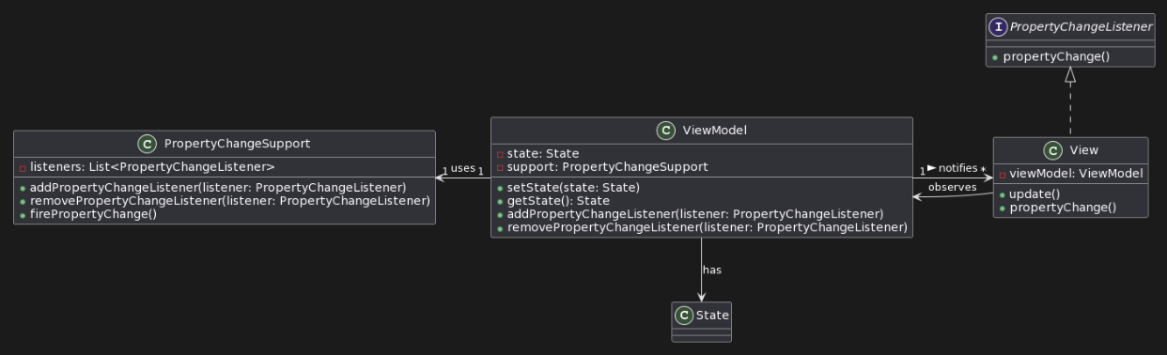
Observer pattern evidence
SignupViewModel: When a new user completes the signup process, this `SignupViewModel` updates its state to reflect the successful registration. All Views observing this `SignupViewModel` (like the `SignupView`) get notified to update their display, showing a confirmation message or redirecting the user to another page.
LoginViewModel: Similarly, after a user logs in, the `LoginViewModel` updates its user authentication, which then triggers an update in the `LoginView`, redirecting the user to the `LoggedinView`.
UML Class Diagram showing structural relationship between View and ViewModel.

Slide 18
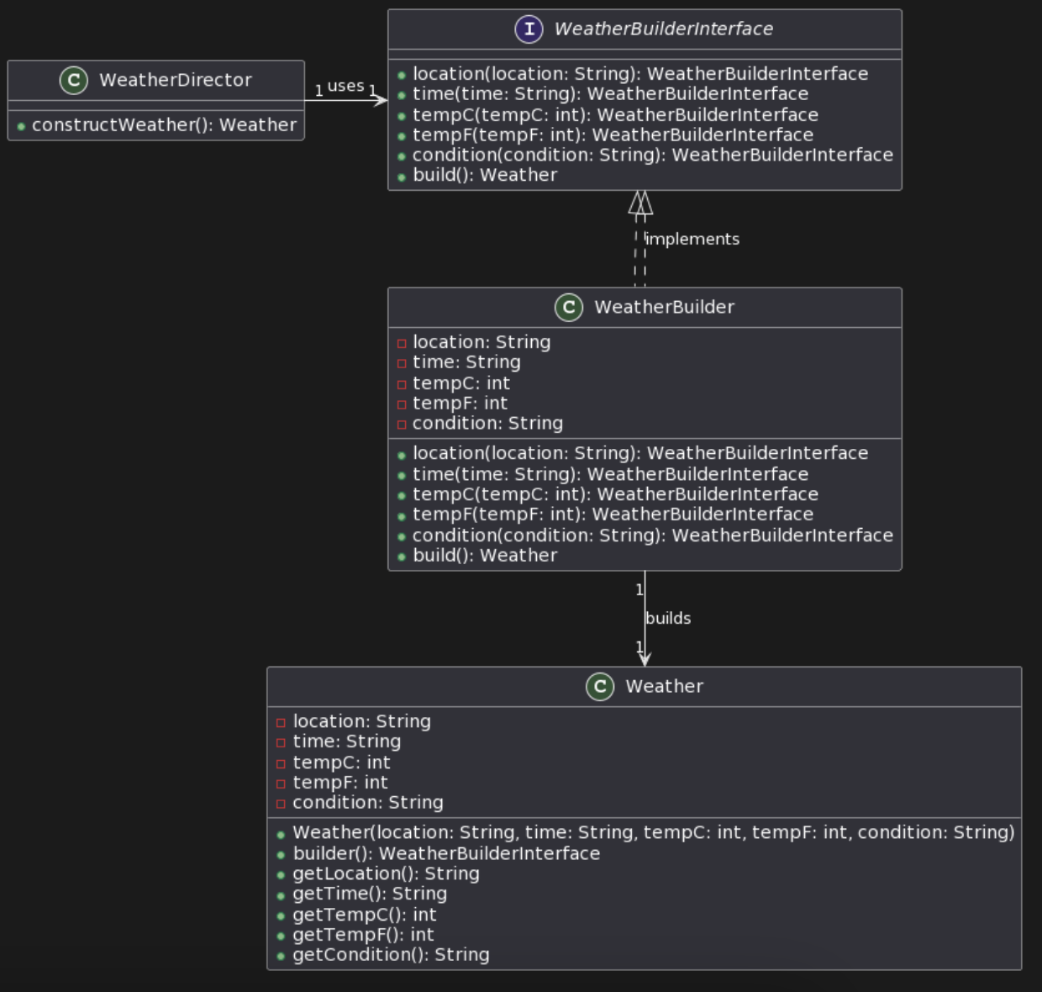
Builder pattern
Complex Object Creation: As the Weather class represents a complex object in our domain model, requiring several properties to be set during its instantiation (like `location`, `time`, `tempC`, `tempF`, `condition`).
Builder Implementation: The nested WeatherBuilder class is implemented within the Weather class to facilitate the step-by-step construction of a Weather object.
Sample UML Class Diagram for Weather and WeatherBuilder

Slide 19





Builder pattern evidence
Class Involvement:
Weather Class: This class acts as the complex object for which the Builder Pattern is implemented.
WeatherBuilder Class: A nested static class within Weather that provides methods to set the properties of Weather and a build method to instantiate the Weather object.
WeatherBuilder Methods:
Fluent Interface: Each method in WeatherBuilder returns the builder instance itself (return this;). This design supports fluent chaining of method calls, making the client code more readable and intuitive.
Clear Purpose: Each method is named after the field it sets (location, time, tempC, tempF, condition), clearly indicating its purpose. This clarity enhances code readability and maintainability.
Default Values and Validation: The Builder Pattern allows for setting default values or adding validation logic within the builder methods. This can ensure that the Weather object is always in a consistent state.

Slide 20

Testing

Slide 21

Code organization

Slide 22
Thank you for your participation
Presented by team24

