Slide 1
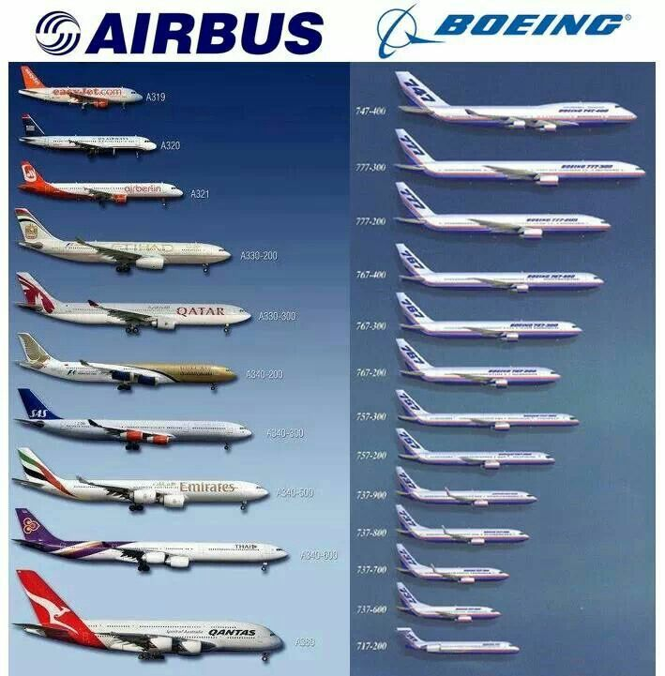
Initial Sizing

Slide 2
Aircraft Sizing
One of the most important parts of aircraft design
Determines how big the aircraft is (specifically mass)
Based on the mission requirements
We know what the aircraft does – its in the specification
We need to determine how big it is.
One method (the fastest) is to use the mass of the aircraft we will replace
We will use a slightly more sophisticated method
However, it is still based on using past data
It is also an iterative process

Slide 3
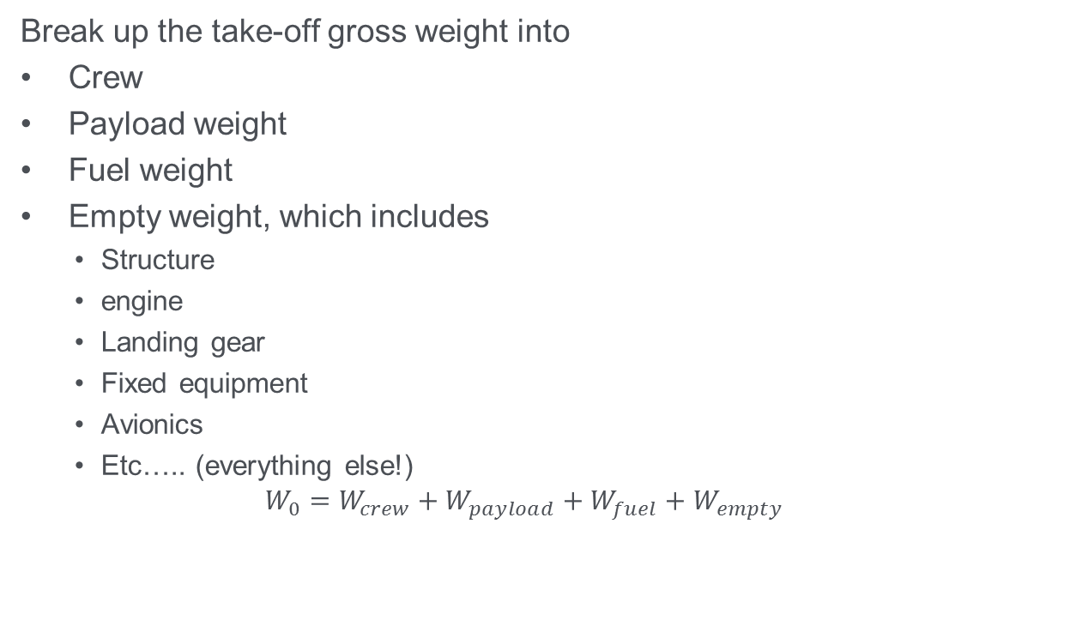
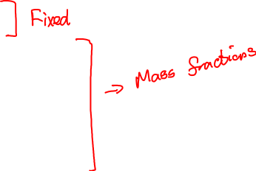
Take-off Weight Build-up
Break up the take-off gross weight into
Crew
Payload weight
Fuel weight
Empty weight, which includes
Structure
engine
Landing gear
Fixed equipment
Avionics
Etc….. (everything else!)
$$W_{0}=W_{crew}+W_{payload}+W_{fuel}+W_{empty}$$

Slide 4
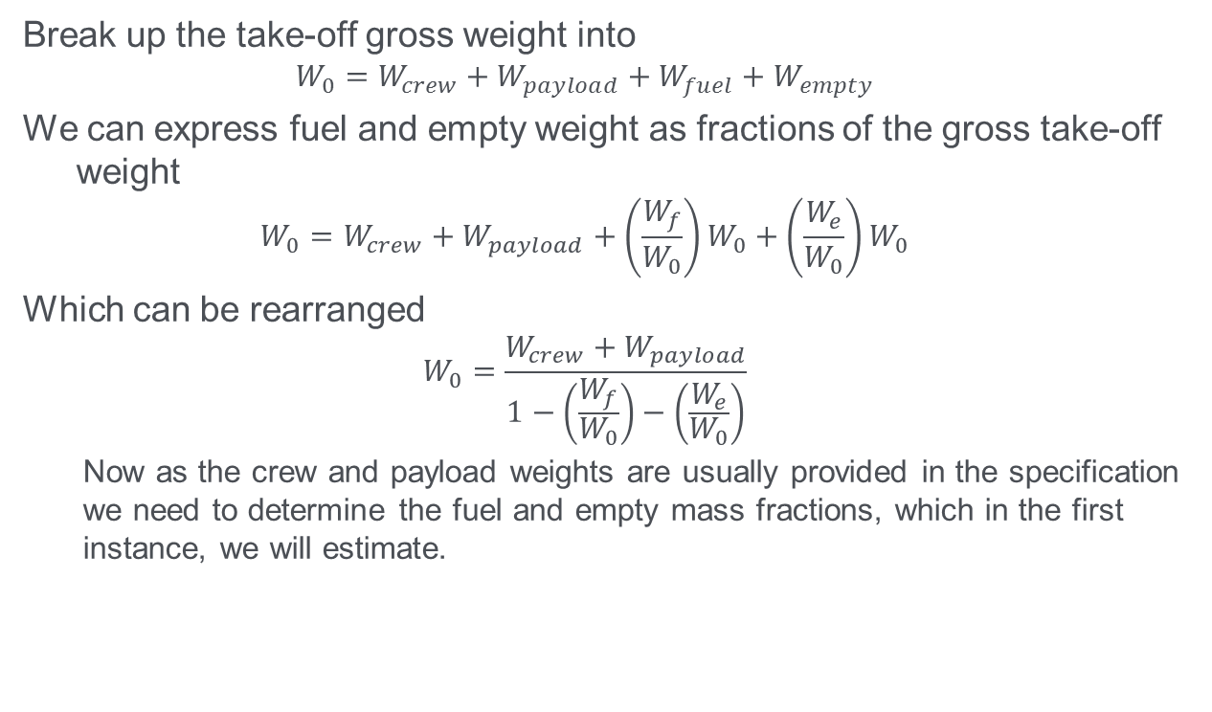
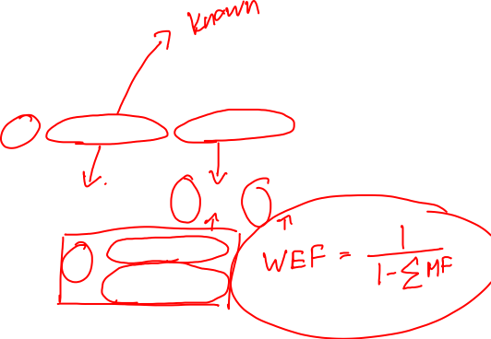
Take-off Weight Build-up
Break up the take-off gross weight into
$$W_{0}=W_{crew}+W_{payload}+W_{fuel}+W_{empty}$$
We can express fuel and empty weight as fractions of the gross take-off weight
$$W_{0}=W_{crew}+W_{payload}+{\left(\frac{W_{f}}{W_{0}}\right)W}_{0}+\left(\frac{W_{e}}{W_{0}}\right)W_{0}$$
Which can be rearranged
$$W_{0}=\frac{W_{crew}+W_{payload}}{1−\left(\frac{W_{f}}{W_{0}}\right)−\left(\frac{W_{e}}{W_{0}}\right)}$$
Now as the crew and payload weights are usually provided in the specification we need to determine the fuel and empty mass fractions, which in the first instance, we will estimate.

Slide 5
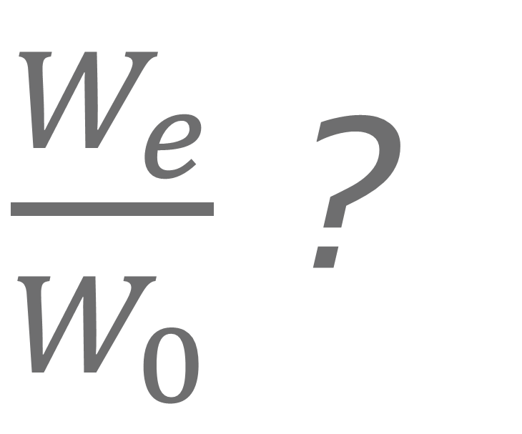
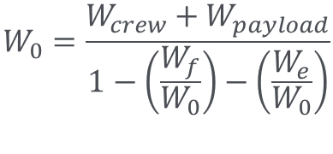
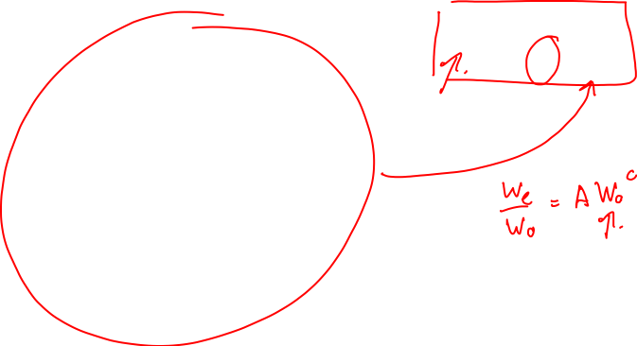
$$W_{0}=\frac{W_{crew}+W_{payload}}{1−\left(\frac{W_{f}}{W_{0}}\right)−\left(\frac{W_{e}}{W_{0}}\right)}$$
$\frac{W_{e}}{W_{0}}$ ?

Slide 6
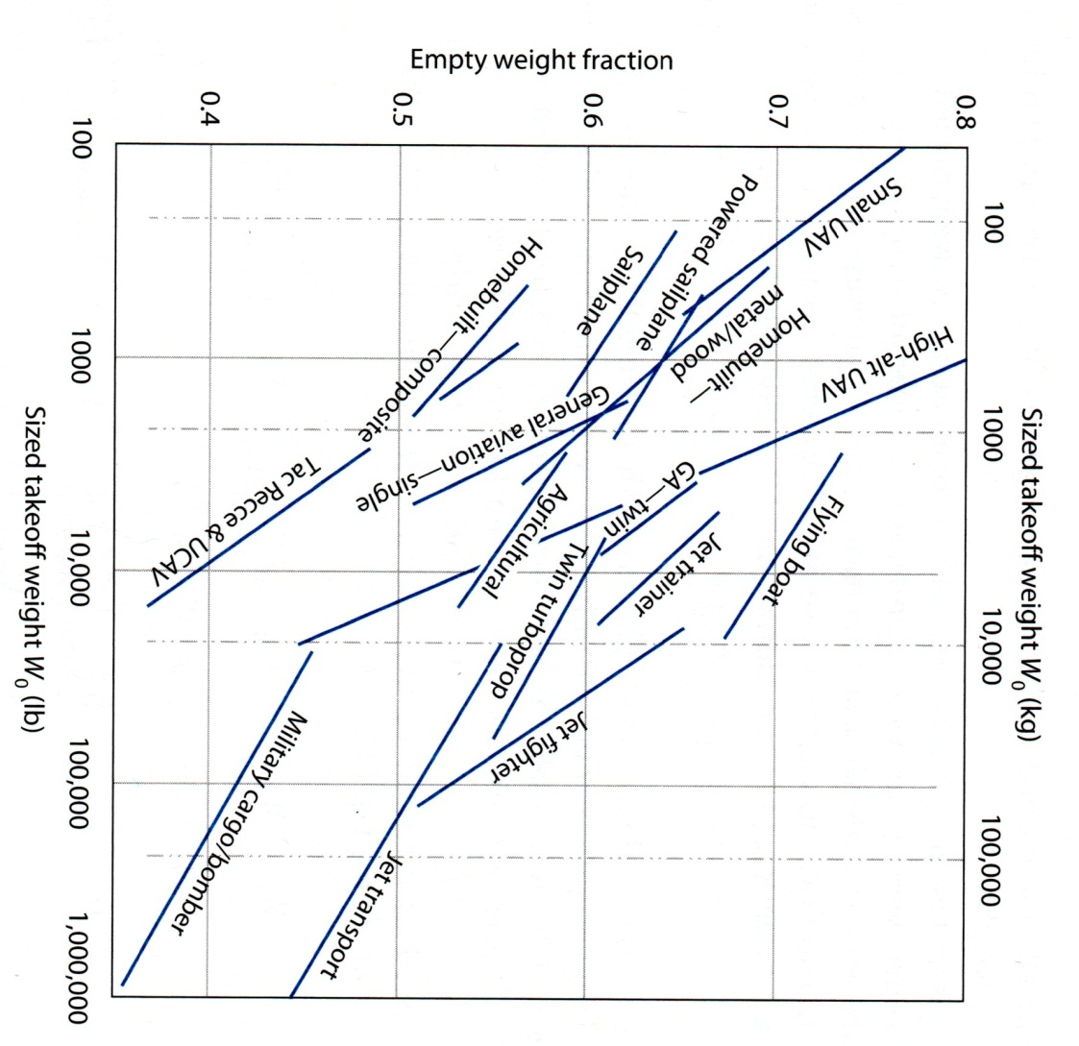
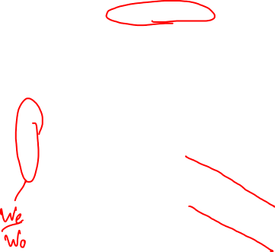
Empty Weight Estimate
The initial empty weight will be estimated from the fraction of empty to take-off weight fraction.
In future iterations this can be improved by adding the mass of the different components.
Empty weight fraction will be estimated from historical data.
Typically lies between 0.3 and 0.7 – quite a range!!

Slide 7
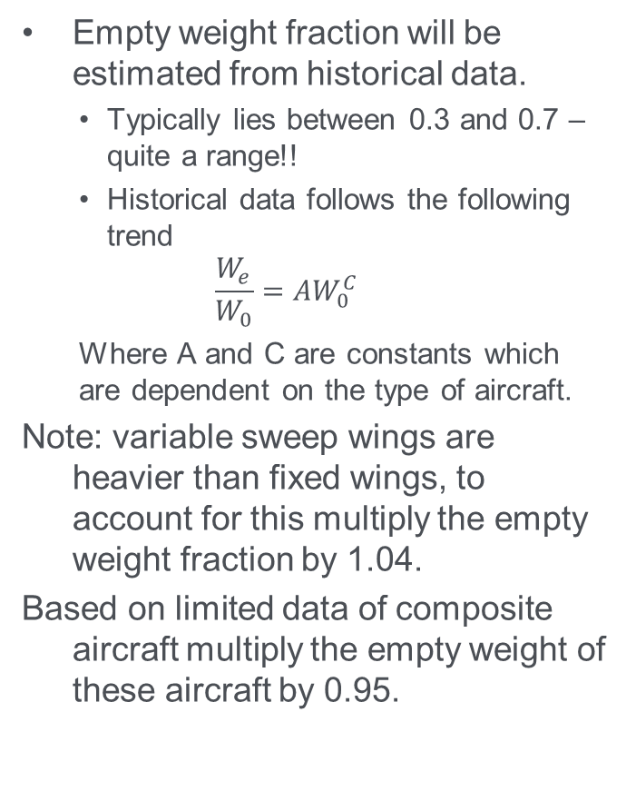
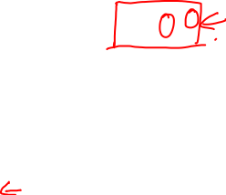
Empty Weight Estimate
Type | A | C
Sailplane – unpowered | 0.83 | -0.05
Sailplane – powered | 0.88 | -0.05
Homebuilt – metal/wood | 1.11 | -0.09
Homebuilt – composite | 1.07 | -0.09
General aircraft – single engine | 2.05 | -0.18
General aircraft – twin engine | 1.40 | -0.10
Agricultural aircraft | 0.72 | -0.03
Twin turboprop | 0.92 | -0.05
Flying boat | 1.05 | -0.05
Jet trainer | 1.47 | -0.10
Jet fighter | 2.11 | -0.13
Military cargo/bomber | 0.88 | -0.07
Jet transport | 0.97 | -0.06
UAV – tactical recce & UCAV | 1.53 | -0.16
UAV – high altitude | 2.48 | -0.18
UAV small | 0.86 | -0.06
Empty weight fraction will be estimated from historical data.
Typically lies between 0.3 and 0.7 – quite a range!!
Historical data follows the following trend
$$\frac{W_{e}}{W_{0}}=AW_{0}^{C}$$
Where A and C are constants which are dependent on the type of aircraft.
Note: variable sweep wings are heavier than fixed wings, to account for this multiply the empty weight fraction by 1.04.
Based on limited data of composite aircraft multiply the empty weight of these aircraft by 0.95.

Slide 8
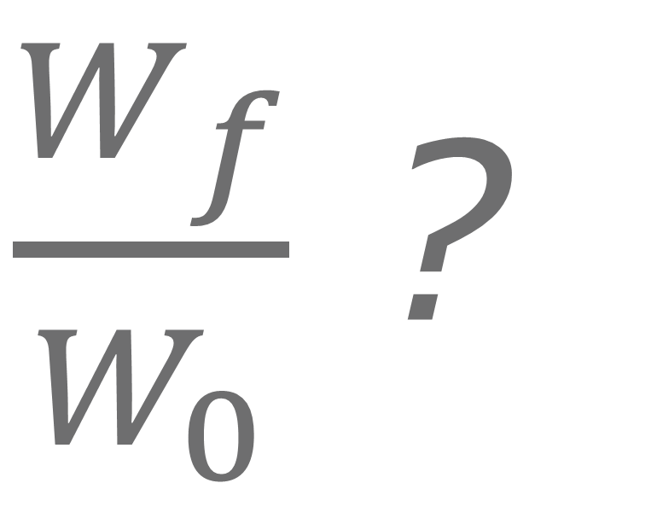
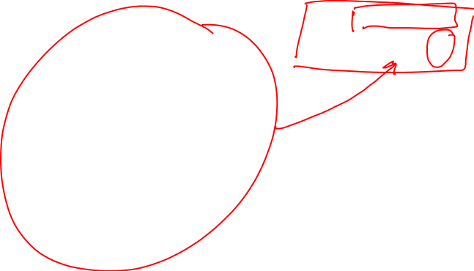
$$W_{0}=\frac{W_{crew}+W_{payload}}{1−\left(\frac{W_{f}}{W_{0}}\right)−\left(\frac{W_{e}}{W_{0}}\right)}$$
$\frac{W_{f}}{W_{0}}$ ?

Slide 9
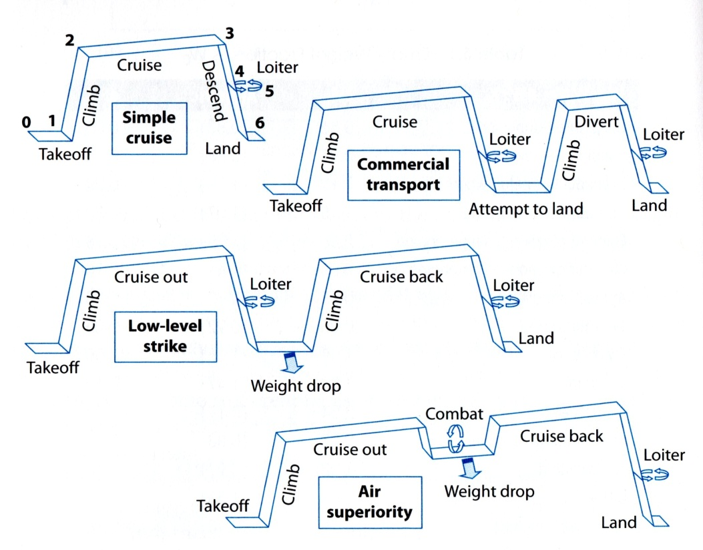
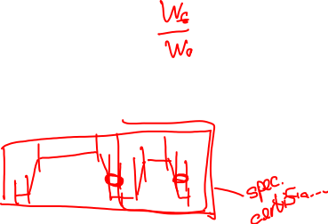
Fuel Fraction Estimates
Highly dependent on the mission profile
Therefore need to fly the mission
In the first instance, fuel can be considered to be proportional to the aircraft weight so fuel fraction can be estimated based on the mission flown.
Mission Profiles

Slide 10

Mission Profiles
Highly dependent on the specification/requirement
Include contingencies, such as,
30 minutes cruise for VFR flight
45 minutes cruise for IFR flight
Loiter, then diversion to alternative airport (commercial IFR)
See regulations (JAR23/25 and FAR23/25 as appropriate)

Slide 11
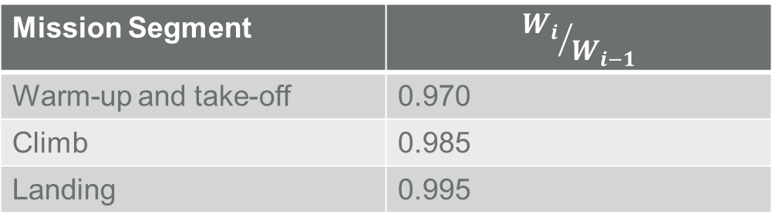
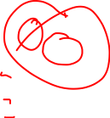
Mission Profiles
Mission segments, legs, are usually numbered
Leg 1 usually refers to engine warm-up and take-off
Similarly the final leg corresponds to landing
For initial sizing the following fractions are reasonable for take-off, climb and landing (unless you want to calculate them yourself).
Mission Segment | $${W_{i}}/{W_{i−1}}$$
Warm-up and take-off | 0.970
Climb | 0.985
Landing | 0.995

Slide 12
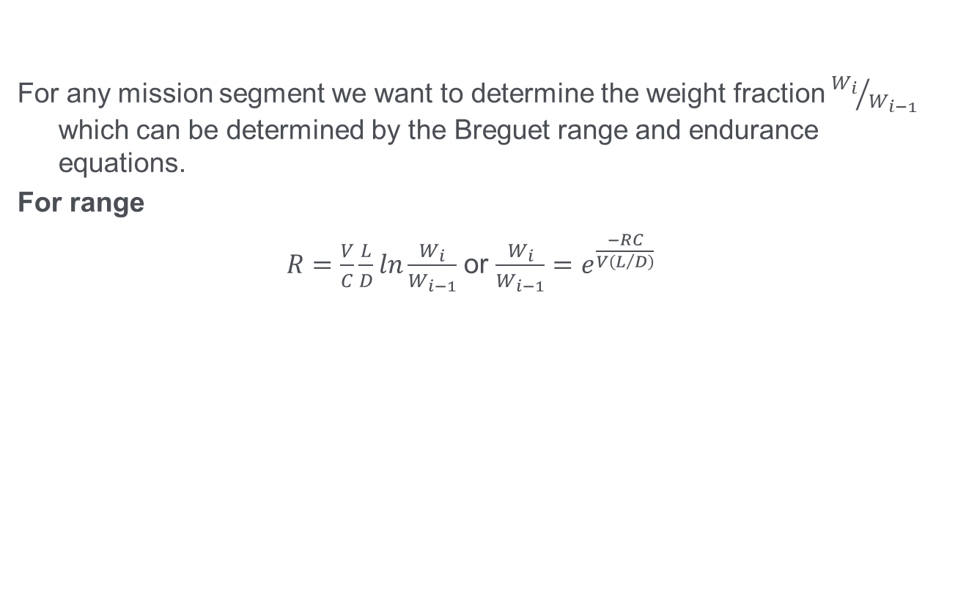

Mission Profiles
For any mission segment we want to determine the weight fraction ${W_{i}}/{W_{i−1}}$ which can be determined by the Breguet range and endurance equations.
For range
$R=\frac{V}{C}\frac{L}{D}ln\frac{W_{i}}{W_{i−1}}$ or $\frac{W_{i}}{W_{i−1}}=e^{\frac{−RC}{V\left(L/D\right)}}$
R | = Range
C | = Specific fuel consumption
V | = Velocity
L/D | = Lift to drag ratio

Slide 13
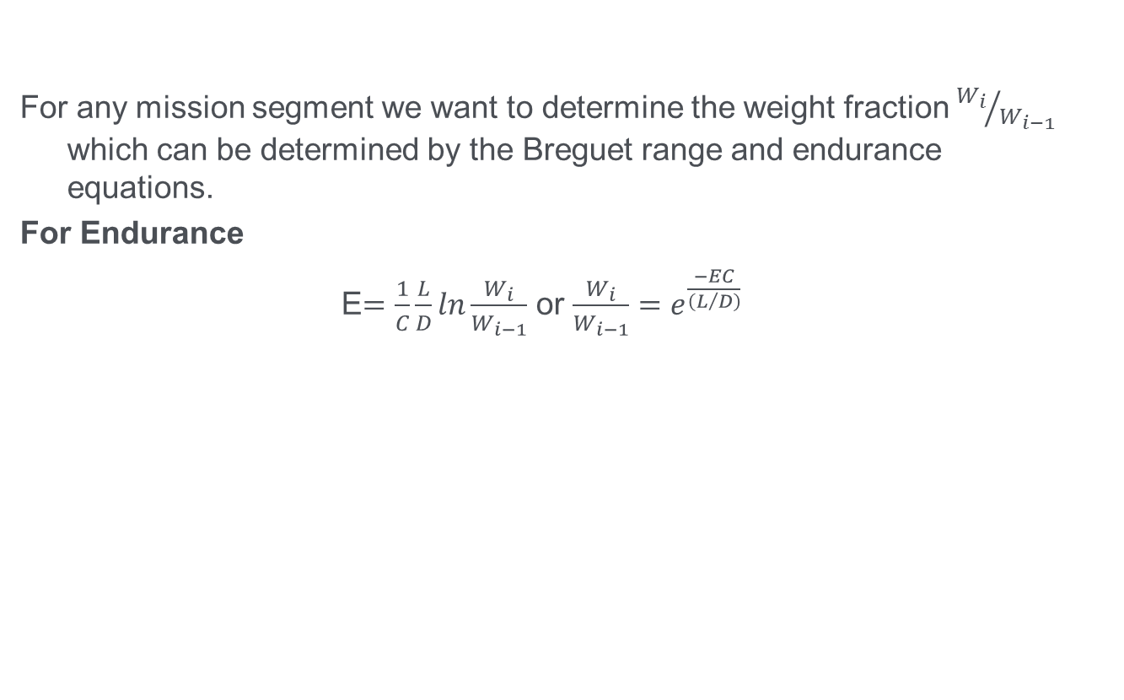
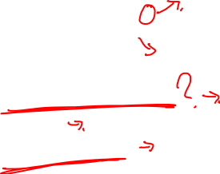
Mission Profiles
For any mission segment we want to determine the weight fraction ${W_{i}}/{W_{i−1}}$ which can be determined by the Breguet range and endurance equations.
For Endurance
E$=\frac{1}{C}\frac{L}{D}ln\frac{W_{i}}{W_{i−1}}$ or $\frac{W_{i}}{W_{i−1}}=e^{\frac{−EC}{\left(L/D\right)}}$
E | = Endurance
C | = Specific fuel consumption
V | = Velocity
L/D | = Lift to drag ratio

Slide 14

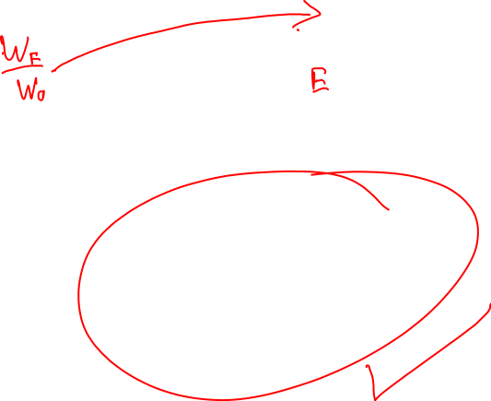
$R=\frac{V}{C}\frac{L}{D}ln\frac{W_{i}}{W_{i−1}}$ or $\frac{W_{i}}{W_{i−1}}=e^{\frac{−RC}{V\left(L/D\right)}}$
C?

Slide 15
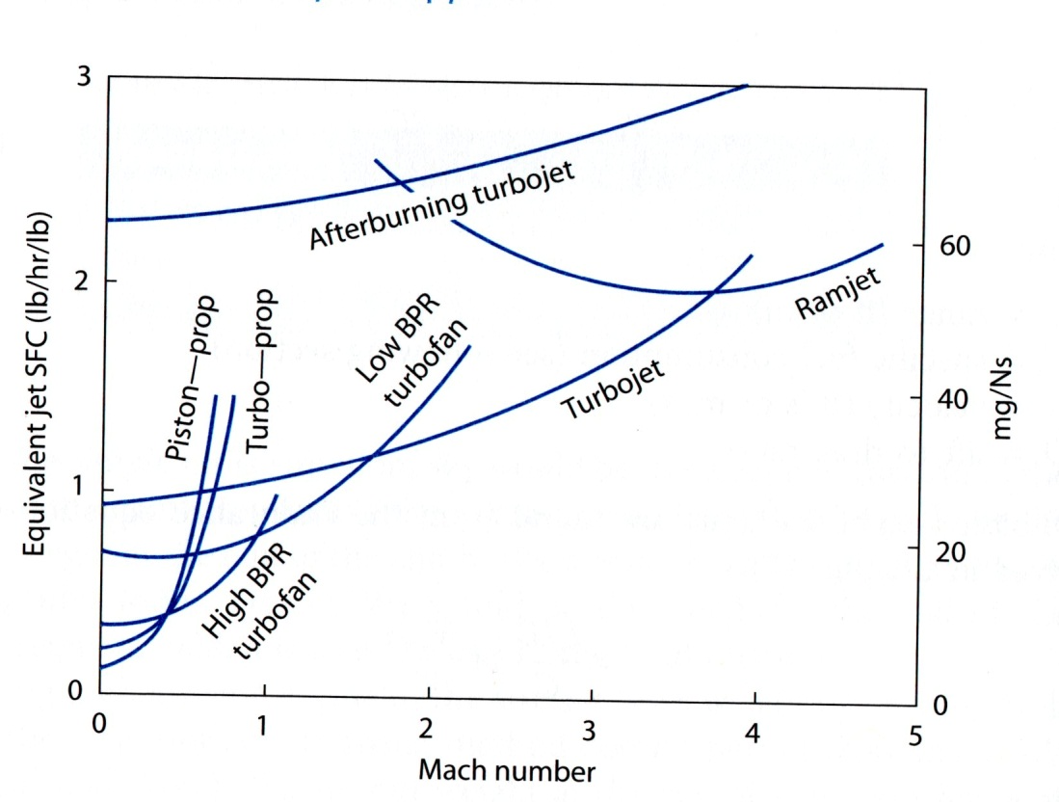

Specific Fuel Consumption
Specific fuel consumption is the fuel consumption per unit of thrust. This is dependent on Mach number and the type of power plant used as shown below.
Typical Jet SFC (mg/Ns) | Cruise | Loiter
Pure turbojet | 25.5 | 22.7
Low-bypass ratio turbofan | 22.7 | 19.8
High bypass ratio turbofan | 14.1 | 11.3

Slide 16
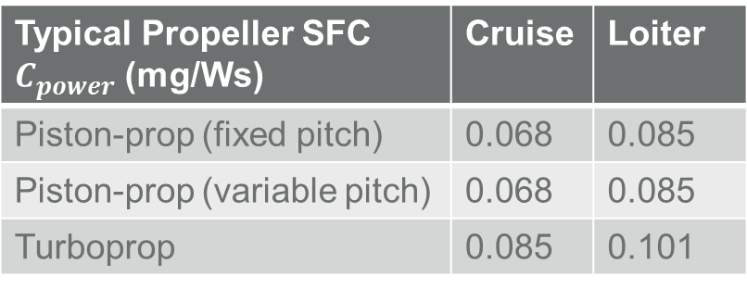
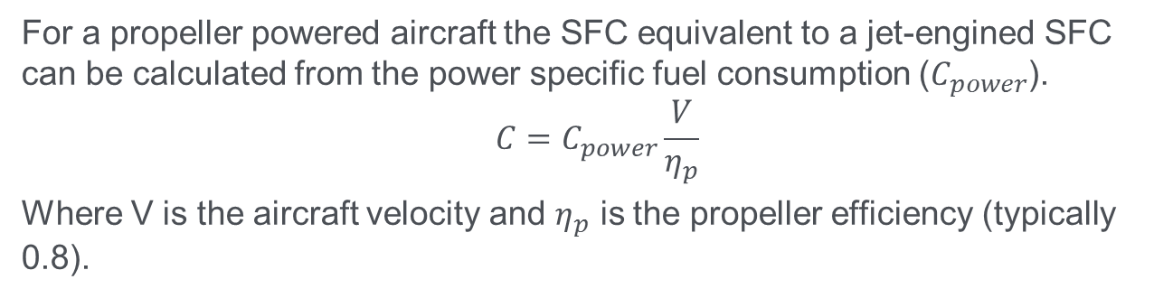

Specific Fuel Consumption (propeller)
For a propeller powered aircraft the SFC equivalent to a jet-engined SFC can be calculated from the power specific fuel consumption ($C_{power}$).
$$C=C_{power}\frac{V}{η_{p}}$$
Where V is the aircraft velocity and $η_{p}$ is the propeller efficiency (typically 0.8).
Typical Propeller SFC $C_{power}$ (mg/Ws) | Cruise | Loiter
Piston-prop (fixed pitch) | 0.068 | 0.085
Piston-prop (variable pitch) | 0.068 | 0.085
Turboprop | 0.085 | 0.101

Slide 17
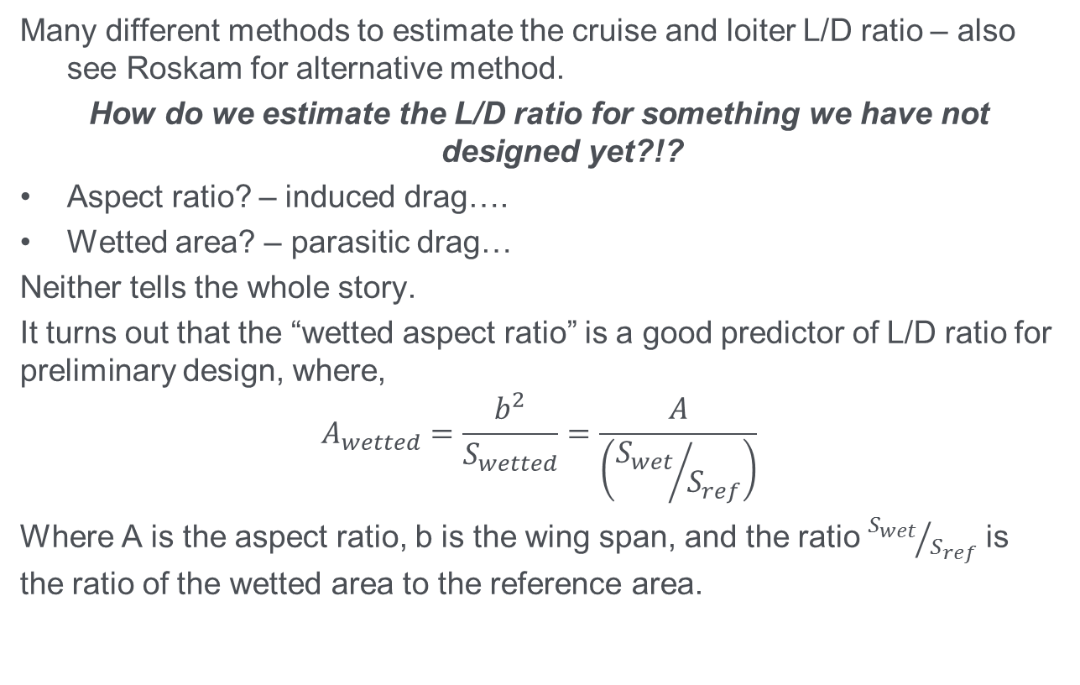
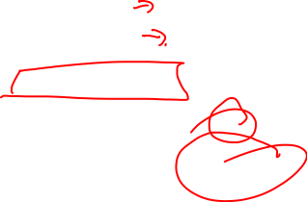
Lift to Drag Ratio Estimation
Many different methods to estimate the cruise and loiter L/D ratio – also see Roskam for alternative method.
How do we estimate the L/D ratio for something we have not designed yet?!?
Aspect ratio? – induced drag….
Wetted area? – parasitic drag…
Neither tells the whole story.
It turns out that the “wetted aspect ratio” is a good predictor of L/D ratio for preliminary design, where,
$$A_{wetted}=\frac{b^{2}}{S_{wetted}}=\frac{A}{\left({S_{wet}}/{S_{ref}}\right)}$$
Where A is the aspect ratio, b is the wing span, and the ratio ${S_{wet}}/{S_{ref}}$ is the ratio of the wetted area to the reference area.

Slide 18
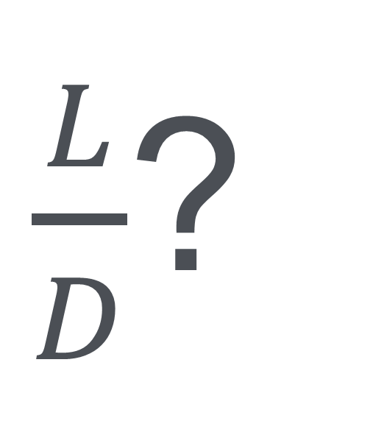
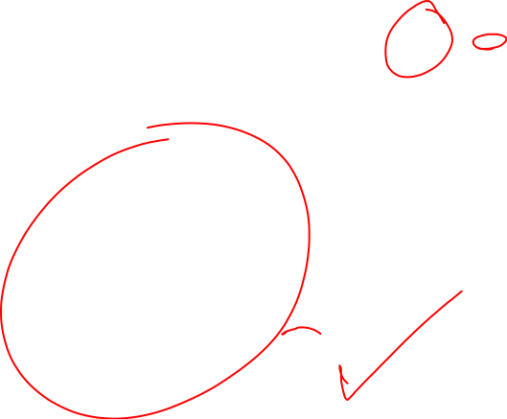
$R=\frac{V}{C}\frac{L}{D}ln\frac{W_{i}}{W_{i−1}}$ or $\frac{W_{i}}{W_{i−1}}=e^{\frac{−RC}{V\left(L/D\right)}}$
$\frac{L}{D}$?

Slide 19
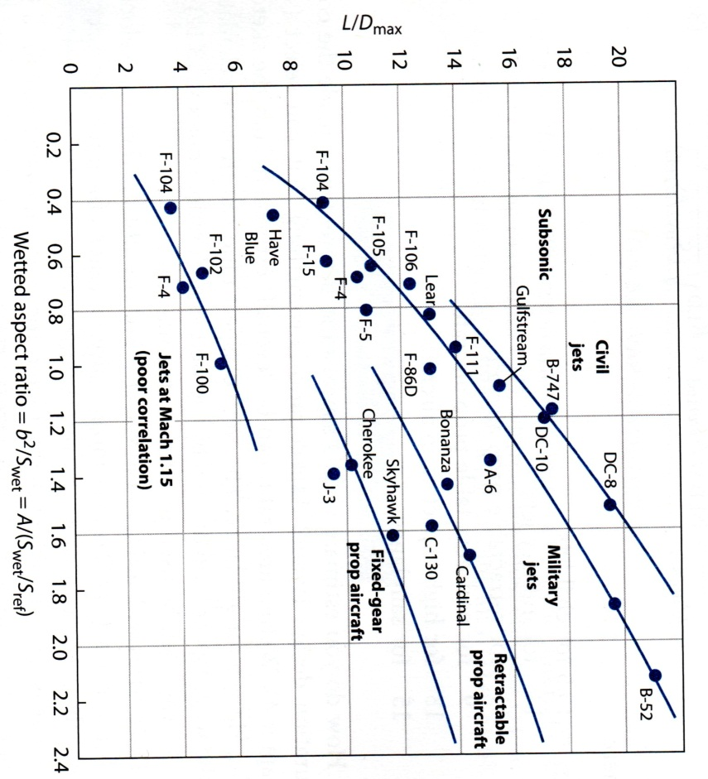

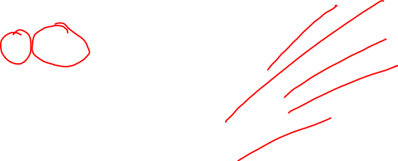
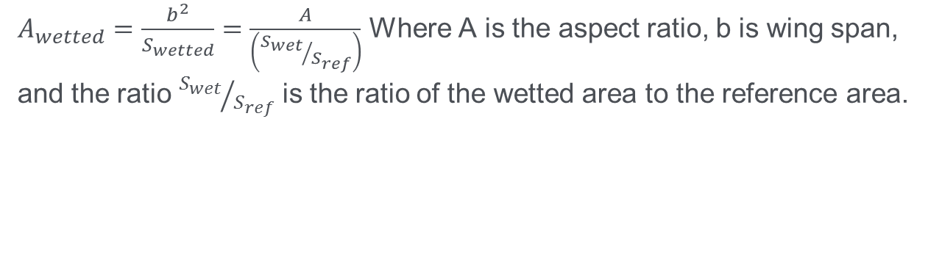
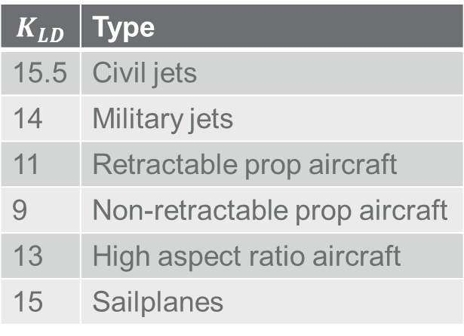
Lift to Drag Ratio Estimation
$A_{wetted}=\frac{b^{2}}{S_{wetted}}=\frac{A}{\left({S_{wet}}/{S_{ref}}\right)}$ Where A is the aspect ratio, b is wing span, and the ratio ${S_{wet}}/{S_{ref}}$ is the ratio of the wetted area to the reference area.
Each of these lines can be described by
$\frac{L}{D_{max}}=K_{LD}\sqrt{\frac{A}{\left({S_{wet}}/{S_{ref}}\right)}}$, where
$$K_{LD}$$ | Type
15.5 | Civil jets
14 | Military jets
11 | Retractable prop aircraft
9 | Non-retractable prop aircraft
13 | High aspect ratio aircraft
15 | Sailplanes

Slide 20
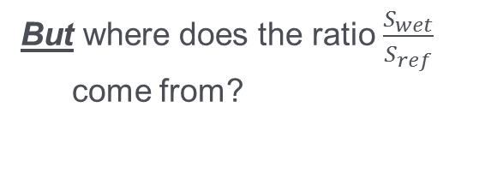

Lift to Drag Ratio Estimation
$A_{wetted}=\frac{b^{2}}{S_{wetted}}=\frac{A}{\left({S_{wet}}/{S_{ref}}\right)}$ Where A is the aspect ratio, b is wing span, and the ratio ${S_{wet}}/{S_{ref}}$ is the ratio of the wetted area to the reference area.
Each of these lines can be described by
$\frac{L}{D_{max}}=K_{LD}\sqrt{\frac{A}{\left({S_{wet}}/{S_{ref}}\right)}}$, where
But where does the ratio $\frac{S_{wet}}{S_{ref}}$ come from?
$$K_{LD}$$ | Type
15.5 | Civil jets
14 | Military jets
11 | Retractable prop aircraft
9 | Non-retractable prop aircraft
13 | High aspect ratio aircraft
15 | Sailplanes

Slide 21
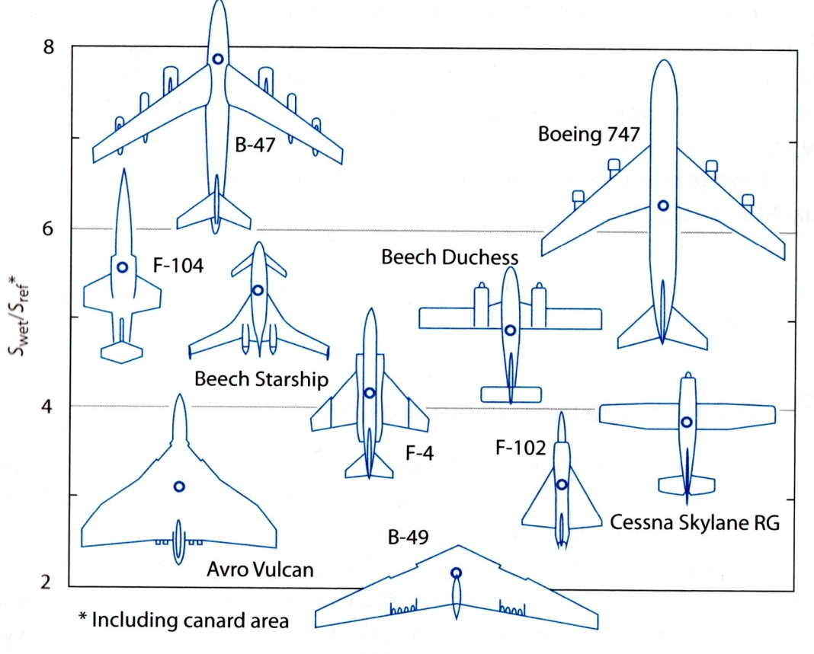
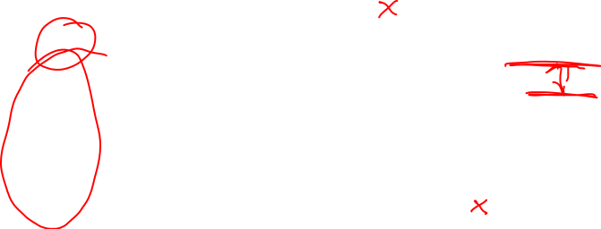
Lift to Drag Ratio Estimation
$A_{wetted}=\frac{b^{2}}{S_{wetted}}=\frac{A}{\left({S_{wet}}/{S_{ref}}\right)}$ Where A is the aspect ratio, b is wing span, and the ratio ${S_{wet}}/{S_{ref}}$ is the ratio of the wetted area to the reference area.
Each of these lines can be described by
$\frac{L}{D_{max}}=K_{LD}\sqrt{\frac{A}{\left({S_{wet}}/{S_{ref}}\right)}}$, where
$$K_{LD}$$ | Type
15.5 | Civil jets
14 | Military jets
11 | Retractable prop aircraft
9 | Non-retractable prop aircraft
13 | High aspect ratio aircraft
15 | Sailplanes

Slide 22

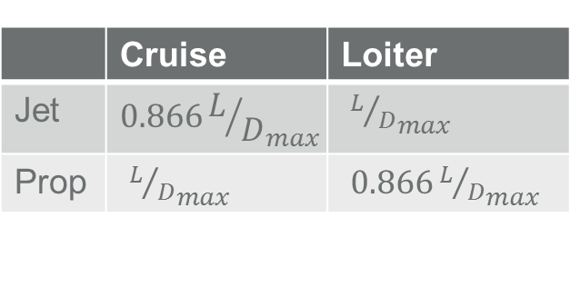
Lift to Drag Ratio Estimation
$A_{wetted}=\frac{b^{2}}{S_{wetted}}=\frac{A}{\left({S_{wet}}/{S_{ref}}\right)}$ Where A is the aspect ratio, b is wing span, and the ratio ${S_{wet}}/{S_{ref}}$ is the ratio of the wetted area to the reference area.
Each of these lines can be described by
$\frac{L}{D_{max}}=K_{LD}\sqrt{\frac{A}{\left({S_{wet}}/{S_{ref}}\right)}}$, where
$$K_{LD}$$ | Type
15.5 | Civil jets
14 | Military jets
11 | Retractable prop aircraft
9 | Non-retractable prop aircraft
13 | High aspect ratio aircraft
15 | Sailplanes
The most efficient cruise and loiter velocities for jet and propeller aircraft occur at different conditions.
 | Cruise | Loiter
Jet | $${0.866L/D}_{max}$$ | ${L/D}_{max}$
Prop | ${L/D}_{max}$ | ${0.866L/D}_{max}$

Slide 23

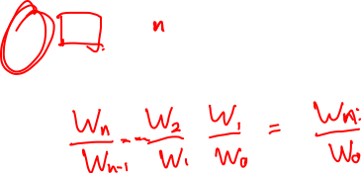
Fuel Fraction Estimate
By multiplying the flight segment weight fractions together the fuel weight fraction can be obtained, including a 1-2% factor to account for unusable/trapped fuel etc.
$$\frac{W_{f}}{W_{0}}=1.01\left(1−\frac{W_{x}}{W_{0}}\right)$$

Slide 24
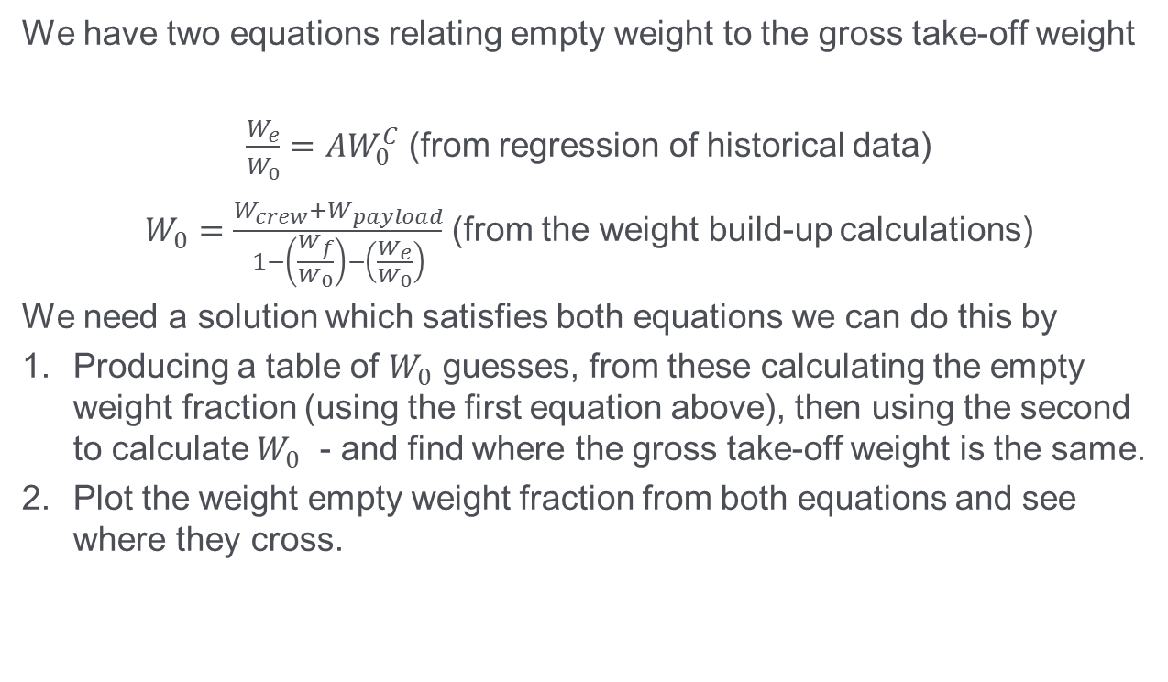
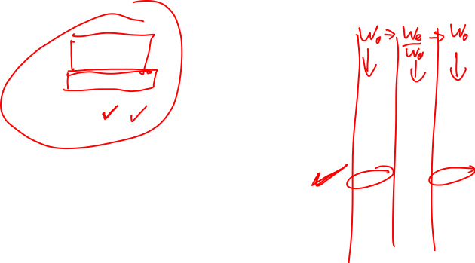
Putting it all together
We have two equations relating empty weight to the gross take-off weight
$\frac{W_{e}}{W_{0}}=AW_{0}^{C}$ (from regression of historical data)
$W_{0}=\frac{W_{crew}+W_{payload}}{1−\left(\frac{W_{f}}{W_{0}}\right)−\left(\frac{W_{e}}{W_{0}}\right)}$ (from the weight build-up calculations)
We need a solution which satisfies both equations we can do this by
Producing a table of $W_{0}$ guesses, from these calculating the empty weight fraction (using the first equation above), then using the second to calculate $W_{0}$ - and find where the gross take-off weight is the same.
Plot the weight empty weight fraction from both equations and see where they cross.

