Slide 1

118573 WIP

Slide 2

WIP
WIP
1. On the Asset Landing Page, add the Following Menu Item - WIP

Slide 3
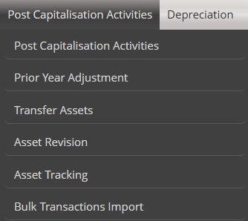


WIP
Under the new Menu Item – WIP, add the following Sub menu Items:
Create/Add to WIP Register
Manage WIP Register
WIP Performance
WIP Spatial View
Asset Unbundling
Transfer WIP
WIP
Create/Add to WIP Register
Manage WIP Register
WIP Performance
WIP Spatial View
Asset Unbundling
Transfer WIP

Slide 4
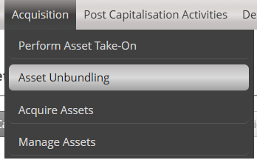
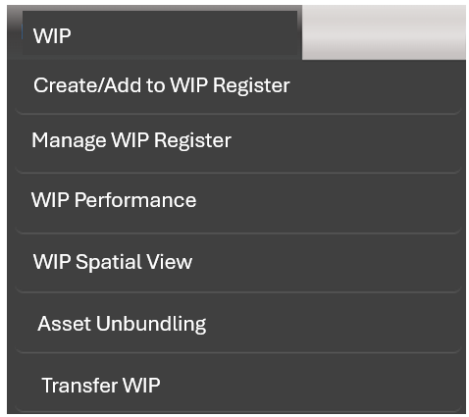
Move the Sub Menu Item - Asset Unbundling under the Acquisition Tab, to the New WIP Menu Item

Slide 5

WIP – Create WIP Register
WIP
When the User select the Sub Menu Item – Create/Add to WIP Register, the following Screen must display.
Refer to the Asset Unbundling Screen that integrates to the Supply Chain Contract Management.

Slide 6
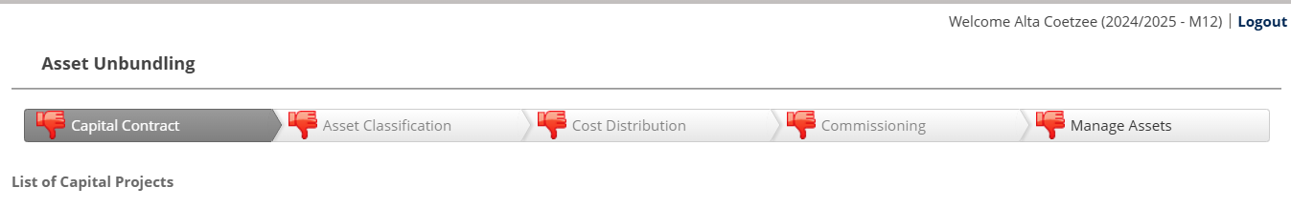
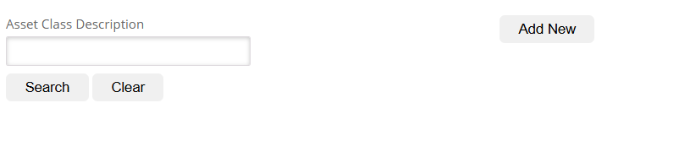
Create/Add to WIP Register
Link Capital Contracts
Add new WIP Project
Capital Contract Description

Slide 7
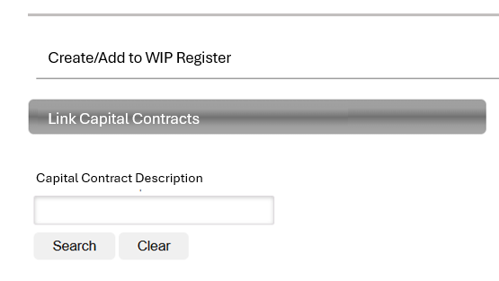

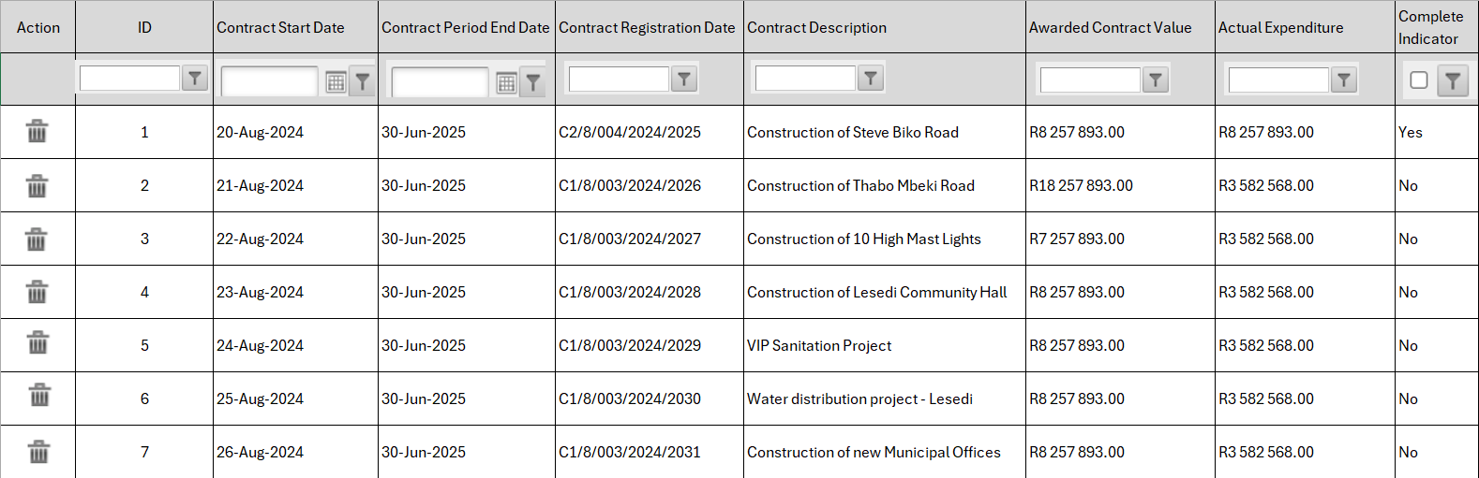
When the user add search criteria, bring back the applicable search result on the following Grid
When the user only selects the search button, return all Capital contracts in the grid
Allow the user to export the Grid to Excel and PDF

Slide 8
Create a new Table for WIP in the database catering for the following columns:
Column Name | Details
WIP ID | Unique ID the system must Generate with each contract that is added or a new Wip Project Created
Project No | This is an open field the user must be able to manage
Asser Register ID | This filed must be linked to the asset register. When a project is managed the user will be able to add the AR ID.
Project Status | This field must be populated by the user when the project is managed – new Asset Setting
Contract Start Date | Must be populated from Contract Management Tables and the user must be able to manage the field
Contract End Date | Must be populated from Contract Management Tables and the user must be able to manage the field
Project Name/Description | Must be populated from Contract Management Tables and the user must be able to manage the field
SCM Contract Number | Must be populated from Contract Management Tables and the user must NOT be able to manage the field
Funding Source | This field must be populated by the user when the project is managed – new Asset Setting
Funding Type | This field must be populated by the user when the project is managed – new Asset Setting
Department | Integrates to General Settings on Department and division
Division | Integrates to General Settings on Department and division
Custodian | Integrates to HR and Payroll

Slide 9
Continue:
Column Name | Details
Latitude | Open field and the user must be able to manage the field
Longitude | Must be populated from Contract Management Tables and the user must NOT be able to manage the field
Contract Value | Must be populated from Contract Management Tables and the user must NOT be able to manage the field
WIP Opening balance | Must be populated from Contract Management Tables and the user must NOT be able to manage the field
Restated Opening balance | TBC
Additions | TBC
Transfer to Assets | TBC
Write Off | TBC
Impairment | TBC
Prior Year Adjustment | TBC
WIP Closing Balance | Must Calculate
Financial Progress% | Must Calculate by taking the Contract Value less all invoices paid against the project
Budget Project | Must be populated from Contract Management Tables and the user must NOT be able to manage the field
Budget Item | Must be populated from Contract Management Tables and the user must NOT be able to manage the field
Completion Date | Must be populated from Contract Management Tables and the user must be able to manage the field

Slide 10
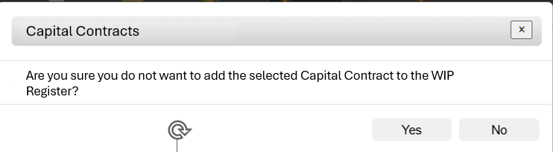
When the grid is displayed the user must be able to Trash a line entry on the grid if the entry is not applicable to the WIP register.
When the user click on the Trash Button the system must display the following Warning Message
If the user selects Yes – the line entry must be removed from the grid.
The grid must automatically refresh.
If the User selects no, the selected line entry on the gid must stay on the grid.

Slide 11
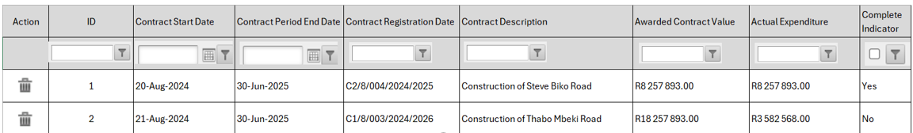
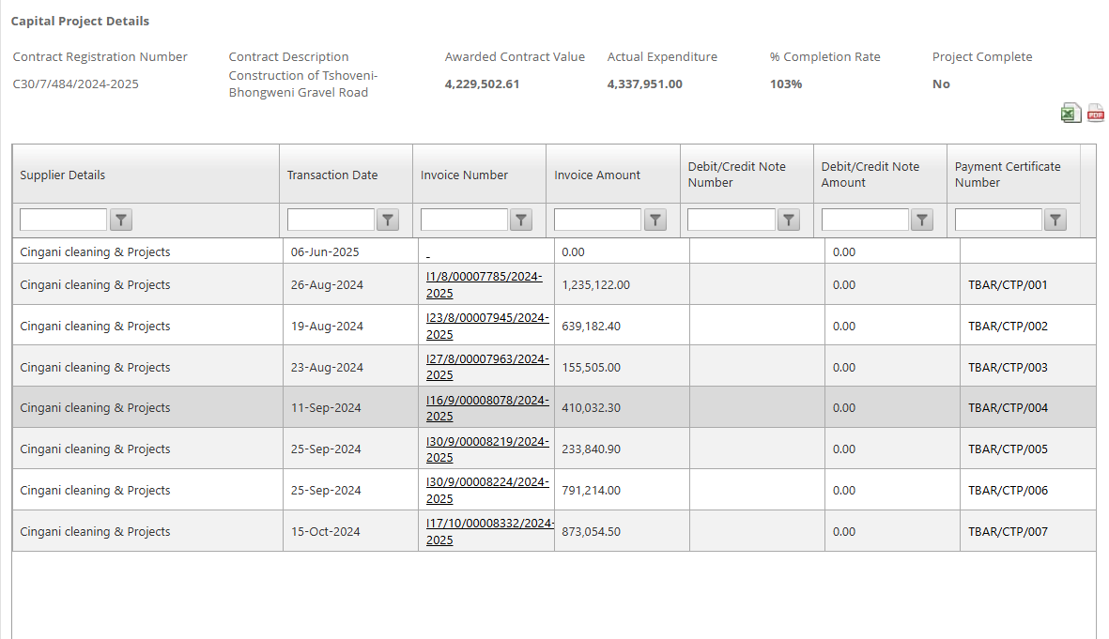
If the user select a entry on the grid the following screen must display showing all the details for the project.
If the user select the Add to WIP register button, the applicable data must be populated in the WIP Register and the WIP Register Project Detail Tables
If the user select the Cancel Button, revert back to the Create/Add to WIP Register Page
Add to WIP Register
Cancel

Slide 12
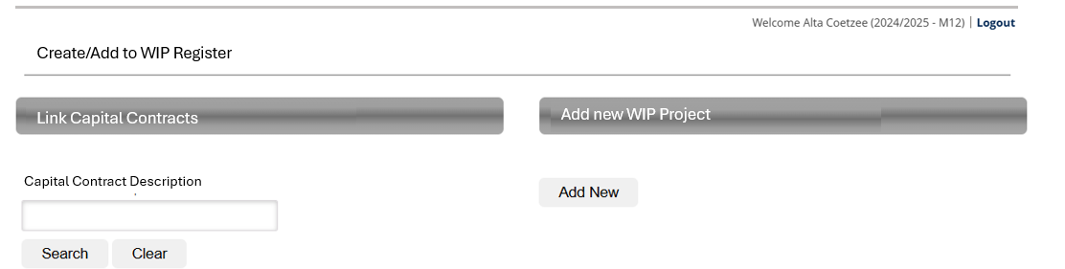
When the user select the Add New option on the Create/Add to WIP Register button, the following screen must display.

Slide 13
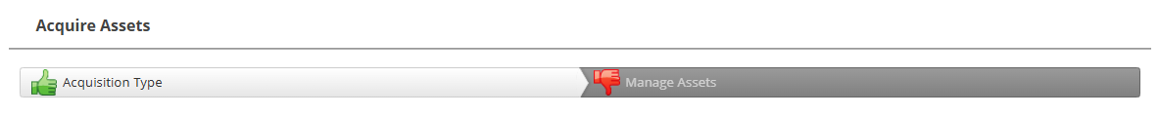


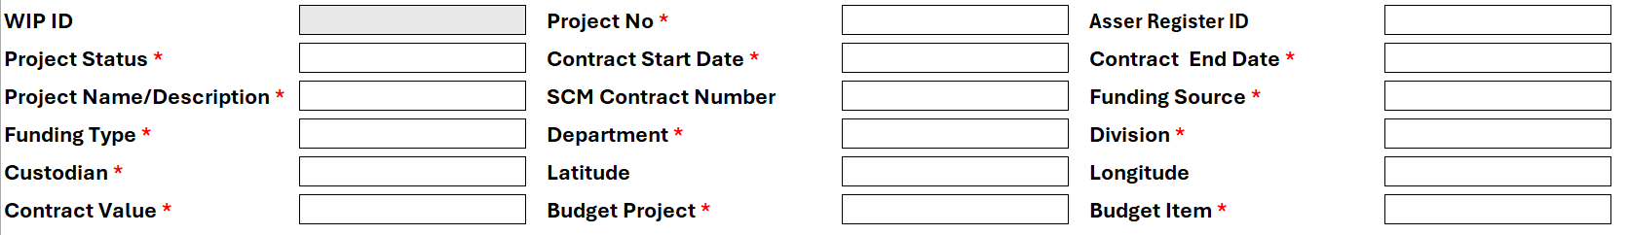

Add new WIP Project
Capture WIP Project Details
Approve New WIP Project
WIP ID – The WIP ID must be automatically generated with the next available unique system WIP ID. This field is not editable.
Project Number – The project number field is an open type in field. This field is compulsory.
Asset Register ID – This is a type in numeric field and must validate against the asset register ID’s
Project Status – Validates against the new WIP setting. Must be a drop down for user to select from.
Contract Start date and Contract End date – Date field – User to select date from a Calander.
Project Name/Description – Type in field
SCM Contract Number – Type in field
Funding Source - Validates against the new WIP setting. Must be a drop down for user to select from
Funding Type - Validates against the new WIP setting. Must be a drop down for user to select from

Slide 14
Department – Validates against the General Settings – Drop down for user to select from
Division – Validates against the General Settings – Display only divisions related to the selected department. Drop down to select the divisions
Custodians – Validates against HR and Payroll. Dropdown for user to select from
Latitude and Longitude – Type in fields
Contract Value – Type in field, numeric.
Budget Project – Validates against the Budget. Drop down for user to select from
Project Item – Validates against the budget and must only display the items related to the Project Selected. Drop down for user to select from.
When the user have completed the form and click on submit, the data must be added to the WIP Register
When the User click on cancel, the system must default back to the Create/Add to WIP register Page.

Slide 15
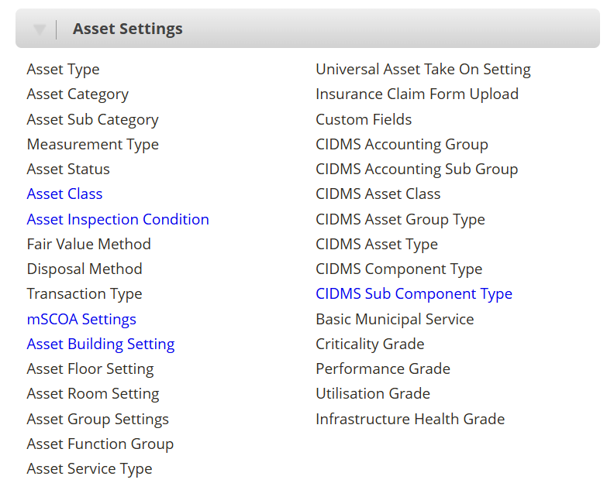

NEW Settings –
Project Status
Funding Source
Funding Type

Slide 16
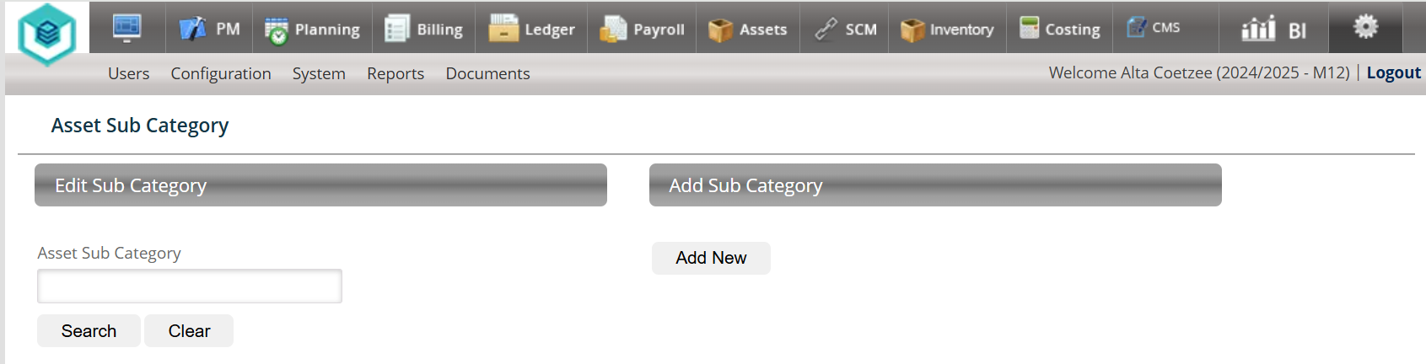



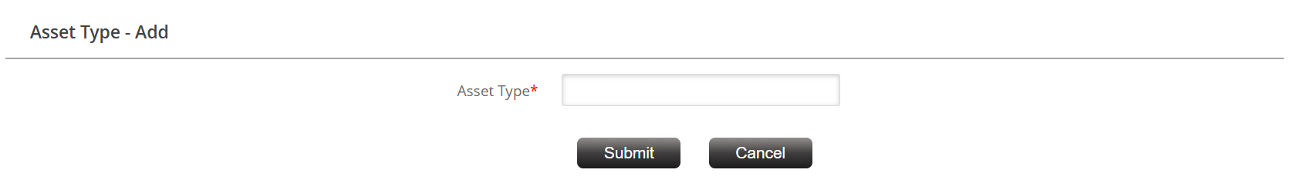

NEW Settings – Project Status
Project Status
Edit Project Status
Add Project Status
Project Status
Project Status - Add
Project Status

Slide 17
NEW Settings – Funding Source
Funding Source
Edit Funding Source
Add Funding Source
Funding Source
Funding Source- Add
Funding Source

Slide 18
NEW Settings – Funding Type
Funding Type
Edit Funding Type
Add Funding Type
Funding Type
Project Status - Add
Funding Type - Add
Funding Type

Slide 19
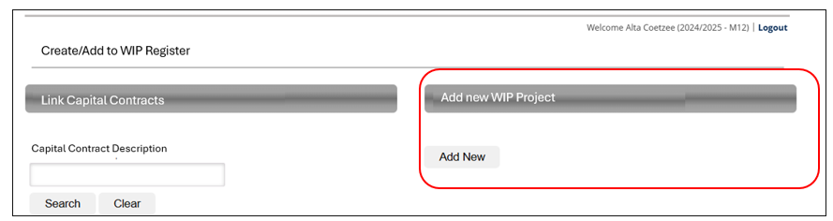

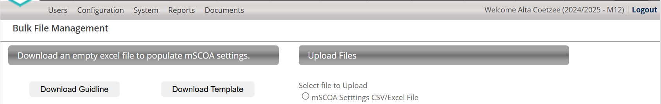


On the Add ne WIP Project Screen, make provision for Bulk Upload of WIP Projects
Bulk Upload – WIP Projects
When the User select the Bulk Upload – WIP Projects, the following screen must display.
Download Template to populate WIP Register
WIP Projects CSV File

Slide 20
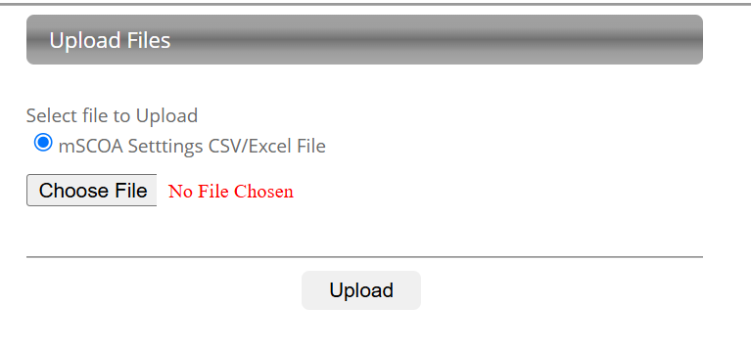
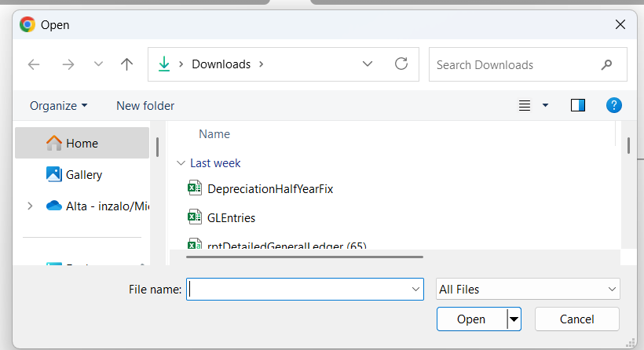
When the user select the Radio Button, the system must allow the user to browse for the upload file on his/her computer.
If the file was successfully loaded, the system must validate against the same rules as per the WIP register. If the system picks up any issues with the upload file, the system must display in a grid below the issues per line ITEM – refer to the normal take on sheet validation screen.
If there is no validations and the data was loaded to the WIP register – the system must display a message that the data was loaded successfully to the WIP register.

