Slide 1

118576: WIP - Manage WIP Register

Slide 2
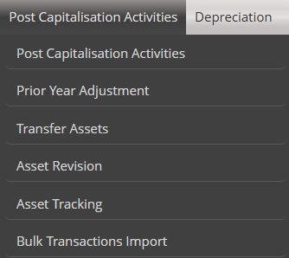


Manage WIP
When the user click on the Manage WIP Register option on the Sub Menu, the following screen must display.
The WIP Register must be available for the user to select line items from the GRID
The user must be able to export the GRID to excel and PDF
WIP
Create/Add to WIP Register
Manage WIP Register
WIP Performance
WIP Spatial View
Asset Unbundling
Transfer WIP

Slide 3

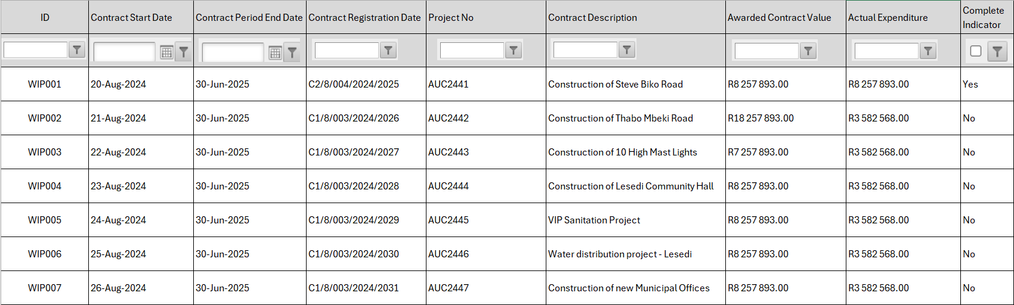
Manage WIP Register
When the user selects a line entry on the Grid, the following screen must display.
The information must populate from The WIP register and the Detail WIP register

Slide 4
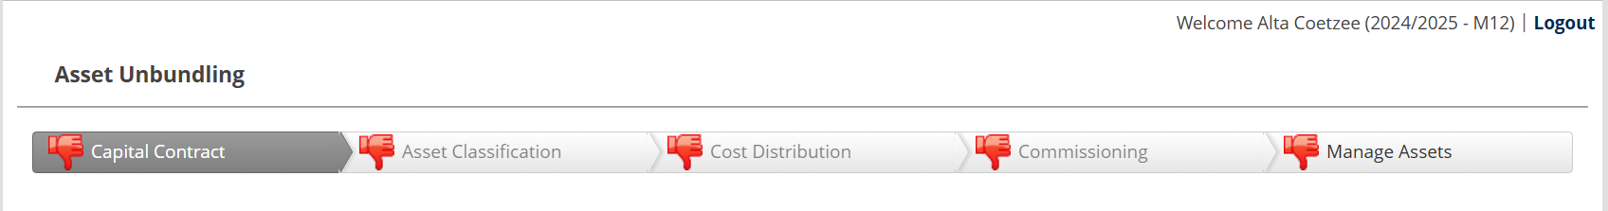
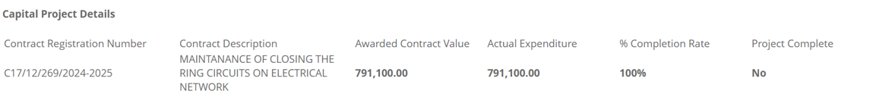


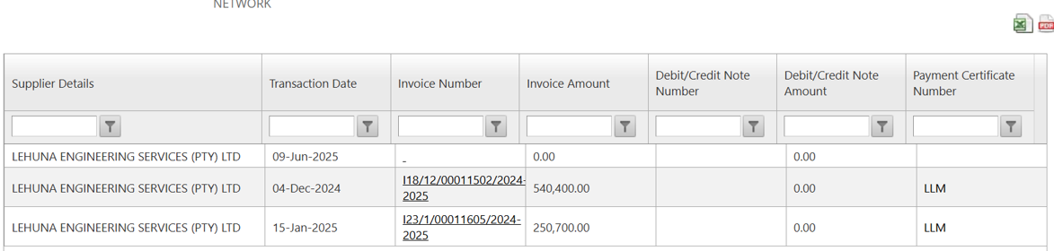

Manage WIP Project
Payment Summary

Slide 5
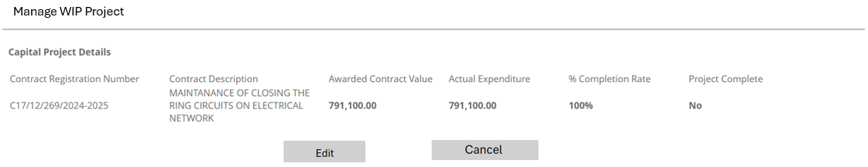
When the user select the Cancel button, default back to the Manage WIP Register Screen
When the user select the Edit Button, the following screen must open:

Slide 6
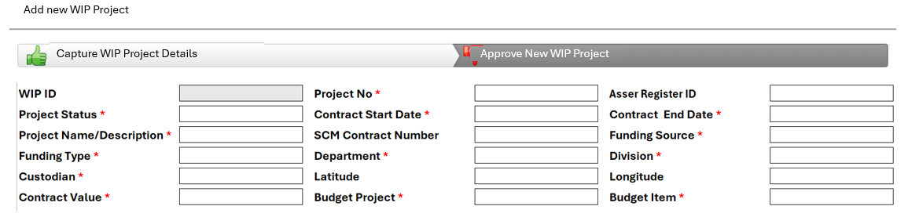
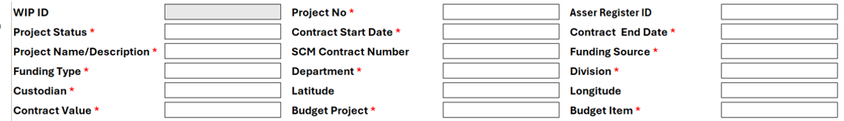


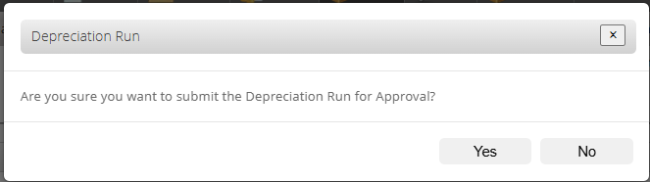
Edit WIP Project
Allow the user to add/upload supporting documentation. The user must be able to add multiple documents (excel, word, pdf). When a document was uploaded, the document links must be available on the Manage WIP Register Screen Grid.
When the user Save, the system must display a message asking if the user is sure he/she want to update the WIP register.
WIP Register
Are you sure you want to update the WIP Register?

Slide 7
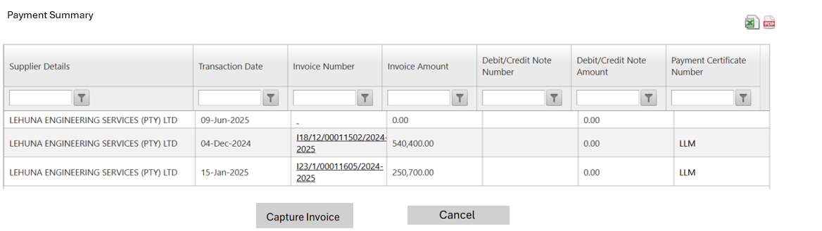
When the user select the Cansel button, default back to the Manage WIP Register Page:
When the user select the Capture invoice Detail, the following screen must open:

Slide 8
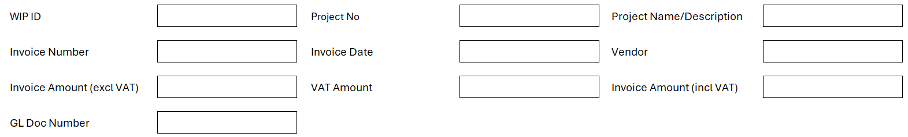

Capture New Invoice
Invoice
Payment Certificate
Allow the user to add/upload supporting documentation. The user must be able to add multiple documents (excel, word, pdf). When a document was uploaded, the document links must be available on the Manage WIP Register Screen Grid.
When the user Save, the system must display a message asking if the user is sure he/she want to update the WIP register.
Invoice Details
Are you sure you want to update the WIP Register Financial Details?

