Slide 1
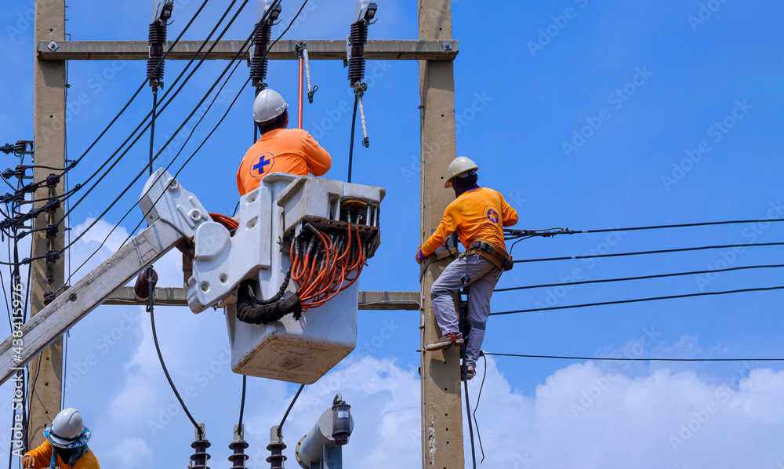
Asset Maintenance – Specifications in Picture
118550 Asset Maintenance - Corrective Maintenance - Capture Maintenance Request
118550 | Asset Maintenance - Corrective Maintenance - Capture Maintenance Request
118547 | Asset Maintenance
118547 | Asset Maintenance

Slide 2
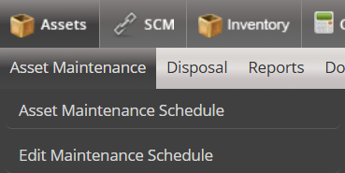
Capture New Maintenance Request
Planned Maintenance
Reactive Maintenance
Capture New Maintenance Request
Link Maintenance Request to an Existing Asset
Approve Maintenance Request
Create Work Order
Manage Work Order

Slide 3
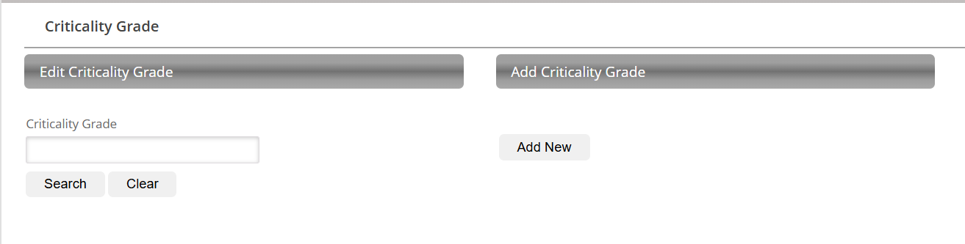


Reactive Maintenance - Capture New Maintenance Request
When clicking on the Capture New Maintenance Request option, the following screen needs to be display.
Capture New Maintenance Request
New Maintenance Request
New Maintenance Request from Customer Care
Link CC

Slide 4
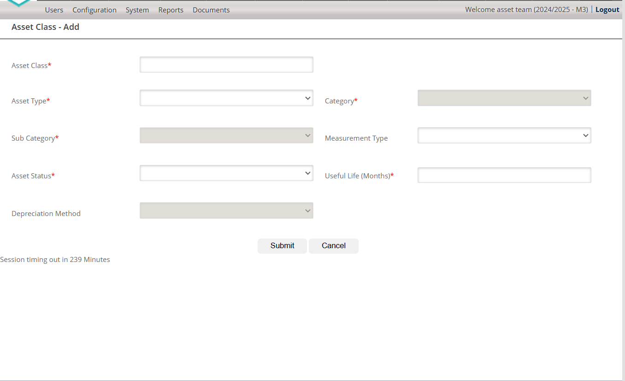








Maintenance Request - Add
Service Group*
Request Date*
14/02/2025
Lead Time*
Proposed Closing Time*
Maintenance Description*
Capturer*
Proposed Budget*
SCOA Item Description*

Slide 5
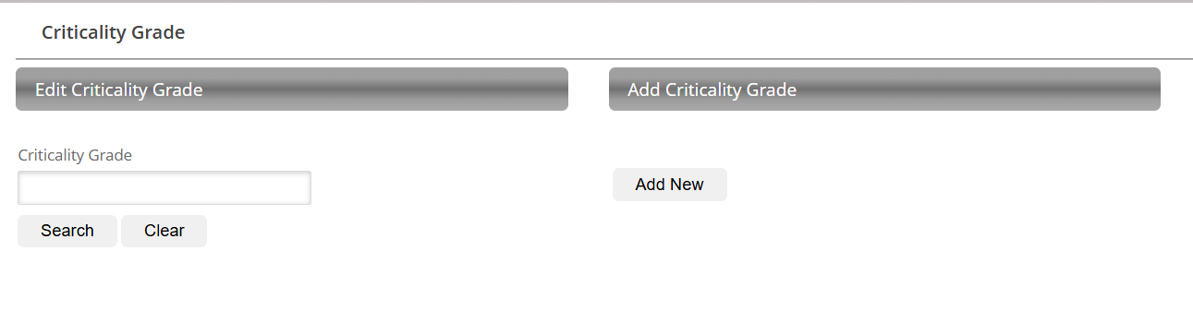

Reactive Maintenance - Capture New Maintenance Request
When clicking on Add New, a Capturing Screen With the following fields must display.
Service Group
Service Group must be a New Asset Setting
The Setting must Allow the user to add a New Service Group
The setting must allow the user to Edit an existing Service Group
Refer to Criticality Grade Setting
Service Group
Edit Service Group
Add Service Group
Service Group

Slide 6
Reactive Maintenance - Capture New Maintenance Request
When clicking on Add New, a Capturing Screen With the following fields must display.
Asset Type *
Use the EMS Asset Setting For Asset Type
Capturing field must be a drop-down
Asset Category *
Use the EMS Asset Setting For Asset Category
Only display asset Categories related to the Asset Type selected
Capturing field must be a drop-down
Asset Sub-category *
Use the EMS Asset Setting For Asset Sub-Category
Only display asset Sub-Categories related to the Asset Type and Asset Category selected
Capturing field must be a drop-down

Slide 7
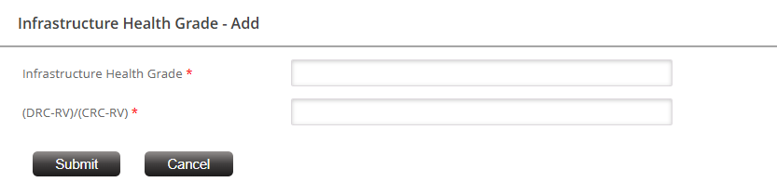
Reactive Maintenance - Capture New Maintenance Request
When clicking on Add New, a Capturing Screen With the following fields must display.
Request Date *
The system must display by default the current date but must allow the user to edit the date by selecting another date from a date picker.
Lead Time *
Lead Time must be a New Asset Setting
The Setting must Allow the user to add New Lead Times
The setting must allow the user to Edit an existing Lead Time
Maintenance Lead Time - Add
Maintenance Description
Lead times in Days

Slide 8
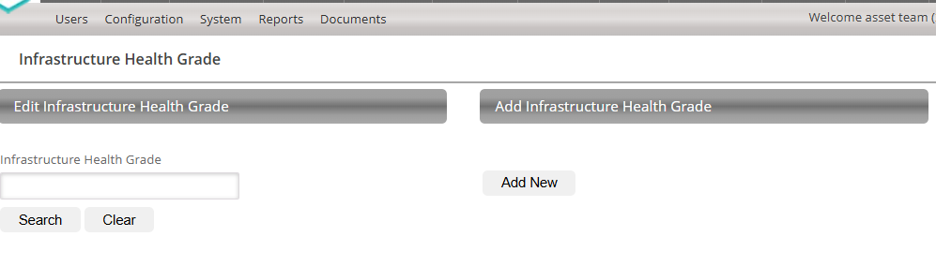

Maintenance lead Time Setting Page
Maintenance Lead Time
Edit Maintenance Lead Time
Add Maintenance Lead Time
Maintenance Lead Time

Slide 9
Reactive Maintenance - Capture New Maintenance Request
When clicking on Add New, a Capturing Screen With the following fields must display.
Proposed Closing Time
If possible can the system calculate the closing time (Request date + Lead time = Proposed Closing Time)
Maintenance Request Description *
Open Type in Field

Slide 10
Reactive Maintenance - Capture New Maintenance Request
When clicking on Add New, a Capturing Screen With the following fields must display.
Capturer
Must populate automatically for the user logging the request.
Select Budget *
Dropdown for Maintenance Budget
Dropdown for the applicable mSCOA Item Code description.
Submit for Approval
Add a Submit Button for approval
System message to ask if the user is sure to submit for approval

