Slide 1

Asset Maintenance – Specifications in Picture
118551 Asset Maintenance - Corrective Maintenance - Link Maintenance to an Asset on the Asset Register

Slide 2
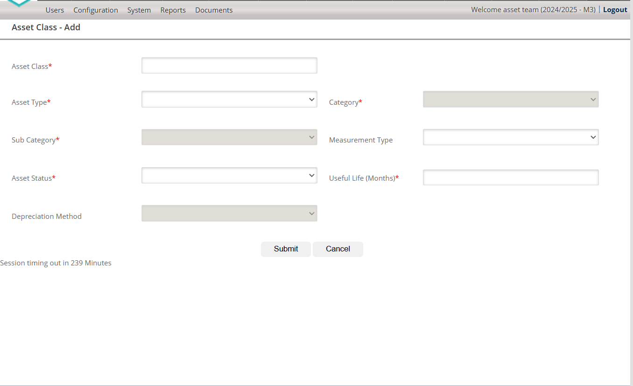








Maintenance Request - Add
Service Group*
Request Date*
14/02/2025
Once a Maintenance request is Submitted, the user must be able to link to Request to an Asset on the Asset Register or select the asset from a spatial platform.
Lead Time*
Proposed Closing Time*
Maintenance Description*
Capturer*
Proposed Budget*
SCOA Item Description*

Slide 3
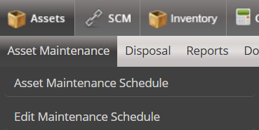
Planned Maintenance
Reactive Maintenance
Capture Maintenance Request
Link Maintenance Request to an Existing Asset
Approve Maintenance Request
Create Work Order
Manage Work Order

Slide 4
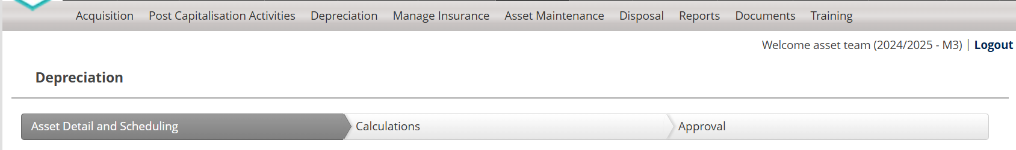
When the Maintenance request was submitted and the user opened the “Link Maintenance Request to an Existing Asset”, the following screen must display”
Maintenance Requests
Logged Maintenance Requests Summary
Link Maintenance Request to an Asset
Approve Maintenance Request

Slide 5
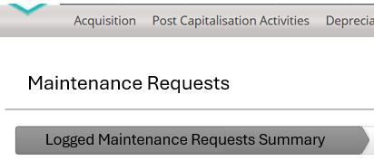

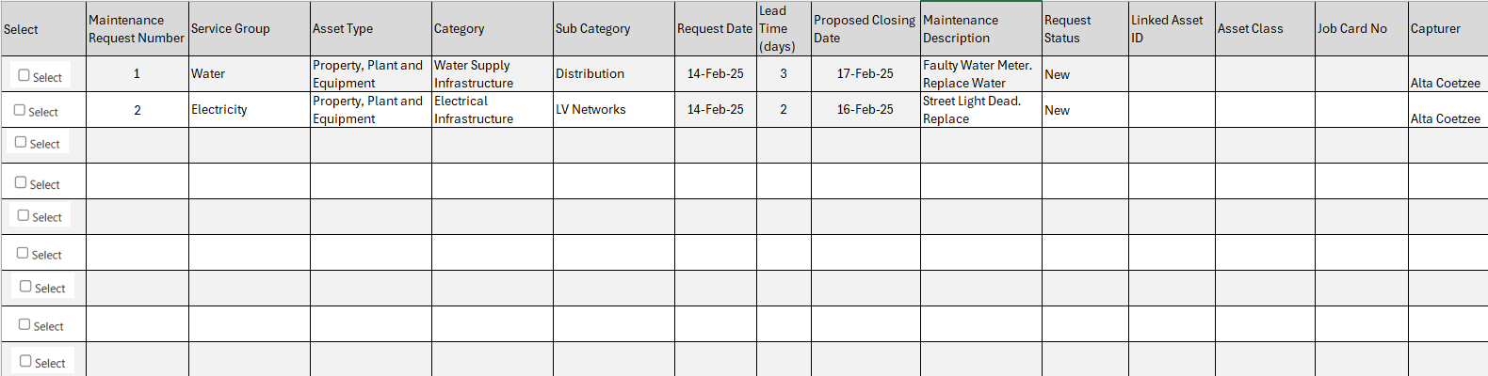
On the Logged Maintenance Request, all maintenance requests submitted, must display in a grid.

Slide 6
Grid Specifications -
The Grid must populate from the Maintenance requests that were captured and submitted.
The system must populate a unique Maintenance Request Number
When a new request was submitted, the status of the request must be automatically populated as “New”
Service Group Asset Type, Category, Sub-Category, Request Date, Lead Time (days), Proposed Closing Date, Maintenance Description and Capturer must populate from the Capture Maintenance Screen when submitted
The User must be able to export the Grid information to Excel or a PDF
The user must be able to select an asset from the grid to be displayed on the Link Maintenance Request to an Asset Screen
When an Asset is Selected with a tick, the record must be displayed on the Link Maintenance Request to an Asset Screen

Slide 7
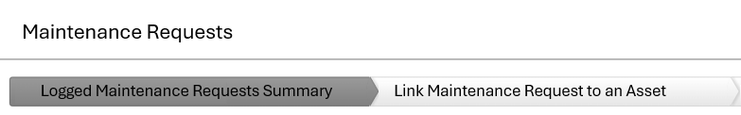

When the User selects the Link Maintenance to an Asset, duplicate the grid from the Logged Maintenance Request Summary screen for the selected record
Link from Asset Register
Link from GIS
When the User selects the Link Maintenance From Asset Register, open the Asset register in a Grid (Use the Manage Asset Grid)
When the User Select the Link from GIS, open the map hyperlink
The Map hyperlink must be a setting

Slide 8
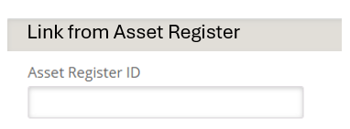
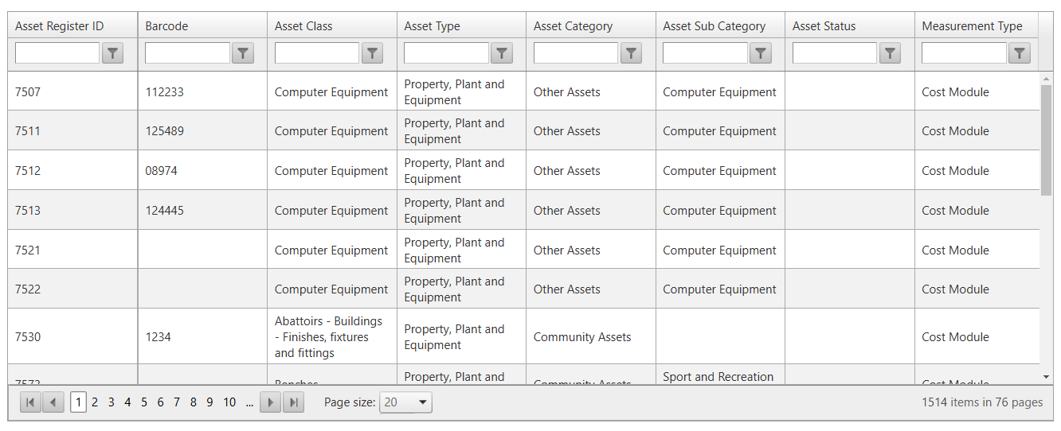
When the User Click on Link from Asset Register, the Manage asset grid must display with filters

Slide 9
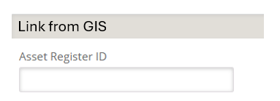
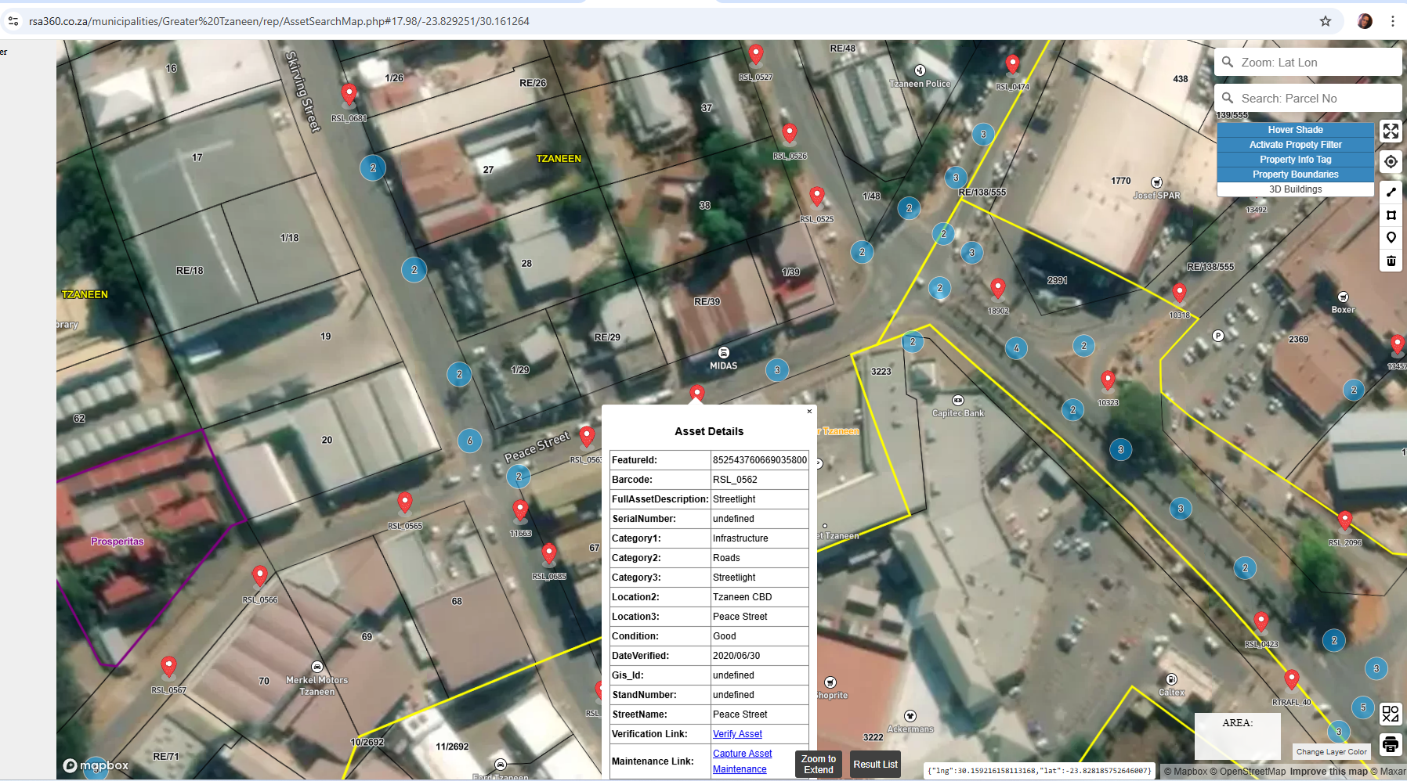
When the User Click on Link from GIS, the hyperlink as per a new asset setting must open in a separate web page

Slide 10
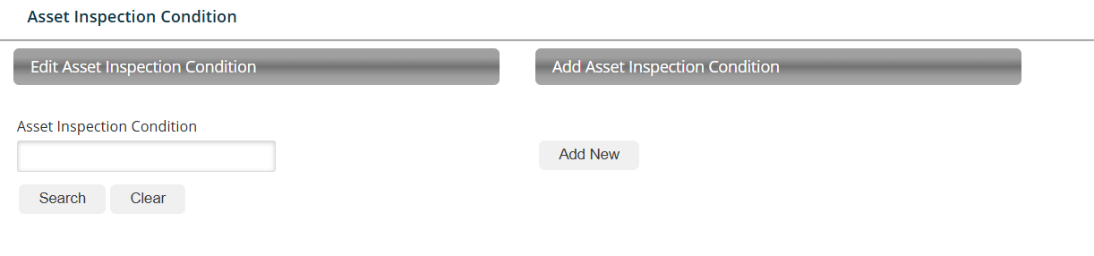
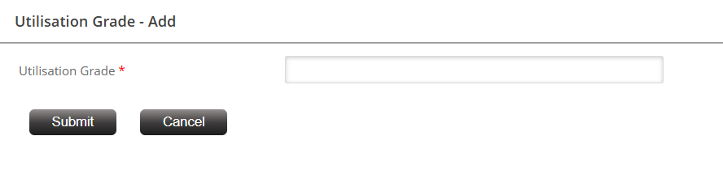


New Map Link Setting
Map Link
Edit Map Link
Add Map Link
Map Link
Map link - Add
Map Type
Map Link

