Slide 1
Brain Tumor Classification
By: Ruar Podushkin

Slide 2
Project Overview
The goal of this project was to identify whether an MRI image of a brain was normal or if it contained one of three possible tumor types
The idea is that an automated way to reliably flag mri scans that contain tumors could save significant time for medical personnel
Transfer learning from a pre-trained image classification model was used in order to achieve very high classification accuracy in a much shorter amount of time than it takes to train an entirely new model
The best model classified images from the validation set with an accuracy of over 99%

Slide 3
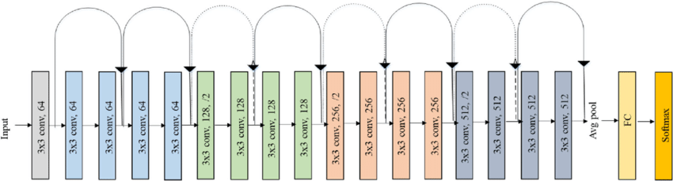
Relevant Works
Transfer learning is a technique through which a model trained on a particular problem can be used to solve a different but related problem [1]
Resnet [2] is a model architecture that achieved great results in general image classification tasks
I decided to try applying transfer learning on resnet by retraining only the last fully connected layer of a pretrained Resnet18 model on my specific problem
Resnet18 architecture

Slide 4
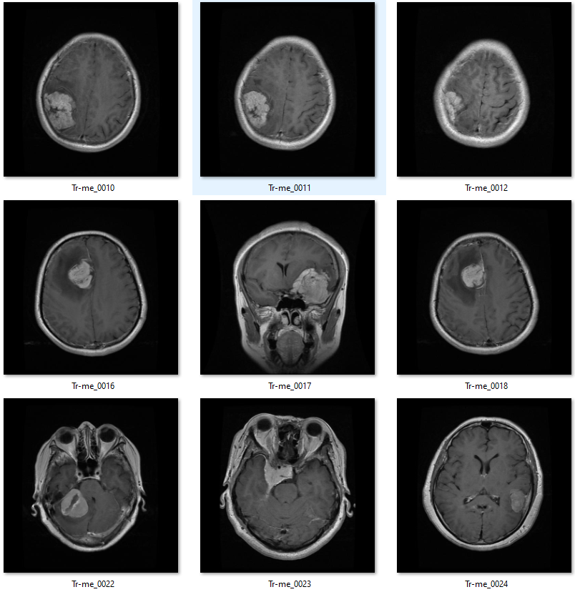
Dataset
The dataset was found on Kaggle under the title Brain Tumor MRI Dataset [3]
It is a combination of three earlier datasets
Contains 7022 images classified into 4 classes: glioma, meningioma, pituitary, and no tumor
The data was already separated into training and test sets
Example images from the unmodified meningioma training set

Slide 5
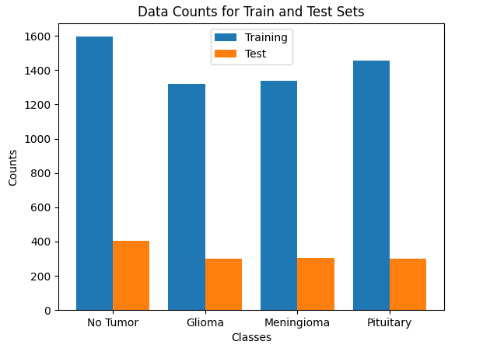

Dataset (Cont.)
The data is generally balanced, only slightly favoring the no tumor class
The test sets contain about 17-20% of the total images in a class
Images from the no tumor class seemed to be more uniform than the other classes in terms of the angle and depth of the scan
Train / Test percentage for each class

Slide 6
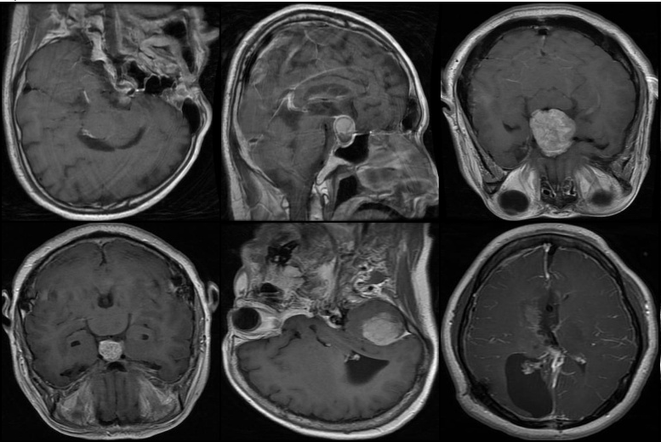
Preprocessing
The raw dataset contained images with inconsistent resolutions and most images had wasted space on the edges
Preprocessing steps were taken to ensure uniformity of the images
Rectangular cropping was done based on the extreme points of the image and the results were scaled to be the same size
Random vertical and horizontal flips were applied to each image
A sample of 6 images after preprocessing

Slide 7
Experiment 1
As mentioned earlier, the tests were done by retraining the last fully connected layer of resnet18 in pytorch
The model was trained for 24 epochs
Stochastic gradient descent was the optimizer for the first test – learning rate and momentum set to 0.001 and 0.9 respectively
Cross entropy was used as the loss function
Took approximately 10 minutes to train using a gpu

Slide 8
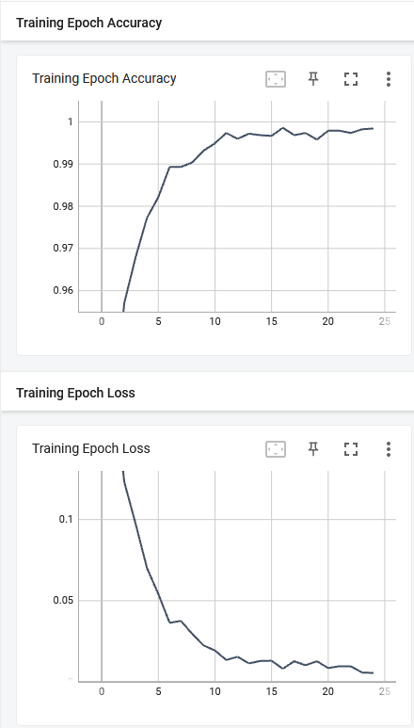
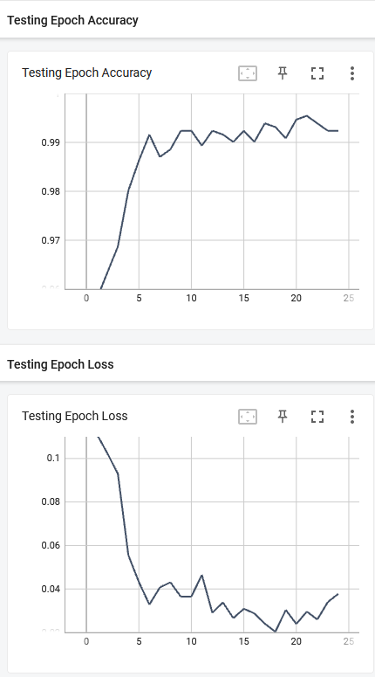
Experiment 1 Results
Final model
Training Accuracy: .9984
Training Loss: 0.0055
Testing Accuracy: 0.9924
Testing Loss 0.0378
Great results overall, but it looked like the testing accuracy and loss were choppy after 5 epochs
Charts for loss and accuracy history

Slide 9
Other experiments
Multiple experiments were conducted using a variety of configurations of hyperparameters
NAdam and SGD were tested using various learning rates
A different loss function called LabelSmoothingCrossEntropy was used for some of the experiments
A learning rate scheduler that decayed learning rate by a factor of 0.1 at specific epoch intervals was added for some of the SGD runs
Each attempt took about 10 minutes to train

Slide 10
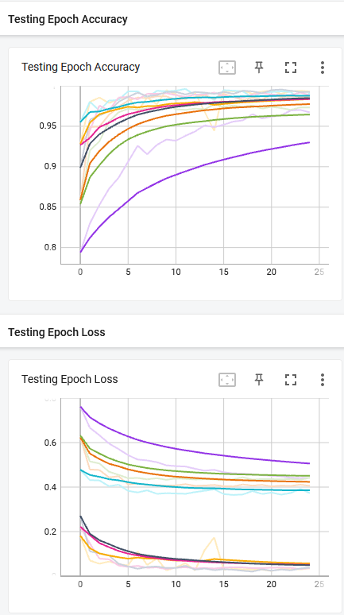
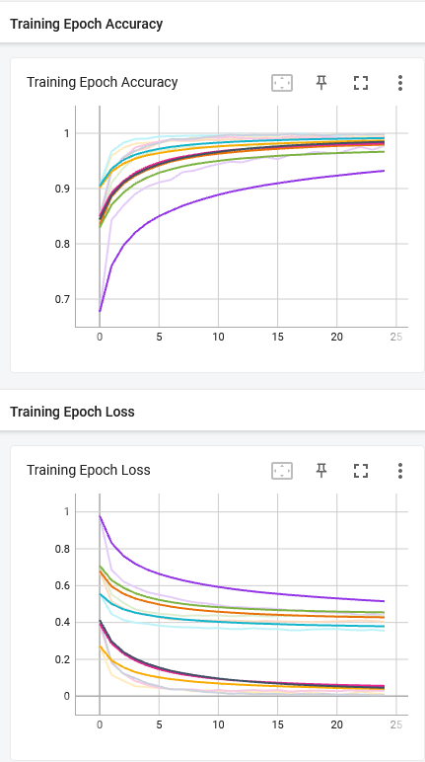
Other Results
Slight improvements in performance were achieved by using NAdam as the optimizer with a learning rate of 0.001 and default values for other optimizer parameters
Standard cross entropy worked best as the loss function
Final results
Training Accuracy: .9960
Training Loss: 0.01240
Testing Accuracy: 0.9931
Testing Loss 0.03446
Smoothed charts for loss and accuracy history

Slide 11
Conclusion
I started the project thinking there would be decent results, but effectiveness of resnet greatly exceeded my expectations
I learned a great deal about transfer learning and pytorch through the process of creating this project

Slide 12
References
https://arxiv.org/pdf/1911.02685.pdf
https://arxiv.org/pdf/1512.03385.pdf
https://www.kaggle.com/datasets/masoudnickparvar/brain-tumor-mri-dataset

Slide 13
Questions?

