Slide 1
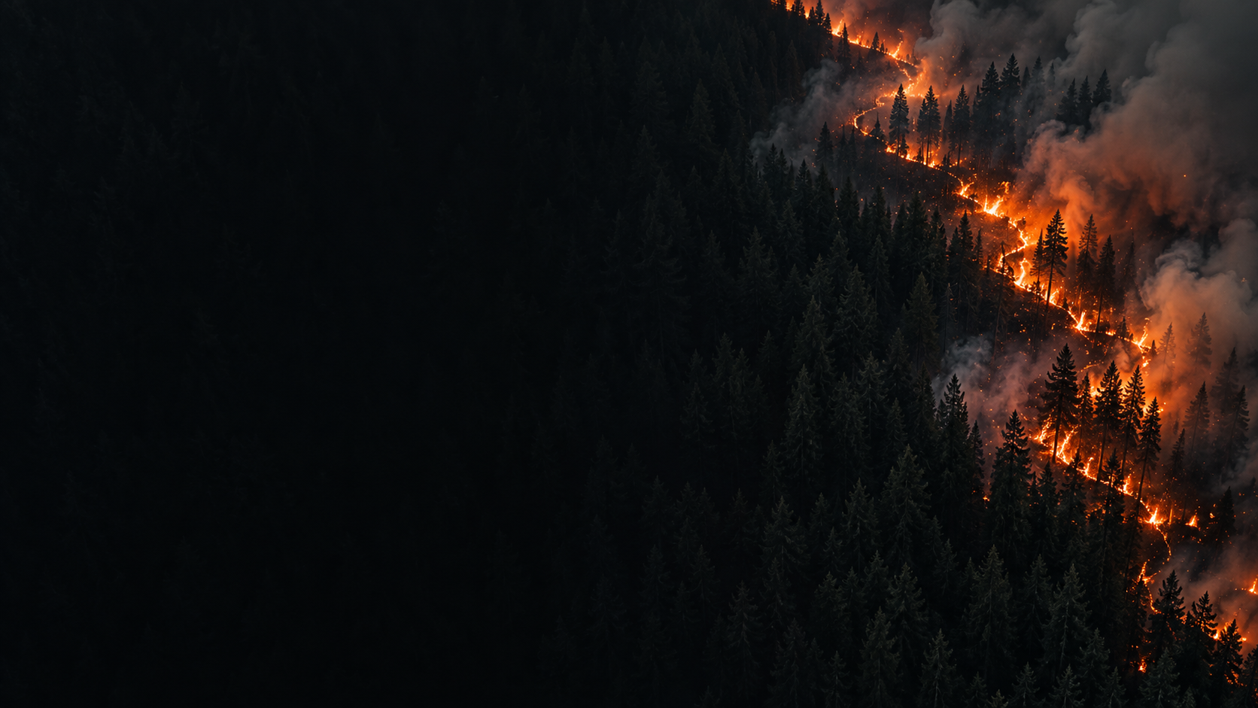
FIREBUILD HACKATHON
FireWatch AI
Drone imagery for tracking
active fire and observed spread
Four-minute concept pitch
AI-generated conceptual image
01
Notes:
FOUR-MINUTE PITCH
0:00–0:20 (20 seconds)
Imagine a responder watching a drone feed. They see smoke and fire, but need a shared view of what is happening on the ground. FireWatch AI proposes to map active fire and track the spread we can actually observe.

Slide 2
PROBLEM
The problem
PROBLEM STATEMENT
Responders see drone video, but still need to establish where active fire is on the ground and what has changed since the last pass.
WHY THIS PROBLEM
END USER (BE SPECIFIC)
Fires caused 141M hectares of global tree-cover loss in 2006–2025. Smoke harms air quality far beyond the flames. Responders need timely observations they can verify.
A fire analyst supporting an incident commander: comparing successive drone passes to report the observed fire front, its timestamp and areas still unseen.
FIREBIRD BUILD
2
Notes:
FOUR-MINUTE PITCH
0:20–1:00 (40 seconds)
Fires caused around 141 million hectares of tree-cover loss worldwide over the twenty years from 2006 through 2025. Smoke also harms communities far beyond the flames. Our specific user is a fire analyst supporting an incident commander. A moving drone provides images, but the analyst still needs to establish where the fire is and what changed. Smoke, changing camera angles and incomplete coverage complicate that comparison. We want every update to include its location, observation time and supporting evidence.
SOURCE AND DEFINITION
WRI/UMD: https://www.wri.org/insights/global-trends-forest-fires . Annual data: https://flo.uri.sh/visualisation/28787896/embed . Derived sum of Tree cover loss due to fires, 2006–2025 inclusive: 141,366,178 ha, rounded to 141M. Gross stand-replacing tree-cover loss at 30% canopy threshold, not net loss after regrowth or permanent deforestation. Some 2025 detections reflect late-2024 fires. Smoke: https://www.epa.gov/wildfires/wildland-fires-and-public-health-effects . No fixed conversion from burned area to AQI.

Slide 3
The proposed product
A current fire map
with a memory
Observed extent and recent movement
Evidence, uncertainty and last-seen time
03
Notes:
FOUR-MINUTE PITCH
1:00–1:25 (25 seconds)
The proposed product is a current fire map with a memory. An analyst could inspect an observed front, compare it with an earlier pass, and open the images behind the result. We focus on existing fire and observed change. Future spread forecasting is outside this initial scope.

Slide 4
The evidence behind the map
RGB + infrared
Visible fire evidence and thermal anomalies
Position + camera pose
Ground location, with calibration and terrain
Weather + temperature
Supporting context with timestamps
Proposed sensor inputs. Hardware and data availability remain open.
04
Notes:
FOUR-MINUTE PITCH
1:25–1:45 (20 seconds)
RGB and infrared provide complementary evidence. Drone position and camera pose help place detections on the ground, together with calibration and terrain information. Weather provides context. GPS alone cannot locate a hotspot, and a thermal color image does not automatically provide a reliable temperature.

Slide 5
The processing workflow
01 Synchronize
Match images with capture-time telemetry
02 Detect and locate
Segment fire evidence and map supported detections
03 Compare and publish
Track observed change across comparable coverage
Computer vision measures the scene. An optional LLM summarizes verified outputs.
05
Notes:
FOUR-MINUTE PITCH
1:45–2:10 (25 seconds)
The workflow matches images to capture-time telemetry, identifies fire evidence, and maps detections where the geometry supports it. It then compares observations of the same terrain. Computer vision and spatial processing produce measurements. An optional language model can summarize those verified outputs for the analyst.

Slide 6
An illustrative observation sequence
First pass
Record a visible front and its ground location
Return pass
Align a fresh observation of the same terrain
Review
Show supported movement and areas still unseen
Illustrative walkthrough, not a live demo or measured result.
06
Notes:
FOUR-MINUTE PITCH
2:10–2:40 (30 seconds)
On the first pass, we record a visible front and its timestamp. On a return pass, we align observations before comparing them. Supported movement appears as observed change. Newly visible terrain appears as new coverage, because revealing a hidden area does not prove that fire spread there. The analyst reviews both observations. This sequence illustrates the intended interaction, rather than a validated live result.

Slide 7
Uncertainty is part of the result
“Insufficient evidence”
is a useful answer
Missing coverage is unknown.
Poor geolocation means no ground-speed estimate.
07
Notes:
FOUR-MINUTE PITCH
2:40–3:00 (20 seconds)
Uncertainty belongs in the output. Missing coverage remains unknown. Weak geolocation means withholding ground distances and speed. Stale observations need clear timestamps. Those distinctions help an analyst decide what evidence is strong enough to share, and where another observation is needed.

Slide 8
What the first prototype must prove
Detection quality
Operational usefulness
Missed fire and false alarms
Boundary and location error
Capture-to-display delay
Observed movement accuracy
Research prototype. No validated field accuracy or latency results yet.
08
Notes:
FOUR-MINUTE PITCH
3:00–3:25 (25 seconds)
Our research has begun with offline public-data pilots. Field performance remains unproven. The next tests must measure missed fire, false alarms, location error and capture-to-display delay. A crucial test is a stationary fire viewed by a moving drone: camera motion must not become reported fire spread.

Slide 9
A focused route to a field pilot
First partner
A drone operator and a responder or fire analyst
First trial
One location with synchronized, labeled recordings
First value test
Can the analyst produce a clearer incident update?
Pilot and customer assumptions require interviews and field validation.
09
Notes:
FOUR-MINUTE PITCH
3:25–3:45 (20 seconds)
We want to work with a drone operator and a responder or analyst on a constrained pilot. Start with synchronized recordings and reviewed labels, then consider a controlled live trial. The value question is whether an analyst can produce a clearer, more timely incident update.

Slide 10
FireWatch AI
A clearer view of
what the fire is doing
Seeking a pilot partner with drone data
and responder feedback
AI-generated conceptual image
10
Notes:
FOUR-MINUTE PITCH
3:45–4:00 (15 seconds)
FireWatch AI aims to make observed fire easier to locate and compare over time. We are seeking a pilot partner with suitable drone data and responder feedback to test that promise. Thank you.

