Slide 1
Satellite evidence for cooling assessments
HeatShield 813
UrbanCool AI, United Arab Emirates
Mussafah, Abu Dhabi: 1 km², 100 cells, one date
Official theme
Urban Expansion, Land Use Change & Heat Risk
HeatShield 813
01
Notes:
Project: HeatShield 813. Registered team: UrbanCool AI. Country represented: United Arab Emirates. Official theme: Urban Expansion, Land Use Change & Heat Risk. The team supplied the registration details and full member names. All five members developed the project collaboratively. The demonstration reports actual results from an independent 1 km² window, using one observation date. The intended future pilot remains M11–M12.

Slide 2
The problem and who is affected
Heat varies across
urban neighbourhoods
Affected communities
People who work outdoors or use exposed public spaces in hot urban districts.
Exposed roofs, paved areas and limited vegetation create different surface conditions within the same city.
Municipal decision gap
Limited cooling budgets need local evidence about where to inspect and what to assess.
This project measures surface temperature at satellite overpass times.
HeatShield 813
02
Notes:
The problem framing comes from the team brief. The PoC does not measure population vulnerability, air temperature or individual heat exposure. It supplies surface observations to support further assessment.
Sources: project brief supplied by the team. Reproducible notebook notebooks/02_main_analysis.ipynb and results/ in https://github.com/Ruba-Babikir/HeatShield-813 . All reported results use the independent 1 km² window on 11 June 2026. No official sector polygons or hyperspectral inputs are used.

Slide 3
The business use case
End user
Evidence supplied by the PoC
Municipal planning and
environmental teams
Observed surface heat
Broad vegetation signals
Dates and data provenance
Reason for each priority
Decision
Which locations should receive a site assessment for cooling measures?
Candidate measures: planting, shade, reflective roofs and cooler pavements.
Current-practice assumption: broad plans and separate imagery or site checks. Planner interviews are still needed.
HeatShield 813
03
Notes:
The target user and decision are proposed in the supplied business case. No user interviews have yet confirmed the current workflow or willingness to adopt the output. Actions in the map are candidates for field assessment.
Sources: project brief supplied by the team. Reproducible notebook notebooks/02_main_analysis.ipynb and results/ in https://github.com/Ruba-Babikir/HeatShield-813 . All reported results use the independent 1 km² window on 11 June 2026. No official sector polygons or hyperspectral inputs are used.

Slide 4
Data used in the reproducible example
Input | Observation and role
Landsat 8, Collection 2 Level-2 | 11 June 2026 at 06:51 UTC Observed land surface temperature
Sentinel-2B, Level-2A | 11 June 2026 at 06:46 UTC Six reflectance bands and spectral indices
Independent study window | 100 cells at 100 m spacing 1 km × 1 km rectangle in Mussafah
Hyperspectral status
No hyperspectral imagery contributes to these results. Satellite 813 access remains unconfirmed.
Sample starts after calibration and quality masking. Exact scene IDs and licences are in the README.
HeatShield 813
04
Notes:
Landsat scene LC08_L2SP_161043_20260611_02_T1. Sentinel-2 scene S2B_MSIL2A_20260611T064619_R020_T40QBM_20260611T104324. USGS Landsat data are public domain: https://www.usgs.gov/faqs/are-there-any-restrictions-use-or-redistribution-landsat-data . Contains modified Copernicus Sentinel data (2026): https://sentinels.copernicus.eu/documents/247904/690755/Sentinel_Data_Legal_Notice . Microsoft Planetary Computer hosted upstream products. WorldCover is not used by this sample. The supplied CSV contains prepared cell values.
Sources: project brief supplied by the team. Reproducible notebook notebooks/02_main_analysis.ipynb and results/ in https://github.com/Ruba-Babikir/HeatShield-813 . All reported results use the independent 1 km² window on 11 June 2026. No official sector polygons or hyperspectral inputs are used.

Slide 5
The implemented workflow
The notebook runs from a small, prepared satellite sample.
01 Load sample
02 Derive indices
03 Rank and test
04 Export evidence
100 cells
Check dates and quality
NDVI, NDBI
MNDWI, BSI
Heat percentiles
Spatial test folds
Maps and table
Interactive HTML
Mean baseline, linear regression and random forest share the same four spatial test folds. Seed = 42.
Raw-scene acquisition and preprocessing sit outside this offline example.
HeatShield 813
05
Notes:
The diagram describes code that is present in the submitted notebook and src/analysis.py. Priority ranking uses observed temperature directly and does not depend on model predictions. Model validation tests relationships between spectral indices and heat. The preprocessing record documents earlier calibration and masking, which this offline example does not rerun.
Sources: project brief supplied by the team. Reproducible notebook notebooks/02_main_analysis.ipynb and results/ in https://github.com/Ruba-Babikir/HeatShield-813 . All reported results use the independent 1 km² window on 11 June 2026. No official sector polygons or hyperspectral inputs are used.

Slide 6
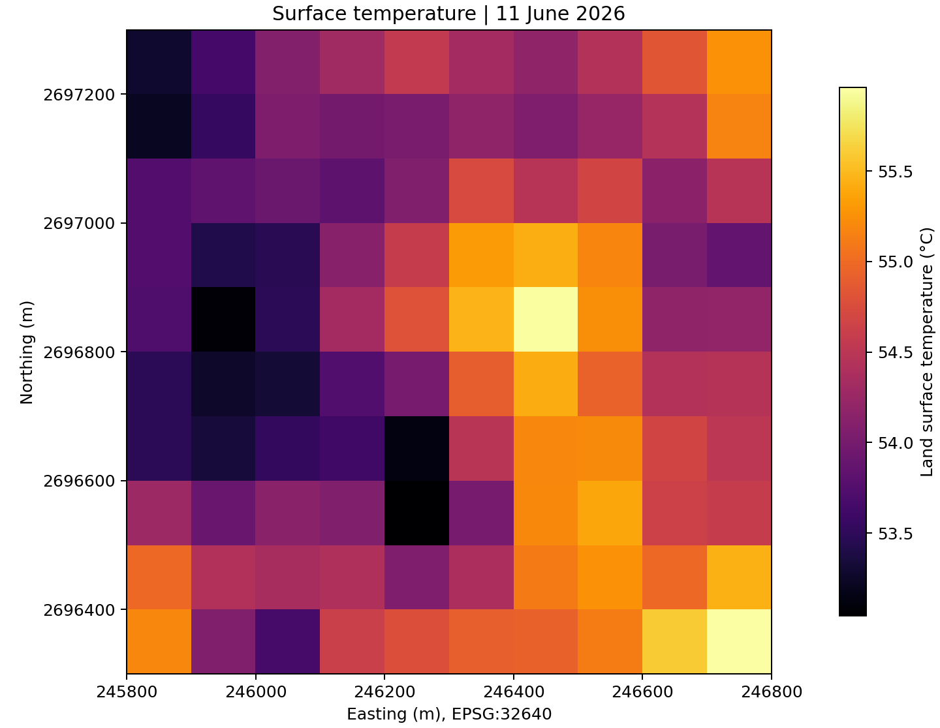
Observed surface temperature
11 June 2026
53.04–55.96 °C
Observed range
54.36 °C
Mean across 100 cells
One satellite overpass.
Persistence is untested.
HeatShield 813
06
Notes:
Actual output results/surface_temperature.png. Minimum 53.043182 °C, maximum 55.959846 °C, mean 54.361105 °C. These are land surface temperatures for the independent study window only. The stated range is not a measure of air temperature.
Sources: project brief supplied by the team. Reproducible notebook notebooks/02_main_analysis.ipynb and results/ in https://github.com/Ruba-Babikir/HeatShield-813 . All reported results use the independent 1 km² window on 11 June 2026. No official sector polygons or hyperspectral inputs are used.

Slide 7
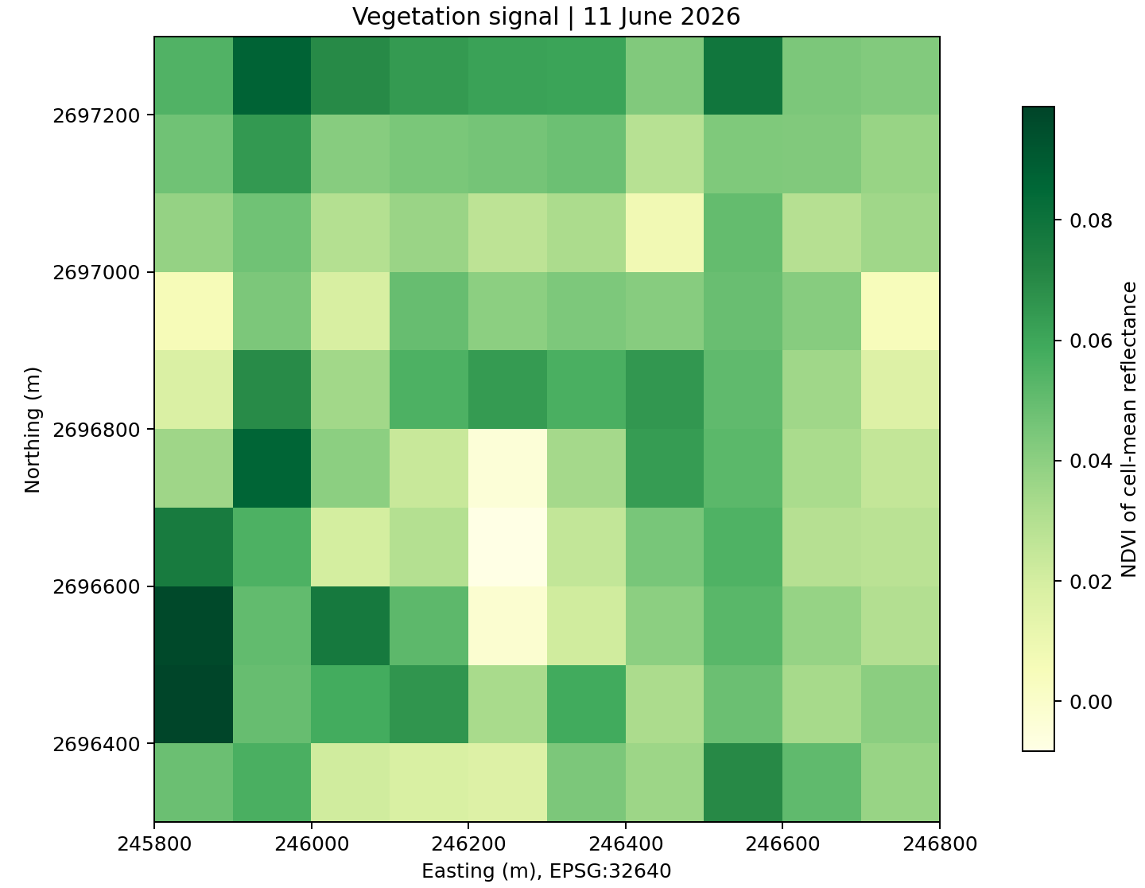
Vegetation signal across the sample
NDVI
A broad signal of
vegetation condition
The analysis also derives NDBI, MNDWI and BSI from the same six bands.
Indices alone do not verify roof or pavement materials.
HeatShield 813
07
Notes:
Actual output results/vegetation_signal.png. NDVI = (near infrared minus red)/(near infrared plus red). Indices are calculated from prepared cell-average reflectance rather than by averaging native-pixel indices. All features are broad spectral proxies. Detailed material labels require independent evidence.
Sources: project brief supplied by the team. Reproducible notebook notebooks/02_main_analysis.ipynb and results/ in https://github.com/Ruba-Babikir/HeatShield-813 . All reported results use the independent 1 km² window on 11 June 2026. No official sector polygons or hyperspectral inputs are used.

Slide 8
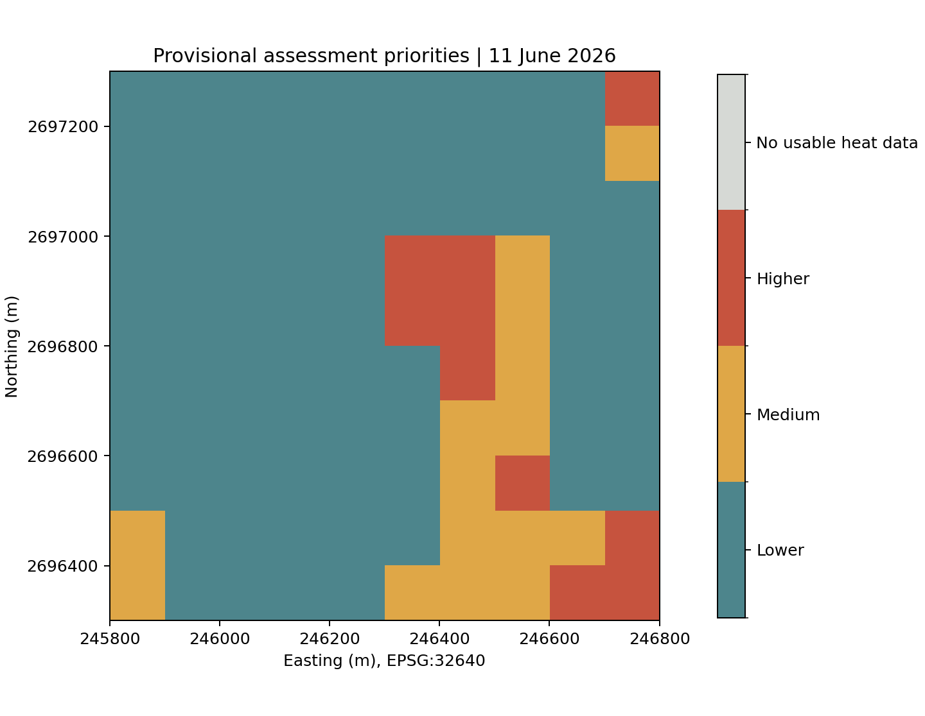
Provisional cooling-assessment priorities
Within-window heat ranking
10 higher
15 medium
75 lower
Higher: score ≥90
Medium: 75 to <90
Lower: score <75
Thresholds are exploratory.
HeatShield 813
08
Notes:
Actual output results/priority_map.png. Heat percentile score = 100 × (average rank − 0.5)/N. Counts follow the chosen rule and are not independently validated risk categories. The priority map uses observed heat directly. Surface features inform candidate site assessments, not this heat score.
Sources: project brief supplied by the team. Reproducible notebook notebooks/02_main_analysis.ipynb and results/ in https://github.com/Ruba-Babikir/HeatShield-813 . All reported results use the independent 1 km² window on 11 June 2026. No official sector polygons or hyperspectral inputs are used.

Slide 9
Evidence behind a mapped priority
window_r09_c09
Evidence field | Actual output
Surface temperature | 55.96 °C
Relative to window median | +1.64 °C
Heat score and priority | 99.5 / 100, Higher
Observation date | 11 June 2026
Candidate assessments
Shade for outdoor use
Planting feasibility and water needs
Reflective roofs, after verifying roofs
Cooler pavements, after verifying paving
Source: results/priority_table.csv. Each candidate action needs a site check.
Interactive HTML supports cell selection, layer changes and CSV export.
HeatShield 813
09
Notes:
The displayed record is selected from the current priority table and corresponds to the highest within-window heat score. The interactive_priority_map.html file presents these same per-cell values and source scene identifiers. This is an editable extract of actual output, not a screenshot of a validated municipal product.
Sources: project brief supplied by the team. Reproducible notebook notebooks/02_main_analysis.ipynb and results/ in https://github.com/Ruba-Babikir/HeatShield-813 . All reported results use the independent 1 km² window on 11 June 2026. No official sector polygons or hyperspectral inputs are used.

Slide 10
Spatial validation shows limited generalisation
Model | Mean MAE | Mean RMSE
Mean baseline | 0.817 °C | 0.934 °C
Linear regression | 0.966 °C | 1.183 °C
Random forest | 0.746 °C | 0.878 °C
Validation design
Four spatial folds
Training cells >200 m
from test-cell centres
Random forest improves mean MAE by 0.071 °C. Linear regression is worse.
All models have negative mean fold R². More dates and independent sites are needed.
Unweighted fold averages. One observation date prevents temporal validation.
HeatShield 813
10
Notes:
Source results/validation_summary.csv and validation_by_fold.csv. MAE means mean absolute error. RMSE means root mean squared error. Each eligible cell is tested once. Fold test sizes are 30, 30, 20 and 20. A >200 m centre-distance exclusion gives a minimum retained training-test centre separation of 300 m. Negative average R² is a warning against strong predictive claims. These results do not establish causal surface effects or operational accuracy.
Sources: project brief supplied by the team. Reproducible notebook notebooks/02_main_analysis.ipynb and results/ in https://github.com/Ruba-Babikir/HeatShield-813 . All reported results use the independent 1 km² window on 11 June 2026. No official sector polygons or hyperspectral inputs are used.

Slide 11
Scope and limitations
One date
No hotspot persistence or held-out-date test.
Independent window
The 1 km² demonstration does not represent all of M11–M12.
Prepared satellite values
Raw-scene calibration and masking are documented but not rerun here.
Surface associations
No direct human heat exposure, material validation or cooling-effect estimate.
Exact-sector expansion needs an authorised boundary and independent ground evidence.
HeatShield 813
11
Notes:
The independent rectangular window avoids redistribution of the restricted official sector polygons in the current files. The administrative boundary source has use restrictions: https://arcgis.sdi.abudhabi.ae/agspublish/rest/services/OpenData/ADSDI_OpenData/MapServer/2/iteminfo . Prior Git history may still contain the earlier notebook and needs a permission review. Site use, vulnerability, cost and water availability are not modelled.
Sources: project brief supplied by the team. Reproducible notebook notebooks/02_main_analysis.ipynb and results/ in https://github.com/Ruba-Babikir/HeatShield-813 . All reported results use the independent 1 km² window on 11 June 2026. No official sector polygons or hyperspectral inputs are used.

Slide 12
Expected impact
A clearer basis for
local cooling assessments
Planners could use traceable surface evidence to select locations for field checks and compare candidate measures.
Longer-term value
A repeatable workflow for comparable heat-adaptation decisions across Arab cities.
HeatShield 813
12
Notes:
Expected benefits are hypotheses for the next phase. No municipality has yet validated adoption or budget effects. The PoC does not quantify cooling, energy savings, health outcomes or returns on investment. Regional expansion depends on additional dates, appropriate data rights, field validation and planner testing.
Sources: project brief supplied by the team. Reproducible notebook notebooks/02_main_analysis.ipynb and results/ in https://github.com/Ruba-Babikir/HeatShield-813 . All reported results use the independent 1 km² window on 11 June 2026. No official sector polygons or hyperspectral inputs are used.

Slide 13
Next steps for incubation
01
Secure the pilot scope
Obtain an authorised M11–M12 boundary and confirm user needs.
02
Expand the evidence
Add observation dates, test persistence and reserve dates for validation.
03
Test on the ground
Check surface labels, candidate actions and operational usefulness.
04
Evaluate hyperspectral value
Use suitable imagery only if access and additional benefit are demonstrated.
Training and mentorship will help the team test responsibly and continue beyond the competition.
HeatShield 813
13
Notes:
The team motivation is to turn satellite observations into decisions with public value and continue development beyond the competition. These milestones are proposed incubation work, not completed capabilities.
Sources: project brief supplied by the team. Reproducible notebook notebooks/02_main_analysis.ipynb and results/ in https://github.com/Ruba-Babikir/HeatShield-813 . All reported results use the independent 1 km² window on 11 June 2026. No official sector polygons or hyperspectral inputs are used.

Slide 14
UrbanCool AI team
All five members developed the project collaboratively.
Member | Role
Nyar Adil Babiker Abdelrahman | Team lead and co-developer
Shahd Ehab Abdulmalek Eshaq | Co-developer
Nour Alhoda Abdulrahman Alahmed | Co-developer
Yosra Ghneem | Co-developer
Ruba Babikir Ali Mohamed | Co-developer
United Arab Emirates
HeatShield 813
14
Notes:
Team roster and full names supplied by the user. Nyar is the team leader shown in the registration portal. Co-developer recognises the shared contribution of all members and does not imply exclusive ownership of individual tasks.

